Slide 1



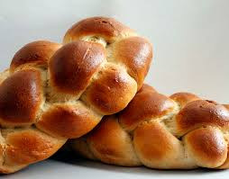
CHALLAH ORDER FORM
MONTHLY ORDER FORM & PAYMENT DUE SEPTEMBER 28TH
Each month you will receive a recipe on how to put your left over challah to good use!
ONLY $20
1 CHALLAH EACH WEEK FOR 4 WEEKS
WEEK 1: _____ PICK-UP FRIDAY 10/5 OR _____ PICK-UP SUNDAY 10/7
WEEK 2: _____ PICK-UP FRIDAY 10/12 OR _____ PICK-UP SUNDAY 10/14
WEEK 3: _____ PICK-UP FRIDAY 10/19 OR _____ PICK-UP SUNDAY 10/21
WEEK 4: _____ PICK-UP FRIDAY 10/26 OR _____ PICK-UP SUNDAY 10/28
NAME: ___________________________________________ CASH / CHECK
For more information, please contact Jacquie at 904-273-9100 or jsinder@bethelbeaches.org.

