Slide 1

All member Meeting
July 29, 2026

Slide 2
Antitrust Statement
This meeting is for the specific purpose described in the agenda.
1. CPESN® meetings are conducted in accordance with the antitrust laws of the United States;
2. All participants should limit discussion to the topics set forth on the agenda and to the activities of the local network;
3. Participation in CPESN Networks is completely voluntary; and
4. Any questions or concerns about antitrust or any other legal matter should be directed to the meeting leader.
There should be no informal, secret, or “rump” meetings in which some or all attendees discuss business matters “off the record.”
Disclaimer: As a reminder, this webinar is a production of CPESN Networks. The use of any recording devices, including but not limited to audio, video, or AI-enabled recording devices, during this webinar is strictly prohibited. Copying, or distribution of audio, video, or any other form of recorded content obtained during this webinar is also strictly prohibited without the express written consent of CPESN USA, LLC.
Questions or concerns about these guidelines or about any CPESN meeting, discussion, or practice should be directed to CPESN USA, LLC’s antitrust counsel, Katie Funk who may be reached by phone at 202-508-3492 or by email at kfunk@bakerdonelson.com.

Slide 3
Our network

Slide 4
CPESN DMV Board 2026-2027
Voting
Lead Luminary –
Fariborz Zarfeshan
Lead Account Manager (Secretary) – Amber Barkley
Managing Network Facilitator (Treasurer) – Dixie Leikach
Chair of Board –
Luminary –
Christine Lee
Luminary – Zahraa Mohammed
At Large – Adel Periera
Luminary – Carla Daniel (Account Manager)

Slide 5

CPESN DMV Staff
Dixie – Lead MNF
Amber – Lead Account Manager
Carla – Account Manager (DC)
Bailey Szamski – ELV Program Champion
Maria Josephs – Account Manager (MD)

Slide 6
Open board seat
Chair – open and close meetings

Slide 7
 | 2026 Actual (6/30/2026) | 2026 Budget | 2025 Actual
Income
Sponsorships | $ 400 | $ 2,000 | $ 0
CE Day | $- 1,665 | $- 1,665 | $- 1,199
ELV | $ 29,167 | $ 38,000 | $47,000 | DC Program Champ Funds Jan-Jun
FtP | $ 5,116 | $ 5,116 | $10,400 | Final Payment Received
NFSP | $ 4,500 | $ 11,000 | $ 8,310
LNF | $ 926 | $ 1,000 | $ 4,696 | 4 Pharmacies Delinquent 2024 & 2025
MBS | $ 619 | $ 1,000 | $ 2,330
RxE2 | $ 0 | $ 2,500 | $ 650 | 3 Studies ($1,000 pd July)
DPP | $ 0 | $ 0 | $ 2,144
Catalyst | $ 0 | $ 20,000 | $ 0
Total | $ 39,063 | $ 78,951 | $75,528

Slide 8
 | 2026 Actual (6/30/26) | 2026 Budget | 2025
Expenses
Bank Charges | $ 149 | $ 200 | $99
Technology | $ 817 | $ 500 | $318
CE Day | $ 0 | $ 0 | $ 0 | Included in Income
Dues/Subsc | $ 1,141 | $ 2,500 | $ 1,214 | DC, MD, DE Memberships (VA?)
Insurance | $ 3,137 | $ 6,000 | $2,217 | Delete DC; increased salaries
Marketing | $ 500 | $ 2,500 | $292
CPESN Mid-Year | $ 2360 | $ 5,000 | $513 | 2026 total plus 2027 bookings
Office | $ 522 | $ 2,000 | $2,082
Payroll | $19,616 | $ 50,000 | $38,449 | Amber, Carla, Dixie and Coaches; Catalyst
Prof Fees | $ 935 | $ 1,500 | $1,080 | Payroll processing and CPA
Shipping | $ 61 | $ 100 | $0
Tax | $5,734 | $ 19,126 | $11,533 | Includes Payroll Taxes
Meetings | $ 35 | $ 7,000 | $3,287 | Includes Travel, registrations, assoc sponsorship, meals, hotel, etc. Not Mid-Year or DMV Annual; Mileage for Catalyst
DPP Coach | $ 0 | $ 0 | $0
Pharmacy Program Support | $ 0 | $ 4,000 | $0 | DPP, Catalyst, etc.
FtP | $ 290 | $ 0 |  | Milestone Incentives
Total | $ 35,297 | $100,426 | $61,988
Net Income | $ 39,063 | $ 78,951 | $13,340
Investments | $ 3,766 | $ - 21,475 | $10,863.79 | JPMorgan MMKT Premier (as of 7/15/2026)

Slide 9
LOGO
Thoughts – Blue Crab instead of Capital, remove heart, and make DMV in the standard medium blue?

Slide 10
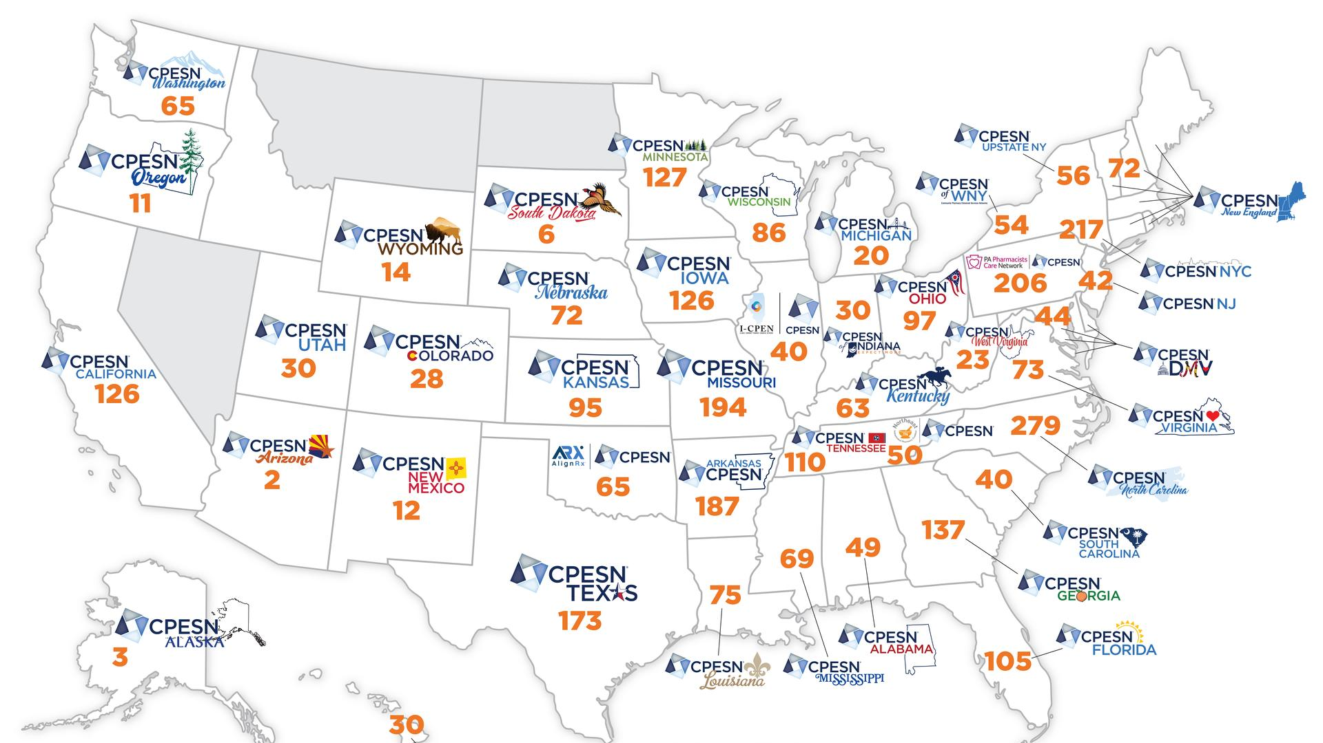

Slide 11
Strategic Plan

Slide 12
CPESN Maryland, Inc dba CPESN DMV
STRATEGIC PLAN
2025-2027
Mission Statement
CPESN® DMV is a regional network of high-performing community pharmacies. Its goal is to improve the quality of patient care and reduce overall healthcare costs through enhanced patient services and collaboration with other healthcare providers.
Key Values
CPESN DMV’s strategic plan outlines long-range goals and actionable strategies to strengthen the organization’s impact on the key values of Pharmacy Ethics, Growth, Outcomes, and Transparency.

Slide 13
CPESN Maryland, Inc dba CPESN DMV
STRATEGIC PLAN (updated)
2025-2027
Goal 1: Financial stability of the network and pharmacies
Goal 2: Organizational sustainability of the network.
Goal 3: Increase awareness of CPESN DMV activities.

Slide 14
CPESN Maryland, Inc dba CPESN DMV
STRATEGIC PLAN
2025-2027
Goal 1: Financial stability of the network and pharmacies
  Increase network pharmacies by 10 % each year
  Have 50% of network pharmacies participating in a payer program
  Add one new payer program each year

Slide 15
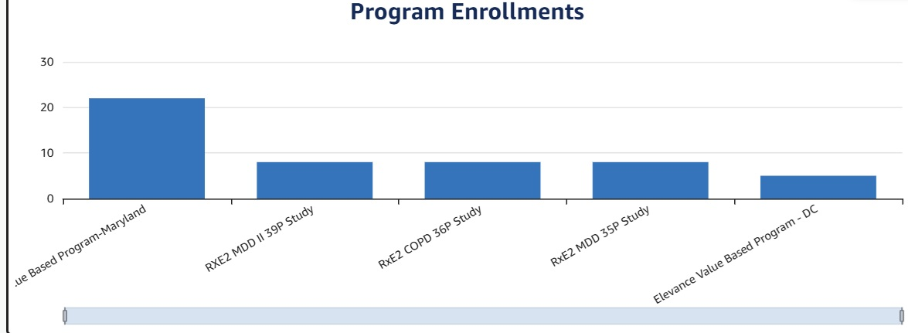
CPESN Maryland, Inc dba CPESN DMV
STRATEGIC PLAN
2025-2027

Slide 16
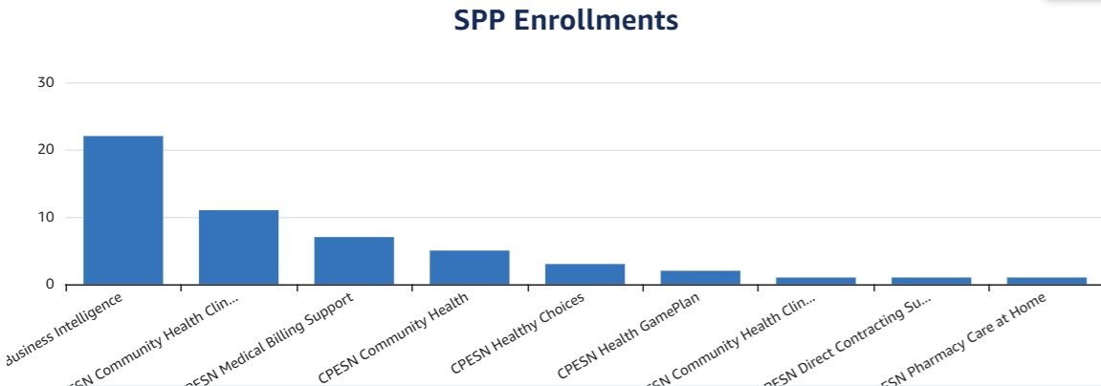
CPESN Maryland, Inc dba CPESN DMV
STRATEGIC PLAN
2025-2027

Slide 17
CPESN Maryland, Inc dba CPESN DMV
STRATEGIC PLAN
2025-2027
Goal 1: Financial stability of the network and pharmacies
  23/44 network pharmacies have sent at least 1 care plan
    Less than 25/quarter since 11/1: 1 but only this quarter, others ok
    Less than 10/quarter since 11/1: 7
  LTC NPIs! May need TSP to turn on
  eCare plans aren’t just for payer programs. They can (should) be sent for ANY clinical service provided (vaccine consult, OTC recommendation, LTC Chart Reviews, Call to prescriber for change, discharge summary review, etc) – just because you aren’t getting paid, this is still our documentation tool! Make it part of workflow!

Slide 18
CPESN Maryland, Inc dba CPESN DMV
STRATEGIC PLAN
2025-2027
Goal 2: Organizational sustainability of the network.
  Create a succession plan for leadership by October 2026
  Strengthen the infrastructure of the network by December 2026
  Connect with at least two new potential payer partners each year

Slide 19
CPESN Maryland, Inc dba CPESN DMV
STRATEGIC PLAN (updated)
2025-2027
Goal 3: Increase awareness of CPESN DMV activities
  Market payer program outcomes annually and share with state pharmacy associations
  Present (CE, poster, white paper) at at least one local and national pharmacy association each year
  Engage student pharmacists at all four Schools of Pharmacy and new graduates

Slide 20
CPESN Maryland, Inc dba CPESN DMV
Minimum Service Sets
CPESN USA Minimum Service Sets (plus Quality Assurance Measures)
  CMRs
  Med Sync
  Immunizations
  Medication Reconciliation
  Personal Medication Record
  Face-to-Face Access

Slide 21
CPESN Maryland, Inc dba CPESN DMV
Minimum Service Sets
CPESN DMV Additional Required Service Sets
  Hand Delivery
  Adherence Packaging
  Our Pharmacies are different than even other independent community pharmacies – we are not here to just dispense prescriptions!

Slide 22
Payer Programs

Slide 23
ELeVance

Slide 24
Current Events
DC market terminated as of July 1st; MD is AT RISK! Dixie now has to submit a weekly summary of our efforts to engage pharmacies; not best use of Dixie’s time.
Patient Lists are now available through the clinical lead’s MOVEIt account.
Pioneer pharmacies can opt in (VBC under Opportunity Alerts in my.cpesn.com; BI) to have their data automatically transferred to Care Plan Opportunities.
Pioneer: Templates now available! However, be careful not to submit eCare plans without first performing the encounters! Once sent, you cannot reverse.
Submitted eCare Plans can be viewed in the Business Intelligence section of my.cpesn.com

Slide 25
Help Yourself
Patient Lists on my.cpesn.com
Pioneer – integrate MOVEIt to Opportunity Alerts
Pioneer – templates
Other TSPs coming!
Verify eCare plans received in my.cpesn.com (screen share)
On Horizon – will be able to verify tentatively payable on your own!
NOW – can verify eCare plans invoiced (screen share)

Slide 26
ACTION ALERT
EVERY pharmacy should enroll in the Elevance program.
To Opt In:
Program Opt-in/Opt-out Gateway New
Program 33: Elevance Value Based Program-Maryland

Slide 27
ACCESS

Slide 28
What Is It?
CMS program for FFS Medicare beneficiaries
4 categories – can qualify for 3/4:
eCKM (Early Cardio-Kidney Metabolic)
CKM (Cardio-Kidney Metabolic)
MSK (Musculoskeletal)
BH (Behavioral Health)

Slide 29
Who Can Participate?
Early enrollees were invited in July to start in August
EVERY pharmacy (at least 30% med sync) will be able to enroll in August to start in Sept
Enrollment will be open continuously. Enroll by Friday – should have patient list by following Thursday
Pharmacies must be an NCPA OR CPESN Member

Slide 30
What will we need to do?
Measurements in Pharmacy using approved devices:
Blood pressure
Height/Weight
Patient Reported Outcome Measures (PROM): Pain Intensity and Improvement Surveys
PHQ-9 (Patient Health Questionnaire)
GAD-7 (General Anxiety Disorder)

Slide 31
What will we need to do?
Measurements in Pharmacy using approved devices, with CLIA waiver/POC training:
Optional HbA1C
Optional LDL-C
No additional payments for this through ACCESS Program– medical billing if credentialed
Can obtain from prescriber, lab report from patient, CRISP HIE (documentation)

Slide 32
Why wouldn’t I participate?
Not willing to get to 30% med sync.
Not willing to dedicate staff to this program and the med sync program.
ALL Pharmacies in the GamePlan Medical program will need to obtain 50% success in achieving the desired outcome by the end of 12 months. Otherwise, NO ONE gets paid for the last six months of work.
ie. Don’t align patients if you aren’t going to do the work!

Slide 33
Resources for More Info
ACCESS to Pharmacy Care website: https://www.accesstopharmacycare.org/
15-minute overview link: https://pages.insightly.services/accesstopharmacycareintro
The link to the webinars is in #2
The link to calculate your med-sync percentage (self-reporting) is in #2

Slide 34
Keep In Mind
There are NO local network program champion funds for this program
Dixie only works 50-60 hours per month and has no capacity for additional hours
New staff are training, but their focus is not ACCESS
In other words, participating pharmacies will need to access other resources for assistance.
ACCESS@ncpa.org

Slide 35
catalyst

Slide 36
What is it?
NCPA Program to support local CPESN Networks.
Up to $50,000 for DMV over 15 months.
Goals worked into the new strategic plan.
CPESN Recruitment and Retention program helps support – first three months participation fee waived by CPESN USA for new participating pharmacies.

Slide 37
CATALYST | 2026 Budget | 2027 Budget | TOTAL
Payroll | $15,000 | $15,000 | $ 30,000
Marketing | $ 3,000 | $ 1,000 | $ 4,000
Meetings | $ 390 | $ 3,610 | $ 4,000 | State Meetings; DMV Annual Meeting
Travel | $ 2,000 | $ 2,000 | $ 4,000 | Mileage, etc.
Program Support | $ 4,000 | $ 4,000 | $ 8,000 | Luminary/Pharmacy Recruitments

Slide 38
NEED EVERYONES HELP – not just Board and Staff!
Do you have other locations?
Is your Retail and LTC NPI enrolled?
Are all NPIs enrolled in at least one payer program?
Who do you know? MD, DC, and DE

Slide 39
RxE2

Slide 40
COPD II 36P
14 Pharmacies Invited
7 Pharmacies Enrolled
3 Pharmacies – Not enough patients
1 Pharmacy – Removed for stalled progress (informed)
1 Pharmacy – Training still pending
2 Pharmacies – Activities complete
3/3 Referrals from 1 pharmacy and pts remaining

Slide 41
MDD GZMH
20 Pharmacies eligible (35-mile radius) - MD
1 Pharmacy LNF Past Due
5 Pharmacies enrolled
1 Pharmacy – removed due to delay in progress (not sure if they are aware)
2 Referrals to Clinical Site so far
Keep chart reviews and interviews going – stalled
DC site – lost program champion

Slide 42
CAD 38P
22 Pharmacies Invited
2 Pharmacies LNF Past Due
2 Pharmacies Enrolled – 1 pending feasibility study
What is going on??

Slide 43
COPD II 36P, MDD GZMH, CAD 38P
Issues
The better the pharmacies do – the more money they make and the more the network benefits!
Best Practices –
  Digital Outreach – frequency of texts; total #
  Phone Outreach – “
Weekly Office Hours every Wednesday at Noon ET
  TEAMS LINK

Slide 44
FtP

Slide 45
FtP Grant
Follow-Up Deliverables
1) MD, DC, DE Medical Billing Guide (share with state pharmacy associations): nitty-gritty, step-by-step, with screenshots when possible. HELP!
2) Posters/CE abstract submissions/Articles – collaborate with Dixie
3) Student project? Let Dixie know

Slide 46
DPP – Umbrella hub

Slide 47

DPP with PGCDOH
2 Ways to Participate
Qualify patients within pharmacy and submit eCare plan
Have a pharmacy staff member train as a lifestyle coach
**Pharmacies participating in ACCESS Program with eCKM could refer patient to our DPP Program to help get patient to goal!**

Slide 48
DPP with PGCDOH
Interested?
Contact Dixie!!
DLeikach@cpesn.com

Slide 49
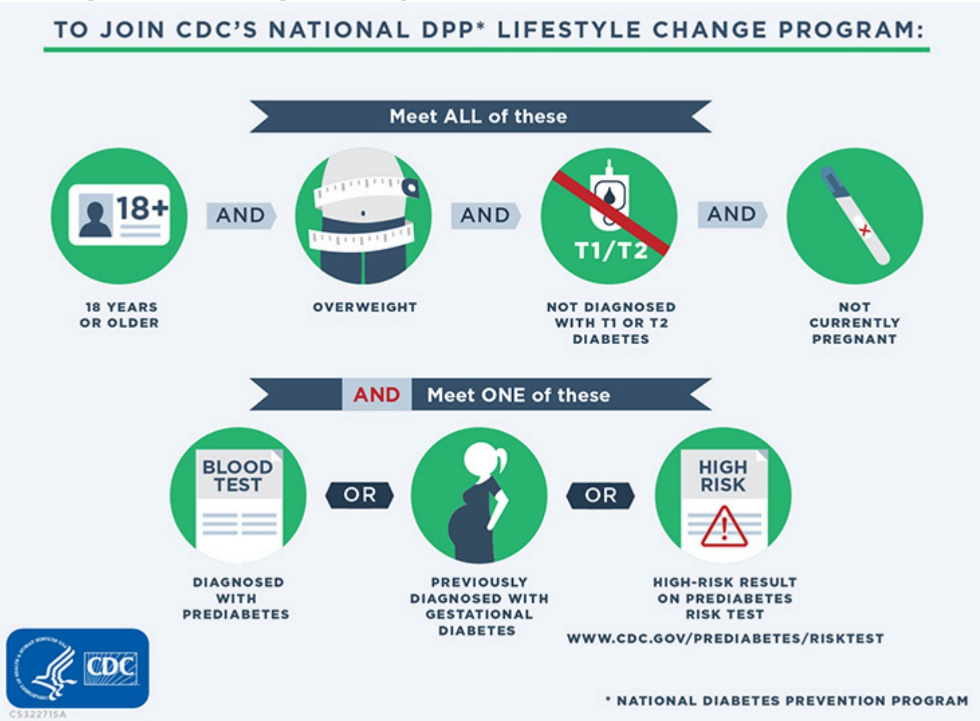

Slide 50
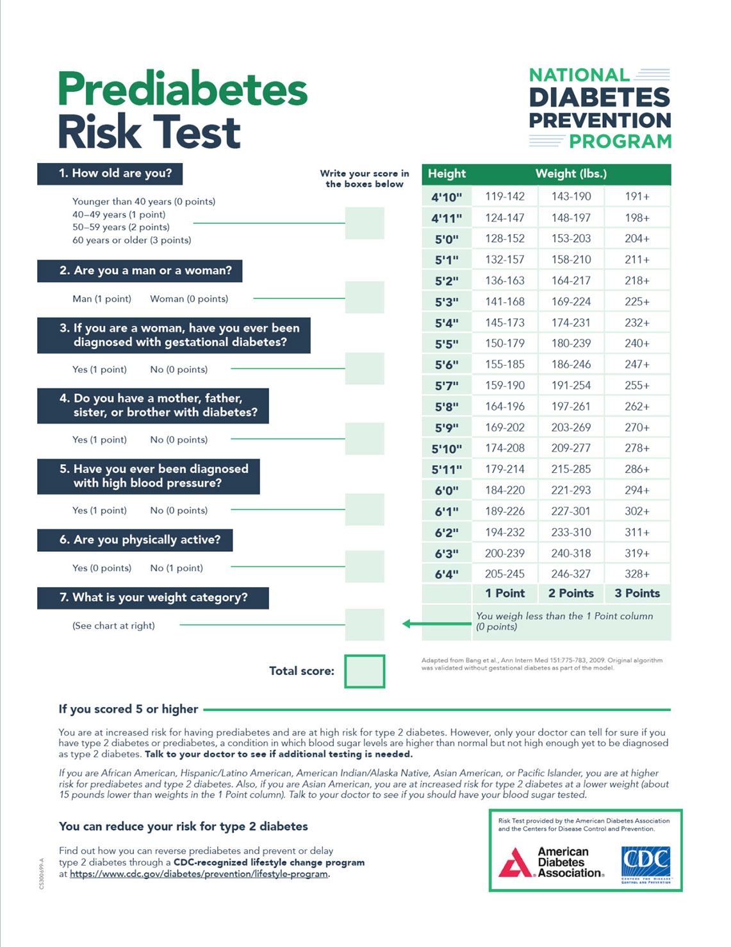

Slide 51
my.cpesn.com

Slide 52
Business Intelligence
Available at no additional charge
Must subscribe

Slide 53
my.CPESN.com
Must have your mobile number in the system
Select ONE business lead for all NPIs
Clinical Lead can be different for each NPI
Clinical Lead will receive an active MoveIt account
Manage all NPIs with one mobile number
Make changes directly in the portal
Toolshed available!

Slide 54
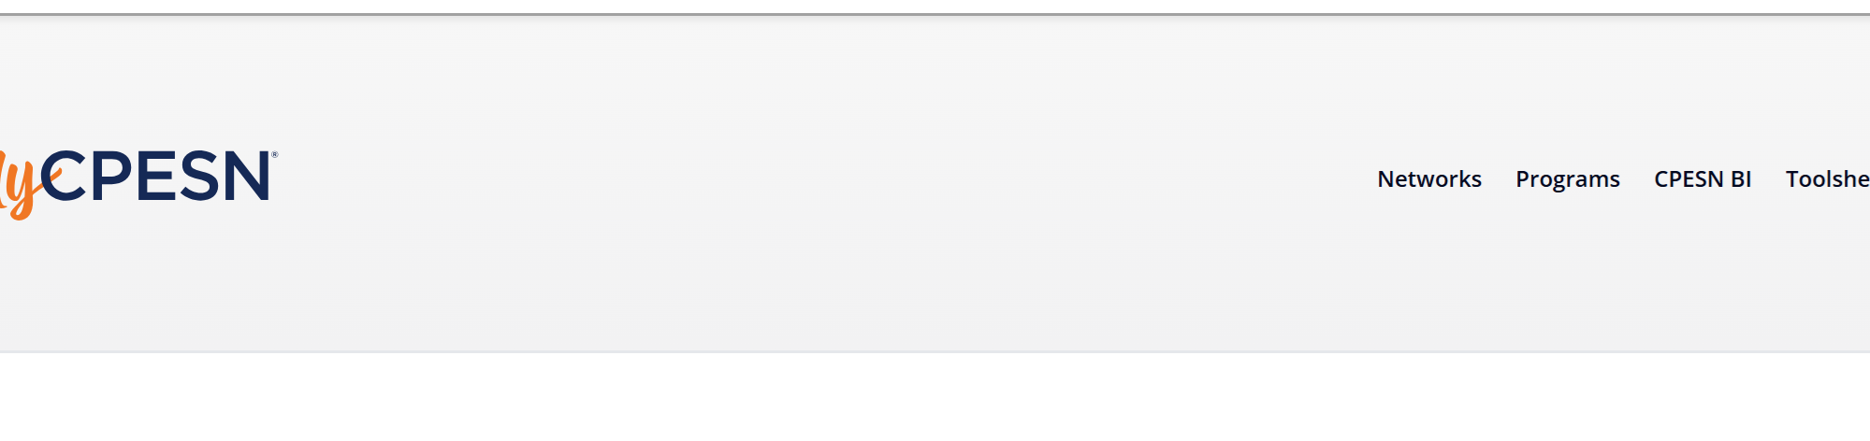
my.cpesn.com
Enter your mobile and receive the code
Main screen – all NPIs
Click Networks to change or add a network
Click Programs to see what you are subscribed to
Click CPESN BI for that information
Click Toolshed for that information

Slide 55
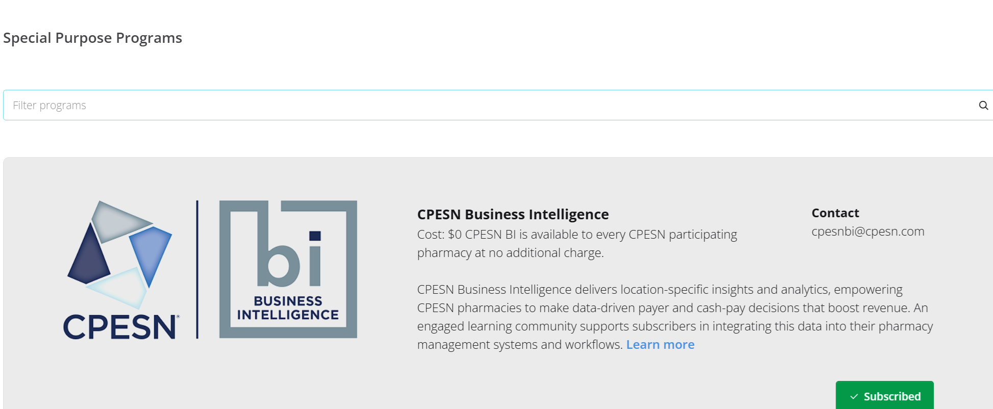
my.cpesn.com
Special Purpose Programs
Click, and then it will turn green and say “Subscribed.”

Slide 56
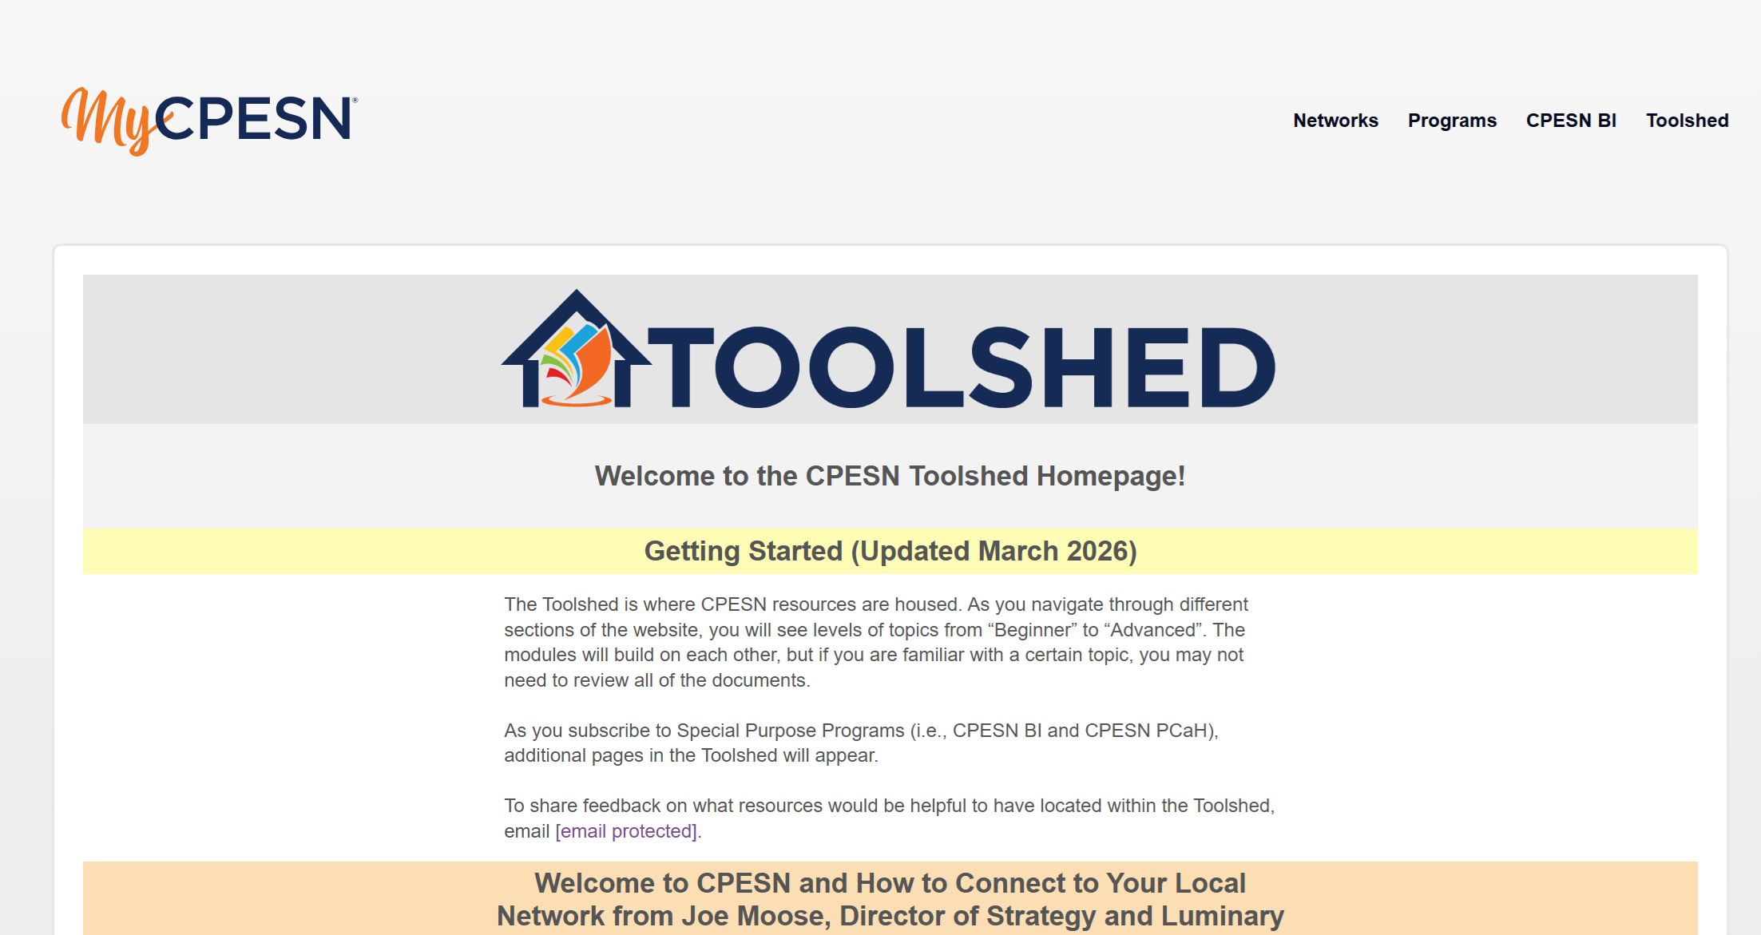
TOOLSHED

Slide 57
GUEST - MATTERS

Slide 58
FUTURE MEETINGS

Slide 59
Future Meetings
Fall Pfizer program?
August Clinical Program Meeting – Wed, 8/26 8 am EDT
September Clinical Program Meeting – Wed, 9/23 8 am EDT
October All-Member Meeting – NEED TO MOVE TO Wed, November 4th at 8 am EDT
SAVE THE DATE – Tentative Annual Meeting and Clinical Education Day Sunday, April 4th in the morning in Owings Mills, MD

Slide 60
OPEN Mic

Slide 61
We are here for you!
Dixie Leikach – Lead Managing Network Facilitator
443-386-1062
Dleikach@cpesn.com
Office Hours Wednesdays at Noon (except the 4th Wed each month)
Lead Account Manager
Amber Barkley
abarkley@cpesn.com
Lead Luminary
Fariborz Zarfeshan
Fariborz@alfapharmacy.com

