Slide 1
A Chauffeur's Tune-up : Staying Fit While Driving
Prepared by Saker Ghanayem PT, DPT
October 14th, 2025

Slide 2
Overview
Data on limo drivers specifically is limited, but research on professional drivers (including taxi, truck, and bus drivers) provides strong insight into musculoskeletal injuries, especially involving the low back and neck.

Slide 3
Prevalence of Musculoskeletal Pain
43%–93% of professional drivers report musculoskeletal pain (MSP)
Most affected areas: Lower back (~53%), neck (~42%), shoulders (~39%), upper back (~25%)
Drivers show higher rates of pain than the general population (~38–40% annual prevalence)
12‑month low back pain (LBP) prevalence: ~53–55%
One‑week LBP prevalence: ~35%; one‑month: ~34%

Slide 4
Major Risk Factors for Back and Neck Pain
Long driving hours and prolonged sitting
Poor seat design and inadequate lumbar support
Awkward or static posture while driving
Vibration exposure from road conditions
High stress levels and limited rest breaks
Longer years of driving, and job dissatisfaction

Slide 5
Study Highlights
Review of 56 studies (~18,882 drivers) found lower back pain prevalence around 53%.
Taxi driver study (Yaoundé, Cameroon): 86.8% reported some musculoskeletal disorder; low back was most affected.
Studies consistently show higher pain rates among long-term, overweight, or stressed drivers.

Slide 6
Common Injury Causes & Safety Recommendations
Causes:
Vehicle collisions
Strains, sprains, and overexertion (loading luggage, entering/exiting vehicles)
Severity: ~⅓ of injured taxi/chauffeur drivers required 31+ days away from work.
Recommendations:
Ergonomic training for vehicle entry/exit and lifting
Maintain vehicle safety & rest schedules

Slide 7
Reducing Injury Risk: Ergonomics & Exercise
Ergonomic Adjustments:
Adjust seat height so hips ≈ knees; use lumbar support
Keep steering wheel close (elbows ~120° bend)
Avoid twisting—turn body to exit
Micro-breaks (1–2 min):
Neck rolls, shoulder shrugs, torso twists
Hip flexor & hamstring stretches
Calf raises, ankle circles
Strength/Mobility (2–3x/week):
Planks, bird-dogs, glute bridges
Band pull-aparts, gentle yoga
Squats, lunges, push-ups

Slide 8
Lifting Mechanics
Keep items close to chest when lifting
Avoid fully flexing or twisting your spine
Ensure feet are flat on the ground
Bending knees to 90 degrees when squatting
Embrace core before picking up luggage
Use momentum when lifting awkwardly placed items

Slide 9
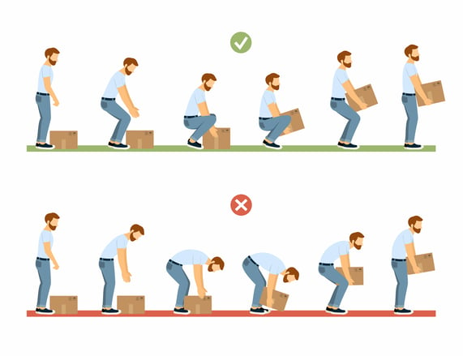
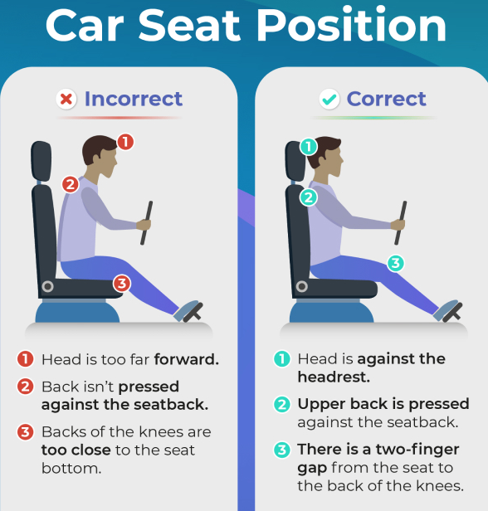
Lifting Mechanics

Slide 10
Summary
Professional drivers, including limo drivers, face significantly higher risks of low back and neck injuries due to prolonged sitting, vibration exposure, and ergonomic issues.
Preventive measures include better seat ergonomics, scheduled breaks, posture awareness, and physical conditioning focusing on core and spinal mobility.

Slide 11
Questions?
Contact Info:
Email: sghanayem@rushpt.com

Slide 12
References
Hoy D et al. (2020). Prevalence of musculoskeletal pain in professional drivers. PubMed: 32810918
Huan M et al. (2023). Global prevalence of low back pain among drivers. PubMed: 38603976
Tella BA et al. (2020). Musculoskeletal disorders in taxi drivers. PMC: 7434558
Mengistu Y et al. (2022). Musculoskeletal disorders among professional drivers in Cameroon. BMC Musculoskeletal Disorders, 22(5971)

