Slide 1



Integrated Referral and Intake System
IRIS
Kane County Year 3 Quarter 3 Meeting: 2.27.24

Slide 2
IRIS 2nd Annual Meeting
Introductions
Welcome and introductions - KCHD IRIS Team
  Kim Peterson, Director of Community Health, IRIS Community & Data Manager
  Michelle Meyer, Assistant Director, Community Health, IRIS Community & Data Manager
  Lorena Nunez, Early Childhood Programs Manager, IRIS Community & Data Manager
  Maria Leon, Family Engagement Specialist, AOK Network, IRIS Community & Data Manager
  Kaitlin Soriano, Violence Prevention Coordinator, IRIS Community & Data Manager

Slide 3
IRIS Annual Meeting Agenda
AGENDA
Welcome and Introductions
Y3Q3 Data Presentation (10/1/23-12/31/23)
New Arrival Resources
Q & A

Slide 4
Kane County IRIS Community
Vision Statement
“The Kane County IRIS Community will build upon strong collaborative relationships with partners to implement a data-driven, comprehensive, closed-loop referral system that identifies gaps in resources so that community members will be more effectively connected with the services they need to support positive outcomes.”
Notes:
Reminder of the “why” we are implementing this system improvement initiative. Keep bigger picture in your mind as Sophia is reviewing the data.

Slide 5
IRIS Illinois State Dashboard

Slide 6
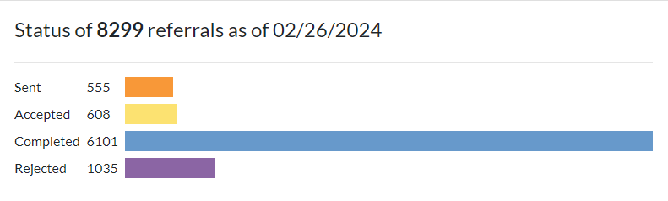
Referral Status as of 2/26/2024-Total Dashboard Summary

Slide 7

188 Total IRIS Organizations
8 New Members!
Ascension Mercy-Outpatient Behavioral Health Services
Community Service Council
The Ivy Academy of Early Learning-Geneva
The Ivy Academy-Elgin
Evergreen Shared Housing
Ellie Mental Health of Aurora
Sycamore Oasis Corporation
Notes:
Updated as of 9.1.23

Slide 8
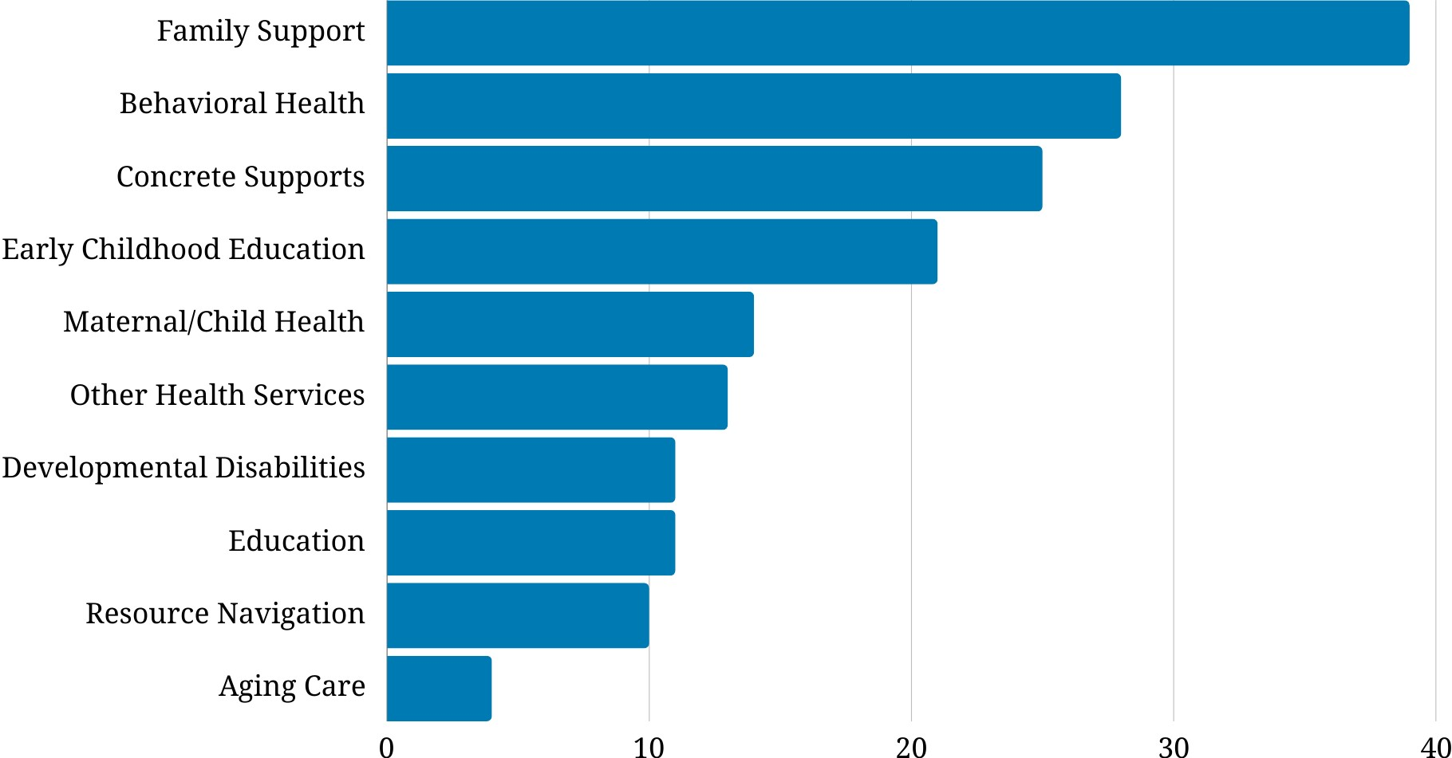
Service Sector Breakdown
Following 4 slides and code by Michael Granger, IMSA Student
Number of organizations

Slide 9
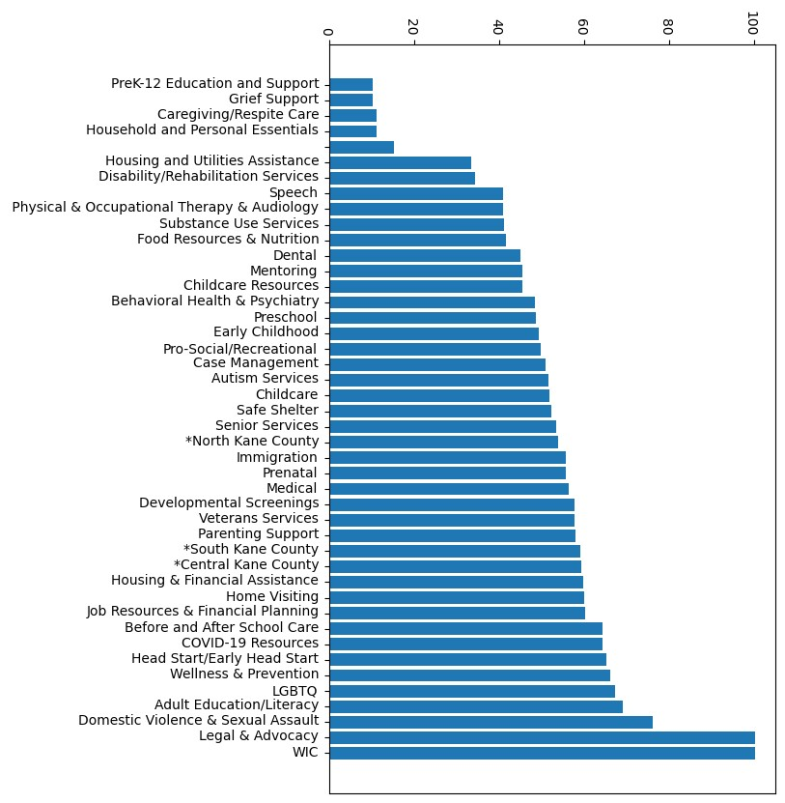
Capacity

Slide 10
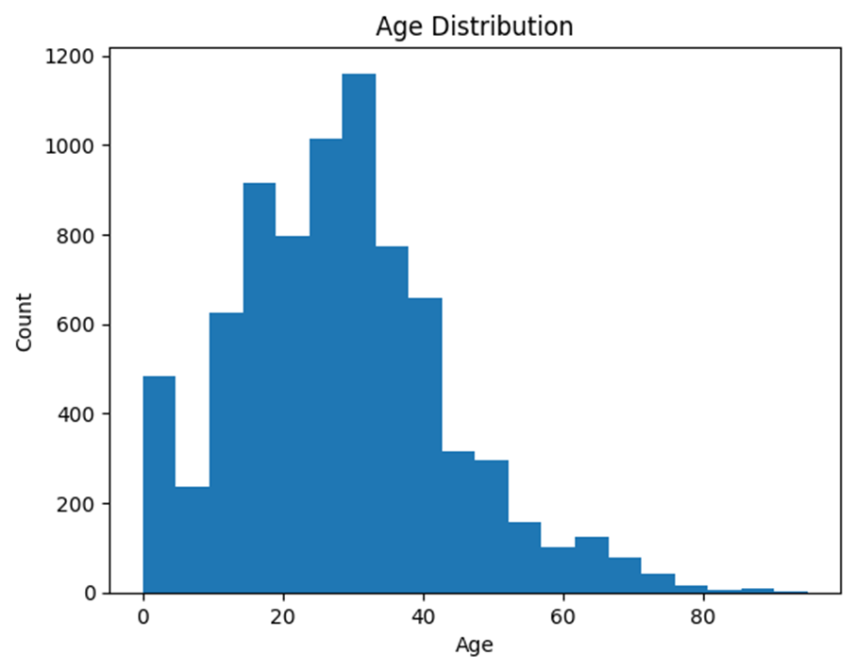
Count of Referrals by Age

Slide 11
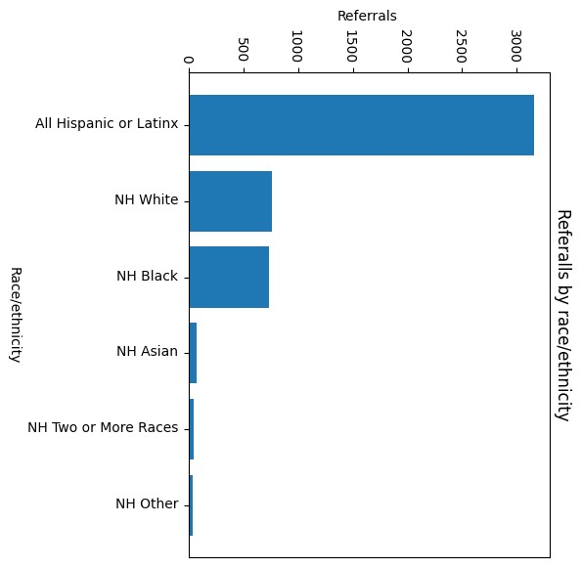
Count of Referrals by Race/Ethnicity

Slide 12
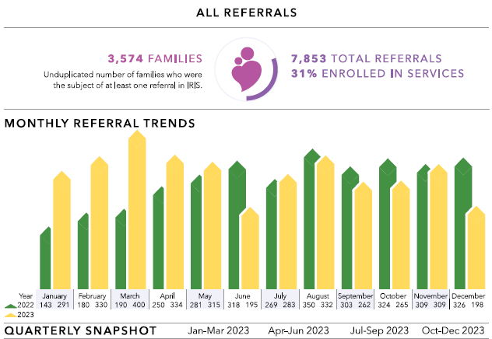
2022 vs. 2023

Slide 13

Response Time (sent to accept/reject)
Community Standards say 5 business days.
Goal Met!

Slide 14
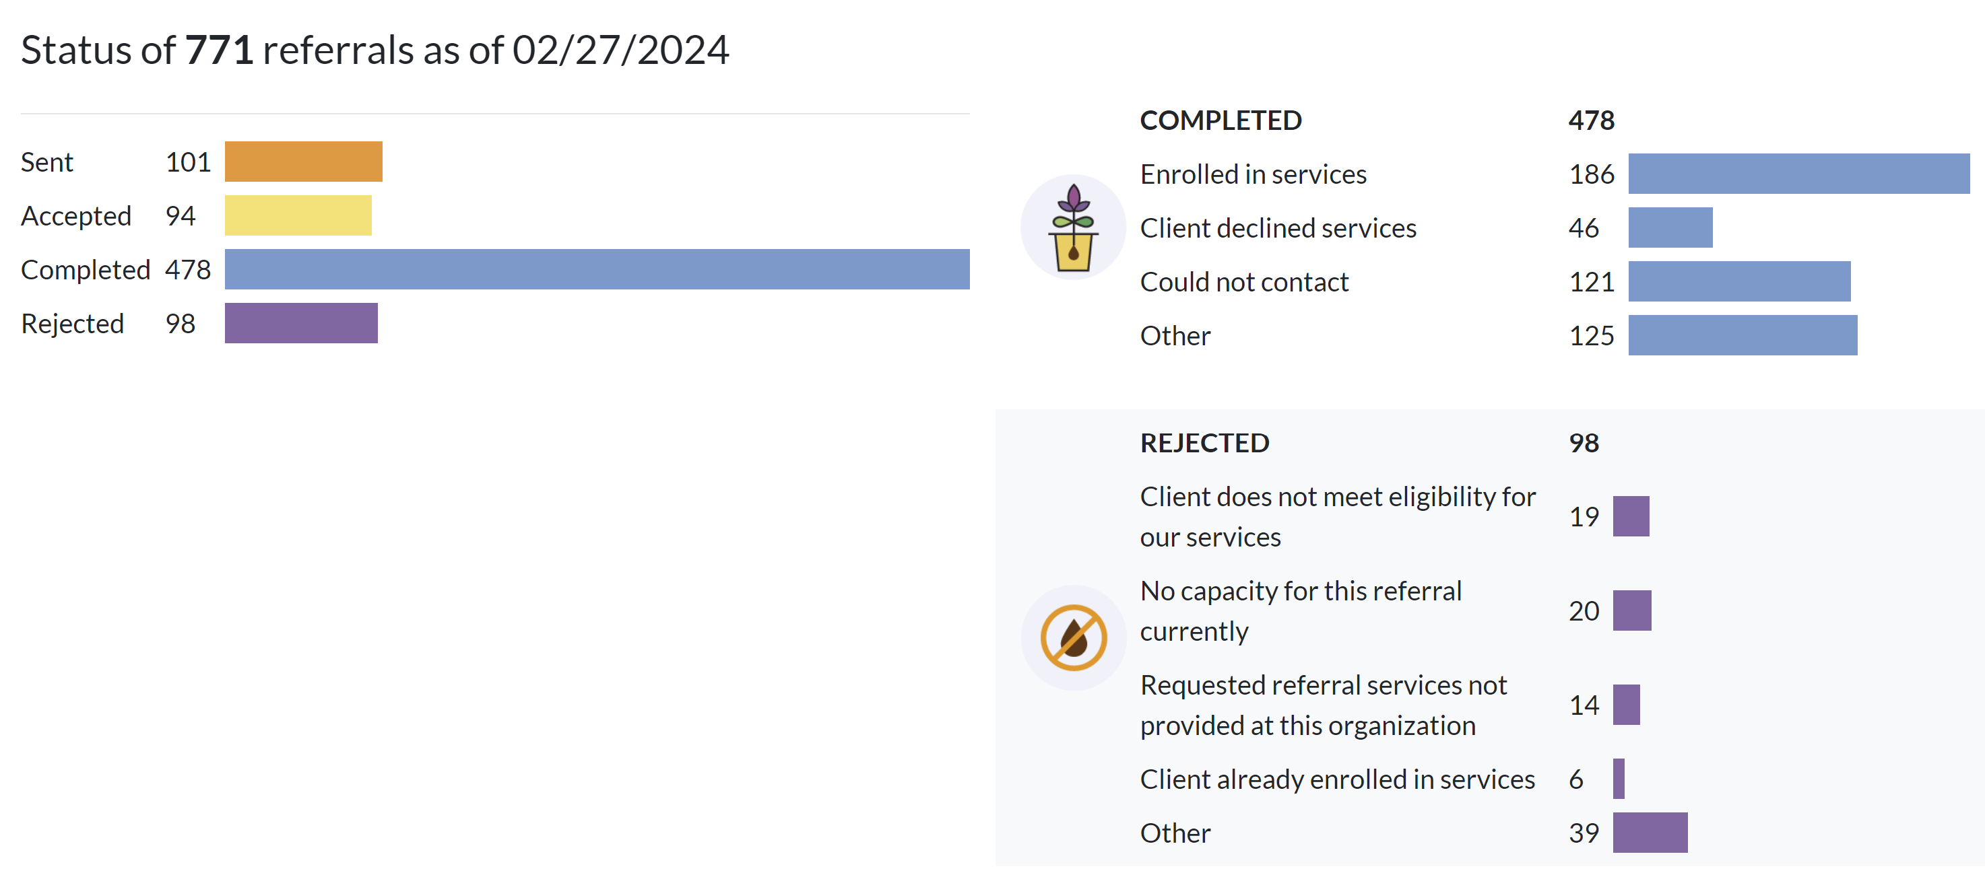
Referral Status (10/1/23-12/30/23)-Total Dashboard Summary

Slide 15
Referral Status Breakdown
Referrals in “Completed” status up by 2% since last quarter
Completed
62%

Slide 16
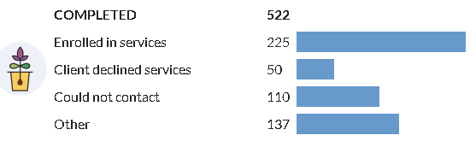
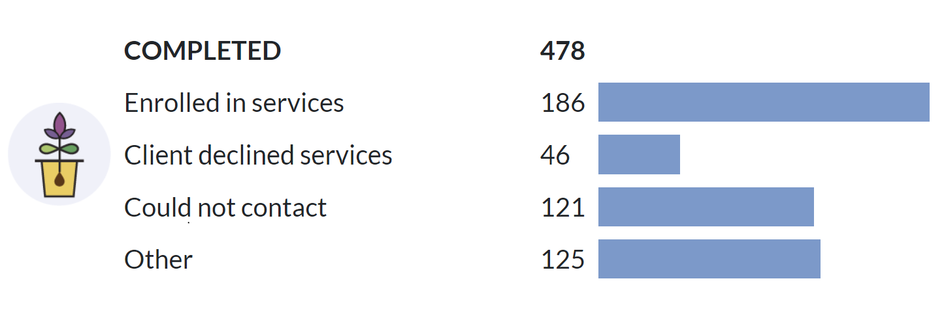
Completed Status Breakdown
July 1, 2023-September 30, 2023
Enrolled status decreased by approximately 5%
Could not contact increased by 5%
Discussion: Any insight as to why this might be?
October 1, 2023-December 31, 2023

Slide 17
KC IRIS Top Referral Organizations

Slide 18
Referrals Sent-Top 5 Organizations
October 1-December 31, 2023
Kane County Child Advocacy Center
Family Service Association of Greater Elgin
KCHD iGrow Home Visitation Coordinated Intake
Aurora Interfaith Food Pantry
Kane County ROE*
* Indicates organizations new to the top 5

Slide 19
Referrals Received-Top 5 Organizations
October 1-December 31, 2023
KCHD-iGrow-Home Visitation Coordinated Intake
VNA Healthcare*
Greater Family Health
Ecker Behavioral Health Center*
Child & Family Connections #4/DayOne PACT (EI)*

Slide 20


Slide 21
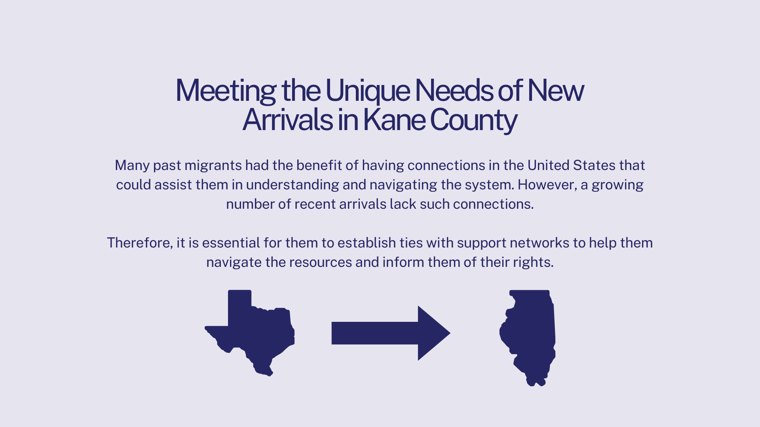

Slide 22
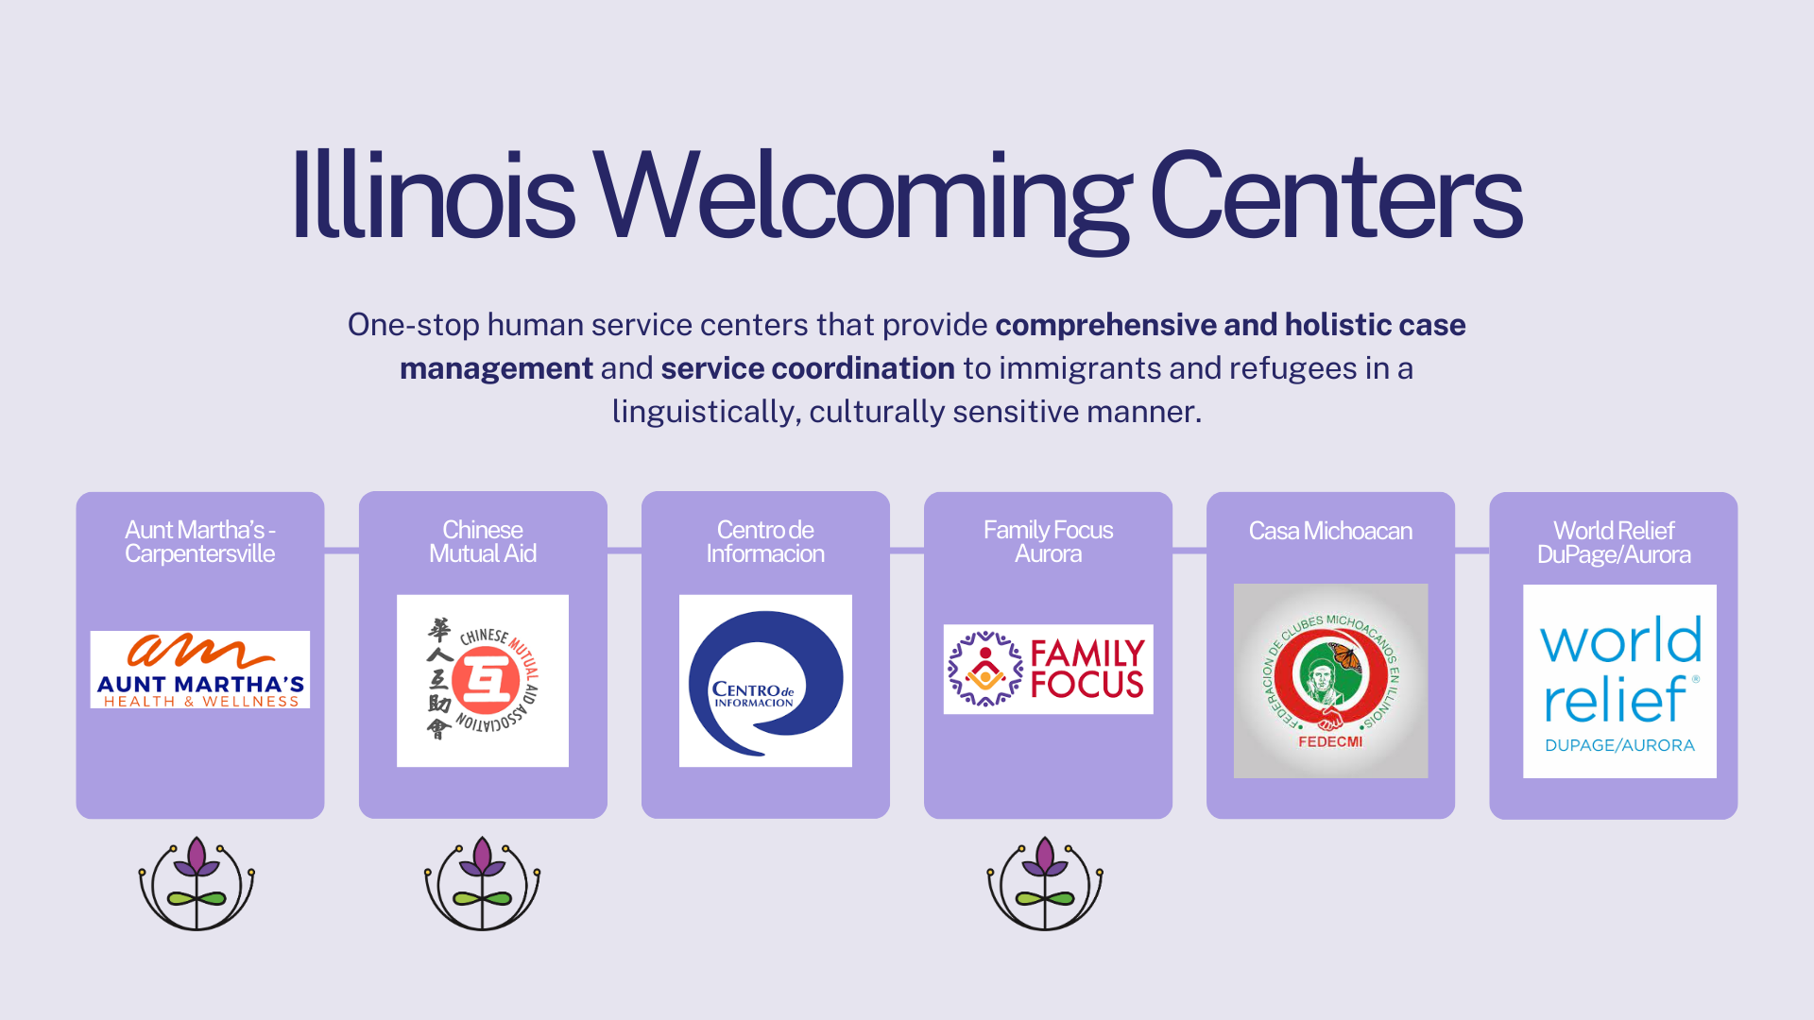

Slide 23
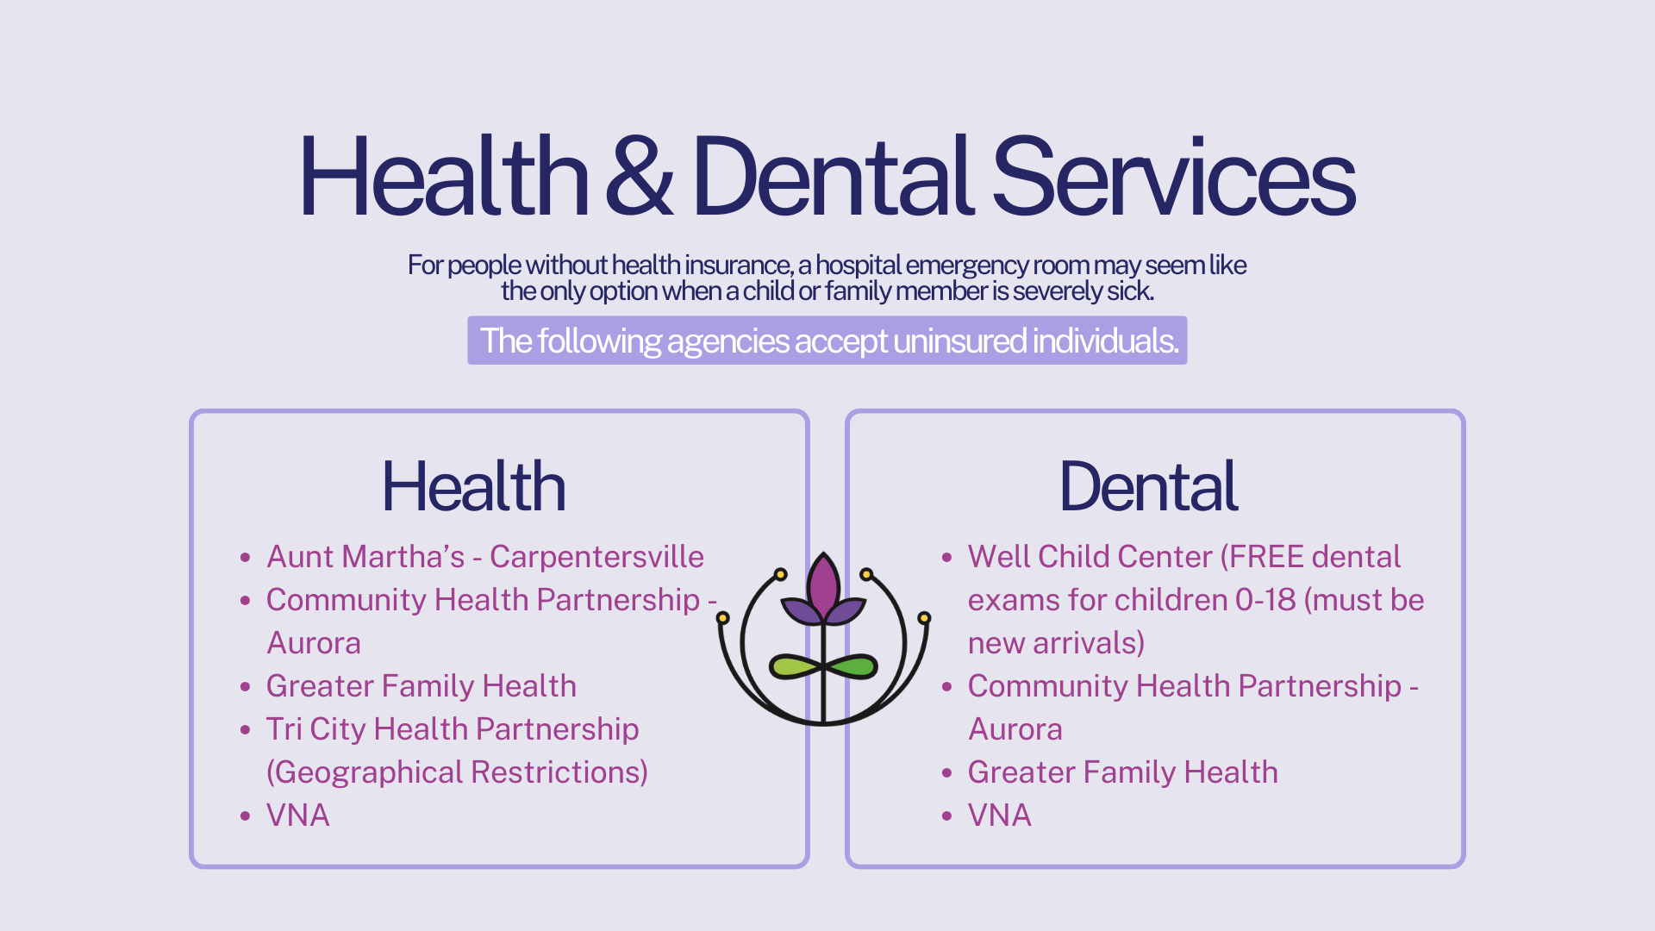

Slide 24
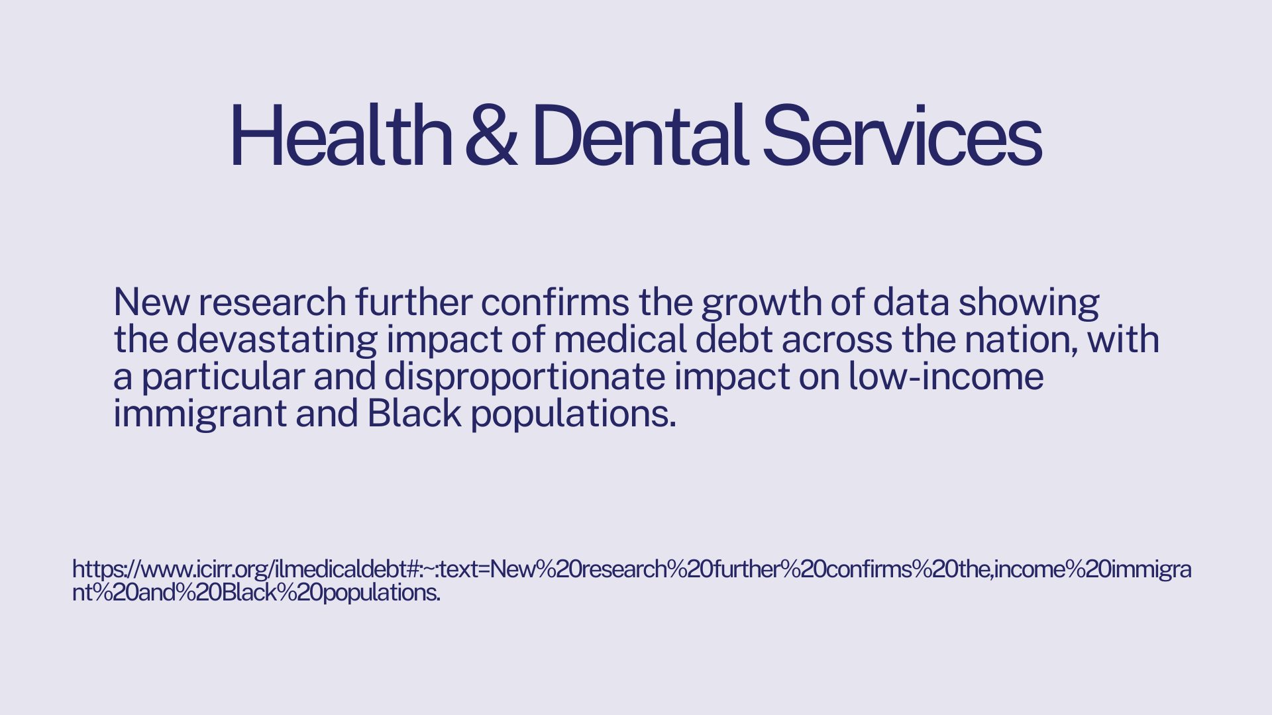

Slide 25
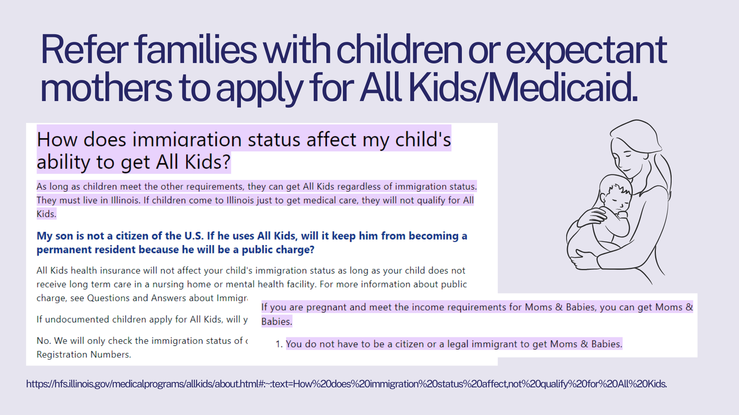

Slide 26


Slide 27
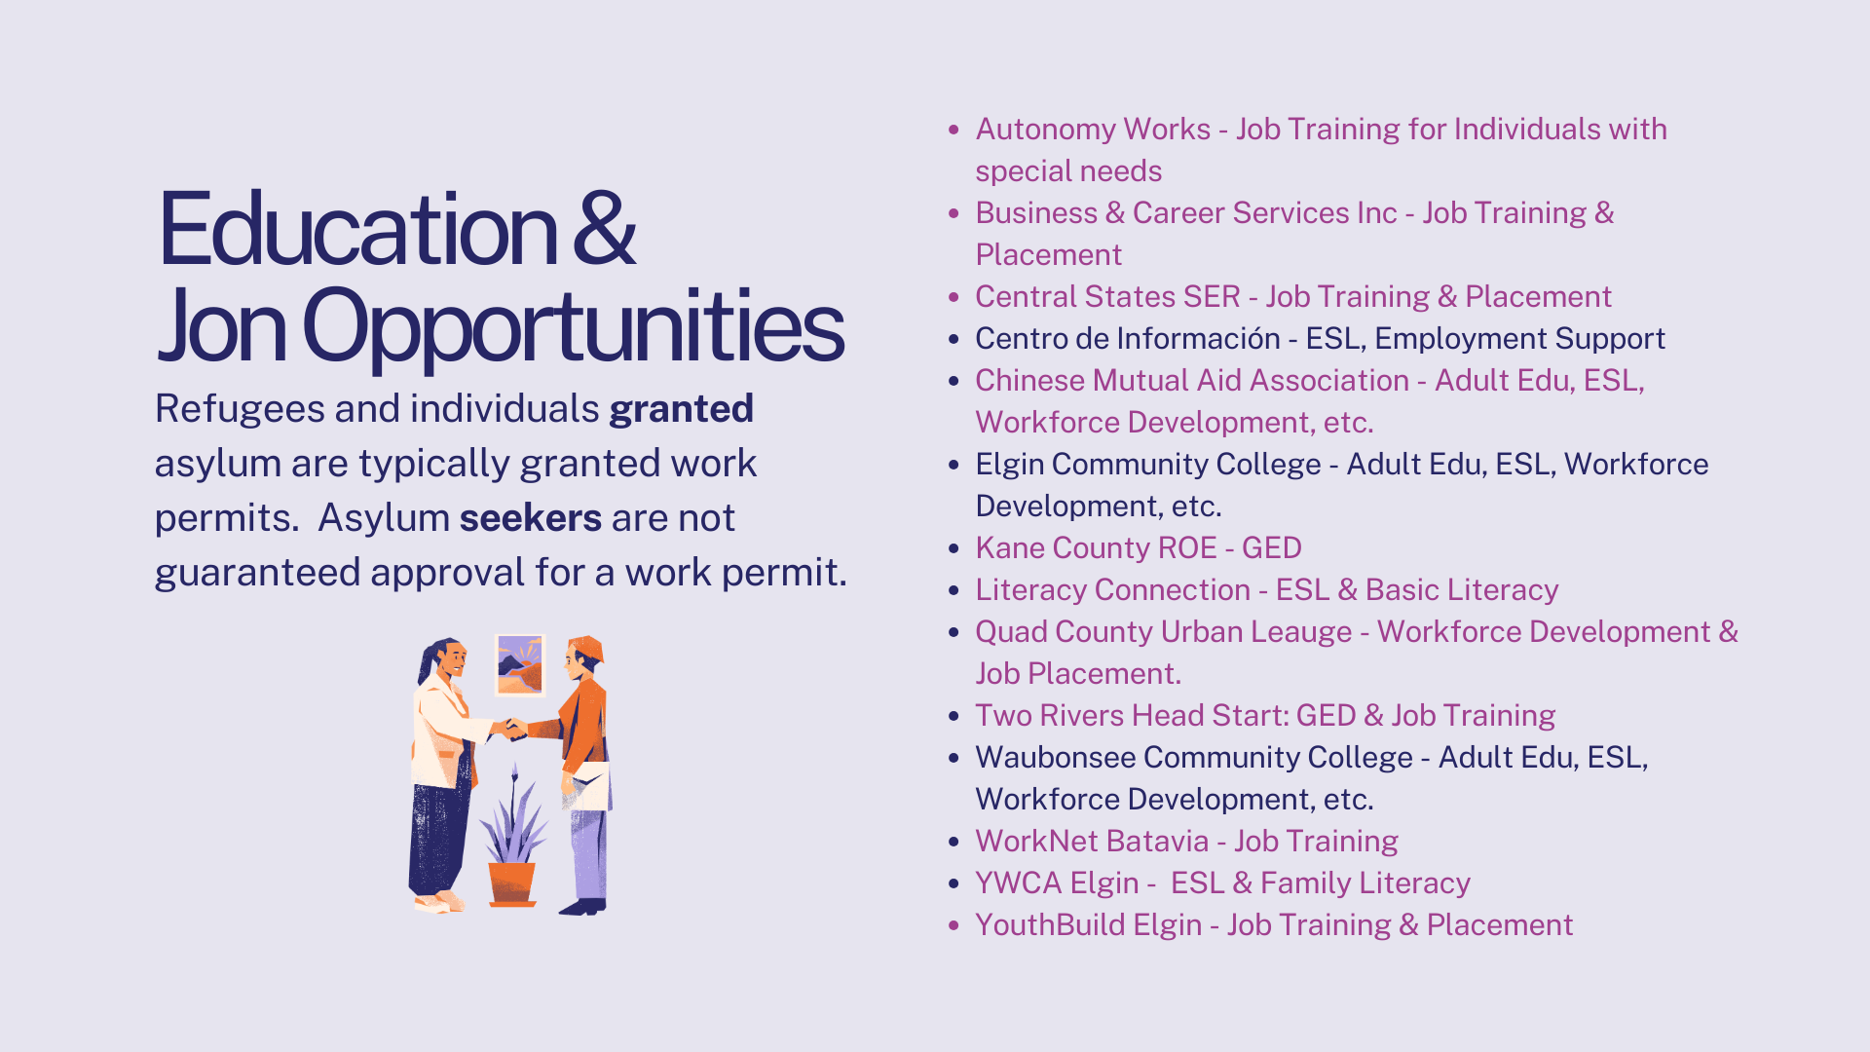

Slide 28


Slide 29
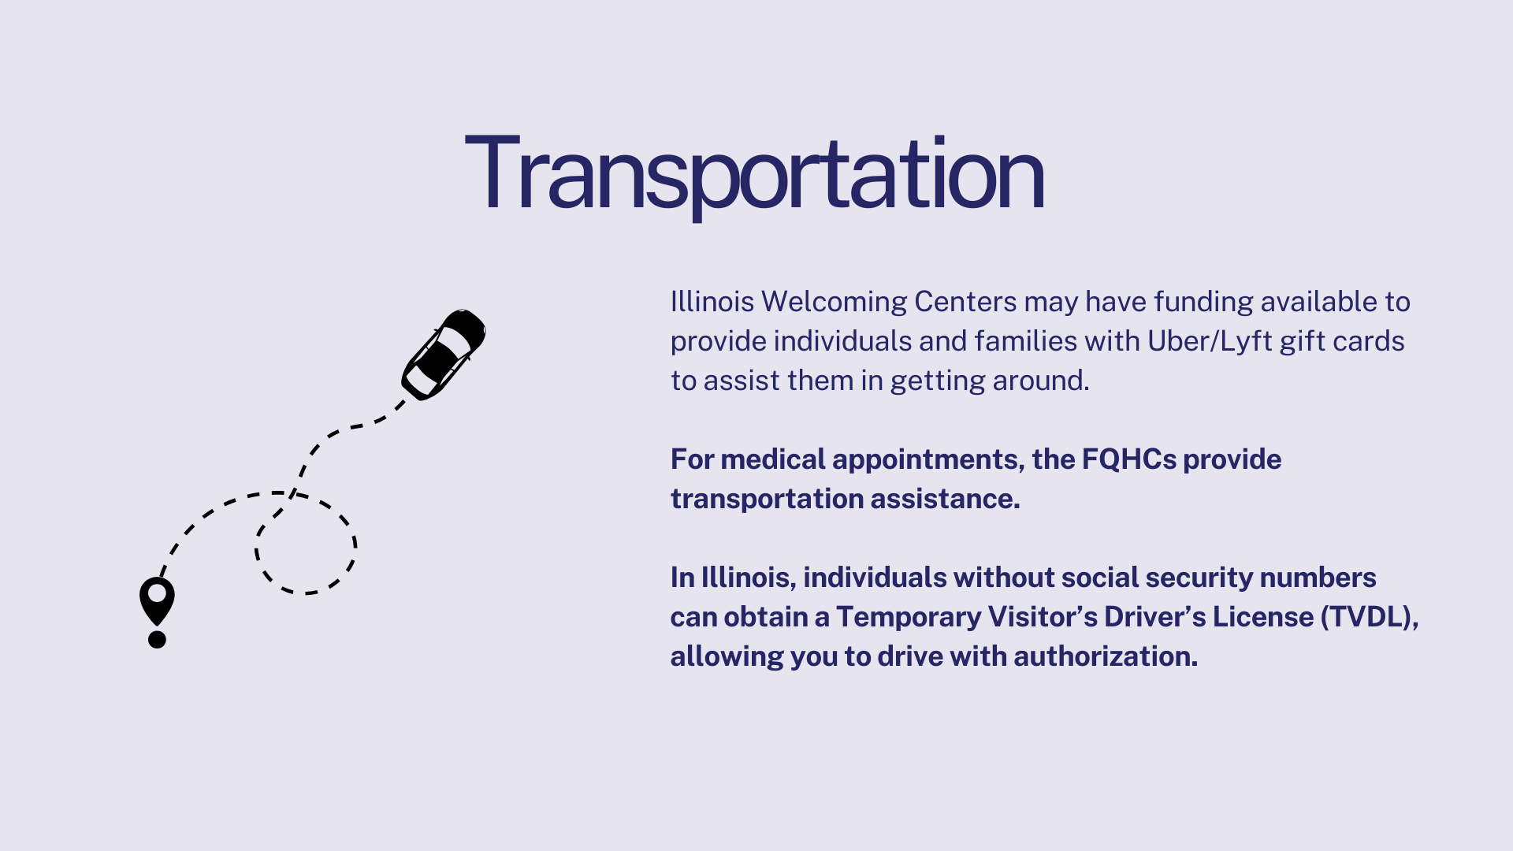

Slide 30


Slide 31
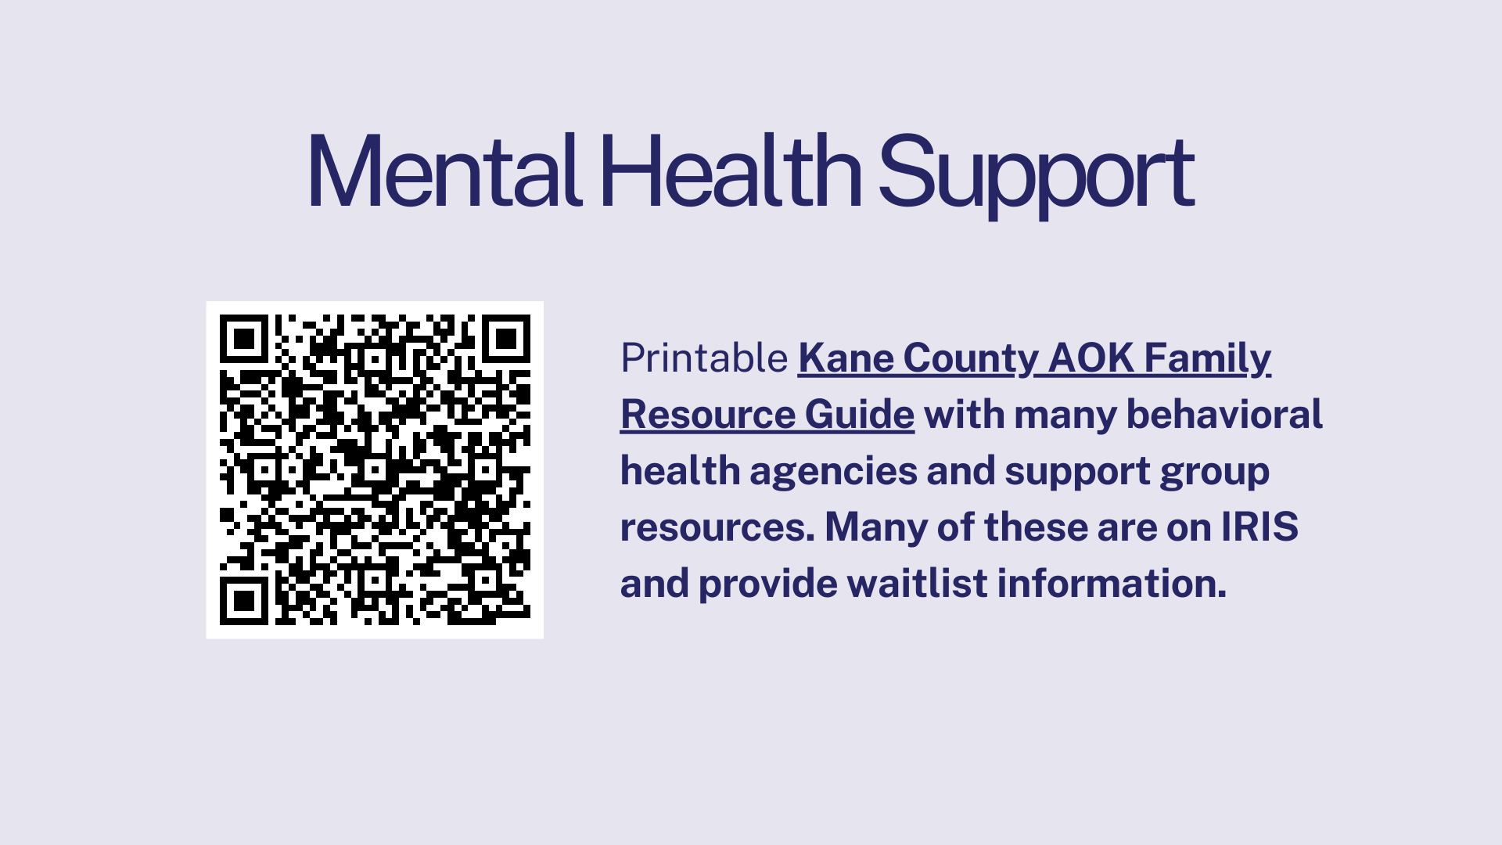

Slide 32
Q & A

