Slide 1



Integrated Referral and Intake System
IRIS
Kane County 3rd Annual Meeting: 05.20.24

Slide 2
IRIS Annual Meeting Agenda
AGENDA
Welcome and Introductions
Annual Data Presentation (3/15/23-3/15/24)
Review of Annual Survey
IRIS Partner Experiences
QI & Goal Setting
Goals?

Slide 3
IRIS 3rd Annual Meeting
Introductions
Welcome and introductions - KCHD IRIS Team
  Michael Isaacson, Executive Director
  Kim Peterson, Director of Community Health, IRIS Community & Data Manager
  Michelle Meyer, Assistant Director of Community Health, IRIS Community & Data Manager
  Lorena Nunez, Early Childhood Programs Supervisor, IRIS Community & Data Manager
  Maria Leon, Children’s MH Program Manager, IRIS Community & Data Manager
  Kaitlin Soriano, Violence Prevention Coordinator, IRIS Community & Data Manager

Slide 4
IRIS Organizations
We have 197 organizations that are part of our IRIS community!
Fresh Start Surgical Gifts
Hesed House
Northwestern Medicine Delnor Hospital
Association for Individual Development- Street Outreach
Metra Police Department
Kane County Health Department - Community Case Manager
Community Organizing and Family Issues
Live4Lali
Pregnancy Aid IL
Notes:
Lorena

Slide 5
Kane County IRIS Community
Vision Statement
“The Kane County IRIS Community will build upon strong collaborative relationships with partners to implement a data-driven, comprehensive, closed-loop referral system that identifies gaps in resources so that community members will be more effectively connected with the services they need to support positive outcomes.”
Notes:
Reminder of the “why” we are implementing this system improvement initiative. Keep bigger picture in your mind as Sophia is reviewing the data.

Slide 6

Challenges and Support
Did you know? You can come to us for the following supports:
You unable to reach a partner
Interested in discussing workflow
Require additional training or a refresher
Due to changes in staffing, you need assistance updating profile contact information
Data questions
Need help connecting to other IRIS communities

Slide 7
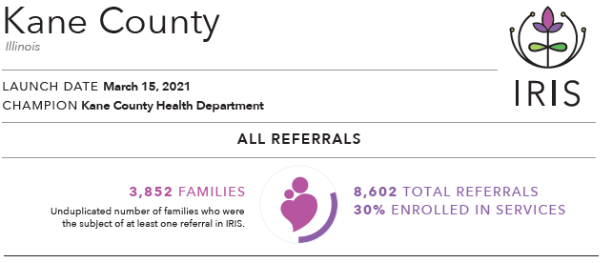
March 15 2021-March 15, 2024

Slide 8
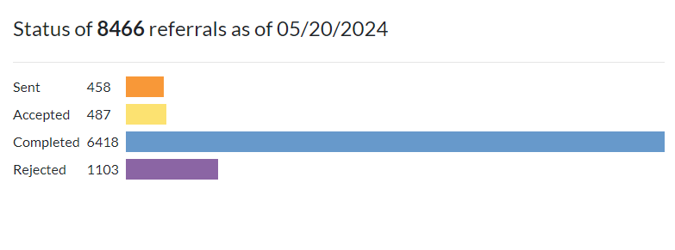
March 15, 2021-March 15, 2024
75% Completion Rate. BRAVO!!

Slide 9
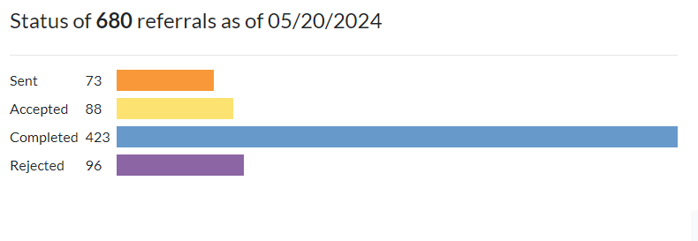
Referral Status (12/15/24-3/15/24)
62.2% Completion Rate as of today.
(lag in completion time)

Slide 10
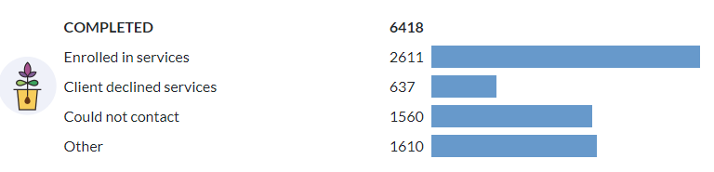
March 15, 2021-March 15, 2024
Out of all completed referrals, 41% ended in enrollment

Slide 11
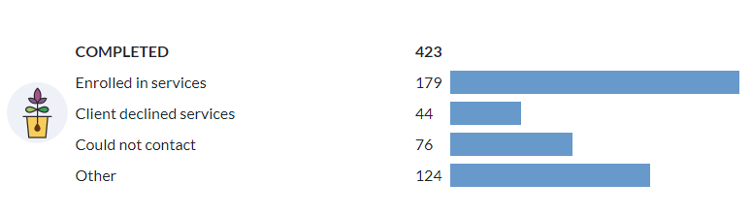
D2024-March 15, 2024
Out of all completed referrals, 41% ended in enrollment (ahead of schedule)

Slide 12
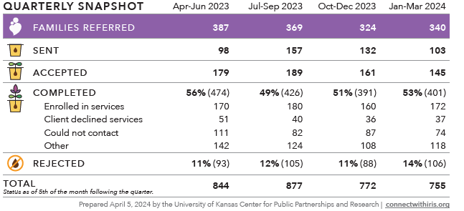
Quarterly Snapshot

Slide 13
Average Response Time
Notes:
Majority of data is from Q2 (6/15-9/15)

Slide 14
Sectors Represented 100%

Slide 15
IRIS Engagement 2024

Slide 16
Referrals Sent-Top 5 Organizations Throughout the Year 2
Family Service Association of Greater Elgin
KCHD-iGrow-Home Visitation Coordinated Intake/Home Visitation Non-IRIS Partner Shell
Kane County State Attorney’s Office-Child Advocacy Center
Family Focus-Parents as Teachers
Kiddie Academy of Carpentersville
Notes:
T-chart-2 columns

Slide 17
Referrals Received-Top 5 Organizations Throughout the Year 2
KCHD-iGrow-Home Visitation Coordinated Intake
Greater Family Health
Child and Family Connections #4/DayOne Pact
VNA Health Care
Elgin School District U46-Parents as Teachers

Slide 18
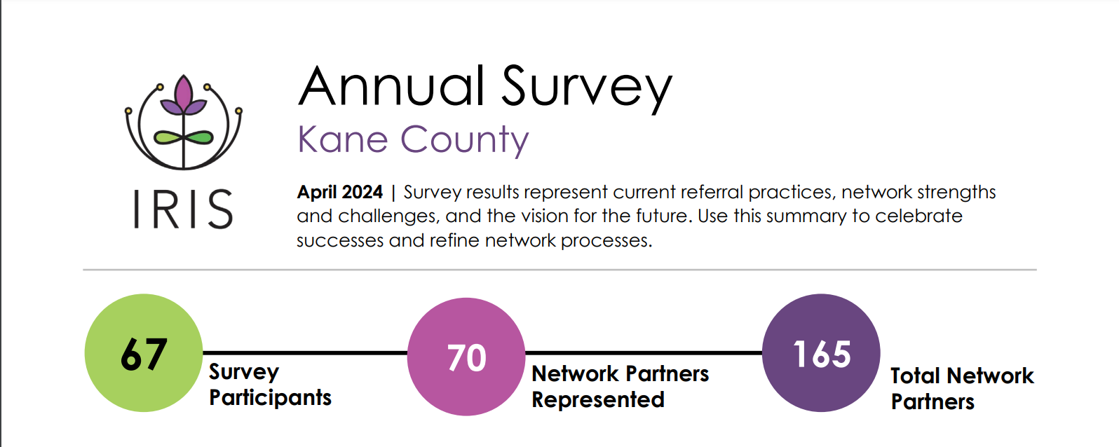
Annual Survey

Slide 19
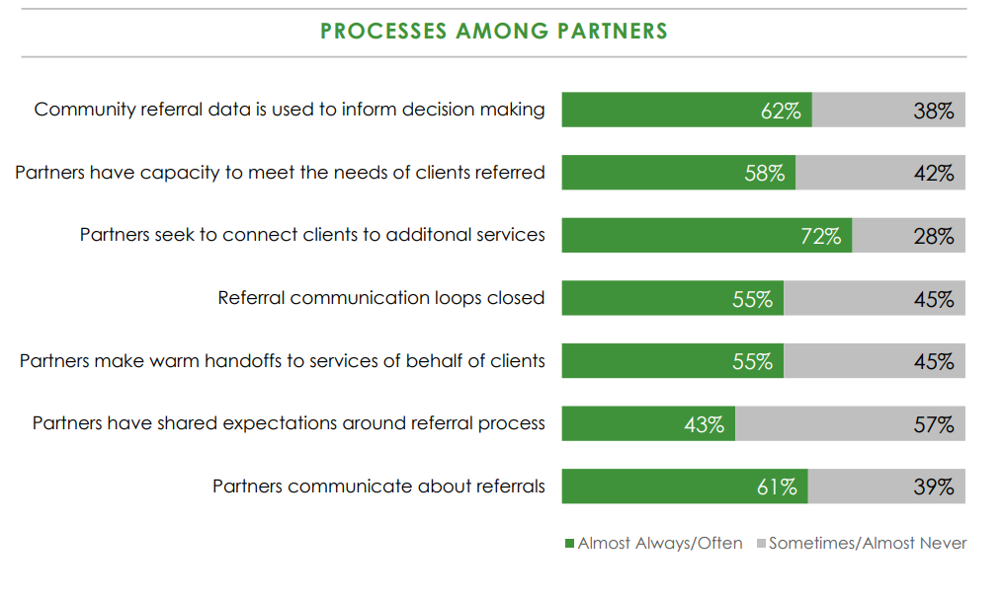
Strengths & Challenges
What strengths can be amplified?
What challenges need to
be addressed?

Slide 20
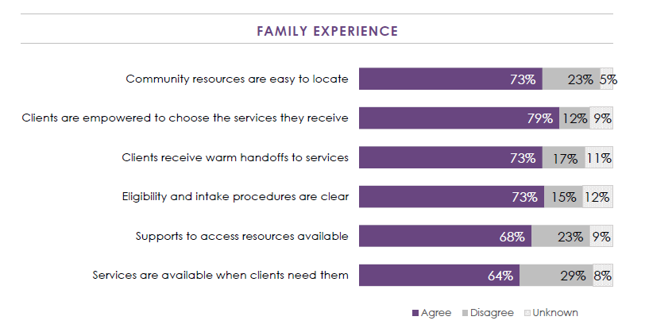
Strengths & Challenges
What strengths can be amplified?
What challenges need to be addressed?
How can you gather information
from families to better understand
strengths and challenges?

Slide 21
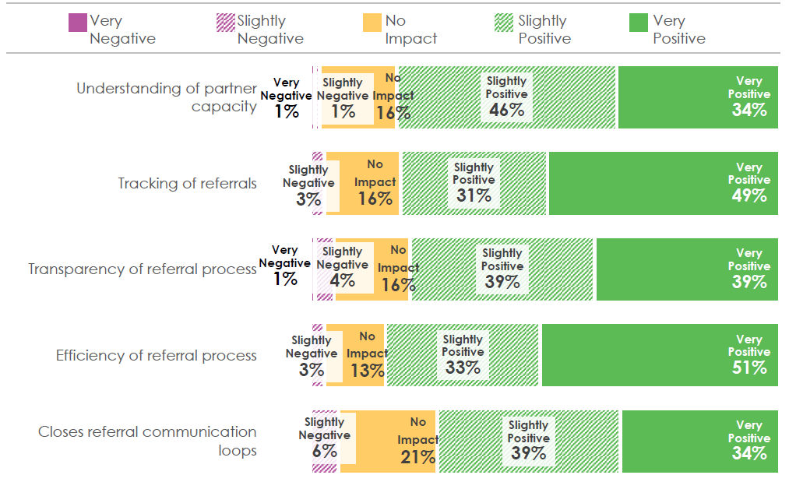
IRIS Impact
What positive impacts can be amplified?
What challenges need to be addressed?

Slide 22
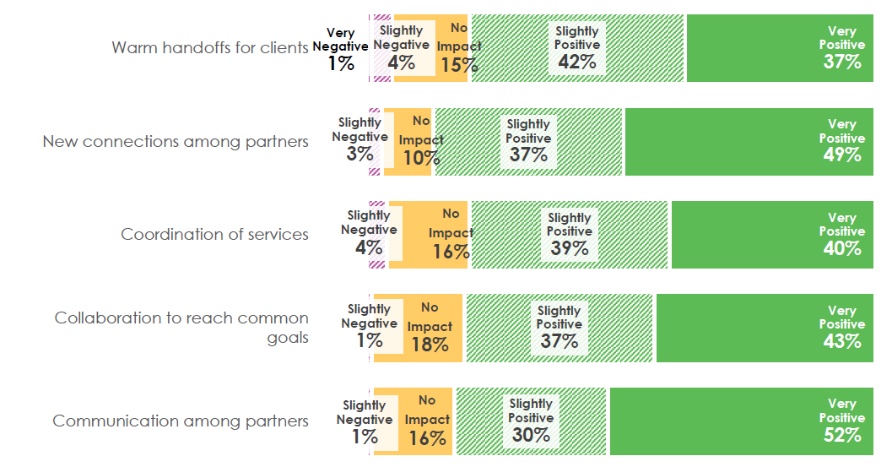
IRIS Impact
What positive impacts can be amplified?
What challenges need to be addressed?

Slide 23
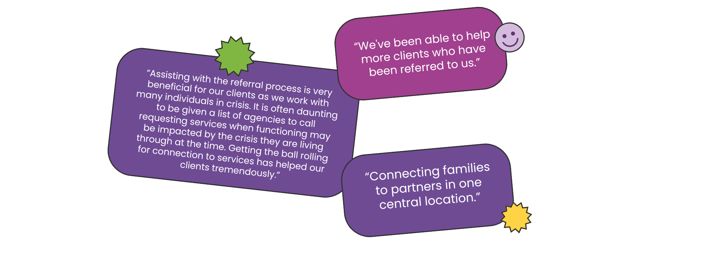
Network Successes
Benefits to Clients – Partner Quotes

Slide 24
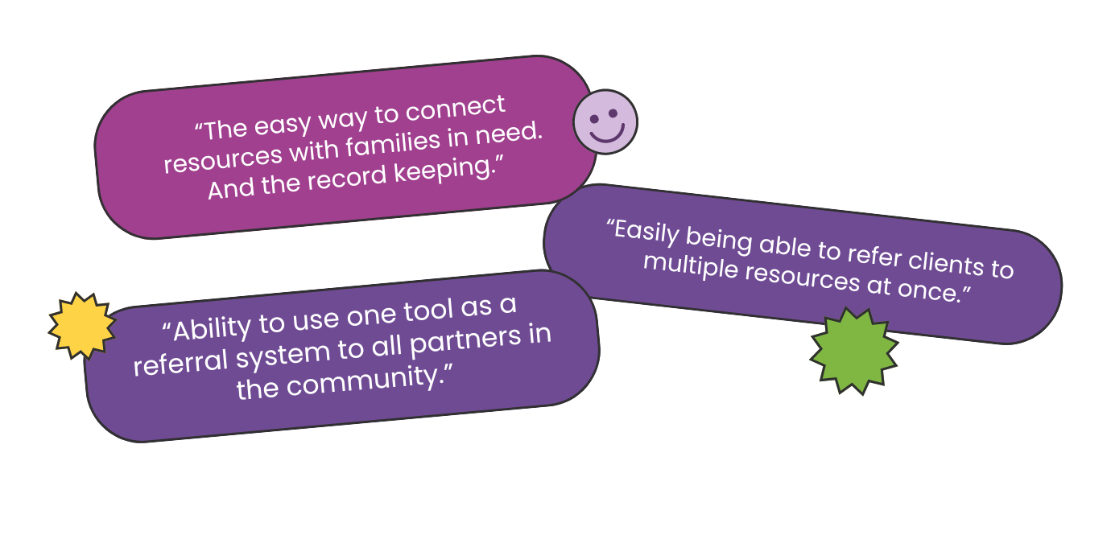
Network Successes
Ease & Convenience – Partner Quotes

Slide 25
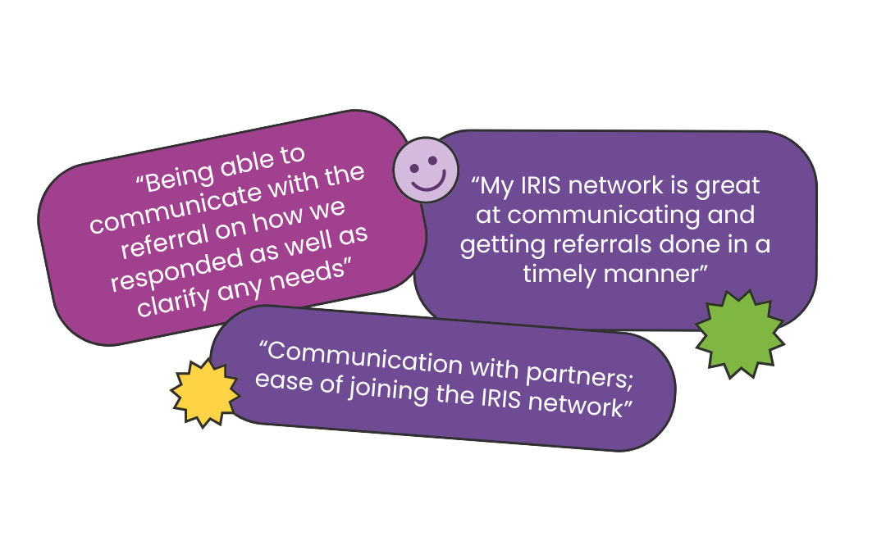
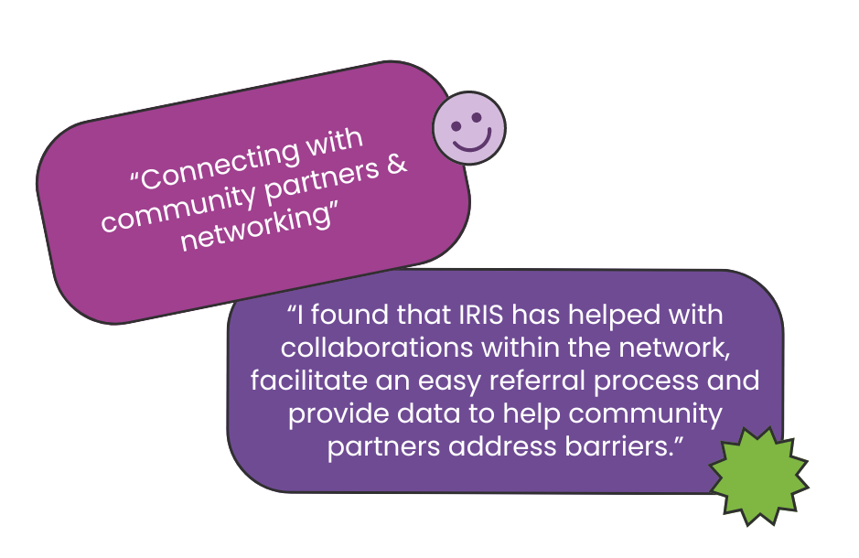
Network Successes
Partner Communication & Connection – Partner Quotes

Slide 26
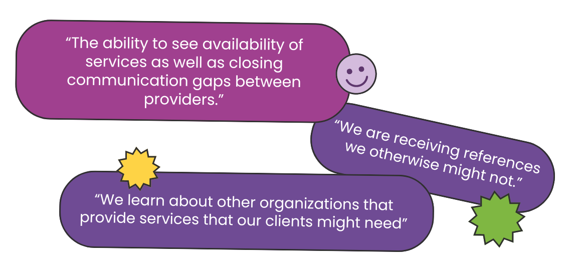
Network Successes
Service Visibility – Partner Quotes

Slide 27
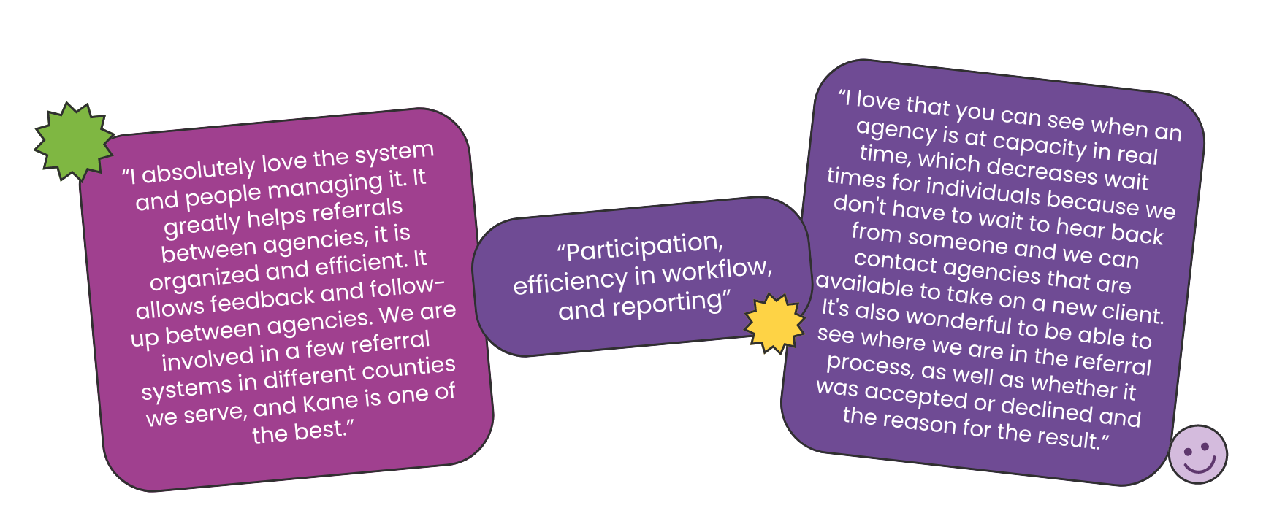
Network Successes
Partner Quotes

Slide 28
Interactive Quality Improvement Discussion
Jamboard
Notes:
https://jamboard.google.com/d/16oJDH0clDKauUrEpeST2A0g2Fl2e0eLoLyWnYU8Z1kk/edit?usp=sharing

Slide 29
Goals for Year 3

Slide 30
Goals
Use notes section and communication center in IRIS to update partners and provide additional details about nature of referrals.
Onboard more schools and senior services
Expand use of Social Determinants of health screening and/or other methods to meet needs.

Slide 31
Q & A

