Slide 1



Integrated Referral and Intake System
IRIS
Kane County Year 4 Quarter 1: 09.09.2024

Slide 2
IRIS Annual Meeting Agenda AGENDA
Welcome and Introductions
Year 4, Quarter 1 Data
Please Take the Survey!
Kane Health Atlas

Slide 3
IRIS Year 4 Quarter 1 Meeting Introductions
Welcome and introductions - KCHD IRIS Team
Michael Isaacson, Executive Director
Kim Peterson, Director of Community Health, IRIS Community & Data Manager
Michelle Meyer, Assistant Director of Community Health, IRIS Community & Data Manager
Lorena Nunez, Early Childhood Programs Manager, IRIS Community & Data Manager
Maria Leon, Children’s MH Program Manager, IRIS Community & Data Manager
Kaitlin Soriano, Violence Prevention Coordinator, IRIS Community & Data Manager

Slide 4
IRIS Organizations
Kane County IRIS has 208 Participating Organizations
New this Quarter
New Hope Counseling Center
Family Recovery Centers
ABC Counseling
Rise Up for Autism
Waubonsee Community College
Humanitarian Service Project
VOA Illinois
Thriveworks Counseling
Youth Outlook
Kane County Sheriff's Office: Employment Assistance
Kane County Sheriff's Office: A Way Out
Notes:
Lorena

Slide 5
Kane County IRIS Community Vision Statement
“The Kane County IRIS Community will build upon strong collaborative relationships with partners to implement a data-driven, comprehensive, closed-loop referral system that identifies gaps in resources so that community members will be more effectively connected with the services they need to support positive outcomes.”
Notes:
Reminder of the “why” we are implementing this system improvement initiative. Keep bigger picture in your mind as Sophia is reviewing the data.

Slide 6

Challenges and Support
Did you know? You can come to us for the following supports:
You unable to reach a partner
Interested in discussing workflow
Require additional training or a refresher
Due to changes in staffing, you need assistance updating profile contact information
Data questions
Need help connecting to other IRIS communities

Slide 7
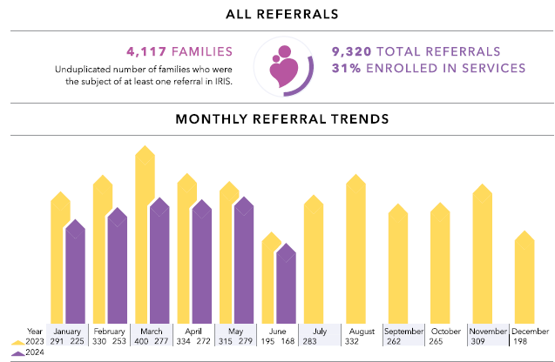
March 2021-June 2024

Slide 8
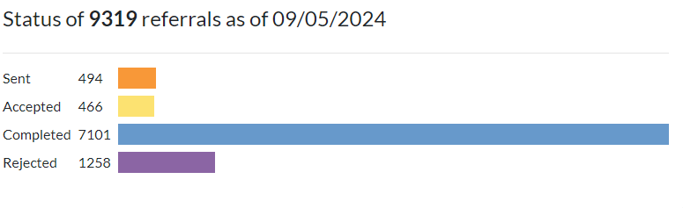
March 2021-June 2024
76% Completion Rate. Up from 75% last quarter. YAY!

Slide 9
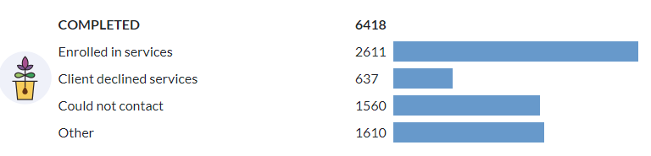
March 2021-June 2024
Out of all completed referrals, 41% ended in enrollment

Slide 10
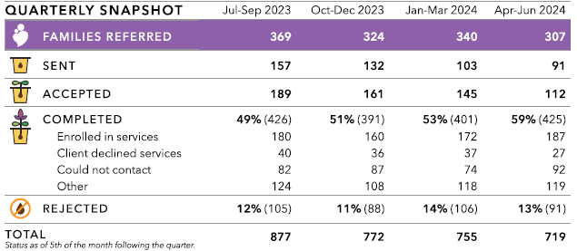
Quarterly Snapshot

Slide 11
Completed Referral Rate
10% improvement in 1 year

Slide 12
Enrollment Rates
Highest enrollment to date!
What strategies do you use to increase likelihood of enrollment?
Notes:
Majority of data is from Q2 (6/15-9/15)

Slide 13
Average Response Time
Notes:
Majority of data is from Q2 (6/15-9/15)

Slide 14
Sectors Represented 100%

Slide 15
Referrals Sent-Top 5 Organizations April 2024 – June 2024
Family Service Association of Greater Elgin
Aurora Police Department- CIU
Kiddie Academy of Carpentersville
Family Focus Aurora-Parents as Teachers Program & Doula
State Representative Barbara Hernandez
Notes:
T-chart-2 columns

Slide 16
Referrals Received-Top 5 Organizations April 2024 – June 2024
Kane County Health Department-iGrow-Home Visitation Coordinated Intake
Child and Family Connections #4/DayOne PACT
Greater Family Health
VNA Health Care
Elgin School District U-46-Parents as Teachers

Slide 17
Reminder: Utilization Survey
Survey
Notes:
Please 2 minutes to take the survey.
PASTE LINK IN CHAT
https://redcap.dph.illinois.gov/surveys/?s=TDT7LK87A8RYD88A

Slide 18
Q & A

Slide 19
Kane Health Atlas
Jamboard
Notes:
Presentation by Liz Alleman

Slide 20
Q&A

