Slide 1
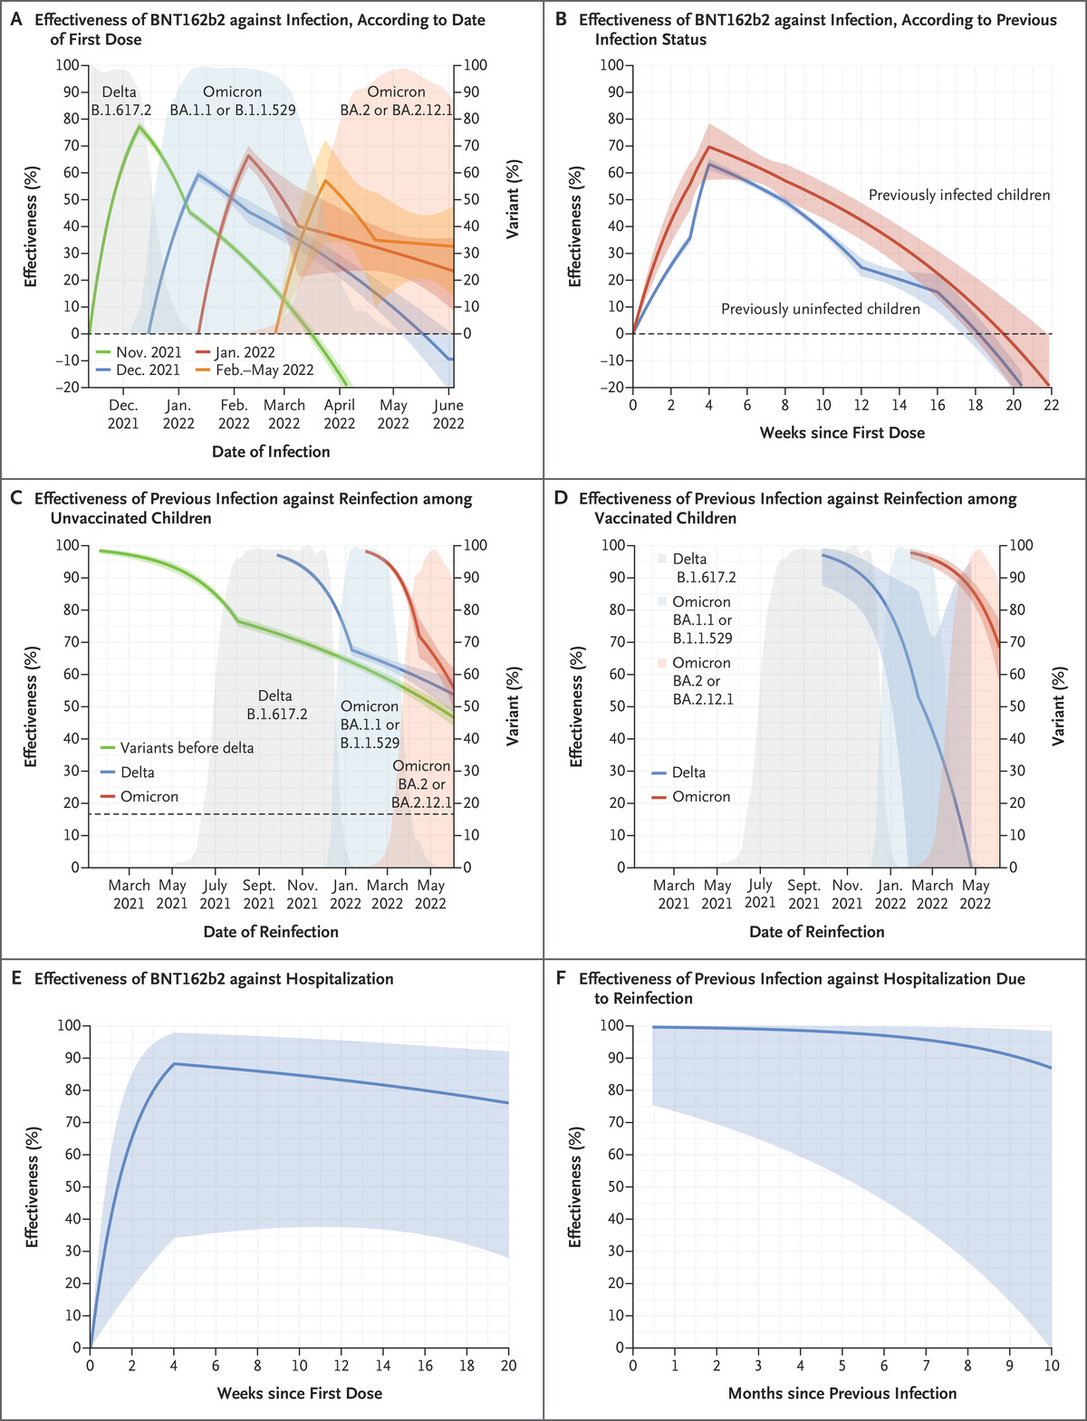
Protection Conferred by Two Doses of BNT162b2 Vaccine and by Previous Severe Acute Respiratory Syndrome Coronavirus 2 (SARS-CoV-2) Infection against Infection and Coronavirus Disease 2019–Related Hospitalization in Children 5 to 11 Years of Age.
D Lin et al. N Engl J Med 2022;387:1141-1143.
Notes:
Figure 1. Protection Conferred by Two Doses of BNT162b2 Vaccine and by Previous Severe Acute Respiratory Syndrome Coronavirus 2 (SARS-CoV-2) Infection against Infection and Coronavirus Disease 2019–Related Hospitalization in Children 5 to 11 Years of Age. The estimated effectiveness of the BNT162b2 vaccine against SARS-CoV-2 infection is shown as a function of time since the first dose, according to the date of the first dose (Panel A; each curve starts at the median date of the first dose) and according to previous infection status (Panel B). The estimated effectiveness of previous SARS-CoV-2 infection against reinfection is shown as a function of time since previous infection, according to the variant type, among unvaccinated children (Panel C) and among vaccinated children (Panel D). In Panels C and D, for each type of previous infection, the curve starts at the median date of the initial diagnosis plus 2 weeks. For variants before delta, the range of these dates is March 11, 2020, to June 30, 2021; for delta, July 1 to December 15, 2021; and for omicron, December 16, 2021, to June 3, 2022. Panel E shows the estimated vaccine effectiveness against hospitalization, and Panel F shows the estimated effectiveness of previous infection against hospitalization due to reinfection. In Panels B, C, and D, effectiveness is calculated for one exposure alone (vaccination or previous infection), given the status of the other exposure. The shaded bands indicate 95% confidence intervals.

