Slide 1
Restraint & Seclusion
High-Risk Interventions
CMS: Centers for Medicare and Medicaid Services
TJC: The Joint Commission: use for deeming

Slide 2
Objectives
After reviewing the slides, you should be able to:
  Discuss regulatory requirements related to the use of restraint and/or seclusion.
  Discuss the patient’s right to be free of restraints unless clinically justified.
  Identify concerns around documentation when restraint and/or seclusion is used.
    Clinical justification
    Orders
    Patient monitoring and evaluation
  Identify staff education and competence expectations.

Slide 3

Restraint and Seclusion…Overarching Principles
Patients have the right to be free from physical or mental abuse, and corporal punishment.
All patients have the right to be free from restraint or seclusion, of any form, imposed as a means of coercion, discipline, convenience, or retaliation by staff.
Restraint or seclusion may only be imposed to ensure the immediate physical safety of the patient, a staff member, or others, and must be discontinued at the earliest possible time.
    CMS §482.13(e) Standard: Restraint or seclusion
Patient Rights

Slide 4

Restraint and Seclusion…Use with Caution
        These are risky interventions
        Should not be “default” intervention
        Should never be used longer than needed
        Always require a change in the patient’s plan of care to include goal of the intervention
  A violation of any of the patient rights related to restraint and seclusion constitutes inappropriate use of restraint or seclusion, and it would be subject to Condition- Level Deficiency (CLD) and possibly Immediate Jeopardy (CMS) or Immediate Threat to Health and Safety (TJC).
    §482.13 (e) Interpretative Guidelines

Slide 5

STOP…
NEVER use restraint or seclusion unless clinically justified:
  NOT for confusion
  NOT because patient is a fall risk
  NOT because the patient is yelling, spitting, or using profanity
  NOT because the patient is refusing to wear a hospital gown
  NOT because the patient keeps taking off the telemetry leads
  NOT because you think the patient might do something
  NOT as part of routine care
  Etc., Etc., Etc.!!!!!

Slide 6
Unintended Consequences
Restraints increase the risk for delirium by fourfold.
    JAMA March 20, 1996:275 (11):852-857. Precipitating Factors for Delirium in Hospitalized Elderly Patients.
“Delirium affects as many as 14% to 56% of all hospitalized patients… It also accompanies mental status changes that lead to confusion, fear, and can manifest in a combative, threatening presentation.”
    The Joint Commission: The Source™, Volume 14, Issue 2, February 2016, Joint Commission Resources An affiliate of The Joint Commission 1515 W. 22nd Street, Suite 1300 Oak Brook, Illinois 60523.

Slide 7
Restraint and Seclusion…Estimated Frequency of Use
27,000 patients are restrained every day or about 5 per hospital and the prevalence is 50 per 1,000 patient days.
    2007 Study in Journal of Nursing Scholarship, Vol 39, Issue 1, Page 30-37, Prevalence and Variation of Physical Restraint Use in Acute Care Settings in the US.
TJC is aware of 130 restraint-related deaths from 2004 - 2015
    Summary Data of Sentinel Events Reviewed by The Joint Commission
40% of hospitals fail to report deaths to CMS.
    Hospital Reporting of Deaths Related to R&S, OIG and HHS, at http://oig.hhs.gov/oei/reports/oei-09-04-00350.pdf

Slide 8

The federal government (known for monitoring the size of your breakfast eggs) does not collect data on how many patients are killed by a procedure that is used every day in psychiatric and mental retardation facilities across the country. Neither do state regulators, academics, or accreditation agencies.
"Right now, we don't have those numbers,‘’ says Ken August of the California Department of Health Services, "and we don't have a way to get at them.''
The regulators don't ask, and the hospitals don't tell.

Slide 9

Restraint and Seclusion…Definitions

Slide 10
Restraint…CMS
CMS: Centers for Medicare and Medicaid Services
Any manual method, physical or mechanical device, material, or equipment that immobilizes or reduces the ability of a patient to move his or her arms, legs, body, or head freely; or a *drug or medication when it is used as a restriction to manage the patient’s behavior or restrict the patient’s freedom of movement and is not a standard treatment or dosage for the patient’s condition *(chemical restraint).
    CMS §482.13(e)(1) and (482.13(e)(1)(i)(B)

Slide 11
Physical Holds
Note regarding physical / therapeutic holds for medication administration, physical exams or tests: these are considered restraint, as patient has right to refuse all of these activities.
Organizational policy should identify types of physical holds allowed and not allowed.

Slide 12
Physical Holds
  The following story ran in The Hartford Courant on October 11, 1998.
    Series Citation: Weiss EM, et al. Deadly restraint: a Hartford Courant investigative report. Hartford Courant 1998; October 11 – 15.
Tristan Sovern, 16, Died: March 4, 1998, Cause: Asphyxiation
Workers restrained Sovern face down on the floor. During the struggle, staffers put a towel over the boy's mouth and held a bed sheet around his head. No one checked Sovern's breathing or pulse during the restraint. One criminal indictment has been issued against a staffer.

Slide 13
Restraint…TJC
TJC: The Joint Commission: use for deeming
The direct application of physical force to a patient, with or without the patient’s permission to restrict his or her freedom of movement. The physical force may be human, mechanical devices, or a combination of the two.
Any method (chemical or physical) of restricting an individual’s freedom of movement, including seclusion, physical activity, or normal access to his or her body that: (1) is not a usual and customary part of a medical, diagnostic, or treatment procedure to which the individual or his or her legal representative has consented, (2) is not intended to treat the individual’s medical condition or symptoms, or (3) does not promote the individual’s independent functioning.

Slide 14
What is not a Restraint §482.13(e)(1)(i)(c)
CMS: Centers for Medicare and Medicaid Services
IV arm boards, unless tied down (or otherwise attached to the bed), or the entire limb is immobilized such that the patient cannot access his or her body.
Unsecured hand mitts are not considered restraints, unless applied so tightly that the fingers or hand are immobilized, or so bulky that the patient’s ability to use their hands is significantly compromised.
Adaptive support used in response to patient’s assessed needs (postural support, orthopedic appliances, tabletop chairs, etc.).
  Note: Patient must be able to easily remove the device.

Slide 15
What is Not a Restraint
Protective equipment, such as helmets, raised side rails on stretchers, etc.
Age and developmentally appropriate protective safety interventions; e.g., stroller safety belts, high-chair safety belts, raised crib rails, etc. if addressed in hospital policy.
Positioning or securing devices used during procedures, e.g., straps/belts on OR table.
Medically necessary restraints during post-anesthesia recovery.
  *If still used after recovery from anesthesia, it is considered a restraint.

Slide 16
What is Not a Restraint
Side rails are not a restraint when used to prevent the patient from falling out of bed – they become a restraint when the patient is prevented from getting out of bed.
Physical escort - if the patient willingly goes with the escort or can easily remove or escape the grasp of the physical escort.
Forensic restrictions / devices applied by external law enforcement (handcuffs, shackles, etc.).
Behavior management in response to patients who exhibit intractable behavior and are severely self-injurious or injurious to others.

Slide 17
Chemical Restraint §482.13(e)(1)(i)(B)
CMS: Centers for Medicare and Medicaid Services
Drug or medication (1) used as a chemical restriction to manage the patient’s behavior, or (2) used to restrict the patient’s freedom of movement, and (3) it is not a standard treatment or dosage for the patient’s condition.
  Example: Ativan ordered and given for agitation, even though there is no documentation of agitation
  Example: Patient gets confused after sundown and wanderers around the nursing unit. Ativan, ordered for agitation, is administered, even though the patient is “sundowning” and not agitated. There is no medication approved for the management of “sundowning”

Slide 18
Chemical Restraint
Use of drug(s) or medication(s) to treat a specific patient’s clinical condition is based on the specific patient’s symptoms, overall clinical situation, and on the physician’s or other LIPs knowledge of that patient’s expected and actual response to the medication.
If chemical restraint is required, then oral route is preferred (and preferably in liquid form).
    Administer with patient in sitting position to avoid aspiration.
    Patient must be closely monitored, as effects of medication can last several hours, particularly sedative effects of some medications.

Slide 19
Chemical Restraint
This story ran in The Hartford Courant on October 11, 1998
    Series Citation: Weiss EM, et al. Deadly restraint: a Hartford Courant investigative report. Hartford Courant 1998; October 11 – 15.
Roshelle Clayborne pleaded for her life.
    Slammed face-down on the floor, Clayborne's arms were yanked across her chest, her wrists gripped from behind by a mental health aide. I can't breathe, the 16-year-old gasped. Her last words were ignored.
    A syringe delivered 50 milligrams of Thorazine into her body, and with eight staffers watching, Clayborne became, suddenly, still. Blood trickled from the corner of her mouth as she lost control of her bodily functions. Her limp body was rolled into a blanket and dumped in an 8-by-10-foot room used to seclude dangerous patients at the XXXXXX.
    The door clicked behind her. No one watched her die.

Slide 20
Chemical Restraint
TJC – Use for deeming
CMS
    If the expectation is that the drug is used to treat a patient’s condition, and the drug enables the patient to more effectively or appropriately function in the world around them than would be possible without its use, then the drug is NOT being used as a chemical restraint.
    If the drug or medication is used within pharmaceutical parameters approved by the FDA and the manufacturer, for the indications that it is manufactured and labeled to address, including dosage parameters, and follows national practice standards, then the drug is NOT being used as chemical restraint.

Slide 21
Restraint…a rose by any other name
True or False
1. Mittens are not a restraint device if they aren’t attached to the bed or chair.
Answer: it depends
If the patient can move their fingers inside the mitten(s), they are an alternative to restraint, BUT if they can’t move their fingers inside the mitten(s) then they are considered restraints.
If the mitten is padded in such a way as to create a “boxing glove” restricting the patient’s use of their hands, then the mitten has become a restraint device.
2. A bed sheet can be a restraint.
True, if the patient’s arms are placed under the sheet and the sheet is so tight around the patient that the patient can’t move (turn side-to-side, sit up, etc.) in bed, or get their arms from under the sheet.

Slide 22
Seclusion
CMS: Centers for Medicare and Medicaid Services
  Involuntary confinement of a patient alone in a (locked) room or area from which the patient is physically prevented from leaving.
  OR
  Staff are present and physically intervene to prevent patient from leaving room or they give perception that threatens the patient such that the patient believes physical intervention will be used to prevent them from leaving, even if door to room is unlocked.
    §482.13(e)(1)(ii)
  May only be used for the management of violent or self-destructive behavior.
    Example: patient/resident attacked and beat another patient/resident in the day room before staff could intervene and separate the two.

Slide 23
Seclusion is Not
Timeout – patient consents to being alone in a room in a designated area for an agreed upon period from which the patient can leave when the patient chooses.
Involuntary confinement for legally mandated but non-clinical purposes (forensic restrictions).

Slide 24

Restraint and Seclusion… Regulatory Requirements

Slide 25
Indication for Use
TJC: The Joint Commission: use for deeming
CMS: Centers for Medicare and Medicaid Services
Use of restraint and/or seclusion must be clinically indicated for the patient.
      Based on individualized patient assessment per §482.13(e) PC.13.02.01
“At risk for harm to self or others” is a concept or model, it’s not a reason to use restraint or seclusion.
A reason for restraint or seclusion is an active behavior, and something the patient does, or tries to do.
  A valid reason is NOT what they MIGHT DO

Slide 26
Alternatives
CMS
Do not have to be tried, but there should be documentation of why alternative(s) were not attempted. §482.13(e)(2)
Alternatives, if attempted, should be appropriate to the patient’s behavior. Example: don’t place the patient close to the nursing station if they are already agitated, and don’t do reality orientation if the patient is trying to pull out their central line, etc.

Slide 27
Restraint and Seclusion…Alternatives
It was 2 a.m., but the intensive care unit (ICU) where I was rotating as a medical student was wide awake.
  In one room, a man with liver failure was moaning as his medical team attempted to insert a central line into his jugular vein.
  In the next room, a woman who had been taken off her ventilator earlier that day had awoken and was screaming, “Get me out of here!”
  At the end of the unit, a man recovering from pneumonia was trying to get out of bed despite being hooked to several intravenous lines.
Three elderly patients. Three different conditions. But on that busy night in the ICU, the medical team responded the same way to all three – with physical restraints.

Slide 28
Alternatives
  I remember another patient from that same ICU rotation who became acutely delirious and was trying to leave the floor. He could have easily been restrained, just as the three other patients were. However, the medical care team took the time to re-orient him, reminding him why he was in the unit and what day and time it was. The team offered him medications to deal with the agitation and anxiety, some of which he accepted. One of the nurses called the patient’s wife and put her on speakerphone to provide a familiar, soothing voice. Taking the time to explore these other options worked.
The patient eventually calmed down without the need for restraints or other aggressive interventions, and the next morning his mental status improved. I hope that stories like his can become the standard, not the exception, in the ICU.
  Ravi Parikh is a resident in internal medicine and primary care at Brigham and Women’s Hospital in Boston.

Slide 29
Least Restrictive
If restraint or seclusion is needed, then the least restrictive type must be used.
  Bed restraint must be avoided when the person has physical condition that would pose undue risk and when person has history of sexual abuse.
        Seclusion and Restraint Standards of Practice: The American Psychiatric Nurses Association, revised May 2007.

Slide 30
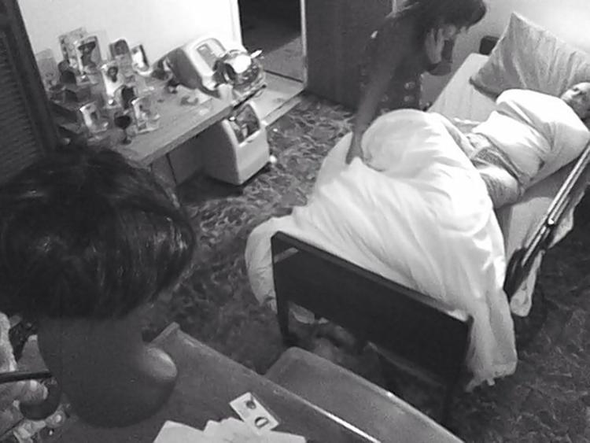
  XXXXX, is accused of trussing up the sheets, trapping XXXX,69, in her bed
  Graham Rayman
  NEW YORK DAILY NEWS May 6, 2016

Slide 31
When Home Becomes a Prison
Home health aide wrapped up client with dementia in bed sheets like a mummy.
  Abuse of some of our most vulnerable elderly members of society like this is outrageous," said XXXX, of the firm XXXX. "The people responsible for this need to be held accountable for this both criminally and civilly.” He added, “The family is very upset and angry.”
  “Nobody should have to suffer such indignity and inhumanity. This woman, who was entrusted with caring for the victim, instead turned the victim's home and bed into a prison.”
  XXXX was employed at the time by XXXX and had only been working in Wilson's home for two days. She is preparing to turn herself into police, according to XXXX. "She will be certainly placed on leave, pending a full review of the facts,” said XXXX, a lawyer for XXXX.

Slide 32
Non-violent/Non-Self-Destructive Use of Restraint
- Orders
- Patient monitoring

Slide 33
Orders
TJC: The Joint Commission: use for deeming
CMS: Centers for Medicare and Medicaid Services
The organization has the freedom (burden?) of writing its policy regarding the following:
  The timeframe of the provider’s order for use and the frequency of reordering.
      Previously required to be no more than 24 hours, with a new order every 24 hours or calendar day.
  Frequency and content of patient monitoring
    Previously every 2 hours
  Hospital can retain the previously required requirements or identify different ones, 482.13(e)(8)(iii) PC.13.02.05 EP 8.
  You will be surveyed to your policy!

Slide 34
Order
TJC – Use for deeming
CMS
Physician or other licensed practitioner (LP) primarily responsible for patient orders restraint or seclusion, 482.13(e)(5) PC.13.02.05 EP 1.
  Hospital policy must identify who can order
  Individual must hold clinical privilege
Consult (can be by phone) attending physician or other LP responsible for care of the patient *as soon as possible if they didn’t order.
  Policy must define “as soon as possible.” 482.13(e)(7)
NO PRN Orders!!!!!! 482.13(e)(6) PC.13.02.05 EP 2

Slide 35
Protocols, aka “PRN Orders”
CMS
  The Patient Rights CoP §482.13(e)(6) indicates “Orders for the use of restraint or seclusion must never be written as a standing order or on an as needed basis (PRN).”
  The CoP for Medical Records §482.24(c)(3) is where you find the CMS references to standing orders, order sets, and protocols. CMS indicates that for the sake of brevity, they use the term “standing orders” as the place holder for all three terms. It’s the “standing order” prohibition that precludes the initiation of restraint use by anything other than by an individual LIP issued order, as TJC and CMS prohibit the use of PRN orders for restraint. A standing order/protocol can also be viewed as a “de facto PRN order” for restraints.

Slide 36
Exceptions to PRN Order Restriction
Geri-chair
  Patient may be out of bed and in Geri-chair several times a day.
Raised side rails
  Patient may be in and out of bed several times a day.
Repetitive self-mutilating behavior
  Must be applied in accordance with specific parameters established in treatment plan.

Slide 37
Emergency Application
CMS
Restraint or seclusion may be initiated in emergency, with order obtained during or immediately after (within a few minutes) of restraint or seclusion being applied.
  Failure to obtain order before, or within a few minutes of emergency application, is considered restraint without an order
  Policy must specify who can initiate emergency application
  §482.13(e)(5)

Slide 38
Simultaneous use of Restraint & Seclusion…
Patient Monitoring
TJC: The Joint Commission: use for deeming
Trained staff (define in policy), continuously (ongoing, with no interruption) monitors patient.
  In person or through use of audio and video equipment in close proximity to the patient PC.13.02.13
    Need to be able to immediately intervene
You cannot continuously monitor more than one patient at a time!!
Unusual (outlier) situations will get scrutiny from surveyor(s).

Slide 39
Discontinue
CMS
Restraint or seclusion must be discontinued at earliest possible time, regardless of the time identified in the order.
  Discontinue when unsafe situation ends
    Hospital policy must specify
      Circumstances under which restraint or seclusion must be discontinued.
      Categories of staff authorized to discontinue, in accordance with State law 482.13(e)(9)
*Consider: if the patient is calm, following commands, and not attempting to dislodge a vital device or kick another staff member and is still in restraint or seclusion, someone should ask staff why because the surveyor certainly will!

Slide 40
Discontinue / Avoid
  When restraints are applied, health care providers should immediately consider what can be done to be able to safely remove the restraints. It should be a 1-2 step, as restraints only contain, they do not treat. In the 1990s and early 2000s, we were sedating and paralyzing so many critically ill patients, and it became a cultural norm to see a patient tied down and in a coma. Thus, it takes an adjustment period for health care providers to get used to seeing patients awake and moving while mechanically ventilated. Once it starts happening, staff realize how right it is for the patients. The “ABCDEF bundle” represents a big culture change for any organization. After you get it going, the nurses won’t have it any other way.
    ICU Delirium and Cognitive Impairment Study Group. ABCDEFs of Prevention and Safety. Accessed Jan 11, 2016. http://www.icudelirium .org

Slide 41
Discontinue – ABCDEF Bundle
Care Bundle to Prevent and Treat Delirium
  ABCDEF Bundle
    Assess for and manage pain
    Both spontaneous awakening and breathing trials
    Choice of sedation and analgesia
    Delirium monitoring and management
    Early mobility
    Family engagement
        ICU Delirium and Cognitive Impairment Study Group. ABCDEFs of Prevention and Safety. Accessed Jan 11, 2016, http://www.icudelirium.org
        The Joint Commission: The Source™ Volume 14, Issue 2, February 2016 Joint Commission Resources An affiliate of The Joint Commission 1515 W. 22nd Street, Suite 1300W Oak Brook, Illinois 60523

Slide 42
Violent/Self Destructive Behavior
Orders
Patient Evaluation
Patient Monitoring

Slide 43
Order
TJC – Use for deeming
CMS
Physician or other practitioner responsible for patient’s care and authorized to order restraint or seclusion, enters order, or gives telephone order (TO).
  *Note: organizational policy must specify who can give an order for restraint or seclusion in accordance with State law
Maximum time
  4 hours, adults (over 18 years of age)
  2 hours, children & adolescents (9-17 years of age)
  1 hour, children (under 6 years of age)

Slide 44
Order
Can be renewed in same time increments, up to 24 continuous hours.
  Before each order is about to expire, the nurse calls, gives update on patient, and receives telephone order (TO) for restraint or seclusion, and in time frame as original order
    TO must be documented by person approved to receive a TO.
      Must include all required components of a TO and must be countersigned by provider approved to order restraint or seclusion, in accordance with organizational policy.

Slide 45
Order
CMS
After 24 hours, if still needed, physician or other licensed practitioner responsible for patient’s care, must see and evaluate the patient, before writing a new order.
  Same time frames, same process
Consult (can be by phone) attending physician or other LP responsible for care of the patient *as soon as possible if they didn’t order.
  Policy must define *“as soon as possible” 482.13(e)(7)
* NOTE: It’s considered very unusual to require restraint or seclusion use for violent/self destructive behavior beyond 24 hours, so surveyors will look closely at this.

Slide 46
Emergency Application
CMS
Restraint or seclusion may be initiated in emergency, with order obtained during or immediately after (within a few minutes) restraint or seclusion applied.
  Failure to obtain order before, or within a few minutes of emergency application, is considered restraint without an order.
  Policy must specify who can initiate emergency application. §482.13(e)(5)

Slide 47
1-Hour Face-to-Face Evaluation
TJC – Use for deeming
CMS
Physician, other licensed practitioner (LP), or *trained RN evaluates the patient in person, within 1 hour of initiation of restraint or seclusion, including chemical restraint. 482.13(e)(12) PC.13.02.11 EP 1
Identify in policy, who can do the face-to-face evaluation, and training they received, if not done by physician.
  *RN can do, if trained

Slide 48
1-Hour Face-to-Face Evaluation
Reason for doing the evaluation: determine if there is a medical condition (sepsis, pulmonary embolus, UTI, etc.) that (if corrected) can lead to change in patient behavior such as decrease in agitation and restlessness, etc., and can expedite removal of restraint or release from seclusion.
Documentation of evaluation includes:
  Evaluation of patient’s immediate situation
  Patient’s reaction to the intervention
  Patient’s medical & behavioral condition
  Need to continue or terminate restraint or seclusion

Slide 49
1-Hour Face-to-Face Evaluation
  Must consult with attending physician or other licensed practitioner responsible for care of the patient as soon as possible after the evaluation, as defined in policy
  Discuss findings, need for other interventions or treatment, and need to discontinue or continue restraint or seclusion use

Slide 50
Patient Monitoring
TJC – Use for deeming
CMS
The organization has the freedom (? burden) of writing its policy for restraint and seclusion regarding the frequency of patient monitoring.
  It’s the hospital’s decision as to how often the patient is monitored and what’s included 482.13(e)(8)(iii) PC.13.02.05 EP 8
    Previously required every 15 minutes
  You can retain the previously required requirements or identify different ones.
  You will be surveyed to your policy!

Slide 51
Simultaneous use of Restraint & Seclusion
TJC – Use for deeming
Patient Monitoring:
  Trained staff (define in policy), continuously (ongoing, with no interruption) monitors patient.
    In person or through use of audio and video equipment in close proximity to the patient - PC.13.02.13.
      Need to be able to immediately intervene
  You cannot continuously monitor more than one patient at a time!
  This is an unusual (outlier) situation, so it will get scrutiny from surveyor(s).

Slide 52
Policies and Procedures

Slide 53
Policies & Procedures
TJC – Use for deeming
Written policies and procedures that guide the use of restraint and seclusion - PC.13.02.09.
  Definition of restraint, including chemical restraint, and definition of seclusion, consistent with state & federal law & regulation.
  Who has authority to order
  Who can initiate use (emergency application)

Slide 54
Policies & Procedures
  Physician and other licensed practitioner training requirements.
    Focus on those who can order restraint & seclusion and those who can do the evaluation.
  Staff training requirements:
    All *staff who have a role in restraint or seclusion use
    Your staff, contract staff, volunteers, students, and medical staff.
    Clinical & non-clinical staff

Slide 55
Policies & Procedures
  Circumstances under which restraint and seclusion discontinued
      Requirement they be discontinued as soon as safely possible
  Who has authority to discontinue restraint and seclusion
  Who can assess (evaluate) and monitor the patient (may not be the same person).
      Includes the 1- hour face-to-face evaluation
  Frequency and content (vital signs, skin, circulation, hydration and elimination needs, mental status, cognitive functioning, level of agitation, etc.) of patient monitoring and assessment.

Slide 56
Training & Education

Slide 57
Training & Education
TJC – Use for deeming
CMS
Train & Assess Competence:
  ALL staff, i.e., your staff, contract staff, volunteers, students, and medical staff having a role in restraint and seclusion use, as per job responsibilities. PC.13.02.17, §482.13(f)(1)
  At orientation/onboarding new staff
  Before participating (as per role and responsibilities) in use of restraint and seclusion.
  Whenever there is significant change in policy or procedure
  Periodic basis, thereafter, as determined by hospital
    This means the hospital must define this frequency.

Slide 58
Training & Education
Training & education
  Patient-centered, trauma-informed, competency-based
Alternatives to use of restraint and seclusion
Techniques to identify staff and patient behaviors, events, and environmental factors that may trigger circumstances that require use of restraint or seclusion (“who / what pushes the patient’s buttons”).
Use of non-physical intervention skills (non-violent crisis intervention).
  Hospital chooses program they will use & which staff receives the education.
  Competence validation is part of the program.

Slide 59
Training & Education
  Method for choosing least restrictive intervention based on assessment of patient’s medical and behavioral status or condition.
  Safe application and use of ALL types of restraints or seclusion used in the hospital.
    Demonstration in skills lab or clinical setting
    Specific to role and responsibility
    Use skills checklist, based on manufacturers’ instructions for use, and on hospital policy & procedure.

Slide 60
Training & Education
  How to recognize and respond to signs of physical (e.g., positional asphyxia) and psychological distress (e.g., increased agitation).
  Clinical indication of specific behavioral changes that indicate restraint or seclusion no longer needed e.g., follows commands, etc.
  Monitoring the physical or psychological well-being of the patient who is restrained or secluded.
    Respiratory and circulatory status
    Skin integrity
    Vital signs
    Special requirements associated with the 1-hour face-to-face evaluation

Slide 61
Training & Education (cont.)
  Use of first aid techniques and certification/recertification in use of CPR
    First aid: Think “baby sitting classes” offered by your community Y/AHEC, Heimlich for chocking, pressure for bleeding, etc.
  Individual(s) doing the training & education qualified by virtue of education, training, and experience in techniques to address patient behaviors that necessitate use of restraint and seclusion.
  Training & education documented

Slide 62
Restraint Death Reporting

Slide 63
Restraint and Seclusion Death Reporting
TJC – Use for deeming
CMS
Report to CMS
    By telephone, facsimile, or electronically
    No later than close next business day following knowledge of patient death
  All deaths that occur while patient in restraint or seclusion.
  Deaths occurring less than 24 hours of removal of restraint or seclusion.
  Each episode known to the hospital that occurs less than 1 week after restraint or seclusion use when it is reasonable to assume use of restraint or seclusion contributed, directly or indirectly, to death.
Document in patient record the date and time death reported to CMS.

Slide 64
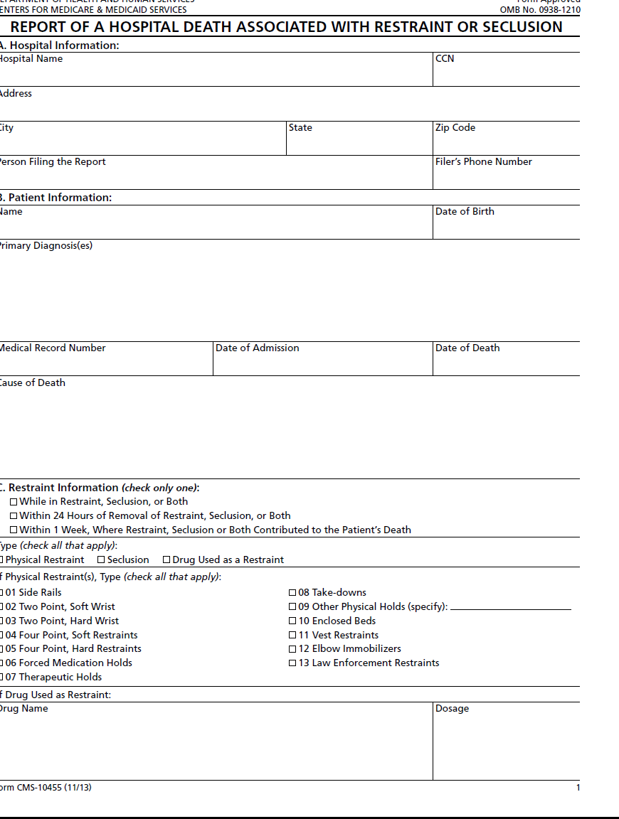
Restraint and Seclusion… DHHS CMS form OMB No.0938-1210

Slide 65
Death Reporting
TJC – Use for deeming
CMS
Exception to CMS Reporting:
  When only soft wrist restraints were used:
    Record death in log or other system
      Patient’s name, DOB, MR #, date of death, primary diagnosis, and name of attending physician or other LIP responsible for care of patient.
    Record within 7 days of death
    Document in patient record, date and time death was recorded in log or other system.
    Make information in log available to CMS, electronically, or in writing, immediately upon request.
CMS

Slide 66

Death Reporting…Responsibilities
Hospital must determine:
  Staff who are responsible for making entries into the log.
    AND
  Staff who are responsible for making the required entry into the patient’s medical record.
  These do not have to be the same person

Slide 67

Performance Improvement (QAPI)
TJC – Use for deeming
Collect and analyze restraint and seclusion date:
  Frequency of use
  Patterns of use
  Injuries to patient, staff, or others

Slide 68

RESOURCES / REFERENCES

Slide 69
Regulatory Resources (Law & Regulation)
Centers for Medicare and Medicaid Services (CMS) State Operations Manual (SOM) Appendix A – Survey Protocol, Regulations and Interpretive Guidelines for Hospitals
    482.13 Condition of Participation (COP): Patient’s Rights
Centers for Medicare and Medicaid Services (CMS) State Operations Manual (SOM) Appendix W – Survey Protocol, Regulations and Interpretive Guidelines for Critical Access Hospitals (CAHs) and Swing Beds in CAHs
    485.645 “Swing Beds”
    485.645(d)(3) Freedom from abuse, neglect, and exploitation
Code of Federal Regulations (CFR), Title 42, Chapter IV, Subpart G, Part 482 Condition of Participation for Hospitals,
    482.13 Condition of Participation: Patient’s Rights

Slide 70
Accreditation Resources
The Joint Commission Requirements for Hospital Accreditation Program
    PC.13.02.01 – 13.02.19 Restraint and Seclusion effective 1/1/26
The Joint Commission Requirements for Critical Access Hospital Accreditation Program
    PC.13.02.01 – 13.02.19 Restraint and Seclusion effective 1/1/26

Slide 71
Accreditation Resources
The Joint Commission Summary Data of Sentinel Events
  https://www.jointcommission.org/
The Joint Commission Standards BoosterPak™ for Use of Restraint and Seclusion for Organizations Using Joint Commission Accreditation for Deemed Status. https://www.jointcommission.org/
The Joint Commission Sentinel Event Alert #8 Preventing Restraint Deaths
  https://www.jointcommission.org/
Ensuring the safety of patients with delirium. (2016, February). The Source. Joint Commission Resources.

Slide 72
Accreditation Resources
The Joint Commission Standards BoosterPak™ for Use of Restraint and Seclusion for Organizations Using Joint Commission Accreditation for Deemed Status. https://www.jointcommission.org/
The Joint Commission Sentinel Event Alert #8 Preventing Restraint Death; https://www.jointcommission.org/
Ensuring the safety of patients with delirium. (2016, February). The Source. Joint Commission Resources.

Slide 73
Print Media
Hendren, J.(2010, January). Nursing home patients killed by chemical restraint. ABC
World News. Retrieved from http://.abc.new.go.com/WN/abc-
Johnson, D. Hospital fined $71,000 for man’s restraint death. Inclusion Daily Express.
Retrieved from http://inclusiondailyexpress.com
Rayman, G. (2016, May 6). Home health aide wraps up Queens client with dementia
in bed sheets like a mummy. New York Daily News. Retrieved from
http://m.nydailynews.com/new-york/queens/caretaker-wrapped-queens-client-sheets-mummy-article-1.2627647
Weiss, E. (1998, October 11-15). Deadly restraint. The Hartford Current. Retrieved
from www.courant.com

Slide 74
Non-regulatory Publications
Bellonci, c., Masters, K.J., (February, 2002). Practice parameters for the prevention and management of aggressive behavior in child and adolescent psychiatric institutions, with special reference to seclusion and restraint. Work Group on Quality Issues, presented to AACAP Council at the meeting of American Academy of Child and Adolescent Psychiatry.
Retrieved from www.aacap.org.
Hospital Reporting of Deaths Related to Restraint and seclusion, Office of Inspector General and Health and Human Services, at
http://oig.hhs.gov/oei/reports/oei-09-04-00350

Slide 75
Non-regulatory Publications
  ICU Delirium and Cognitive Impairment Study Group. ABCDEFs of Prevention and Safety. Accessed Jan 11, 2016. http://www.icudelirium .org.
  Precipitating Factors for Delirium in Hospitalized Elderly Patients. (1996, March). JAMA, 11, 852-857.
  Seclusion and Restraint Standards of Practice: The American Psychiatric Nurses Association, revised May 2007
2007 Study in Journal of Nursing Scholarship, Vol 39, Issue 1, Page 30-37, Prevalence and Variation of Physical Restraint Use in Acute Care Settings in the US.

