Slide 1

Becoming a Tech-Saavy Parent: Living in the age of screens and media
Presented by Eric Connor, MS, LCPC, CSAT
Notes:
T

Slide 2

Introduction

Slide 3
It’s a new age for parenting!
Notes:
Nearly every child under 8 in America (98 percent) has access to a mobile device at home, and youth represent one in three internet users worldwide.

Slide 4
What does it mean to be tech saavy?
Notes:
We understand what
We understand when
We understand why

Slide 5
76 percent of American teens age 13-17 use Instagram. 75 percent of teens use Snapchat. 66 percent of teens use Facebook, essentially flat from 2015, when Pew Research Center data showed 71 percent of U.S. teens using the site. 47 percent of teens use Twitter. Fewer than 30 percent of American teens use Tumblr, Twitch, or LinkedIn.

Slide 6
Why study technology and screen time?
Patterns can be set that have significant, longer effects on the life of the child
Our behaviors and personality have much of their basis in the brain – the media and screens shape this
New research is helping us to learn more – what will work best.

Slide 7
Some Facts
In first few years of life, 700 to 1000 new neural connections every second
Comprised of billions of connections between individual neurons
Built from the bottom up
.

Slide 8

Building Brain Architecture
Early experiences affect the development of brain architecture
Adverse experiences early in life can impair brain architecture, with negative effects lasting into adulthood.

Slide 9
What kids see and are exposed to matters!

Slide 10
By the time they reach age 18, American children will have seen 16,000 simulated murders and 200,000 acts of violence (American Psychiatric Association, 1998). Media violence can be hazardous to children's health, and studies point overwhelmingly to a causal connection between media violence and aggressive attitudes, values and behaviors in some children (Congressional Public Health Summit, 2000).

Slide 11
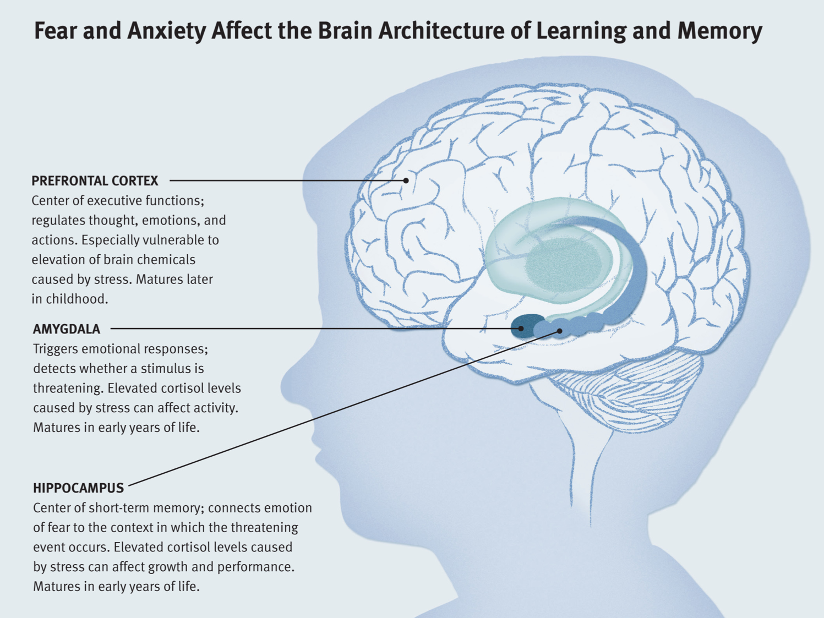

Slide 12
Screens can affect cognitive development
Notes:
Tablets are the ultimate shortcut tools: Unlike a mother reading a story to a child, for example, a smartphone-told story spoon-feeds images, words, and pictures all at once to a young reader. Rather than having to take the time to process a mother’s voice into words, visualize complete pictures and exert a mental effort to follow a story line, kids who follow stories on their smartphones get lazy. The device does the thinking for them, and as a result, their own cognitive muscles remain weak.

Slide 13

Potential negative affects of excessive screen time include …
Poor
quality of
sleep

Slide 14
Increased risk of exposure to violence & explicit sexual content
There is a steady rise of violence / sexual content in media, & kids essentially have instant access to that content.
There appears to be strong correlation between media violence & aggressive behavior.

Slide 15
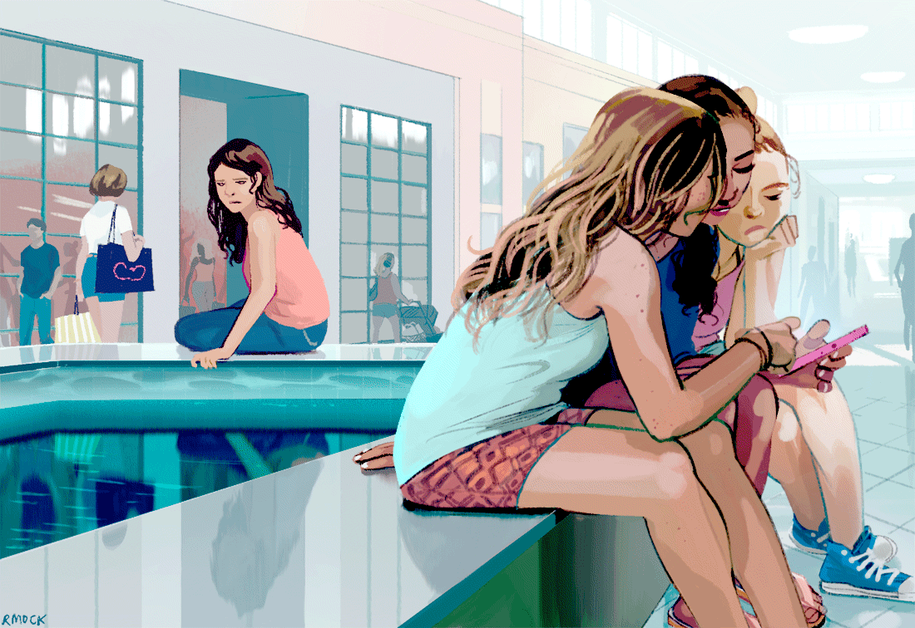
Children / teens are susceptible to receiving sexually charged text messages & may be pressured to post or view explicit sexual material on social media.

Slide 16
Other negative effects may include …
Disengagement from / unrealistic expectations of the “real world”
Development of various mental / social / physical problems

Slide 17
Age 9
.
Notes:
Average age when kids exposed to pornography
The brain hasn’t developed enough to fully process what it is being exposed to
Pornography is affected how kids date each other – we are losing the stages of courtship we used to see

Slide 18
From a recent study just published… 1 in 7 teens are sending sexual texts 1 in 4 are receiving them

Slide 19
71% of teens keep their online habits from their parents and 90% of the 8 to 16 year olds who have viewed online porn did so while doing homework.
Notes:
Most pornography is being done while kids study

Slide 20
So how much screen time is appropriate???
Notes:
Quote from kidsinthehouse video -> “The American Academy of Pediatrics recommends 0 hours of screen time for children under the age of 2. And I think that’s a great recommendation, because what they’re saying is your child should be moving and interacting with the world around them. They don’t need to be passively watching the screen in order to learn. As our kids get older, we want to limit their screen time, because we don’t want them sedentary, just sitting and looking all the time. So rules will be different in different houses. In my house, during the school week, there is no screen time other than what’s required for homework. And on the weekends, the screen time is really limited. My kids can choose – are they going to go on the computer or are they going to watch a movie? You want to limit it. You want to consider all the screens in your house and just come up with a rule that works for you.”

Slide 21
What other steps can we take?

Slide 22
Modeling an appropriate amount of screen time and a healthy relationship with technology – remember: not all technology is “BAD”!
Monitoring / discussing the content that your child is viewing
Notes:
79% of teens and young adults who would like help in stopping porn use say they have nobody in their life to help them quit.

Slide 23
Open monitoring – know passwords – create agreements that allow involvement
Create conversations – early and often. Be open to learning.

Slide 24
Staying up-to-date on current technology-related / social media trends
Stay calm– seek to understand. Teen brains aren’t fully developed – don’t understand full extent.

Slide 25
.

Slide 26
Resources
CommonSenseMedia.org
KidsInTheHouse.com

