Slide 1
NAMI New jersey Hearts & Minds a program focused on inner and outer wellness
August 3, 2020
Program coordinator Elena Kravitz,
Certified Psychiatric Rehabilitation Practitioner
heartsandminds@naminj.org
Criminal Justice and Mental Health
Co-presenter Jay Yudof, MS,
Certified Psychiatric Rehabilitation Practitioner
jyudof@naminj.org

Slide 2
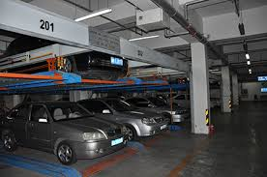
What’s Coming
Intro slides
Why does it happen
Individual advocacy
Systems advocacy
Further Reading/Q&A/Action Steps

Slide 3
Let’s Start with warnings – This topic
…is uncomfortable – may remind some people of places they’ve been, or never want to go..
…is scary – involves deadly force and fatalities
non-deadly force isn't always
… can be divisive – some people use the issue as an excuse to say “we need more psych hospitals” and/or – this would not happen if all mental health service recipients would take their Rx” – We and others reject those.
We welcome opposing viewpoints

Slide 4
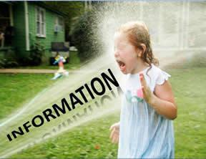
And the disclaimer
This is not a research talk, and we are hardly experts – we just want to open the dialog
We would love to collaborate with folks on various academic and advocacy projects
While not PPT gurus, we often use more pretty pictures – not much pretty here

Slide 5
A word about us
Elena – Professional systems and individual advocate with 20 years experience, serving people inside and a outside of forensic mental health
Jay – “Civil libertarian” with 22 years of systems advocacy experience, and an unpublished textbook chapter “Stigma and Advocacy in Forensic Mental Health Social Work”

Slide 6
What are we talking about here
The frequent and problematic intersection of the mental health and criminal justice systems, and the inappropriate flow of adults and youth with mental health conditions into justice and corrections, sometimes called transinstitutionalization (TI)…
TI is rising
The combination of the unpredictability of our disorders and the gaps in our treatment system make TI a potential reality for many of us/our loved ones, even for people who have no history of criminal behavior.
The problem is a social one, and is not to be solved inside any one system; mental health, corrections, etc.
We need to advocate for a range of interventions to help reduce this reality.

Slide 7
Why does it happen (1/3)
Odd behaviors some of us may have when at our worst, sometimes fueled by lack of sleep and/or substances
Dancing atop a police car
Put it on dad’s tab
Behaviors which come from cognitive issues some of us with developmental or other conditions – bad choices of friends ,serving as lookout, confessing to please police under coercion
Normal involvement of police in aid, distress, medical, workplace and family disputes, etc. getting involved with symptoms and behaviors…
Police issues: the homogeneity of 911 response, “welfare checks” gone wrong, gun seizure warrant service, training/performance
Sedation during restraint leading to mania

Slide 8
Why does it happen (2/3)
Recipients’ over-reaction to police use or show of force
Failure of the “traditional intercept model” including inadequate diversion from justice at arrest, booking, risk tiering and bail, prosecution, sentencing, probation, and parole
…and higher rates of tech violations and reincarceration
…and the lack of depth of the mental health system to serve folks
Inadequate representation of many defendants leads to life-long TI labels and intrusive oversight
Mentally disturbing aspects of incarceration …
Well-meaning TI – prejudices and fibs leading to people being criminalized “for their own protection,” or bail being blocked

Slide 9
Why does it happen (3/3)
Societal fears, sensationalism, and prejudice playing a role, sometimes leading to …
Disparities created in confidentiality, including disclosure in mental health settings being used for prosecution, gun seizure
..as well as use of mental health laws to detain sexual offenders
Use of mental health commitment for “social control” – probably not a significant factor in the US today
Racial/ethnic and financial disparities, including clear over-dx of thought disorders in African-American youth and high representation of African-Americans throughout the public mental health system
Social factors - poverty, unemployment
…and we can spend a whole talk on the complex interaction of mental illness, homelessness, substance use, veteran status, and incarceration

Slide 10

The problem with jails and prisons
“Can drive anyone crazy” rules, coercion, victimization and fear, very reduced access to friends/family and myriad coping skills
The things which often help people survive – strong relationships, work details often do not work well for PWPD
PWPD often commit infractions, get more solitary, stay longer, get less parole..
“Goes double” for isolation – our folks end up with more time in solitary/isolation
Have limited resources for treating mental health conditions – most prisoners in general population may get nothing but Rx
Do not do well identifying and diverting people with very severe symptoms
The things which often help people survive – strong relationships, work details often do not work well for PWPD
Have specific challenge in discharge, aftercare linkage (including benefits reinstatement)

Slide 11
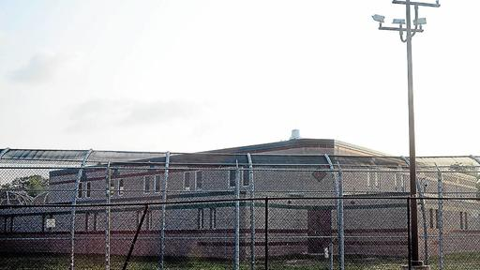
The Problem with Forensic Psychiatric commitments and Hospitals
People find themselves in them for the wrong reason
Over-reliance on segregation, chemical restraint
Court involvement lasting decades
Often in more restrictive settings for longer periods than the likely result of a guilty plea

Slide 12
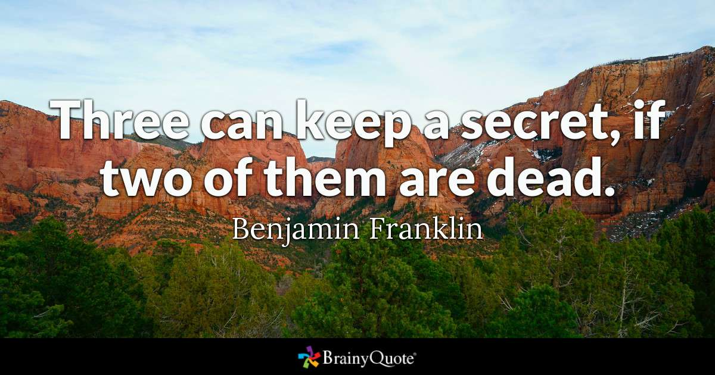
Some Things Each of Us Can do to stay out (1/2)
Be very conscious of the law, what we disclose to whom, what we do for whom – including
Remember that DUIs can take place even when taking only prescribed Rx as prescribed
Know yourself – be extra cautious at times of risk…anger, Rx change, the wrong people/place/things
And your own wellness plan, PAD, and trusted crisis resources in the community
Ask your local NAMI

Slide 13
Some Things Each of Us Can do to stay out (2/2)
Make your own decisions RE: consent searches, insisting on mental health screening, insisting on ambulance vs police transport
Be aware/wary of “welfare checks”/gun seizure warrant service/police mental health encounters
We do not have suggestions on what to disclose…
Remember that cops responding to a home will not look away from illegal drugs, weapons, etc.
While trained to avoid use of deadly force, people do die in police mental health encounters, nt usually the cops
Be aware that you (person with a psych disability of any age) have right under the ADA in arrest, jail

Slide 14
If arrested/charged with a crime
Say nothing until speaking to a lawyer
Be wary of lawyers with no MH/CJ background
Be even more wary of MH/CJ defenses – brief explanation
IST, NGRI, detainer, Megan’s, MH parole
You certainly can pay for someone’s legal defense, but that does not give you much role in dictating defense strategy, etc.
Remember that cops, prosecutors, etc., are typically “squares,” and are impressed with doctor letters, etc.

Slide 15
If you/someone you care about are incarcerated
Know what services are available to you in your jail and discharge/linkage resources
Local NAMIs know the landscape
PACT can follow people into jails, ICMS can cover people on jail discharge,
screening services can go into jails and get someone whose behavior meets commitment standards transferred to a hospital on detainer
Advocate for access to in-incarceration and appropriate aftercare resources
Sometimes families serve as linage to in-community treatment team

Slide 16
Systems Advocacy may seek incremental or sweeping change (1/2)
Some NJ counties have a subset of
Police departments with CIT training…
Forensic aftercare services to assist with jail discharge and linkage
Mental health courts
Mental health probation units
The AOC and AG have been doing some studies, ad the AG has funded some CIT increments
They could benefit from a PRAINC Sequential Intercept Model Training…
ABQ has been the first US city this year to make mental health, substance, domestic violence calls the responsibility of social workers, not police

Slide 17
Systems Advocacy may seek incremental or sweeping change (2/2)
Many US states lead NJ in “outpatient competency restoration”
Some have statute, case law, or policy which caps NGRI stays commensurate with priginal crime
NJ bail reform has helped many populations, but not our folks much
Marijuana decriminalization has had some benefits for many of our folks, and insrance mandates would go further

Slide 18
Crisis Intervention Training
40 hour course for law enforcement – it’s pricey – $ = police hours
Many NAMIs are very involved, and help facilitate
No specific evidence that the PDs are referring more people to NAMI or other peer support as a result
Well researched international model, with documented benefits including
Reduced likelihood of fatalities and injuries on both sides
More likely person will get mental health services, not jailing
Cost savings and keeping PD focused on crime
www.cit-nj.org

Slide 19
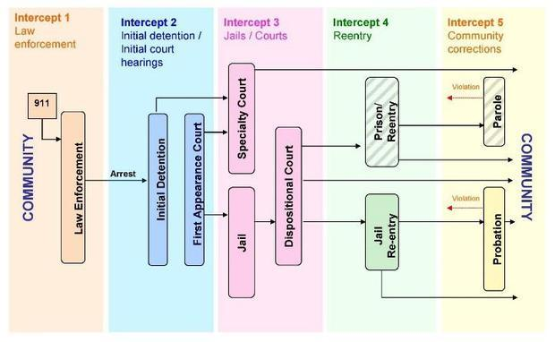

Slide 20
Jay’s Version of the SIM Workshop (1/3)
What are we doing in our communities, workplaces, schools, congregations, etc. to help people build resilience, accept that non-crisis help seeking is a strength, reduce stigma,?
And, as basic “what are we doing to house the unhoused, feed the hungry, etc.”
What are we doing to help people access services which prevent mental health crisis?
E.g., call center, peer support access, therapy and Rx regardless of cost, non-crisis export for treatment
What are we doing at the point of police encounter?
E.g., CIT, police training and accountability, other non-triggering response, focus on help not criminalization, “equal protection,” careful and tightly controlled use of non-deadly force and sedation during arrest/non-arrest sub-duement
What are we doing to divert cases before arrest, before prosecution, before incarceration?
Are we getting useful egalitarian evaluations
Are we using leverage to help people choose treatment options vs criminalization, and have the options to offer, e.g. possibly TJ housing

Slide 21
Jay’s Version of the SIM Workshop (2/3)
For those incarcerated at each level (jail, prison, detainer to various settings, what are we doing to help them get better, not worse
Controlling victimization, treatment meeting people where they are at and what they need (medical, therapy, voc rehab), avoiding solitary
For those incarcerated, what are we doing to make discharge/re-entry work?
E.g., benefits reinstatement, housing and aftercare/re-entry programs , specialized parole units, equal access to expungement

Slide 22
Jay’s Version of the SIM Workshop (3/3)
Throughout the process, are we paying needed attention to some specific needs?
Trauma history and co-incurring substance use are not special needs, they are universal in our population – Calling for a “Comprehensive, Continuous, Integrated System of Care (CCISC, http://kenminkoff.com/ccisc.html)
Veterans, people of various ethnic and other minorities, people with sexual offender status
Are we making changes so that there is uniformity across the jurisdiction and appropriate oversight and accountability?
And ensuring use of best/evidence-based practices and data-driven evolution?
Remember that CIT, Intercept model, and Integrated Treatment of Mental Health & Substance use co-occurring Disorders are all EBPs
And making sure that peer and family advocates are involved in the change and oversight process?

Slide 23
For Further Reading
www.bazelon.org/our-work/criminal-justice-2/
www.samhsa.gov/gains-center
www.peteearley.com/
http://www.pacenterofexcellence.pitt.edu/documents/PracticalAdviceOnJailDiversion.pdf
https://csgjusticecenter.org/topics/mental-health/
Crisis Response Models Virtual Learning Community Series: Peer Respites as a Voluntary Alternative to the Emergency Department and Other Crisis Services + Post-Webinar Small Discussion Group August 12, 2020, 3:00-4:00 p.m. ET
https://t.e2ma.net/click/8je2lc/ocrrtv/05prvh

Slide 24

Questions
Action Steps
/
!
!
!
!
!
!
!

