Slide 1
Managing Substance Use During Times of Crisis
Audra Tonero, LPC, LCADC, ACS
Cross-Street Counseling, LLC
13 Madison Ave, Suite B
Madison NJ 07940
973-727-9120
audra@crossstreetcounseling.com
www.crossstreetcounseling.com

Slide 2
Goals
Understand emotional responses (in the face of a pandemic)
Recognize the overlap of mental health/substance abuse
Harm-reduction Techniques
Develop effective ways to deal with another's use
Notes:
Thank you Meredith, I am so happy to be here today. I have built in a few spots to pause for questions and will also take questions at the end. Listed are the goals I will cover today

Slide 3
Responding to Pandemic
Uncertainty
Fear
Projection
Isolation
Fatigue
Negative Thinking
Poor Coping
Follow Recommended Guidelines
Notes:
Sometimes our emotions will seem all over the place. That is so accurate. None of the experience is linear. It changes by the day, week and sometimes even the hour. I am not telling anyone anything they have not already realized or experienced on their own. I only hope the validation is helpful.
I feel like every week the trajectory of the virus is changing and recently I have heard our area is doing well, other areas of the country are not. So while in the beginning we were glued to news and not sure what to do, once there was an easing back into going out/outside….I feel glued to the news again, kicking up anxiety and projection again. We were just feeling a little more comfortable seeing some people and now is the fear it will shut down again.
At highest risk for symptom relapse are those with pre-existing mental health and substance abuse issues.

Slide 4
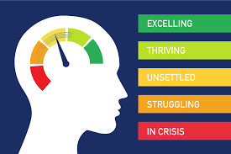
Emotional Reactions Vary and Change Over Time
Notes:
Thinking about the descriptors in the previous slide, It is important to envision emotions occurring on a continuum. Not necessarily labeling them as “good” or “bad” but either recognizing when you are using your skills to remain in the excelling/thriving time or manage the unsettled and struggling times and when you might not be, in order to avoid a crisis situation. Times when you feel yourself in the unsettled struggling time might be an indicator your skills need a little “tune-up” per say. It is important to recognize that we have no control over feelings and thoughts but we can control our response.

Slide 5
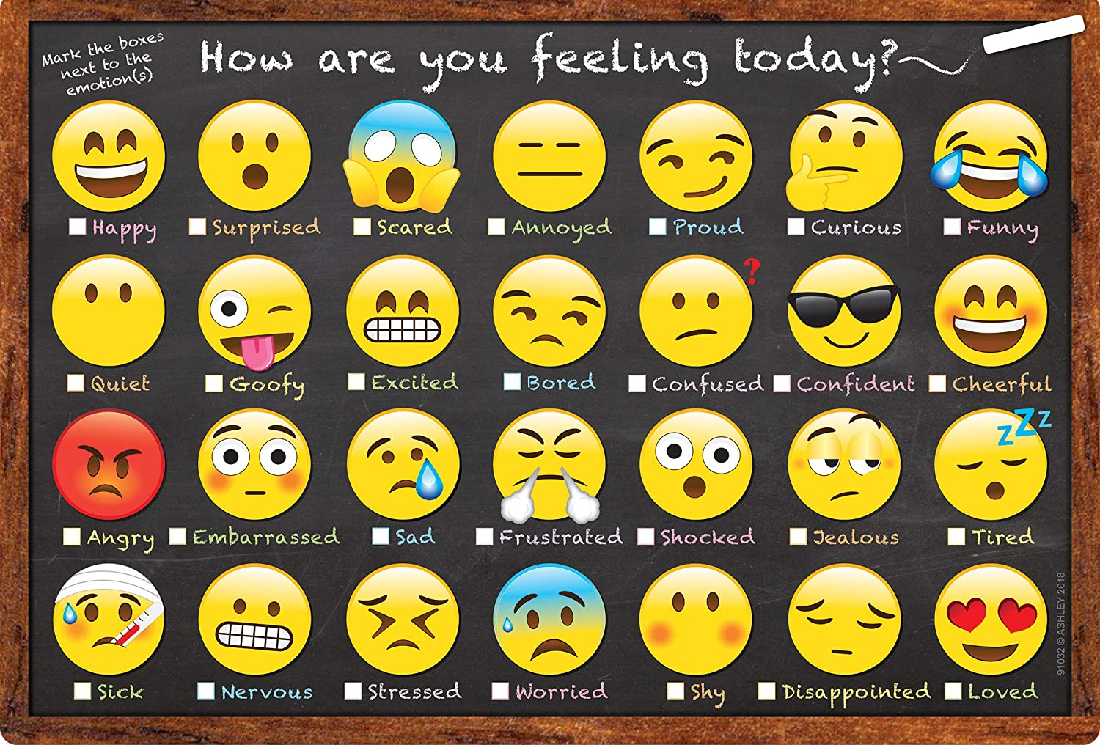
Daily Check-In
Personal Check in:
How am I feeling?
What am I reacting to?
Isolation?
Media?
Social Media?
Anxious? Depressed?
Other intense emotions?
What skills can I use to manage the feelings?
Notes:
Creating a routine for daily mental health check-ins is important during times of crisis/COVID and non-crisis times
But this is even more important in times of crisis. (discuss the slide)
In the face of uncertainty, even those without mental health or substance abuse hx may have found themselves reacting. Depression and anxiety tend to pull us away from the actions and behaviors that will help us. Something that became really popular were zoom happy hours.
Situations like this may have impacted people in different ways, some relapsed and began using again, others saw an increase in their use.

Slide 6
Abstinence? Harm-Reduction?
Notes:
At times it feels like abstinence is the only way to address substance use. Pushing abstinence for someone who may not be ready for it or open to it, may cause contention. As someone who works with college students and young adults mainly, I had to adapt to this modality because if I began with the abstinence conversation….many times it was a short conversation.
The goal at the end may be abstinence, and that is fine, but this is a technique that allows someone some say and movement depending on where they are on the substance abuse continuum.

Slide 7
Criteria
Mild (2-3)
Moderate (4-5)
Severe (6+)
Tolerance
Binge Use
Identify the need to cut down/stop, unable to
Increased time thinking about use, engaging in use, recovering from use
Cravings
Negate responsibilities
Give up social, occupational, recreational activities
Negative impact on relationships
Despite consequences, continue use
Withdrawal Symptoms
Notes:
This gives you a little more information about the criteria used to discuss concerns associated with use. Less about diagnosing, more about giving parameters to identify and discuss concerns.

Slide 8
Substance Use Continuum
No Use
Experimentation
Social Use
Occasional Use
Binge Use/
Abuse
Mild Abuse
Moderate Abuse
Severe Abuse
Notes:
As with emotions, substance use also occurs on a continuum. The continuum shows no use to severe abuse/dependence. For some it is difficult to understand that use can have an ebb and flow to it. If you are socially using alcohol/drugs that means there is no negative impact on your life, you set the terms of use, you do not go overboard, you do not miss your obligations, negatively impact relationships….etc mild to moderately abusing alcohol and or other drugs means maybe you are experiencing some negatives associated with use, going overboard, needing time to recover from effects, taking away from other responsibilities, negatively impacting a relationship…….moderate to sever abuse means more life areas would be impacted, you are less able to set limits and stick to them, you ponder stopping, but then decide not to, you experience blackouts, regrets, priorities are off, relationship issues, you may use and drive, have a tolerance, and sever would also include physical dependence. Physical dependence is a time where “harm reduction” would not be a good idea. Alcohol and benzo’s=seizures.
Being in one area over another (outside of severe) could potentially move up and down along, meaning you can also reduce the use, make some different choices around use.

Slide 9
Questions?

Slide 10
Harm Reduction Approach
If physical dependence is indicated, this approach may not be recommended.
Goal: Prevent or reduce the negative consequences associated with use and improve health/mental health.
Identify areas in life impacted by use/abuse
Set goals/limits around use
Engage a professional if needed
Review, assess effectiveness, make adjustments as needed
Notes:
There are two substances that if a person tries to stop cold turkey could lead to seizure if physical dependence is indicated, alcohol and benzo. Consult a medical professional.
Harm Reduction is described by the name….reducing the harm. If we look back on the criteria for disorder, one can
Abstinence may be best, but, becoming self-aware is also important.
Engage a professional if needed.
Identify areas in life impacted by use/abuse.
Set goals/limits around use
This approach can reduce shame, guilt, resistance. The ultimate goal may be abstinence, and that may be determined after the review assess and adjust.

Slide 11
Strategies to support reduction goals
Use network for support
Understanding what is in our control and what is not
Being comfortable with discomfort
Express challenges
Participation in something (community, work, volunteer, cause…)
Engage with mental health/substance abuse specialist
Knowledge of other’s boundaries/consequences of continued use
Development of healthy coping strategies
Notes:
Being comfortable with discomfort
Reframing
Understanding the consequences
Healthy Coping

Slide 12
Strategies to support reduction goals
Understand what is in control and what is not (reframe)
Being comfortable with Discomfort (emotional regulation)
Be able to identify personal consequences associated with continued use
Notes:
Identifying thoughts (are they focused on others or myself). I cannot control my thoughts and feelings, but I can control my reactions. People feel bad or upset or a failure if they “think about use” or urge. This is a normal part of behavior change. : Because we decide to change it does not mean negative thoughts and feelings automatically stop. Pandemic connected…..you can only control how seriously you take this and your attitude and engaging in the helpful actions.
Emotional RegI: Being comfortable with disco: this Is usually a driving force behind substance abuse. Discomfort fells awful, feels like it will never end, but most diff sits have an end. When you are in a positive headspace, it is easier to come up with alternatives to drinking when emotions are dysregulated, make a list. Some ideas to move through it: reframe. Breathing, grounding, accept that you are feeling uncomfortable, distraction, reach out to someone, journal, walk, Understand the state is not lasting forever, you can self-sooth (grounding), mindfulness, take a pause, journal. Engage in the opposite action. Break time down into smaller pieces. Most urges, episodes have a beginning, middle and an end. Our brain distorts this to being “the worst and never ending”
Create a list of gains for reaching and reinforcing your goals, and conversely a list of losses.
Develop a crisis plan. May include a text line, hotline, zoom groups, therapist, asking someone for help or to just be present with you for a bit.

Slide 13
Questions?

Slide 14

Dealing with Another’s Use
Notes:
Boundaries, limits. If we think back to the last slide, someone knowing what the potential consequences of continued use is, could be helpful and important consequence. What are the challenges associated with another's use? Many times we get drawn in to concern about some and we mobilize to fix or help. These actions are typically brought out with anxiety, fear, anger or sadness. Most of the time the rescue role just has us moving in the same loops over and over again. Letting someone know where the line is if they continue to harmfully engage in substance use, can help direct choices.
Challenges: fear that something will happen. Set our feelings and emotions connected to the other progress/success. Anger, distrust. In and out of negotiations. Threats. Feel so out of control do anything to feel a sense of control.

Slide 15
Communication and Boundary Strategies
Intervention really depends on the level of the disordered use
Communicate specific concerns
Listen to the persons goals
Identify your Boundaries
Consistency is important
Recognize your need for help
Notes:
Someone is a severe abuse may need a higher level of intervention in order to get to the place they can follow through with goals. If someone is planning to embark on harm-reduction, you can meet them where they are at and communicate your specific concerns, (go back to the criteria list) and use examples of actions/behaviors you have witnessed. Express direct concern
Let the person discuss their goals.
Identify your boundaries….Set boundaries you can enforce. Consistency is important.
Recognize if you need assistance and support to engage in this process.

Slide 16
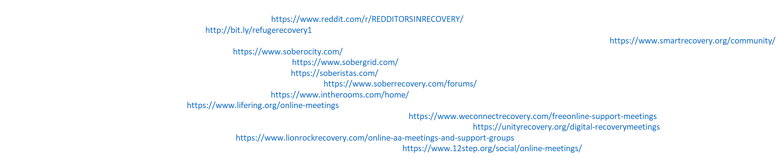
Online/Zoom Meeting Resources
12- Step Online Meetings:
Narcotics Anonymous: https://www.na.org/?ID=virtual_meetings
Alcoholics Anonymous: http://aa-intergroup.org/directory.php
Cocaine Anonymous: https://www.ca-online.org/
Marijuana Anonymous: https://ma-online.org/
Resources for Managing Stress and Anxiety:
CDC Support for Stress and Anxiety: https://www.cdc.gov/coronavirus/2019-ncov/prepare/managing-stress-anxiety.html
SAMHSA Support for Stress and Anxiety: https://www.samhsa.gov/sites/default/files/tips-social-distancing-quarantine-isolation-031620.pdf
The National Alliance for Mental Illness (NAMI) HelpLine Coronavirus Information and Resources Guide: http://bit.ly/NAMIresource
Hay House Free Resources (inspirational podcasts, movies and ebooks) https://www.discover.hayhouse.com/freeresources/
Hazelden Betty Ford Foundation contains online support meetings, blogs, mobile apps, social media groups, and movie suggestions, including the online support community, The Daily Pledge: https://www.hazeldenbettyford.org/recovery%20/tools/daily-pledge
Tips for Staying Connected and Safeguarding Your Addiction Recovery”: http://bit.ly/HBF-Tips
Shatterproof: “How I’m Coping with COVID-19 and Social Isolation as a Person in Long-Term Recovery” provides helpful suggestions: http://bit.ly/shatterproof-coping

Slide 17
Thank you for attending! Q&A

