Slide 1
‘Tis the Season … RFP Season!
Prepping for the 2023 RFP Season is critical for a successful 2023 booking season.
If you are with an IHG property you should consider the following steps
Check IHG RFP/Cvent Transient weekly for any new RFI’s or RFPs
Corporate Travel Marketplace – where all 2023 RFP Resources are located
2023 RFP Strategy - including IHG RFP (Cvent Transient) HCM Attributes Checklist – also attached for your convenience; due by June 30th (along with blackout dates – screenshot further below)
IHG Way of Sales Key Accounts Tool – for account information & City Volume Tool
Business Case and Prospecting report - the top 25 key accounts produced in your market
  Here is the path to run the report: Merlin > IHG Reporting > Sales & Marketing > Business Travel > Business Case and Prospecting Report
Please be on the lookout for more information as shared in Hotel Bulletin/Sales Digest and the monthly brand calls

Slide 2
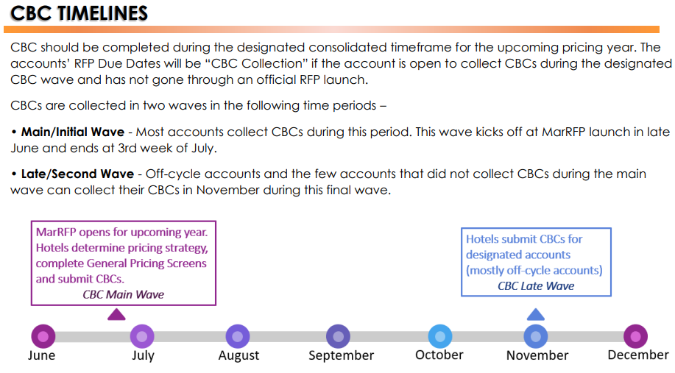
Marriott RFP Tips
A few extra tips:
Keep in mind that travel managers will only consider properties with a strong business case that meets the criteria of their travelers in your market. Do your homework!
Review the BT Account Overviews found in MarRFP
Are they accepting CBCs?
Be on time! Submit your case during the proper timeframe.
Endorsements from your current travel guests go a long way in supporting your case.
Do you meet their amenity requirements? Give them the bottle of water!

Slide 3
HILTON AND CHOICE
For our HILTON partners
Step 1: RFP Preparation Sheet – Identify which BTS accounts are valuable and whether your hotel can meet the requirements.
Step 2: Take the CARP (Corporate Account Request to Participate) training. It is so much easier if you understand the process.
Step 3: Present a strong business case for your property, answer every question accurately, and provide local market knowledge.
Step 4: Complete OnQ Training (course #2597) – OnQ Solicitation Training Management in the Hilton University platform.
Step 5: Request access to OnQ SM
Step 6: Update the Property Maintenance section on OnQ and update PiM.
Step 7: Respond to RFP in OnQ SM.
https://lobby.hilton.com/departments/globalsales/Documents/AmericasSales/HiltonWorldwideSales/BusinessTravelSales/QualifierInformation2018/CARP Recording_TrainingSessions_May2018.mp4
CHOICE Hotels
Cvent guide and RFP Process:
ttps://apps.choicecentral.com/ccweb/content/resources/marketing/LanyonMenu.html
Business Case Guide:
https://apps.choicecentral.com/ccweb/content/resources/marketing/2018BusinessCaseNavGuide.pdf
Cvent Frequently Asked Questions:
https://apps.choicecentral.com/ccweb/content/resources/marketing/LanyonFAQ.html

