Slide 1
International School Funding & Budget
Working together to create the school our students need!

Slide 2
Goals of tonight
Build understanding of school funding (and related issues)
Share overall school budget funding and staffing information
Share what funding we get from the district and how we use it
Build understanding of what is centrally funded, what is school funded, what is PTSA supported
Share impact of PTSA funding – the difference between “basic” and what we want for our children

Slide 3
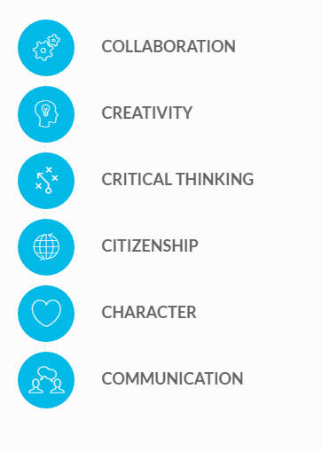
International School
Our mission is to provide all students with the 21st Century skills they need to be successful in college, career, and life in a complex world.

Slide 4
Sources of Funding
District – District determined support – Basic Education
District – School determined support – Basic Education
PTSA – School requested/PTSA determined support – Enriching Education

Slide 5
Funding in Washington
State Funding
  Proto-typical school model
  Categorical/Targeted Funds
  Fund Basic Education as defined by the State
  Local Effort Assistance (LEA) or “levy equalization”
Local Funding
  Local Property Taxes
    Education and Operations
    Capital Projects
    Debt Service Fund
    Transportation Vehicle Fund
Federal Funding
  Federal Grants (like Title I)
  Special Education Funding
  Limited English Proficiency

Slide 6
WA State per Student Funding
In 2014, Washington spent $9,908 per pupil. $2,248 below the U.S. Average and ranked 38 out of 51.
Data: Education Week, Quality Counts 2017, audited data Chart: Colorado School Finance Project

Slide 7
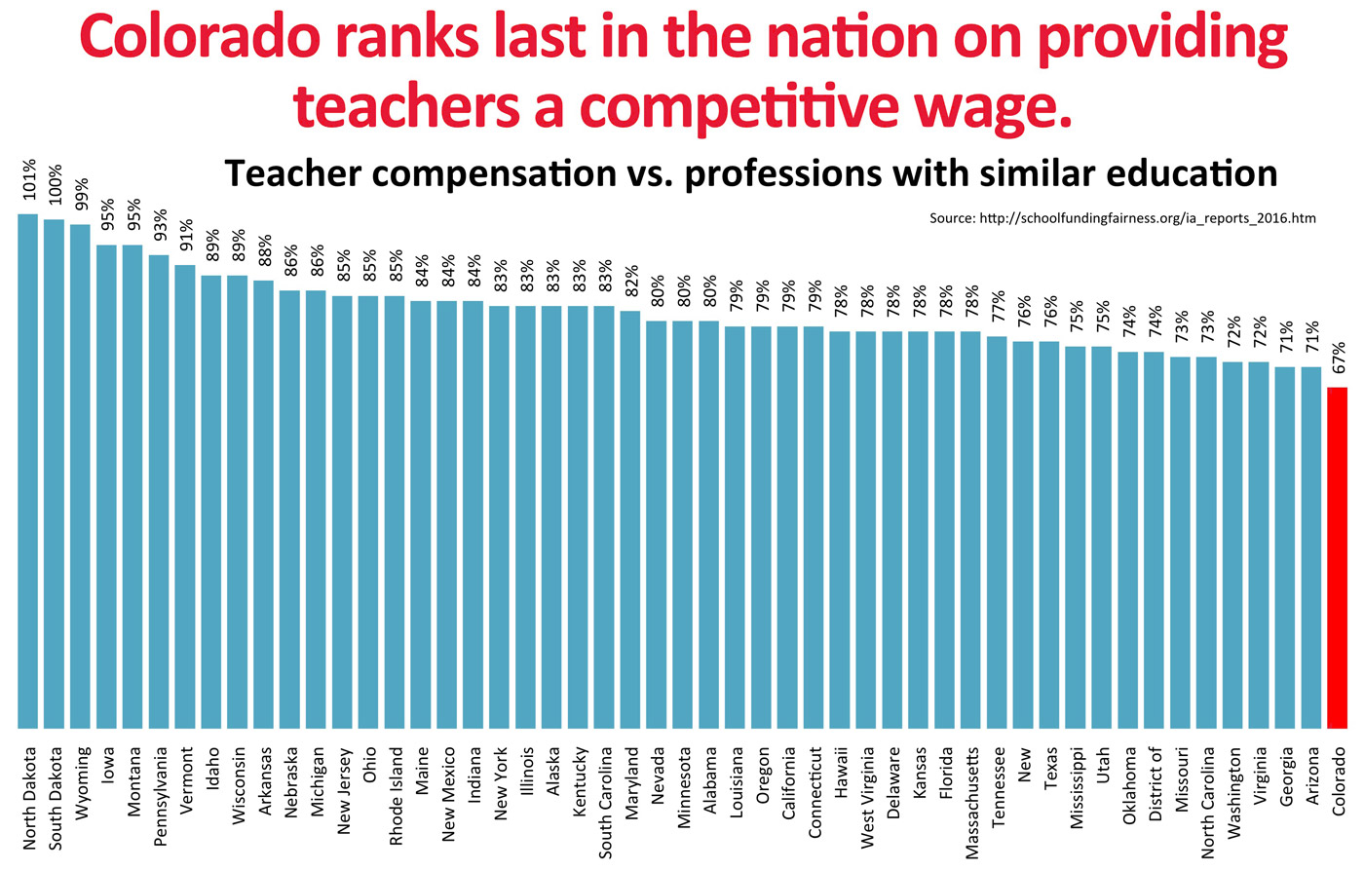
Competitive Teacher Compensation

Slide 8
Per Pupil Spending in Washington
Source: OSPI General Fund Expenditures, Revenues and Ending Total Fund Balance per Pupil by Enrollment Groups Fiscal Year 2014-2015

Slide 9
General Fund Revenue Sources
$ 000’s
$274,400
$258,620
$226,133
$228,995
31.2%
32.4%
$72,536
34.6%
33.7%
$67,497
$65,051
59.2%
57.2%
$119,180
55.8%
55.2%
$109,887
$104,345
4.6%
5.5%
5.5%
4.6%
5.0%
5.7%
4.9%
5.0%
Note: Other Revenue is Transfers from other funds & revenues from surplus sales, other government entities and other school districts.

Slide 10
General Fund Expenditures
$’s in Millions
$276.0
$258.6
12.3%
$233.9
12.8%
13.0%
11.6%
10.8%
11.2%
58.4%
57.6%
57.1%

Slide 11
What is “Basic Education”?
"It is the paramount duty of the state to make ample provision for the education of all children residing within its borders, without distinction or preference on account of race, color, caste, or sex.” -- Article IX, Section I of the Washington State Constitution

Slide 12
McCleary Case
Equity for All Children
  Opportunity
  Cost to Citizens
“Ample” or Adequacy of Funding
  Funded at the level necessary for specific requirements or basic education
Paramount Duty
  First responsibility to fund
Are we using our local levy to pay for Basic Education that should be funded by the state?

Slide 13
Local Property Taxes
Supplement Salaries
Implement additional educational programs and opportunities
  Seven period days at secondary
  Music and Art in elementary schools
  World languages in middle schools
  Tutorial after school
  Extra planning period for secondary teachers
  Assistant principals at elementary schools
  Smaller class sizes
  Greater support to students – reading specialists, counselors, psychologists, nurses, etc.

Slide 14
District Level - Looking Forward to 2017/2018
Uncertainty –
  Local levy limit currently scheduled to be reduced from 34.6% to 30.6% in 2018 tax year
    $5.3 million drop in revenue in 2017/2018
    An additional $4.8 million drop in 2018/2019
  State funding of McCleary which may come with conditions –
    Limiting how funds are spent
    Reducing local levy collections
Renewal of local levies in Spring 2018

Slide 15
District Determined Resources for School
Teachers: Approximately one teacher for every 28 students
Classified Staff: Office manager, attendance secretary, counseling secretary, registrar, front office support
Research Technology Specialist
Instructional Technology Curriculum Leader
Special Education staff (teacher and para-educators)
Custodians, building maintenance, etc.

Slide 16
District Provided but School Determined Resources
Total Basic Allocation for 2016 – 2017 was about $73,000
Support is based on number of students, with some factors (students receiving free/reduced lunch, students with high needs) adding support to some level.
Leadership funds (bargained in the contract) $12,545 of Basic Allocation
Technology Allocation was $1,156 additional (printers, toner, cords, mice, cameras, etc.).
Total discretionary amount provided to school: $62,000 approx.

Slide 17
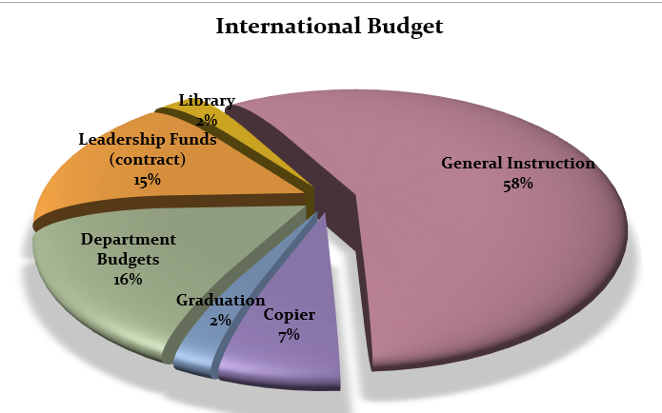

Slide 18
What is in “General Instruction”?
Stuff: Paper, pens, note-cards, postage, clinic supplies, emergency preparedness supplies, toner for copiers, resource materials, department needs beyond budget, everything and the kitchen sink, etc.
People: Additional hours for 5th Grade Info nights, Focus Week, 5th Grade BBQ, Curriculum Night, Senior Project, extra projects, etc.

Slide 19
What are Leadership Funds for?
Compensate teachers for taking on essential leadership roles in school
  Department Chairs
  Tech Team
  Social/Emotional Learning Team
  PTSA Liaison
  Other Leadership roles in service of the school

Slide 20
Activity Hours
Given in hours, not dollars
Compensate teachers/staff for work related to student activities
ASB advisors and activities
Student club advisors
Additional student related duties (homework clubs, senior project support, etc.)

Slide 21
PTSA Support – Enriching Learning Opportunities for our Students
World Lang Intern Stipends, Visas, Bus Passes
Art Supplies/Guest Faculty
Band and Orchestra Instrument Repairs and Music
Biology Fetal Pigs
Campus Improvement
Library
Shakespeare Play
Retreats
Scholarships
Food
YES Counselor
Student Support (ex tutorial, etc.)
Emergency Supplies
Baccalaureate
High School Retreat
6th Grade Retreat
Graduation (additional wish/cost)

Slide 22
PTSA Support – Enriching Learning for our Students
Guiding Philosophy: Teachers have the biggest impact on student learning. Invest in their learning!
PTSA Staff Resources to date: $14,000
  Conference Registrations (EMP, ACDA, NCCE, Music, ISTE) $4839
  Conference Attending Costs (approximate) $5500
  Release time for collaboration, thus far $3304
  Professional Learning Books/Materials $ 500
Previous years have similar types of spending
  Peer coaching, technology training, team collaboration, professional learning

Slide 23
Impact of Professional Learning
Social and Emotional Learning plan
Vertically aligned curriculum (ongoing work)
Stronger student support program (content area and holistic)
Transformational use of technology
Embedded “real world” learning (6Cs and technology)
Teacher learners and leaders collaborating to strengthen overall program
Better teaching and learning for your students

Slide 24
Impact of PTSA Support
Provides the means to get from “Basic Education” to what we want for our children
Provides resources to create enriching experiences
Supplements and strengthens District resources and programs
Ensures all children have support for all things, from snacks to field trips
Creates opportunities for building instructional capacity for all staff and strengthens our collective abilities to provide a 21st century education to all students

Slide 25
Next Steps
Define more specifically what 21st century skills look like in daily practice with the 6Cs
Collaborate within our school to create lessons, opportunities, and resources to support 21st century learning
Support teachers to further develop 21st century knowledge and skills by collaborating with educators outside our district and experts in the field
Explore resources of Makerspaces to support interdisciplinary learning
Continue partnership with PTSA to create the school our students need

