Slide 1

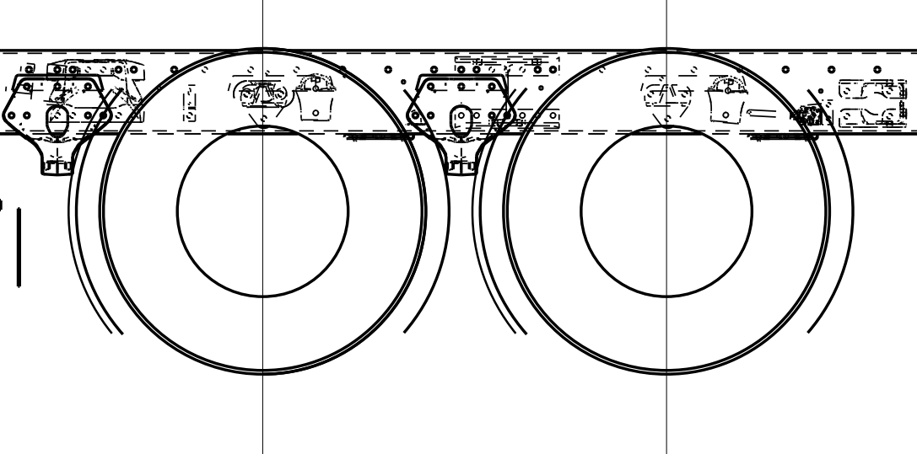
Ride Height is the difference in measurement from the ground to the frame rail flange and the centerline of the axle.
From the factory build notes:
Manual Measurement
Measurement #1
Location: center point between tandems.
Measure from the bottom frame rail flange to the ground and record that measurement
Measurement #2
Location: center point of the axle shaft flange.
Measure from the center point of the axle shaft to the ground and record that measurement
Subtract measurement #2 from Measurement #1 and that is your ride height. The goal is to have 8.75 inches unladen (empty)
Ride
Height

Slide 2
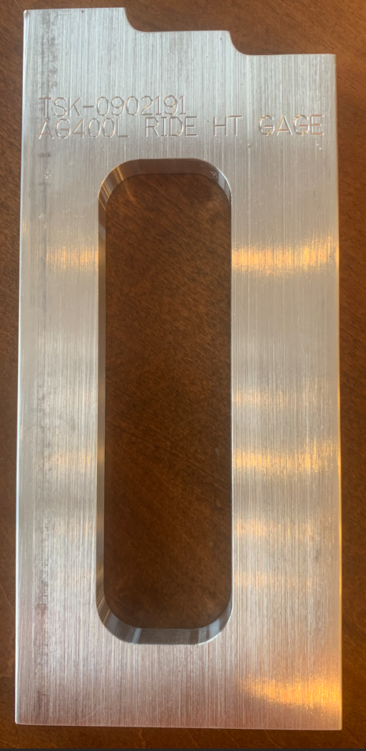
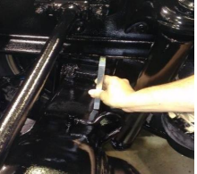
Manual measurement is difficult to complete properly. The suspension bracketry bolted to the frame rail blocks frame rail measurement. Also, the center point of the axle shaft is inside of the wheel/tire surface making it difficult to get an accurate measurement. There are tools that help with the measurement but using the AG400L ride height tool makes measurement more efficient.
Upper Limit shoulder
Steps for checking proper ride height with the Gage
The chassis should be unladen (empty) when checking ride height with the gage
Ensure the air system has at least 110 psi
Air bags should be fully inflated
Ride height should be checked at the rear axle, passenger side
Place the ride height gage between the rear top of the axle housing and the frame rail bottom flange as shown in the pic
The gage should fit between the axle housing and the frame rail flange
The frame rail should not sit on the lower limit shoulder or the upper limit shoulder
If the frame rail is below or above the gage limits then the ride height needs to be checked and set properly by a dealer
Goal
Lower Limit shoulder
***Ensure gage is placed at the rear edge of the top of the axle, not centered on the axle***

