Slide 1


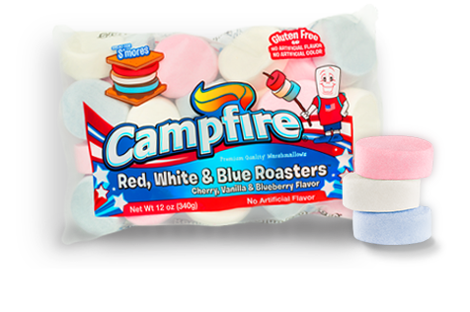

Slide 2


Naturally flavored: Red (Cherry), White (Vanilla), Blue (Blueberry)
No Artificial Colors!!
Fat Free & Gluten Free
Allergen Free
“Roaster” Flat Disc Shaped
Happy Birthday America!!
FOB cost $29.88 Case / 12 = $2.49 unit
Get you orders in now. Limited supply. Product will be available by May 1st if not earlier!!!!!
Please contact Good Food Services | 803 315 0692 | orders@goodfoodservices.com | www.goodfoodservices.com.

