Slide 1

The World is changing!
CT this year and beyond, Big Trends—the world and the USA
John L. Glascock, PhD
University of Connecticut
SIOR, FRICS,
ULI-Scholar,
NAIOP-Scholar,
NAR-Scholar (twice)
Consultant to UK HM-Treasury, Cincinnati, Washington DC, US Treasury, Shenzhen China, S. Korea, Taiwan...DTZ, Macquarie Bank…

Slide 2
Before I go to Connecticut…
Three Quick questions?
1. What area of the world leads in GDP?
2. What areas of the USA dominate in population?
3. What is/was the biggest change since the 1950s?

Slide 3
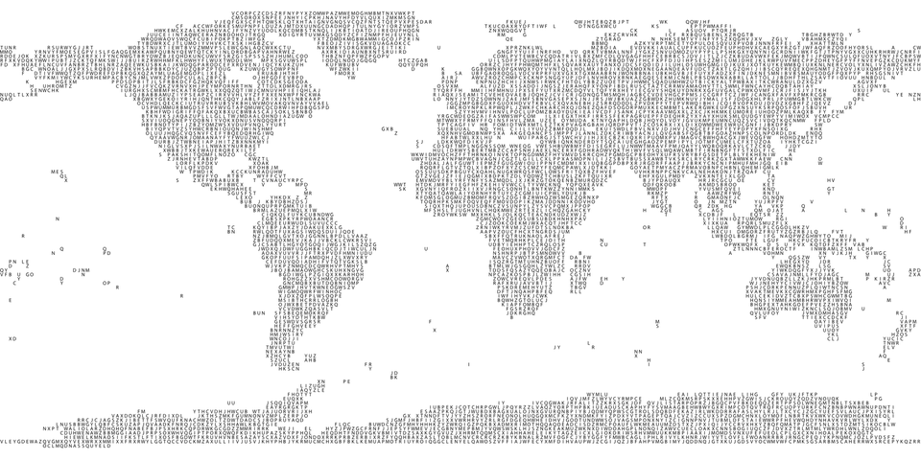
1. What area of the World leads in GDP?

Slide 4
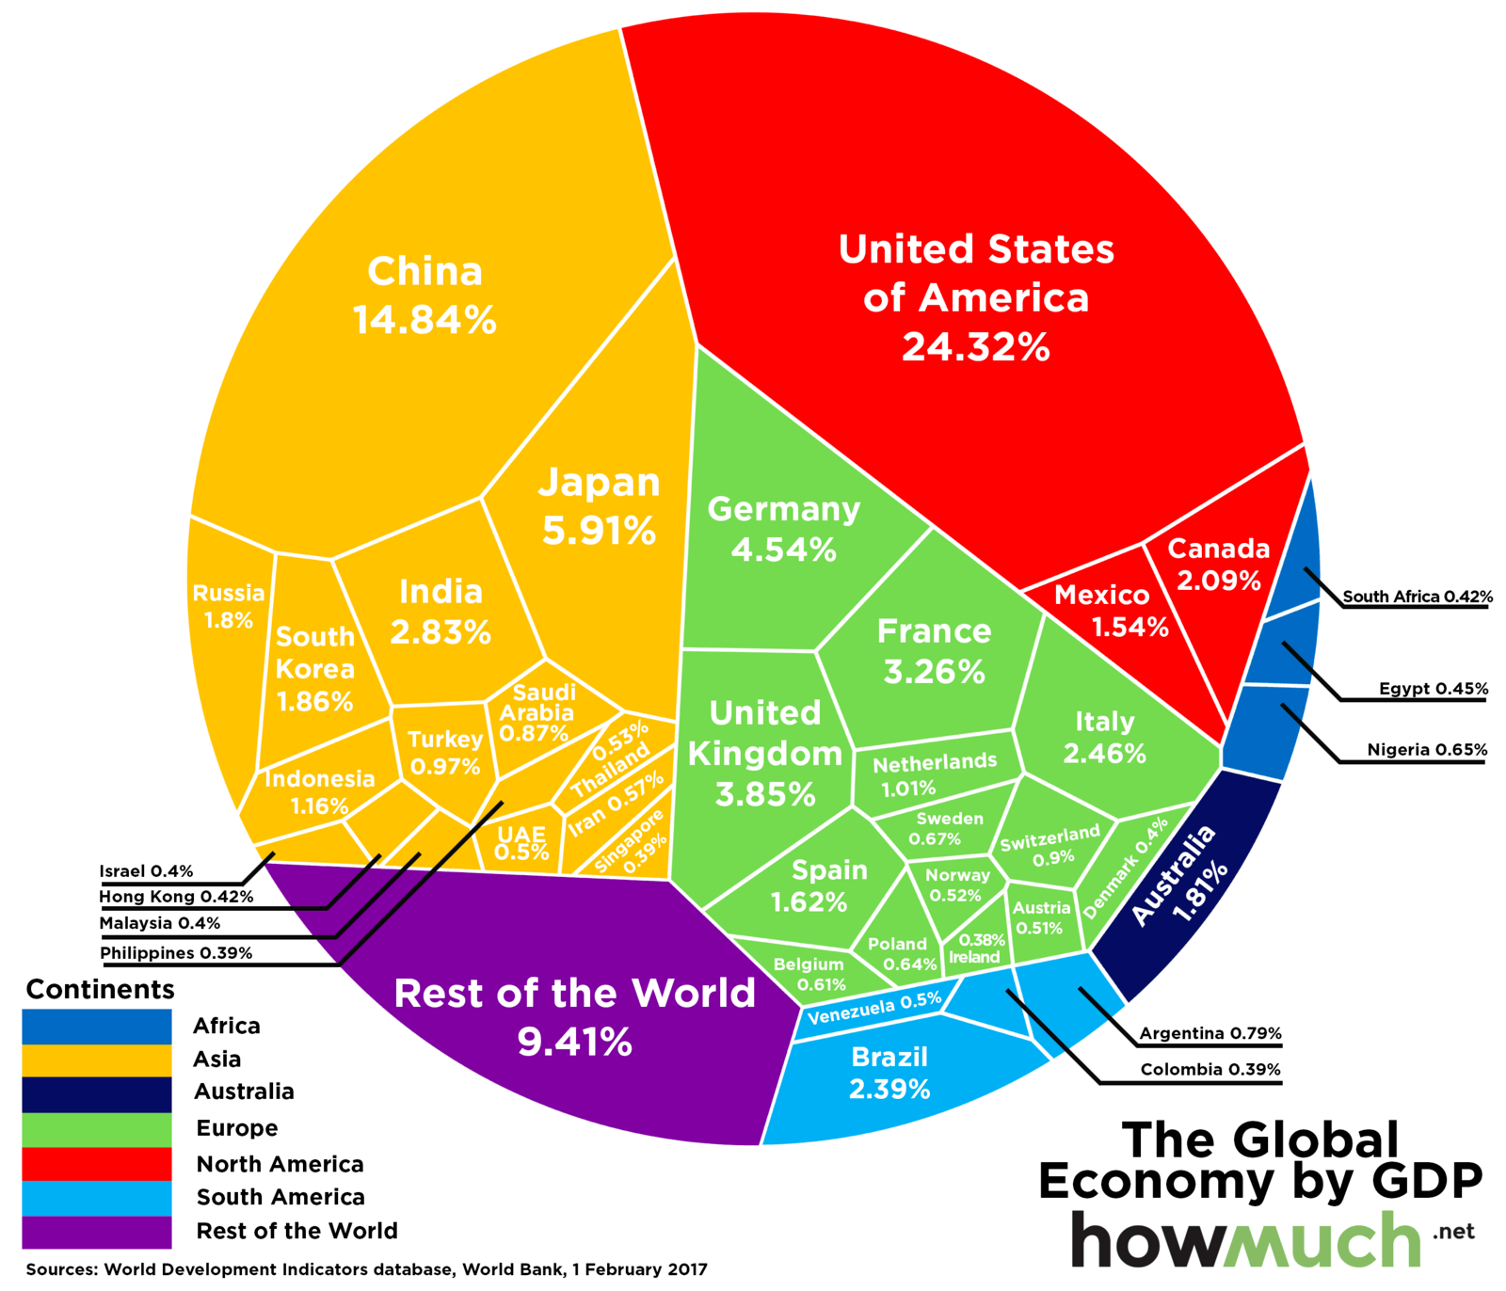
Observation 1: Asia is NUMBER 1

Slide 5
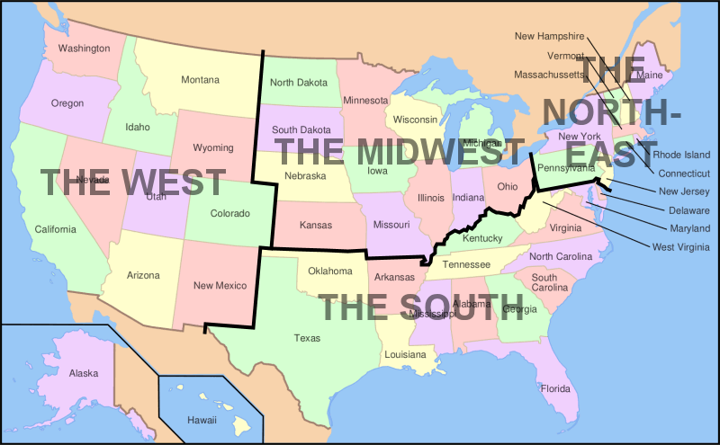
2: What USA area dominates in population ?

Slide 6
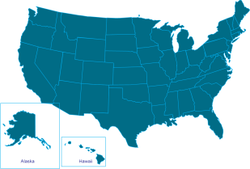
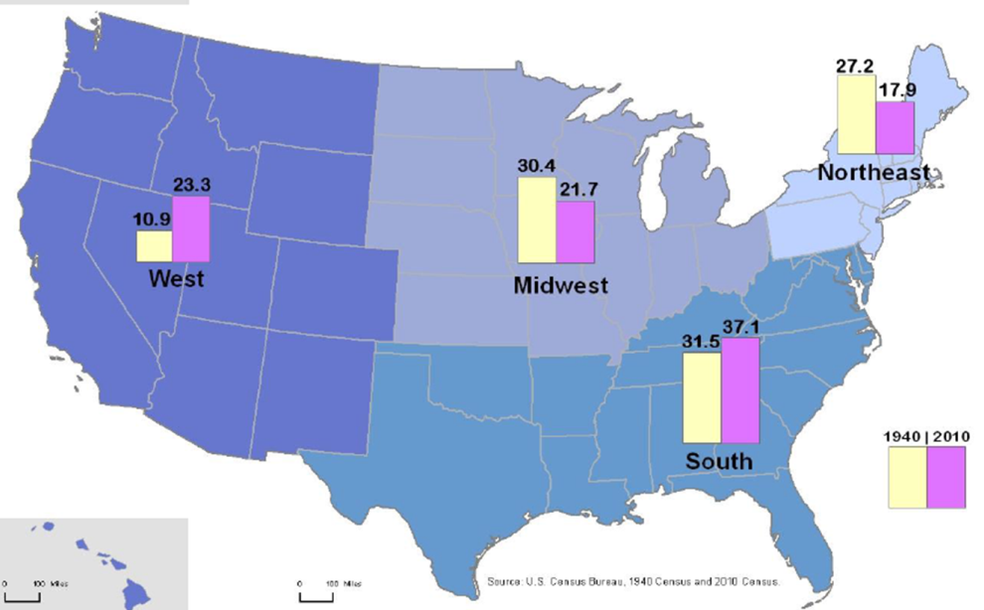
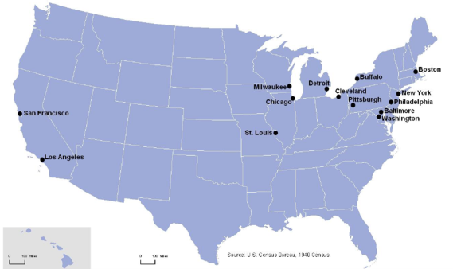
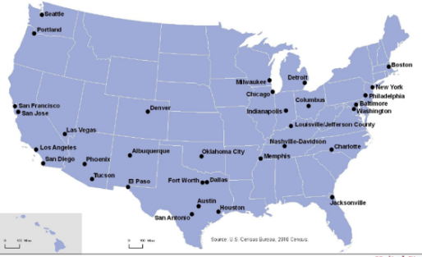
United States of America
Total Population in mil
Age Distribution: 1940 & 2010
% of US Population By Region
Cities of >500k population
1940
2010
Source: Historical Statistics of USA, University of Connecticut Library
USA Census Bureau

Slide 7
2. Today 2018-Population
The SOUTH
is larger than
The Mid-West &
The East
S > MW + E

Slide 8




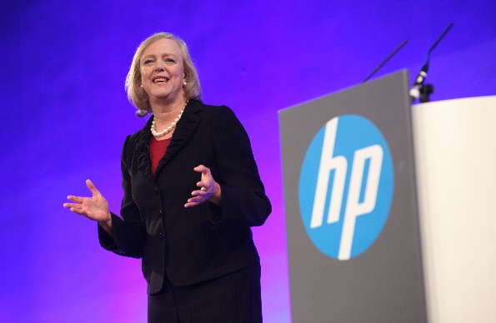

3. What is the Big-BIG trend since the 1950s?

Slide 9


And, just in case you forgot!

Slide 10
WOMEN: starting to be treated fairly!
The good news:
More women executives…more opportunities
Implications:
Houses will be bought later—more renting
Education is suffering/ 1950 & Today!
Fewer children—smaller families/houses
Concentration of like-(social)-minded people
Preference for urban areas

Slide 11
Back to the Story-CONNECTICUT
Last year was a great year in a subdued way…
1- lots of good small development
around the state
2 – houses prices stabilizing and
slightly up
3 – employment by state citizens is down

Slide 12
State of CT and Region!
I’ll do my three in reverse order
Have to keep you awake!
3 Key points to take away:
1. The Region is gaining but slower than the USA!
2. CT is losing employment
3. all areas lost jobs Waterbury/Norwich, etc., areas hurt the most!

Slide 13
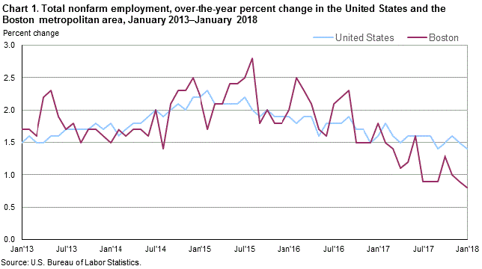
The Region—Boston in particular!

Slide 14
CONNECTICUT
March 2017 to March 2018
Employment
2017 1,832,161 employed people
2018 1,818,350
14,000 lost jobs….
people appear to have left the state

Slide 15
All areas have been losing jobs
October 2017… March 2018
Hartford 599,000 592,000 - 7,000
Bridgeport
Stamford
Norwalk 443,100 438,000 - 5,100
New Haven 312,700 308,700 - 4,000
Waterbury 105,500 103,400 - 2,100
Springfield, MA 354,300 357,300 + 3,000
Worchester, MA 339,000 343,300 + 4,300

Slide 16
House Prices
Had a good year and prices seems to be stabilizing, BUT…
Continued job loss will have an effect on prices
People moving from rural areas to urban areas
Moe renting seems to be indicated
Some areas are over-supplied with lower priced condos (Vernon)!
Classically GOOD areas (Simsbury and Madison) are losing students!

Slide 17
Back to why the Region is growing more slowly
WE NOW trade with Asia
NOT Europe!
and Europe is weakening!!!!

Slide 18
Some comparisons
2006 2017 growth
USA 13.2 19.4 47%
China 2.5 11.8 372
Japan 4.9 4.8 - 2
Germany 2.8 3.4 21
United Kingdom 2.3 2.5 8.7
India 1.0 2.4 140
France 2.2 2.4 9.1

Slide 19
Global Port Ranking – 2007: Grubb-Ellis

Slide 20

Airports
JFK is smaller than Cincinnati Airport
JFK is not in top 20 worldwide…

Slide 21
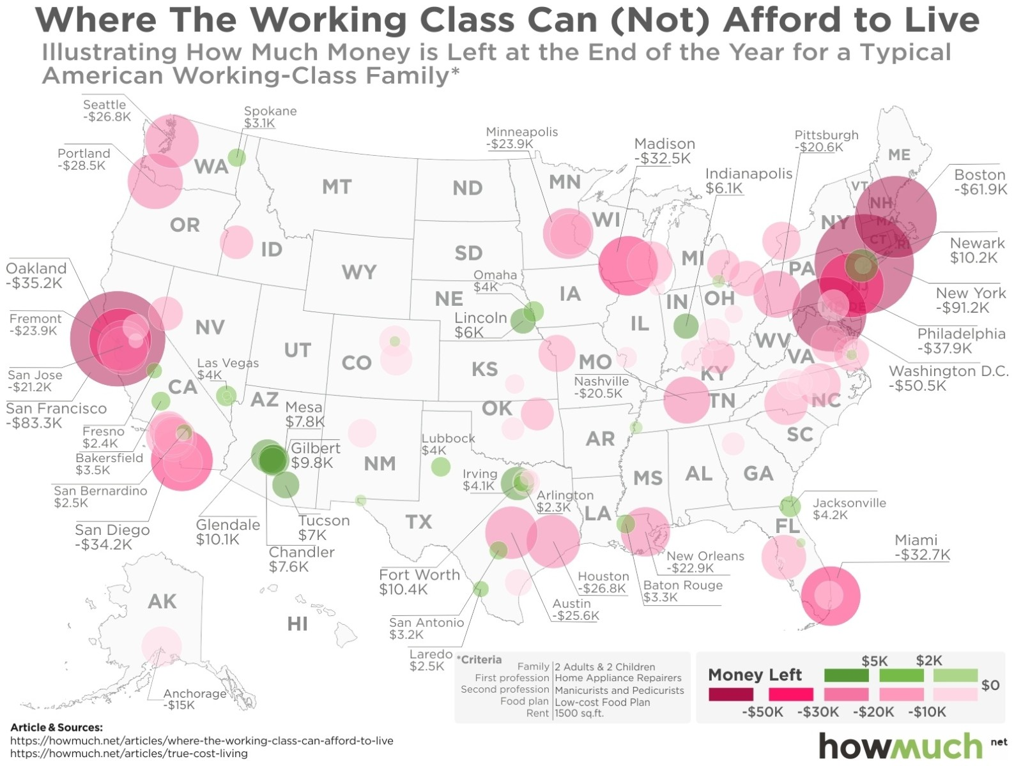
The East Pushes you AWAY!

Slide 22
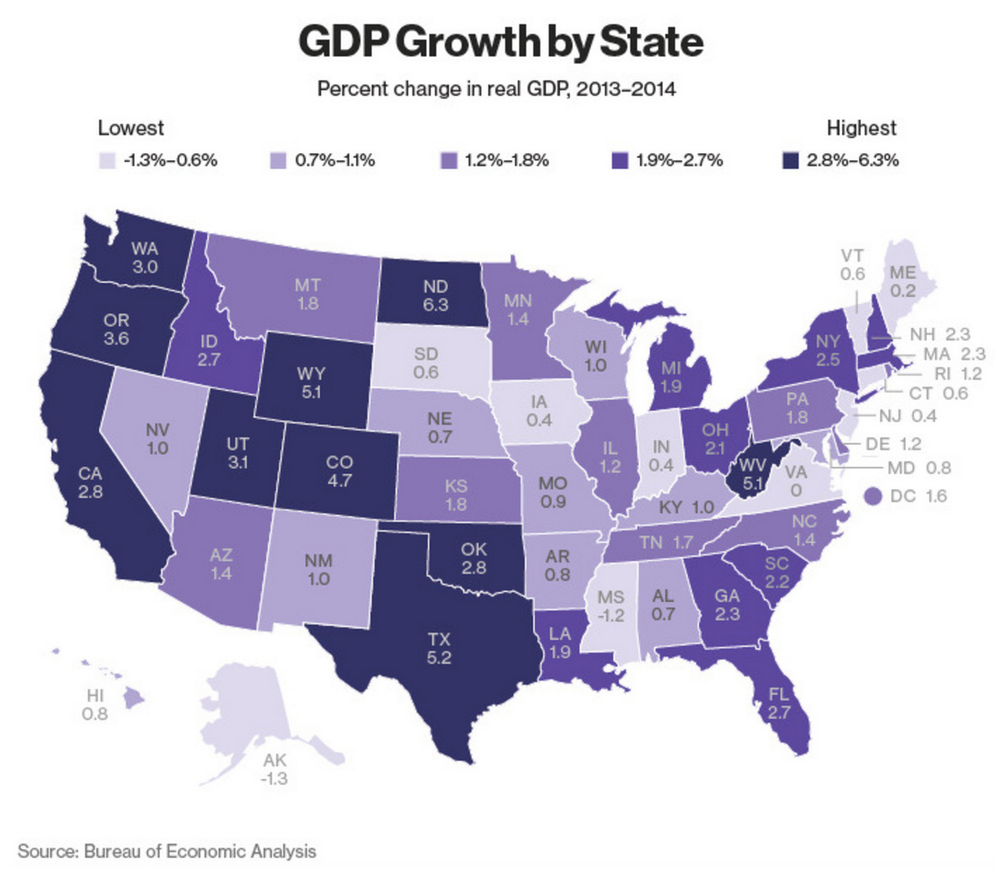
The EAST is weak!

Slide 23
Quick summary
CT is in a relatively shrinking economic market and has old industries that are becoming more efficient and has no strongly growing market segment.

Slide 24


QUESTIONS?
Paris
Detroit

Slide 25
The rich have preferences
Ronald REAGAN
… believed that regular citizens should not be allowed to own houses—there were to him wasting money that industry could use (via lower costs to themselves if citizens were not allowed to borrow to buy housing).
What a GUY! Not!!!

Slide 26
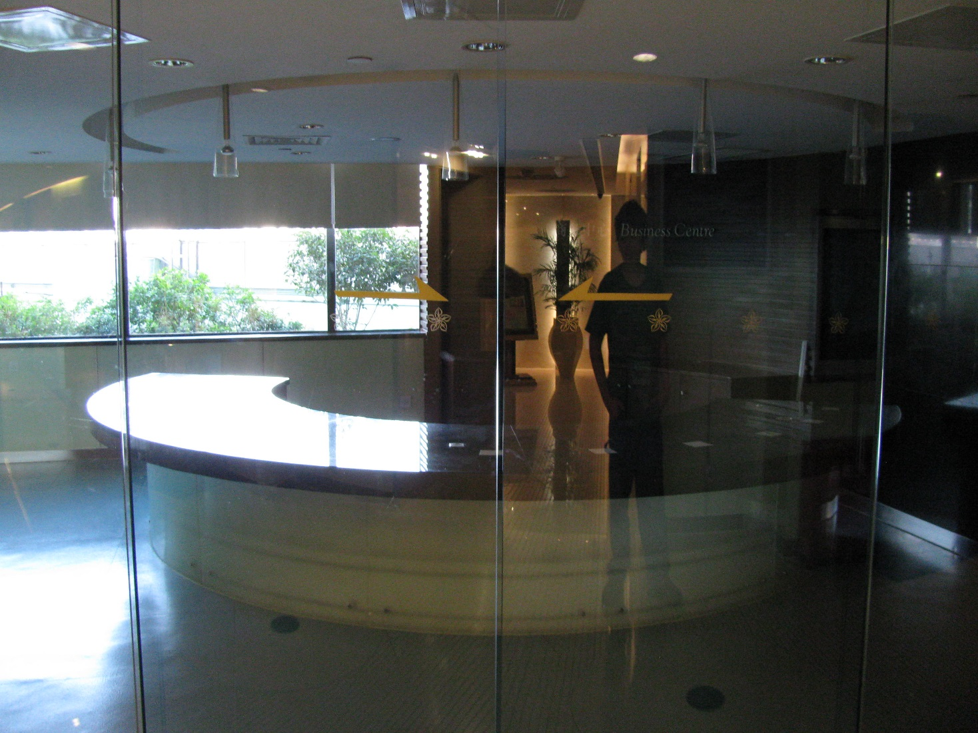
Shenzhen—A planned Business Center!
That’s my son’s shadow as we take the picture

