Slide 1


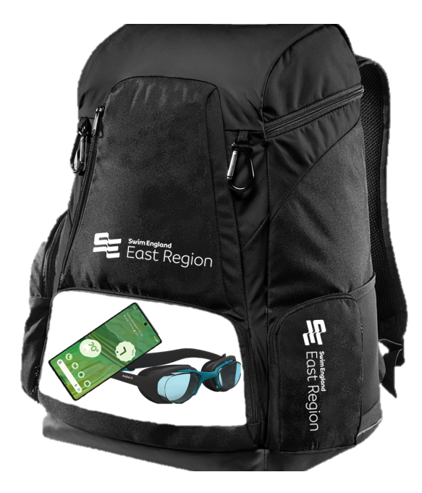

Wavepower
Mobile Phones
Wavepower prohibits all use of mobile phones or any devices in changing areas during
Swim England regulated activity.
Keep it in your bag!
Keep your mobile phone in your bag whilst in the changing area.
eastwelfare@swimming.org

