Slide 1

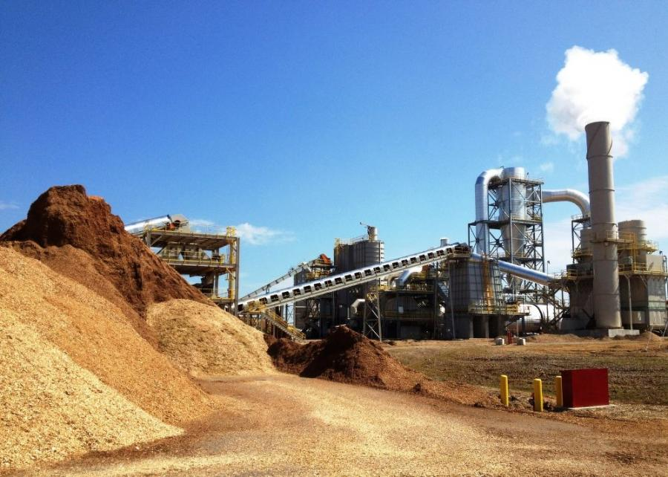


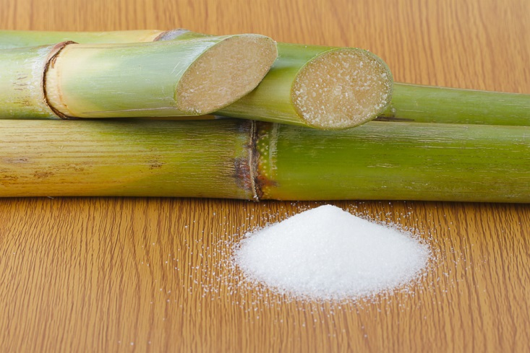
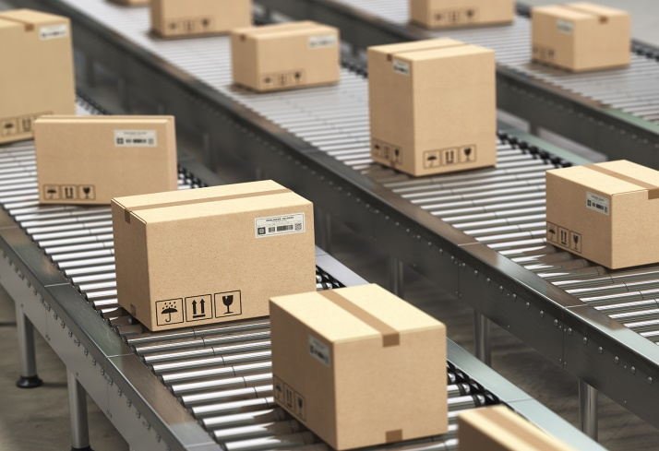
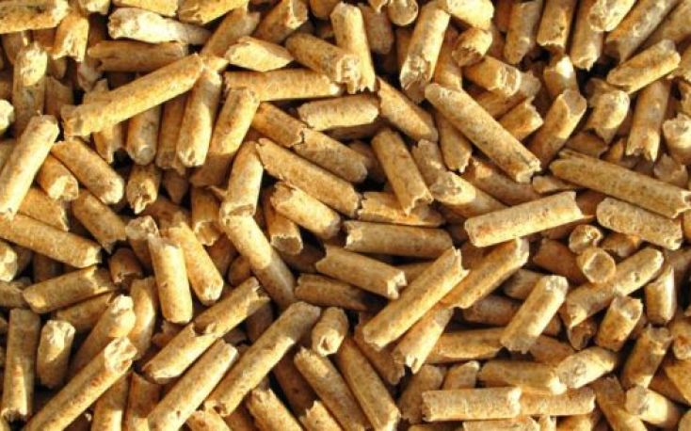
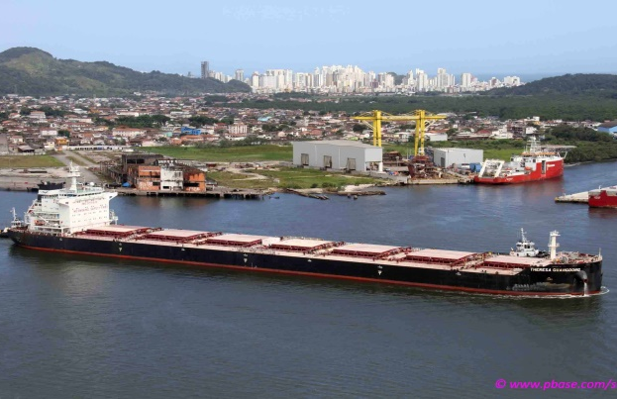
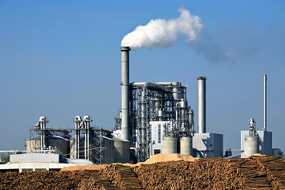
INTRODUCING CBA’s
REMEDIAL BIOMASS SOLUTIONS (RBS) – BIOMASS OPTIMIZATION AND DECARBONIZATION TECHNOLOGY

Slide 2

WHAT IS THE REMEDIAL BIOMASS SOLUTIONS (RBS) PROCESS?
The RBS Process is a Patented chemical-thermal technology designed to drop-in to existing biomass operations, or be constructed from new at a proposed or existing biomass operation.
RBS provides the end user with the capability to reduce cost of production through optimization of components of the process, i.e. dryer, conditioner and pellet mill increased throughput, while improving energy density, allowing for the use of higher moisture content, lower quality feed material.
RBS also reduces the volume and impact of emissions of the overall operations, including a substantial reduction in carbon oxides, including CO2 and CO2-e compounds through capture and displacement with utilization of the captured carbon oxides to produce commercial-grade products.
The RBS process reduces cost of operations, while generating additional sources of revenue through the qualification of eligibility for several tax credit programs including IRS 45Q, CA offsets, LCFS and RIN’s.
The end result is a process optimization that saves the client costs while generating additional revenue, and converting the operation to Carbon Neutral or Carbon Negative thereby improving the client’s ESG score, and getting ahead of the Climate Risk Assessment facilitating Decarbonization of multiple Supply Chains in multiple Industry Sectors.
RBS 2

Slide 3
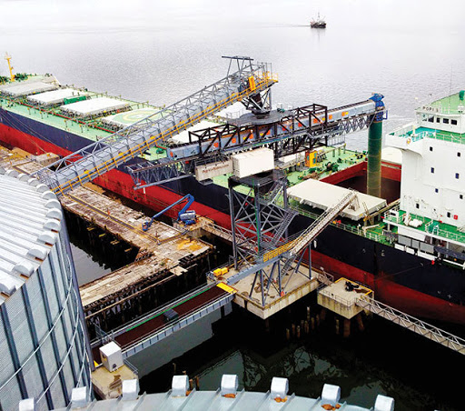
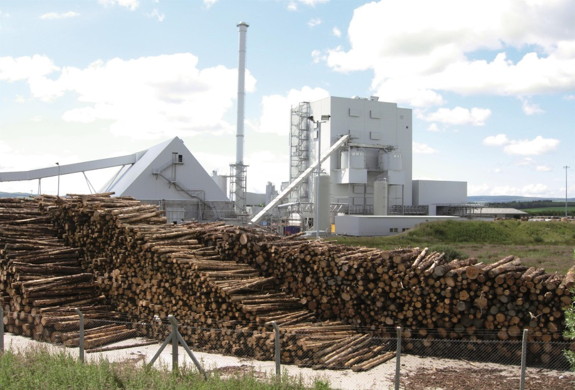
RBS PROCESS OVERVIEW
Reduces operating/production costs of wood-pellet manufacturing, electrical generation, paper/pulp and liquid biofuel production
Carbon Capture & Utilization (CCU) system capable of 50% + reduction & capture of inherent CO2 & CO2-e compounds contained in all forms of Biomass
RBS process is eligible for IRS Section 45Q 12-year tax credits upon commissioning of process
Ability to produce a “torrefied-spec” chip or pellet from lower quality feedstock
All residual captured carbon oxides utilized to produce commercial-grade fertilizer. Complete Sustainability Cycle – Ability to achieve Carbon Negative Status, Improve ESG Score & get ahead of Climate Risk Assessment
Higher bulk & energy density increasing global commodity value
Scalable, modular complete or drop-in systems ranging from 30 TPH to 250 TPH (250k TPY to 1 MM TPY) installed between feedstock & dryer and after dryer at operating plants
RBS 3

Slide 4
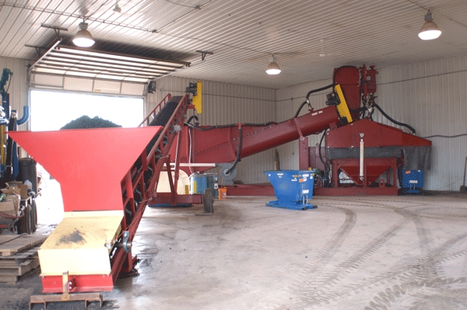
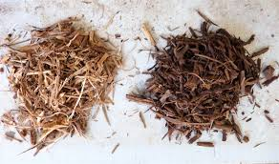
RBS PROCESS HIGHLIGHTS
Sustainable & Carbon Negative
Reduces operating/production costs of wood-pellet manufacturing, electrical & steam generation, pulp/paper and liquid biofuel production
Produces a stable, non-friable chip or pellet that does not reabsorb moisture (hydrophobic), resists spontaneous combustion (SC) & biological activity, and does not require special handling considerations or secondary concerns post treatment
Lucrative commodity trading arbitrage margin due to ability to transport more BTU’s per vessel.
Increased plant efficiency for power plant user (4%-12%) – reduced fuel cost & demand to meet base load – Reduced plant operational costs – CO2 reduction & APC fixed & variable O&M & consumables cost
Global Patent protection – EPRI endorsed
CBA RBS Proof of Concept Pilot Plant
CBA RBS Torrefied Wood Chips
Upgraded Coal
RBS 4

Slide 5
RBS OPERATIONS & MAINTENANCE BENEFITS
Significant increase in dryer efficiency and throughput due to proprietary chemical treatment – increased fiber & structural compaction density
Increase in Boiler Efficiency: 4% - 12%
Reduced fuel demand to meet base load power: up to 25% = Arbitrage
Reduced usage/need for WESP & RTO
Reduce overall costs of emissions control systems or APC, fixed & variable O&M costs: Up to 92% (varies by biomass type)
RBS FUEL QUALITY & STABILITY BENEFITS
Ability to produce a torrefied-spec chip or pellet without the torrefaction gas and tar generation
Improve heat content: 30% - 80% (varies by biomass type) Ability to utilize lower- quality & higher moisture green fiber feedstock
Ability to achieve Carbon Negative status due to Carbon Oxide capture, & utilization as fertilizer for Agriculture and Re-Forestation
Reduce moisture content: 35% - 70%
Resists moisture re-absorption, spontaneous combustion & biological activity
Fixation and donation of Green Hydrogen in final product
No special storage or handling required
RBS 5

Slide 6
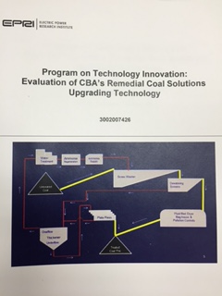
ENERGY INDUSTRY & R&D SUPPORT
Electric Power Research Institute (EPRI) sponsored comprehensive RCS/RBS Technology evaluation – Recommended Commercial Application – February 2016
EPRI evaluation program was co-sponsored by PSEG – ERT, a $12B Market Cap U.S.-based utility. Combustion analysis conducted by University of Utah
EPRI program included full testing and combustion analysis of both U.S.- based and International carbon intensive solid fuels
Independent industry commissioned pilot studies completed by major U.S. – based producers and U.S. – based power utility
Over 600 independent carbon intensive solid fuels test programs conducted & recorded in CBA’s database on all solid carbon fuel types from the U.S., Europe, Asia, Australia, S. America & Africa
RBS 6

Slide 7

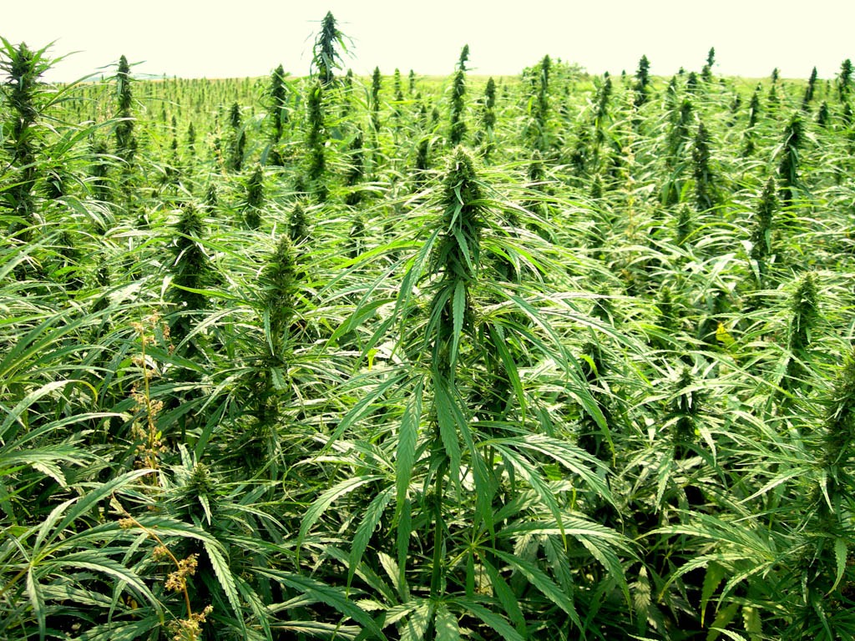
RBS PROCESS: BIOMASS-TYPE VERSATILITY APPLICATIONS
All species of traditional green fiber woody biomass: softwoods, hardwoods, bark, Bamboo etc.
Pulp/Paper Sludge
Sugarcane Bagasse
Industrial Hemp
Municipal & Industrial Biosolids
Agro crops/waste/residuals
Food waste
Municipal garbage
Animal manure
Chicken litter
Bio-char and charcoal
Peat
Cardboard Recycling
OSB & Composite materials
LOCATE RCS SYSTEM AT MINE-MOUTH
LOCATE RCS SYSTEM AT STRATEGIC PORT
RBS 7

Slide 8
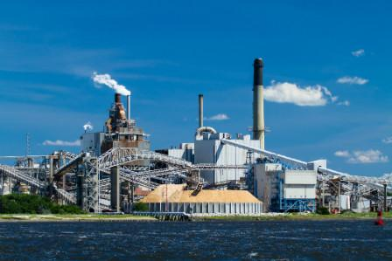
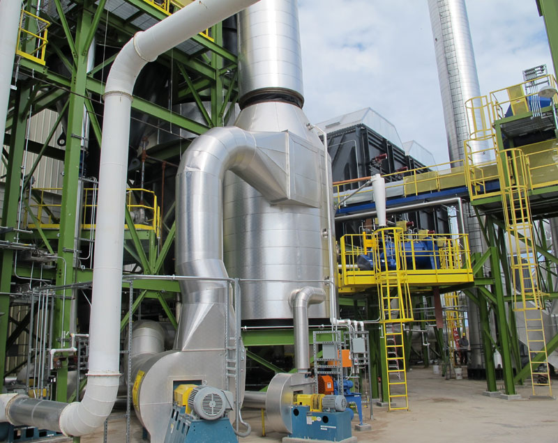
RBS PROCESS: INDUSTRY APPLICATIONS
Pulp & Paper
OSB Manufacturing
Composite Manufacturing
Bamboo Product Manufacturing
Electric Generation
Residential & Industrial Wood Pellet Production
Biochar Production
MSW Management/W2E
Supply Chain Decarbonization
Alcohol Production/Fermentation
Hemp & Cannabis Industry
Biofuel & Renewable Diesel Transportation Fuel Production
Chemical & Fertilizer Industry
RBS 8

Slide 9
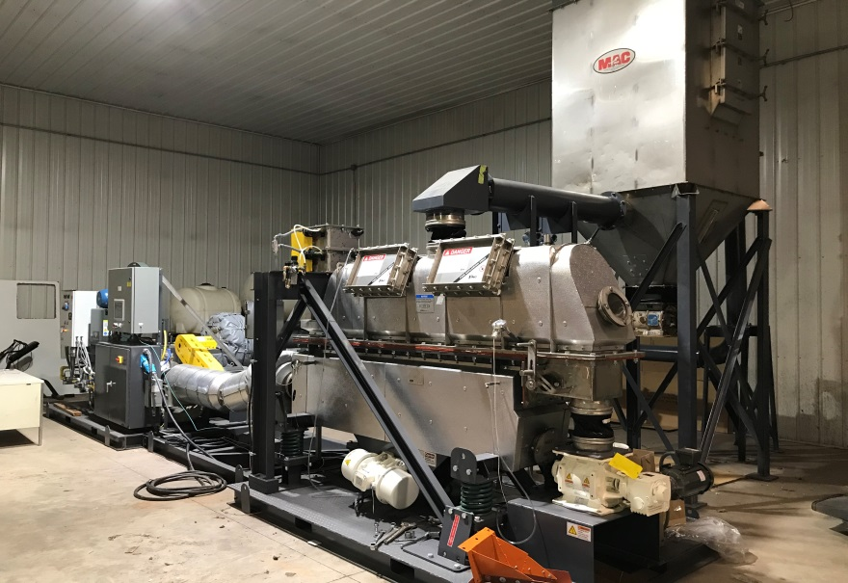
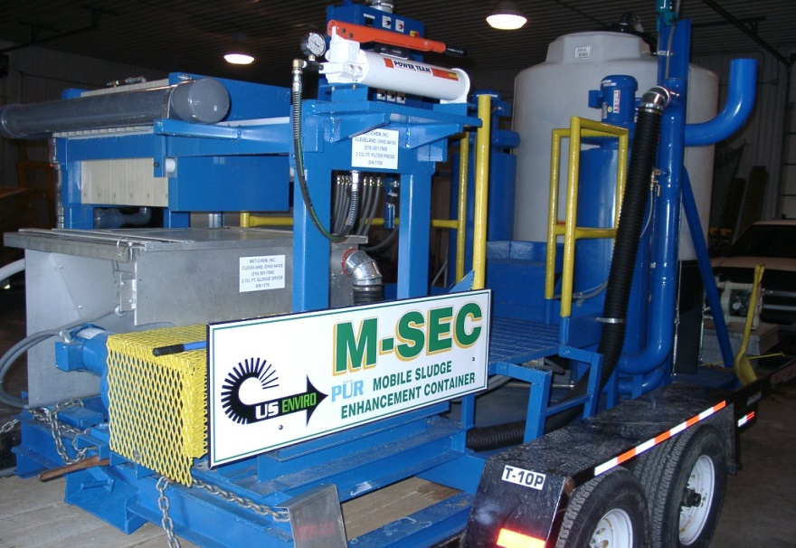
CBA - RBS PILOT & BENCH TESTING CAPABILITIES
CBA has developed and maintains a diverse level of solid and semi-solid drying application expertise with regards to the implementation of CBA’s technology portfolio
CBA’s Corporate Campus includes multiple pilot unit capabilities and expertise from solids & semi-solids treatment and drying, to modular & mobile water and wastewater pilot & benchtop treatment units
500 lb./hr. FBD with Recirc System
M-SEC Pilot Unit
RBS 9

Slide 10
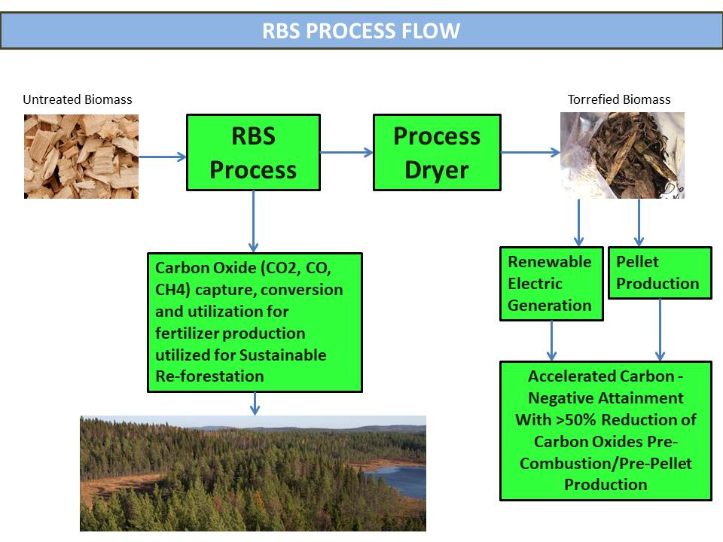
RBS PROCESS FLOW
Water Treatment
SRS-MET System
RBS 10
RCS 9

Slide 11
RBS CO2 & CO2-e Capture – Sequestration – Utilization: - Process Flow
RBS 11

Slide 12
SUGARCANE BAGASSE CASE STUDY: RBS UPGRADE PERFORMANCE
ANALYSIS | RAW | TREATED | % CHANGE
Moisture | 50.00 | 4.88 | -90%
BTU/LB. (MJ/kg) AR | 3,586 (8.34 MJ/kg) | 7,446 (17.31 MJ/kg) | +51%
¹MF BTU/LB. | 7,172 | 7,828 | +8%
Sulfur | 0.08 | 0.08 | -
Boiler Efficiency |  |  | +8.66%
Heat Rate |  |  | -500+ BTU/kWh
Ash /AR | 9.18 | 9.24 | -
¹ Increase in calorific value attributable to the proprietary chemistry
RBS 12

Slide 13
PINE WOOD CHIPS CASE STUDY: RBS UPRADE PERFORMANCE
ANALYSIS | RAW | TREATED | % CHANGE
Moisture | 58.90 | 6.87 | -88%
BTU/LB 1(MJ/kg) AR | 3,786 (8.80 MJ/kg) | 8,558 (19.90 MJ/kg) | +55%
Sulfur | <0.03% | <0.03% | -
Boiler Efficiency |  |  | +10.46%
Heat Rate |  |  | - 475 BTU/kWh
Ash/MF | 0.69 | 1.01 | +31%
Pre Post
Pre Post %Change
Mercury .07 <.02 (71%)
BTU 8,687 11,940 37%
SO₃ in Ash 14.1% 0.20% (98%)
%Change
Mercury .07 <.02 (71%)
BTU 8,687 11,940 37%
SO₃ in Ash 14.1% 0.20% (98%)
1 Increase in calorific value attributable to the proprietary chemistry
RBS 13

Slide 14
RBS Process – Power Plant Technical/Economic Benefits Model Tool
Total $avings
RBS 14

Slide 15
RBS CO2 & CO2-e Capture – IRS 45Q Tax Credit Value
$ - IRS 45Q Tax Credits run for 12-years from date of installation
Excerpt from CBA’s proprietary 45Q CCU tax credit calculations based on methodology approved by the IRS & USEPA (GHGRP – 40 CFR Part 98)
Tax Credit Value per year
RBS 15

Slide 16
RBS CO2 & CO2-e Capture – Financial & Sustainability Snapshot
Financial Snapshot – 500,000 MTPY RBS Plant (chip or pellet):
Revenue realized from operational efficiencies, Federal tax credits, CA Carbon Credits, Voluntary credits & fertilizer sales
Above-average IRR & NPV
Complete & comprehensive financial proforma available upon request & execution of an NCNDA
Achieve Fast-Tracked Carbon Neutral/Negative Status
Get ahead of Climate Risk Assessment
Improve ESG Score increasing Corporate Valuation & Re-capitalization status
Decarbonization of the Supply & Logistics Chain
RBS 16

Slide 17
CBA ASSETS, EXPERIENCE AND QUALITY
CBA Brings: brings
Ability to provide substantial operational savings, increased valuation and Carbon Negative status to the Biomass industry through a high performance, engineered, stable, reliable and optimized technology.
“We don’t produce the Biomass, we just make it better”
Proven technology recognised by EPRI, IRS, DOE, USEPA & EERC and needed by the Biomass industry
Ability to deliver – commission - operate process plants anywhere
26 years experience working with the Energy, Biomass and Power Generation industries
CBA Core Management Team includes over 200-years of combined experience in the Energy, Chemical, Power Generation, Remediation, Civil & Environmental Engineering & Analytical Fields of service
RBS 17

Slide 18

THANK YOU AND CONTACT INFORMATION
THANK YOU!
CBA Environmental Services, Inc.
57 Park Lane
Hegins, PA USA 17938
(570) 682-8742 – Main
www.cbaenvironmental.com
Bruce L. Bruso – President & CEO
bbruso@cbaenvironmental.com
(570) 527-6446 - Mobile
RBS 18

