Slide 1

Terminology, Trends, and Inclusive Settings for LGBTQ+ Clients
Nancy Mullen, MSW

Slide 2

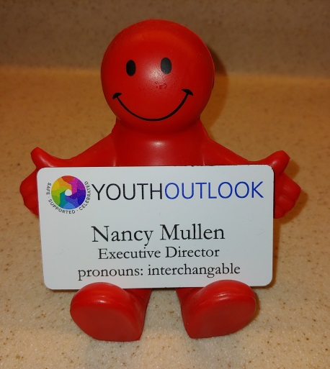

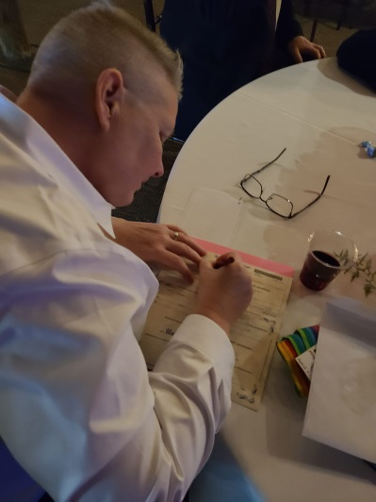
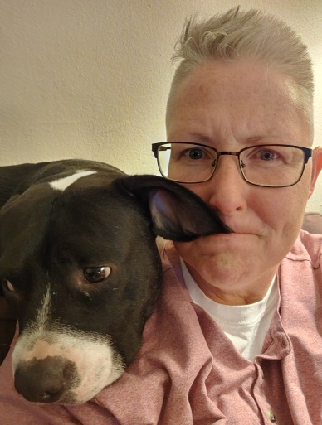
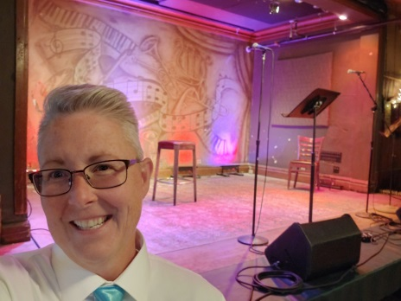
Just Your Average Office Boi
Pastry Chef
Author
Exec Director
Storyteller
Dog Dad
Officiant

Slide 3
How we introduce ourselves matters
I AM NOT MY BIO
WITH OUR KIDS
Nancy Mullen, Executive Director of Youth Outlook:
“Hi, I’m Nancy. I work for Youth Outlook and I use pronouns interchangeably, please.”
How are you introducing yourself? What pronouns do you use?

Slide 4
Youth Outlook’s service area
Not for profit agency providing supportive, social, educational, and recreational services to lesbian, gay, bisexual and transgender (LGBT) youth since 1998 in DuPage, Kane, DeKalb, LaSalle, Suburban Cook, Will, Peoria, and Whiteside Counties
Youth Outlook is the first and longest running not for profit dedicated solely to LGBT youth in IL

Slide 5
What does Youth Outlook do?
Direct service to LGBT youth:
Drop-in Centers
Youth Leadership
Indirect service to LGBT youth:
Community Education and
Professional Development

Slide 6
Who is served?
Youth groups serve ages 12 through 20
Young adults group serves ages 18 through 24
Youth identify as gay, lesbian, bisexual, pansexual, transgender, non-binary, questioning, unsure, allied, heterosexual, cis-het—all are welcome
Our parent/caregiver group runs at the same time as our Transcend drop-in centers.

Slide 7
Our Work Today
Review current terminology used at Youth Outlook
Increase participant knowledge of some current local and national trends related to health and mental health needs for LGBTQ+ individuals
Increase understanding of the challenges for access to appropriate medical care for LGBTQ+ clients
Identify affirming practices for working with LGBTQ+ clients

Slide 8
The first rule of training with Nando
What is said here,
stays here.
What is learned here,
leaves here.
And…

Slide 9
Language is evolving

Slide 10
Everybody has ‘em
And they are not the same things!
Sexual identity (biology)
Gender identity (the identity you experience in your thinking/feeling/relating to the world)
Sexual orientation (relational—about those other people)
Gender expression/presentation (how you show yourself to the world)
Notes:
When we do Adolescent Development and Current Trends presentations, we spend a lot of time on this section, but we wanted to do a bit more today than the usual 101 so we’re not going to spend a lot of time here. A quick review--Many if not most of the Youth Outlook kids are very clear on these terms and they discuss them at length during drop in center hours. They are very aware of the nuances of language and have far more descriptors to express themselves than we have had in previous generations.

Slide 11
Terms We’re Hearing
L
G
B
T
Q
Q
A
A
I
2 S
Not as much as you might think!
Starting to hear this again
A big yes!
Depends on the group and the youth!
Nope, nope, nope
Still good!
More than ever!
A few folks have known
Once, in 25 years, from a staff member
ASK!!!

Slide 12

Pansexual
A person who has the potential to experience sexual, romantic, physical and/or spiritual attraction for members of all gender identities/expressions
This term is used most frequently by current youth attending Youth Outlook
Notes:
So what are we hearing?

Slide 13

Asexual
A person who generally has a low level of sexual attraction to others
We are seeing more youth in the drop in centers identifying as asexual or “ace”. There are many different understandings and experiences of asexuality and it exists on a spectrum.
Notes:
It was rare in our early days that we’d meet more than a few kids per year that identified as asexual. Now it’s sometimes more than half the kids in each group.

Slide 14

Transgender
A term for a person whose gender identity differs from the sex they were assigned at birth
  Youth Outlook’s biggest groups (pre-COVID) were our Transcend groups in Naperville and Palatine.
Notes:
In our mixed LGBT groups, usually at least half the room identifies as trans and/or non-binary. Not just a local trend. I hear this from other youth groups across the country. Trans youth services are in high demand. Counseling services, medical services, assistance with name change process—all high demand.
We’ve also seen an explosion of practitioners who have no specialized training in working with trans kids advertising that they do. Our service area is fortunate that we have some reputable agencies and some private practice therapists that have dedicated a lot of time to this topic and actually do specialize in the issues that trans and non-binary folks face.

Slide 15

Non-Binary (Enbees or NBs)
An umbrella term that reflects gender identities that don’t fit the accepted binary of male and female. Individuals may feel/express they are both masculine and feminine, neither, or some mixture thereof.
Terms under this umbrella: genderqueer, gender fluid, agender (lacking gender), bigender (moving between/among genders based on situation), etc.
Non-binary folks may use they/them/theirs pronouns or others such as xe/ze or ey

Slide 16

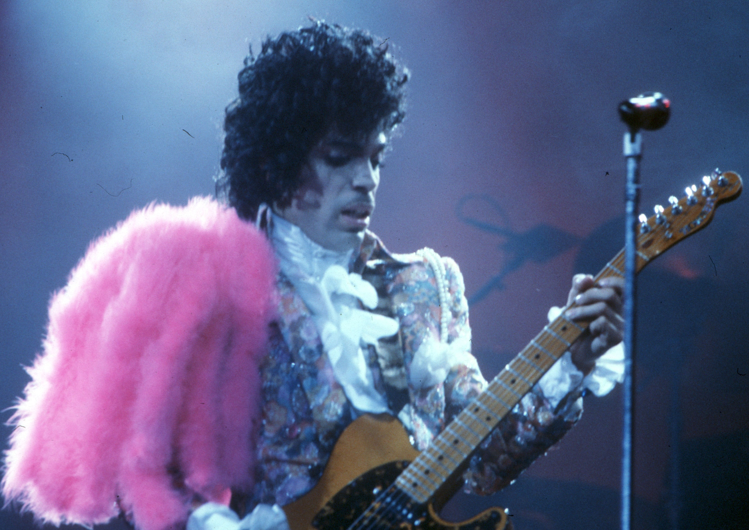

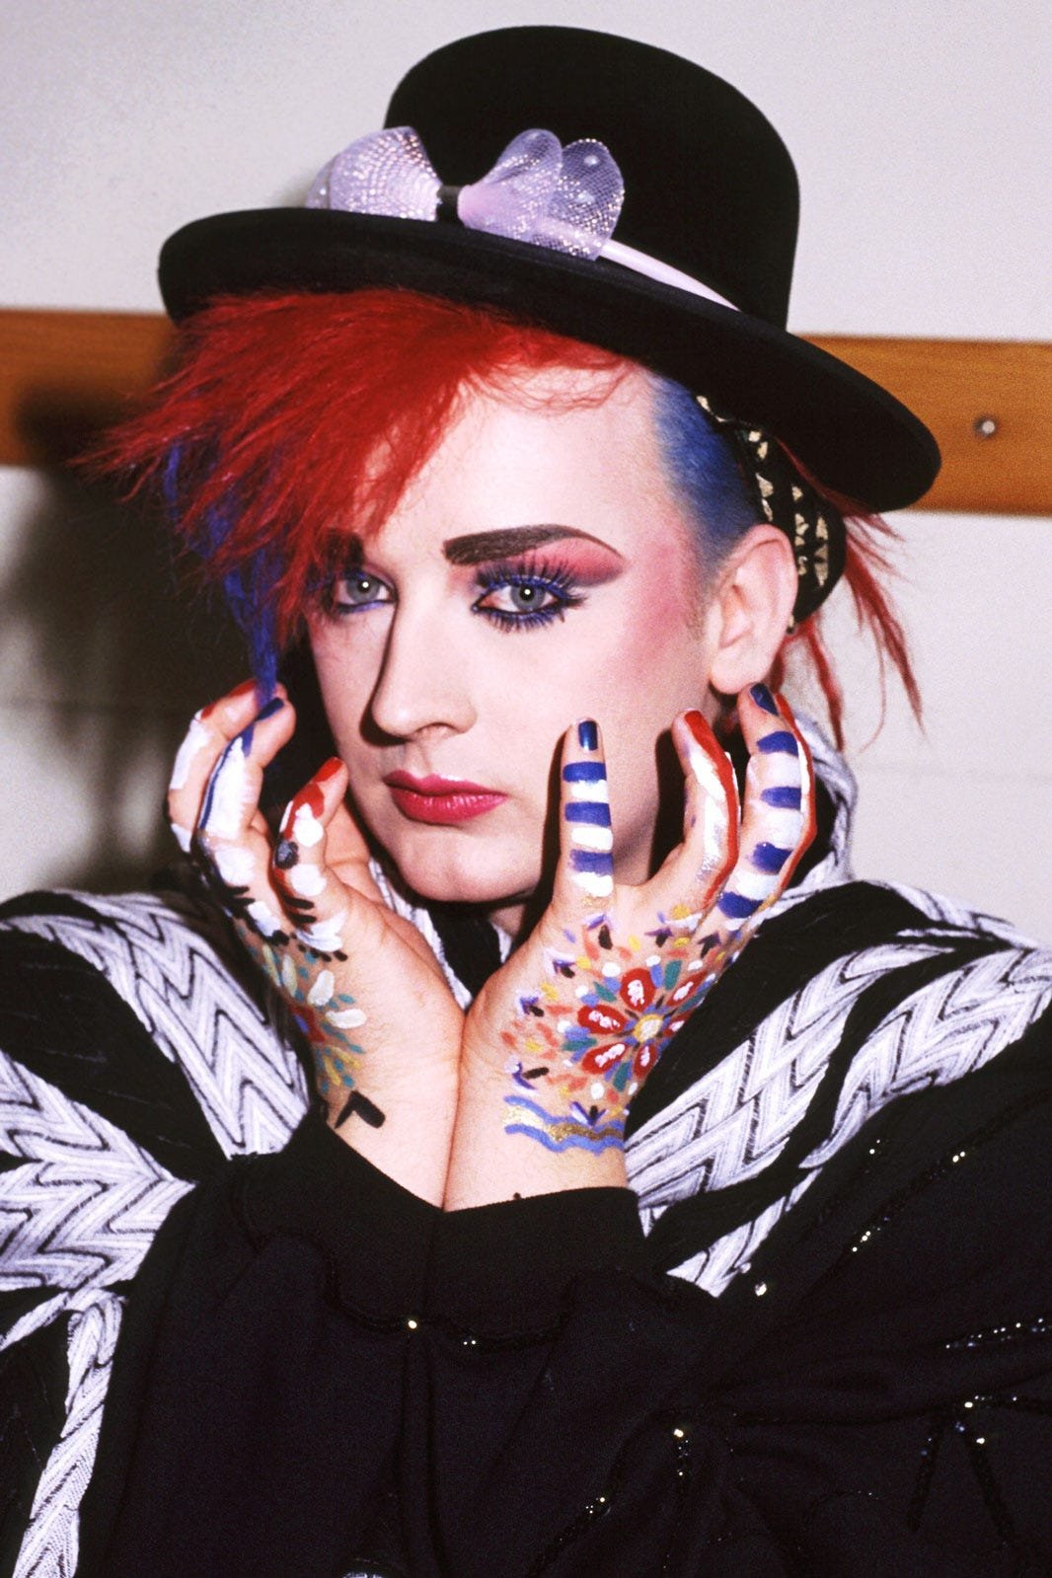
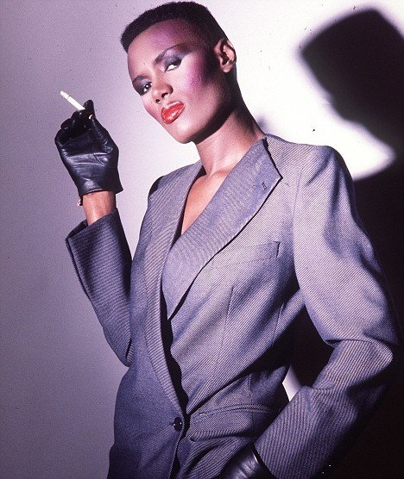
It’s not a trend
Variations in gender expression are timeless and for folks who might know 1980’s music, this is especially not new.
Annie Lennox
Prince
David Bowie
Grace Jones
Language has grown and evolved
Has become more nuanced

Slide 17
Pronouns
Normalize asking folks what pronouns they use:
    She/her/hers
    He/him/his
    They/Them/Theirs (useful for NB clients)
    Other examples: xe, ze, ey
    None or just use their name
Notes:
Youth Outlook went to a practice several years ago of introducing ourselves with our pronouns when we meet new kids, or facilitate meetings. You saw it on the slide when we first started. If there’s one easy thing to do to set the tone for your clients, it’s this—please start naming your pronouns when you meet new patients or clients. Put it in your sign off on your email. Put it on your business card, your name badge, your Zoom identifier…put it out there wherever you have an opportunity. Even if you choose not to ask directly what a patient’s pronouns are, it sets the stage for it to be okay to talk about them right from the start. It’s your first statement.

Slide 18
Transition
The process through which transgender people begin to live as the gender which they identify, rather than the one typically associated with their sex assigned at birth
Social transition may include things such as changing names, pronouns, hairstyle and clothing (be careful with pronouns on the phone)
Medical transition may include medical components like hormone therapy and gender affirming surgeries
Legal transition may include changing one’s name, gender marker on various documents
There is no one way to transition!
Notes:
We have met kids who are transitioning as young as 5 years old. This shift is going to change how and if people need to “come out”. If kids go through school as themselves, being called the name that fits them, how is that going to change the coming out process? How will they present it to their docs and counselors after they feel fully socially transitioned? What does this mean to folks who are transitioning at the time they meet a new doc? How do you structure you services to make it most comfortable for folks who are in the midst of this transition?

Slide 19
Our most common themes
Decreasing age of our youth
Gender exploration
Shifting parental education and support
Increasing school trainings at middle and high school levels

Slide 20
Historical Themes v Current
1998-2002
2018-2022
Youth were mostly 16-19 years old
Exploring orientation
Majority were not out to their families
Schools did not engage
Decreasing age of coming out nationally, now mostly 12-15
Exploring gender
Shifting parental education and support
Increasing school trainings at middle and high school levels

Slide 21
Youth Outlook by the Numbers (2022)
Other Data to Note:
  49.5% of youth reported experiencing verbal harassment based on their orientation or identity
  7.5% reported experiencing physical harassment based on their orientation or identity
  5.5% reported having to leave home against their wishes
  16.5% reported leaving home because it didn’t feel safe to be there
  76.5% reported seeing a therapist in their lifetime
  54% are currently seeing a therapist
Mental Health/Substance Use Data:
  54% report considering suicide in their lifetime
  43.5% take medication to support their mental health
  30% report that they have tried alcohol
  19% report that they have tried drugs

Slide 22
Health Care Challenges
Lack of insurance coverage isn’t always the problem
No available doctors
Doctors who lack expertise
Homophobic and transphobic practitioners
Hetero-centered policies
Changes in HIV trends and education
Disproportionately affected by COVID 19
Etc.
Etc.
Etc.

Slide 23
The grown up bully
The “D” word
Notes:
As part of Youth Outlook’s work, we track the GLSEN national survey that examines school climates in high schools across the country. In 2015 and 2016, we saw the first upticks in bullying that we’d seen after more than a decade of declines in bullying. I wondered if this would apply across generations and in looking at information released in the fall of 2020 by the American Center for Progress, we’re seeing the expanded effect of discriminination against the adult population as well.

Slide 24
LGBT directed violence
School bullying
National increase in hate crime—specifically targeting trans Black women

Slide 25
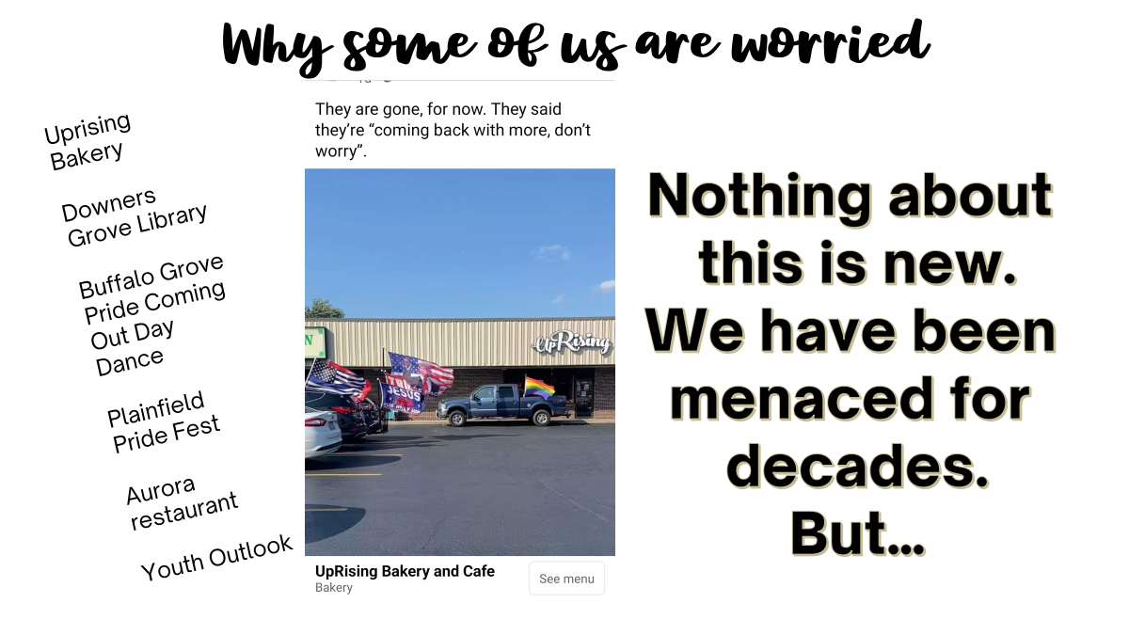

Slide 26
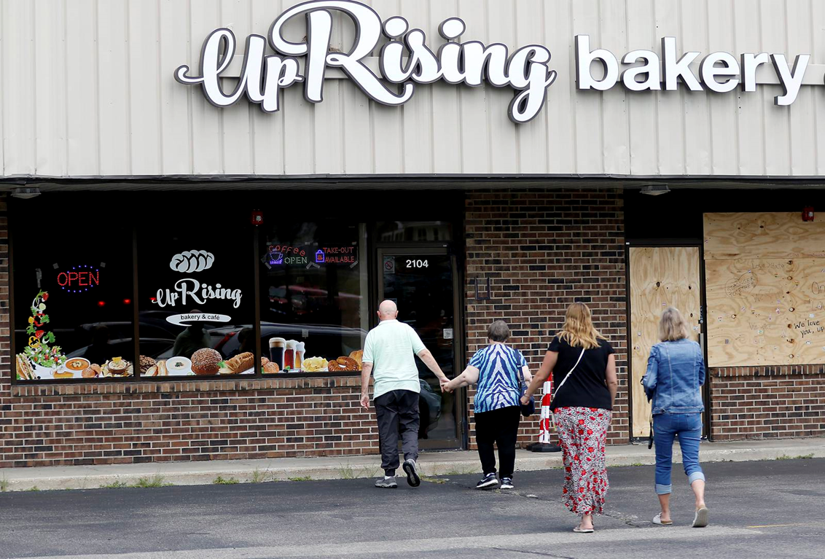
Consider the health and mental health implications

Slide 27
Health Care Challenges For LGBTQ+ patients

Slide 28
The given health challenges
Limited access to culturally sensitive health care providers
Higher rates of tobacco use
Reproductive health
    Lack of comprehensive sex education in schools
Hormone use supervision
Affective disorders
    Double the rates of their straight peers. Still.
Anecdotally, we’re hearing reports of high rates of anxiety and depression
Suicidal Ideation/Attempts
  The Trevor Project reports LGB youth are 3 times more likely to attempt
  This statistic doubles with family rejection
  Attempts are nearly 2 times higher among Black and Hispanic youth
Suicides

Slide 29
Challenges at home for young adults
The 40 to None Project reports that half of all teens get a negative reaction from their parents when they come out
Family conflict is the most common cause of all youth homelessness
More than 1 in 4 are thrown out of their homes
40% of homeless youth identify as LGBTQ
  This is highly disproportionate as they only make up around 3-5% of the general population
Gay and transgender youth also face significant challenges in foster care and the juvenile justice system

Slide 30
Further victimization
Homeless LGBTQ youth and young adults face more vulnerability on the streets:
  Great risk for: victimization, unsafe sexual practices and mental health issues than straight homeless young people
  60% have been sexually victimized on the streets, compared to 33% of straight homeless youth
  Gay and transgender homeless youth are 7 times more likely to experience acts of sexual violence

Slide 31
Challenges T/GE Students Face
USED IN SCHOOL TRAININGS
Incorrect and disrespectful use of names and pronouns
Lack of access to appropriate restroom facilities
Lack of access to appropriate locker room facilities
Rigid or gendered dress codes
Confidentiality
Lack of role models, lack of information
Varying support from family
Safety in hallways, bus, other unsupervised spaces
Most schools in our area do not have a policy in place for supporting T/GE students
Notes:
Some of these points are also challenges to kids in treatment. Many of our youth have talked about being misgendered, being outed, being addressed by the dead names, having a roommate they didn’t feel was appropriate for them, and having care providers who are disinterested or even hostile to them.

Slide 32
Who’s affected?
It didn’t look like what I thought it would
Gen Z’s report more discrimination than Baby Boomers
  Gen Z’s = 57%
  Millennials = 42%
  Gen X = 30%
  Boomers = 20%
  We do need to wonder if it is less reported in other generations because that generation is accustomed to having fewer resources.
  Also…

Slide 33
Location, location, location
Gen Z’s report incidents in schools
Millennials report work discrimination
Next gen, Generation Alpha, may have a different experience as digital natives.
Gen X’s report work and housing discrimination
Boomers report community/public setting discrimination and retirement housing settings

Slide 34
The effect you’ll hear about
School discrimination affects drop out rates, school engagement, missed days, and GPA.
Work discrimination is reported as being refused a job or promotion
Both of these issues add to unemployment and underemployment in the LGBT community
Unemployment and underemployment directly affects ability to secure housing, denial of rental or mortgage applications
Notes:
37% of LGBT people report being unable to rent or buy a home in the study released in fall of 2020
More than half of LGBT people are currently reporting a negative psychological effect due to discrimination of some kind, with 66% of trans folks reporting same. The number increases to 77% for reports from Black LGBT individuals.

Slide 35
Violence and the LGBT Client

Slide 36
Beyond the schools
Sexual orientation is the third highest ranking hate crime reported in the US 15% in 2018
SOGI attacks yield a higher level of violence
Violence against trans-feminine people of color especially alarming (*82% for 2017)
First ranking in IL—Racially motivated, 68%
Second ranking in IL—sexual orientation, 19.6%
Third ranking in IL—religion, 7%
US Dept of Justice
Notes:
Check in question with our kids—what are you afraid of? Being murdered for who they are.
Our kids are highly aware of the violence directed at Black trans women. Some of them will talk about it, some of them want to discuss anything but that when they come to a group. Group is their space to laugh with friends and connect so they intentionally screen out heavy topics. The word they have used to describe what we’re seeing in headlines is absolutely chilling—they are afraid to be hunted.

Slide 37
IPV Issues for LGBT Folks
Gay men are 2x more likely than straight men to experience physical violence in a relationship
Trans folks are 3x more likely to be stalked
Trans women are 3x more likely to experience sexual violence
Youth under 24 are 3x more likely experience sexual violence
Lesbians are 2x more likely to be isolated by abusive partners
2015 LGBT Intimate Partner Violence Report

Slide 38
The first CDC findings, 2015
There’s been a long held impression that IPV isn’t an issue in the LGBT community. This 2015 study gave us a whole new understanding.
The lifetime prevalence of rape, physical violence and/or stalking by an intimate partner is extremely high in the LGB community with lesbian women (43.8%), gay men (26%), bisexual women (61.1%), and bisexual men (37.3%) reporting experiencing this violence.

Slide 39
Also in CDC findings
Nearly half of bisexual women (48.2%) and more than a quarter of heterosexual women (28.3%) were first raped between the ages of 11 and 17.
We have to address the idea of “corrective” rape.
“You haven’t met the right man yet.”
“You just need to have sex with the right guy.”
We have to address the idea that women don’t rape.

Slide 40
Added risks
We face all the same risks in violent relationships plus…
We might be afraid to be outed at work, in community, to family.
We might be afraid of losing our kids with a court system that isn’t knowledgeable about LGBT families
HIV status might be used against us.
There is still a perception that IPV is a “fair fight” or a fight between equals.

Slide 41
Mental health in post-COVID times
54% of LGBT adults reported increase in anxiety issues
60% of LGBT adults reported increase in depressive symptoms
Sleep disruption
17% reported daily anxiety/ 35% report several times in a 2 week period
14% reported daily symptoms/32% report several times in a 2 week period
14% reported daily difficulty/30% report several times in a 2 week period
Notes:
This is just what we’ve got so far. At Youth Outlook, we’re anticipating an increase in anxiety over the coming 18 months with youth returning to schools, dealing with bullying and discrimination issues again, or dealing with PTSD from this past year.

Slide 42
The Post-COVID world for our kids
Youth Outlook youth raise the following concerns about mental health care:
Lack of MH providers
Long waiting lists for appropriate health care (1 year at Lurie gender clinic)
Long commutes for in-person appointments complicated by transportation issues
Lack of privacy for telehealth appointments
Our colleagues in schools observe:
Students display gaps in social skills
Students struggle with anxiety
Students struggle with depression
Students starting high school now missed most of their middle school experiences, (or missed middle school entirely) creating gaps in social and emotional development as well as educational

Slide 43
Creating an affirming setting

Slide 44
Interacting with LGBT Young People
Remember there is likely a backstory as to homeless status
Ask about name and pronouns when you introduce yourself
They may not be out to family due to safety issues, or out only to certain family members
They might mistrust you
Use the name and pronoun they offer—they may not have time/money/resources to change their name legally
Remember that LGBT youth are more likely to be forced out of school than are cisgender/heterosexual students

Slide 45
Time to update!
Some practices/businesses are running with old, outdated forms even on computers
  Binary be gone!
  Update your forms to leave a blank for gender
  Make a space for any name that is not on someone’s insurance card
  When someone gives you their name and pronouns, use them everywhere.
  Do not out anyone by using a dead name
  Never out a client to a family member—it may not be safe for them
Notes:
Pregnancy test story

Slide 46
We are all LGBT Waldos!
Can we see ourselves?
  Website references
  Photos of us
  Inclusion on forms
  Are there LGBT magazines or books in the waiting area?
  HIRE US!!! Are we on staff? Are we wearing the lab coats and the stethoscopes? Are we at the front desk? If we can’t be, what IS there that tells us we’ll be welcome at a location?
Help us see ourselves in your office/clinic/practice, just like buying a house.
Show us--US!

Slide 47
Mislabeling and Misgendering
First, it DOES happen.
Second, make apology short and to the point. “I’m sorry, and thank you. I will be more aware.”
Third, move on!
No, seriously. Move on!
Notes:
Training example—I’m sorry, I was just, I just saw…I thought…
NO!

Slide 48
You set the tone
Model it. Ask. Do not assume anyone’s orientation, gender identity or pronouns.
Model it again. Correct yourself if you’re wrong. It’s okay to make mistakes. Admit you don’t know a certain term.
Model it a third time. Make room for discussion. Remember that some of these discussions will be difficult!

Slide 49
What health issues are pressing?
Lung cancer
Breast, cervical and ovarian cancer
HIV
HIV rates among young black men who have sex with other men (MSM) is higher than any other group in the country
3 out of 4 diagnoses of HIV are among young men 13-34 years old
Be aware of the pressure to keep comprehensive sex ed out of the school curriculum

Slide 50
What About LGBTQ Families?
Families with means…
Support Networks
Youth Outlook is already receiving emails from families in other states that are planning to move to more supportive areas.
Families are researching areas of supportive states where their child will have the best access to care and access to schools that have supportive policies for LGBTQ students.
Movement to help individuals and families relocate to states where they can get gender affirming care.
Pipeline to sanctuary states
What does that mean for IL?

Slide 51
The Anticipated Outcome
Families will not always be able to move as a unit.
Employment will be affected if a wage earner doesn’t have a job that can transfer them to a sanctuary state.
We’re already seeing changes in youth plans for college and where they are willing to consider attending
Additional stressors on existing resources including (especially) mental health providers
Longer wait lists
Requests for community services that do not yet exist or cannot be easily replicated
Housing issues (possible increase in shelter usage or homelessness)

Slide 52
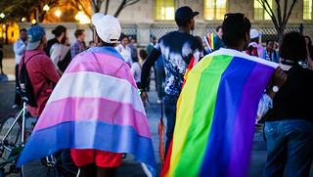
Layers of LGBTQ+ Trauma 2023
Client
Bullying, loss of care, loss of support, risk of/separation from family, neglect of medical needs
Family
Risk forced relocation, loss of employment, loss of housing, loss of children, separation from rest of family
Historical
Denial of rights, discrimination, hate crime, no resources, no care, loss of family and friends, HIV/AIDS
Community
Massive anti-LGBT legislation, increase in hate crimes, increase in bullying, refusal of care, silencing, isolation
What should we be looking for from an ACEs perspective?

Slide 53
Addressing our suicide risk
Suicide is the third leading cause of death among teenagers following accidents and homicides. (Homicide is the leading cause of death among Black male-identified teenagers.)
Across all suicide attempts other than guns, only 4% are fatal. 90% of firearm suicide attempts are fatal.
Firearm suicides are one half of all suicides committed each year.
80% of youth who attempt suicide by firearm use a gun owned by a family member
Notes:
An early study at Harvard (2001), gave us the first peek at this topic—24% of those that survived a firearm suicide attempt said they waited less than 5 minutes between making the decision to attempt and taking action.
This is a big topic and it gets a range of reactions. We’re opening up a discussion about safety and asking about safety practices in homes around a topic that people can be highly reactive to. What’s the most digestible message? It’s not get rid of your guns. But it could be How do you secure your guns so your family members don’t all have access? Where do you keep them? Are they locked up? Where do you keep the key or the code? Could they be locked up?

Slide 54
Community Resources

Slide 55
Youth Outlook
Drop in centers
Youth leadership
Off site visits to GSAs
  DeKalb, Naperville, Naperville Transcend, Palatine Transcend, Sterling, Elmhurst and soon Downers Grove
  Virtual group every Friday over Zoom, now a permanent service
  Virtual young adult social group
We are back NEXT WEEK and outdoors all summer!
Parent/caregiver group, Thrive, will remain virtual through the summer
We are now accepting requests for staff training and professional development

Slide 56
360 Youth Services
360 Youth Services “provides life changing services through prevention education, counseling and shelter”
Transitional Housing Programs serve homeless young people ages 18-24 by providing assistance with education, employment and interpersonal skills with the goal of independent living
Opened our first LGBTQ-specific transitional housing program in June 2014
  Serve 8 residents, ages 18-21 years old for up to 18 months
  In Naperville
  360youthservices.org

Slide 57
Medical Resources
Lurie Children’s Gender Clinic
Howard Brown Health Center
Planned Parenthood in Aurora
Fred Ettner, Lincolnwood
Jessica Lapinski, Bloomingdale

Slide 58
Resources
Local:
  Youth Outlook
  Family Services Assoc.
  Open Door Clinic
  DeKalb Pride Network
  West Suburbs Community Network: Professionals Supporting LGBTQ youth
  Email for therapist referrals
State:
  The Illinois Safe Schools Alliance
  PFLAG (Parents, Families, Friends of Lesbians and Gays)
  Pinwheels
  Gender Expansive Youth Network
  Gender and Sex Development Program and Lurie Children’s
  Howard Brown Health Center
  TransLife Center at Chicago House
  Transformative Justice Law Project
  The Crib (Night Ministry)
  The Center on Halsted
  Neon Street Dorms, El Rescate
  Glenview Youth Services
  Equality Illinois
  Broadway Youth Center
  Live Oak Chicago

Slide 59
Resources continued
National:
  Trans Student Educational Resources (transstudent.org)
  The Trevor Project
  TransLife Line
  Trans Youth Family Allies
  WPATH (World Professional Association for Transgender Health)
  Forty to None Project
  Human Rights Campaign
  Philadelphia Trans Health Conference
  Inter/Act Youth
  GLAAD
  National Center for Transgender Equality
  Gender Spectrum
  GLSEN
  We Happy Trans
  Family Acceptance Project
  Human Rights Watch
  It Gets Better Project

Slide 60
Thank you!
Nancy Mullen, MSW
Executive Director
815.754.5331
nancy.mullen@youth-outlook.org

