Slide 1

Innovative Strategies For a Changing Workforce
“Recruitment & retention “hacks” in today’s employment environment”

Slide 2

U.S. Chamber of Commerce
“The Worker Shortage Across America”
ILLINOIS - 2023
Illinois has 76 available workers for every 100 open jobs
Job Openings: 349,000
Unemployed Workers: 266,155
Labor Force Participation Rate: 64.4% (% of population that is working or actively looking)
Unemployment Rate: 4.1
Quit Rate: 1.8 (# of employees who voluntarily quit as a % of total employment)
Hiring Rate: 3.4 (all additions to payroll as a % of total employment)

Slide 3


Little Bit of History

Slide 4


Slide 5
CRISIS = OPPORTUNITY!
(Re-evaluate Roles, Re-tool, & Restructure)
The Crisis/Problem
Key Admin Staff Leaving During Covid
  Create HR Department
Can’t find enough DSP for Day Program
  Created Rec Team (Degreed)
DSPs in Residential Program Struggling
  Created Residential specialist
  Developed Mentor Program
Difficulty with call-ins/Coverage
  See Next Slide

Slide 6


FIREMAN CONCEPT

Slide 7

DIFFERENTIALS
“Pay People For What They Do”
On-call
Unpopular shifts
Covering shifts (last minute)
Weekends
New Roles & Responsibilities

Slide 8

Is it really just about the MONEY though???

Slide 9

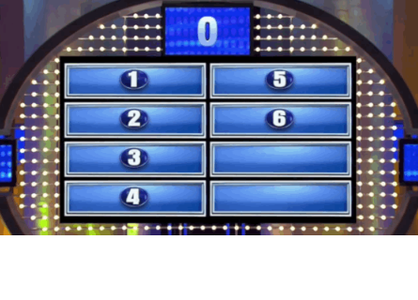
Advancement/Education
Money & Benefits (distant 2nd)
Feeling of belonging

Slide 10

Younger Workforce Struggles
-REALITY CHECK-
Mental health
Coping Skills
Resilience
Confrontation avoidance
General life skills

Slide 11


Destination Employer
Reinforce
Culture

Slide 12
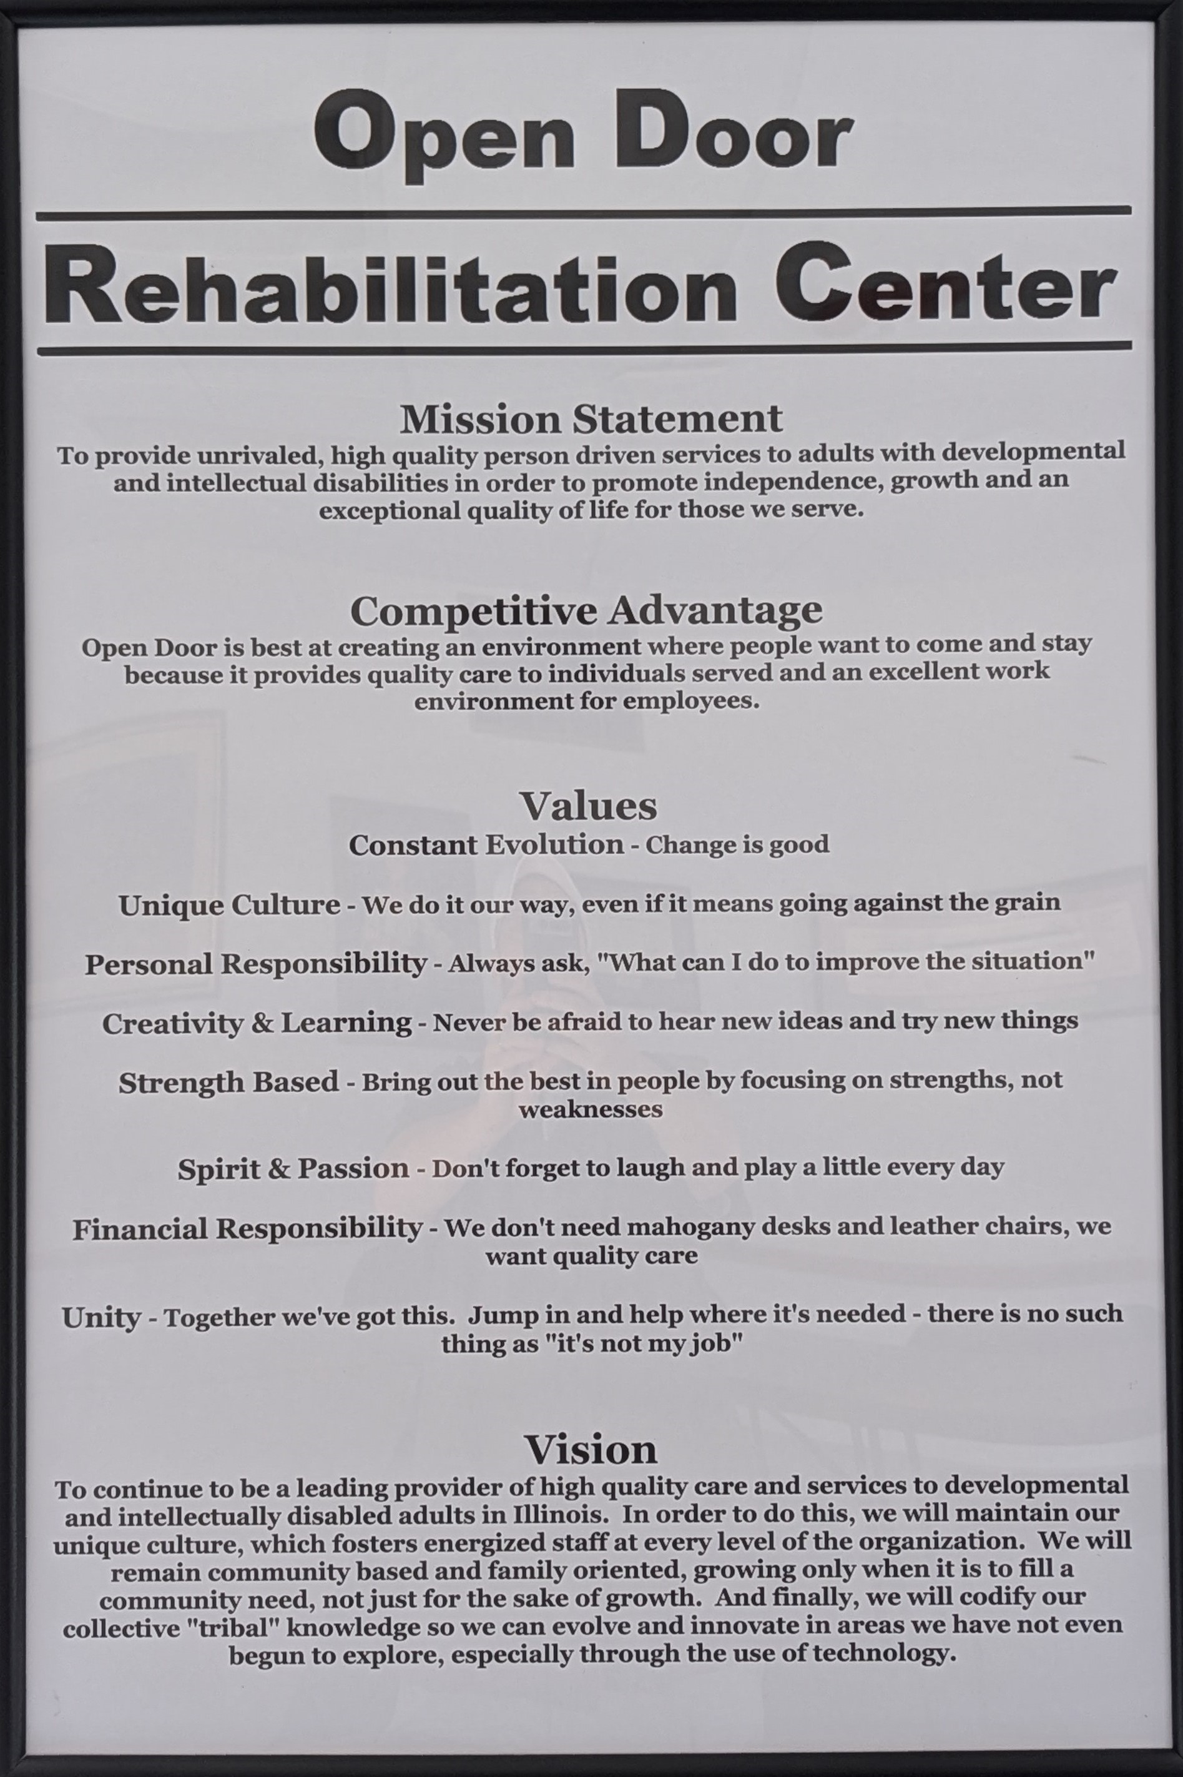
While you are Changing…
BE TRUE TO YOUR MISSION & VALUES

Slide 13




Attract
Retain
Train
*Develop*

Slide 14
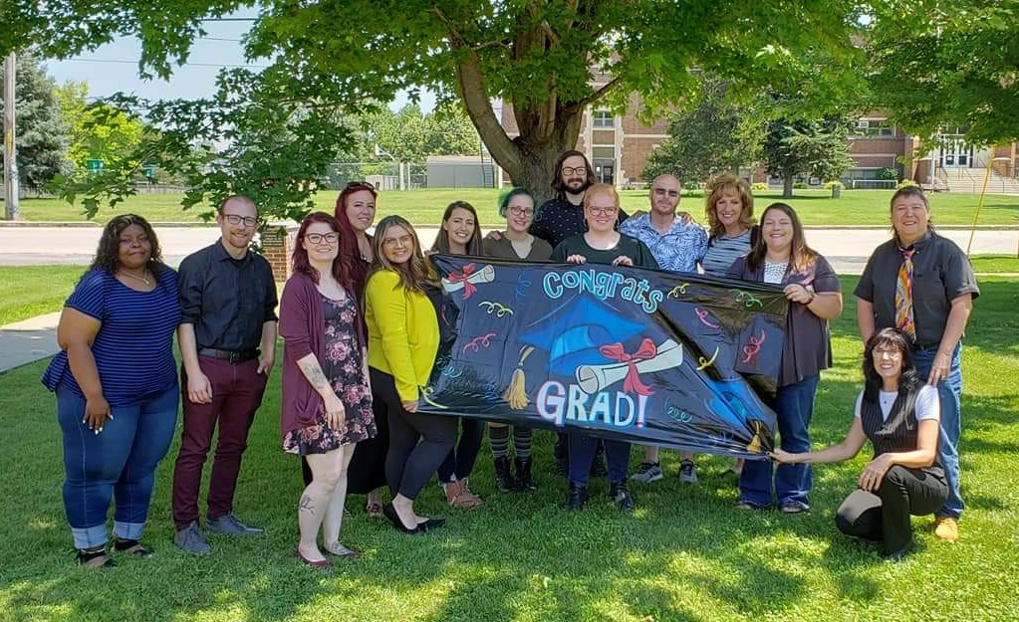
OG Leadership Class –
Our Leaders of Tomorrow
Leadership Class
Started Jan 2021
26 weeks
Graduates are now teachers
Now required for all levels in organization

Slide 15
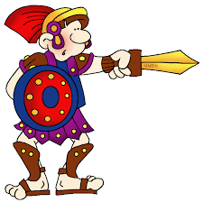



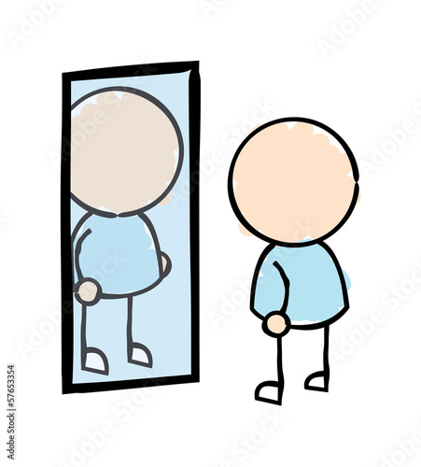

PROACTIVITY
Cheap Seats
In the Arena?
Square Squad
Lone Nut!
Proactive Pause
Look in Mirror

Slide 16
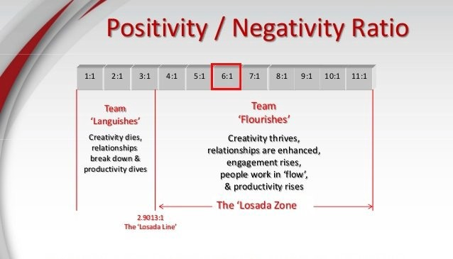




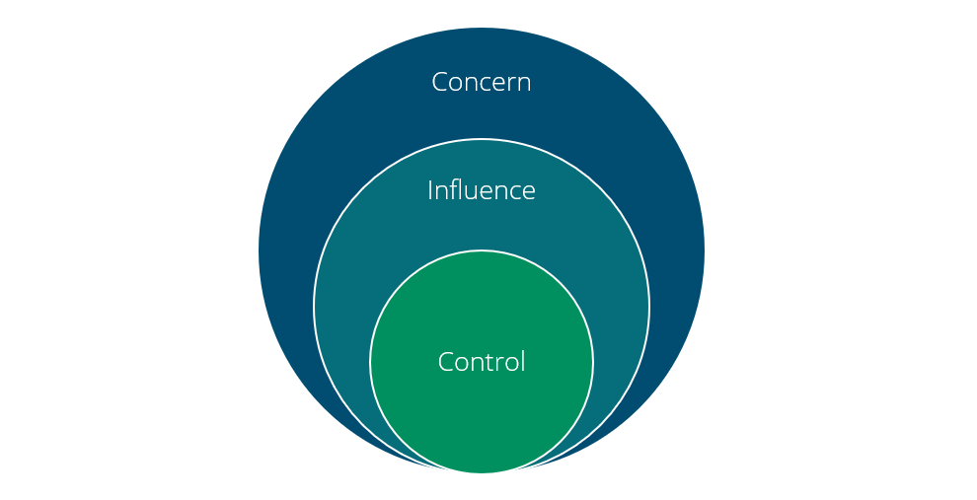
POSITIVE PSYCHOLOGY
Losada Model
Who’s Happier?
Luck of Irish
Circle of Influence
Post Traumatic Growth
20 Sec. Rule

Slide 17


KNOW YOURSELF & OTHERS
D.I.S.C.
Your Bird?
Your Values!
Welcome to the FLOCK!

Slide 18
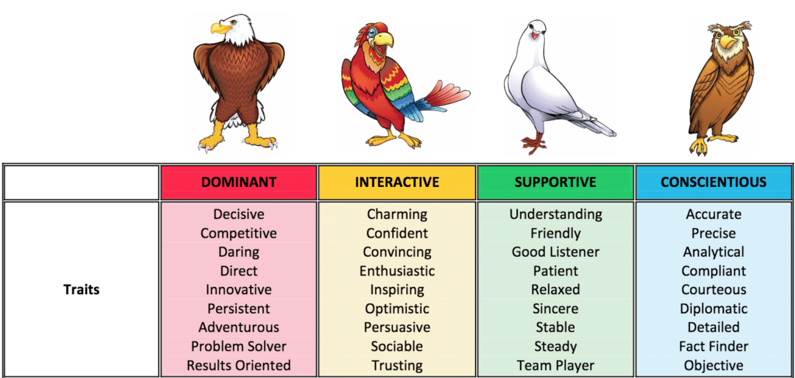
BIRD IS THE WORD!

Slide 19




BUILDING BETTER RELATIONSHIPS
Story in My Head
Radical Candor!
Rumbling!
C.A.R.I.N.G.
&
F.I.R.E.
Emotional Bank Acct

Slide 20

More Ways to Attract & Retain New Talent

Slide 21

“BONUSES WITH A TWIST”
Annual $1500 Tuition Reimbursement AND $500 learning stipend – to encourage employees to “sharpen their saw”
Annual $500 Fun Fund - encourage life experiences and self care
Monthly $25 cell phone reimbursement (pay them for what they do)
Holiday Roulette - $25 minimum, 4-8 hr. PTO, $500 Fun Fund
Staff Appreciation – Taco Trucks, iced coffee bars, families included
Birthday & Work Anniversary $$$
Company SWAG
Motivosity- Next Slide

Slide 22
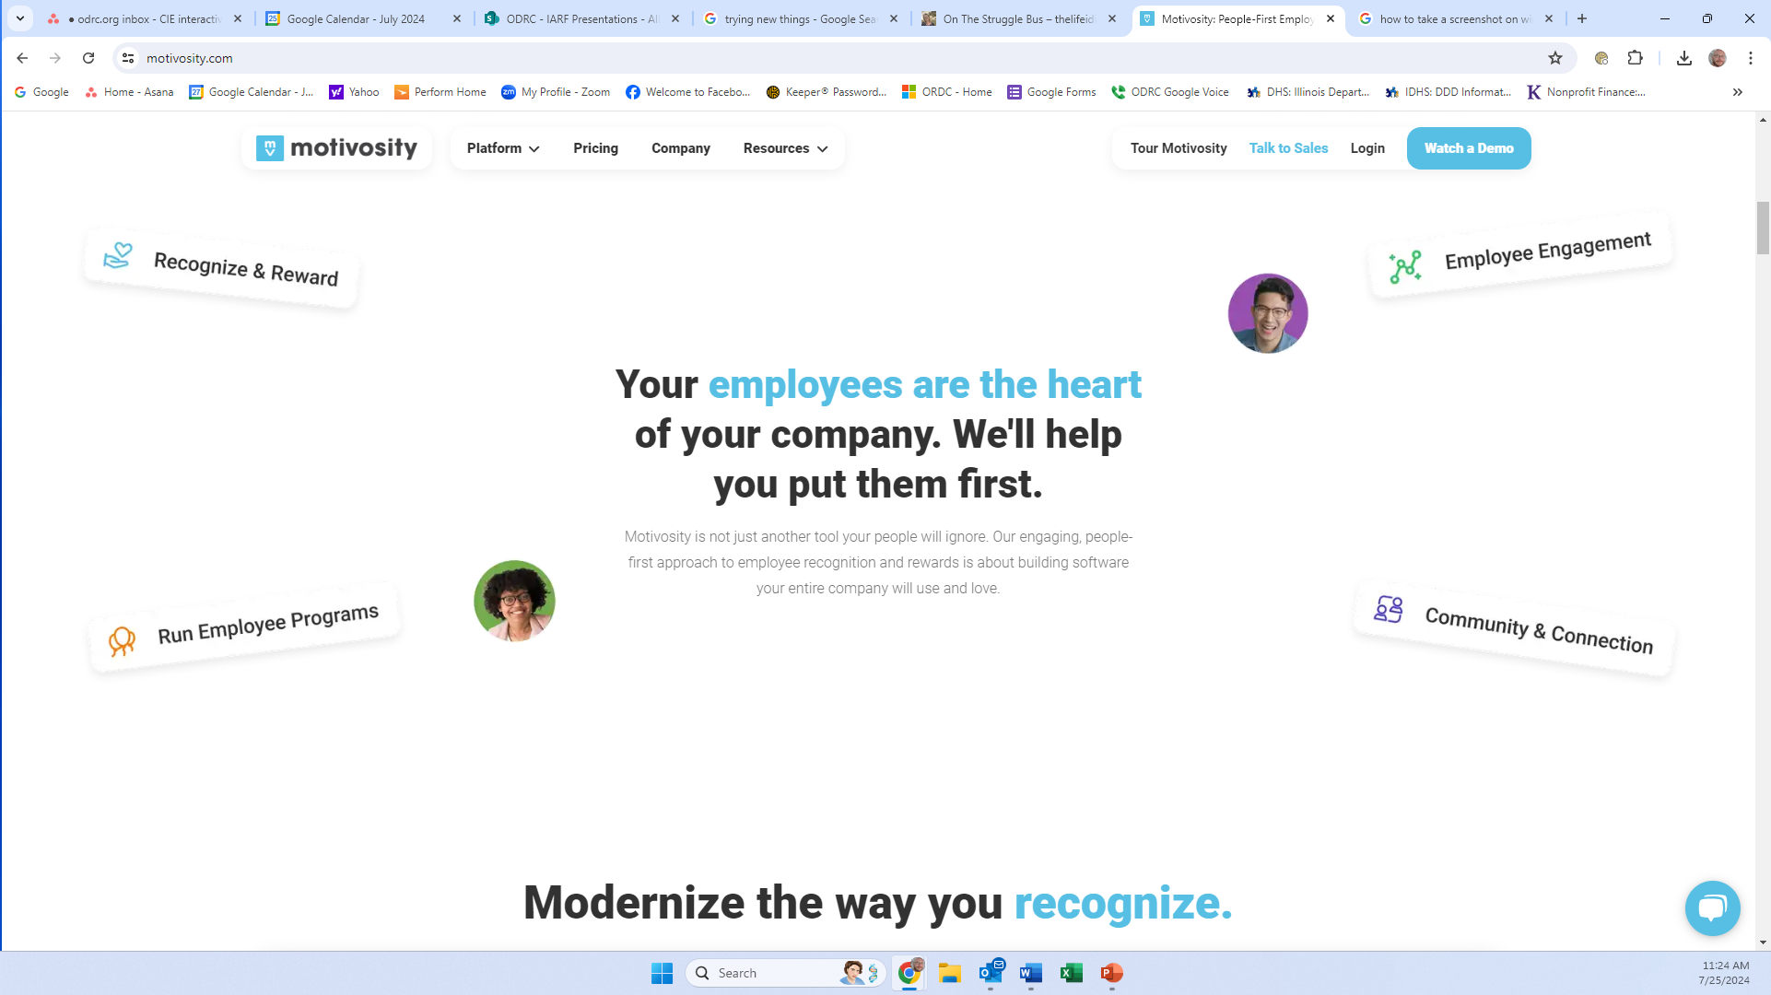

Slide 23
New Language & Vocabulary
(rinse & repeat…often)
“CRISIS is an opportunity”
“Live our VALUES”
  Constant evolution – “change is good”
  Strength based – “build on strengths”
“Destination employer”
“Pay for what they do”
“Proactive pause”
“Clear is kind”
“Rumble”
“Square squad”
“Cheap Seats”
“What’s your bird?”
“Emotional bank account”
“Sharpen your saw”
“Circle of influence”
C.A.R.I.N.G. (model for relationships)
F.I.R.E. (model for conflict)

Slide 24

Work Language = Work Culture

