Slide 1
PTELL and the Morass that is the Illinois Property Tax System
Association of Community Mental Health Authorities of Illinois
April 13, 2023 @ 1:00 pm

Slide 2
Who is TFI?
The Taxpayers’ Federation of Illinois supports sound tax policy and fiscal practices that encourage economic growth in Illinois. The Federation evaluates Illinois’ overall state and local tax structure and individual tax provisions using the following guideposts:
Adequacy
Stability/Predictability
Equity/Fairness
Collectability/Transparency/Simplicity
Efficiency

Slide 3
Agenda
Overview of the Property Tax System
PTELL
Questions?

Slide 4
Revenue Generated by Tax Type in 2022

Slide 5

Where Do Property Taxes Go?

Slide 6
Total Property Values

Slide 7
Total Property Taxes

Slide 8
Property Tax Rate Over Time

Slide 9
Effective Property Tax Rate Over Time

Slide 10
What is PTELL?
P
roperty
T
ax
E
xtension
L
imitation
L
aw

Slide 11
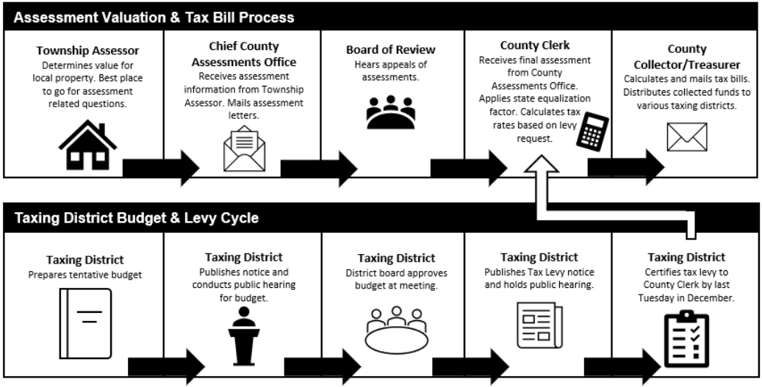
Property Tax Cycle

Slide 12
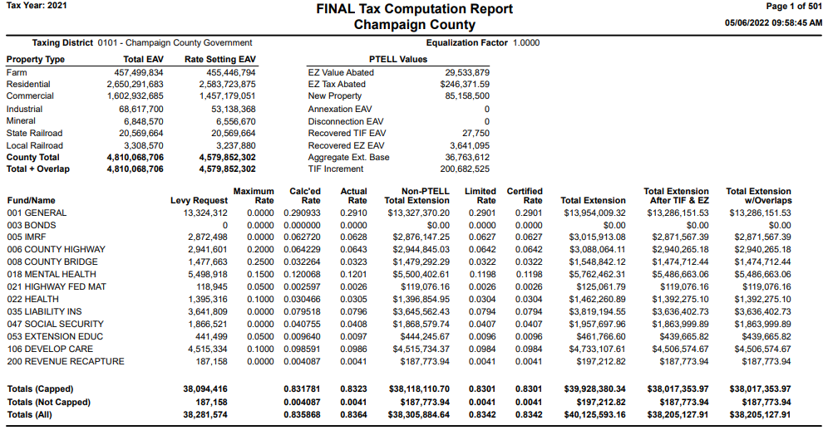
Champaign County Rate Calculation

Slide 13
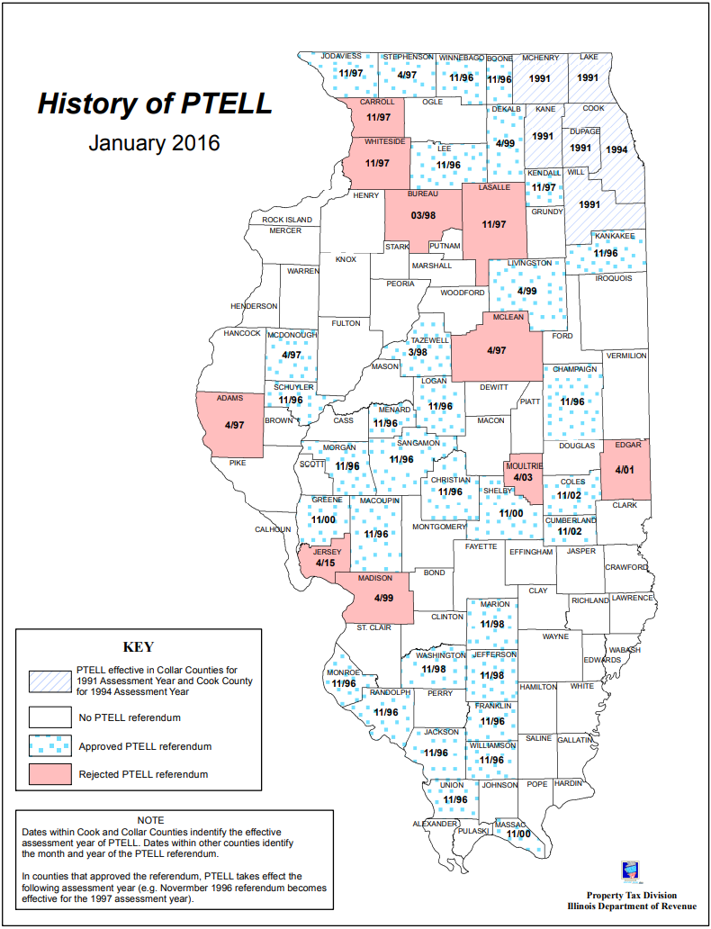
Where does PTELL Apply?

Slide 14
Property Tax Extension Limitation Law
A determination was made that increases in property value didn’t reflect increases in the cost of providing local services
CPI would be a better measure
Roughly speaking, taxing districts can increase their levy by 5% or CPI, whichever is less
Does not apply to home rule governments
Special rules for taxing districts that are in multiple counties

Slide 15
What PTELL Isn’t (Tax Caps)
Doesn’t limit the change in a property’s assessment
Doesn’t limit the change in an individual property tax bill

Slide 16
How Do the Old Levy Statutes Fit In?
35 ILCS 200/18-45: Prior to extension, the county clerk shall determine the maximum amount of tax authorized to be levied by any statute.
35 ILCS 200/18-195: Limitation: Tax extensions made under Sections 18-45 and 18-105 are further limited by the provisions of this Law. (PTELL)
This means all the “old” laws still apply, unless they are limited by PTELL.

Slide 17
PTELL Terminology
Aggregate Extension
Aggregate Extension Base
Extension Limitation
Limiting Rate
New Rate
New Property
Debt Service Extension Base

Slide 18
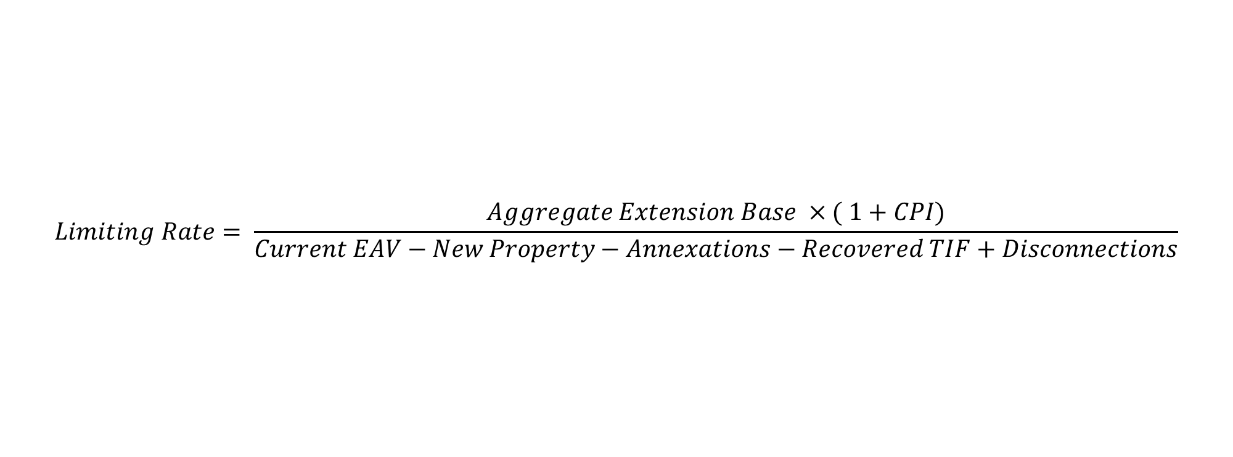
PTELL Math
$$Limiting Rate= \frac{Aggregate Extension Base ×( 1+CPI)}{Current EAV−New Property−Annexations−Recovered TIF+Disconnections}$$

Slide 19
PTELL Math
$$Limiting Rate= \frac{Aggregate Extension Base ×( 1+CPI)}{Current EAV−New Property−Annexations−Recovered TIF+Disconnections}$$
Amount levied last year which was subject to PTELL
Inflationary Increase
Value of property in the taxing district
Adjustments so denominator reflects property that was taxable last year

Slide 20
Champaign County Rate Calculation

Slide 21
Into the Weeds of PTELL
Maximum limiting rate is for the aggregate rate
  This means a district can increase the levy for one fund by 10% and reduce another levy, but the aggregate tax rate cannot exceed the limiting rate.
  Only PTELL referenda apply to taxing districts. This means if under “old” law a taxing district was rate limited to 0.10% and needed a referendum to increase the maximum rate to 0.15%, the taxing district DOES NOT need to put the question on the ballot. (Aggregate rate can’t exceed limiting rate. Limiting rate can be increased by PTELL referendum.)
  Same for backdoor referendum
  Calculated rate cannot exceed the absolute maximum rate set by statute (if there is one)

Slide 22
Into the Weeds of PTELL
Does not apply to all funds (usually…)
  Exempts bonds issued before taxing district was subject to PTELL
  Contributions to firefighter’s pension fund
  Expenses for joint recreational programs for persons with disabilities
  Refund recapture levy
Three instances where a taxing district can request separate limiting rate calculations
  Village for library funds
  County or township community health board
  County or township board for the care and treatment of persons with a developmental disability.

Slide 23
PTELL Referenda
Increase the extension limitation (% increase in taxes)
Increase the limiting rate (specify the new tax rate)
Levy for a new fund
  Funds that the taxing district never levied
  Funds that are subject to a backdoor referendum, but the district hasn’t levied for in the previous three years
Increase the debt service extension base (bond payments)
These are the only referenda for taxing districts covered by PTELL to increase property taxes.
Levy ordinances authorize a set amount of money to be levied. None of the referenda options ask voters for a specific dollar amount.

Slide 24
Champaign County Rate Calculation

Slide 25
Into the Weeds of PTELL
Exceptions to 5% or CPI increase in levy
  “New property”
  Annexations
  Recovered TIF property
  Referendum passed

Slide 26
Does PTELL Work?
Percentage of Taxing Districts whose Levies were Reduced due to PTELL
School Districts | 91%
Municipalities | 67%
Townships/Road Districts | 68%
Counties | 68%
Special Districts | 73%

Slide 27
Annual Property Tax Increases

Slide 28
Aggregate Extension Limit
Limited to schools, park districts, library districts, and community colleges.
Limiting rate should increase each year regardless of what the taxing district actually levies.
5% limit per year

Slide 29
Best PTELL References
Illinois Department of Revenue’s
PTAX-1080, Property Tax Extension Limitation Law Technical Manual (illinois.gov)
PTAX-60, Illinois Property Tax Rate and Levy Manual

Slide 30

Questions?

Slide 31
Maurice Scholten, Legislative Director
Taxpayers’ Federation of Illinois
maurice@illinoistax.org
Mobile: 773-332-7741

