Slide 1


City of Boca Raton
FY 2025 – 26 Tentative Budget Hearing
September 8, 2025
Presented by
The Office of Management & Budget

Slide 2



Vision, Mission & Our Values
Vision
“Boca Raton: A world-class community where modern amenities and innovation embrace safe, beautiful, charming neighborhoods and a vibrant economy, enriched by exceptional recreational and cultural offerings.”
Mission
“To responsibly provide outstanding services to enhance our unique quality of life.”
Our Values
Fairness We treat everyone with equality and compassion.
Integrity We demonstrate honesty and the highest level of ethical behavior.
Respect We value diversity and differing viewpoints.
Service We are committed to excellence.
Trust Others believe in us as a result of our actions.

Slide 3

Strategic Focus Areas & Priorities
Community Safety
  Maintain the highest levels of citywide safety. (CS.1)
Financially Sound
  Strengthen the city's long- term financial position to ensure ongoing high- quality provision of city services. (FS.1)
Vibrant Economy
  Improve resources and incentives for small businesses to start and thrive in the city. (VE.1)
Quality of Life
  Ensure arts and entertainment, cultural, parks and venues and services meet the needs of present and future residents. (QL.1)
  Promote the character and livability of all neighborhoods and public spaces. (QL.2)
  Celebrate the city's rich history and cultural heritage. (QL.3)

Slide 4
Strategic Focus Areas & Priorities (Cont.)
World Class Services
  Employ data-driven decision-making for holistic strategic policy development and to judiciously embrace risks and capitalize on opportunities. (WS.1)
  Increase the efficiency and effectiveness of services through continued evaluation and process improvement. (WS.2)
  Provide high-quality, safe and secure, well planned and maintained infrastructure. (WS.3)
Transportation and Mobility
  Create location-responsive and appropriate TOC (transit-oriented community) overlays. (TM.1)
  Develop transportation and mobility options for traffic improvements, mitigation efforts, and expansion of multi-modal and alternative transit solutions. (TM.2)
Growth Management
  Promote development that allows residents and businesses to thrive while meeting future challenges and leveraging opportunities. (GM.1)
  Preserve community livability through responsible development standards, proactive code compliance, and targeted revitalization. (GM.2)

Slide 5
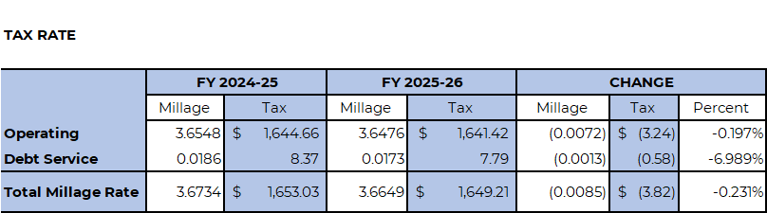
Millage & Property Tax Comparison
FY 2024-25 and FY 2025-26
The proposed FY 2025-26 total millage rate is 3.6649 mills per $1,000, which is slightly lower than the FY 2024-25 rate. A home with a taxable value of $450,000 in the City of Boca Raton will pay $1,649.21 in ad valorem taxes.

Slide 6
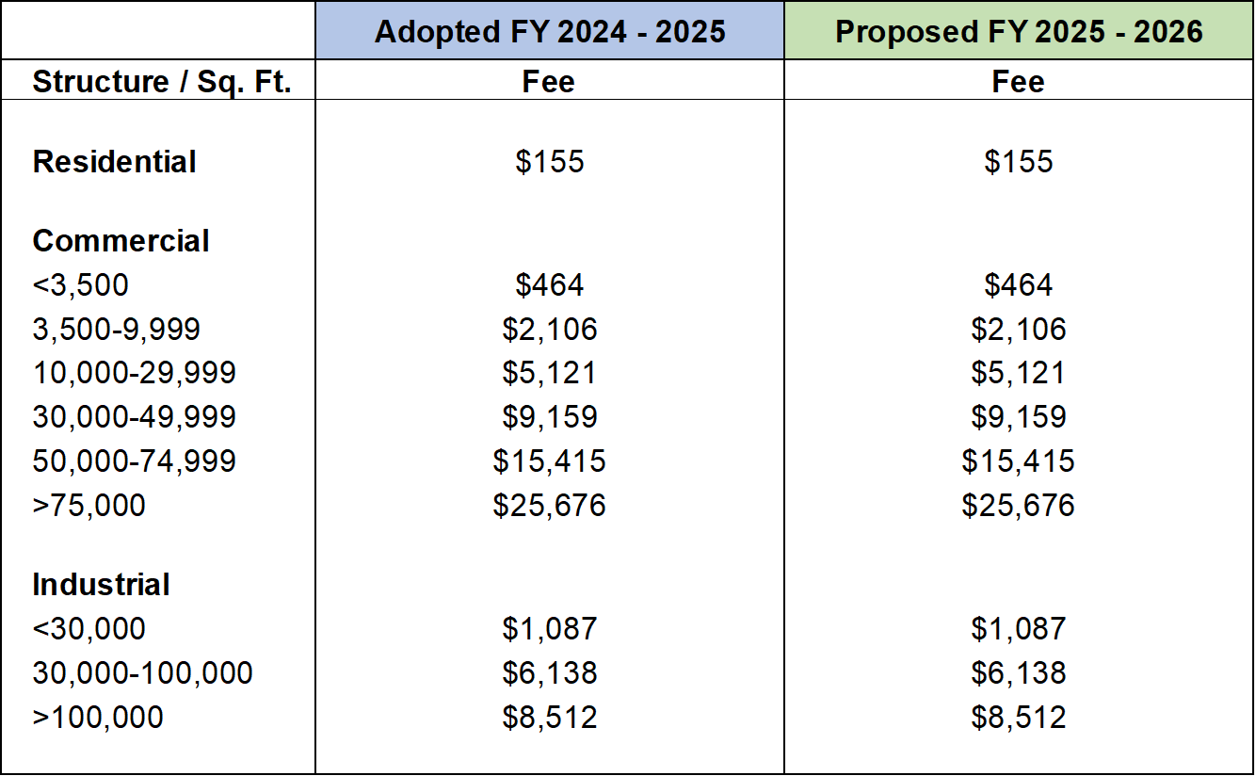

Fire Assessment Comparison
FY 2024-25 and FY 2025-26
The proposed FY 2025-26 fire assessment fee for residential properties is $155, which is unchanged from the FY 2024-25 fee. Commercial and industrial fees are also unchanged from FY 2024-25.

Slide 7
Assessed Valuations

Slide 8
New Construction*

Slide 9
Tax Rate and Assessed Valuation

Slide 10
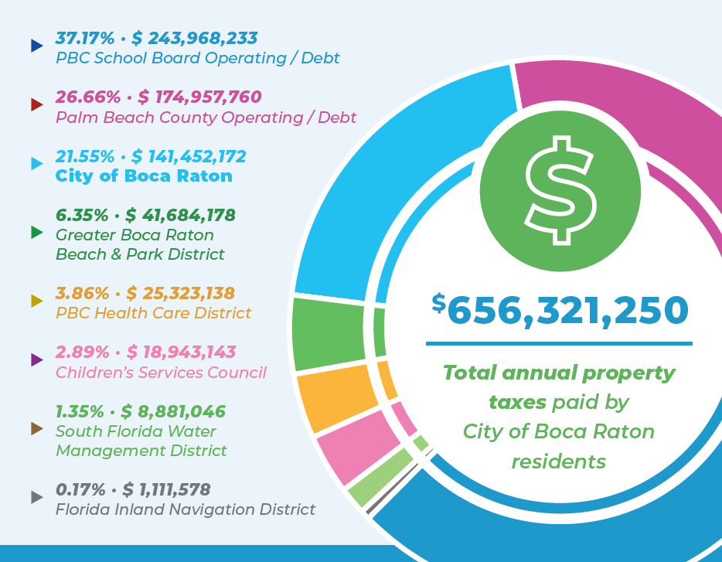
Your Property Tax Bill by Taxing Authority

Slide 11
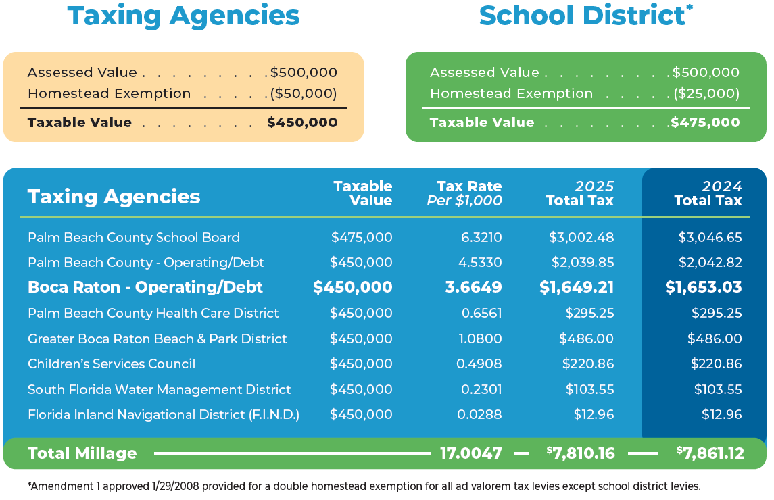
Tax Bill Comparison

Slide 12
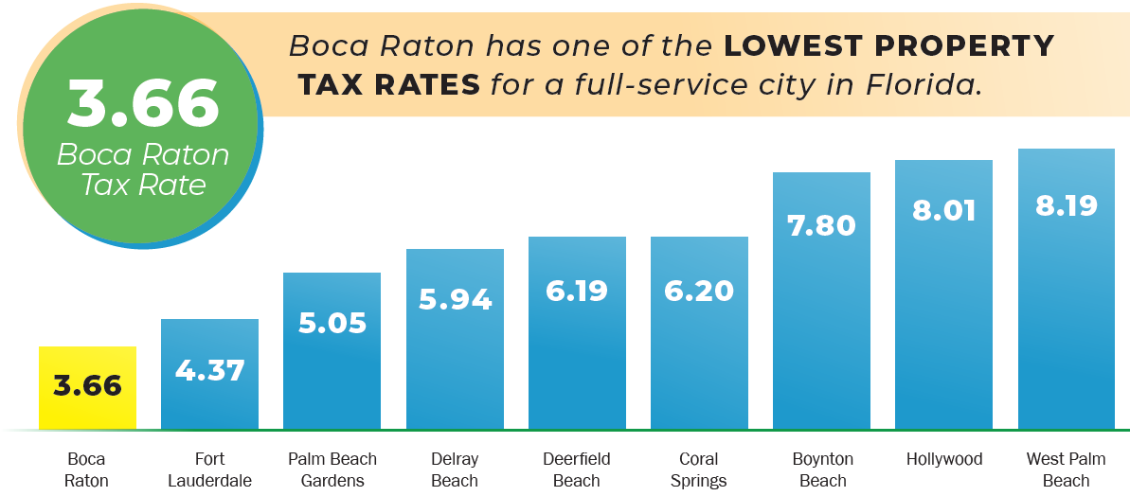
Tax Rate Comparison

Slide 13
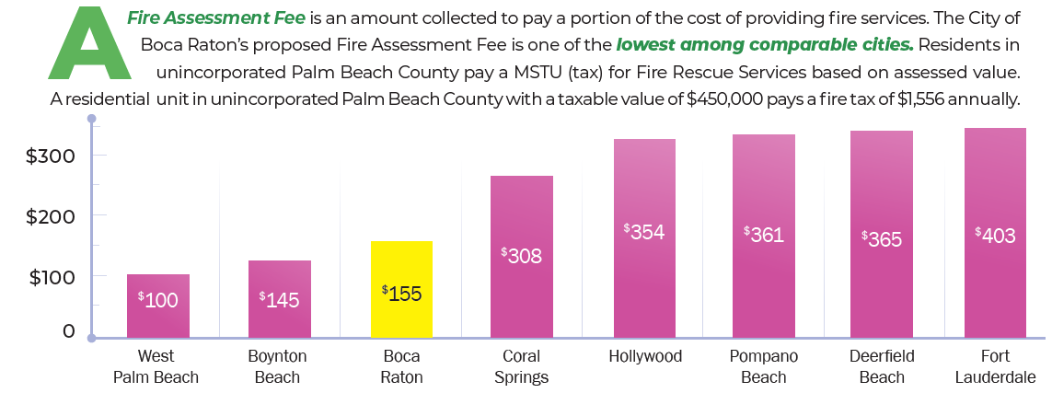
Fire Assessment Fee

Slide 14
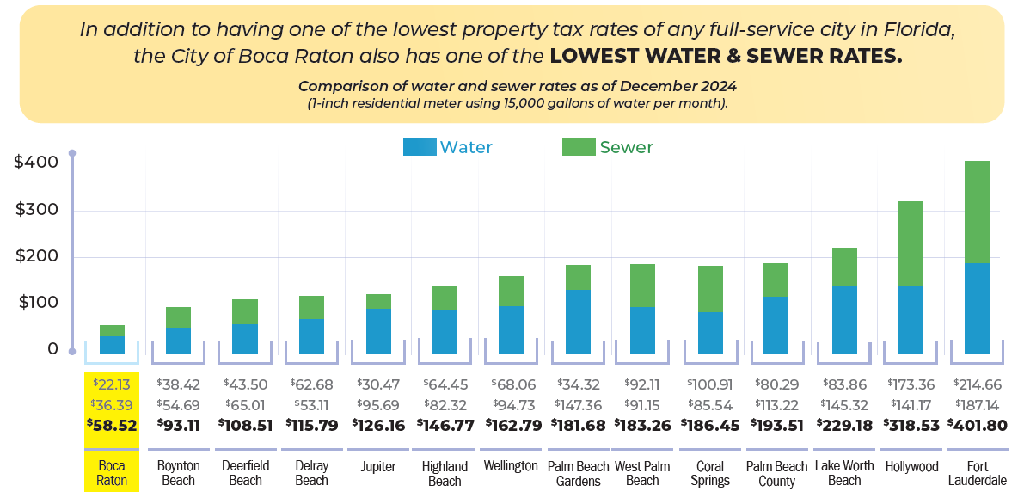
Water & Sewer Rates

Slide 15
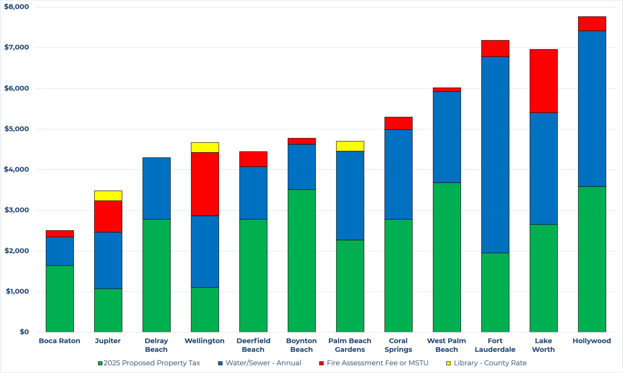
Total Taxes and Fees Comparison

Slide 16
General Fund Revenue Sources Comparison
APPROVED BUDGET FY 2024-25
PROPOSED BUDGET FY 2025-26
 |  | $ 120,279,700
 | Ad Valorem Taxes
 | Franchise Fees & Utility Taxes | 16,980,000
 | Licenses & Permits | 24,715,300
 | Intergovernmental Revenue | 25,540,100
 | Charges for Services | 36,544,000
 | Fines, Misc. & Transfers | 2,414,100
 | Interest Earnings | 6,888,000
 | Fund Balance | 14,646,200
 |  | $ 247,425,400
 |  | $ 135,586,900
 | Ad Valorem Taxes
 | Franchise Fees & Utility Taxes | 17,149,800
 | Licenses & Permits | 25,232,900
 | Intergovernmental Revenue | 23,275,600
 | Charges for Services | 41,888,800
 | Fines, Misc. & Transfers | 6,935,300
 | Interest Earnings | 4,782,000
 | Fund Balance | 0
 |  | $ 254,851,300

Slide 17
General Fund Expenditures by Department Comparison
APPROVED BUDGET FY 2024-25
PROPOSED BUDGET FY 2025-26
City Council | $ 470,100
City Manager | 9,004,200
City Attorney | 2,120,500
Financial Services | 6,647,700
Development Services | 6,457,000
Police Services | 74,434,200
Fire/Rescue Services | 71,926,000
Public Works & Engineering | 18,933,300
Recreation Services, City Parks | 18,817,200
Recreation Services, Park Operations | 13,438,000
Recreation Services, Golf | 4,780,400
Non-Divisional | 20,396,800
 | $ 247,425,400
City Council | $ 498,100
City Manager | 8,898,800
City Attorney | 1,882,500
Financial Services | 6,425,100
Development Services | 5,749,400
Police Services | 81,339,800
Fire/Rescue Services | 76,396,800
Public Works & Engineering | 20,973,500
Recreation Services, City Parks | 17,637,000
Recreation Services, Park Operations | 11,991,600
Recreation Services, Golf | 4,721,600
Non-Divisional | 18,337,100
 | $ 254,851,300

Slide 18
General Fund - Summary of Changes from FY 2025 to FY 2026
Summary of Changes | Total | % of FY25 Budget
FY 2025 Approved Budget | 247,425,400 | 100.00%
CIP Shift | 8,276,700 | 3.35%
COLA & Step Increases | 4,655,555 | 1.88%
Pension Increases | 3,780,600 | 1.53%
Net New Positions | 239,802 | 0.10%
Net Budget Reductions | (9,526,757) | -3.85%
FY 2026 Proposed Budget | $ 254,851,300 | 103.01%

Slide 19
Statement of Fund Balance: General Fund
 | FUND BALANCE October 1, 2025 |  |  |  |  |  |  |  | $ 85,625,300
 |  | 2025-26 Revenue |  |  |  |  | $ 254,851,300
 |  | 2025-26 Expenditures |  |  |  |  | (254,851,300)
 | Net Increase (Decrease) |  |  |  |  |  | -
 | Fund Balance:
 |  | Restricted for:
 |  |  | Army Corps of Engineers Reserve |  | 170,000
 |  | Committed to:
 |  |  | Hurricane/Disaster Emergency Reserve |  | 25,485,200
 |  | Unassigned:
 |  |  | 10% Fund Balance Reserve |  | 25,485,200
 |  |  | Available Fund Balance |  | 34,484,900
 | FUND BALANCE September 30, 2026 |  |  |  |  |  |  |  | $ 85,625,300
 |  |  |  |  |  |  | -0-

Slide 20

What’s New for FY 2025-26: General Fund
 | Salaries, Benefits & Capital Costs
Programs (including associated personnel)
Traffic Infraction Enforcement Program Special Events Permits Program | 82,200 93,500
Total General Fund | 175,700
Positions – 3 New Full-time Positions
Customer Services Rep II ($40,200, 50% funded by CRA) | 40,200
Planner II ($32,400, 35% funded by CDBG / $32,400, 35% funded by SHIP) | 27,800
Recreation Superintendent | 128,900
Total General Fund | 372,600

Slide 21
What’s New for FY 2025-26: Other Funds
 | Salaries, Benefits & Capital Costs
Sanitation Fund – 1 New Full-time Position
Assistant Sanitation Superintendent | 96,700
Total Sanitation Fund | 96,700
Beach & Park District Fund – 1 New Program
Community Accessibility Program | 144,800
Total Beach & Park District Fund | 144,800
Water & Sewer Operating Fund – 5 New Full-time Positions
Plant Mechanic | 61,000
Network Crew Chief | 61,000
Wellfield Supervisor | 88,400
Plant Electrician | 74,700
Utility Scada Technician | 83,200
Total Water & Sewer Operating Fund | 368,300

Slide 22
What’s New for FY 2025-26: Other Funds
 | Salaries, Benefits & Capital Costs
Information Technology Fund – 1 New Full-time Position
Development Manager | 131,100
Total Information Technology Fund | 131,100
Workers' Compensation Fund – 1 New Full-time Position
Administrative Assistant (Part-time converting to Full-time) | 44,300
Total Workers' Compensation Fund | 44,300
Community Redevelopment Agency Fund – 2 New Full-time Positions
Police Officer/CRA | 248,300
Cultural Arts Administrator | 129,700
Total Community Redevelopment Agency Fund | 378,000

Slide 23
What’s New for FY 2025-26: Other Funds
 | Salaries, Benefits & Capital Costs
Building Permit Services Fund – 1 New Full-time Position
Permit & Licensing Tech (converting 3 PT to 1 FT, $35,000, 50% funded by GF) | 35,000
Total Building Permit Services Fund | 35,000

Slide 24
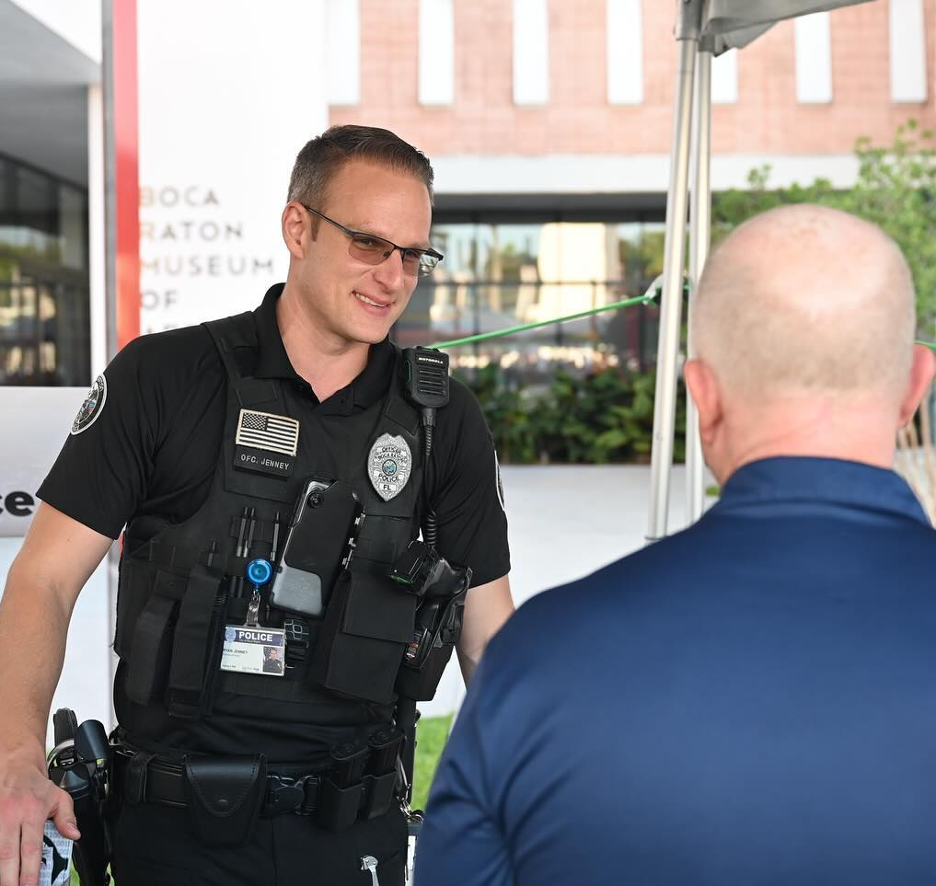
Alignment with Strategic Priorities
Strategic Focus Area: Community Safety
These investments specifically support Strategic Priority CS.1: to “maintain the highest levels of citywide safety”.
Positions:
Police Officer/CRA
Projects:
Police Department Headquarters
Fire Rescue Upgrades
Police Services Upgrades
Innovative Technology and Artificial Intelligence
(Also aligns with “World Class Services”)
Security Enhancements/Expansion
(Also aligns with “World Class Services”)
Air Compressor System for SCBA

Slide 25
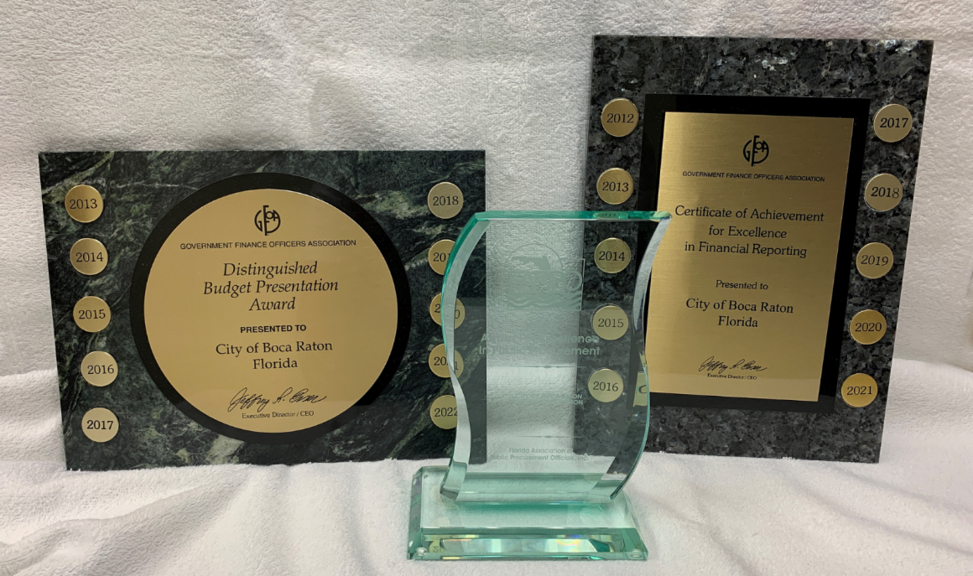
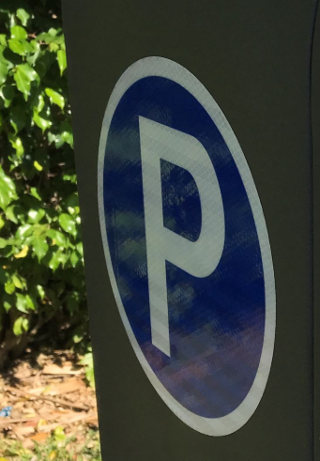
Alignment with Strategic Priorities (Cont.)
Strategic Focus Area: Financially Sound
These investments specifically support Strategic Priority FS.1: to “strengthen the city's long- term financial position to ensure ongoing high- quality provision of city services”.
Positions:
Customer Services Rep II
Administrative Assistant
Projects:
Critical Infrastructure Improvement
(Also aligns with “World Class Services”)
Raw Water Well Equipment/Expansion
(Also aligns with “World Class Services”)
Meter Reading Technology Improvement
(Also aligns with “World Class Services”)
Water Network System Improvement
(Also aligns with “World Class Services”)
Transit Oriented Community (TOC) Redevelopment Downtown
(Also aligns with “World Class Services, Quality of Life,
Growth Management & Transportation and Mobility”)

Slide 26
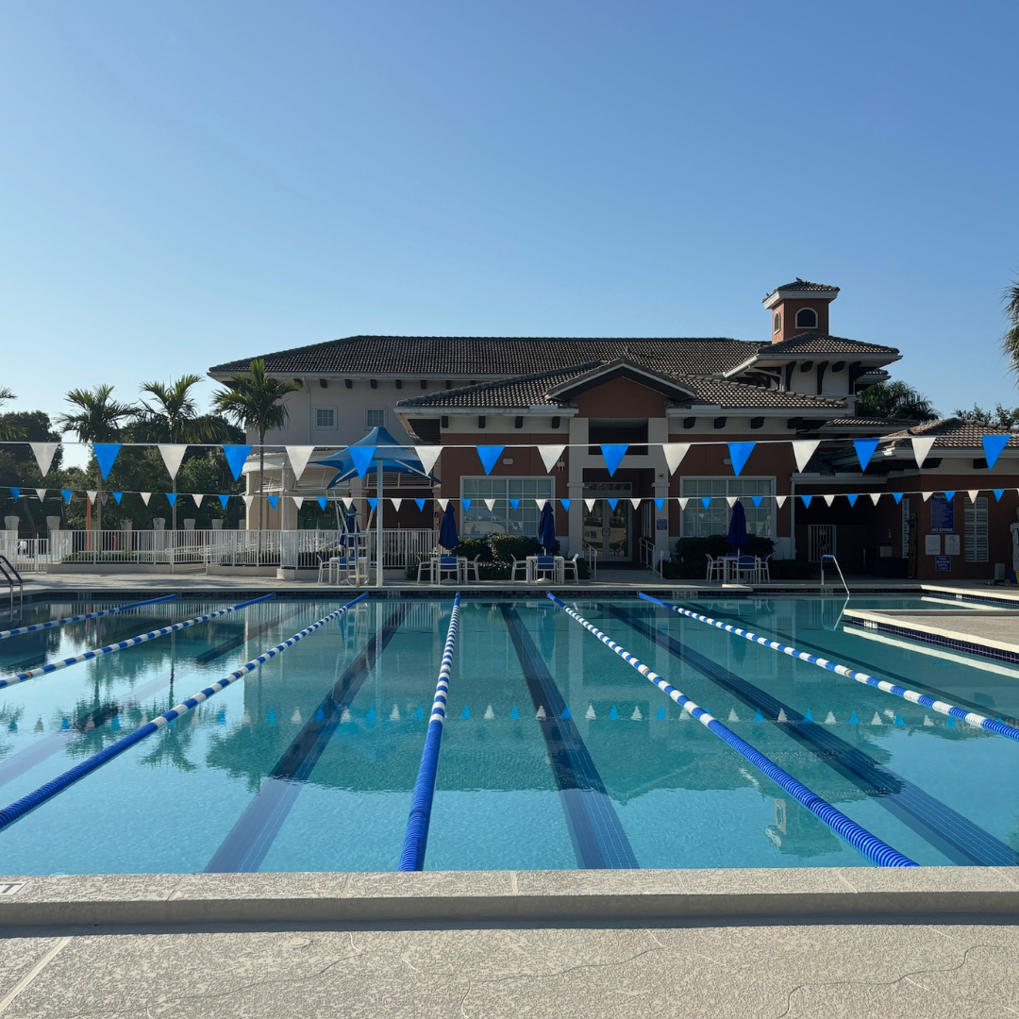
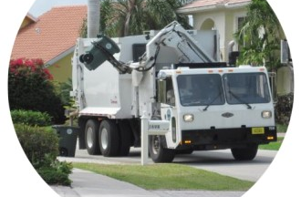
Alignment with Strategic Priorities (Cont.)
Strategic Focus Area: Quality of Life
These investments specifically support Strategic Priorities QL.1 and QL.2: to “ensure arts and entertainment, cultural, parks and recreational venues and services meet the needs of present and future residents” and to “promote the character and livability of all neighborhoods and public spaces”.
Positions:
Aquatics Maintenance Technician
(Also aligns with “World Class Services”)
Assistant Sanitation Superintendent
(Also aligns with “World Class Services”)
Projects:
Mizner Park Improvements
Boardwalk Renovations
Gumbo Limbo Nature Center
Transit Oriented Community (TOC) Redevelopment Downtown
(Also aligns with “Financially Sound, World Class Services,
Growth Management & Transportation and Mobility”)

Slide 27
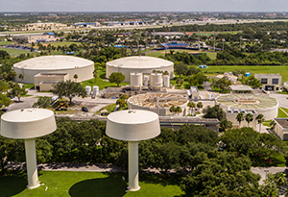
Alignment with Strategic Priorities (Cont.)
Strategic Focus Area: World Class Services
These investments specifically support Strategic Priorities WS.2 and WS.3: to “increase the efficiency and effectiveness of services through continued evaluation and process improvement” and to “provide high-quality, safe and secure, well planned and maintained infrastructure”.
Positions:
Planner II (Also aligns with “Growth Management”)
Permit & Licensing Tech (Also aligns with “Growth Management”)
Plant Mechanic
Network Crew Chief
Wellfield Supervisor
Plant Electrician
Utility Scada Technician
IT Development Manager
Aquatics Maintenance Technician (Also aligns with “Quality of Life”)
Assistant Sanitation Superintendent (Also aligns with “Quality of Life”)
Transit Oriented Community (TOC) Redevelopment Downtown
(Also aligns with “Financially Sound, Quality of Life, Growth Management &
Transportation and Mobility”)

Slide 28
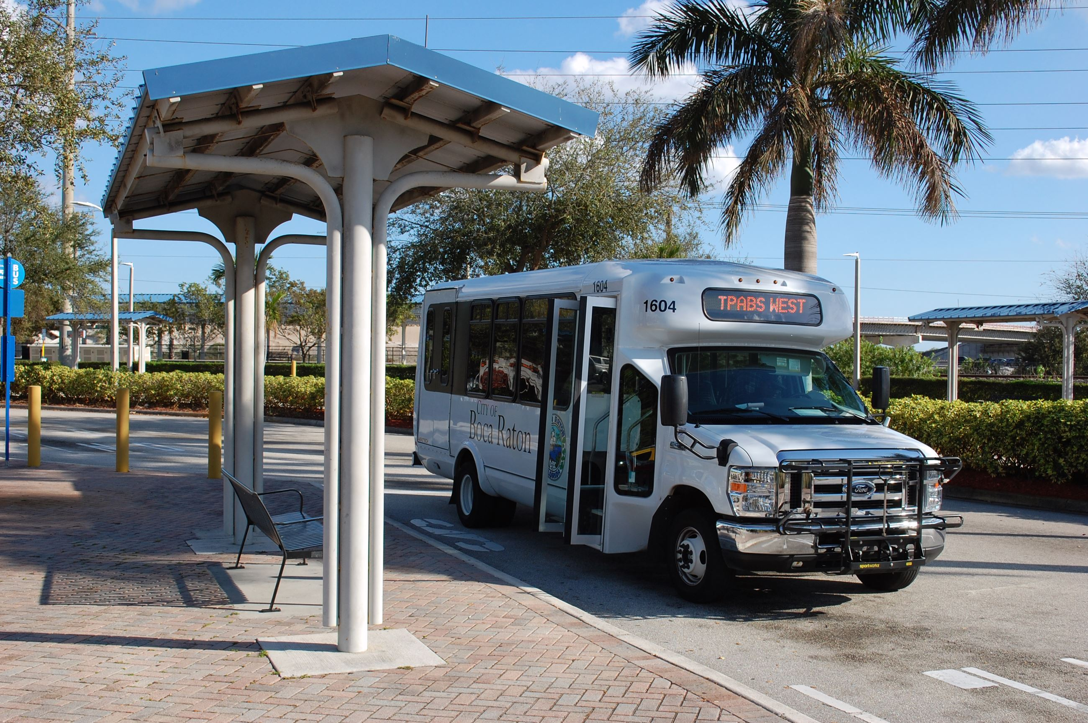
Alignment with Strategic Priorities (Cont.)
Strategic Focus Area: World Class Services
These investments specifically support Strategic Priorities WS.1, WS.2 and WS.3: to employ data-driven decision-making for holistic strategic policy development, to judiciously embrace risks and capitalize on opportunities, to “increase the efficiency and effectiveness of services through continued evaluation and process improvement” and to “provide high-quality, safe and secure, well planned and maintained infrastructure”.
Projects:
City Services Building
Water/Sewer Buildings and Facility Upgrades
Municipal Fleet Garage and Associated Site Work
Railroad Crossings
Sewer System Repairs
PFOS Removal Upgrades
Innovative Technology and Artificial Intelligence
(Also aligns with “Community Safety”)
Security Enhancements/Expansion (Also aligns with “Community Safety”)

Slide 29
Alignment with Strategic Priorities (Cont.)
Strategic Focus Area: World Class Services
These investments specifically support Strategic Priorities WS.1, WS.2 and WS.3: to employ data-driven decision-making for holistic strategic policy development, to judiciously embrace risks and capitalize on opportunities, to “increase the efficiency and effectiveness of services through continued evaluation and process improvement” and to “provide high-quality, safe and secure, well planned and maintained infrastructure”.
Projects (con’t):
Critical Infrastructure Improvement (Also aligns with “Financially Sound”)
Raw Water Well Equipment/Expansion (Also aligns with “Financially Sound”)
Meter Reading Technology Improvement (Also aligns with “Financially Sound”)
Water Network System Improvement (Also aligns with “Financially Sound”)
Wastewater Upgrades, Replacement and Expansion
(Also aligns with “Growth Management”)
Pump Station Modifications (Also aligns with “Growth Management”)

Slide 30
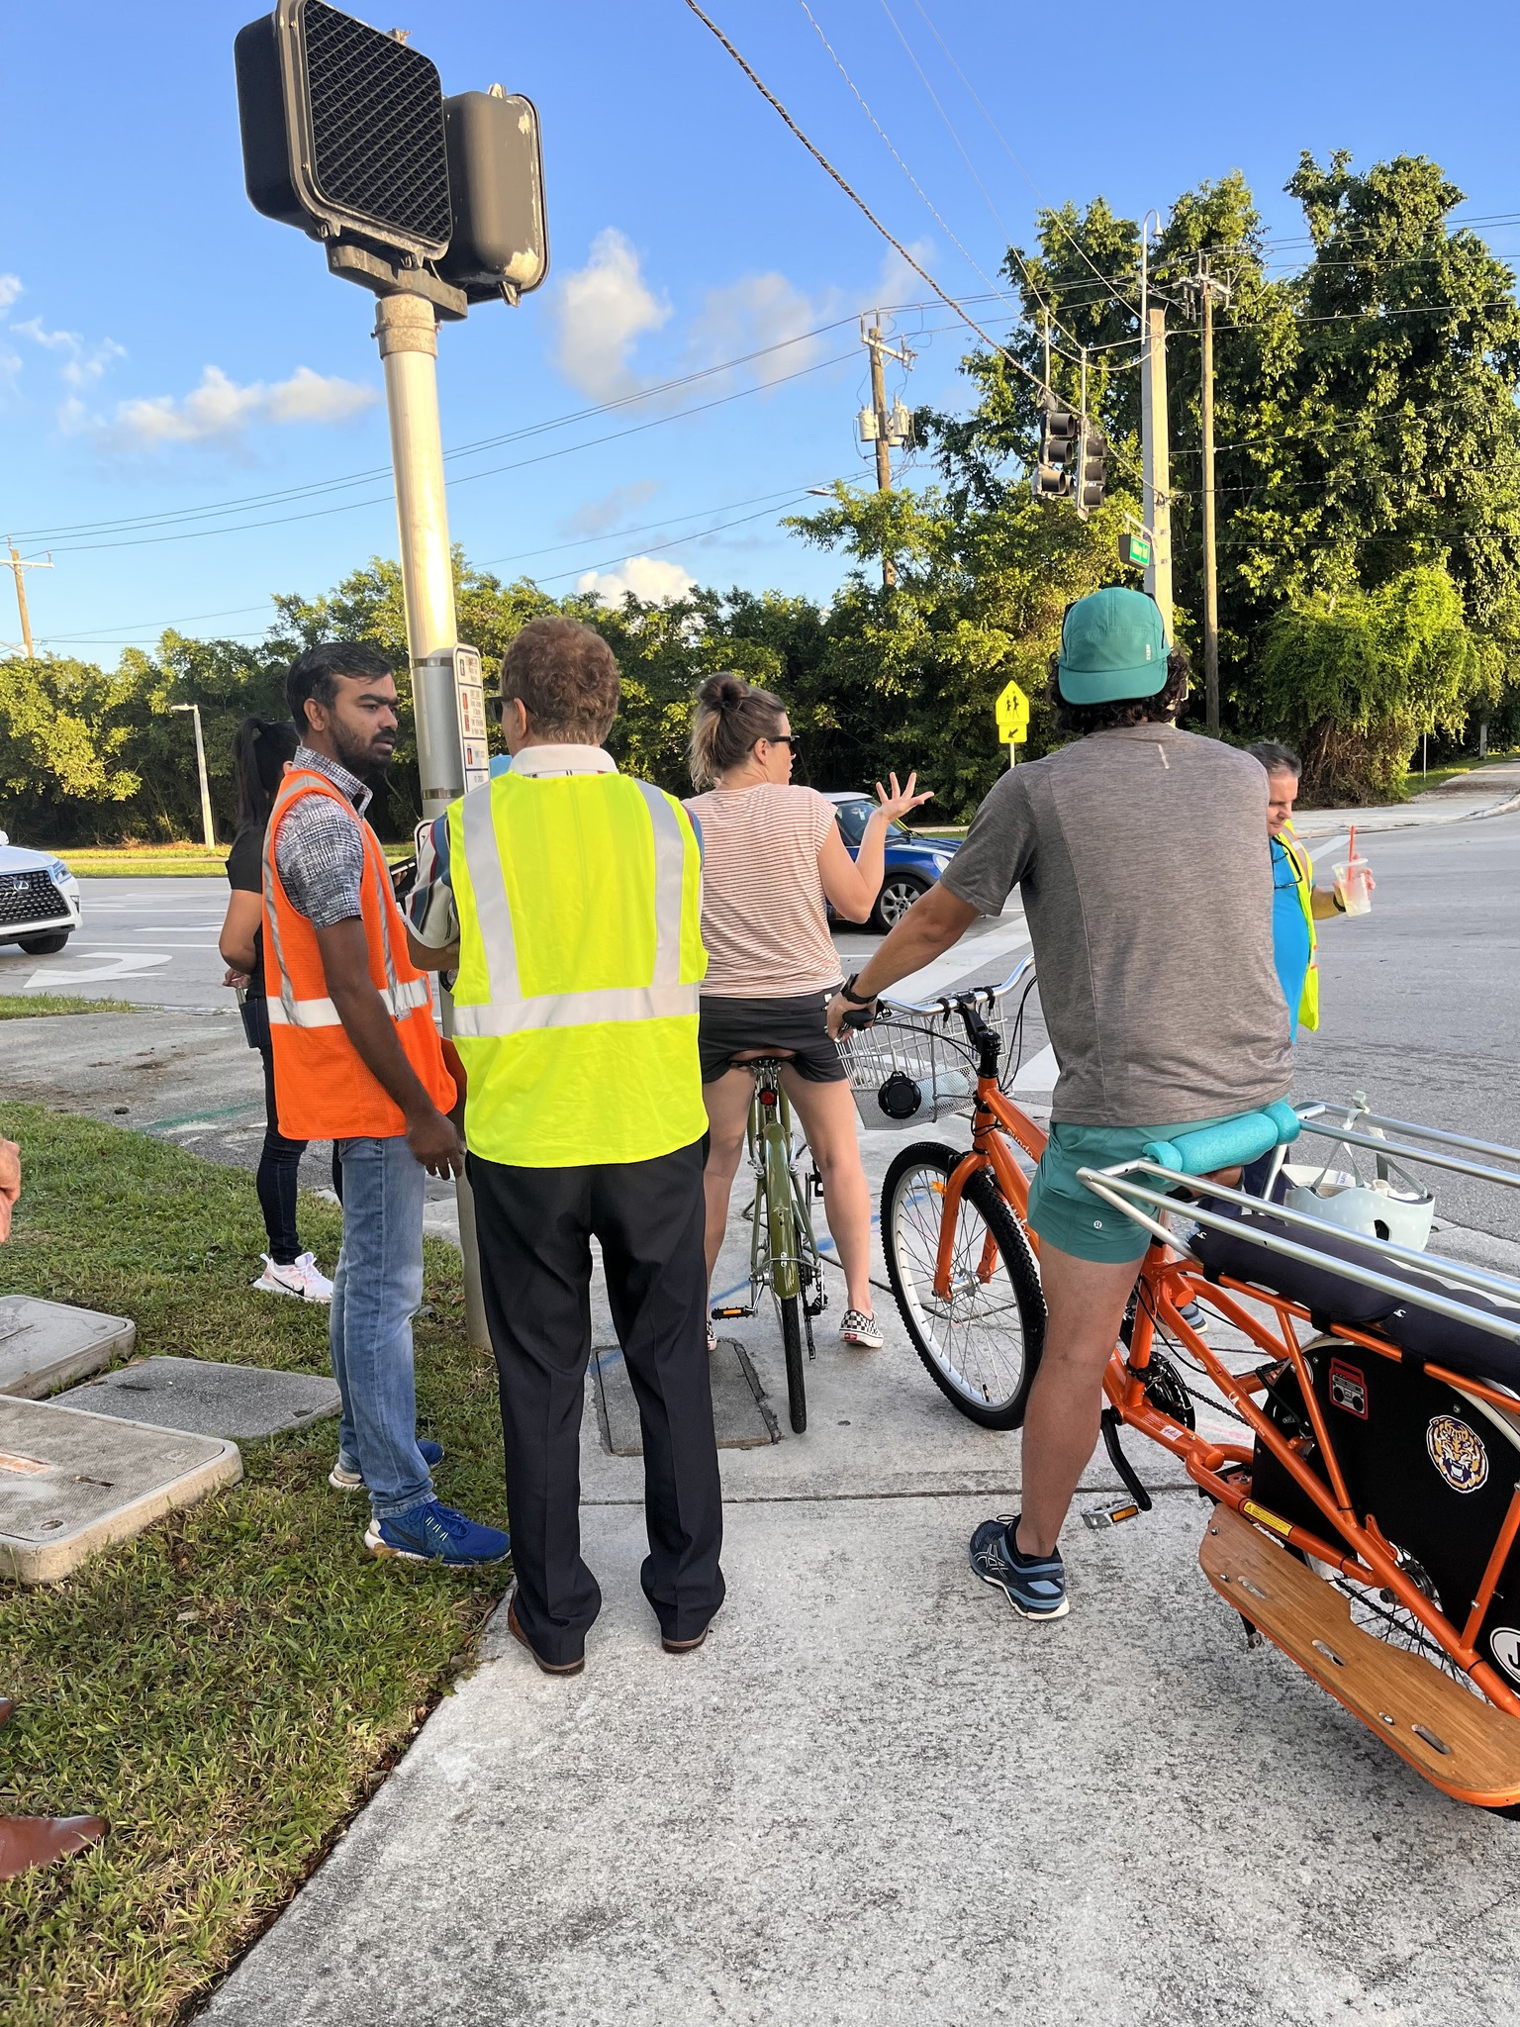
Alignment with Strategic Priorities (Cont.)
Strategic Focus Area: Transportation & Mobility
These investments specifically support the Strategic Priorities: to “create location-responsive and appropriate TOC (transit-oriented community) overlays” and to “develop transportation and mobility options for traffic improvements, mitigation efforts, and expansion of multi-modal and alternative transit solutions”.
Programs:
Traffic Infraction Enforcement Program
Projects:
Transit Oriented Community (TOC) Redevelopment Downtown
(Also aligns with “Financially Sound, Quality of Life,
World Class Services & Growth Management”)
Vision Zero Demonstration Projects
El Rio Trail Enhancements
Downtown Palmetto Park Road Connectivity and Mobility
CRA East/West Pedestrian Connectivity Consultant and Implementation
Traffic Signal Mast Arm Upgrades
CRA Parking Analysis and Planning
Mobility and Connectivity Improvements

Slide 31
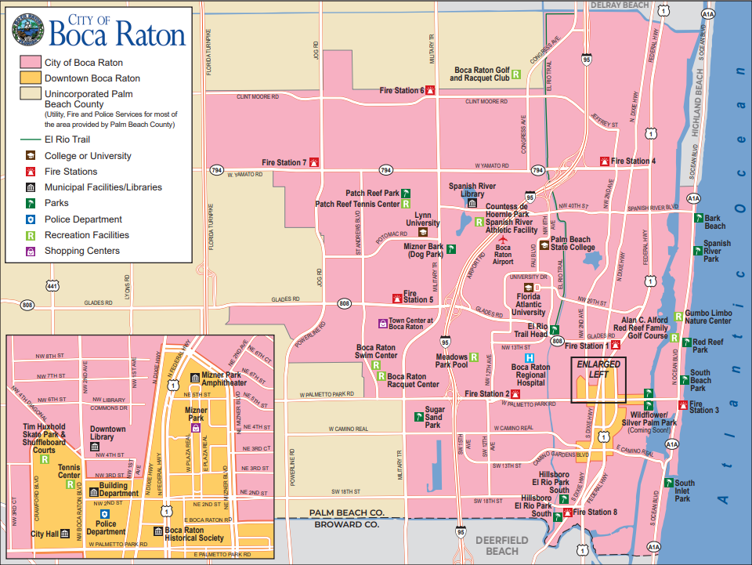
Alignment with Strategic Priorities (Cont.)
Strategic Focus Area: Growth Management
These investments specifically support the Strategic Priorities: to “promote development that allows residents and businesses to thrive while meeting future challenges and leveraging opportunities” and to “preserve community livability through responsible development standards, proactive code compliance, and targeted revitalization.”
Positions:
Planner II (Also aligns with “World Class Services”)
Permit & Licensing Tech (Also aligns with “World Class Services”)
Projects:
Wastewater Upgrades, Replacement and Expansion
(Also aligns with “World Class Services”)
Pump Station Modifications (Also aligns with “World Class Services”)
Transit Oriented Community (TOC) Redevelopment Downtown
(Also aligns with “Financially Sound, Quality of Life,
World Class Services & Transportation & Mobility”)

Slide 32
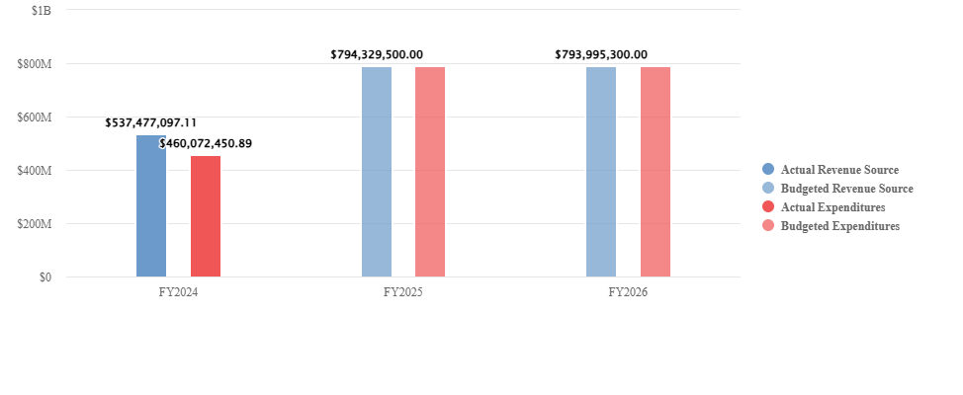
City-Wide FY 2025-26 Budget Summary
City of Boca Raton is projecting $794M of revenue in FY2026, which represents a 0.04% decrease over the prior year. Budgeted expenditures are projected to decrease by 0.04% or $334.2K to $794M in FY2026.

Slide 33
City-Wide Revenue Sources FY 2025-26
 | FY2024 Actual | FY2025 Approved | FY2026 Proposed | FY2025 Approved vs. FY2026 Proposed ($ Change)
AD VALOREM TAXES | $144,239,732 | $155,073,600 | $168,353,100 | $13,279,500
OTHER TAXES | $23,919,122 | $16,798,100 | $16,672,800 | -$125,300
UTILITY SERVICE TAXES | $20,063,812 | $20,474,800 | $20,973,800 | $499,000
LOCAL BUSINESS TAXES | $1,598,964 | $1,853,000 | $1,804,000 | -$49,000
PERMITS | $18,260,393 | $15,014,000 | $17,020,500 | $2,006,500
FRANCHISE FEES | $16,544,671 | $16,980,000 | $17,149,800 | $169,800
CONNECTION FEES | $1,399,572 | $707,400 | $888,500 | $181,100
OTHER LICENSE AND PERMIT FEES | $688,924 | $678,000 | $592,000 | -$86,000
GENERAL GOVERNMENT | $1,385,891 | $1,073,100 | $1,263,000 | $189,900
PHYSICAL ENVIRONMENT | $177,415 | $200,000 | $200,000 | $0
PUBLIC SAFETY | $17,137,449 | $16,968,000 | $17,663,000 | $695,000
GRANTS | $3,088,035 | $8,658,900 | $7,697,800 | -$961,100
STATES SHARED REVENUES | $15,170,038 | $16,372,600 | $16,732,600 | $360,000
SHARED REVENUE/LOCAL UNIT | $36,919,276 | $36,270,900 | $31,866,700 | -$4,404,200
CHARGES FOR SERVICES | $83,804,803 | $82,062,200 | $88,013,300 | $5,951,100
TRANSPORTATION | $2,781,549 | $2,208,000 | $2,678,000 | $470,000
CULTURE-RECREATION | $12,760,670 | $12,120,700 | $12,859,600 | $738,900
COURT CASES | $655,841 | $696,000 | $670,000 | -$26,000
LIBRARY FINES | $46,387 | $36,500 | $38,000 | $1,500
VIOLATIONS OF LOCAL ORDINANCE | $1,276,365 | $1,487,500 | $1,465,300 | -$22,200
MISCELLANEOUS REVENUES | $7,766,741 | $8,116,900 | $23,128,400 | $15,011,500
INVESTMENT EARNINGS SUMMARY | $45,706,167 | $26,996,500 | $28,095,000 | $1,098,500
ADMIN REVENUES | $59,371,802 | $93,713,300 | $79,383,500 | -$14,329,800
Operating Total: | $514,763,619 | $534,560,000 | $555,208,700 | $20,648,700
TRANSFERS IN | $22,713,478 | $51,405,200 | $51,913,500 | $508,300
RESERVES - REVENUES | $0 | $208,364,300 | $186,873,100 | -$21,491,200
Total: | $537,477,097 | $794,329,500 | $793,995,300 | -$334,200

Slide 34
City-Wide Operating Costs FY 2025-26 - Category
 | FY2024 Actual | FY2025 Approved | FY2026 Proposed | FY2025 Approved vs. FY2026 Proposed ($ Change)
PERSONNEL EXPENSES | $219,314,267 | $241,807,500 | $243,476,300 | $1,668,800
OTHER OPERATING | $186,216,179 | $187,873,700 | $199,877,600 | $12,003,900
SUPPLIES | $6,650,585 | $10,031,900 | $10,331,600 | $299,700
CAPITAL OUTLAY | $25,177,943 | $298,870,500 | $282,844,100 | -$16,026,400
Operating Total: | $437,358,974 | $738,583,600 | $736,529,600 | -$2,054,000
TRANSFERS OUT | $22,713,478 | $51,405,200 | $51,913,500 | $508,300
RESERVES | $0 | $4,340,700 | $5,552,200 | $1,211,500
Total: | $460,072,452 | $794,329,500 | $793,995,300 | -$334,200

Slide 35
City-Wide Operating Costs FY 2025-26 - Department
 | FY2024 Actual | FY2025 Approved | FY2026 Proposed | FY2025 Approved vs. FY2026 Proposed ($ Change)
City Council | $423,238 | $470,100 | $498,100 | $28,000
City Manager | $52,866,342 | $69,614,000 | $68,001,000 | -$1,613,000
City Attorney | $1,865,251 | $2,116,500 | $1,882,500 | -$234,000
Financial Services | $14,530,227 | $17,430,400 | $16,173,200 | -$1,257,200
Development Services | $23,644,884 | $54,643,600 | $69,772,700 | $15,129,100
Police Services | $73,457,291 | $81,260,100 | $86,781,700 | $5,521,600
Fire/Rescue Services | $73,980,482 | $84,069,500 | $87,241,500 | $3,172,000
Utility Services | $88,599,531 | $184,696,200 | $174,859,000 | -$9,837,200
Public Works & Engineering | $49,555,702 | $142,700,100 | $135,803,900 | -$6,896,200
Recreation Services, City Parks | $21,387,384 | $29,861,200 | $26,623,500 | -$3,237,700
Recreation Services, Park Operations | $20,369,054 | $23,385,700 | $22,799,800 | -$585,900
Recreation Services, Golf | $4,316,767 | $4,718,400 | $4,721,600 | $3,200
Recreation Services, BPD | $25,241,383 | $27,830,300 | $27,606,100 | -$224,200
Non Divisional | -$12,878,560 | $15,787,500 | $13,765,000 | -$2,022,500
Total: | $437,358,976 | $738,583,600 | $736,529,600 | -$2,054,000
TRANSFERS OUT | $22,713,478 | $51,405,200 | $51,913,500 | $508,300
RESERVES | $0 | $4,340,700 | $5,552,200 | $1,211,500
Total: | $460,072,454 | $794,329,500 | $793,995,300 | -$334,200

Slide 36
The Office of Management & Budget

