Slide 1
COM update for Faculty Senate
August 2024

Slide 2
Updates and new programs
Prematriculation program
Admissions 192 M1s this year
Enhanced academic advising and counseling
Academic/career advisors
Academic support team
Enhanced learning center support; implemented learning contracts
PDAT
NEOMED Connect
M2 curriculum revisions
M/F independent study
T/W active learning, formative feedback
Th exams
Stronger integration within and between courses
AIMS
M4 boot camp
iSeek
Student education fellow / instructor (JieJi Hu)
New student diversity categories
rural; educational or economically disadvantaged; military-affiliated
CMHA still pending in the legislature

Slide 3
LCME status
Curriculum mapping fully implemented
Student dissatisfaction with Dean’s responsiveness 12%→ 3%
Student dissatisfaction with CC responsiveness 29% → 4%
Dissatisfaction with preclinical curricular integration 40% → 14%
8.3 Curricular design, review, revision/content monitoring U→ SM
8.5 Medical student feedback U→ SM
Standard 8 Curricular management, evaluation, & enhancement U→ CM
Next report August 2025
Anticipated LCME survey visit ≈ March 2027

Slide 4
M1 CBSE mean scores
 | AY22-23 | AY23-24
NEOMED M1 | 37.7 | 42.8
National M1 | 42.3 | 43.0

Slide 5
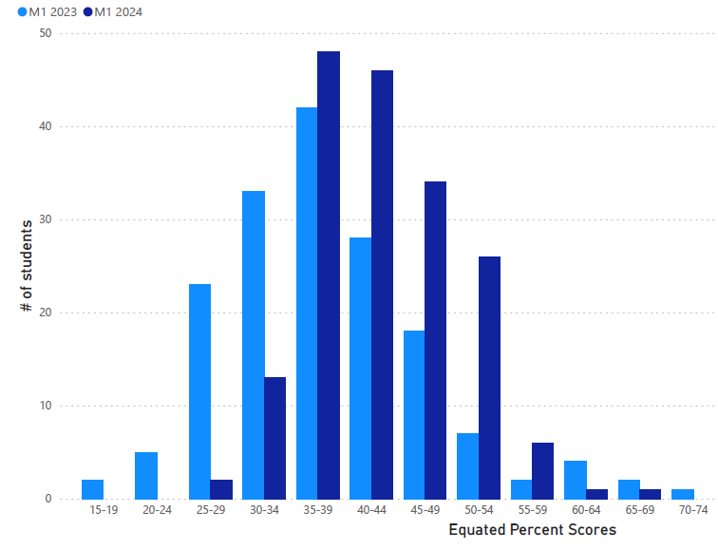
M1 CBSE distribution

Slide 6
M2 First attempt gateway CBSE
 | AY22-23 (n=156) | AY23-24 (n=181)
Pass rate | 68% | 80%
Mean score | 63.4 | 68.1

Slide 7
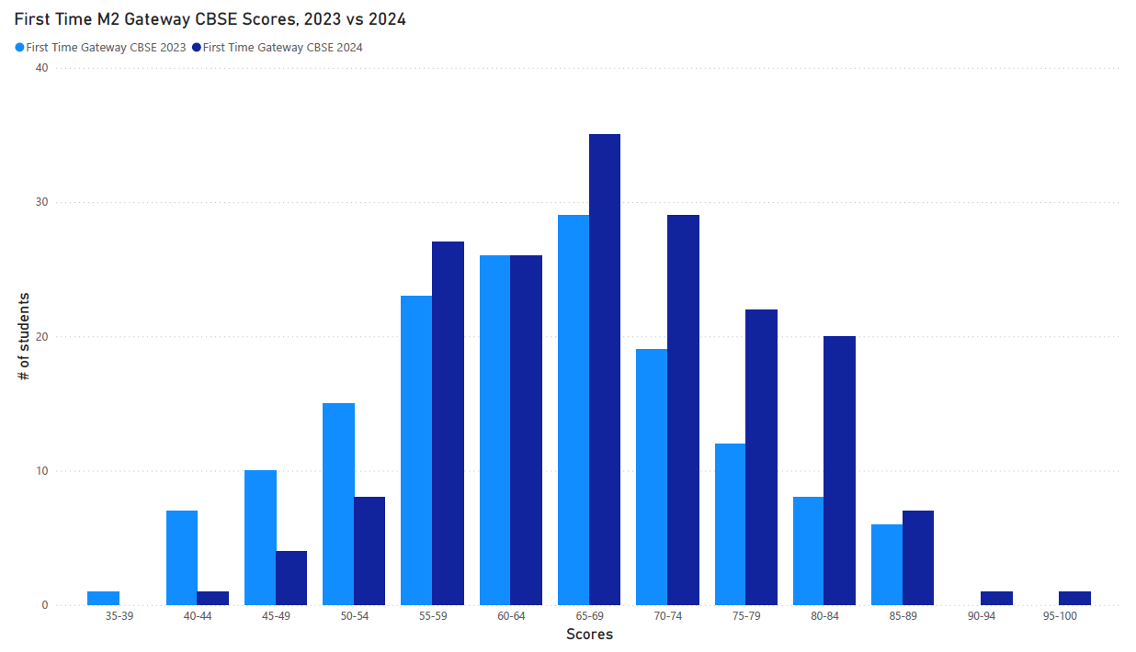
M2 1st Gateway CBSE score distribution

Slide 8
M3 % pass 1st attempt on each subject exam
 | AY22-23 | AY23-24
Surgery | 94% | 95%
Internal Medicine | 94% | 99%
Family Medicine | 98% | 97%
Pediatrics | 98% | 98%
Psychiatry | 98% | 98%
Ob/Gyn | 94% | 97%

Slide 9
2024 GQ (2 years out of date)
 | Rate the quality of your educational experience in the following clerkships
 | (Percent answering “Good” or “Excellent”)
%ile | Emergency Medicine | Family Medicine | Internal Medicine | Neurology | Ob/Gyn | Pediatrics | Psychiatry | Surgery
90 | 96.6% | 95.4% | 97.4% | 93.6% | 90.8% | 96.2% | 97.0% | 92.2%
 |  | 92.8% |  |  | 88.3%
75 | 93.9% | 91.6% | 96.4% | 90.6% | 86.1% | 93.7% | 94.1% | 88.6%
 | 91.9%
50 | 89.2% | 88.6% | 93.6% | 85.7% | 81.8% | 89.7% | 90.3% | 85.3%
 |  |  |  |  |  |  | 87.4%
25 | 85.1% | 84.5% | 90.3% | 75.9% | 76.1% | 84.9% | 86.8% | 80.8%
 |  |  | 90.1% | 70.0% |  | 84.7% |  | 76.6%
10 | 74.7% | 78.7% | 87.8% | 68.1% | 70.6% | 81.1% | 82.7% | 76.3%
Valid N | 155 | 155 | 155 | 155 | 155 | 155 | 155 | 155

Slide 10
M3 NBME subject exam scores (1st attempt)
 | AY22-23 NEOMED Mean | AY22-23 National Mean | AY23-24 (as of May 2024)
Surgery | 71.2 | 73.8 | 71.9
Internal Medicine | 72.6 | 74.1 | 73.0
Family Medicine | 73.7 | 75.5 | 74.5
Pediatrics | 75.1 | 77.9 | 76.5
Psychiatry | 83.1 | 84.5 | 83.7
Ob/Gyn | 76.4 | 78.4 | 77.5

Slide 11
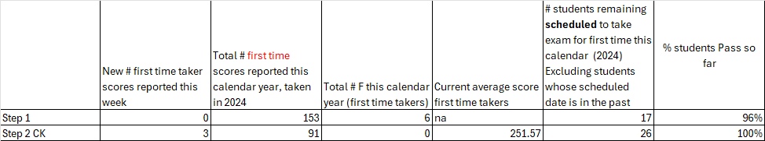
USMLE results (as of 8/1/2024)

Slide 12
2024 Match
122 matches (98%)
38.5% at an affiliated institution
55.4% in Ohio
49.2% primary care

Slide 13
Badging https://www.neomed.edu/medicine/academics/badging/
Rural medicine
Social justice
Urban primary care practice
Research and scholarship
Awarded through learning communities
Health equity & advocacy leadership (Mike Appleman)
Research & scholarship (Bill Chillian)
Bronze (50) / Silver (150) / Gold (350) / Platinum (500)
Listed in Dean’s letter and “Distinguishing characteristics” (ERAS)
New proposals welcome (need faculty champion)

Slide 14
Plans
Fully implement integrated M2 curriculum under M2 program director
Seek opportunities to improve M1
Refine prematriculation, AIMS programs. Make AIMS a course?
Enhance M3 rotation quality
Clerkship-wide Zoom didactics
Emphasize mid-clerkship feedback, H&P observ., grading timeliness
Implement and expand badging programs
Admit 200 M1’s next year
Foster scholarship within budgetary constraints
Improve data quality (clinical faculty roster, student outcome tracking)
Prepare for LCME site visit AY2026-2027; likely mock site visit this year
CMHA??

