Slide 1

Practical Implementation for District Leadership Teams (DLTs)
Regional Educational Laboratory Central
Sam Glickman, MBA, MS
Senior Research Associate
Erica Lee, PhD
Senior Researcher

Slide 2




Warm up
Think of one new activity, practice, or initiative that you’ve successfully undertaken, either individually or as part of a team.
In 5 words or less, what helped make that new endeavor successful?

Slide 3

Warm up
Think of one new activity, practice, or initiative that has been less successful, either individually or as part of a team.
In 5 words or less, what contributed to the new endeavor being less successful?

Slide 4

The change process
Implementation science seeks to make the change process more predictable, systematic, and effective.

Slide 5
What is implementation science?
Implementation science refers to the strategies and tools used to enhance the adoption, implementation, and sustainability of a program or practice.
(Adapted from Powell et al., 2015)
Powell, B. J., Waltz, T. J., Chinman, M. J., Damschroder, L. J., Smith, J. L., Matthieu, M. M., Proctor, E. K., & Kirchner, J. E. (2015). A refined compilation of implementation strategies: results from the Expert Recommendations for Implementing Change (ERIC) project. Implementation Science, 10(1), 21.
Source: Powell et al., 2015.

Slide 6





Implementation stages
Exploration
Installation
Initial implementation
Full implementation
Assess need
Examine fit and feasibility of usable innovation
Assure resources
Develop supports
Initiate practice
Use data and Plan, Do, Study, Act (PDSA) cycles to improve supports
Practice is consistent and delivered with fidelity
Positive program outcomes
Adapted from Fixsen et al., 2005.

Slide 7
Implementation teams and the early stages
Exploration
Installation
Initial implementation
Full implementation
Forming and refining the implementation team
Adapted from Fixsen et al., 2005.

Slide 8




Implementation teams
A group who oversees, attends to, and is accountable for performing key implementation functions.
  Small, skilled
  team
  Guided by
  a team charter
  Diversity of
  perspective
  Defined
  leadership

Slide 9






Implementation team functions
Planning
Problem-solving
Collecting data
Building
infrastructure
Analyzing and
studying data
Communicating

Slide 10

Implementation team: Role clarity to support functions
Strong implementation teams clarify roles and responsibilities within the team.
Research shows that role clarity is a critical predictor of success, sustainability, and scalability for implementation
Planning
Problem-solving
Collecting data
When teams are unclear about key members’ roles and responsibilities, the implementation process often stalls or fails.
Communicating
Building
infrastructure
Analyzing and
studying data
Sources: Fixsen et al., 2005; Collaborative for Implementation Practice, & National Implementation Research Network, 2021.

Slide 11
Implementation team roles
Leaders (or co-leaders)
Convene and guide the team’s work.
The co-leadership model is an intentional strategy to avoid the “solo hero” model.
Champion
Drives the change process forward by building buy-in, supporting staff, and bridging gaps.
Data lead
Takes the lead on acquiring and managing data related to the Action Plan.
Ensures that data is used to guide real-time adjustments and decisions.
Other potential roles
Facilitator: Drafts agendas, targets specific decisions to be made, and distributes materials.
Recorder: Captures notes, documents explicit decisions, and shares them with the team.

Slide 12
Implementation team questionnaire
Do you have a small, designated, and committed team?
Does your team have the skills, perspectives, and expertise to support implementation of the action plan?
Does your team have an identified leader or co-leaders?
Have you considered assigning team members to other specific roles?
Does your team meet regularly?

Slide 13

DLTs: A Practical Implementation Guide for Systems
Three strategic levers to help DLTs develop and implement their action plans
The team: Strengthen and refine the DLT to support effective implementation
The data: Conduct a thorough needs assessment as a team before developing your system’s action plan
The plan: Engage in deliberate PDSA cycles as a team throughout the implementation of your system’s action plan

Slide 14
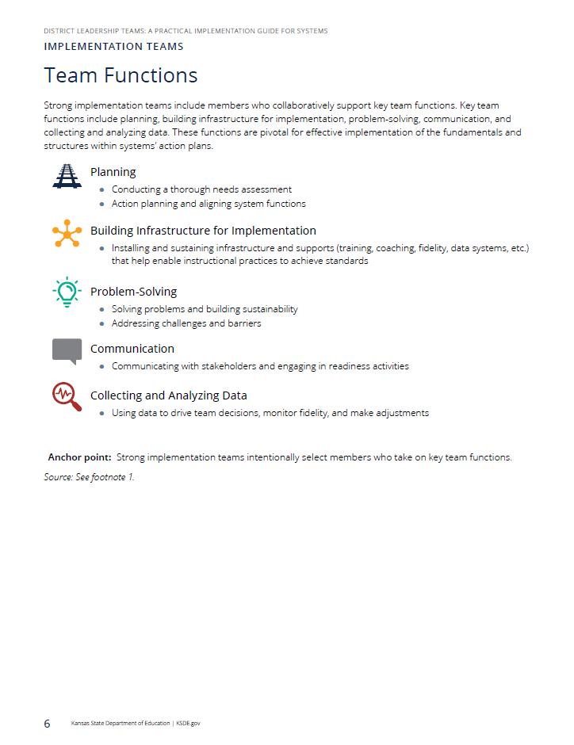
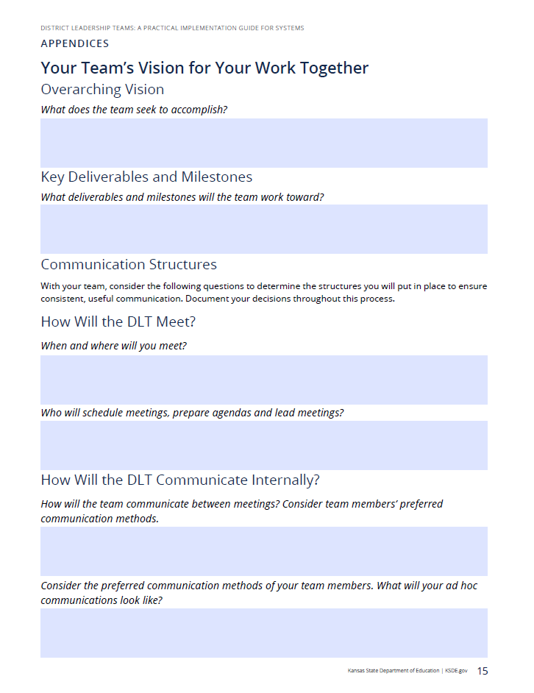

Slide 15
References
Collaborative for Implementation Practice, & National Implementation Research Network. (2021). Implementation teams: Best practices and tools to establish implementation teams. University of North Carolina at Chapel Hill. https://www.implementationpractice.org/wp-content/uploads/2021/05/NIRN-Practice-Guide-Implementation-Teams_7.29.21.pdf
Fixsen, D. L., Naoom, S. F., Blase, K. A., Friedman, R. M., & Wallace, F. (2005). Implementation research: A synthesis of the literature. University of South Florida, Louis de la Parte Florida Mental Health Institute, National Implementation Research Network.
Powell, B. J., Waltz, T. J., Chinman, M. J., Damschroder, L. J., Smith, J. L., Matthieu, M. M., Proctor, E. K., & Kirchner, J. E. (2015). A refined compilation of implementation strategies: results from the Expert Recommendations for Implementing Change (ERIC) project. Implementation Science, 10(1), 21.

Slide 16
Disclaimer
This work was funded by the U.S. Department of Education’s Institute of Education Sciences (IES) under contract 91990022C0015, with REL Central, administered by Mathematica. The content of the presentation does not necessarily reflect the views or policies of IES or the U.S. Department of Education, nor does mention of trade names, commercial products, or organizations imply endorsement by the U.S. government.

