Slide 1
KESA Monthly Update
October 2026

Slide 2

Topic for this Update
Basics of Implementation Science - RMC & Mathematica
Notes:
Want to nail down these objectives with you today
Starting with Why

Slide 3
School Improvement Theory of Action
If we strengthen coherence across Kansas,
By focusing on a few high-leverage, fundamental actions,
Then our students will develop more knowledge and skills leading to greater opportunities and fewer limitations.

Slide 4
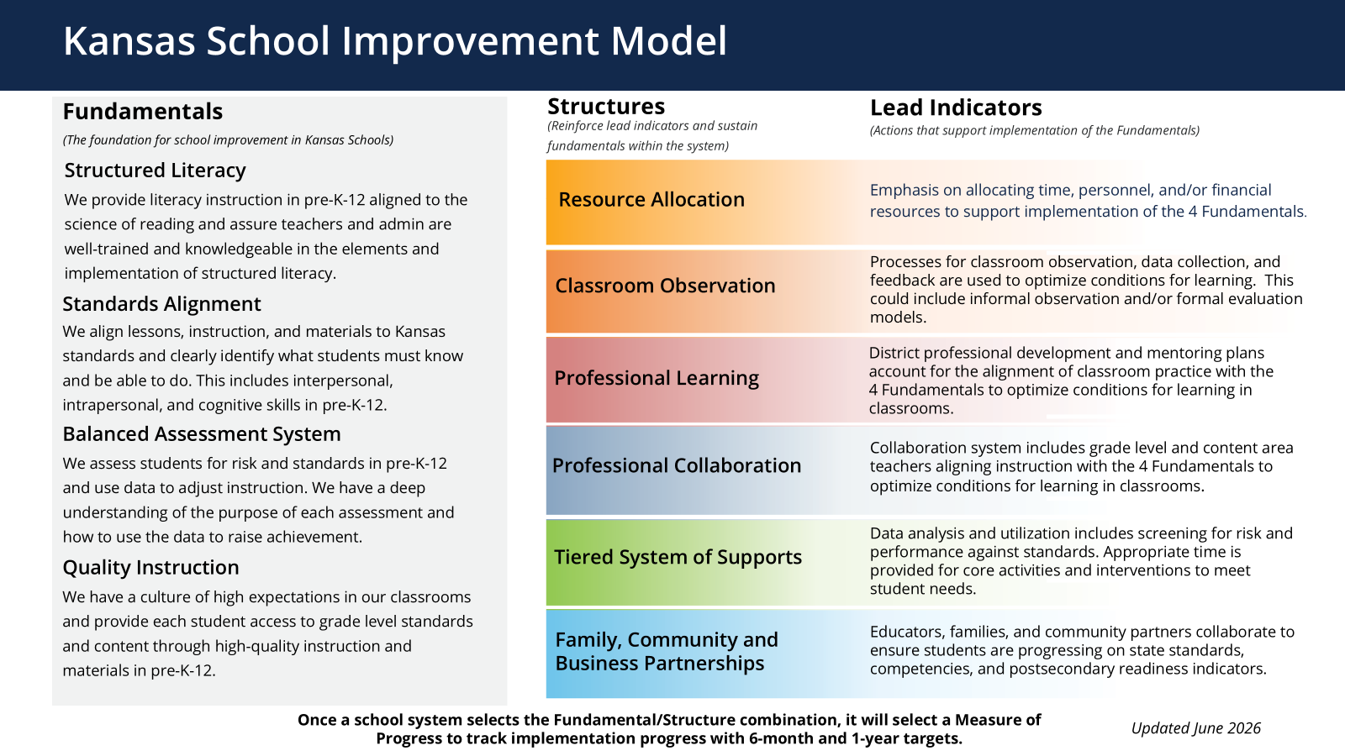
Notes:
Updates and Changes

Slide 5
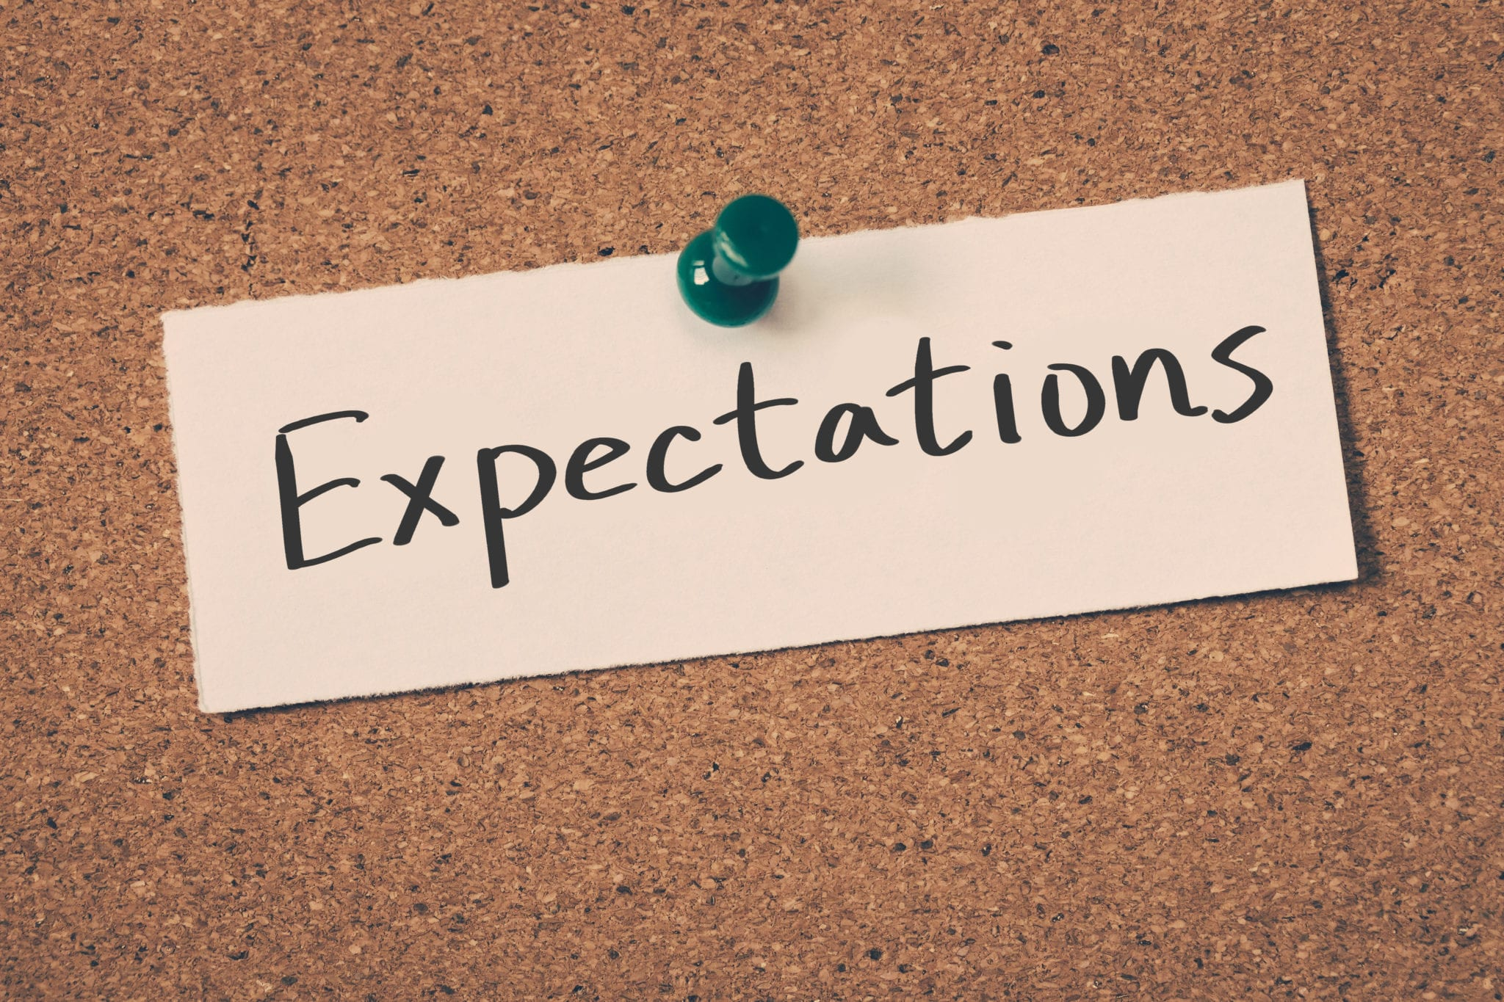
KESA this year
School Improvement Day
Submission of Action Plan
Implementation of Action Plan
KESA 6-month Check-in
Meet Compliance Area Standards

Slide 6
What is an accreditation decision based on in 2026-2027?
KESA Area | What is evaluated? | What are the standards used to evaluate?
School Improvement | Each System’s KESA Action Plan | Ready-to-Implement Action Plan: Clear Aligned Data-driven
Student Outcomes | In process - No Evaluation (determined by Division of Accountability) | In process - No Evaluation (determined by Division of Accountability)
Compliance | Each KESA Compliance Area (10) | 26-27 KESA Compliance Guide

Slide 7
Team Changes
Name Change - from Accreditation & Design to Implementation & Supports
That’s the extent of the change for 2026-2027
The new team is a blend of Regional Executives and Special Populations staff.
Central Region Executives, this year only:
  Tammy Fellers, Beth Parker, Kerri Maggard - ESSDACK
  Jill Lachenmayr - Orion
  Noalee Augustine-McDonald - Smoky Hill

Slide 8

Community of Practice
Focused on the one of most challenging aspects of school improvement — Implementation
PDSA Standards-based discussions
Opportunity to learn from each other

Slide 9
Implementation Standard/Indicator Focus
Community of Practice Padlet

Slide 10
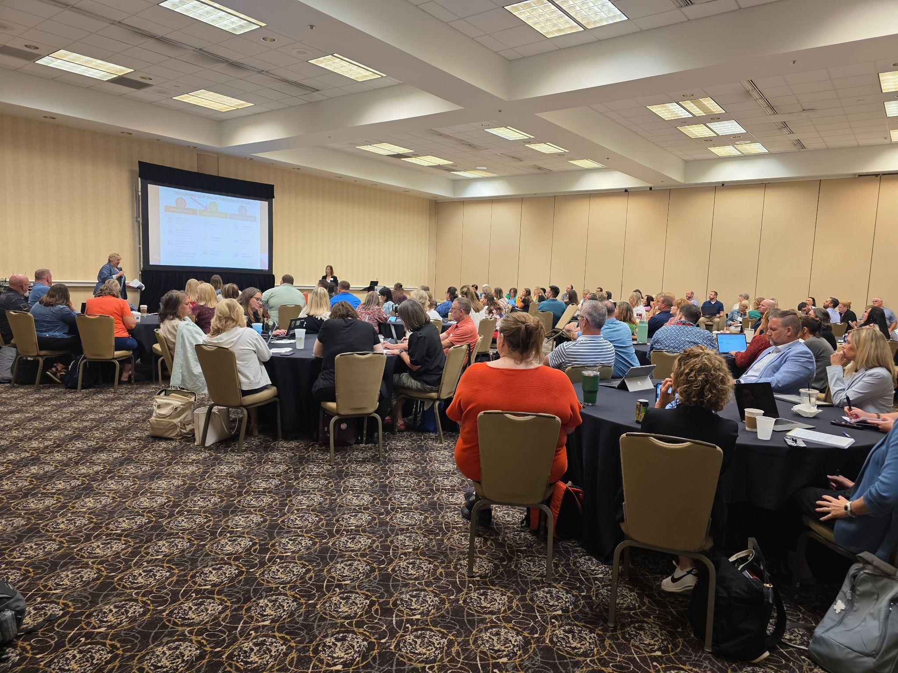
KSDE Annual Conference
Audience: District & Building Leadership Team Members
Dates: July 26-28, 2027
Location: Wichita Hyatt Regency
Notes:
A & D team member

Slide 11
KESA Monthly Updates
Mark your calendars for the 2026-2027 KESA Monthly updates
      Aug. 10
      Sept. 14
      Oct. 12
      Nov. 9
      Dec. 14
      Jan. 11
      Feb. 8
      Mar. 8
      Apr. 12
      May 10
2nd Monday of each month
10:30 – 11:15
ZOOM LINK

Slide 12
Check out our KESA Resources webpage
If you would like to subscribe to the KESA listserv, email accreditation@ksde.gov
(please share with any new staff you might have)

Slide 13
Next KESA Monthly Update
November 9th
ZOOM LINK
Community of Practice Focus:
Standard 1 (Plan), Indicators 2 & 3

