Slide 1


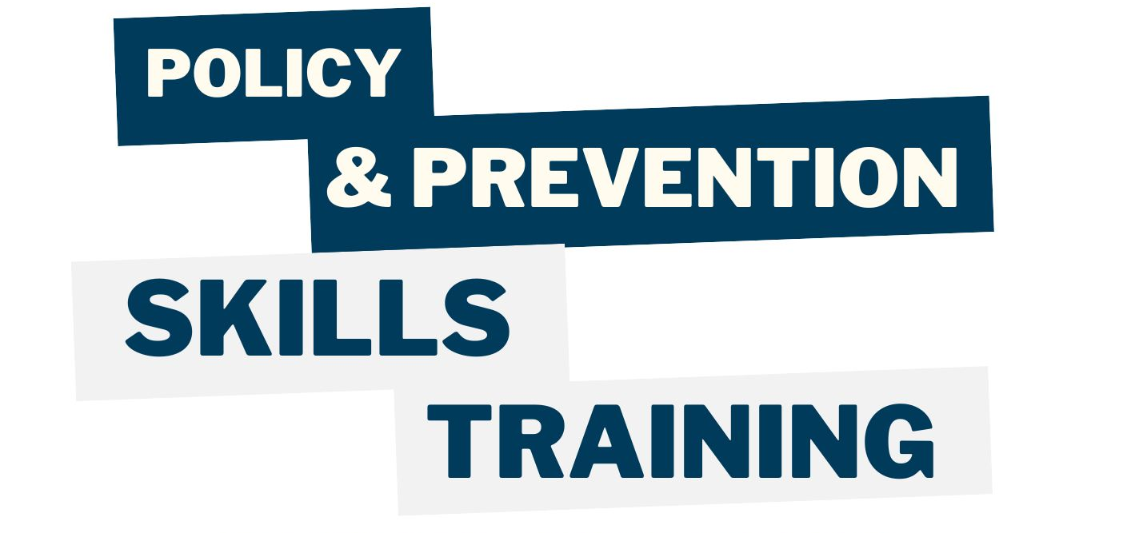
Tuesday March 10 2026

Slide 2

Our Mission
We are a statewide alliance of like-minded agencies, organizations, and coalitions working to prevent non-medical underage cannabis use.

Slide 3
Our Approach
We understand that youth norms are derived from adult norms, youth access is related to adult access, and youth use is related to adult use.
Therefore, we will be addressing adult activities, but with the end goal of preventing and reducing youth use.

Slide 4
Our Supporters
Prevention Network and the Michigan Department of Health and Human Services/ Substance Use, Gambling and Epidemiology
The in-kind contributions of time and talent from our partners through the state
NOTE: MYCAEA does not accept funds from the cannabis industry or cannabis trade groups

Slide 5

A WORD
ABOUT WORDS
Is it marijuana, marihuana, or cannabis?
Where is the local dispensary?
Person first language

Slide 6

In case I say something outrageous
The views, opinions, and content expressed in this presentation do not necessarily reflect the views, opinions, or policies of Prevention Network or the Michigan Department of Health and Human Services.

Slide 7

Why not weed? Why not now?
    Potency
    Mental Health & Mental Illness
    Cannabis Use Disorder (addiction)
    There’s More?
A little good news
(Prevention works)
Your job, should you choose to accept it.

Slide 8
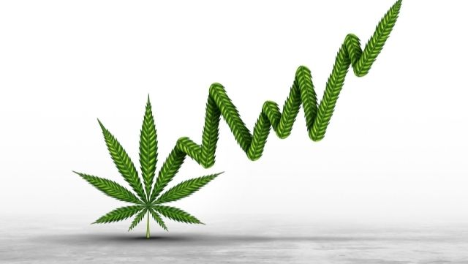
Potency

Slide 9
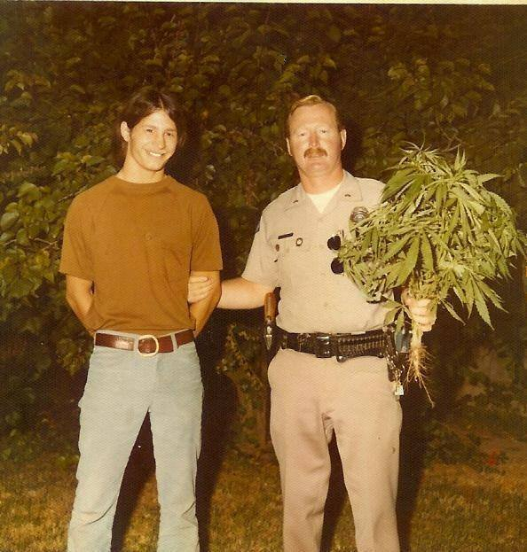
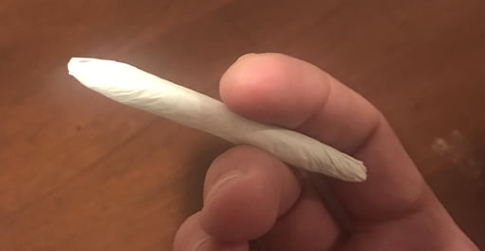
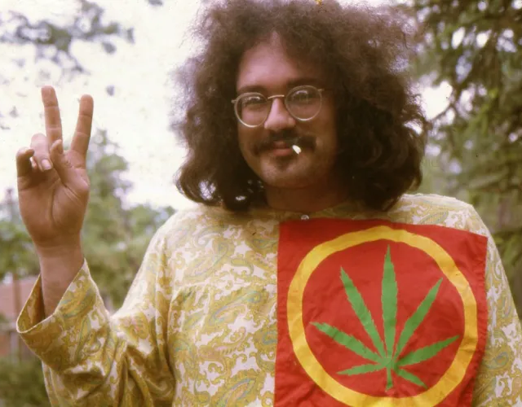
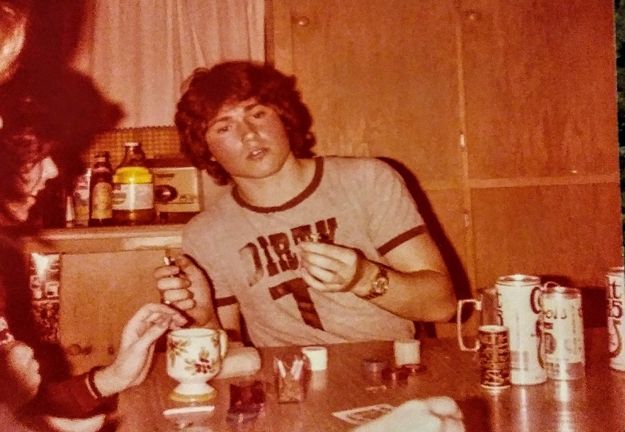
1970s
https://www.reddit.com/r/trees/comments/al72zl/old_school_joint_ran_out_of_raws_and_filters_old/
https://www.reddit.com/r/OldSchoolCool/comments/7j2vwz/my_uncle_getting_caught_growing_weed_in_the/
https://norml.org/blog/2020/07/24/a-founder-looks-at-50-the-free-john-sinclair-rally-public-protests-sometimes-matter/
https://www.reddit.com/r/OldSchoolCool/comments/7m9o1k/my_dad_smoking_some_weed_in_a_dirty_t_70s/?rdt=51678

Slide 10
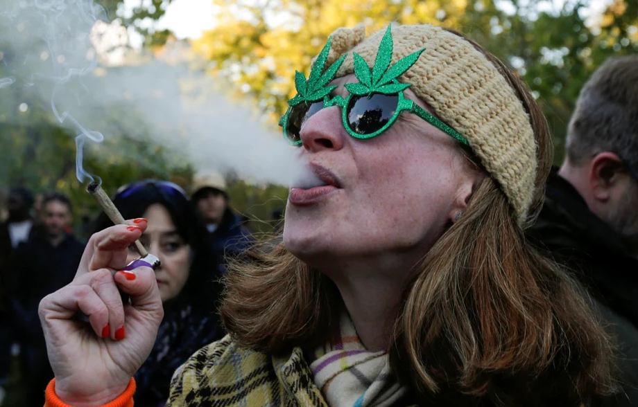
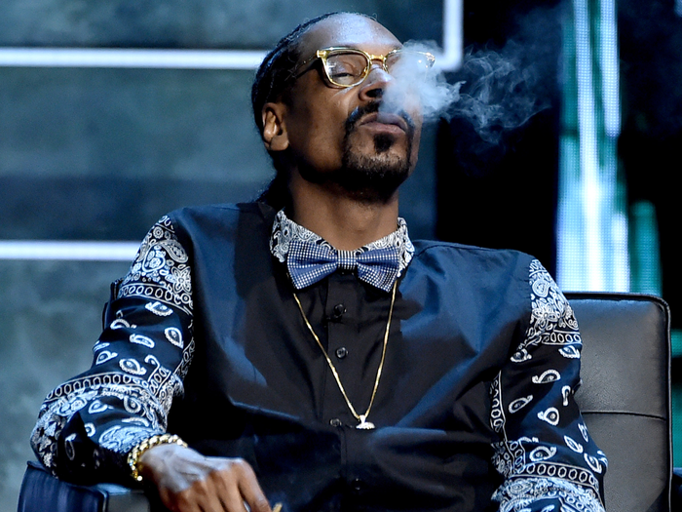
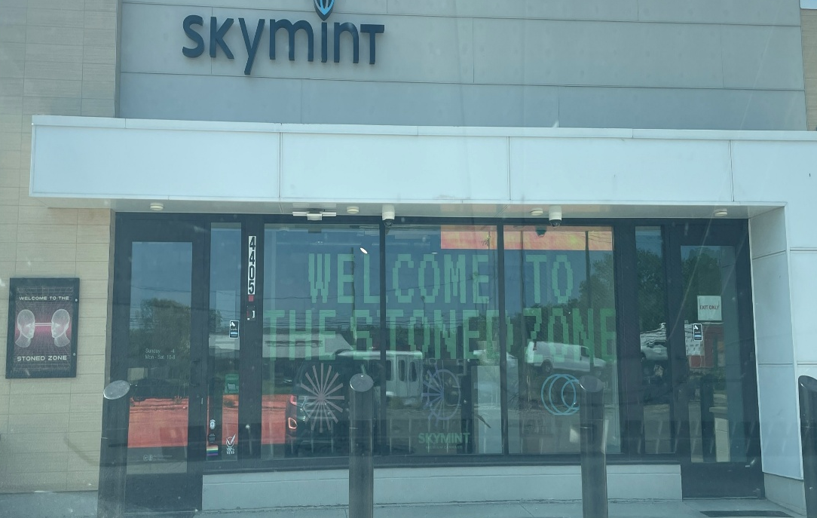
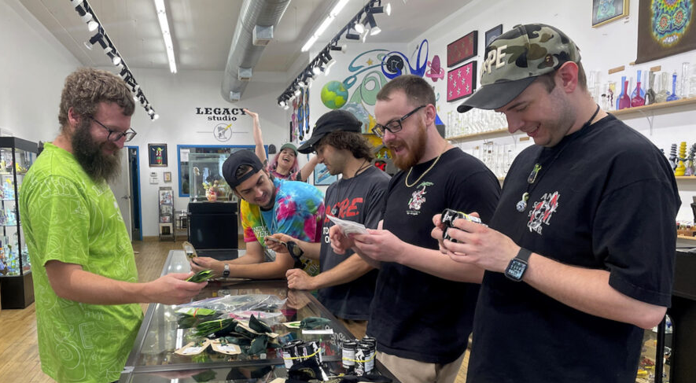
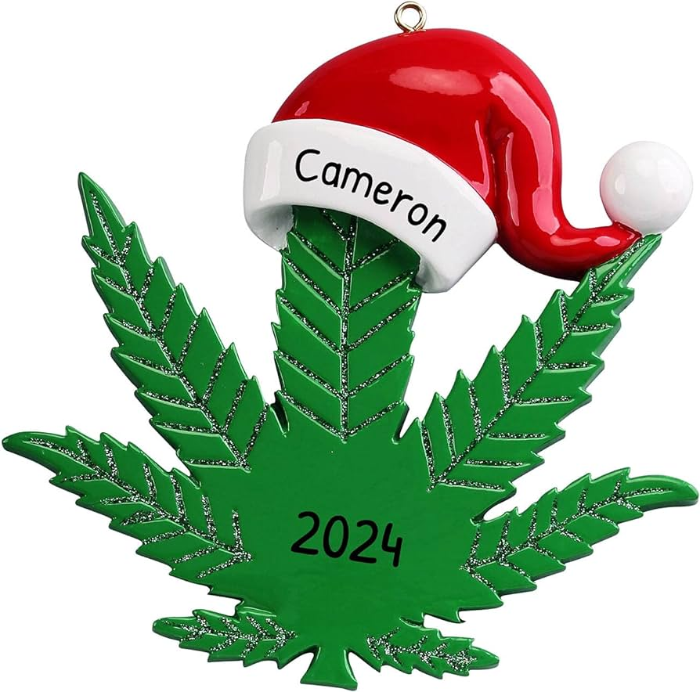
Today
https://www.nbcnews.com/health/mental-health/chronic-pot-use-may-have-serious-effects-brain-experts-say-n924441
https://www.insider.com/celebrities-who-smoke-weed-2018-10
www.amazon.com
https://newhampshirebulletin.com/2023/08/11/pot-smell-and-safety-concerns-ignite-disputes-over-public-smoking/
Photo credit: Anthony Nicholas GCPC

Slide 11
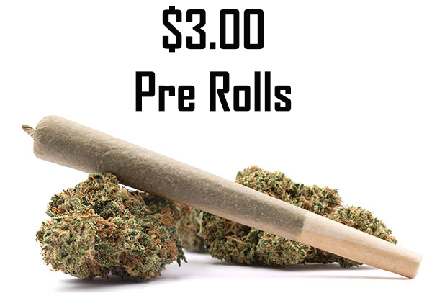
Flower or “pre-rolls”
1970s
1% – 4%
Today
20% - 30%

Slide 12
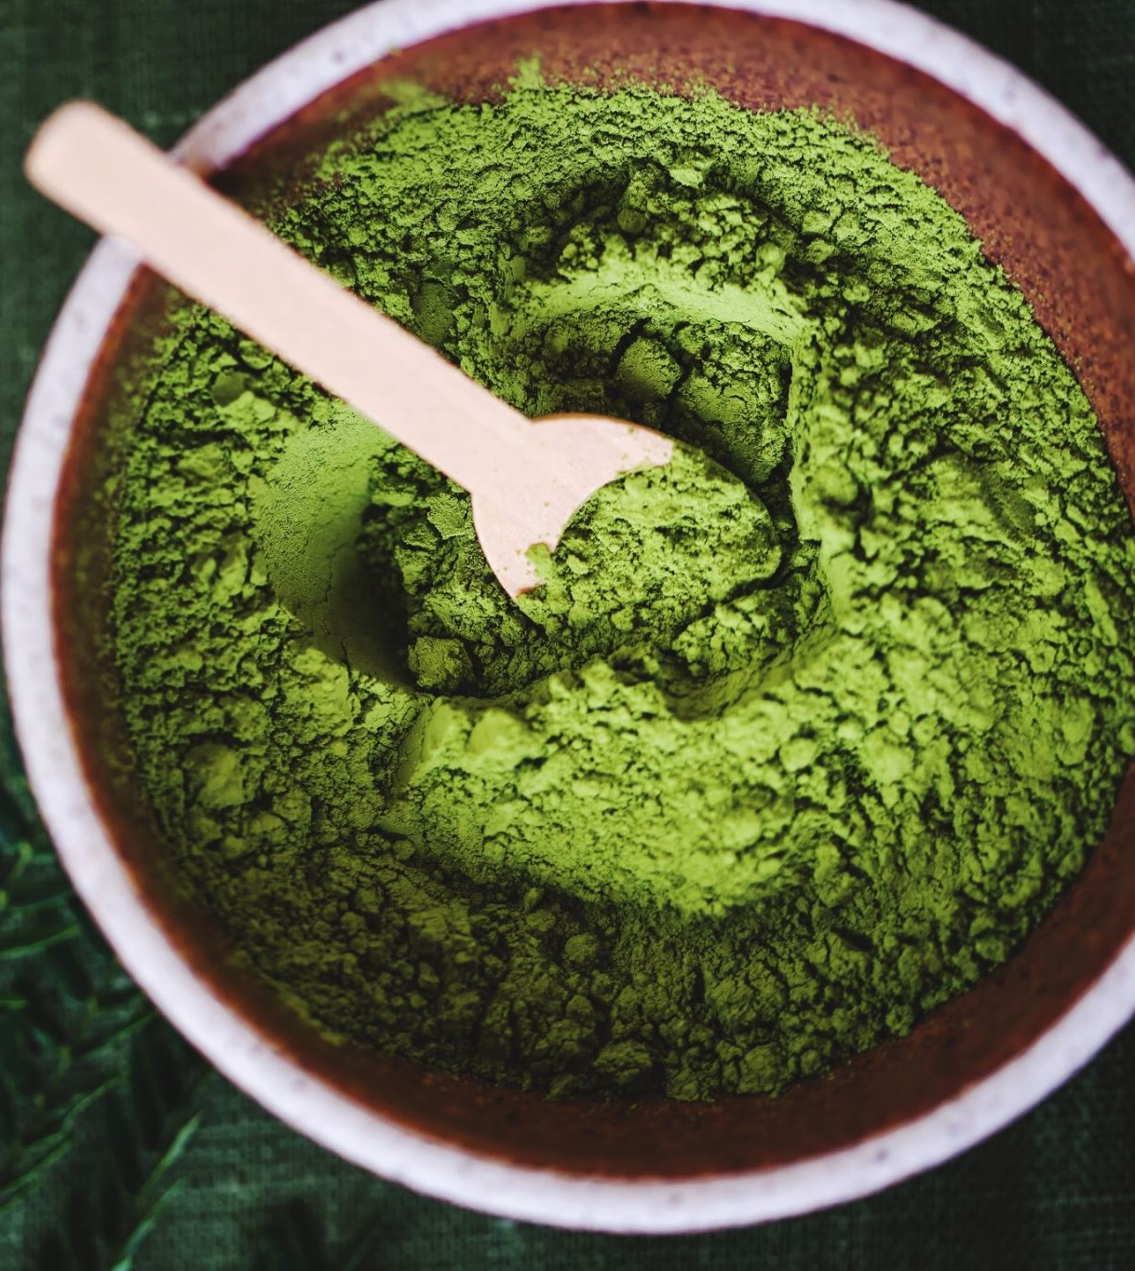
According to weedmaps.com…
GM-UHOH 35.23%
Umami Butter 35%
Beyond Blueberry 34%
Runtz x Z x AC 33.72%
Xeno 30.5%
https://weedmaps.com/news/2023/07/highest-thc-strains-2023/?lid=rr04bez7ye4z&utm_medium=email&utm_source=braze&utm_campaign=marketingblast&utm_content=news&utm_term=USA_CAN

Slide 13
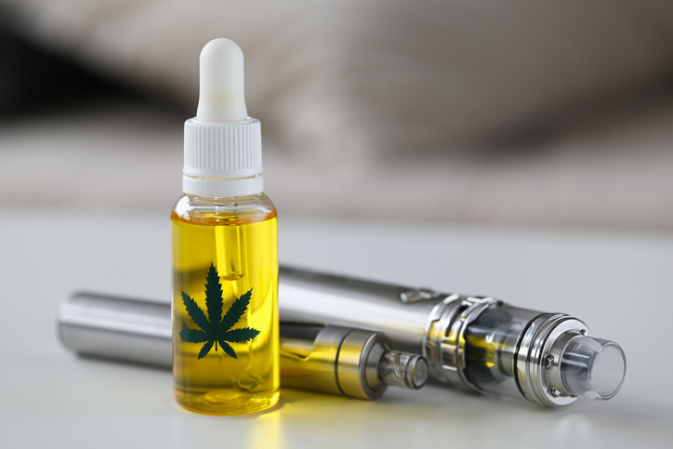
Vape Oils
1970’s
1980’s Vape pens didn’t exist
Today distillate oil 85% - 90%
live resin 65% - 95%
https://yourhighnesscannabis.ca/thc-percentage-chart/

Slide 14
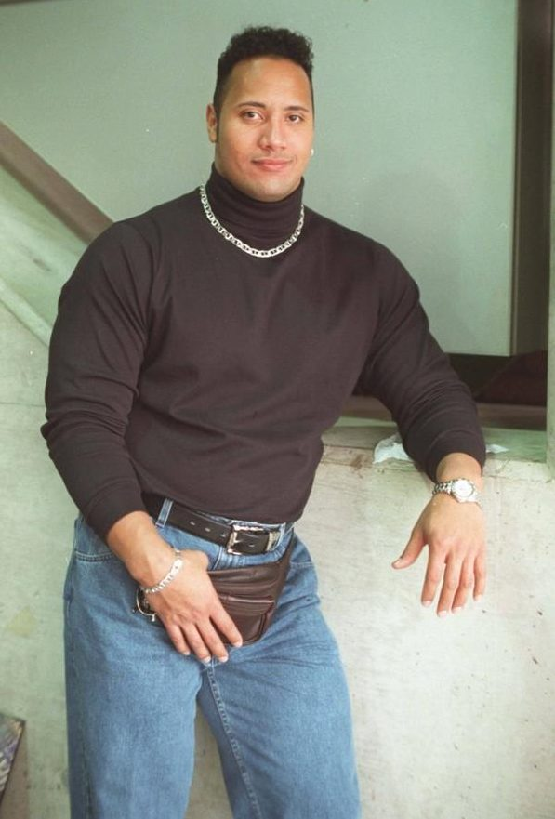
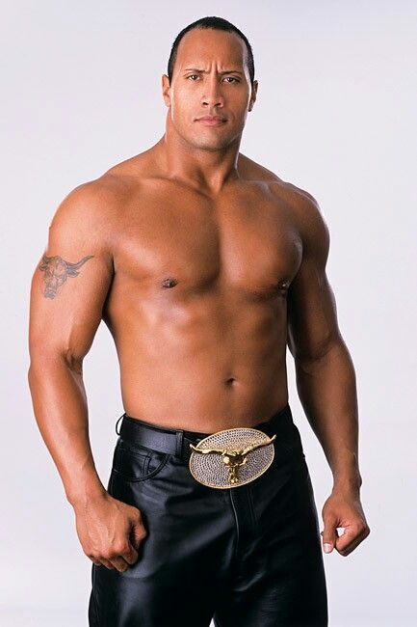
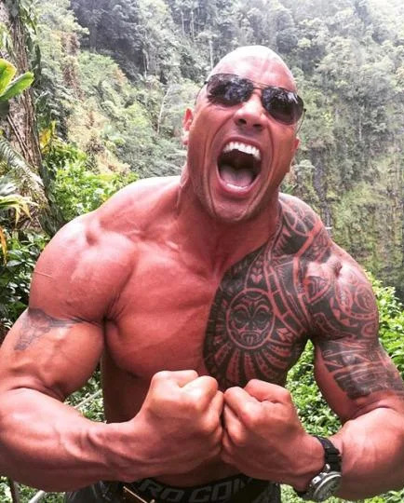
The Bottom Line
1980’s cannabis
2000’s cannabis
Today’s cannabis

Slide 15
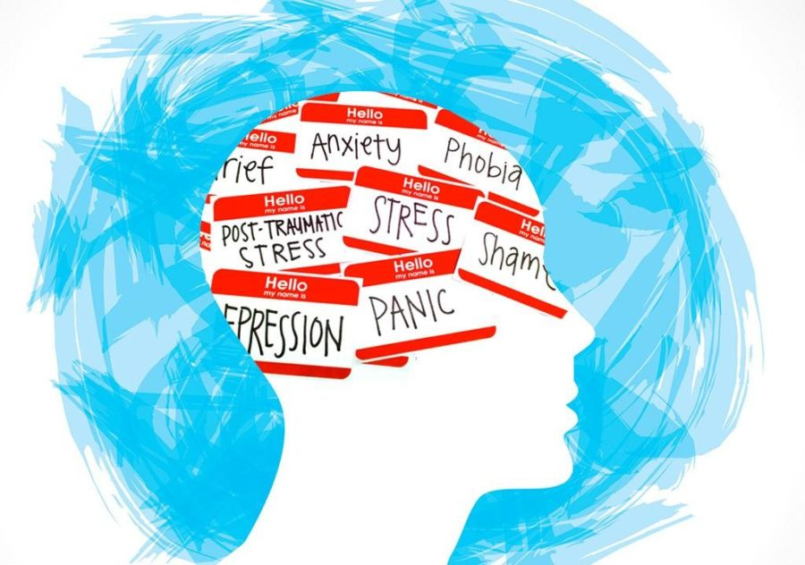
Adolescent Mental Health

Slide 16
Cannabis and Adolescent Mental Health – Anxiety and Depression
A causal relationship between cannabis use and depression has been elusive, however use is associated with a higher risk of several mental health challenges adolescents experience.
https://www.healio.com/news/primary-care/20220430/theres-a-real-risk-there-cannabis-use-exacerbates-depression

Slide 17

Cannabis and Adolescent Mental Health - Psychosis
Adolescents age 15 – 18 exposed to cannabis had more psychosis episodes than the control group
Maternal Cannabis use during pregnancy may contribute to psychosis in the child during later stages in the child’s life

Slide 18
Cannabis and Adolescent Mental Health - Schizophrenia
Adolescent exposure to cannabis is associated with higher risk of developing schizophrenia compared to adult use
Both high and low frequency 12 to 18 year old cannabis users were six times more likely to develop schizophrenia compared to those who had never used cannabis.
Limitations in the study included not factoring in the potency of the cannabis used. This study did NOT establish a causal relationship, but an increase in risk of developing schizophrenia.
https://medicalxpress.com/news/2022-01-cannabis-schizophrenia-young-people-linked.html

Slide 19
Cannabis and Adolescent Mental Health – Anxiety and Depression
A previous meta-analysis of 11 longitudinal and prospective studies showed that adolescents who used cannabis were more likely than nonusers to attempt suicide, experience suicidal ideation, and develop depression or anxiety.
https://www.healio.com/news/primary-care/20220430/theres-a-real-risk-there-cannabis-use-exacerbates-depression

Slide 20
Cannabis and Adolescent Mental Health – Bipolar Disorder
According to the International Bipolar Foundation:
High rates of co-occurrence of cannabis and bipolar disorder
Use worsened manic symptoms in pre-existing bipolar in individuals
Cannabis use decreased treatment response in adolescents
https://ibpf.org/do-you-recommend-cannabis-use-for-teens-with-bipolar-disorder/

Slide 21
Cannabis and Adolescent Mental Health – Bipolar Disorder
According to the International Bipolar Foundation:
Use impacts some of the same chemicals in the brain that play a role is psychotic symptoms
Marijuana use may increase the risk of new manic symptoms by as much as three times in people with bipolar disorder.
https://ibpf.org/do-you-recommend-cannabis-use-for-teens-with-bipolar-disorder/

Slide 22
Cannabis and Adolescent Mental Health – Suicide Ideation
“The results of the study indicated that even people who used cannabis nondaily, fewer than 300 days a year, were more likely to have suicidal ideation and to plan or attempt suicide than those who did not use the drug at all.”
https://scitechdaily.com/new-research-suggests-a-link-between-cannabis-use-and-suicide-in-young-adults/

Slide 23
Cannabis and Adolescent Mental Health – Suicide Ideation
Among study participants who did NOT have a previous major depressive episode, suicide ideation (thinking about suicide)had occurred in:
3% of those who did not use cannabis
7% of those who used cannabis, but not daily
9% of those who had used daily (more than 300 days in previous year)
14% of those with a cannabis use disorder.
https://scitechdaily.com/new-research-suggests-a-link-between-cannabis-use-and-suicide-in-young-adults/

Slide 24
Cannabis and Adolescent Mental Health – Suicide Ideation
Among study participants with depression, suicide ideation occurred in:
35% of those who did not use cannabis
44% of those who used cannabis, but not daily
53% of those who had used daily (more than 300 days in previous year)
50% of those with a cannabis use disorder.
https://scitechdaily.com/new-research-suggests-a-link-between-cannabis-use-and-suicide-in-young-adults/

Slide 25

The Bottom Line
Despite popular public opinion, cannabis use has not been proven to alleviate any adolescent mental health issues. In fact, it has been proven to make matters worse for any existing mental health challenges.

Slide 26
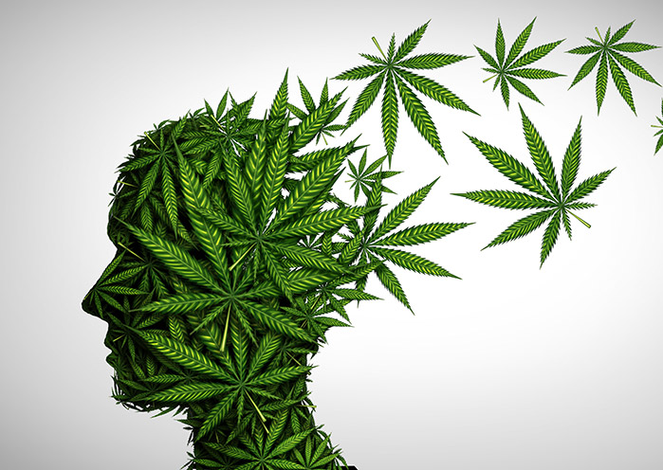
Addiction

Slide 27

Addiction is a treatable, chronic medical disease involving complex interactions among brain circuits, genetics, the environment, and an individual’s life experiences. People with addiction use substances or engage in behaviors that become compulsive and often continue despite harmful consequences.
American Society of Addiction Medicine
https://www.asam.org/quality-care/definition-of-addiction

Slide 28
The Diagnostic and Statistical Manual of Mental Disorders Fifth Edition (DSM-5) assesses 11 criteria to determine an SUD diagnosis.
SUD is a diagnosable medical condition as opposed to a concept or derogatory term.

Slide 29
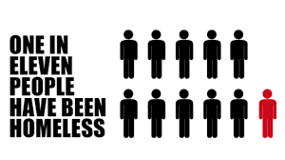
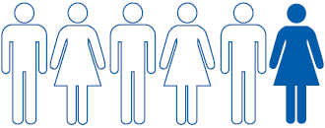

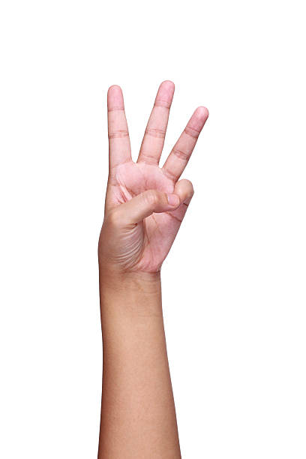
According to the National Institute on Drug Abuse at the US Department of Health and Human Services, approximately 9 percent, or about 1 in 11, of those who use marijuana will become addicted.
This rate increases to 17 percent, or about 1 in 6, if you start in your teens.
It goes up to 25–50 percent among daily users.

Slide 30
The Bottom Line
Addiction is a diagnosable medical condition
Cannabis is addictive.
Not everyone who uses will get addicted.
Starting to use in your teens increases the chances you will get addicted.
Daily users are more likely to get addicted.

Slide 31
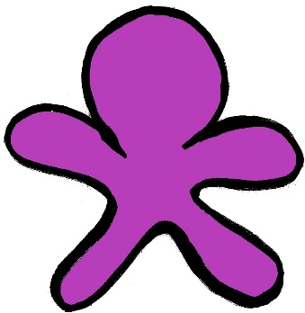


10 volunteers please
Notes:
These 10 represent the middle and high school population our community.

Slide 32
A Little Good News
We know what works to reduce the chances that a young person will use cannabis (and other illicit illegal intoxicating substances)

Slide 33
A Little Good News
Research – The epidemiology of youth cannabis use
Risk and Protective Factors
Reducing ACEs and increasing PCEs
Effective programming
Impacting the environment
You

Slide 34
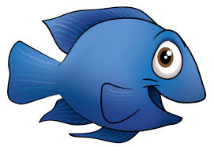

Environment
The water feels a bit warm today
What’s water?
Notes:
Our job is to shape the environment our youth are brought up in. If we do it correctly, they aren’t aware of the effort that has gone into shaping this environment. It is simply the world they know.

Slide 35
Environment
Everything around us
Community & peer norms
Policy and enforcement
Access to a commodity

Slide 36
Epidemiology
Epidemiology is concerned with the distribution and determinants of health in populations.
Friis R.H., & Sellers T.A.(2009) Epidemiology for Public Health Practice (4th ed.). Jones& Bartlett Publishers LLC

Slide 37
Epidemiology – Distribution
Who?
How Many?
How Often?
How Frequently?
So What? Impact

Slide 38
Epidemiology – Determinants
Protective Factors
Risk Factors
Adverse Childhood Experiences
Positive Childhood Experiences
Social Determinants of Health

Slide 39
Risk Factor
Any attribute, characteristic, or exposure that precedes and is associated with a higher likelihood
of problematic outcomes
-National Academy of Sciences, Institute of Medicine, 2009
PROBLEMATIC OUTCOMES
Notes:
Transition to a discussion of Hawkins & Catalano’s risk and protective factors for substance misuse and other behavioral health disorders:
In the 1980s, Drs. David Hawkins and Richard Catalano at the University of Washington became aware of William Dawber’s work about the risk and protective factors for heart disease. Applying this notion of risk and protective factors to substance use disorders, they conducted a review of the research literature and identified prospective, longitudinal studies to create a list of risk and protective factors for juvenile delinquency, substance misuse, and other problems occurring in adolescence. As with the risk factors for heart disease, their initial list has been expanded over time due to new research published on this topic.
Ask participants to read the definition of “risk factor” on the slide: Any attribute, characteristic, or exposure that precedes and is associated with a higher likelihood of problematic outcomes.⁵ In Information Sheet 1.10, participants will find a table from the Surgeon General’s report on research-based risk factors for adolescent and young adult substance initiation and misuse.
Make the following points about risk factors:
There is not a causal relationship between risk factors and substance misuse. Instead, the more risk factors that are in a child’s environment, the higher the likelihood is that they will misuse substances.
Risk factors exist in multiple domains, including the individual, family, and community/school domains.
It is possible to have multiple risk factors and one significant, mitigating protective factor, such as a supportive teacher or coach, or a strong though non-traditional family unit.

Slide 40
Protective Factor
Any attribute, characteristic, or exposure that precedes and is associated with a lower likelihood of problematic outcomes
-National Academy of Sciences, Institute of Medicine, 2009
PROBLEMATIC OUTCOMES
Notes:
Ask participants to read the definition of “protective factor” on the slide: Any attribute, characteristic, or exposure that precedes and is associated with a lower likelihood of problematic outcomes.⁵ Refer back to the HIV illustration or to the frog/pond analogy and ask participants for examples of protective factors in each analogy.
Emphasize the following:
Protective factors can reduce the negative impact of risk factors.
A single significant protective factor can mitigate a longer list of risk factors. For example, the influence of a mentor, positive role model, or strong support system can reduce the impact of multiple risk factors. It isn’t a matter of how many protective factors are present, though more is certainly better, but the strength of the protective factors that are present.
Resilience is the ability to recover from or adapt to adverse events and is therefore protective.
Prevention is not just about eliminating negative behavior; it is also about supporting protective factors and striving to optimize well-being.
Refer participants to Information Sheet 1.10, where participants will find a table from the Surgeon General’s report on research-based protective factors for adolescent and young adult substance initiation and misuse.
Ask for—or provide—an example of how cultural identity can be a protective factor. One protective factor that has been associated with positive outcomes in minority mental health is having a strong tie with one’s cultural background and/or racial/ethnic identity.¹¹ For example, among Native Americans, following traditions and being encouraged to learn about the Native American culture, are a protective factor. In Latino cultures, family bonding and respect are strong cultural norms.

Slide 41
Risk and Protective Factors
Multiple Domains
Societal
Community
Relationships
Individual
Developmental Perspective
Older Adulthood
Middle Adulthood
Young Adulthood Adolescence
Middle Childhood
Early Childhood
RESEARCH DRIVEN

Slide 42
Where Do ACEs and PCEs Fit In?
By moving “upstream,” we can impact
adverse childhood events (ACEs) and increase positive childhood experiences (PCEs).
We move upstream by reducing risk factors, increasing protective factors, and addressing
the SDOH.
Notes:
Share with participants that many of them might be familiar with the terms “adverse childhood experiences” (ACEs) and “positive childhood experiences” (PCEs) and that they might be wondering how they fit in with the risk and protective factor framework for substance misuse prevention.
Refer to the definitions of ACEs and PCEs that you have posted on chart paper on the wall. Let participants know that they can find additional information about ACEs and PCEs in the Additional Resources section.
Share the following points with participants:
Participants can find additional information about ACEs and PCEs in the Additional Resources section of their manual.
ACEs are highly stressful and potentially traumatic experiences that can happen to any of us before we turn 18. An ACE can be a single event, or it can include multiple events that affect our safety, our sense of security, our trust, or even our very sense of self when we are threatened or violated.
When these adverse experiences aren’t buffered by PCEs, or when they are ongoing or overwhelming, they can cause a toxic response that can affect the developing brain and body and have a negative ripple effect on our health and life outcomes as an adult.
The work we do in substance misuse prevention that reduces research-based risk factors, increases protective factors, and addresses the SDOH also affects ACEs and PCEs.

Slide 43
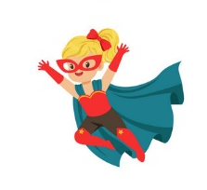



The Role You Play

Slide 44

What can I do?
When we meaningfully involve young people in positive activities and events, we decrease the chances a young person will use cannabis.
What is there for youth to get involved in around here?
This Photo by Unknown Author is licensed under CC BY-SA-NC

Slide 45
What can I do?
When we minimize the perception of risk of adolescent cannabis use by making use sound harmless, we increase the chance a young person will use cannabis.
What does our community environment tell young people about the risks of youthful cannabis use?
This Photo by Unknown Author is licensed under CC BY-SA-NC

Slide 46
Perception of Harm
Chance of Use

Slide 47
The Bottom Line
This isn’t our first rodeo. The prevention field is building on three plus decades of research and incredible successes.
We understand that increasing protection and decreasing risk leads overall to healthier decisions.
We can all play a role in doing that. In fact, most risk and protective factors require your involvement
This Photo by Unknown Author is licensed under CC BY-SA-NC

Slide 48
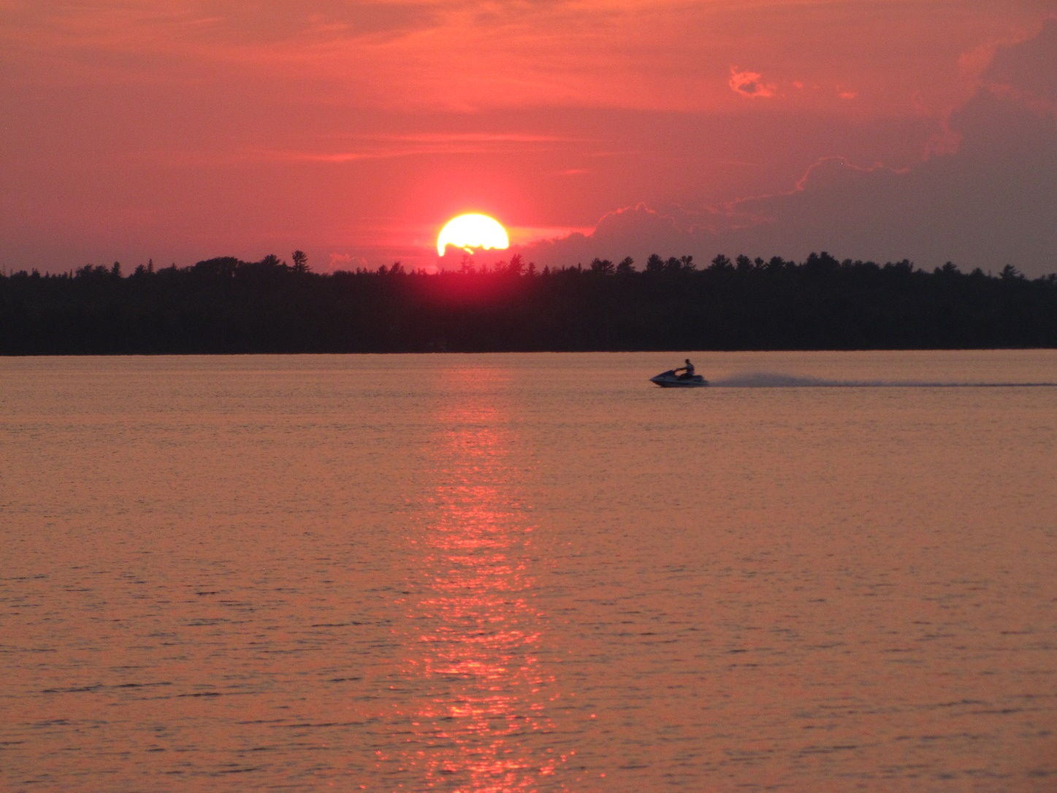
Thank you for making a difference.
Thanks for being here today.
Stay safe, you’re pretty important.
Photo Credit: Ken Dail
Used with permission
Notes:
KEN

