Slide 1


FULTON COUNTY BOARD OF ASSESSORS
2025 Assessment Notices and Homestead Filings
“We build on a foundation of VALUE, SERVICE and TRUST”

Slide 2
Fulton County Board of Assessors
Created by State law (O.C.G.A. 48-5-290)
Consists of 5 members appointed by the Fulton County Board of Commissioners
Identify and appraise all taxable property
Compile real & personal property tax digest annually
Set policies and procedures for the office
First level of appeal resolution
Appoints a Chief Appraiser who oversees day-to-day operations
Current Members:
Pamela Smith, Chair
Lee Morris, Vice-Chair
Michael Fitzgerald
Ed London
Melinda Kaplan

Slide 3
STAFF INTRODUCTIONS AND HOUSE RULES
Roderick Conley, Chief Appraiser
DIVISIONAL LEADERSHIP:
James Whitman, Deputy Chief Appraiser
Support Services (GIS, Fieldbook, Homestead)
Tara Parker, Deputy Chief Appraiser
Residential
Curtis Broden, Deputy Chief Appraiser
Commercial/Industrial
Dewayne Pinkney, Deputy Chief Appraiser
Personal Property/Administration

Slide 4

LEGISLATION
2024 Legislation
HB 581
Statewide Floating Homestead Exemption; Assessment Notice; Three-Year Lock; Settlement Conferences; Sales Ratio Study
HR 1022
Companion Constitutional Amendment to HB 581 For Opt-Out of Statewide Floating Homestead Exemption (opt-out by resolution by March 1, 2025)
2025 Legislation
HB 92 (HB 581 clean-up)
Revenue and taxation; postpone date by which local governing authorities can opt out of base year homestead exemption
Effective January 1, 2025

Slide 5
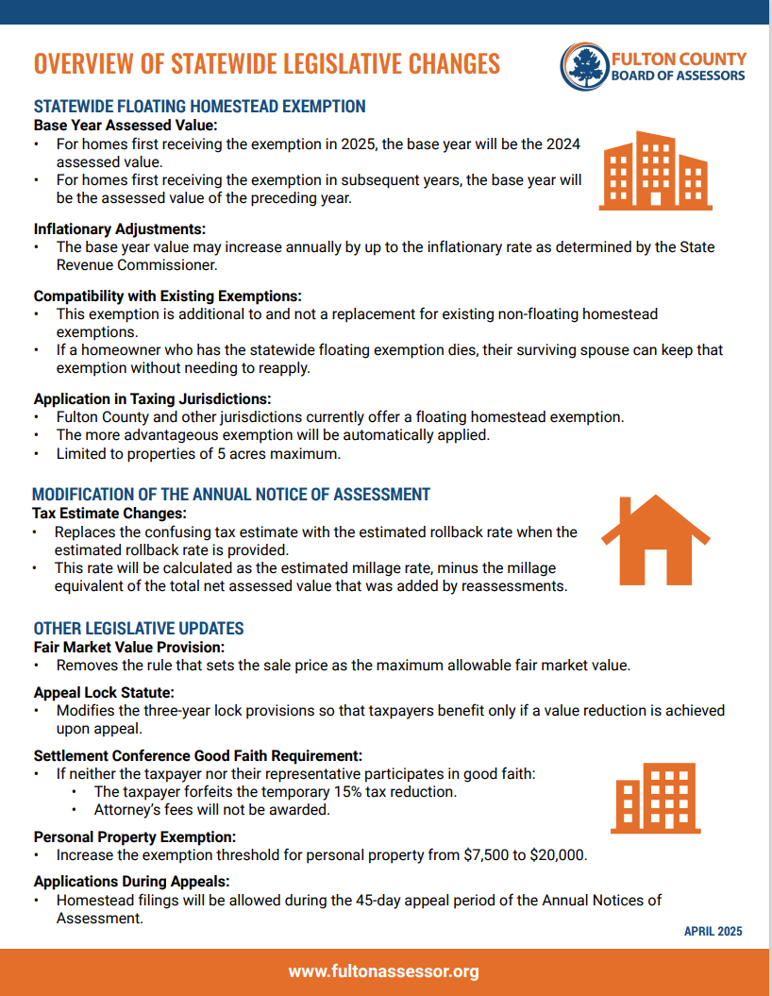

OVERVIEW OF LEGISLATIVE CHANGES

Slide 6

2025 ASSESSMENT NOTICES
https://www.youtube.com/watch?v=ZvVhJfEub5k

Slide 7
APPRAISAL TIMELINE
January 1 - Date of Assessment/Return Period Begins
April 1 - Return Period Expiration (Real & Personal Property)
April 1 – Homestead Exemption Deadline
(for current tax year)
July 1 (no later than) – Annual Notice of Assessment Mailing
September 1 (no later than) – Digest Submission

Slide 8
APPRAISAL PROCESS
Processing of Land Splits & Combinations
Listing of New Construction
Processing of Permitted Activity
Sales Verification
Revaluation of Assessments (based on the market)
Processing of Appeals

Slide 9
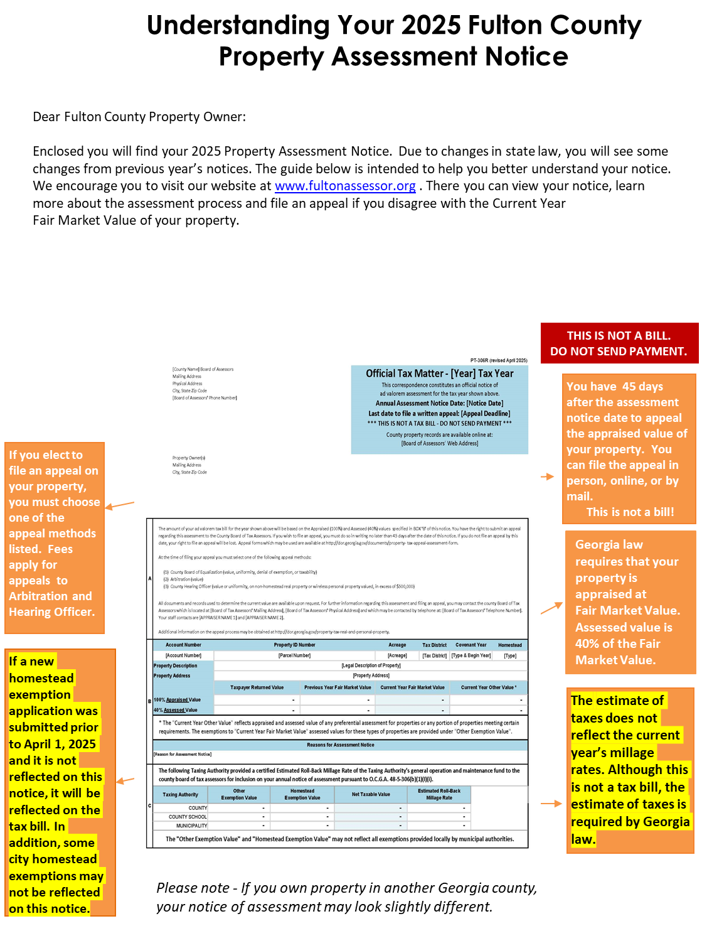
ANNUAL NOTICES OF ASSESSMENT
Mailed
  Tuesday, June 17th
45-Day Appeal Period
Appeal Deadline
  Friday, August 1st

Slide 10

Homestead Exemptions
If you own and live in a house in Fulton County, you may qualify for a homestead exemption…
A homestead exemption is a legal provision established by state law and local legislation that may reduce the assessed value of owner-occupied homes.
While you can apply for a homestead exemption at any time, the deadline in order to qualify for the current tax year is April 1.
Extended Filing Period – June 17th thru August 1st

Slide 11

Available Exemptions
There are a variety of exemptions available to the citizens of Fulton County…
There are basic exemptions which only require the applicant to own and occupy the property as of January 1 to qualify.
There are special exemptions for which one may qualify depending on their age and income levels.
Additionally, there are exemptions especially for Disabled Veterans, Veteran’s Surviving Spouse…

Slide 12
Available Exemptions (cont)
  Surviving Spouse of a Peace Officer or Firefighter killed in the line of duty.
  Low Income (Poverty) - Federal adjusted gross income (of all residents of the household) for the preceding taxable year cannot exceed 200% of the Federal Poverty Level as established by the U. S. Department of Health and Human Services, dependent on the # of persons in the household.

Slide 13
WHAT YOU NEED
A BASIC HOMESTEAD EXEMPTION:
A Valid Georgia Driver’s License or Georgia Identification Card
Social Security Number
Registration for Vehicles Owned by and Registered by the property owner(s) and spouses
PROPERTY IN THE NAME OF A TRUST:
Trust Affidavit (trust documents)
SPECIAL EXEMPTIONS (SENIORS AND INCOME BASED):
State and Federal Tax Returns
Social Security Award Letter if you do not file income tax.
Your name must be on the deed in order to apply!

Slide 14

ONLINE SERVICES
Homestead & Special Exemptions
Real Property Returns (Jan. 1 – April 1)
Business Personal Property, Aircraft & Marine Returns (Jan 1 – April 1)
Real and Business Personal Property Appeals
Change of Mailing Address (Real Property Only)

Slide 15
CONTACT US
MAIN LOCATION:
Peachtree Center @ 235 Peachtree St. (Administrative Office)
Phone: 404-612-6440
SATELLITE LOCATIONS:
Government Center @ 141 Pryor St.
Alpharetta @ 11575 Maxwell Rd.
Greenbriar Mall @ 2841 Greenbriar Parkway
North Fulton Service Center @ 7741 Roswell Rd. NE
South Fulton Service Center @ 5600 Stonewall Tell Rd.

Slide 16

QUESTIONS

