Slide 1

’MARK to Markets
War, Technology, and Markets
Recap of the first quarter 2026 and market outlook

Slide 2
Contents
Markets
Economy
Thought Leadership

Slide 3
Oil Spike Pressures Global Markets
MARKETS
Spike in Oil Hits Energy Importers More
Returns Since Iran-US Conflict Began
Equities | YTD | 1-Year | 3-Year
S&P 500 | -4.3 | 17.8 | 18.3
International Developed | -1.1 | 21.9 | 14.2
Emerging Markets | -0.1 | 30.3 | 15.4
Bond and Alts | YTD | 1-Year | 3-Year
U.S. Aggregate | 0.0 | 4.3 | 3.6
Gold | 7.1 | 47.2 | 32.0
Global 60/40 | -2.3 | 13.9 | 11.2
  Source: FactSet. Data as of 03/31/2026.
  It is not possible to invest directly in an index. Indexes are unmanaged, do not incur management fees, costs, and expenses and cannot be invested in directly. Index performance assumes the reinvestment of dividends.
  Source: FactSet. Data as of 02/28/2026-03/31/2026.
Notes:
Higher oil prices have put pressure on global markets, but the impact hasn’t been equal. U.S. equities declined the most for the quarter overall, but since the start of the conflict, they have held up better than other regions, while international and emerging markets gave back earlier gains.
The key difference comes down to energy exposure—countries that rely more on imported energy, like parts of Europe and Asia, have seen weaker performance, while the U.S. has been more resilient as a net energy exporter.
At the same time, bond markets have been challenged as rising inflation concerns pushed yields higher, though that has improved income opportunities. Gold initially benefited from uncertainty but gave back some gains as the dollar strengthened.
Importantly, diversified portfolios have helped cushion the impact, with a global 60/40 portfolio down about -2.3% for the quarter—highlighting the value of diversification in a more volatile environment.

Slide 4
U.S. Economy Holds Steady, Led by the Consumer
ECONOMY
The U.S. Economy Rests on Three Pillars*
% of GDP (Level)
Contribution to GDP Last Two Years (%)
Total Trade (Exports - Imports) = Drag on GDP (-3%)
*Composition of U.S. GDP (Q4 2025). Red slice is Net Exports (Exports-Imports) which is -3%. Data as of 02/20/2026. Source: BEA
Data as of 03/31/2026 Sources: BEA, FactSet.
Notes:
The U.S. economy has grown at a steady, near-trend pace, with the consumer consistently serving as the primary driver—accounting for roughly two-thirds of overall activity.
While growth moderated slightly in 2025 compared to 2024, it remained solid overall. Consumer spending continued to contribute the most to GDP, though at a slower pace, while business investment stayed positive but modest. Government spending provided a larger boost in 2024 and eased in 2025, and trade remained a drag on growth.
Overall, the data reflects a resilient economy over this period, with growth supported by multiple pillars even as it normalized.

Slide 5
Business: Investments in AI Are Driving Growth
ECONOMY
AI Spend Drove Nearly 40% of 2025 GDP Growth
Hyperscaler Capex Is Surging Higher
($, Billions)
Data as of 03/15/2026. Source: Goldman Sachs, FactSet, JP Morgan
Data as of Feb 2026. Source: Federal Reserve Bank of St. Louis. Contribution to Real GDP Growth, Q1-Q3 2025.
Notes:
Business investment has remained a key support for economic growth, led by a surge in capital spending from large technology companies. Hyperscalers continue to ramp up investment, particularly in infrastructure tied to artificial intelligence.
This wave of spending is increasingly showing up in the broader economy. AI-related investment—across equipment, software, and data centers—has made a meaningful contribution to GDP growth in 2025, accounting for a notable share of expansion.
Overall, strong capital spending, especially tied to AI, has become an important offset to softer areas of the economy and a key driver of continued growth.

Slide 6
AssetMark’s View
ECONOMY
Consumer: Moderating
Corporates: AI Boom
Government: OBBBA Stimulus
Goods: Tariffs push up prices
Shelter: Slowing, but sticky
Energy: Oil prices higher
GROWTH
INFLATION
Growth risks are rising and inflation could reaccelerate if the conflict continues.
Cautious
Neutral
Good
Current
Growth: Cautious = Negative growth aka recession; Neutral = Trend Growth (1-2%); Good = Above Trend (2+%)
Inflation: referring to the headline CPI trend. Cautious = Moving Above 3%; Neutral = 2-3%; Green = At Fed’s Target of 2%

Slide 7
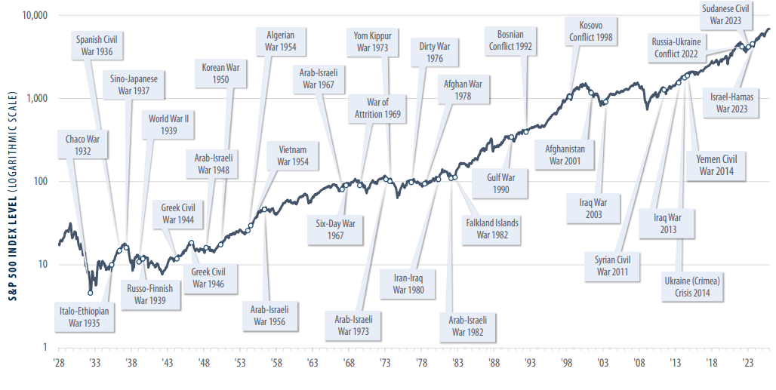
Wars & Conflicts Have Been a Constant in History
THOUGHT LEADERSHIP
Though uncertainty may temporarily shape the market, maintaining a long-term perspective is critical.
Data as of 2/28/2026. Source: Bloomberg, FactSet.
Notes:
Conflicts and geopolitical shocks have been constant throughout modern history.
While markets often react sharply in the short term, the long-term trend has remained upward. Even through wars, crises, and periods of uncertainty, the broader trajectory of the market has reflected economic growth and innovation over time.
The key takeaway is that maintaining a long-term perspective is critical. Short-term volatility is normal — but history shows that disciplined investors who stay focused on long-term fundamentals are typically rewarded.

Slide 8
Volatility Tends to Rise in Midterm Years
THOUGHT LEADERSHIP
Average Drawdown
Since 1980: -14%
Data as of 03/31/2026. Source: FactSet.
Notes:
Historically, midterm election years have tended to experience higher volatility and deeper drawdowns. Since 1980, the average intra-year drawdown has been about 14%, and several of the more pronounced pullbacks occurred during midterm cycles.
That said, volatility does not automatically mean negative full-year returns. In many midterm years, the S&P 500 ultimately finished higher despite meaningful interim declines.
The takeaway for investors is to expect turbulence during election cycles, but to remain focused on long-term fundamentals rather than short-term political uncertainty.

Slide 9
Key Talking Points
THOUGHT LEADERSHIP
Economic Impact
Limited impact to growth and inflation if the conflict is short-lived
AI investment and tax benefits provide some buffer
Persistent oil shock raises stagflation (lower growth & higher inflation) risks
Investor Takeaway
History shows market impacts from geopolitical conflicts are short-lived
Volatility may rise, but long-term trends remain intact
Stay diversified and stick to your financial plan—these plans are built to navigate periods of volatility

Slide 10
Index Information
 | Asset Class | Index | Definition
EQUITIES | U.S. Equity / Large Cap | S&P 500 | Measures the performance of 500 leading companies in the U.S. weighted by market cap. Constituents generally have a market-cap above $5 billion and represent approximately 80% of the investable market.
 | International Developed Equity | MSCI EAFE | Measures the equity performance of countries considered to represent developed markets, excluding the U.S. and Canada.
 | Emerging Markets (EM) Equity | MSCI Emerging Markets | Measures the equity market performance of countries considered to represent emerging markets.
BONDS | U.S. Bonds | Bloomberg U..S Aggregate | Measures the performance of USD-denominated, investment-grade, fixed-rate taxable bond market of SEC-registered securities. The index includes Treasury bonds, Government-related Corporate, MBS (agency fixed-rate and hybrid ARM pass-throughs), ABS and CMBS sectors.
ALTS | Gold | Bloomberg Gold – Total Return | Measures the performance of futures contracts on gold and is quoted in USD.
INDEX BLEND | Global 60/40 | 60% MSCI ACWI, 40% Bloomberg | Measures the performance of a blend of global equities and global bond indexes used as a benchmark for balanced portfolios.

Slide 11
Index Information
 | Asset Class | Index | Definition
BONDS | Short Treasury | Bloomberg Short-Term Treasury Index | Measures the performance of the U.S. treasury bills, notes, and bonds under 1 year to maturity.
 | U.S. Bonds | Bloomberg U.S. Aggregate | Measures the performance of USD-denominated, investment-grade, fixed-rate taxable bond market of SEC-registered securities. The index includes Treasury bonds, Government-related Corporate, MBS (agency fixed-rate and hybrid ARM pass-throughs), ABS and CMBS sectors.
 | Intermediate Treasury | Bloomberg Intermediate-Term Treasury Index | Measures U.S. dollar-denominated, fixed-rate, nominal debt issued by the U.S. Treasury with maturities of 1 to 9.99 years to maturity.
 | Long Treasury | Bloomberg U.S. Treasury Long Index | Measures the performance of U.S. Treasury bonds that have at least 10 years left until maturity.
 | Muni Bonds | Bloomberg Municipal Index | Measures the performance of the Bloomberg U.S. Municipal bond market.
 | Investment Grade | Bloomberg U.S. Credit Index | Measures the investment grade, U.S. dollar-denominated, fixed-rate, taxable corporate and government-related bond markets.

Slide 12
Important Information
This is for informational purposes only, is not a solicitation, and should not be considered investment, legal or tax advice. The information has been drawn from sources believed to be reliable, but its accuracy is not guaranteed and is subject to change.
Investing involves risk, including the possible loss of principal. Past performance does not guarantee future results. Asset allocation cannot eliminate the risk of fluctuating prices and uncertain returns. There is no guarantee that a diversified portfolio will outperform a non-diversified portfolio. No investment strategy, such as asset allocation, can guarantee a profit or protect against loss. Actual client results will vary based on investment selection, timing, market conditions, and tax situation. It is not possible to invest directly in an index. It is not possible to invest directly in an index.
Investments in equities, bonds, options, and other securities, whether held individually or through mutual funds and exchange traded funds, can decline significantly in response to adverse market conditions, company-specific events, changes in exchange rates, and domestic, international, economic, and political developments. Investments in bonds and fixed income related securities involve market and interest rate risk (prices can decline, if interest rates increase), and default risk (an issuer being unable to repay principal and interest). High-yield bonds are generally subject to greater risk of default than investment-grade bonds. Real estate investments are subject to credit and market risks, typically based on changes in interest rates and varied economic conditions. Investing in alternative investments, including managed futures, commodities, and currencies is not appropriate for all persons, as the risk of loss is substantial. Investments in futures involve market, counterparty, leverage, liquidity, interest rate, foreign currency, commodity, volatility, and other risks.
The market indices shown are non-managed indices shown for reference purposes. Index performance reflects the reinvestment of dividends. It is not possible to invest directly in an index, and index performance does not reflect any deduction for investment advisory fees.
The exclusion of investments based on industry or ESG factors reduces the number of available investment choices and can impact overall investment performance.
For more complete information about the various investment solutions available, including the investment objectives, risks and fees, please refer to the Disclosure Brochure and applicable Fund Prospectus. Please read them carefully before investing. For a copy, please contact AssetMark.

Slide 13
Important Information
Important Information
Bloomberg® and the referenced Bloomberg Index are service marks of Bloomberg Finance L.P. and its affiliates, (collectively, “Bloomberg”) and are used under license. Bloomberg does not approve or endorse this material, nor guarantees the accuracy or completeness of any information herein. Bloomberg and AssetMark, Inc. are separate and unaffiliated companies.
AssetMark, Inc. is an investment adviser registered with the U.S. Securities and Exchange Commission. AssetMark Asset Management, a division of AssetMark, Inc., includes the firm’s proprietary investment strategies. GuideMark® and GuidePath® Funds are distributed by AssetMark Brokerage™, LLC, member FINRA, an affiliate of AssetMark, Inc. AssetMark, and third-party strategists and service providers are separate and unaffiliated companies. Each party is responsible for their own content and services.
©2026 AssetMark, Inc. All rights reserved.
8855340.1 | 04/2026 | EXP 04/2028

