Slide 1
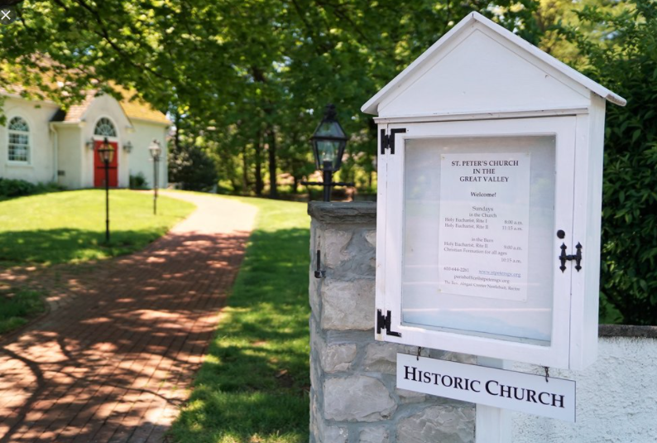
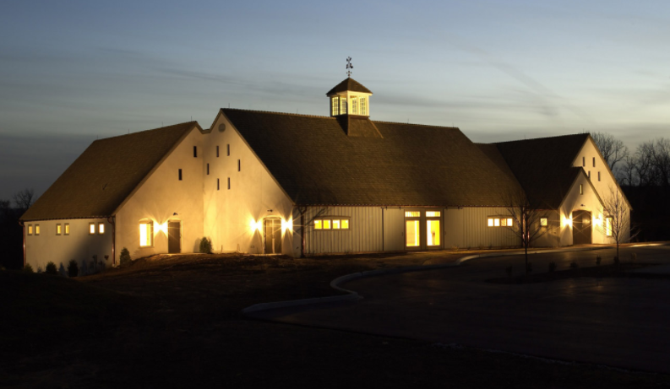
St. Peter’s Church in the Great Valley
Financial Review
October 25, 2026

Slide 2
Financial Meeting
Agenda – St Peter’s Financial Meeting
St Peter’s organization and basics
Transition year - 2026
Revenue & expenses in 2026
High Point revenue change 2019 - 2027
Endowment – Increased and more
2027 stewardship goals and status
2027 Budget
Questions

Slide 3
Financial Meeting
St. Peter’s Mission
The mission of St. Peter’s Church in the Great Valley is, by the power of the Holy Spirit, to nurture people of all ages in the knowledge and love of God in Jesus Christ, and to make Him known in the wider community.

Slide 4
Organization
St. Peter’s Church in the Great Valley
Founding
Parish Started
1700
Vestry
Mission
Resources
Rector
Ministries
Staff & Budget

Slide 5
Financial Meeting
St. Peter’s Financial Basics
Vestry - responsible for parish financial matters
Finance Commission – recommends financial actions to vestry. Commission members - Jan Himmelreich, Mike Harman, Joe Herbst (chair), Paige Infortuna, Steve Ockenden, Wilson Smith
Operations
  Rector – John Kennedy
  Treasurer – Paige Infortuna
  Parish Administrator – Melissa Shaner
  Bookminders – Stacey Dillon – Moving to Realm
Annual Audit – Carl O’Fria audits financial statements (new 25)

Slide 6
Financial Meeting
St. Peter’s 2026 – Transition Year
Thank you – Clarke French – Interim Rector
Thank you – Profile, Prayer, and Search Committees
Welcome – John and Emma Kennedy
Thank you – St Peter’s Parishioners
  A “Big Step Up in Pledge”
Thank you - Jean Bowman for the wonderful gift

Slide 7
Sources of Income 2026 Forecast
Notes:
As you can see pledges are critical to funding everything that happens at St. Peter’s
The Assistant Rector Funding is also a source of pledging, but was handled outside of the operating budget
We bring those dollars in on a monthly basis to track our true costs
Rental income accounts for about 12% of the budget. We work closely with Robert Ryan Catering on rental of our buildings and grounds.

Slide 8
High Point Rental Revenue

Slide 9
Expense Categories 2026 Forecast
Notes:
Salaries and Benefits are the largest expense item in the budget. We have a great team!
Property is the second largest expense. We have 16 acres and 3 buildings to look after.
The BB&G4J are amazing Stewards of our bucolic setting. They save us thousands and thousands of dollars a year.
Outreach is a budgeted item
Diocesan support – there is an annual assessment that we pay to support the DIOPA. This is mandatory and based on a prior year’s budget.
There are expenses associated with the rental of our facilities (set up, cleaning, staff)

Slide 10
Financial Meeting
Stewardship Goals for 2027
Please pledge!
As of October 23, we have received 43 pledges; 82 pledges short of goal.
We have received $205,000 of pledges, need $295,000 more for 2027 goal of $500,000!

Slide 11
Financial Meeting
Endowment Funds and Balances 9/30/26
Endowment Fund | Balance | Purpose
21st Century | $1, 530,000 | Capital improvements, special one-time projects
General Church Foundation | $405,000 | Operating budget
Churchyard | $673,000 | Churchyard
Rentschler | $266,000 | Special music events
Hudson | $93,000 | Music
Washington (New!) | $20,000 + | New – Operating budget
Total | $2,987,000 | Highest Ever

Slide 12
Financial Meeting
2027 Budget – Draft 3 – Important Points
 | 2026 Forecast | 2027 Budget Draft 3 | Comment
Pledge (some 26 prepaid) | $435,000 | $500,000 | +15% - Big step up!
Pecora / Seeds Rental Rev | $75,000 | $94,000 | +25% and rental AFTER costs is what matters
Parish Savings – estimated usage | $66,000 | $37,000 | Will use ~50% of 12/31/26 Savings balance in 2027
Property Expense | $148,000 | $138,000 | Reduce expenses in 2027 – Snow, heat, repairs & inspect
Salary & Benefits Expense | $370,000 | $411,000 | Rector and staff with benefits for full year
Net Surplus (Deficit) | ($30,000) | ($19,000) | Pledge and rental after cost are most important

Slide 13
Financial Meeting
Fulfilling the Mission of St. Peter’s
Summary
Welcome John Kennedy!
  New Rector - New Life, New Energy, New Growth!
Meet the Pledge Goals
  125 Pledges & $500,000 of Pledges
Parish Growth
  Grow number of parishioners and pledgers 2027 – 2030
  Increase in average pledge - $4,000 – continue to grow
Successful Launch of Jaccaranda and Seeds of Celebration
Receive the Bowman Gift – Thank you

Slide 14
St. Peter’s Church in the Great Valley
Financial Meeting
October 25, 2026
Thank you for your attention
Questions?
For further information contact me at jeherbst1@gmail.com

Slide 15
Financial Meeting
Revenue – 2026 Forecast vs. 2027 Budget
Revenue | 2026 Forecast | Draft 2027 Budget | Variance
Pledge | $435,000 | $500,000 | +15%
Unpledged | $35,000 | $13,000 | -63%
Plate, E & C, Gifts | $51,000 | $28,000 | -45%
Grave Openings | $17,000 | $16,000 | -6%
High Point Rental | $75,000 | $94,000 | +25%
Legacy Rental | $12,000 | $12,000 | 0%
Interest Income | $23,000 | $23,000 | 0%
Endowment Income | $34,000 | $55,000 | +62%
Parish Savings | $66,000 | $37,000 | -44%
Total | $748,000 | $778,000 | +4%

Slide 16
Financial Meeting
Expenses – 2026 Forecast vs. 2027 Budget
Expenses | 2026 Forecast | Draft 2027 Budget | Variance
Salaries & Benefits | $370,000 | $411,000 | +11%
Property | $148,000 | $138,000 | -7%
High Point related | $71,000 | $54,000 | -24%
Administration | $61,000 | $63,000 | +3%
Worship | $59,000 | $60,000 | +2%
Outreach | $30,000 | $30,000 | 0%
Diocese support | $30,000 | $30,000 | 0%
Other | $9,000 | $11,000 | +22%
Total | $778,000 | $797,000 | +2%

