Slide 1

COVID Relief Fund Monitoring: Emergency Assistance to Nonpublic Schools (EANS)
Kevin Walters
Michigan Department of Education

Slide 2

ESF: Emergency Assistance for Non-Public Schools
The Department awarded these grants to State educational agencies (SEAs) for the purpose of providing services or assistance to eligible nonpublic schools to address the impact that COVID-19 has had, and continues to have, on nonpublic school students and teachers in the state.
CARES
No EANS funding was provided under CARES.
CRRSA
$86.7M of funding was provided for EANS I under this act.
ARPA
$86.7M of funding was provided for EANS II under this act.

Slide 3
EANS Data Classification Levels
CRRSA
ARPA
Non-public schools recommended by MDE (Based on Risk Assessment)
K-12 Non-public schools (No preschool programs)
Allocations, Obligations, Expenditures, Liquidations
Allowable Uses and Eligible Expenditures
SEA
Non-Public Schools

Slide 4

EANS
Target Population(s)
Non-public elementary schools in Michigan
Non-public secondary schools in Michigan
Allocations, Earmarks, and Set Asides
Allotment related to children aged 5 through 17 at or below 185% of the poverty line.
No required reservations of funds under EANS but may reserve up to half of 1% or $200,000, which ever is greater, for administrative costs.
Considerations for PPP Loans received by non-public schools.
More information on EANS can be found here.
Federal FAQs
Federal Fact Sheet
Allowable Uses and Eligible Expenditures
Supplies to sanitize, disinfect, and clean school facilities.
Personal protective equipment (PPE);
Improving ventilation systems, including windows or portable air purification systems.
Training and professional development for staff on sanitization, the use of PPE, and minimizing the spread of infectious diseases.
Physical barriers to facilitate social distancing.
Other materials, supplies, or equipment to implement public health protocols, including guidelines and recommendations from the Centers for Disease Control for reopening a operation of school facilities to effectively maintain health and safety of students, educators, and other staff.
Expanding capacity to administer coronavirus testing to effectively monitor and suppress the virus, to conduct surveillance and contact tracing activities, and to support other activities related to coronavirus testing for students, teachers, and staff.
Educational technology (including hardware, software, connectivity, assistive technology, and adaptive equipment) to assist students, educators, and other staff with remote or hybrid learning;
Redeveloping instructional plans, including curriculum development, for remote or hybrid learning or to address learning loss;
Leasing sites or spaces to ensure safe social distancing;
Reasonable transportation costs;
Initiating and maintaining education and support services or assistance for remote or hybrid learning or to address learning loss.

Slide 5
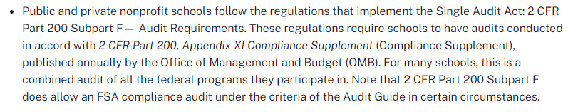
Federal Auditing Rules – Nonpublic Schools
https://www.ecfr.gov/cgi-bin/text-idx?SID=9753a50d824a942cb367a62721b97431&mc=true&node=pt2.1.200&rgn=div5#sp2.1.200.f

Slide 6
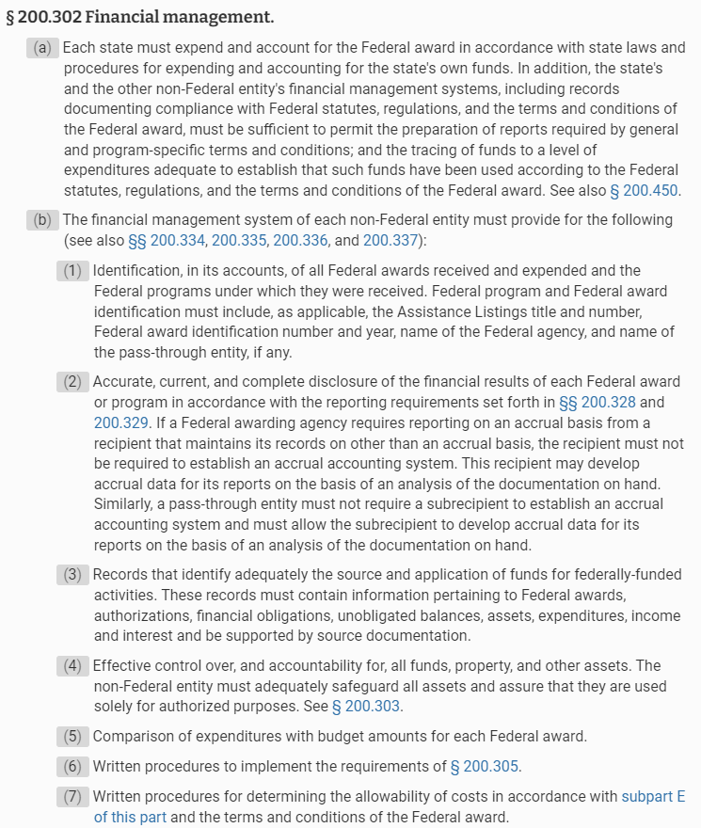
Federal Auditing Rules – Nonpublic Schools
eCFR :: 2 CFR 200.302 -- Financial management.

Slide 7
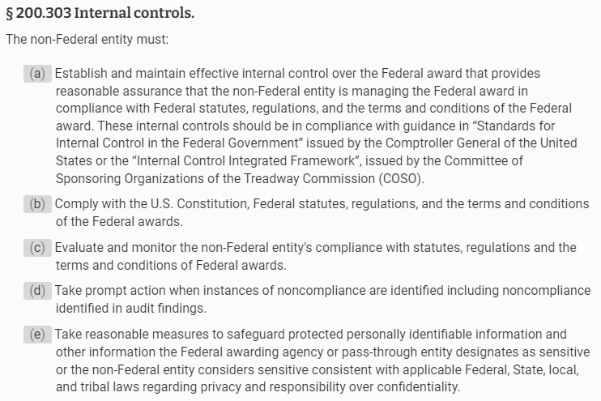
Federal Auditing Rules – Nonpublic Schools
eCFR :: 2 CFR 200.303 -- Internal controls.

Slide 8

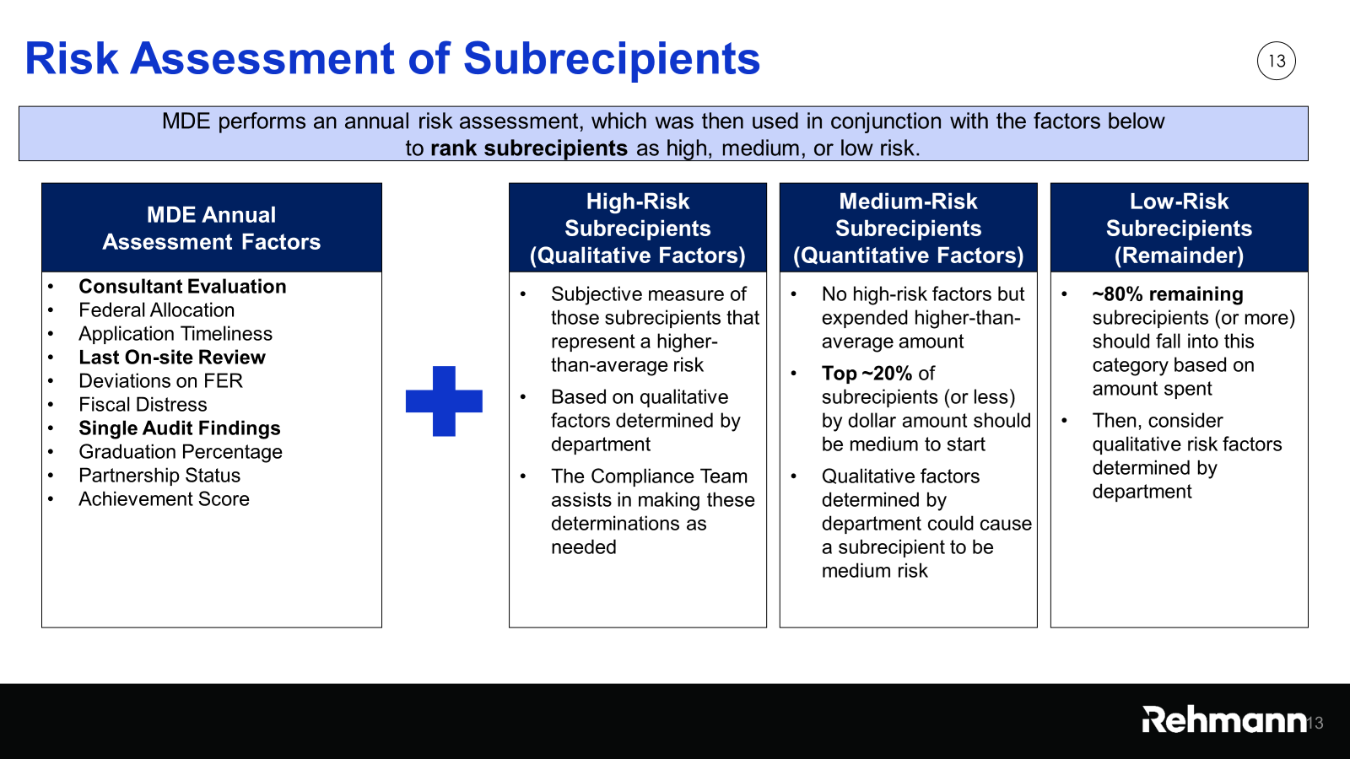
Public School Risk Assessment (Rehmann)

Slide 9
Nonpublic School Risk Assessment (Rehmann)
High-Risk Nonpublic Schools
Allocation Amount/
Other Factors
Top 10-15%
Medium-Risk Nonpublic Schools
Allocation Amount/
Other Factors
20-25%
Low-Risk Nonpublic Schools
Allocation Amount
Remaining 75-80%
MDE Risk Assessment of Nonpublic Schools
30-45 (EANS I) 10-15 (EANS II)
60-75 (EANS I) 20-25 (EANS II)
200+ (EANS I) 75-80 (EANS II)

Slide 10
Sampling and Testing Examples (Rehmann)
The amount of sampling and testing during the monitoring effort is a matter of professional judgment and is based on the assessed level of risk for the program overall and the subrecipient. The Compliance Team worked with MDE to assess overall program risk and subrecipient risk.
The following are examples of monitoring steps that the Compliance Team will take to test expenditures.
All costs: Compare against general program requirements and the Uniform Guidance
Equipment and real property: Agree amount to purchase order, invoice, receiving report, and equipment inventory
Other goods and services (including payments to contractors): Agree amount to purchase order, invoice, and receiving report
Notes:
BB
The UG is pretty clear:
2 CFR 200.332(d) Pass-through entity monitoring of the subrecipient must include:
1. Review financial and performance reports
2. Follow-up on known deficiencies detected through audits, on-site reviews, etc.
3. Issue a management decision for applicable audit findings
4. Resolve audit findings that are directly related to the subawards provided by the PTE
2 CFR 200.332(e) Depending upon the pass-through entity's assessment of risk posed by the subrecipient:
1. Provide subrecipients training and technical assistance
2. Perform on-site reviews of program operations
3. Arrange for agreed-upon procedures (if no single audit will be required)
The minimum requirements don’t include anything with procurement or eligibility. Those weren’t excluded because the initial plan was CRF… they were excluded because they are not required for low-risk subrecipients under the UG.
As we have determined our population, assessed risk on an overall and program specific basis, we can move into sampling.
This sampling guide provides an overview of the level of effort required for by applying the overall program risk against the type of recipient or transaction that occurred.
Based on the overall program risk, sampling of transactions would generally occur for funds spent directly on the state for things like payroll, equipment, payments made to contractors and for payments made to beneficiaries.
Based on the overall program risk, first sampling of subrecipients would occur for the population of subrecipients based on these populations and then samples of transactions would be made using detail provided by the given subrecipient.
Standard sample sizes for subrecipient transactions are outlined in the monitoring policies and procedures document in the toolkit John mentioned previously.
This sample of transactions at the subrecipient level would be driven on the subrecipients risk level.

Slide 11
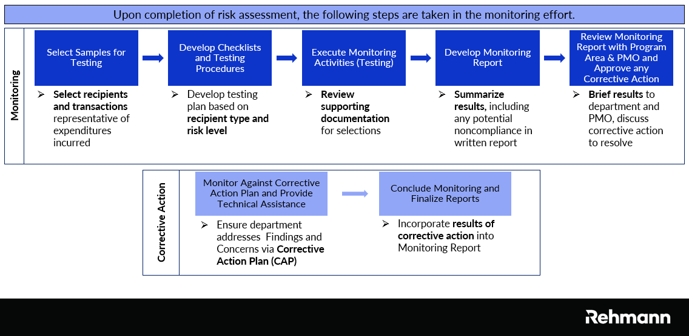
Monitoring Approach (Rehmann)

Slide 12
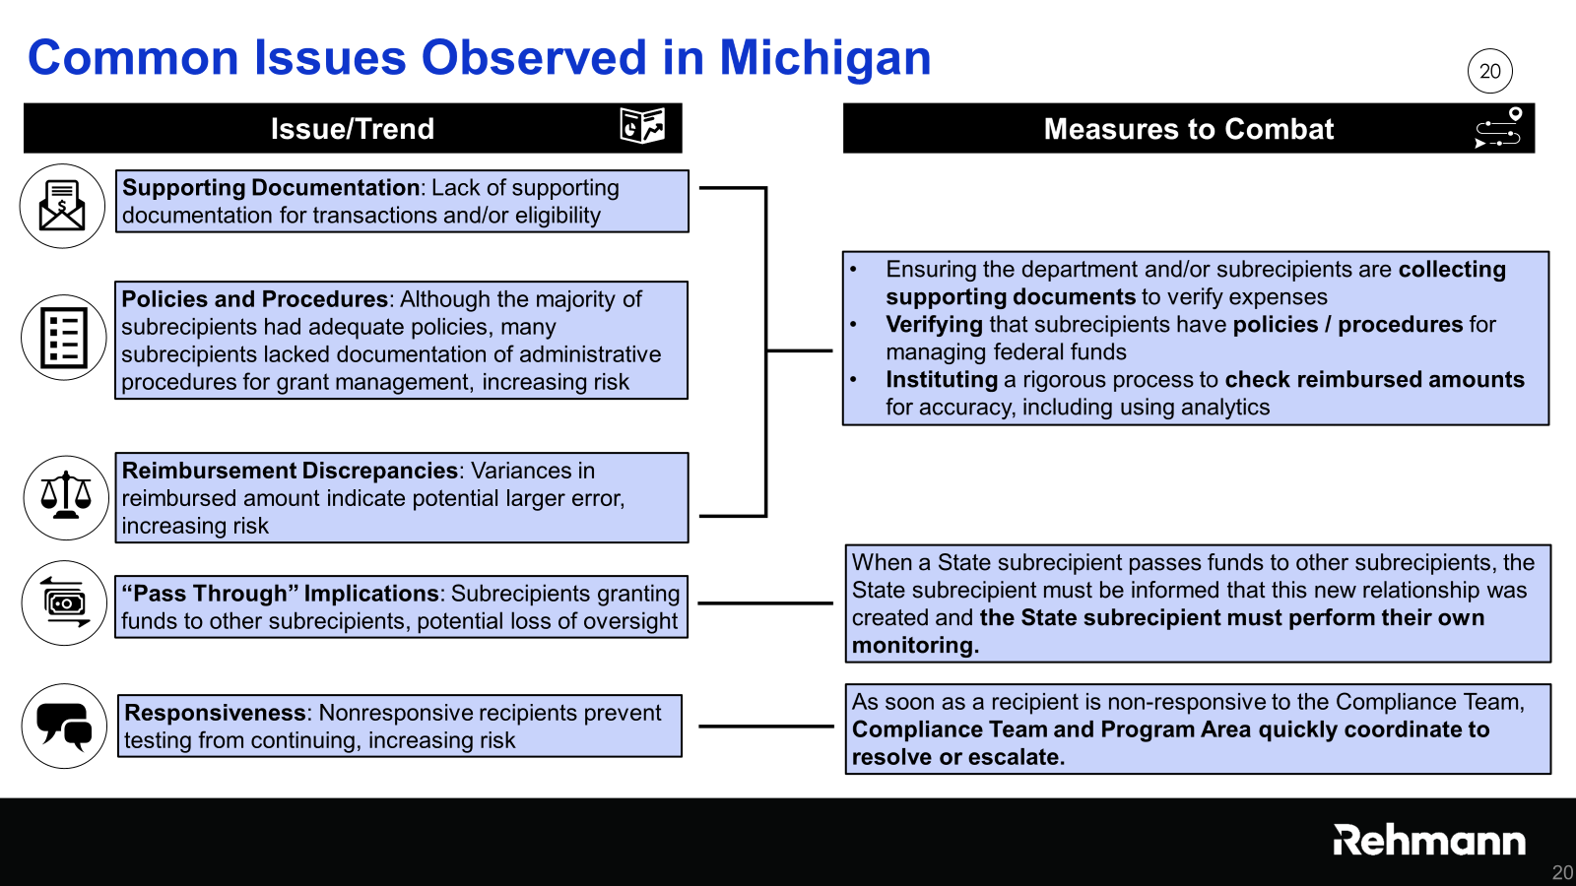
Risk Assessment (Rehmann)

Slide 13
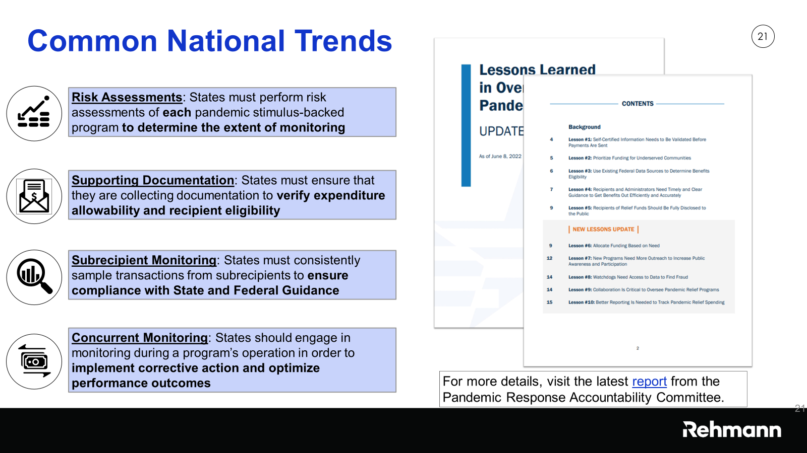
Risk Assessment (Rehmann)

Slide 14

Notes:
You can use this type of slide for text, images, shapes and tables to help add information in a different way. Duplicate this slide to add additional images of important locations in your visit.

Slide 15
Kevin Walters
Supervisor, Grants Contracts & School Support
Office of Financial Management
517-335-0543 (office) or 810-728-5254 (cell)
MDE-CARES@michigan.gov or waltersk5@michigan.gov

