Slide 1


Welcome
Welcome to the 2025 ANAC
Annual Business Meeting: Virtual
November 15, 2025
Notes:
Darcel

Slide 2
Rules of Conduct
Agree to hold discussion until all agenda items are presented
During discussion – please use raise hand icon or enter your name into the chat box to be recognized
The host will recognize next discussant in order
Comments are limited to 2 minutes
Further comments are welcome by email: anac@anacnet.org
At any time- enter your question/comment into the chat box
All participants will be on mute, please do not umnute yourself unless called upon.
Notes:
Darcel

Slide 3
Meeting Agenda
MEETING AGENDA
Open - Welcome & Ground rules: Darcel Reyes 2 mins
Presidents’ report:
Mitchell Wharton (2025) 10 mins
Darcel Reyes (2026) 5 mins
Introduction of New Executive Director: Darcel Reyes 2 mins
Introductory Remarks: Shey Thorn 3 mins
Treasurer’s 2025 Report : Deb Winters 10 mins
Executive Director 2025 Report: Carole Treston 10 mins
Exit remarks: Carole Treston 3 mins
Open Discussion 15 mins
Notes:
Darcel

Slide 4
President’s Report: 2025

Slide 5
President’s Report: 2026

Slide 6
2026 Board of Directors
President
Darcel M. Reyes, PhD, ANP-BC, AACRN, FAAN
President-elect
Anthony Velasco, MS, AGPCNP-BC, CNS, CMSRN, ACRN, AAHIVS
Secretary
Robin Beach, PHD, FNP-C, AACRN, FAANP
Treasurer
Deb Winters, AACRN, APRN-BC
Director-At-Large
Rasheeta Chandler, PhD, RN, FNP-BC, FAANP, FAAN
Director-At-Large
Emily Barr, PhD, RN, CPNP-PC, CNM, ACRN, FACNM,
FAAN
Director-At-Large
Nathaniel Albright, APRN, AAHIVS, ACRN
Director-At-Large
Peter Oates, RN, MSN, NP-C
Director-At-Large
Jonah Pierce, RN, ACRN
Director-At-Large
Bridgette Picou, LVN, ACLPN

Slide 7

ANAC 2026 and Beyond

Slide 8


Slide 9
Welcome Shey Thorn

Slide 10
Treasurer’s Report: Deb Winters

Slide 11
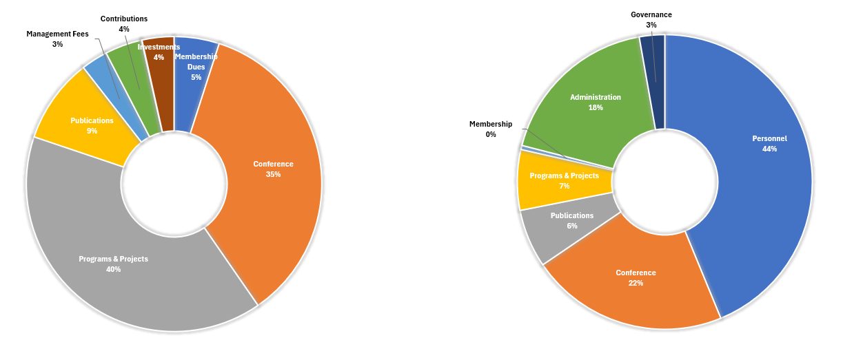
ANAC Overview - 2024 Financials
2024 Revenues - $1,356,930
2024 Expenses - $1,483,197
Notes:
REVENUE
Programs & Projects (Grey 40%)was the largest source of revenue followed by
Conference (Orange 35%)
Investments remained stable from 2023 to 2024 at 4%
EXPENSES
Personnel (blue) was highest at 44%. The next slide will show the breakdown of personnel effort.
Conference expenses (orange) was the next highest category at 22%

Slide 12
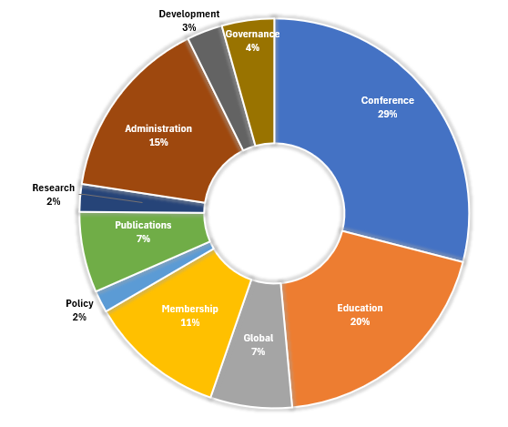
ANAC Overview - 2024 Expense Structure
2024 Expenses - $1,483,197
Notes:
This slide breaks down the personnel effort accounting for 44% of expenses
Conferences (29%) is the largest category overall and includes staff time planning, executing and evaluating. This also includes site and speaker costs.
Education (20%) includes staff effort on planning non-conference educational programs e.g. webinars, HIV & Aging, CNE, production costs
Administration (15%) continues to be healthy. The industry standard is 15-20% of budget.
Membership expenses include staff effort, modest outlays to chapters, committees and shared scholarship/grants to members. This expense remained the same as in 2022 (11%)

Slide 13
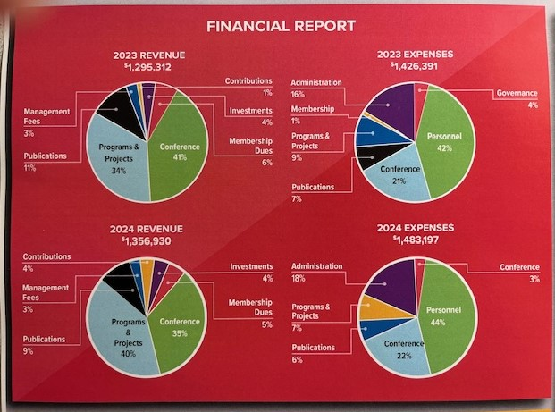
ANAC FINANCIAL REPORT 2023-2024
Notes:
Revenue Deficits were compensated by cash reserves & investment gains.

Slide 14
HIGHLIGHTS
Financial Statements (Audited) – Years ending December 31, 2024 & 2023
  Audit complete – No exceptions or concerns
Investments
  Our investment principal was $472K in 2017, primarily due to proceeds of house (Ohio office). Our principal + earnings reached a maximum of $600K in 2024.
  In Q3 2024, a $200K transfer was recommended by the Finance Committee and approved by the BOD to allow for full funding of operating, programmatic, conference, governance and staffing expenses.
  A $150K loan from investments was required in Q1 2025, due to a delay in payment on a pharma grant contract. When the grant was received, half the amount was put back into the investment account. Other half was placed in & remains in a Wells Fargo restricted savings account.
  Despite this & market volatility, ANAC current investment portfolio is approximately $437,000.
  Overall aim is to ensure that the investment account is restored to the $500,000 minimum balance approved by the BOD in the investment policy.

Slide 15
Executive Director’s Report

Slide 16
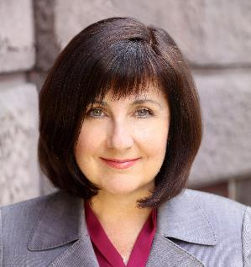

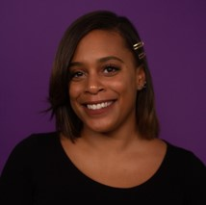
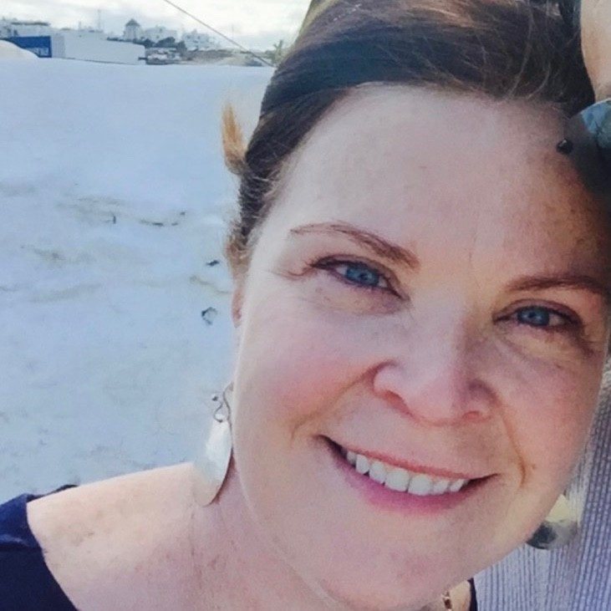
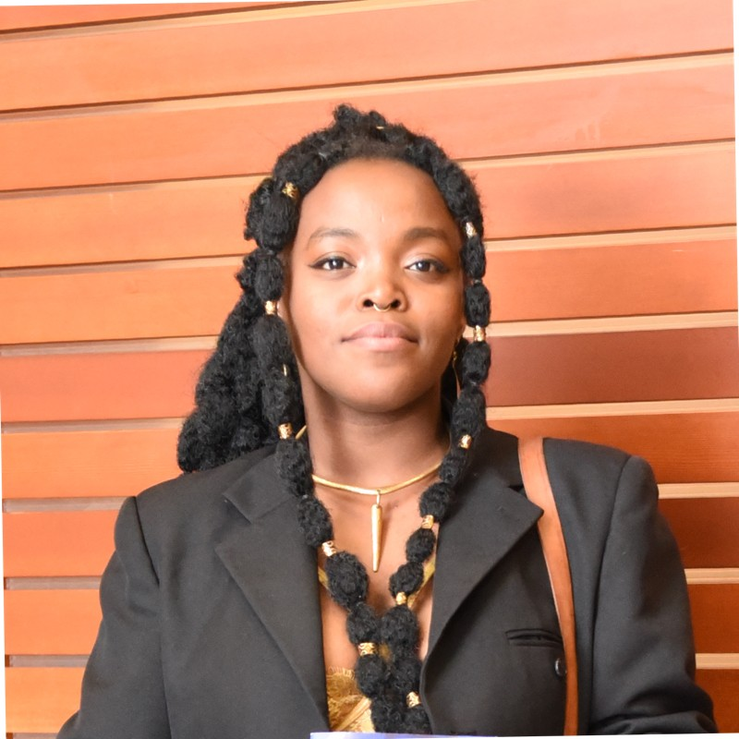
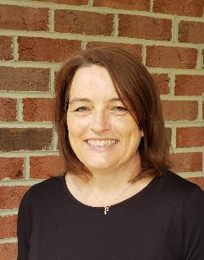

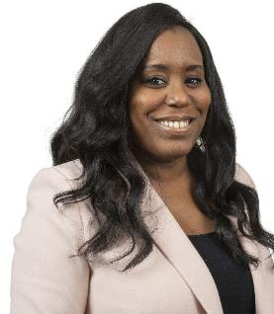
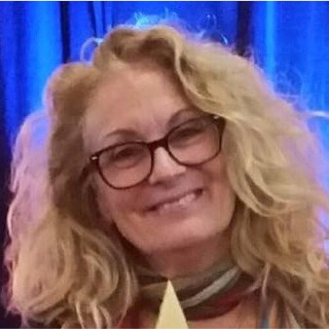
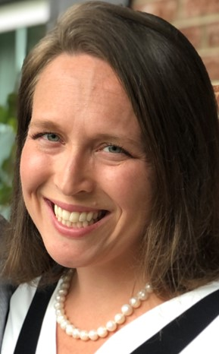
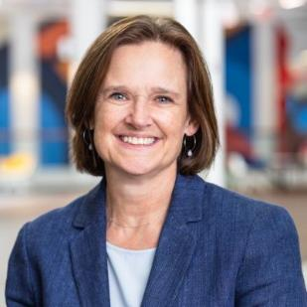
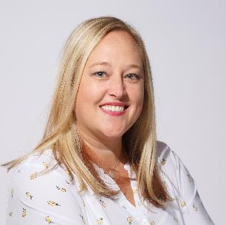
ANAC staff
Carole Treston
Jen Lafontaine
Nakera Dumas
Sheila Tumilty
Mwikali Kamami
Lynda Wileman
Wendy Laxton
Mary Smith
Kat Ngaruiya
Donna Sabatino
Julie Kramer
Sara Lundenberger

Slide 17

Association of Nurses in AIDS Care
Mission: ANAC fosters the professional development of nurses and others involved in the delivery of health care for persons at risk for, living with, and/or affected by the human immunodeficiency virus (HIV) and its comorbidities. ANAC promotes the health, welfare, and rights of people living with HIV around the world.

Slide 18

Mission: 2025 Professional Development
ANCC Accredited NCPD Provider
  Requires evidence –based, global standards
  Promote Highest Professional Standards for Nursing
  Effective and sustainable strategy to improve professional nursing practice.
Programs
Conference:ANAC2025 in Philadelphia-Up to 17 contact hours, including 4.25 Pharm credits
Webinars: Six with clinical updates & topics
2025: Southern Strategy pilot: 3 sites
2025: SHINE Part 1: 2/6 sites. 4/6 sites in Q1 2026
Established four partnerships : NBNA, SAC, HPTN096, NAHN
2026: Looking ahead: Member Directory. Topics & Speakers to anac@anacnet.org
SHINE Part 2 TBD

Slide 19
Mission: 2025 Advocacy
Policy & Advocacy Committee
Federal Lawsuit
Position Statements: Members->Committees->Policy Committee->BOD
Nurses UnCensored series
Nursing Coalitions: ANA Organizational Affiliates, Nursing Community
HIV Coalitions: FAPP, AIDSUnited, Emergency Clinical Response TF
Save HIV Funding
2026: Looking ahead: Advocacy Academy

Slide 20
Membership & Chapters 2025
Membership: Small but Mighty N=1800
  Looked to as the voice of nurses ( domestic & global)
  Trend towards global membership growth continues
  2025: 40% of ANAC membership =global members
  Three Town Halls
Member Survey: 252 responses. 70% nurses
  Education & Networking highest ranked
  20% on a committee
  40% affiliated with a local chapter
Chapters:
Chapter of the Year: Houston
Central Banking : Open to all US chapters now: JulieK@anacnet.org

Slide 21
Committees 2025
Member Committees
Awards
Chapters
Clinical Practice
DEI
Global
Membership
Policy & Advocacy
Research
Rural
****HIV+ warm-line start-up; looking ahead into 2026
Board/Appointed Committees
Bylaws
Conference
Development
Finance
JANAC Editorial Board
Nominating

Slide 22
THANK YOU & REFLECTIONS

Slide 23

QUESTIONS & DISCUSSIONS
Further questions & discussions can be addressed to the BOD & staff at anac@anacnet.org

