Slide 1

May 7, 2026
Veteran Directed Care:
Promoting Independence through Self-Direction

Slide 2
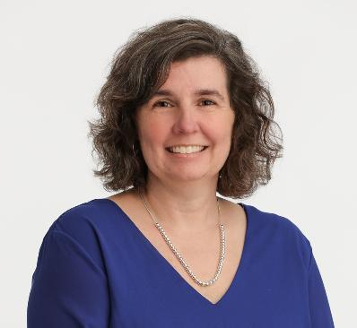
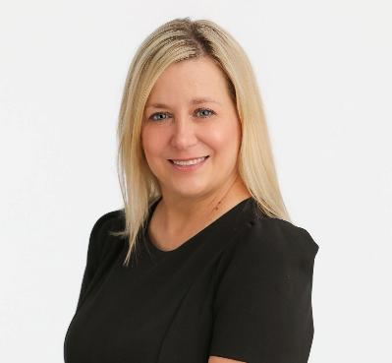
Melissa Blake
Director, Veteran Directed Care
Bay Aging mblake@bayaging.org
804-758-2386 x1219
Area Agency on Aging (AAA) headquartered in Urbanna, VA
Nonprofit 501(c)(3) established in 1978, currently serving 33,000+ people annually
Our Mission: To provide the programs and services people of all ages need to live independently in their communities
Jennifer Beck
Director, Veteran Services
Bay Aging
jbeck@bayaging.org
804-493-0238 x1409

Slide 3




Through its comprehensive transportation, housing, community living and health services programs, Bay Aging, a Virginia nonstock corporation established in June 1978, is committed to ensuring every client has a choice and ready access to a range of services to help them remain independent in their chosen home.
HEALTHY LIVING | HOUSING | TRANSPORTATION
Active Lifestyle Centers | Multi-Family: | Public Transportation
Adult Day Care | Service-enriched | Medicaid Transportation
Advance Care Planning | Senior Apartment | New Freedom Mobility
Care Coordination | Communities | Management
Caregiver Support | Housing Choice | MedCarry Non-Emergency
Companion Care | Voucher Program | Medical Transportation
Legal Aid | Single-Family: | Deviated Fixed Routes:
Meals on Wheels | Weatherization | The Rivah
Ombudsman/Advocacy | Emergency Home Repair | (Tappahannock)
Options Counseling | Housing Rehabilitation/ | Paper Trail (West Point)
Personal Care | Reconstruction | Microtransit (serving
Senior Employment Training | Indoor Plumbing | Gloucester Point to
Transitional Care | Rehabilitation | Gloucester Courthouse)
Veteran Directed Care | Community Action | Seasonal Trolleys
VICAP Insurance Counseling | Program Partnership
Volunteer Program | Development & Planning

Slide 4

What is Veteran Directed Care (VDC)?
Veteran Directed Care is a self-direction program that enables veterans of all ages to remain independent at home by hiring their own employees to provide personal care assistance.
Does the veteran need assistance with:
Personal Care Services?
Activities of Daily Living (Bathing, dressing or preparing meals)?
Are they feeling isolated?
Could their caregiver benefit from additional assistance providing care for them?

Slide 5
How does the veteran access the program?
The VA Primary Care Physician must refer them to Veteran Directed Care.
The VA will complete an assessment and determine their annual budget based upon their level of need and where they live.
Bay Aging will receive the VDC referral and an Options Counselor will connect with the veteran to begin the enrollment process.

Slide 6
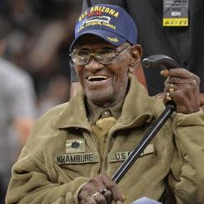









Referral Flow Chart
Veteran
Veteran
VA Primary Care Physician
VA Veteran Directed Care Coordinator
AAA (Hub)
AAA (Spoke)
Notes:
October: 61 ATS (3 or 5% were 30 days or less)
November: 87 ATS (1 or 1% were 30 days or less)
December: 75 ATS (2 or 3% were 30 days or less)
January: 59 ATS (4 or 7% were 30 days or less)

Slide 7
What is the veteran’s role in VDC?
The veteran acts as their own employer or designates an authorized representative to act on their behalf to hire employees to provide personal care services to them.
The Options Counselor assists the veteran with completing all employment forms and helps develop a budget that meets their individual care needs.
Bay Aging will establish the veteran as a household employer with the IRS and state/local tax agencies, process their employees’ payroll, and file and pay all employment taxes related to VDC services.

Slide 8
The Options Counselors
Options Counselors (OCs) perform assessments, assist with enrollment, facilitate completion of new hire packets, and develop spending plans.
OCs are the boots on the ground, maintaining monthly contact with veterans. Many veterans see their VA Primary Care Physician (PCP) only once or twice a year; Information provided by OCs to the VA and a veteran’s PCP serves as valuable feedback related to the veteran’s health status.
OCs keep a watchful eye on clients and alert the VA to any changes needed to promote overall health, including a need for supplies, ramps or a budget increase.
OCs inform veterans of other services that may be available to them, such as caregiver respite, transportation, homemaker, and home health aide services.
Veterans who live in the Bay Aging service area may qualify for their Adult Day Care facility. Veterans receive preference for Bay Aging’s service-enriched rental housing for older adults.

Slide 9
Financial Management Services
Enrollment Team – processes all employee and employer packets, completes criminal history searches, updates tax exemption and direct deposit changes.
Budgets, Invoices & Timesheets Team – processes bi-weekly payroll, enters budgets based on VA approved spending plans, and processes invoice payments.
Billing Team – bills monthly claims for services to the VA, provides monthly statements to veterans, and provides monthly cumulative reports to VA staff.
Customer Service Team – provides technical assistance to employers and employees related to electronic timesheets, Participant Dashboard, and the Employee Self Service portal.

Slide 10
In Veteran Directed Care, the veteran is in control.
Veteran
Makes decisions based on budget
Hires and dismisses workers
Manages workers
Evaluates Workers
Assigns hours of services
Determines goods and services

Slide 11
VDC Hub & Spoke Model of Service
Bay Aging works with partners using the Hub & Spoke model of service.
Bay Aging is approved by the VA, Administration for Community Living, and The Lewin Group to provide all components of VDC services nationwide:
Options Counseling
Financial Management Services
And as a HUB for all administration in the Hub & Spoke Model

Slide 12












VDC Hub & Spoke Partners
Veterans Affairs Medical Centers (VAMCs)
Perry Point VA Medical Center-VA Maryland Health Care System
Durham VA Medical Center
Fayetteville VA Medical Center
W.G. (Bill) Hefner Salisbury Dept. of Veterans Affairs Medical Center
James E. Van Zandt VA Medical Center
Butler VA Medical Center
Erie VA Medical Center
Lebanon VA Medical Center
William Jennings Bryan Dorn Veterans Affairs Medical Center
James H. Quillen VA Medical Center
Hampton VA Medical Center
Central Virginia VA Health Care System
Salem VA Medical Center
Beckley VA Medical Center
Martinsburg VA Medical Center
VA Caribbean Healthcare System-Puerto Rico & US Virgin Islands
Washington DC VA Medical Center
In addition to providing Financial Management Services, Bay Aging manages referrals from participating VAMCs, assists with agencies’ Readiness Review, performs administrative functions, and fronts payroll to veterans’ employees while claims are processing.

Slide 13
Summary of Veterans by VA Medical Center
VAMC | Veterans Served
Altoona PA | 6
Beckley WV | 111
Butler PA | 2
Columbia SC | 52
Durham NC | 34
Erie PA | 35
Fayetteville NC | 15
Johnson City TN | 6
Martinsburg WV | 94
Hampton VA | 355
Richmond VA | 665
Washington DC | 73
Baltimore MD | 207
Puerto Rico / USVI | 153
Salisbury NC | 27
Salem VA | 3
 | 1838

Slide 14
14

Slide 15
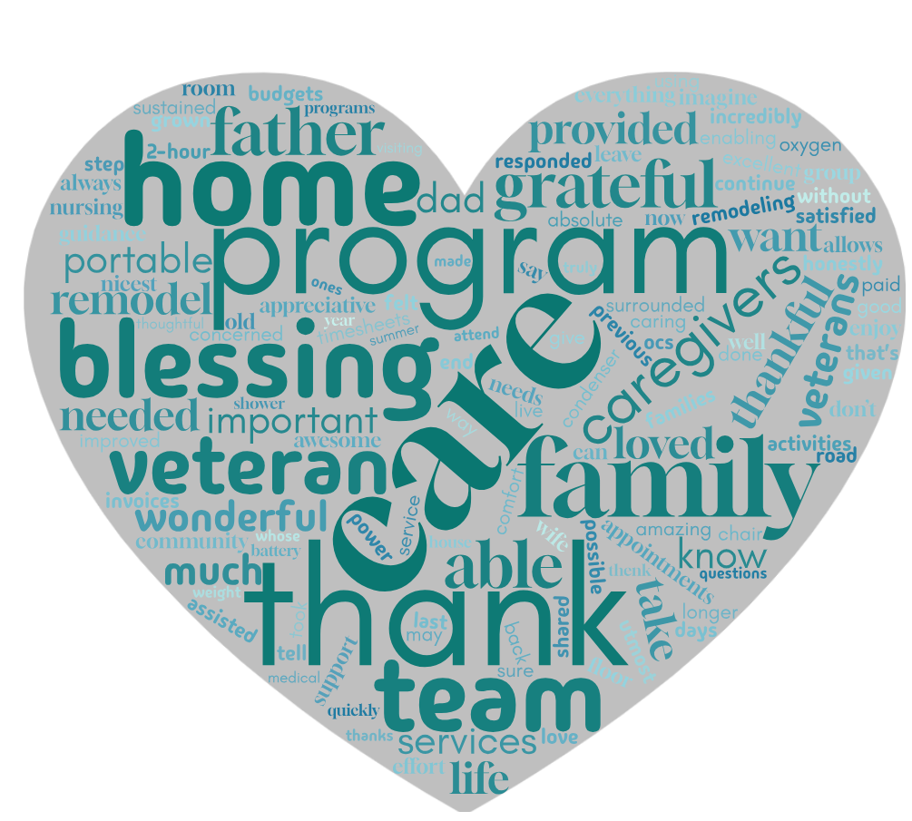
What is our impact?

Slide 16



Success Stories
I take care of my 89-year-old father. This program has been a blessing for both of us. Being able to take care of my father is very important to me and this program allows me to do that. You don’t know how grateful I am, programs like this are very important for our veterans and their families. I want to say how grateful and thankful my father and I both are for this program.
I would like to tell you what an absolute blessing this program is and has been for my dad and all of us who care for him. I was so sure he may have to go to a nursing home, but this wonderful program has given us a way to continue caring for him in the comfort of his own home by loved ones!!
Your guidance with this amazing program for veterans has been such a blessing for us. I honestly do not know what we would have done without this program. I can only imagine how this program has grown, you have always been there when we needed you and we are truly thankful. Thank you so very much for everything.

Slide 17



Success Stories, continued
I want to thank my OC and the Bay Aging team for the wonderful care made possible for my Stepdad at the end of his life. He needed care, and through Bay Aging, he was able to be sustained at home with his wife and family because of the caregivers provided by Bay Aging. Our OC was AWESOME and responded quickly to any questions or needs we had. Our caregivers were paid well and took good care o him. He loved them like family, and that’s what it felt like. We give our utmost thanks to Bay Aging for their excellent service and thoughtful care for our veteran.
Thank you, thank you, thank you. Because of your services, he was able to live out his last days surrounded by the love of his family, in his own home.
I was on the road back from Lunenburg County to visit a veteran, whose bathroom we assisted in remodeling over the summer. He is incredibly appreciative and satisfied with the remodel, and our services. He shared that the bathroom is now the nicest room in his house. Before the remodel, he had been using a portable shower provided by the VA and was concerned that his bathroom floor would no longer support the weight of his power chair. It was a group effort – from OCs to the Budgets, Invoices & Timesheets Team!
With VAMC approval under the Vendor Purchase program, a veteran was able to use $3,625.00 of his VDC budget to purchase a portable oxygen condenser with a 10-12 hours batter life. This was much improved from his previous portable oxygen condenser with a 2-hour battery life. Enabling him to leave home to attend medical appointments and enjoy activities in his community.

Slide 18
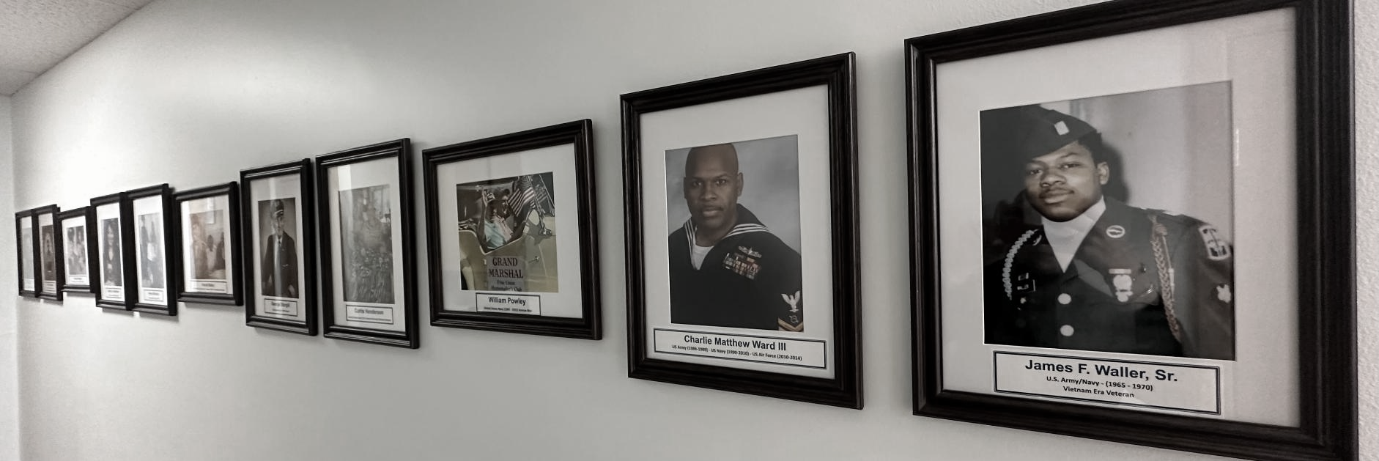
THE WALL OF HONOR

Slide 19

Current Impact
We are currently serving
10 veterans that are
100+ years old.
With 4 more veterans
turning 100 this year!
Our team honors veterans who have reached 100 years or older by sending them a special birthday card.

Slide 20
Helpful Resources
Am I eligible for VA Health Care? https://www.va.gov/health-care/eligibility/
How to apply for VA Health Care https://www.va.gov/health-care/how-to-apply/
Virginia Department of Veterans Services https://dvs.virginia.gov
Virginia Veterans Network is a FREE online hub of resources and services for veterans and service
members managed by the Virginia Department of Veterans Services. https://vesa.dvs.virginia.gov
Veteran Directed Care https://www.va.gov/GERIATRICS/pages/Veteran-Directed_Care.asp
Bay Aging www.bayaging.org/veteran-directed-care/

Slide 21
Questions?
Melissa Blake
Director, Veteran Directed Care
Bay Aging
mblake@bayaging.org
(804) 758-2386 x1219
Jennifer Beck
Director, Veteran Services
Bay Aging
jbeck@bayaging.org
(804) 493-0238 x1409

