Slide 1


Dementia Plans and Initiatives
Building Virginia’s dementia capability

Slide 2
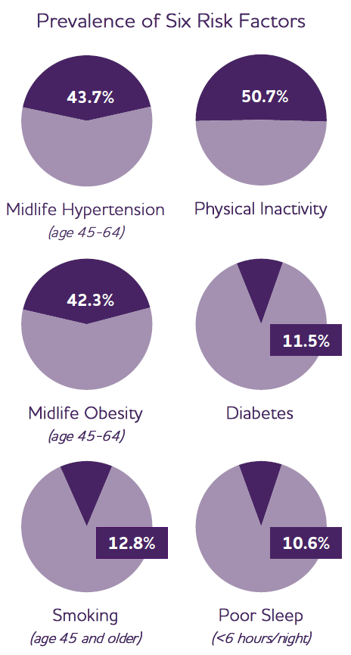
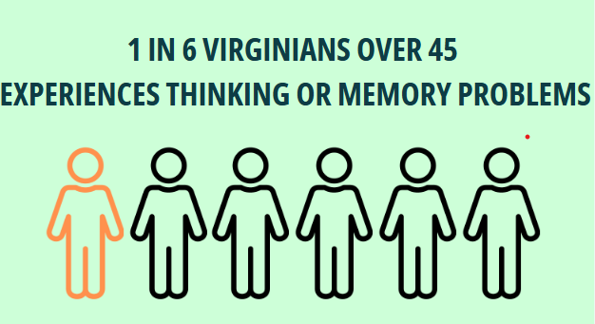
The need in Virginia
Data are from the Behavioral Risk Factor Surveillance System (BRFSS).

Slide 3
Overview
Building a Dementia Capable Virginia
  Brain health and dementia across the lifespan
Promoting Cognitive Health
  Cognitive screening
  Brain health initiatives
Dementia Capable Virginia

Slide 4
A dementia capable Virginia
What would that look like?
Widespread dementia and brain health awareness and understanding
Timely accessibility of assessment, diagnosis, and treatment
Availability of ‘guides’ (dementia care specialists/navigators/care coordinators) anywhere in the state
Availability of respite options across the state
Well-trained, effective, and available workforce for in-home or long-term care

Slide 5
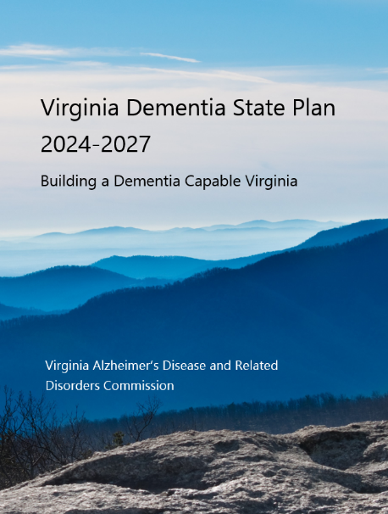
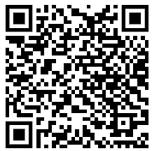
Virginia’s Dementia State Plan
Provides a blueprint for a dementia capable Virginia
Six goals, 20 objectives, 110 strategies addressing
Coordinated approach at the state level
Better data
Workforce and caregiver education and training
Improved coordinated care for individuals
Research efforts
Brain health and dementia risk reduction

Slide 6
Lifecourse model of dementia
Preclinical
Symptoms Emerge
Where do I start?
Living in community
Person-centered HCBS
Living in care setting
Person-centered positive care
Brain health education
Dementia awareness
Cognitive baseline
Advance care planning
Regular screening
Early & accurate diagnosis
Access to DMT*
Person- centered referrals
Care navigation
Respite services
Dementia Friendly communities
Staff training
Non-pharma approaches
Hospice & palliative
DMT = Disease-modifying treatments

Slide 7

Preclinical:
All about education
Brain health education
Dementia Friends initiative
  Raise awareness and understanding
  Reduce stigma
Annual wellness cognitive screening
Encouraging advance planning
  National Healthcare Decisions Day April 16 (death & taxes)
  Links to advance directives on

Slide 8
Lifecourse model of dementia
Preclinical
Symptoms Emerge
Where do I start?
Living in community
Person-centered HCBS
Living in care setting
Person-centered positive care
Brain health education
Dementia awareness
Cognitive baseline
Advance care planning
Regular screening
Early & accurate diagnosis
Access to DMT*
Person- centered referrals
Care navigation
Respite services
Dementia Friendly communities
Staff training
Non-pharma approaches
Hospice & palliative
DMT = Disease-modifying treatments

Slide 9
Where do I start?
People don’t know what they don’t know
Most people start with primary care, usually a family member initiates, on average about 15 months after symptoms appear
But, disease-modifying treatments work best for Alzheimer’s disease the earlier they are started

Slide 10
Where do I start?
Alternative starting points:
  DementiaCapableVirginia.org
  Alzheimer’s Association www.alz.org 800-272-3900 (24/7 helpline)
  Area Agencies on Aging
  Virginia 2-1-1 Easy Access
  Virginia Navigator
  Healthcare providers
Education and awareness campaigns could shorten that 15-month period.

Slide 11
Cognitive screening
Why do a cognitive screen?
  Respond to concerns or worries
  Establishes a baseline
  May catch changes early
How do I do a cognitive screen?
  Use the AD-8 Tool (available on DCV or on PeerPlace)
  8 questions on functioning, good at discriminating MCI from typical functioning
What happens next?
  Referral to PCP, provide My Dementia Capable Journey brochure

Slide 12
AD-8 Tool
For each question, answer Yes, a change; No, no change, or n/a or don’t know
1. Problems with judgment (e.g., problems making decisions, bad financial decisions, problems with thinking)
2. Less interest in hobbies/activities
3. Repeats the same things over and over (questions, stories, or statements)
4. Trouble learning how to use a tool, appliance, or gadget (e.g., VCR, computer, microwave, remote control)
5. Forgets correct month or year
6. Trouble handling complicated financial affairs (e.g., balancing checkbook, income taxes, paying bills)
7. Trouble remembering appointments
8. Daily problems with thinking and/or memory
©2005 Washington University, St. Louis, Missouri

Slide 13
AD-8 Tool
Scoring:
0-1 Normal cognition
2 or more Cognitive impairment is likely to be present
This is NOT a diagnostic tool, only a screening instrument
Like taking a blood pressure reading
©2005 Washington University, St. Louis, Missouri

Slide 14
Capacity issues
Early and accurate diagnosis may be difficult to obtain
Often 6-12 month wait for a full diagnostic workup, which involves
  Brain scan (MRI or amyloid PET)
  Maybe a blood biomarker test (definitely in the next few years)
  Pen & paper tests of cognitive domains (3-4 hours)
  Two visits (assessment & diagnosis)
  Treatments currently REQUIRE confirmed amyloid buildup by PET, spinal fluid or blood test

Slide 15
Disease modifying treatments
Currently infusions, not available everywhere
  Lecanemab (Leqembi)
  Donanemab (Kisunla)
Both reduce amyloid plaques
Early evidence from follow up data (after end of clinical trials) shows delays of around 18 months in cognitive decline

Slide 16
Lifecourse model of dementia
Preclinical
Symptoms Emerge
Where do I start?
Living in community
Person-centered HCBS
Living in care setting
Person-centered positive care
Brain health education
Dementia awareness
Cognitive baseline
Advance care planning
Regular screening
Early & accurate diagnosis
Access to DMT*
Person- centered referrals
Care navigation
Respite services
Dementia Friendly communities
Staff training
Non-pharma approaches
Hospice & palliative
DMT = Disease-modifying treatments

Slide 17
Person-centered HCBS
Consider the full range of home and community-based services (HCBS)
  Think about hospice and palliative care for in-home services
Think about the whole person, not just the dementia
Also need to think about supporting caregivers
  Education
  Support groups
  Encouraging and supporting caregiver self-care

Slide 18
Three levels of care navigation
Community health workers
Caregiver support specialists
Dementia Care Specialists
Dementia Care Management programs
Community education
Education, screening, referrals
GUIDE program
Community dementia care coordination
‘Clinical’ dementia care coordination
Education, screening, referrals
Dementia subject matter expert
Education, referrals
Integrated with clinical care team
Dementia subject matter expert

Slide 19
Respite Services
Think broadly about respite—not just for the caregiver
Overnight stays in long-term care communities
Adult day programs
Social respite programs

Slide 20

Dementia Friendly Communities

Slide 21
Lifecourse model of dementia
Preclinical
Symptoms Emerge
Where do I start?
Living in community
Person-centered HCBS
Living in care setting
Person-centered positive care
Brain health education
Dementia awareness
Cognitive baseline
Advance care planning
Regular screening
Early & accurate diagnosis
Access to DMT*
Person- centered referrals
Care navigation
Respite services
Dementia Friendly communities
Staff training
Non-pharma approaches
Hospice & palliative
DMT = Disease-modifying treatments

Slide 22
Long-term care settings
Links to quality, free trainings on Dementia Capable Virginia
Importance of person-centered care
Consideration of non-pharmacological approaches
Hospice and palliative care

Slide 23
Dementia Capable Virginia
DementiaCapableVirginia.org

Slide 24
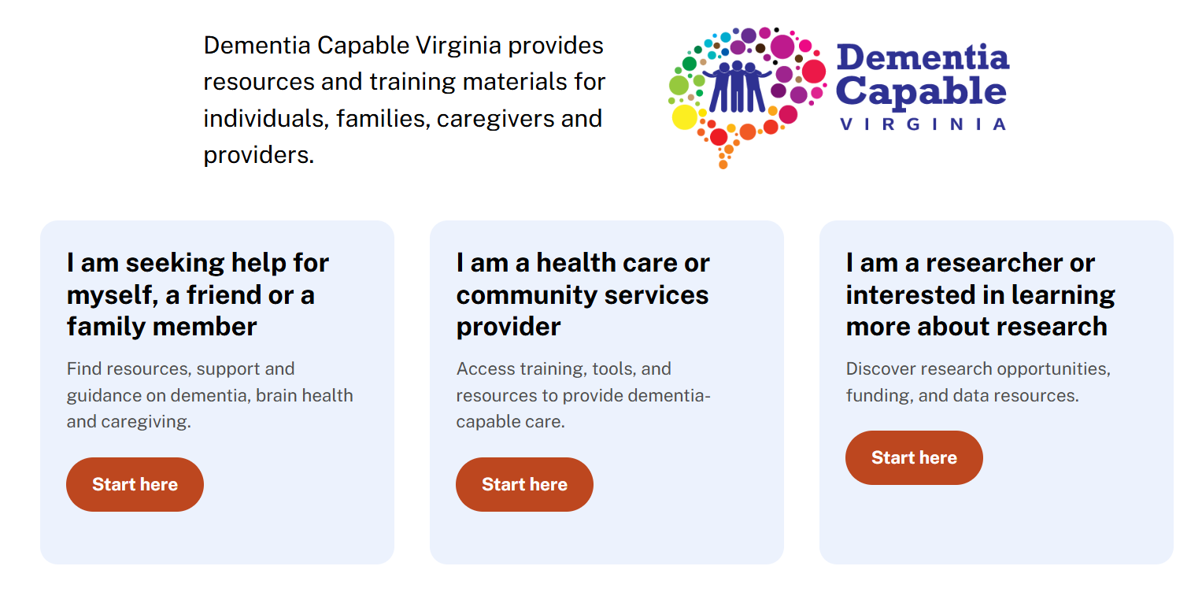
DementiaCapableVirginia.org

Slide 25
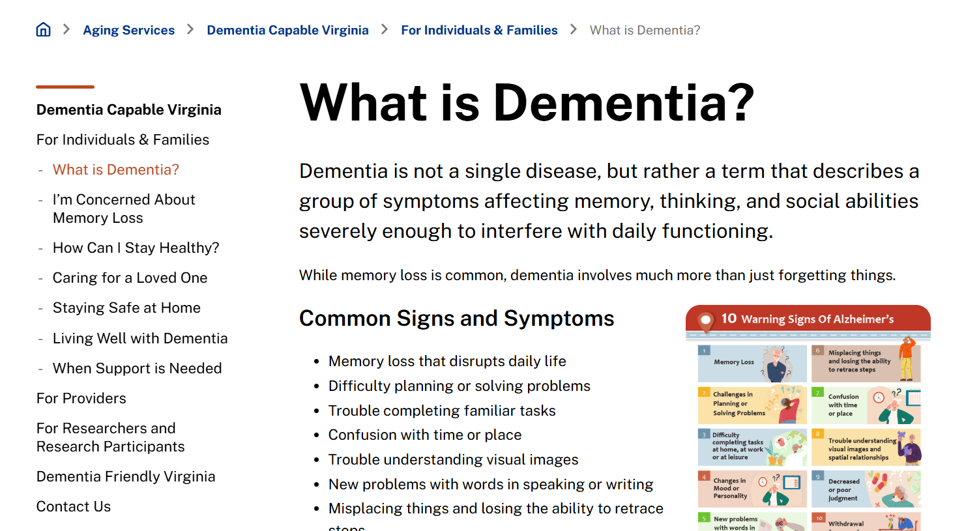

Slide 26
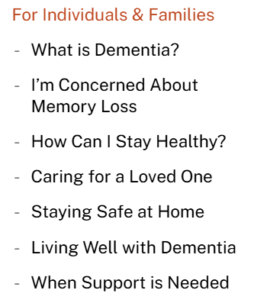
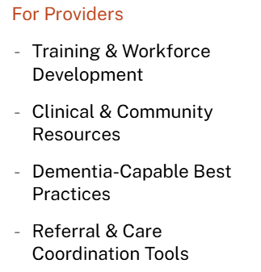
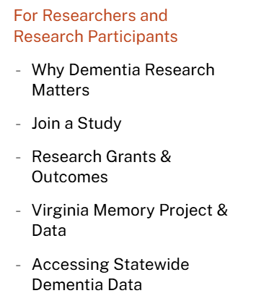
Navigating Dementia Capable Virginia

Slide 27
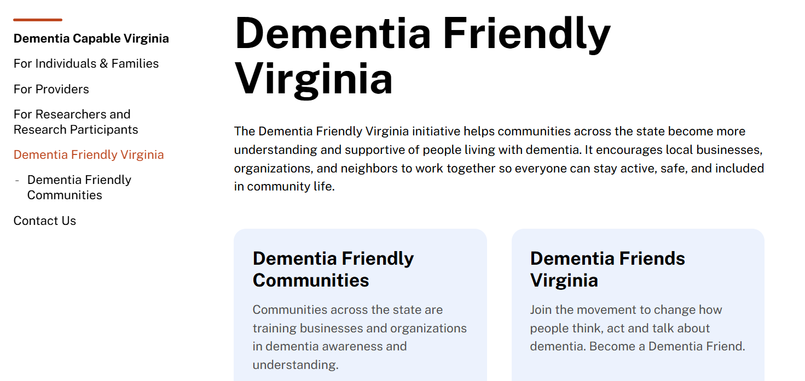

Slide 28

Contact
George Worthington
george.worthington@dars.virginia.gov
804 662 9154
dementia@dars.virginia.gov
dars.virginia.gov/aging/dementia-services
dementiacapablevirginia.org

