Slide 1

Data:
Leveraging PeerPlace Tools for Meaningful and Essential Data
Presented Christy Miller and David Baker

Slide 2
Introduction
Christy Miller, Home and Community Based Services IT Operations Manager
David Baker, IT Operations Specialist

Slide 3
Our Agenda Topics
Client level data
Unmet Needs/Waitlist data
Dashboards+
Q&A

Slide 4
Topic One
Client level data

Slide 5
“Information is data endowed with relevance and purpose.”
Peter Drucker
Presidential Medal of Freedom, 2002
Data alone isn't useful unless it helps you make better decisions and take effective action.

Slide 6
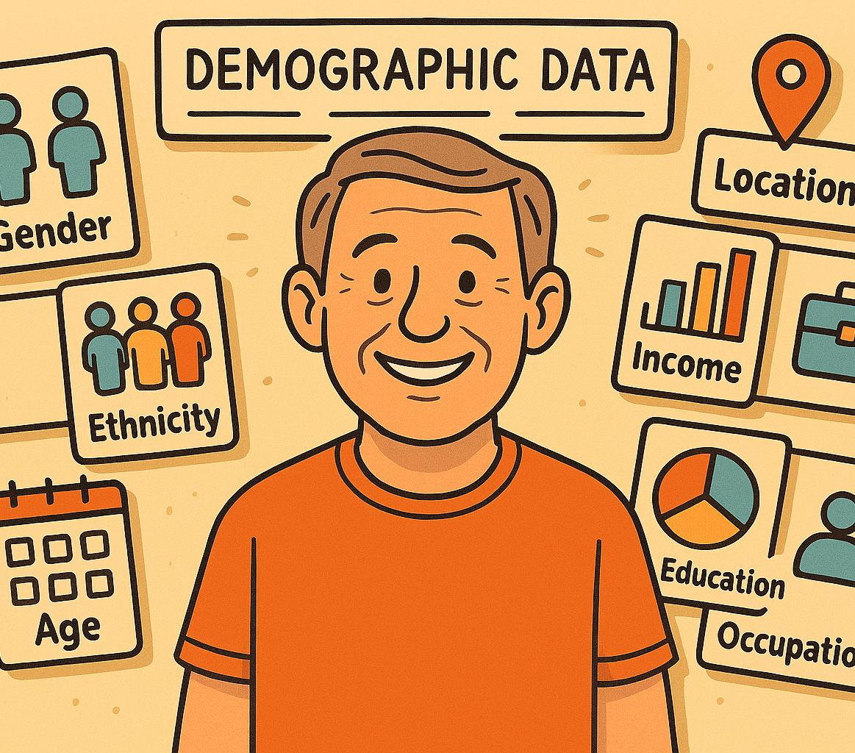
Individual / Client Level Data:
More than Name, Address and Phone Number

Slide 7
Demographic Data
Greatest Social Economic Need
Data Element Examples in PeerPlace

Slide 8
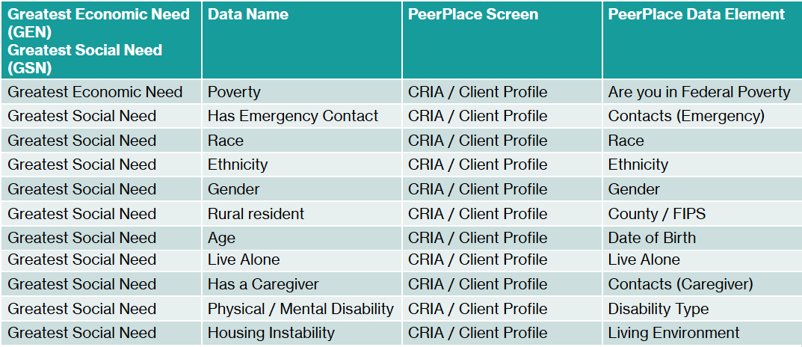
Data Elements Matrix

Slide 9
Detailed Demographics Report
The “Detailed Demographics” report in PeerPlace includes the ability to run the report for one single program or for “All Programs” within your agency which provides you with both a program level option as well as an agency level option for the report
The “Detailed Demographics” report includes a listing of unduplicated individuals served during the designated date span with their demographic information
The “Detailed Demographics” report pulls data from the Client Profile and is color coded to identify the corresponding Client Profile section for each data element
The “Detailed Demographics” report is a useful report which can help with identifying both the number of individuals served at your agency by demographic category as well as identify those where critical demographic information is missing

Slide 10
Example of Client Profile Data
*Please note: this presentation and the slide included screenshots of PeerPlace, the DARS client management system, that is used by Area Agencies on Aging and NWD Partners. These screenshots have been removed to comply with PeerPlace's policy that the proprietary technology is not shared with external audiences.
Data on report is housed in the Demo environment and does not represent real data

Slide 11
Example of Filtering a Report
Filter for Specific Demographic
Filter for Missing Demographic
*Please note: this presentation and the slide included screenshots of PeerPlace, the DARS client management system, that is used by Area Agencies on Aging and NWD Partners. These screenshots have been removed to comply with PeerPlace's policy that the proprietary technology is not shared with external audiences.
Data on report is housed in the Demo environment and does not represent real data

Slide 12
Topic Two
Unmet Needs/Waitlist data

Slide 13
Topic Three
Dashboards+

Slide 14
Dashboards+ introduction
*Please note: this presentation and the slide included screenshots of PeerPlace, the DARS client management system, that is used by Area Agencies on Aging and NWD Partners. These screenshots have been removed to comply with PeerPlace's policy that the proprietary technology is not shared with external audiences.

Slide 15
Questions and Answers
Q&A

Slide 16
Conclusion slide
Thank you!
Please send your questions to nwdhelp@dars.virginia.gov

