Slide 1

Strengthening Language Access and Disability Inclusion Across Services and Community Life
Karen Rhoads
Community Services Specialist

Slide 2
Mission:
The Virginia Department for the Deaf and Hard of Hearing removes barriers to effective communication so that persons who are Deaf and hard of hearing can fully participate in programs, services and opportunities throughout the Commonwealth.
Programs:
Virginia Relay
Interpreter Services Program (ISP)
Technology Assistance Program (TAP)
Community Services Program (CSP)

Slide 3





Virginia Relay

Slide 4


Interpreter Services Program: ISP
Connects you to a network of qualified sign language interpreters and coordinates requests for interpreters and captioning services (CART) for state government meetings, events, and court appointments.
For you to know…
Virginia Quality Assurance Screening (VQAS)
Assess and provides feedback to interpreters to enhance their professional growth.
Interpreter Referral Agencies Directory
Available for nongovernment agencies.
For more information, contact ISPRequests@vddhh.virginia.gov

Slide 5
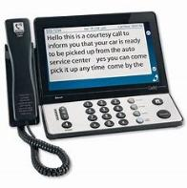

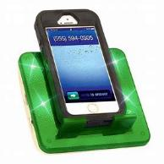

Technology Assistance Program: TAP
Provides adaptive telecommunication equipment to residents of Virginia with a hearing loss, hearing and vision loss, or speech difficulties. Equipment is free of charge to eligible applicants, including VETERANS.
Equipment Devices
Telecommunication Devices
Personal Amplification Devices
Signalers

Slide 6
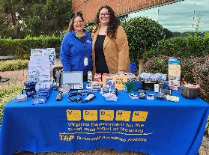
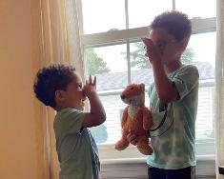

Community Services Program: CSP
Responds to requests for information & referrals on topics related to hearing loss.
Provides education & training to government agencies and the general public.
Offers technical assistance to help organizations provide effective communication & reasonable accommodations.
Conducts outreach to promote public awareness about hearing loss.
2023 Projects launched…
Deaf Mentor Project ages 0-8
DeafBlind Services Project (SSP)

Slide 7
Serving the population with hearing loss

Slide 8


Top 4 Causes of Hearing Loss:
Aging
Exposure to loud noises (occupation, hobby)
Heredity
Illness/Medication

Slide 9
Types of deafness
DEAF
Having a severe to profound hearing loss
Unable to understand normal speech
HARD OF HEARING
Having a mild to severe hearing loss
Difficulty understanding normal speech
LATE-DEAFENED
Hearing loss later in life
DEAFBLIND
Loss of hearing
AND
vision
DEAF PLUS
Has hearing loss and other disabilities

Slide 10
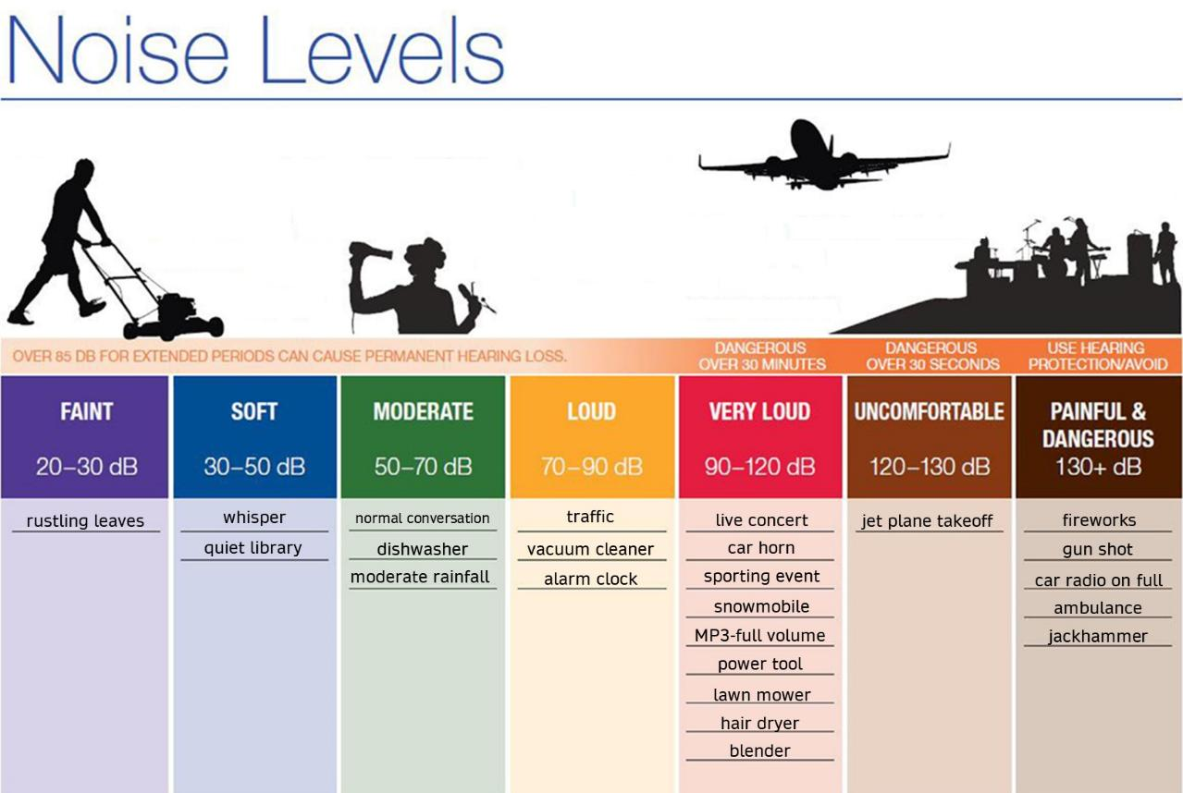
American Academy of Audiology www.audiology.org

Slide 11
Types of deafness:
Late-Deafened
May/may not use Sign Language
May/may not have clear speech
May/may not be able to communicate with you through reading or writing
May require an interpreter or written communication
May/may not use hearing aids

Slide 12
Message: ---- removed ---- a ---- is ---- -- ---- laboratory, ---- --- ------ into -- -- ---- for ---- ----- -- ------. ---- ---- known -- ----- ----- ------- and ---- ---- ---- best ---- to tell ---- cancer is --------. ---- ------- also ---- ------- (cell) material. -------- ---- --- urine, ------ (---- ---- around ---- ----- ---- ----- cord), -----(mucus ---- --- ----), ------- (------ cavity) ----, ------ (chest -----) ----, ------/------ -----, and ---- ---- ---- during - ------.
25 % of the Message

Slide 13
Message: ---- removed during a ---- is ---- -- ---- laboratory, where --- ------ into thin ------ for viewing ----- -- ------. ---- ---- known as ----- (tissue) ------ and ---- usually ---- best ---- to tell ---- cancer is --------. The ------- also examine ------- (cell) material. -------- material is --- in urine, ---- fluid (---- ---- around ----- and ----- cord), ----- (mucus ---- the ----), ------- (------ cavity) fluid, ------ (chest -----) fluid, ------/------ -----, and ---- fluid ---- during a ------.
50 % of the Message

Slide 14
Message: Tissue removed during a biopsy is sent to a pathology laboratory, where it is sliced into thin sections for viewing under a microscope. This is known as histologic (tissue) examination and is usually the best way to tell if cancer is present. The pathologist may also examine cytologic (cell) material. Cytologic material is present in urine, cerebrospinal fluid (the fluid around brain and spinal cord), sputum (mucus from the lungs), peritoneal (abdominal cavity) fluid, pleural (chest cavity) fluid, cervical/vaginal smears, and in fluid removed during a biopsy.
100 % of the Message

Slide 15
Communication Tips
Get Their Attention:
1) Get in their line of sight
2) Waving a hand in their direction
3) Lightly tapping on their shoulder (try not to startle)
Rephrase Your Question or Statement:
-shortening and simplify question or statement
Reduce Background Noise:
-Eliminate as much as possible (Music, TV, conversation)
- Choose quieter location or request seating in less crowded areas.
Appearance and Visual Cues MATTER:
- Proper lighting and visibility
- Face the person while speaking, maintain eye contact
- Avoid hiding your mouth, looking around, eating or chewing gum while conversing.
- Gestures can help get idea across but be respectful and remember that miming is different from American Sign Language (ASL).
Speak One at a Time:
- Group setting – one person at a time
- No side conversations or talk over another
Be Understanding:
- Always exercise patience
- If frustrated, take a deep breath
Speak Clearly and Loudly:
- Face the person, enunciate while speaking (don’t exaggerate your speech)
- SLIGHTLY raised voice **DO NOT shout!
- Pace your speech – not too fast or not too slow
Ask How They Prefer to Communicate:
- Each person has their own preferred means
- Be willing to help to improve interaction
- Verbal, writing, typing on phone
Repeat Yourself

Slide 16

Got Questions?

Slide 17




Contact information:
VDDHH
Virginia Department for the Deaf and Hard of Hearing
info@vddhh.virginia.gov
(804) 662-9502
Karen Rhoads Community Services Specialist
Karen.Rhoads@vddhh.virginia.gov
(804) 256-3912
Serving Statewide

