Slide 1

Data with Dignity: An Equity‑Centered Approach for Supporting Older Adults
NWD Summit – May 7 2026 at 9:00 AM
Presented by Rachel Coates, Bureau Director
Arlington County, VA
Notes:
Good morning. Today we’re going to talk about something that sounds technical but it’s about a very human promise: making sure every older adult gets the support they deserve. We’re going to show you how we use information to keep our programs fair and effective.
This presentation explains how the Arlington Agency on Aging (AAA) uses data responsibly and equitably to improve services for older adults, ensuring programs are fair, effective, and centered on lived experience rather than just numbers. I hope to break down technical data processes into clear, relatable concepts, focusing on how the Arlington Agency on Aging (AAA) uses information to make services better and fairer for everyone.

Slide 2
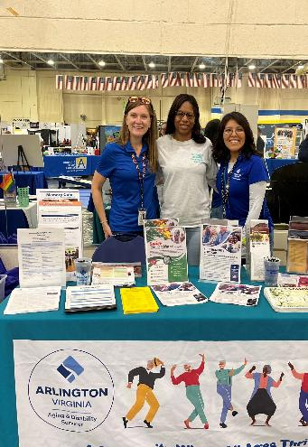
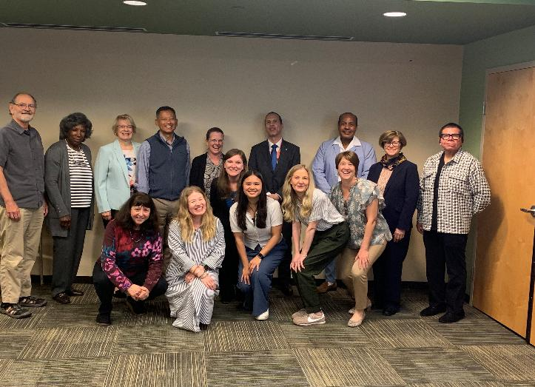
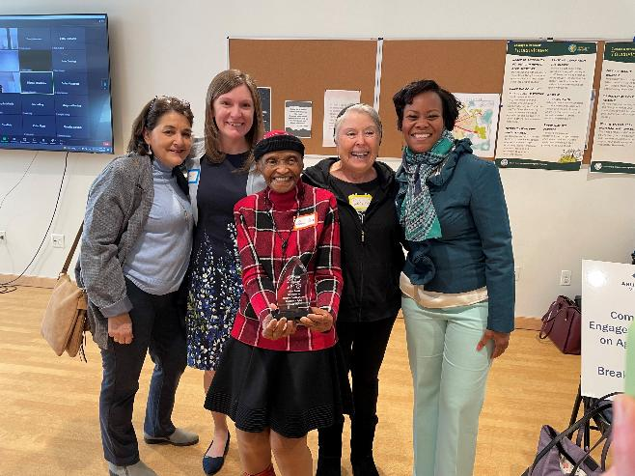

Welcome
Rachel Coates
Bureau Director, Arlington County Department of Human Services, Aging and Disability
Passionate about older adults, data informed decision making, and advocacy
15+ years with Arlington County: Adult Protective Services, AAA, Community Supports
Rcoates@arlingtonva.us
Notes:
Introduction of the speaker. Rachel Coates is a passionate advocate in the field of aging and a champion of inclusive, livable communities for all. Since 2020, she has served as Bureau Director of the Community Supports and Coordination Bureau in Arlington’s Department of Human Services (DHS) overseeing the Agency on Aging (AAA), Adult Protective Services, Nurse Case Management and other programs that strive to deliver the highest quality of service to enhance the quality of life for older adults in Arlington, VA. She works closely with key stakeholders like the Commission on Aging to engage older adults in community planning and helped Arlington receive designations of Age-Friendly from the World Health Organization/AARP and Dementia Friendly.
Photos of Rachel Coates from various community events.

Slide 3
Arlington’s Older Adults (60+)
  38,097 (16% of total population)
  Race (adults 60+):
    69% White
    10% Black or African American
    10% Asian
    13% Hispanic or Latino/a
  Poverty:
    15% (at or below 149% of FPL)
      7% collect SNAP (food stamps)
Housing:
  49% of older adults lives alone.
  67% own their home.
  33% rent.
  Housing cost burdened (spending 30% or more of household income on housing):
    25% of homeowners
    50% of renters
Housing Subsidies:
599 receive Housing Choice Voucher
538 receive Housing Grant
869 received real estate tax relief
Notes:
Arlington is home to more than 38,000 adults age 60 and above, totaling 16% of our population. This number has grown by 48% since 2016. Most Arlington’s older adults are White (69%) with Black/African Americans and Asians totaling 10% each respectively, and 13% identifying as Hispanic or Latino. We know that 15% (at or below 149% of FPL) yet only 7% collect SNAP (food stamps). When it comes to housing, half of our older adults live alone, with 67% as homeowners and 33% renting. What is truly concerning to us is that 25% of homeowners and 50% of renters are housing cost burdened (spending 30% or more of household income on housing). We have housing assistance programs that support renters and homeowners in the federal housing choice voucher program and our local housing grant program – for renters to pay 30% of their income on housing, and then for older homeowners the real estate tax relief program to help with rising property taxes.

Slide 4
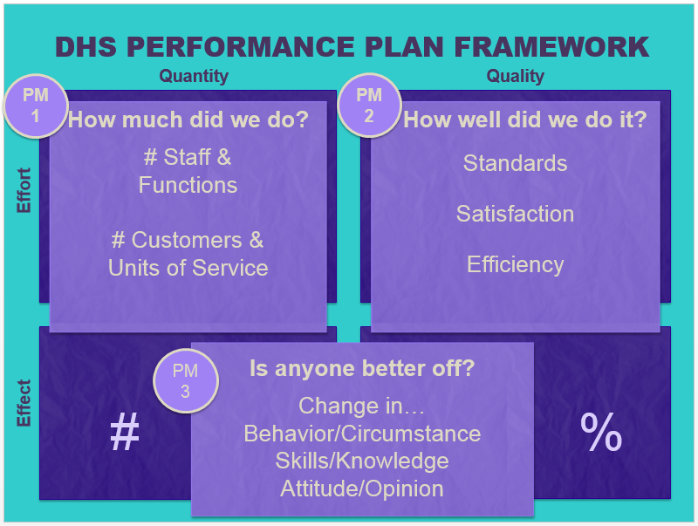
Performance Measurement Plans (PMP)
The 3 Key Questions:
1. How much did we do?
2. How well did we do it?
3. Is anyone better off?
Tool Spotlight: PeerPlace
HOW ARLINGTON USES INFORMATION TO IMPROVE OUR COMMUNITY FOR ALL
Notes:
As aging services increasingly rely on data to guide programs and decision‑making, it is essential that the ways we collect, manage, and use data honor the dignity, rights, and lived experiences of older adults. Data with Dignity introduces a framework for human‑centered, equitable data practices that prioritize respect, transparency, and empowerment, particularly for older adults who may face systemic barriers, digital inequities, or historical reasons for mistrust.
Arlington isn't just providing services; we are committed to 'equity.' That means we don't just give everyone the same thing; we make sure everyone gets what they specifically need to thrive. To do that, we have to look at the numbers to see who is being left behind. We use data to move from guessing to knowing.
The number of people we serve is important – but it’s not enough
How well we perform our tasks is important – but it’s not enough
Results/outcomes = driving force behind the success of our services
In Arlington, we use a Performance Measurement Plan for every program. We don't just count how many rides or meals we provide; we ask the most important question: 'Is anyone better off?' We use a secure system called PeerPlace to make sure we are tracking progress safely and accurately. Outcomes (PM3) are the priority and are aligned to each program’s purpose, tracked securely using PeerPlace
Arlington uses a "Performance Measurement Plan" (PMP) for every program (like Meals on Wheels or Transportation). We ask:
1. How much did we do? = Outputs (Example: Number of rides provided)
2. How well did we do it? = Quality and Effort: (Example: Were the rides on time?)
3. Is anyone better off? = Outcomes (Example: Can you now get to your doctor or the grocery store more easily?)
PM2 is about how well the program works; PM3 is about the outcomes experienced by clients
PM2: Intersection of quality and effort
There are lots of ways of measuring PM2, there is no one best way; clearest picture is when you mix and match
PM3 is aligned with program purpose: if purpose is to keep clients out of the hospital, PM3 should include a measure of hospitalization.
Usually reported as a percentage

Slide 5
Is anyone better off?
The Inverted Pyramid
Measurable Outcomes: positive or negative changes in skills, behavior, or circumstance; no judgment
Staff/Clinical Assessment of functioning or situation; consider inter-rater reliability
Client Self-Report of improvement in functioning or situation; consider tool, sampling, response rate
Proxy Goals: associated with improved outcomes, but are not outcomes by themselves
Outcomes: clear yes/no
Assessments
Self-report
Notes:
Data should uphold dignity, trust, and transparency. Arlington uses data not just to count services, but to understand outcomes and equity, asking, “Is anyone better off?” rather than stopping at outputs or efficiency metrics.
Measurable Outcomes: positive or negative changes in skills, behavior, or circumstance; no judgment
Staff/Clinical Assessment of functioning or situation; consider inter-rater reliability
Client Self-Report of improvement in functioning or situation; consider tool, sampling, response rate
Proxy Goals: associated with improved outcomes, but are not outcomes by themselves
Outcomes (PM3) are the priority and are aligned to each program’s purpose, tracked securely using PeerPlace.
For Performance Measure 3 (PM3), there’s a clear order of preference:
Outcomes: clear yes/no: maintaining employment for 90 days, eviction, hospitalization, etc. About 60% of current measures.
Assessments: Examples: rating of symptom severity or housing stability
Can be documented as part of each service encounter – i.e., psychiatrists assess client’s improvement at every visit – or on periodic assessments – i.e., CAB CCU staff assess housing and economic stability at case opening and closing
Guidelines, training, and monitoring needed to keep inter-rater reliability high
Self-report: Can be collected via survey or as part of each service encounter.
The more specific, the better: “Have you been suspended from school in the last 30 days?” versus “Has your school behavior improved?”
Tool: consider validated questionnaires
Response rate: if you give a survey to 50 clients, and only 5 return the survey, how much do those 5 responses tell you about overall client outcomes?
This framework emphasizes clarity, reliability, validated tools, and careful interpretation of self‑reported data.

Slide 6
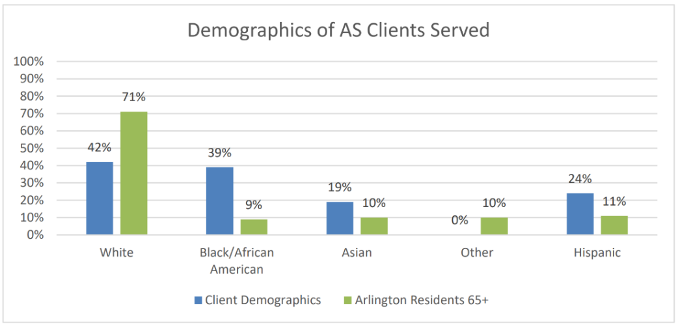
Ensuring Equity: Is Everyone at the Table?
We compare who we serve with who lives in Arlington to find out if we are reaching everyone, and identify who is missing.
The Dashboard: We use the Arlington Race and Ethnicity Dashboard to see if certain groups are under-using services compared to their population size.
The "Story Behind the Data": If we see a gap, we don't just ignore it. We ask why.
  Is it a language barrier?
  A lack of internet?
  A lack of trust?
Example: In 2025, data showed that Black residents were "over-represented" in Adult Services. This told us there was a higher need in that community, leading us to focus more resources there.
Notes:
Arlington isn't just providing services; we are committed to 'equity.' That means we don't just give everyone the same thing; we make sure everyone gets what they specifically need to thrive. To do that, we must look at the numbers to see who is being left behind.
How do we know if we are being fair? We compare who we serve with who lives in Arlington to find out if we are reaching everyone. If 10% of Arlington older adults speak Spanish, but only 2% of our clients do, we know we have work to do. We use the 'Arlington Race and Ethnicity Dashboard' to spot these gaps immediately. We use the Dashboard to see if certain groups (like Black, Hispanic, or Asian residents) are under-using services compared to their population size. Then we seek to understand "Story Behind the Data": If we see a gap, we don't just ignore it. We ask why. Is it a language barrier? A lack of internet? A lack of trust?
The example here highlights that in 2023, data showed that Black residents were "over-represented" in Adult Services. This told us there was a higher need, leading us to focus more resources there.
Arlington follows a county-wide plan called RACE (Realizing Arlington’s Commitment to Equity). It means we 'Normalize' conversations about fairness, 'Organize' our staff to be culturally competent, and 'Operationalize' equity by using a checklist, an 'Equity Lens', before we spend a single dollar of the budget.
Normalize: We talk openly about fairness and race.
Organize: We train our staff to recognize and fix biases.
Operationalize: We use an "Equity Lens", a checklist used before every budget or program change to ensure it helps, not hurts, vulnerable neighbors.
Assess: We look at the numbers every year to see if we’ve closed the gap.

Slide 7
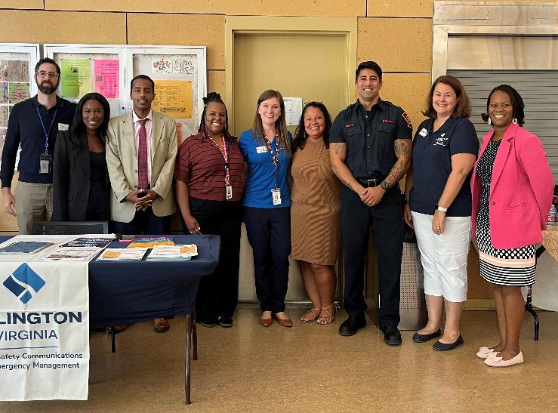
Continuous Improvement in Action
Digital Equity: Data showed that nearly 16% of Arlington older adults lack home internet.
  Action: Launched the Digital Equity Initiative to provide tablets and tech training to older adults.
Language Access: Data showed a need for more non-English resources.
  Action: Expanded the Community Ambassador Program to recruit volunteers who speak Spanish, Amharic, and other languages to do outreach in their own neighborhoods.
Health Needs: The Aging and Disability Resource Center (ADRC) tracks the top 3 requests: Food, Housing, and In-home care.
  Action: Used this data to win a new grant for the Benefits Enrollment Center, helping older adults apply for SNAP and tax relief more quickly.
Surveys: Resident Satisfaction Survey answers go directly into our performance reports.
Commission on Aging: We share our data reports and use "lived experience" to help explain what the numbers mean.
Notes:
RACE (Realizing Arlington’s Commitment to Equity) means we:
Normalize: We talk openly about fairness and race.
Organize: We train our staff to recognize and fix biases.
Operationalize: We use an "Equity Lens", a checklist used before every budget or program change to ensure it helps, not hurts, vulnerable neighbors.
Assess: We look at the numbers every year to see if we’ve closed the gap.
Here is what this looks like in real life. When our data showed that many older adults lacked internet access, we launched the Digital Equity Initiative. When data showed a language barrier, we recruited and trained more multilingual Ambassadors and hosted outreach events in specific community locations. Data tells us where the 'fires' are so we can put them out.
Digital Equity: Data showed that nearly 16% of Arlington’s older adults lacked home internet.
Action: Launched the Digital Equity Initiative to provide tablets and tech training to older adults.
Language Access: Data showed a need for more non-English resources.
Action: Expanded the Community Ambassador Program to recruit volunteers who speak Spanish, Amharic, and other languages to do outreach in their own neighborhoods.
Health Needs: The Aging and Disability Resource Center (ADRC) tracks the top 3 requests: Food, Housing, and In-home care.
Action: Used this data to win a new grant for the Benefits Enrollment Center, helping older adults, primarily those in shelter and experiencing housing instability, apply for SNAP, Medicaid and other benefits more quickly.

Slide 8
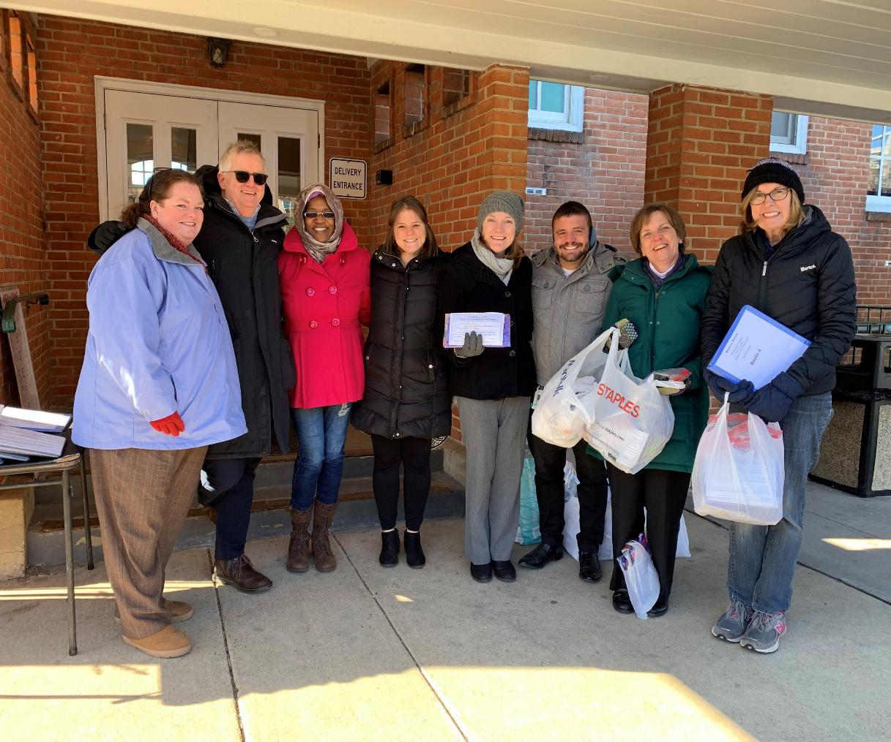

Data in Action
Notes:
So what does this look like in action?

Slide 9
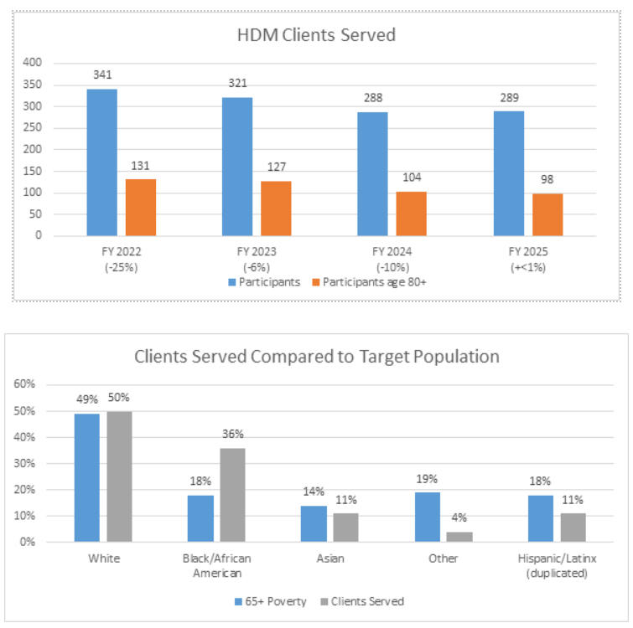
Home Delivered Meals:
How Much Did We Do?
Impact of funding changes
Stable client counts with increased meals delivered
The Home Delivered Meals (HDM) Program serves a higher percentage of Black residents than the overall population of Arlington residents 65+ in poverty.
Notes:
The slide applies the PMP framework to Meals on Wheels, showing:
Stable client counts with increased meals delivered
Strong satisfaction and nutrition outcomes
Evidence that most participants experienced stable or reduced nutrition risk, across racial and ethnic groups
This illustrates how outcome data, not just service volume, demonstrates program value.
In FY 2025 there was almost the same number of HDM clients served compared to the previous year. The number of participants 80+ years old decreased 6%. The total number of meals delivered increased 4%. The Home Delivered Meals Program serves a higher percentage of Black residents than the overall population of Arlington residents 65+ in poverty. Residents identifying as Hispanic/Latino/a and Other are underserved.

Slide 10
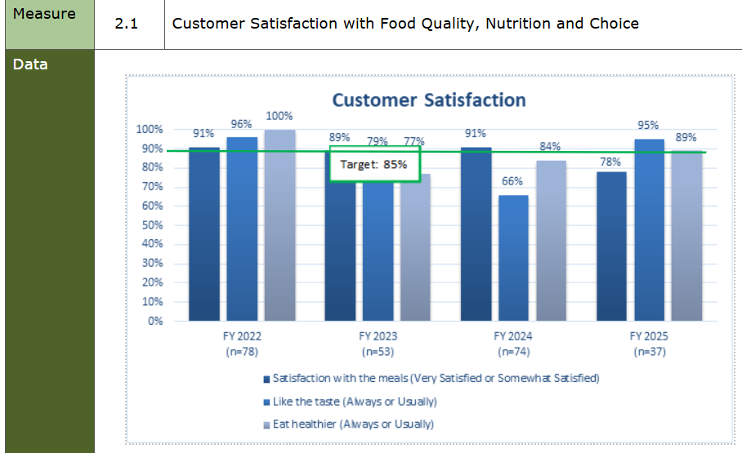
How well did we do it?
In FY 2025, MOW recipients were contacted to participate in the customer satisfaction survey.
Fewer respondents.
Response rate of 38%.
Changes to methodology
Increase in satisfaction with taste and eating healthier
Notes:
In FY 2025, 97 of the 189 active MOW recipients were contacted to participate in the customer satisfaction survey. 37 participants responded to the survey, equating to a response rate of 38%.
Of the survey respondents, 35% identify as white, 43% identify as Black/African American, 5% identified as Asian, 5% identify as other, and 11% Hispanic.
The results were as follows:
78% of respondents (29/37) reported the meals were “very satisfying” or “somewhat satisfying”.
95% of participants (35/37) responded “Always” or “Usually” when asked whether they like the taste of the meals.
89% of participants (33/37) reported that they “Always” or “Usually” eat healthier because of the meals.

Slide 11
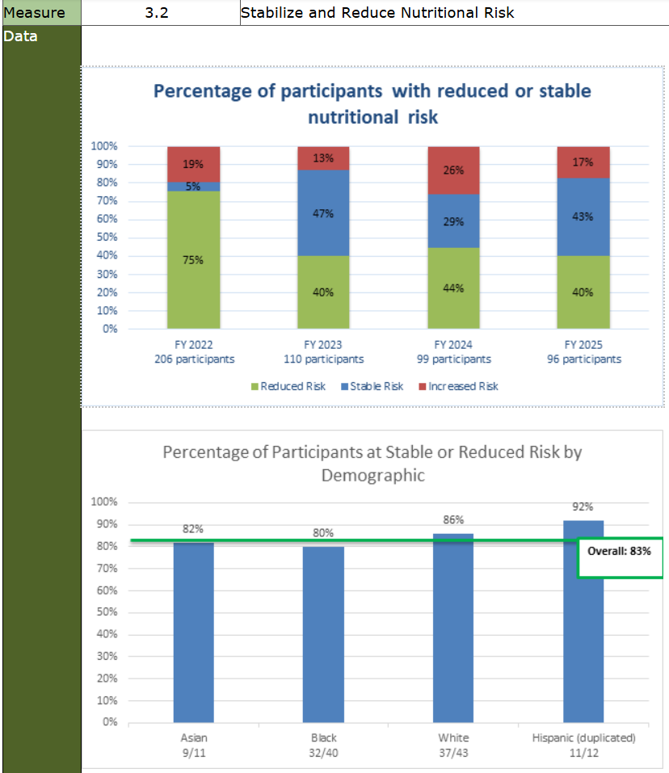
Is anyone better off?
In FY 2025, 184 participants were assessed for nutritional risk
Comparison data from FY 2024 was available for 96 participants.
Nutrition Screening Initiative (NSI) scores were compared between FY 2025 and the previous fiscal year to determine if the nutrition risk score was lower, remained the same or had increased.
Of those assessed, 83% reflected reduced or stable risk and 17% reflected increased risk.
Notes:
Between July 2024 and June 2025, 184 participants were assessed for nutritional risk. Comparison data from FY 2024 is available for 96 participants. Nutrition Screening Initiative scores were compared between FY 2025 and the previous fiscal year to determine if the nutrition risk score was lower, remained the same or had increased.
Of those assessed, 83% reflected reduced or stable risk and 17% reflected increased risk.
Data on race and ethnicity is available for 97% of participants. Among these, the following breakdown represents those at stable or reduced risk:
82% Asian/Asian Americans
80% Black/African Americans
86% White participants
92% Hispanic/Latino participants
Nutrition is a key factor in maintaining health and independence, especially for older adults. Malnutrition can result in a decline in physical health, including loss of bone and muscle mass, decline in cognitive function, higher hospitalization rates, and mortality.
As part of the initial assessment and annual reassessment process, participants are asked questions from the Nutrition Screening Initiative (NSI) checklist and a score is computed based on their answers. A score of six or higher is considered high-risk and nutritional education is provided. Individuals who score an 11 or higher are offered one-on-one Nutrition Counseling.
Age is a factor in nutrition risk. Research indicates that adults aged 85 and older are at particular risk for malnutrition. In FY 2025, for the participants who received the NSI, 24% (44/184) are ages 85 and above.
The AAA tracks the nutrition risk of participants aged 80 and older. Of those age 80 and above, 83% scored a 6 or higher on the NSI.
The AAA Registered Dietitian (RD) offers one-on-one nutrition counseling to participants who score 11 or higher on the NSI or who answer “yes” to unintentional weight gain or loss. In FY 2025, the AAA RD provided one-on-one nutrition counseling to 26 individuals and launched a new Nutrition Education initiative, a quarterly nutrition newsletter which provides nutrition education and evidenced-based nutrition handouts to all Meals on Wheels participants.
This illustrates how outcome data, not just service volume, demonstrates program value.

Slide 12
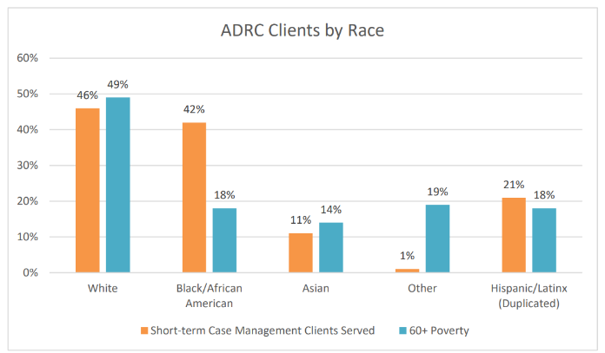
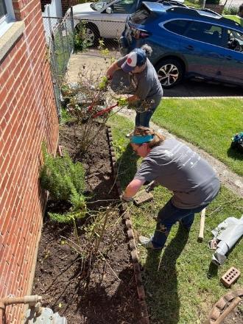
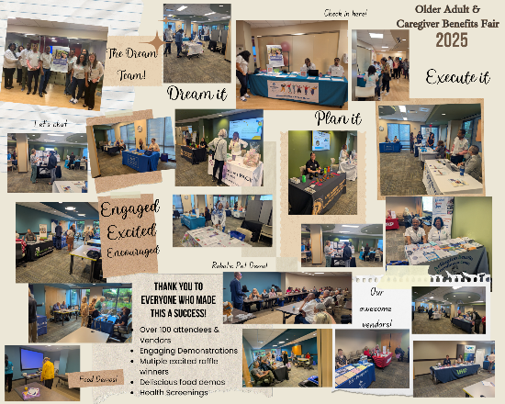
Aging & Disability Resource Center (ADRC)
For short-term case management, the ADRC serves predominately Black/African American, White, and Hispanic/Latino residents.
The percentage of Black/African American residents served is higher than the population of Arlington residents age 60+.
The Asian and Other residents served are significantly lower than the percentage of the population age 60+.
Action Step: Older Adult & Caregiver Benefits Fair; Targeted Outreach; and Strengthening community partnerships (Volunteer projects)
Notes:
The ADRC serves predominately Black/African American, White, and Hispanic/Latino residents. The percentage of Black/African American residents served is higher than the population of Arlington residents age 60+. The Asian and Other residents served are significantly lower than the percentage of the population age 60+. The Hispanic/Latinx residents were served proportionally to the percentage of the population 60+

Slide 13
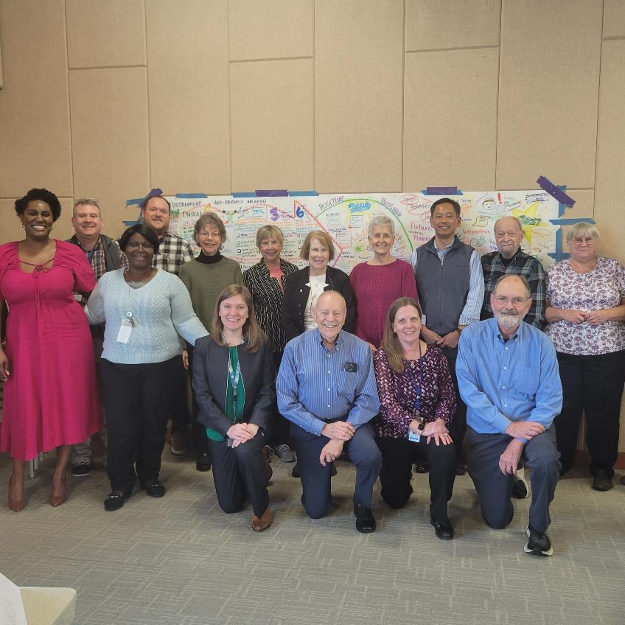

Thriving in uncertainty
Adapting to change​
Use data to embrace agility, prioritize needs, respond more quickly and effectively to shifts, customer demands, and unforeseen challenges.​
Real-world impact​
Using data to stay ahead of disruption help to proactively embrace change and continuously innovate.​
Notes:
We are entering unprecedented times, with level funding and increasing needs, cuts to programs like SNAP and Medicaid and a growing number of older adults and caregivers in need of home and community-based services and supports.
Data enables organizations to adapt, stay agile, and create real-world impact in the face of change and disruption. By using data intentionally, Arlington’s aging services can prioritize needs, respond quickly to emerging challenges, and continuously innovate - rather than reacting after problems escalate. In short, data is a tool for resilience, not just reporting.

Slide 14
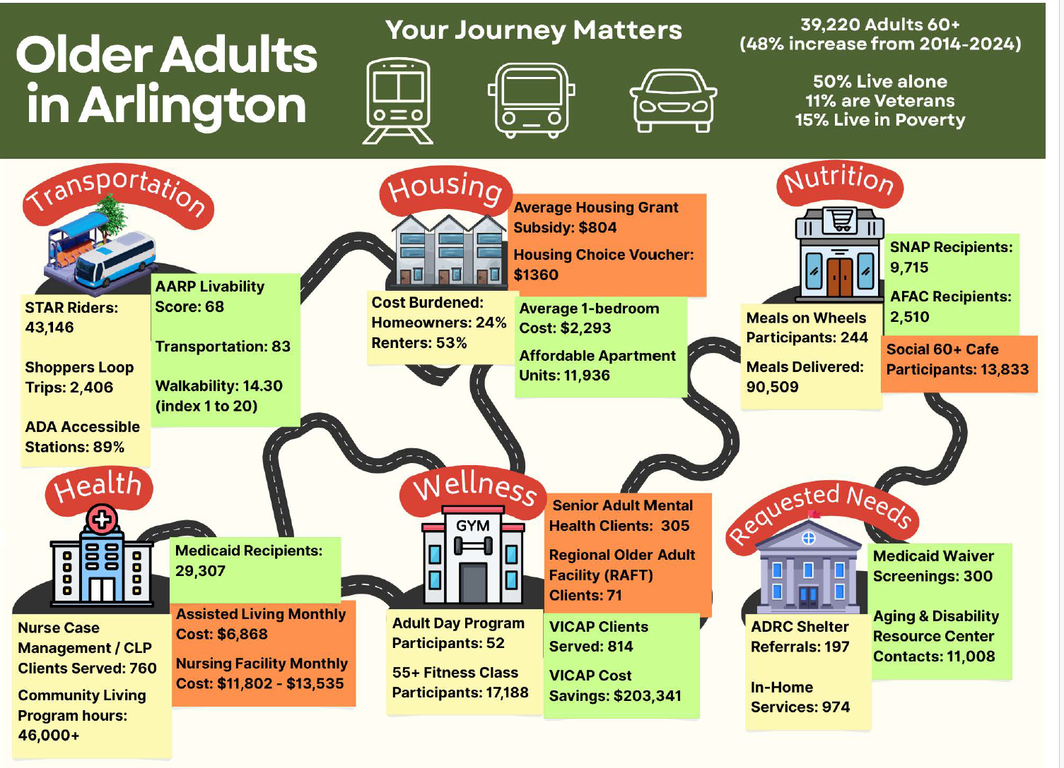
DATA TIPS
1. Look at your data
2. Tell your story with data
3. Have fun with data!
Notes:
Data isn't just numbers - it’s your voice and the voice of the people we serve.
Data is framed as a tool for storytelling and community partnership. Residents are encouraged to engage through surveys, public dashboards, and the Commission on Aging to ensure data reflects real experiences.
When someone completes a survey, it helps us improve the system for the next person. We invite the Commission on Aging to help us interpret what these numbers mean for real people.

Slide 15
Q & A
Data Resources
Population and Housing Unit Estimates Datasets
Population Data | Cooper Center
Census Bureau Data
Arlington County, VA population by year, race, & more | USAFacts
Arlington County :: Demographics :: County :: Arlington :: Age
Arlington DHS Performance Measurement Program: how Arlington’s Department of Human Services uses data to track outcomes and ensure they are meeting their community goals.
Notes:
As I stated previously, Data isn’t just numbers - it’s people’s lives, and it should be used with care, curiosity, and respect.
The core message is that data should uphold dignity, trust, and transparency. Arlington uses data not just to count services, but to understand outcomes and equity, asking, “Is anyone better off?” rather than stopping at outputs or efficiency metrics.
Arlington County :: Demographics :: County :: Arlington :: Age
Population and Housing Unit Estimates Datasets
Arlington County, VA population by year, race, & more | USAFacts
Population Data | Cooper Center
Census Bureau Data
Arlington DHS Performance Measurement Program: how Arlington’s Department of Human Services uses data to track outcomes and ensure they are meeting their community goals.

