Slide 1
From Systems to People
Advancing Person-Centered Practice Across Health and Human Services​
No Wrong Door Virginia Summit
May 6, 2026
​

Slide 2
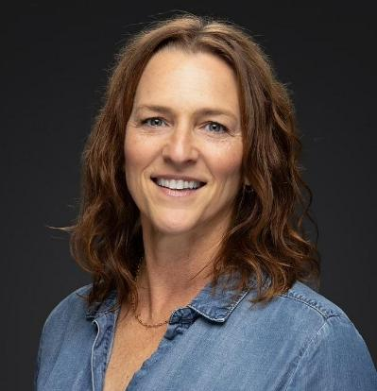

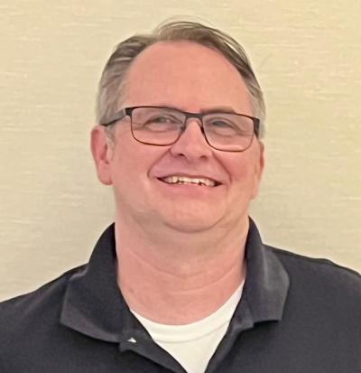

Meet the Panel
Nickie Brandenburger
Co-Director of the Center for Family Involvement at Virginia Commonwealth University’s Partnership for People with Disabilities
Adyam Redae-Woodson
Director of HIV Hepatitis Prevention: Virginia Department of Health
John Stewart
Project Manager for the DARS grant, Real Pay for Real Jobs: An EPIC Model
Moderator: Melissa White - Training and PCOC Specialist, No Wrong Door Virginia

Slide 3
Nickie Brandenburger
Co-Director of the Center for Involvement at Virginia Commonwealth University’s Partnership for People with Disabilities

Slide 4
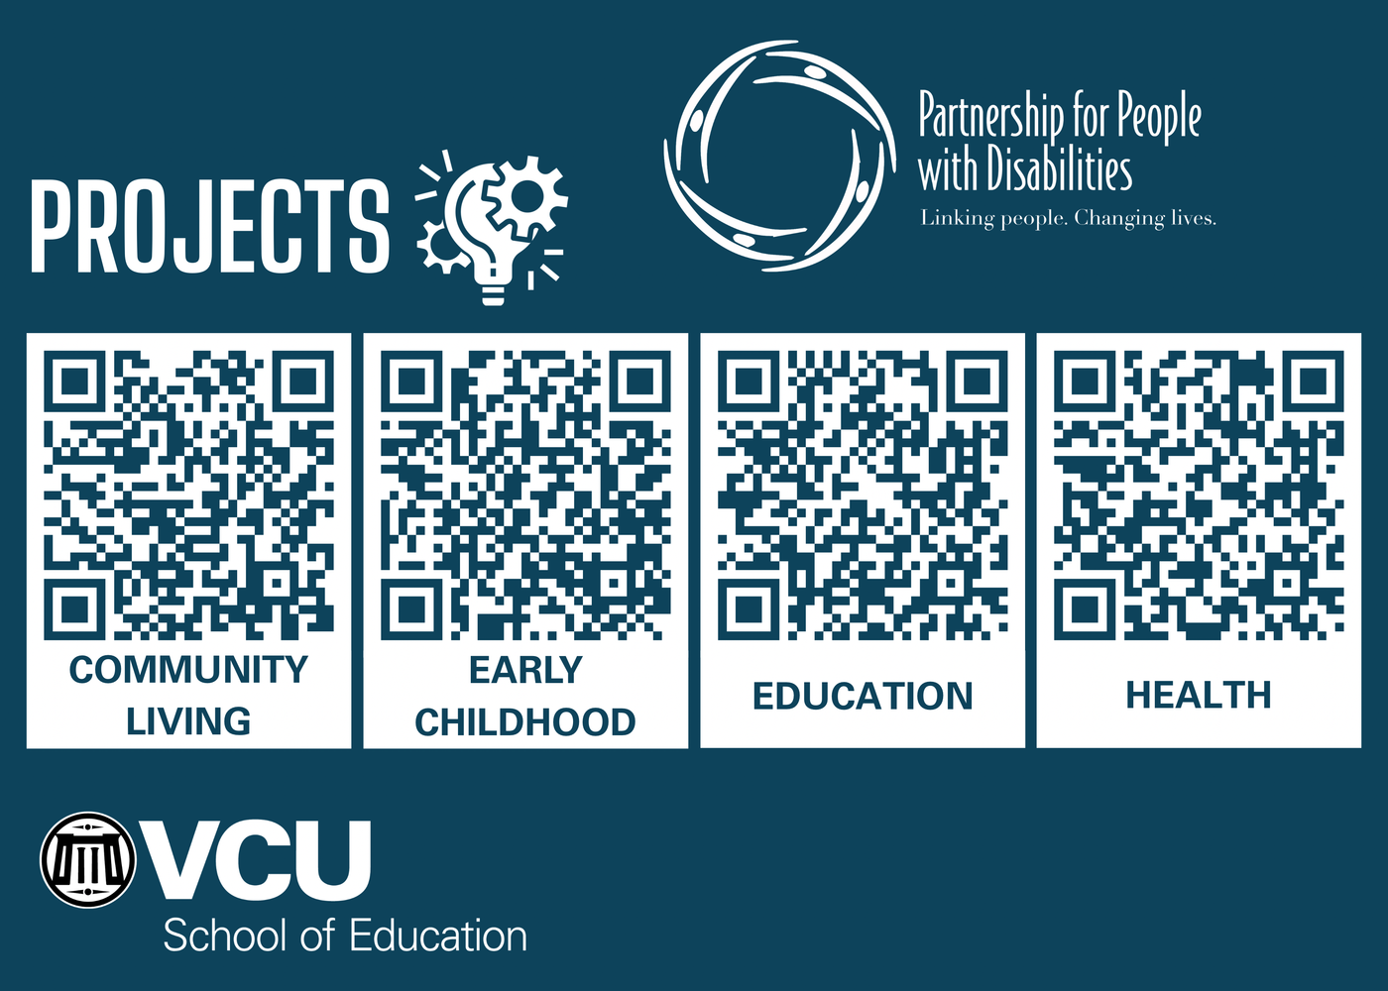
Projects
Served 40 years as Virginia’s University Center of Excellence in Developmental Disabilities (UCEDD)
Located at VCU’s School of Education as one of two disability focused centers

Slide 5

What do we provide?
Emotional support
Informational support
Systems navigational support
Affiliates with Family Voices and Parent to Parent USA

Slide 6
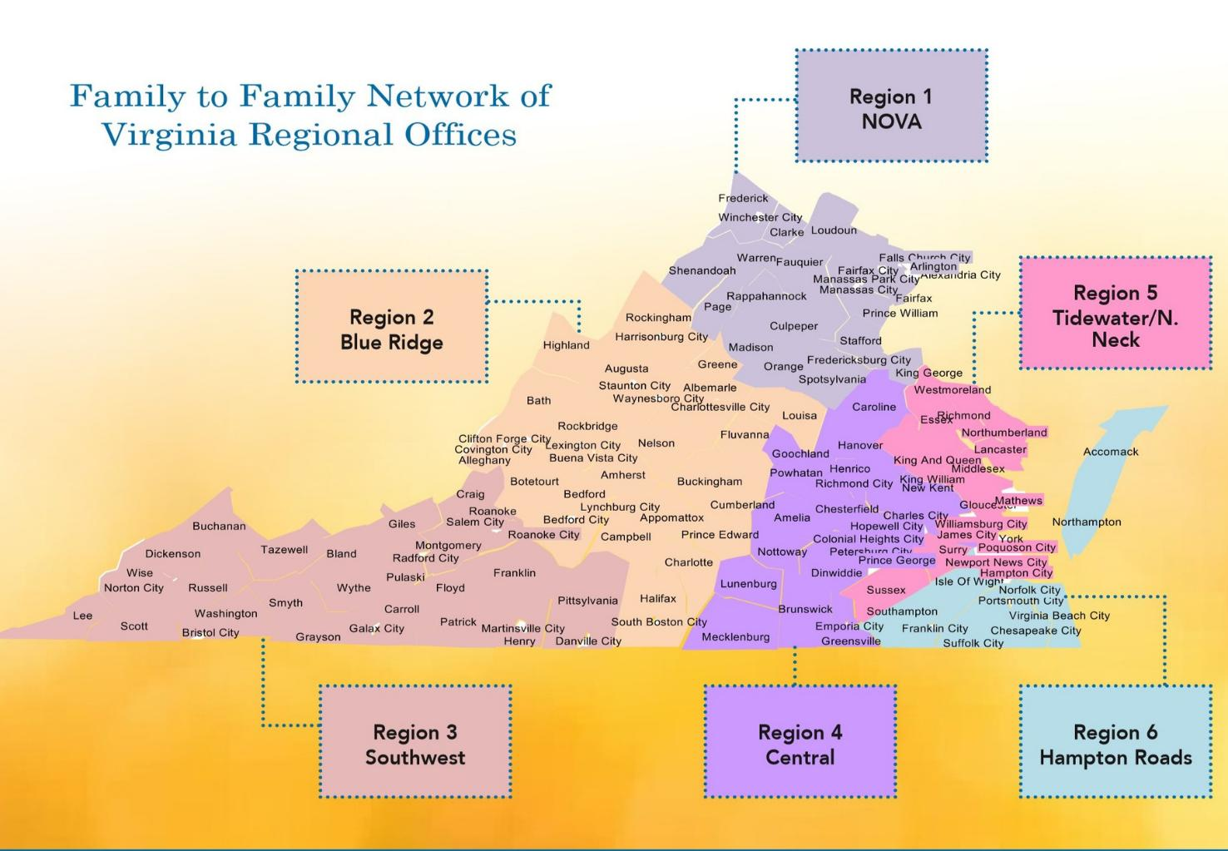
Regional Offices
15 Staff and 51 Family Navigators
Parents and Caregivers
Know, live and utilize supports and resources in their regions

Slide 7

Specialized Peer Support
Cultural Brokers
    Latino, African American and Refugee communities
Deaf Hard of Hearing Navigators
    Lived experience with a child with hearing loss, general awareness around early hearing loss detection
Specialists
    Blind/visual impairment, Aging families, Mental Health and Rural communities
Genetic Navigators
    Lived experience with a child with a genetic disorder
Pre-Employment Transition Services (Pre-ETS) Ambassadors
    Lived experience with a child currently or formerly in transition

Slide 8
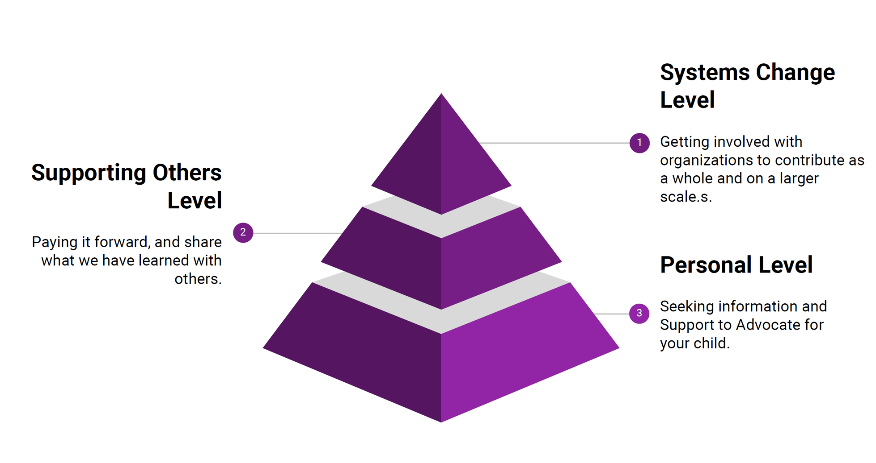
Family Engagement

Slide 9
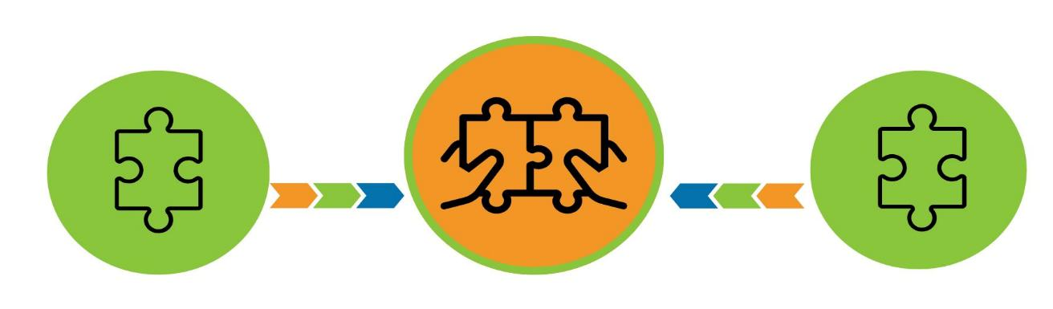
How are families matched?
Matching is based on perceived sameness
Age of person with disability
Diagnosis
The support they need
Culture/language
Location in Virginia

Slide 10

Family Needs Assessment:
Common concerns
Access to CSB/DD waiver
  Understanding of the CSB eligibility process, DD Waiver screening, priority level for waiting list
Supported Decision Making
  Spectrum of options, guardianship, conservatorship, authorized rep, advanced directive etc.
Transportation
  Rural vs. urban, family support, training needs of employee
Maintaining benefits
  Medicaid and SSI, fear, misinformation, poverty
Emotional Support
  Listen, validate, share and recognize achievements. Advocacy fatigue is REAL!
Other
  Immigration, limited follow through/motivation, culture, family caregiving responsibilities

Slide 11

Center for family involvement programs

Slide 12
John Stewart
Project Manager for the DARS grant, Real Pay for Real Jobs: An EPIC Model

Slide 13


From Systems to People: The EPIC Approach
The contents of this presentation were developed under grant H421D220008 from the U.S. Department of Education (Department). The Department does not mandate or prescribe practices, models, or other activities described or discussed in this document. The contents of this flyer may contain examples of, adaptations of, and links to resources created and maintained by another public or private organization. The Department does not control or guarantee the accuracy, relevance, timeliness, or completeness of this outside information. The content of this presentation does not necessarily represent the policy of the Department. This publication is not intended to represent the views or policy of or be an endorsement of any views expressed, or materials provided by any Federal agency (EDGAR 75.620).

Slide 14

Virginia’s SWTCIE Project:
Real Pay for Real Jobs an EPIC Model
Grant awarded through the Rehabilitation Services Administration (US Department of Education)
Virginia’s Sub-minimum wage to Competitive Integrated Employment project
October of 2022 through Sept of 2027
Charged with creating a model demonstration project “ to assist individuals with disabilities currently employed in, or contemplating, subminimum wage employment (i.e., SWTCIE program participants) to engage with State vocational rehabilitation (VR ) agencies so they may obtain competitive integrated employment (CIE)”.

Slide 15

EPIC project 4 strategies
Strategies
education
Individuals and families better informed about CIE and how to navigate the system
partnership development
traditional and non-traditional partners better aware of each other
individualized services
wraparound services teams built to the individual’s goals and needs
capacity building
providers equipped to meet the needs of individuals

Slide 16




education
  Helps people and their caregivers better understand and know how to access Competitive Integrated Employment (CIE), addressing their individual needs and facilitating greater self-determination
Peer Mentoring
Connect people with individuals with lived experience
Family Navigation
Connect families to families with lived experience
Paid Work Experience
Connect people and families to hands on information

Slide 17

partnership development
    Many other needs can impact an individual’s ability access to employment. We need to be connected to partners that can provide resources to address these.
Local Advisory Councils
Community Academies
Professional Development
Virginia Easy Access

Slide 18






takes a holistic view of people to identify resources, needs, and additional supports to address these
Charting the Life Course Life Domains:
Daily Life & Employment
Community Living
Safety & Security
Healthy Living
Social & Spirituality
Advocacy & Engagement
Charting the LifeCourse Framework and Tools, iconography, and assets developed by the LifeCourse
Nexus © 2024 Curators of the University of Missouri | UMKC-IHD, UCEDD • www.lifecoursenexus.com

Slide 19

Local Advisory Councils
Variety of Stakeholders across each region
  Individuals with lived experience
  Family members with lived experience
Help adapt the project to local communities
Build partnerships between agencies/ eliminate silos
  Increase collaboration
  Braid resources

Slide 20


Community Academies information
Draw together a wide array of service providers
  Serving individual with disabilities
  Serving individual without disabilities
Service providers share in 3 minutes:
  Who do you serve/ who is eligible
  The geographic area that you serve
  The services you provide to individuals
  The goals of your program
We share information on
  Holistic approach
  Integrated Resource Teams
  Virginia Easy Access

Slide 21
Professional Development
Behavioral Economics and the Culture of Poverty
Provides additional opportunities to bring partners together
  Provide partners with information they are seeking
  Helps them to be speaking a common language
  Reinforces relationships
Trauma Informed Care
Financial Wellness for People with Disabilities
Medicaid Waiver for Virginians with Developmental Disabilities

Slide 22


Virginia Easy Access
Assist individuals, families, VR staff and other professionals to both traditional and non-traditional partners
  CSBs
  Schools
  DSS
  CILs
  Re-entry programs
  AAAs
  Work Incentive Specialists
  Housing resources
  Utility relief programs
  Adult education
  Veteran’s programming
  Prevention programming
  Disability law resources
  Legal aid
  Public library resources
  Early intervention programming
  Transportation resources
  Supportive decision-making resources
  Parent Resource Centers
  Food resources
  PT/OT resources
  Peer mentoring
  Family Navigation
  Assistance with vital records/ IDs

Slide 23


individualized services
  Individuals and their VR Counselors build
  Integrated Resource Teams from applicable partners
Participant driven
Individual and VR counselor drive the process
Employment focused
Centered around the individual’s employment goal
Greater collaboration
Brings supports together to build integrated plan
Blend resources
Agencies braid together their available supports

Slide 24


capacity development
  Helping providers have what they need to meet people’s needs
Supported Employment
To help match people to and support them in jobs that meet their strengths, preferences, interests and needs
Customized Employment
To create jobs built around the strengths, preferences, interests and needs of the individual

Slide 25
Adyam
Redae-Woodson
Director of HIV Hepatitis Prevention:
The Virginia Department of Health

Slide 26
HIV Prevention
Status Neutral
Service Navigation Program
No Wrong Door Virginia 5/6/2026

Slide 27
What is Service Navigation?
Navigation refers to the function of linking clients with essential health and community services.
Navigation coordinates care, and services across siloed mental, behavioral, and physical health care delivery systems, leading to greater holistic and person-centered care.
Navigation also assists individuals in overcoming other barriers to care and to increase their engagement and active participation in care.

Slide 28
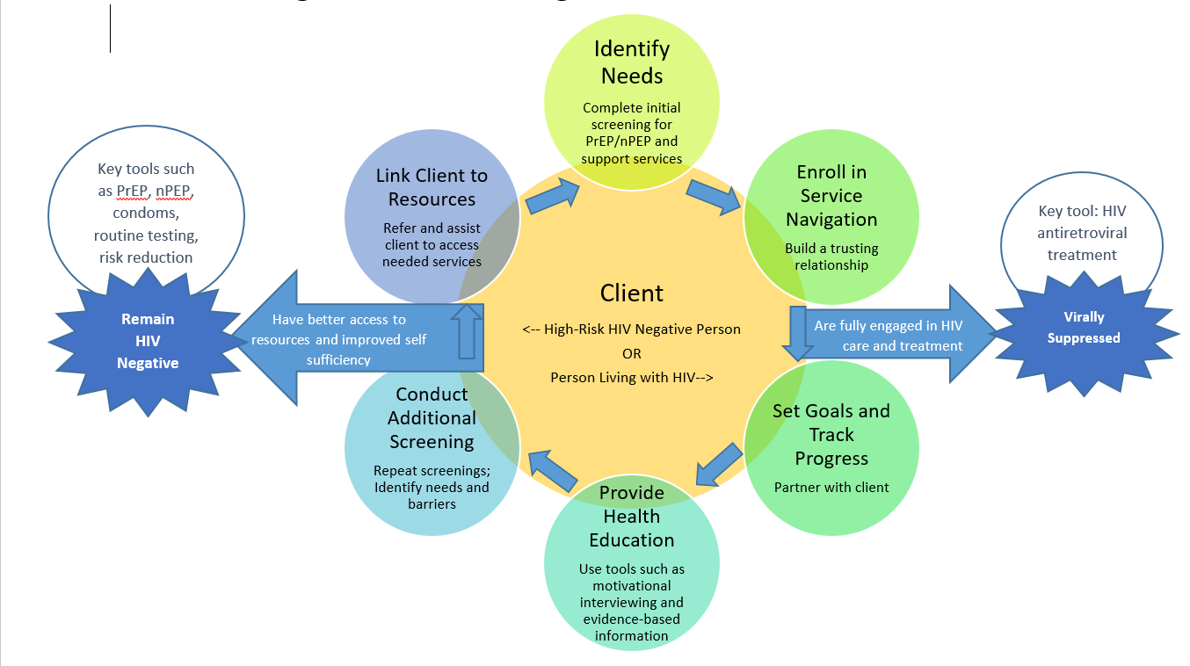
Model

Slide 29
Overview of SNSN
Status Neutral Service Navigation
  10 CBOS – at least one in each Region
    Provide HIV, STI, and HCV testing, along with partner services and linkage to medical care for clients with HIV.
    Screen, refer, and link clients to PrEP and supportive services, including health insurance
    .Conduct outreach and distribute condoms across all sites.
    Three CBOs also offer stigma‑reduction group services.
HIV tests | 6,722
Linkage to Care referred | 26
Linkage to Care linked | 26
HCV tests | 3,761
HCV referred to care | 41
HCV linked to care | 39
STI tests | 5,887
STI referred to treatment | 84
STI linked to treatment | 84
Service Navigation screened | 4,571
Service Navigation referred | 1,763
Service Navigation linked | 1,527
PrEP screened | 2,957
PrEP referred | 1,371
PrEP linked | 464

Slide 30
SNSN Services
Referring and linking individuals:
  Pre-exposure prophylaxis (PrEP)
  Non-occupational post-exposure prophylaxis (nPEP)
  Linking people to health care systems
  Screening and assisting with enrolling individuals into health insurance
  Assisting with transportation
  Identifying and reducing barriers to care
  Delivering health education to clients to influence their health-related attitudes and behaviors.

Slide 31


Status Neutral Service Navigation
HIV Negative
PrEP/nPEP Navigation
Health Education/Risk Reduction
Referrals to Other Services
Condom Distribution
All Virginians
HIV Positive Ryan White Ineligible/Pending
HIV Positive Ryan White Eligible
Linkage to Care
Health Education/Risk Reduction
Referrals to Other Services
Condom Distribution
Linkage to Care
Health Education/Risk Reduction
Referrals to Other Services
Condom Distribution
HIV Test
*Optional Services
Social Marketing
Stigma Reduction
Faith
Initiatives
Medical Transportation
Early Intervention Services (EIS)
Ryan White Mental Health
Ryan White Psychosocial Support
Ryan White
Substance Abuse Services

Slide 32

What are the benefits of SNSN?
Referral source for clients to supportive services
  ie. Mental health, job readiness
Building Collaboration
Increasing coordination for STD and HIV prevention
Addressing Health Disparities and reducing stigma

Slide 33
Other SN Program
Comprehensive Harm Reduction
  16 Authorized Sites, 14 Funded
    Current Outcomes:
      Served 4,525 individuals• Completed 15,115 visits• Distributed 713,246 syringes• Reversed 828 overdoses• Distributed 83,437 condoms• Linked 158 people to family planning services• Distributed 6,121 Naloxone kits• Performed 672 HIV tests• Performed 419 HCV tests
    Pregnancy Pilot for 3 Sites
      Purpose to find and recruit women who are pregnant or nursing
      Sites will provide HIV/STI, hepatitis, and syphilis testing and referral to treatment, case management, OTC birth control, pregnancy tests, pre- and postpartum support, transportation, and peer recovery support
    Current Outcomes:
      16 enrolled, nine connected to housing, eleven connected to licensed mental health care, and two babies born and received treatment

Slide 34
Contact Information:
Adyam Redae-Woodson, MA, PMP
Director, HIV and Hepatitis Prevention
Adyam.Redae@vdh.vigrinia.gov
Questions?

Slide 35
Panelist Q&A

