Slide 1
Working Together:
For Real
Creating Stronger Partnerships And Meaningful Collaboration

Slide 2
Session goals
Share how we used simple, real‑world ways to connect with stakeholders and community partners through the Greater RVA No Wrong Door Advisory Council Meeting.
Learn tips on how to build shared purpose, strengthen trust, and create engagement opportunities that feel genuine—not forced.
Sharing one example of how we created more engagement and explore other ways to connect as well as collaborate

Slide 3
Let’s get grounded
Guidance on NWD Advisory Councils

Slide 4
Our roles
No wrong door
Area Agency on Aging
Lead, Educate, Advocate
NWD Coordinator
Advocate, Administer, Support
NWD Advisory Council
Advise, Coordinate, Collaborate

Slide 5

Reflection
Is your council engaged? Purpose Driven?
What word or phrase would you use to describe your council?

Slide 6
Building and engaging
Important Questions:
Why does your council exist?
What unique perspectives do members bring?
What is our shared goal and purpose?

Slide 7
The Span Center’s
Mapping exercise
Business and Marketing Mapping

Slide 8
The Span Center
Business Mapping exercise
Your
Organization
Same/Similar Organizations
Organizations your agency receives referrals from...
Organizations your agency refers to...
Other Organizations
Government
Health
Emergency
Faith Based

Slide 9
The span center marketing Mapping exercise
RVA NWD
Marketing
Plan 101
NWD Assets
Outreach Ideas
Identify
Priority Partners
NWD Features

Slide 10
Our BIG Reflection
Technology is wonderful but relationships matter.

Slide 11
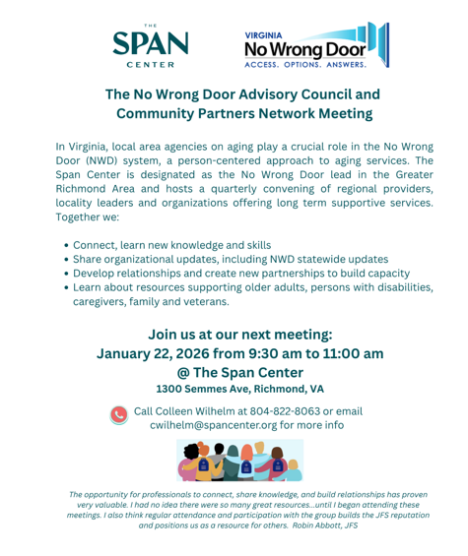
We started to invite everyone

Slide 12
From our partners
“It certainly is of value to me. I love the guest speakers you have. And the networking with other providers in this space. This meeting offers up one of the few times I get to "pull back from the work" and get a larger perspective of who is doing what while at the same time digging deep into the "workflow" across our many systems and get granular about individual needs.”
Heather, Circle Center

Slide 13
From our partners 2
“A space where we get to hear updates both about statewide initiatives, regional work, and local work. Given our service area is also more than just one county or city it is very helpful to be in a regional meeting of partners serving the same population to learn about the advocacy work, data efforts, research, and local support being provided by community partners.” Jennifer, Family Lifeline

Slide 14
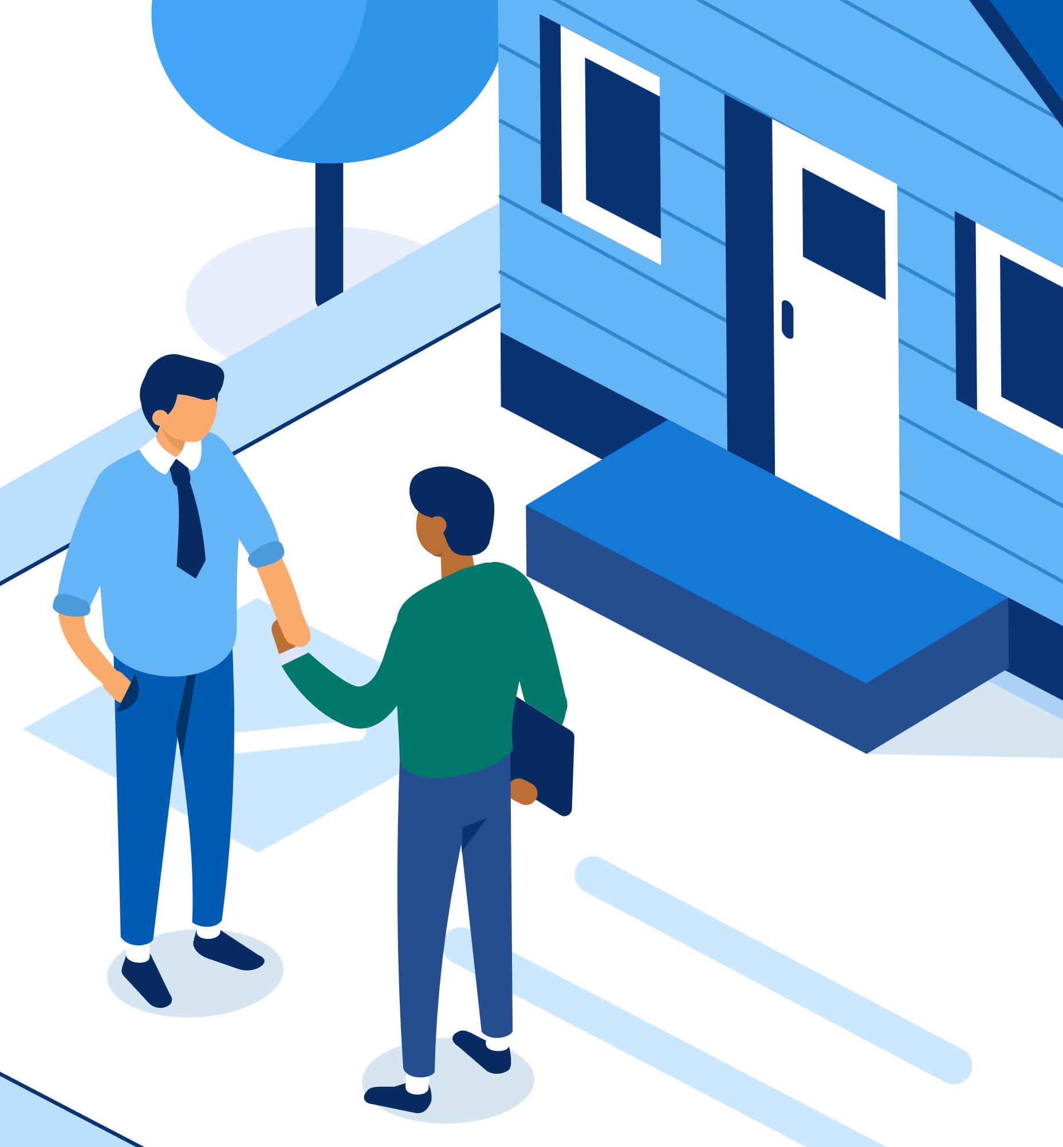
Make a plan
Build on what you have
Survey members, partners, contractors
Other HCBS organizations meetings
Find an issue or shared purpose
Change it up - have a partner host
Let us brainstorm together – group activity

Slide 15
Q and A
Colleen Wilhelm
cwilhelm@spancenter.org

