Slide 1
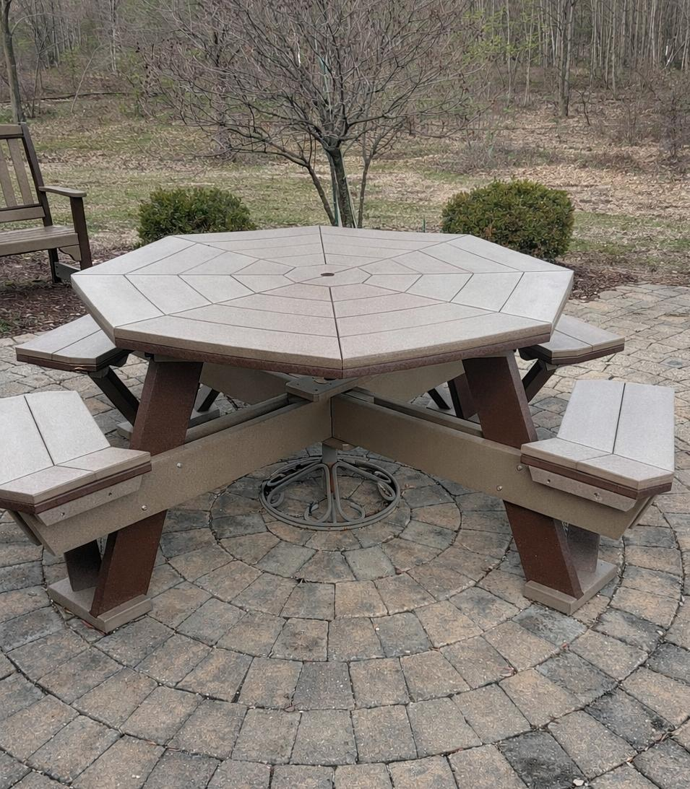

Opening the Door Isn’t Enough
Building Tables That
Include Everyone
Gayl Brunk, Executive Director
Valley Associates for Independent Living
Access is step one—Shared power is the goal

Slide 2

Quick Show of Hands
Who has an advisory council?
Who has a board of directors?
Who includes individuals with lived experience?
Who gives them decision-making power?

Slide 3
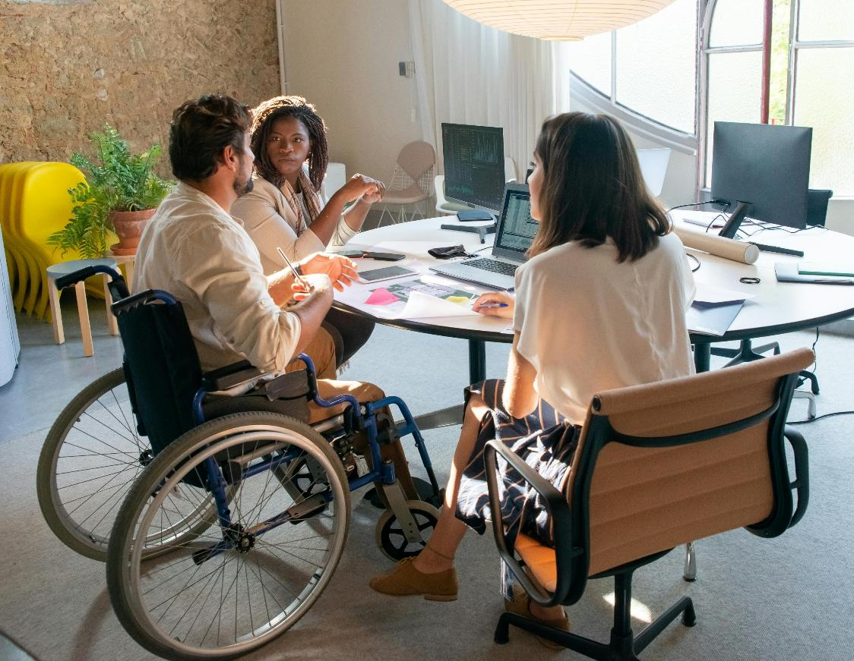
Core Message
Access gets people in the room
There’s power in being in the room
Inclusion = influence + decision-making

Slide 4


Why Lived Experience Matters
Better decisions
Increased trust
Programs that actually work
Innovation & practical solutions
Avoid costly missteps

Slide 5

Common Pitfalls
Token Representation
  Inaccessible Meetings
  Inaccessible Materials
  Professionals Dominate Discussions

Slide 6

Recruitment:
Where Are You Looking?
Move beyond 'who we know'
Engage disability organizations
Partner with Centers for Independent Living
Connect with peer networks
FreePik

Slide 7
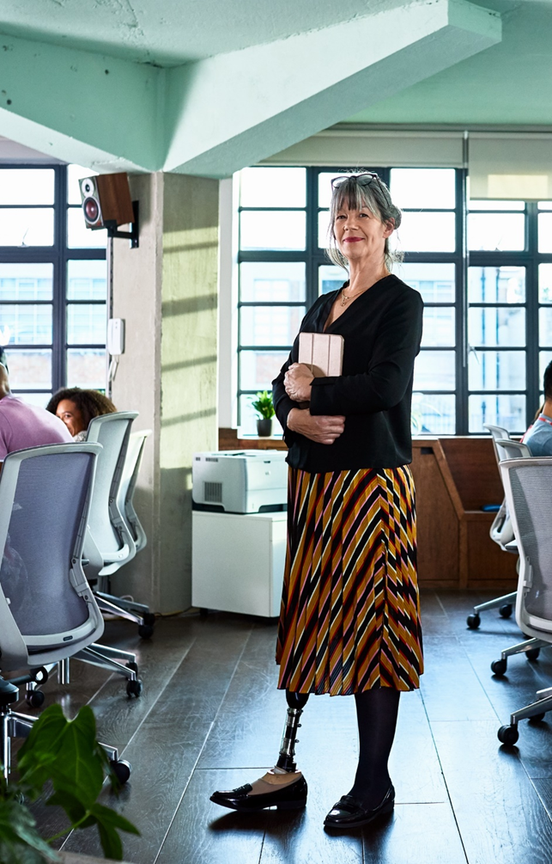
Recruitment: Remove Barriers
Offer stipends
Flexible meeting options
Clear expectations of influence
Plain language invitations

Slide 8
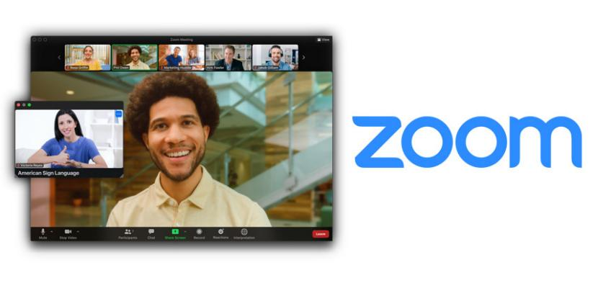
Accommodations
Ask proactively
Captioning or interpreting
Transportation or virtual options
Provide materials in advance
Build into the budget

Slide 9


Creating Space for Voice
Round-robin sharing
Facilitated discussions
Leadership speaks last
Collect input before meetings

Slide 10
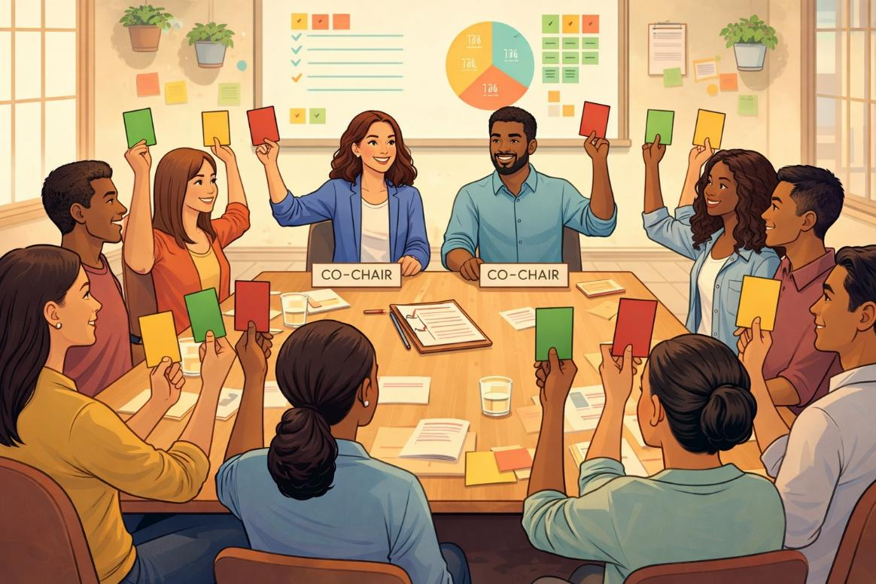
Shared Power
Voting roles
Leadership positions
Co-Chair opportunities

Slide 11

Inclusion or Illusion?
We have one consumer on our board
Consumers have voting power
Meetings are accessible
No compensation provided
FreePik

Slide 12

Activity:
Spot the Barrier
Scenario:
There is a meeting at 2 pm this Wednesday on the 2nd floor. There is no elevator. RSVPs were due this Monday and the materials were sent Wednesday morning.
What are the barriers?

Slide 13


Spot the Barrier
Materials sent the same day
FreePik

Slide 14
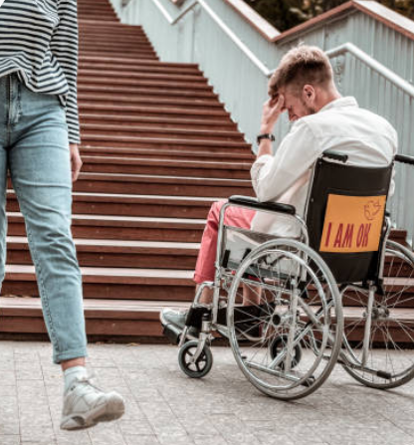

Spot the Barrier 2
Meeting on the 2nd floor with no elevator
iStock

Slide 15

Build It Better
Accessible location or virtual option
Materials in advance
Structured participation

Slide 16

Self-Assessment
Rate your organization (1–5):
Recruitment diversity
Accessibility
Influence of lived experience

Slide 17

3 Immediate Actions
Add accommodation question to invitations
Identify 2 new recruitment partners
Remove participation barriers

Slide 18
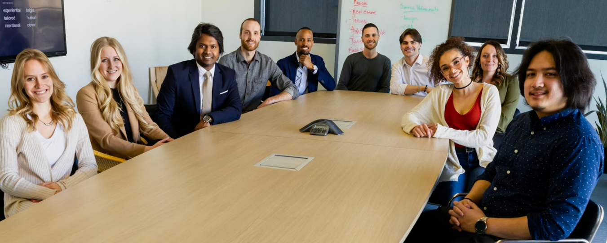
Final Reflection
Who is missing from your table?
What would change if they were truly heard?
Unsplash

Slide 19
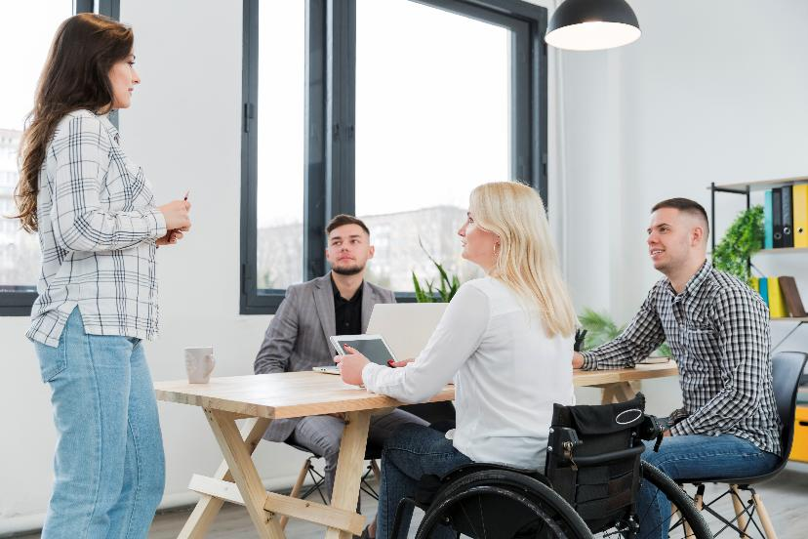
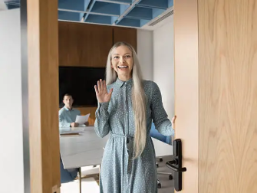
Closing
Opening the door is compliance
Building the table is leadership

