Slide 1



Accessibility:
Become An Information Access Champion!
The importance of using plain language to empower accessibility
May 6, 2026

Slide 2

Virginia’s DD Council
Authorized under the federal Developmental Disabilities (DD) Assistance and Bill of Rights Act.
Guided by federal State Plan Priorities.

Slide 3
Agenda
Information Access
Plain Language
Inclusion, Collaboration, Continuous Improvement
Putting it All Together
Be an Information Access Champion

Slide 4


What is information access?
Information should be easy to get, easy to understand, correct and respectful
Information that helps people live their lives the way they want

Slide 5



Why Information Access?
For many years, Virginians with I/DD and their families reported difficulty finding, understanding and using information on community services and supports that would help them live the lives they want.
These challenges are compounded by the complexity of the service delivery system and the fragmentation of sources of information.
As a result, people with disabilities and family members report increased stress, anxiety and frustration.

Slide 6
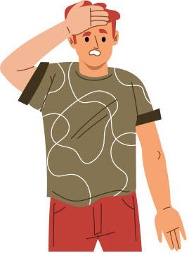
One parent said…
It is not necessarily LACK of information. It is information OVERLOAD. Trying to sort through lots of information that is not useful or helpful, trying to find out what is really helpful…

Slide 7

Another parent said…
You read a paragraph on a website, and you have read it in your own language or in another language. And you still don't understand.
Lees un parágrafo de una website,
y lo has leído en tu idioma o en otro idioma. Y sigues sin entender.

Slide 8
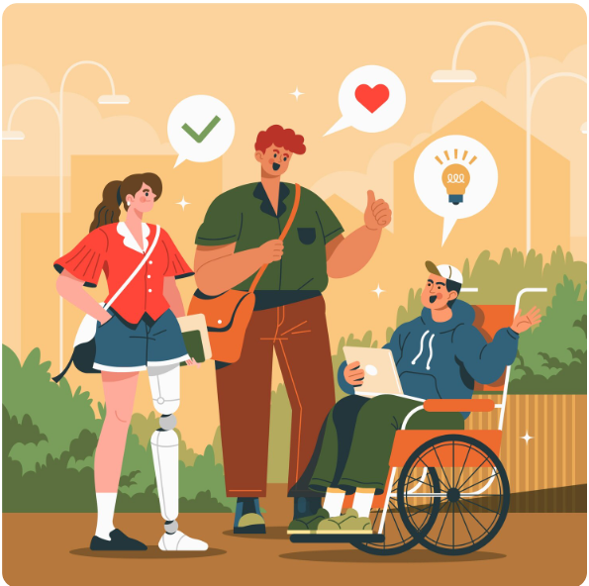
Why is this important?
Everyone deserves equal access to information.
Information helps people to live their lives, in the way that they want.

Slide 9



Systems Change
What does this mean in terms of information access?
What’s my role or my agency's role?
Systems Change Initiatives:
  Information Access Champions!
  Provide Training & Technical Assistance
  Community of Practice for Information Access

Slide 10
What do we do?
Use plain language!

Slide 11
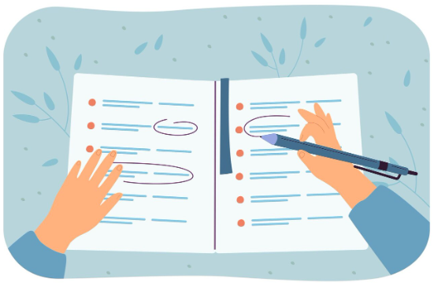
What is plain language?
Talk or write in a way that is easy to understand
This takes practice
This is an important skill

Slide 12
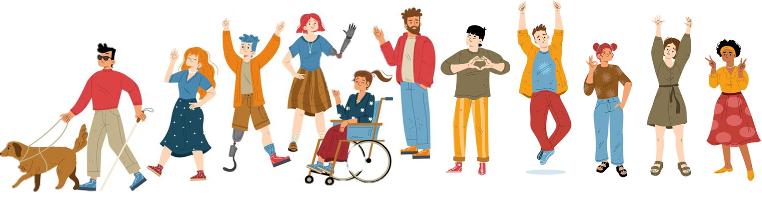
Who benefits from clear/plain language?
People with intellectual disabilities
People with limited English proficiency
  People who speak English as a second language
  Spanish speakers, ASL speakers, etc.
People who are busy
People who are stressed
EVERYONE!

Slide 13

Basic Rules
Use common words
Define complex words/concepts
Use shorter sentences
Use active voice
Avoid unclear pronouns
Include all of the same info as the original version

Slide 14
Use Common Words
Avoid trying to sound academic
Example 1
  Before: Staff invariably provide high-quality assistance to patients.
  After: Staff always help patients to the best of their ability.

Slide 15
Use Common Words (continued)
Example 2
  Before: Staff must provide written notice of their legal obligation and compliance with regulations.
  After: Staff must put in writing that they will follow the law and other rules.

Slide 16
Define Complex Words/Concepts
Complex words/concepts includes jargon
Sometimes using complex words is unavoidable
Define the complex word the first time it appears

Slide 17
Define Complex Words/Concepts (continued)
Example
People with disabilities can waive their right to institutional care and use home and community-based services instead.
  Waiving a right means to give up that right.
  Institutional care is care that is given in hospitals, state schools, group homes and other places that the government funds.
  Home and community-based services are services that are given in traditional personal homes.

Slide 18
Use Shorter Sentences
Write up to 15-20 words per sentence
Longer sentences can be confusing
Break longer sentences into shorter sentences

Slide 19
Use Shorter Sentences (continued…)
Example: Before
“Developmental disability,” as defined in federal law, is a severe, chronic, often lifelong disability that causes substantial limitations in several major life activities such as: self-care, receptive and expressive language, learning, mobility, self-direction, the capacity for independent living, and economic self-sufficiency.

Slide 20
Use Shorter Sentences (example continued…)
After
“Developmental disability,” as defined in federal law, is a severe, chronic, often lifelong disability.
It causes substantial limitations in several major life activities.
These include self-care, receptive and expressive language, learning, mobility, self-direction, the capacity for independent living, and economic self-sufficiency.

Slide 21
Use Active Voice
The subject should be doing the action
Example 1
  Passive: The State Plan was developed by a committee.
  Active: A committee developed the current State Plan.

Slide 22
Use Active Voice (continued)
Example 2
  Passive: Complaints should be dealt with as quickly as possible.
  Active: Deal with complaints as quickly as possible.

Slide 23
Avoid Unclear Pronouns
Pronouns are words like “they,” “she,” “he” and “it”
Example:
Before: Parents of students with disabilities can talk with school staff about Individualized Education Plans (IEPs). They can be helpful for their children.
After: Parents of students with disabilities can talk with school staff about Individualized Education Plans (IEPs). IEPs can be helpful for the parents’ children.

Slide 24
Include all the same info as the original version
Access to information = access to all the same information
Concerned about length? Consider what’s important
  Background?
  History?

Slide 25
Remember…
Clear and plain language improves information access
Clear and plain language is accessibility

Slide 26




What Other Things Do We Need to Think About?
Information Access Champions Values…
Accessibility
Inclusion
Collaboration
Continuous Improvement

Slide 27

Accessibility
People with disabilities should be able to get information important to them.
Notes:
Clear, understandable and jargon-free.
Written at a 5th – 8th grade level.
Shared in different ways.
Available in braille, large print and audio recordings when needed.
Available by talking to a knowledgeable and helpful person.
On accessible websites.

Slide 28

Inclusion
All people should have access to information that respects their culture, is translated well and meets their community’s needs and preferences.
Notes:
We respect all cultures, types of families and languages.
We translate information so that meaning and intent are not lost.
We accept and respect people’s life choices, beliefs and the LGBTQ+ community.
Your culture and beliefs affect the way that you share info. This can happen without you realizing.
Example 1: “When a child becomes an adult, they should live on their own to be independent.” Assumes the child is from Western culture. In other cultures, the child may be expected to live with their parents until they have married.
Example 2: a flyer about family services. The flyer has pictures of families with mom, dad, child. What about other types of families?

Slide 29

Collaboration
People with disabilities, families, advocates, service providers and policymakers should work together to make information access inclusive.
Notes:
We make sure the lived experience of people with disabilities and families is a part of solutions.
We pay people with disabilities and families for their knowledge and expertise.

Slide 30

Continuous Improvement
Plans for information access should be regularly reviewed to make sure they work well and meet changing needs.
Notes:
We create lasting solutions.
We use feedback and data to improve.
We hold ourselves and others accountable.
We change as our understanding of cultures grows.
We are not road-blocked by change in leadership, fear or jadedness.
We keep up with new technologies, including artificial intelligence (AI).

Slide 31
Putting it All Together

Slide 32

Real Life Example: Before

Slide 33
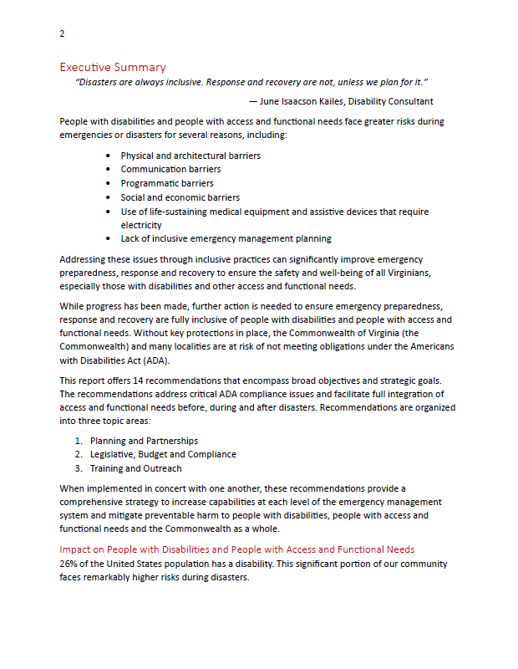
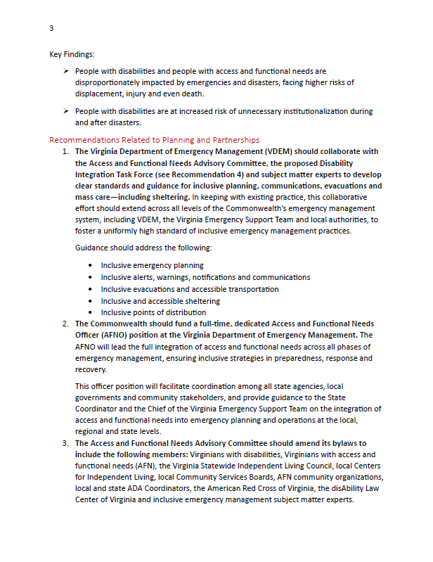
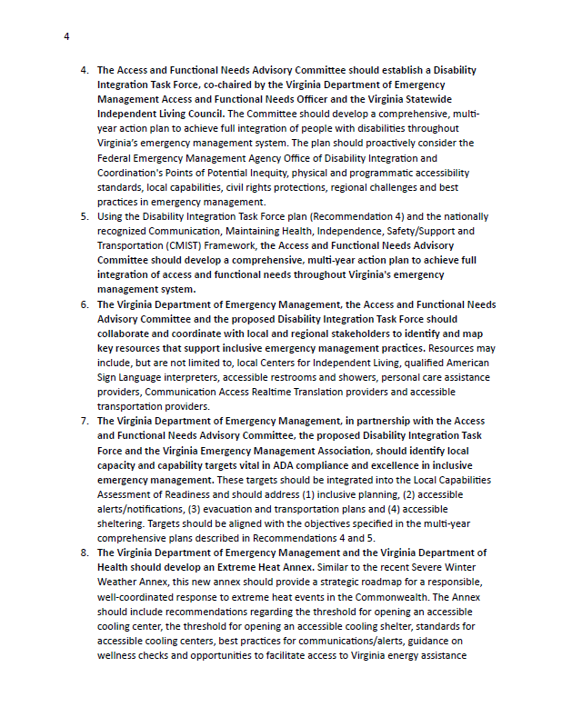
Policy Assessment

Slide 34
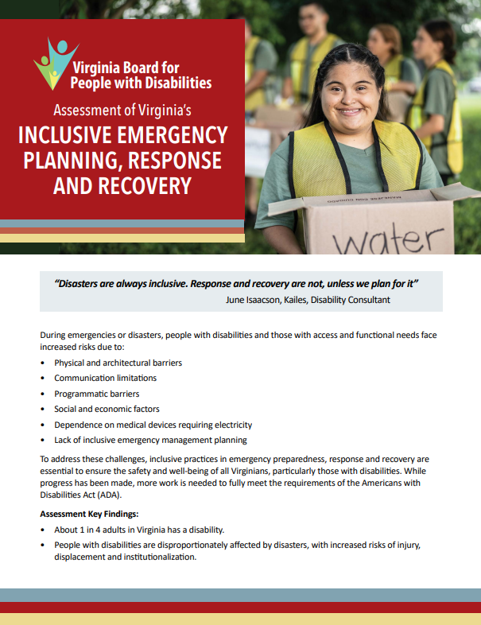
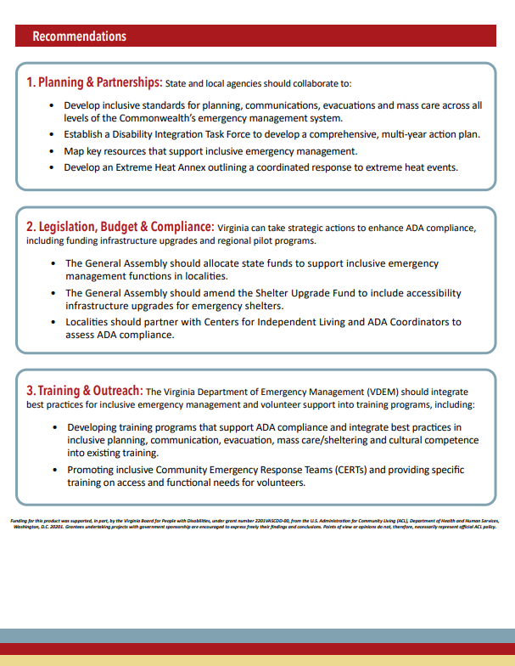
Infographic

Slide 35
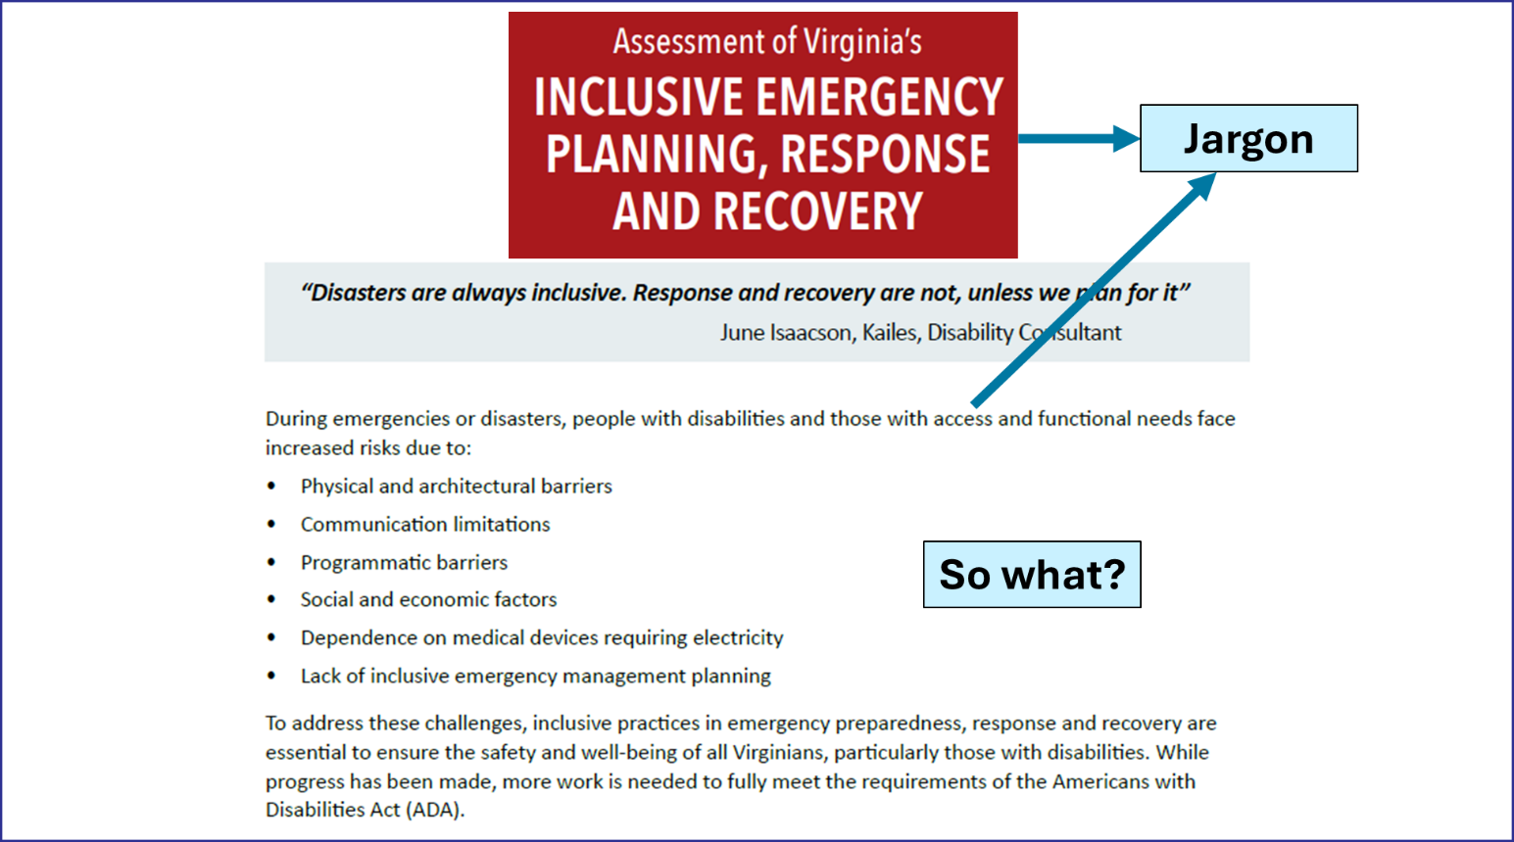
Infographic: Taking a Closer Look

Slide 36
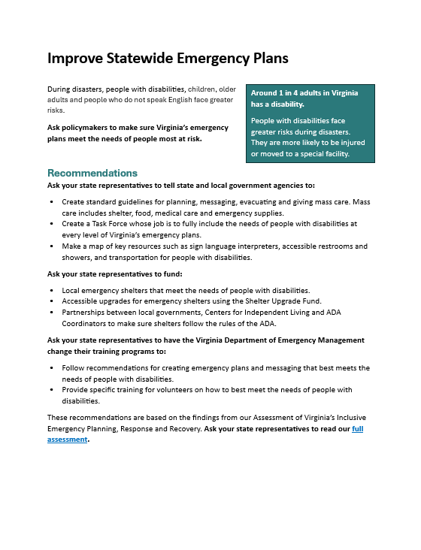
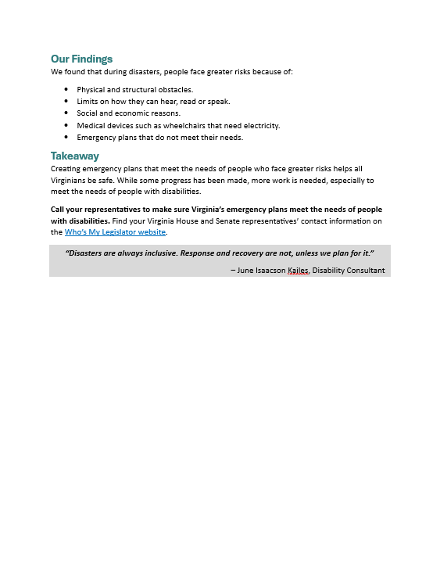
Time to Seek Feedback

Slide 37
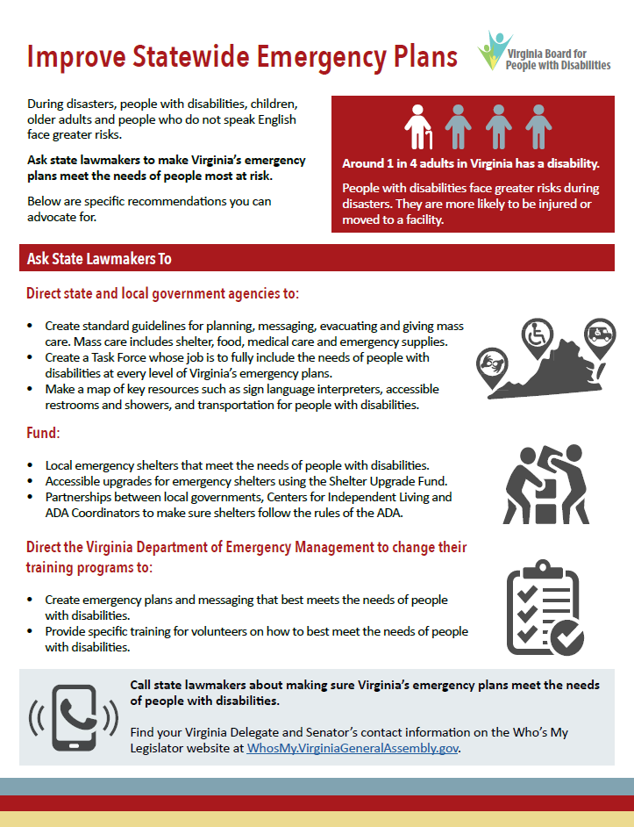
Real Life Example:
After

Slide 38
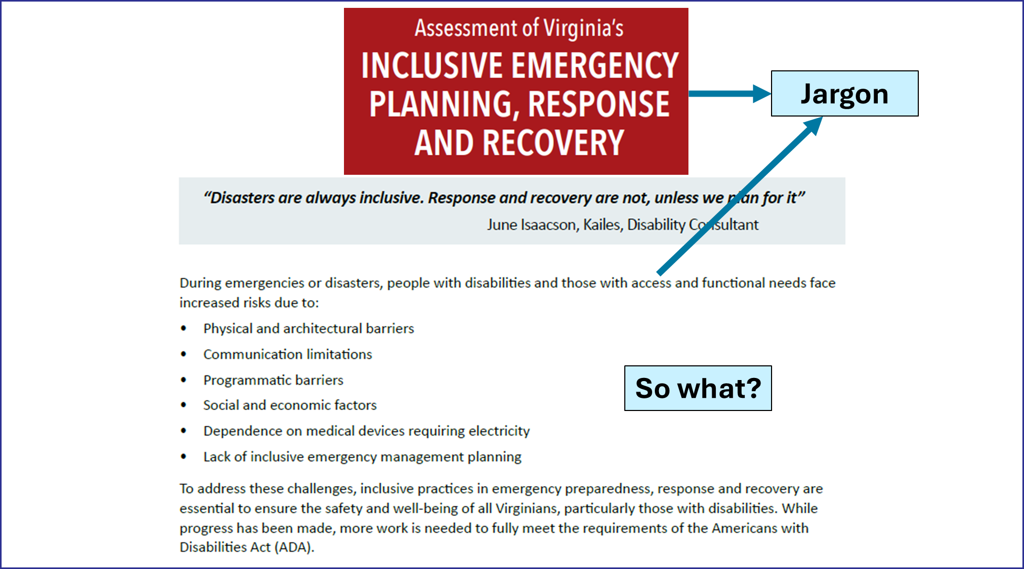
Top: Before

Slide 39
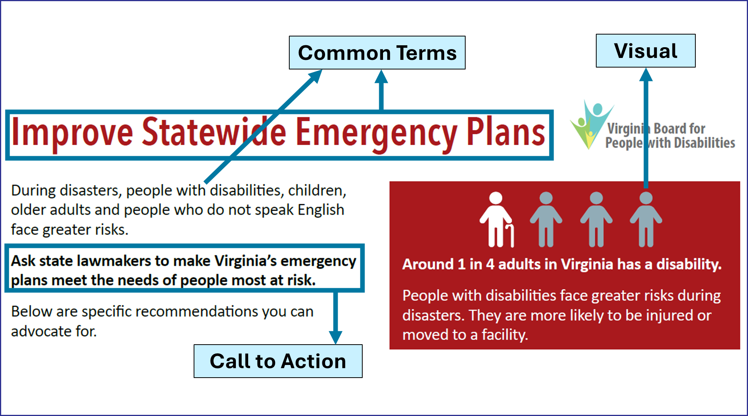
Top: After

Slide 40
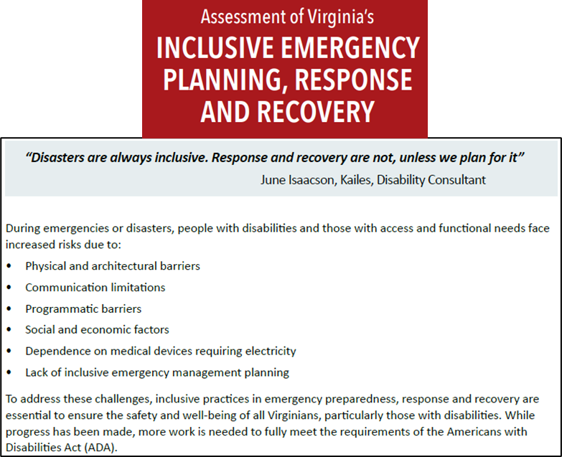
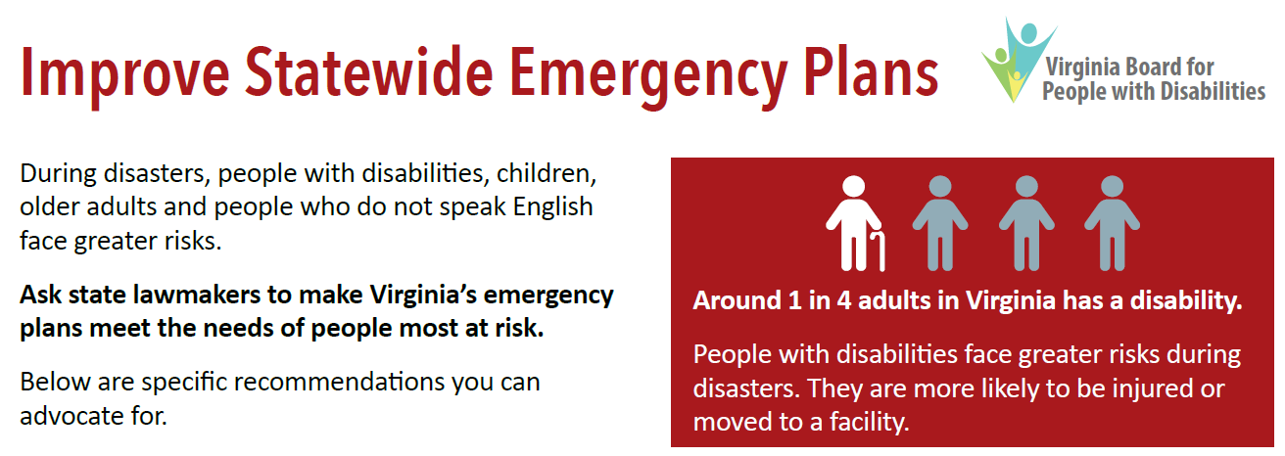
Top Before & After
Before
After

Slide 41
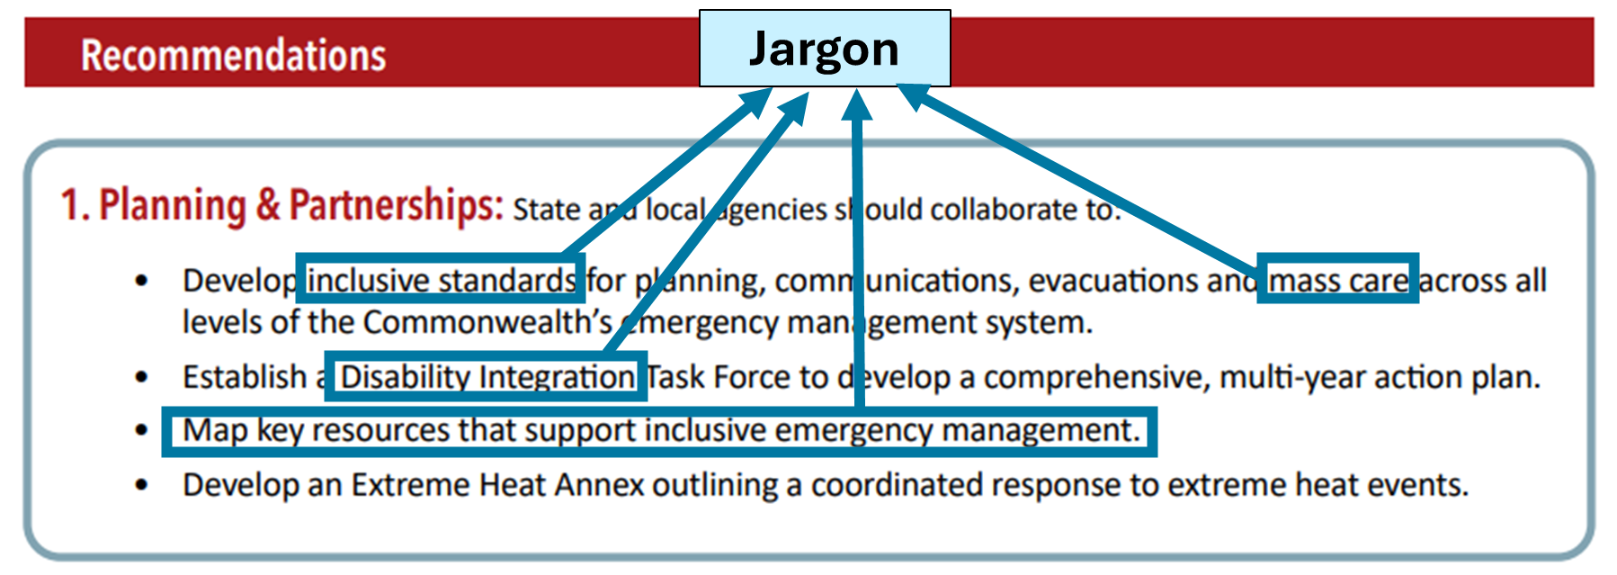
Recommendation 1: Before

Slide 42
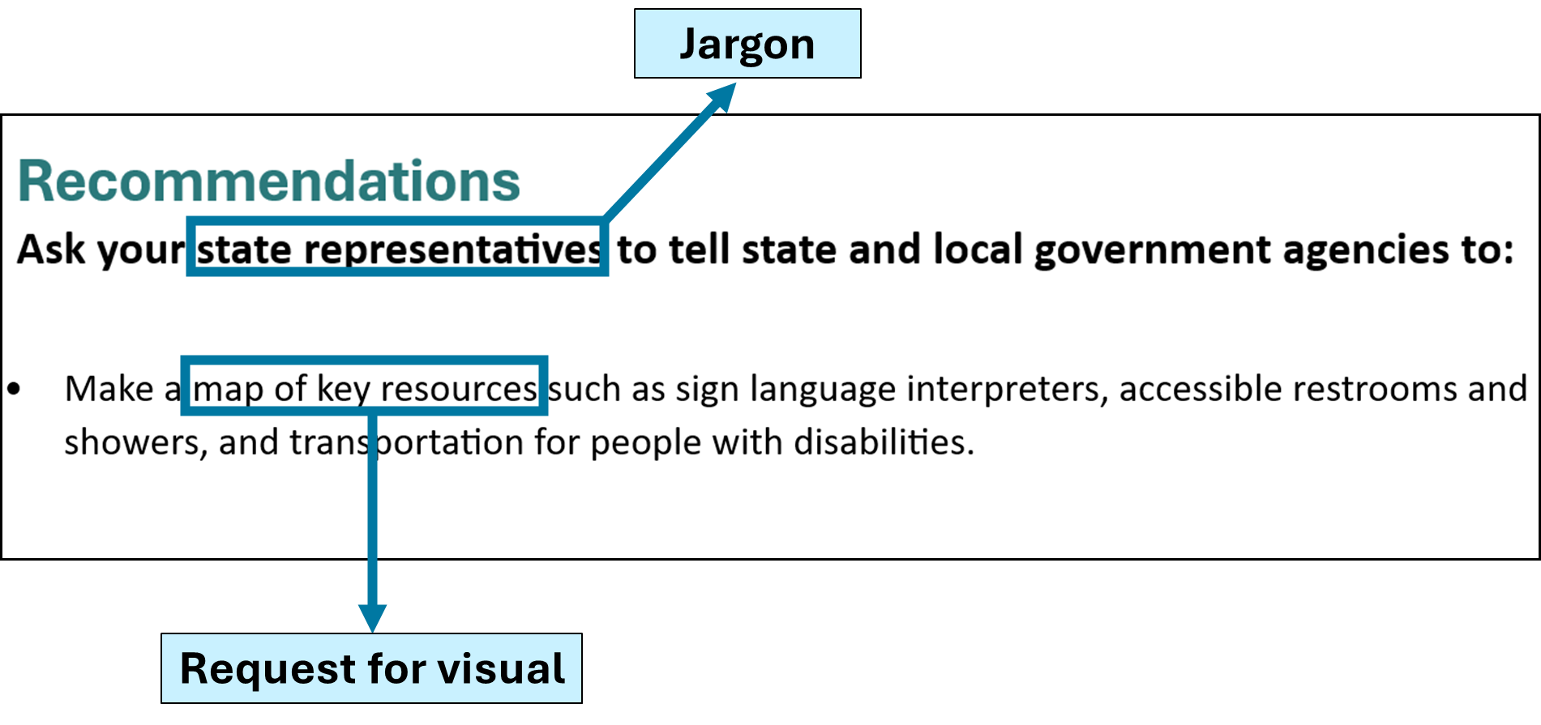
Feedback

Slide 43
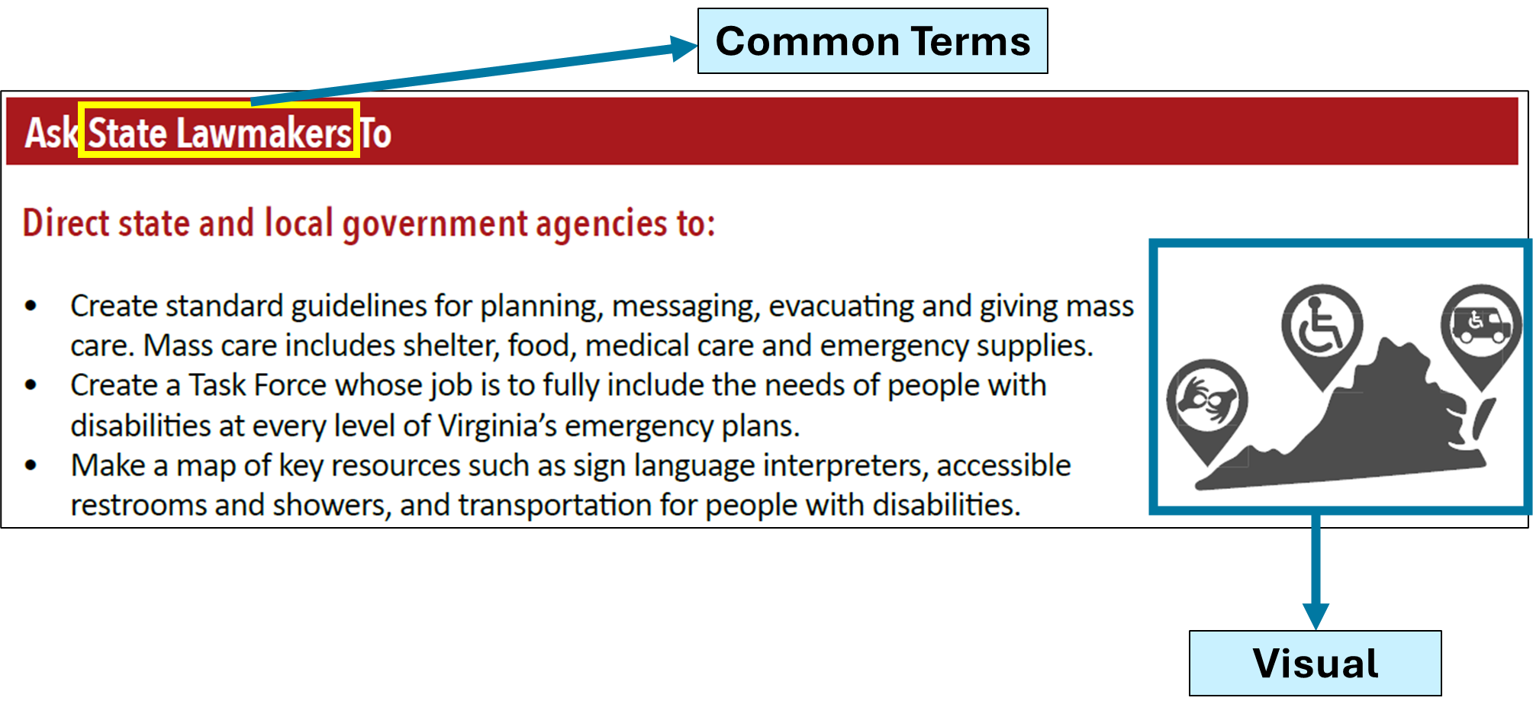
Recommendation 1: After

Slide 44
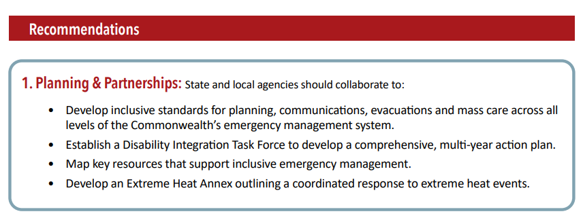
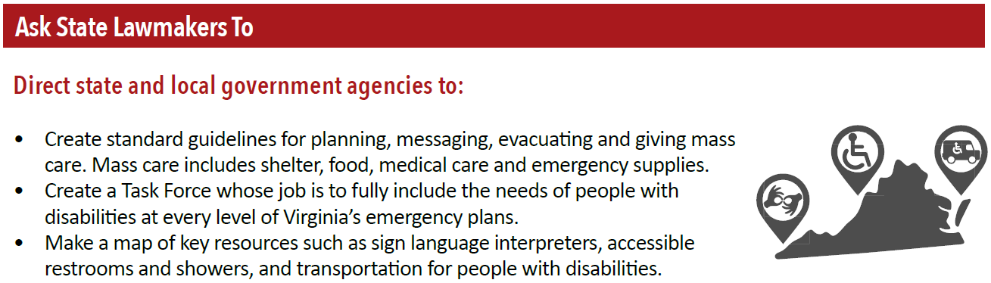
Recommendation 1 Before & After
Before
After

Slide 45
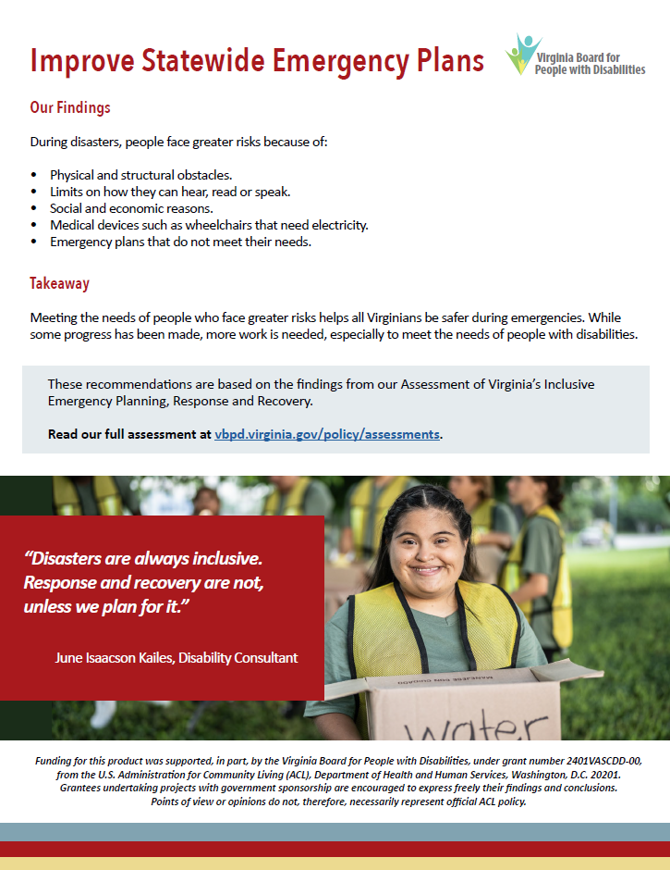
Final Infographic in Plain Language

Slide 46

Be an Information Access Champion
Pledge to make information as inclusive and accessible as possible
Evaluate and improve in collaboration with the disability community
https://vbpd.virginia.gov/policy/information-access/#pledge

Slide 47





As an Information Access Champion
A champion is not perfect. But they are always trying. They improve information access by following info access values.

Slide 48
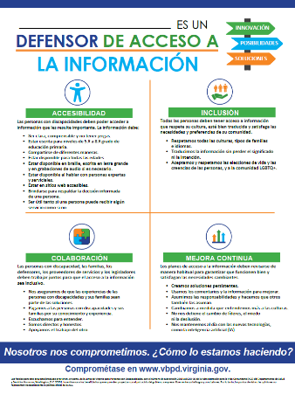
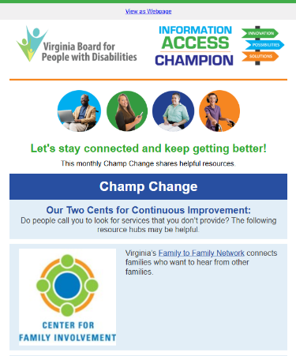

A Champion Will Get…
Wall of Champions
Ebadge
Checklist
Poster
Champ Change

Slide 49




Thank you
Questions & Feedback
Thank you!!
Email
Linh.Nguyen@vbpd.virginia.gov
Teri.Morgan@vbpd.virginia.gov
Social Media
@VABoard
Website
https://vbpd.virginia.gov/policy/information-access/

