Slide 1

Foundations of the Older Americans Act and the Aging Services Network
2026 No Wrong Door Summit

Slide 2
Objectives
Describe the purpose and key provisions of the Older Americans Act and why it matters for aging services.
Explain the roles of the State Unit on Aging and Area Agencies on Aging (AAAs) in Virginia’s aging services network.
Illustrate how state and local aging agencies collaborate to deliver coordinated services and supports to older adults and caregivers across the Commonwealth.

Slide 3
History of the Older Americans Act (OAA)
1965
Older Americans Act (OAA) enacted
Medicaid enacted
1973
Area Agencies on Aging (AAAs) established
2020
OAA most recently reauthorized
1961
First White House Conference on Aging
Medicare enacted

Slide 4
White House Conference on Aging
Aim:
  Identify the needs of older Americans and formulate solutions across various sectors (community, state, federal)
Key Issues:
  Financing health care for the aged
  Income security
  Employment
  Housing
  Social services
1950’s
National leaders recognized the need for coordinated response to address aging population
1956
President Eisenhower Creates the Federal-State Council on Aging
1958
Legislation establishes White House Council on Aging
1961
First White House Conference on Aging is held

Slide 5
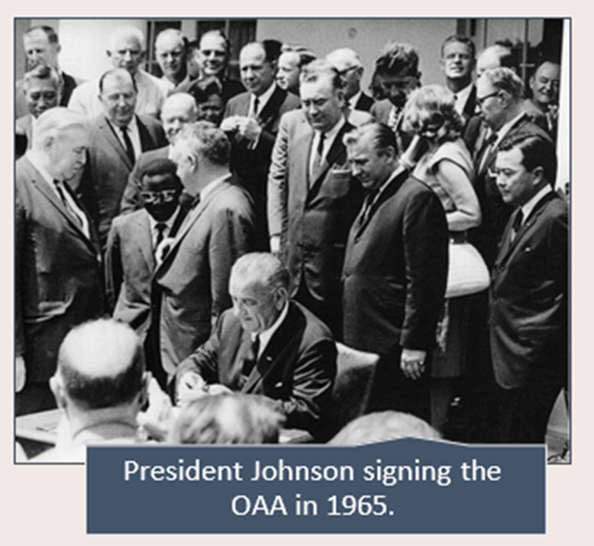
1965 Great Society Legislation
Policies aimed at eliminating poverty and racial injustice:
  Social Security Amendment:
    Medicare established
    Medicaid established
  Housing & Urban Development Act
    HUD Department established
  Older Americans Act
    Administration on Aging established
    State Units on Aging created
    OAA has been reauthorized 18 times
      1973 established Area Agencies on Aging (AAA)

Slide 6
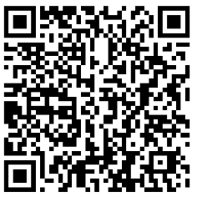
State Units on Aging
56 SUAs are located in each of the 50 states and 6 territories
The Department for Aging and Rehabilitative Services (DARS) is the designated SUA in Virginia
Role of SUAs
Develop and administer the State Plan on Aging
Lead statewide planning, policy development, and administration for aging services and the Older Americans Act
Establish and maintain the state's Planning and Service Areas (PSAs); designate Area Agencies on Aging
Provide technical assistance to relevant agencies and organizations
Scan for VA State Plan for Aging Services 2023-2027

Slide 7
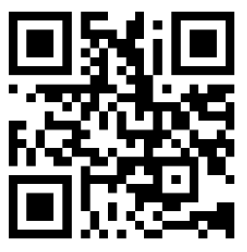
Virgina DARS
Mission: To improve the employment, quality of life, security, and independence of older Virginians, Virginians with disabilities, and their families.
Some Key Programs and Services:
Vocational Rehabilitation (VR)
Disability Determination Services
(for SSDI & SSI)
Adult Protective Services
(through local departments of social services)
Disability Services (e.g., Independent Living & Brain Injury Services)
Aging Services
State Long-Term Care Ombudsman
No Wrong Door
Scan for DARS website:

Slide 8

Division for Aging Services
Mission:
to foster the independence and well-being of older Virginians and support their caregivers through leadership, advocacy and oversight of state and community programs, and guides the Commonwealth in preparing for an aging population.
Role:
oversee the implementation of the federal Older Americans Act (OAA) services as well as other federal and state-funded programs that support older adults and caregivers.

Slide 9
SUA Activities in Virginia
Distributes federal and state funding to AAAs
Monitors the delivery of aging services by AAAs
Implements federal and state discretionary grant programs
Leads the No Wrong Door (NWD) Virginia System
Facilitates constituent advisory boards and councils
Develops and implements the State Plan for Aging Services
Oversees Virginia’s 25 Area Agencies on Aging (AAAs)
Within DARS, the Division for Aging Services:

Slide 10
Area Agencies on Aging
What is an Area Agency on Aging (AAA)?
  A public or private nonprofit agency designated by an SUA to address the needs and concerns of all older persons at the regional and local levels
  AAAs are responsible for a geographic area, also known as a planning and service area (PSA)
  AAAs coordinate and offer services that help older adults remain in their homes
Virginia has 25 AAAs, and each community in Virginia has a designated AAA to serve it
  AAA structures vary:
14 AAAs
Private Nonprofit Organizations
5 AAAs
Joint Exercise of Powers (local government established)
1 AAA
Community Services Board (CSB)
5 AAAs
Part of a County or City Government

Slide 11
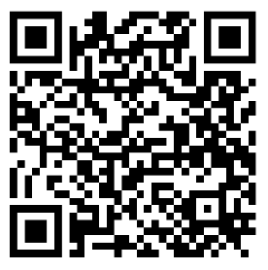
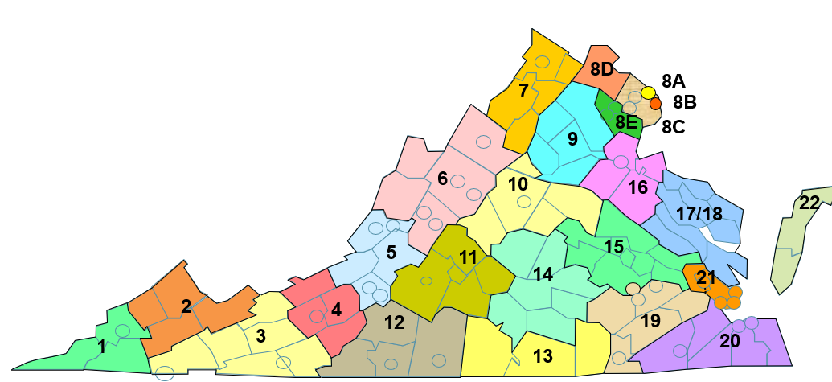
Map of Virginia’s AAA’s
Scan to for AAA look-Up

Slide 12
OAA Services: Local and State Roles
AAA
Coordinates and provides OAA services directly to older adults and caregivers in the community
SUA
Administers OAA funds to AAAs
Monitors and provides AAAs technical assistance for OAA services

Slide 13
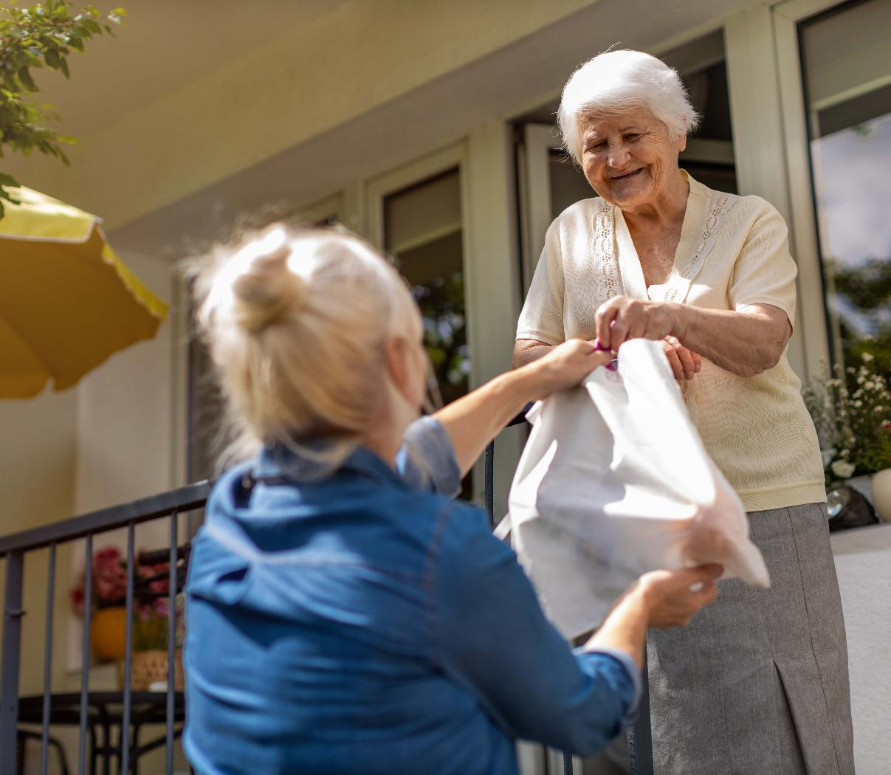
Overview of OAA Programs and Services

Slide 14
OAA Title III
Part A: Establishes the Framework
Maximize Independence and Dignity
Remove Individual and Social Barriers
Continuum of Care
Managed In-home and Community-Based Services
State Units on Aging (SUAs)
Develop and Administer State Aging Plan
Advocate for Older Individuals
Designate Area Agencies on Aging (AAAs)
Establish Policies, Procedures, Service Standards
Provide Technical Assistance
Area Agencies on Aging (AAAs)
Develop and Administrator Local Aging Plan
Establish Advisory Council
Provide Services
Establish Focal Points to Provide Services
Facilitate Coordination of Community Services
Part B: Support Services & Senior Centers
Community-Based Services and In-Home Services: adult day care, checking (reassuring contact), chore, homemaker, personal care, residential repair and renovation.
Access Services: care coordination, information and assistance, transportation.
Part C: Nutrition / Meals
Subpart 1: Congregate (Group)
Subpart 2: Home Delivered
Part D: Disease Prevention and Health Promotion
Part E: National Family Caregiver Support Program

Slide 15
Other OAA Title Sections
Title IV: Activities for Health, Independence and Longevity
Demonstration Grants / Programs
  Aging & Disability Resource Center Grants
  Alzheimer's Disease Grants
  Evidence Based Programs (Chronic Disease Self-Management Program)
Title V: Community Service Senior Opportunities Act
Older American Community Service Employment Program
  States
  National Contractors
Title VI: Grants for Native Americans
Federally recognized American Indian Tribes
Native Hawaiian Program
Title VII: Vulnerable Elder Rights Protection Activities
Ombudsman
Elder Abuse, Neglect, and Exploitation
State Legal Assistance Development
Program is managed by the DARS Office of the State Long-Term Care Ombudsman
Program is managed by the DARS Adult Protective Services Division
Program is managed by the DARS Division for Aging Services
Program is managed by the DARS Division for Rehabilitative Services

Slide 16






General Eligibility
Individuals aged 60 and over can qualify for most OAA services. A few programs are available to younger individuals.
OAA is not an entitlement program (i.e., guaranteed access to benefits), like Social Security, Medicare or Medicaid.
OAA services can be curtailed due to lack of funding.
OAA clients self-declare income. AAAs do not verify income or ability to pay. Services are not means tested.
OAA clients are asked to voluntarily contribute to some OAA services, but it is not required.
OAA services are targeted to individuals with greatest economic need and greatest social need.

Slide 17
AAA Required OAA Services
Access & Support Services:
Care Coordination
Options Counseling
Public Information and Education
Information, Referral, & Assistance
Transportation
Legal Assistance

Slide 18
AAA Required OAA Services
Nutrition Services:
Congregate Meals
Home Delivered Meals
Nutrition Counseling
Nutrition Education

Slide 19
AAA Required OAA Services
Other Services:
Long-Term Care Ombudsman Program
Elder Abuse Prevention
Disease Prevention and Health Promotion
Caregiver Support

Slide 20
Other OAA Services
Adult Day Care/Services
Assistive Technology
Caregiver Counseling & Training
Care Transitions
Checking (Reassurance)
Chore Services (Heavy Housework)
Consumable Supplies
Emergency Services
Employment (Title V Services)
Financial Consultation
Homemaker Services (Light Housework)
Medication Management
Money Management
Personal Care Services
Residential Repair & Renovation
Respite Care
Socialization & Recreation
Assisted Transportation (door to door)
Volunteer Services

Slide 21
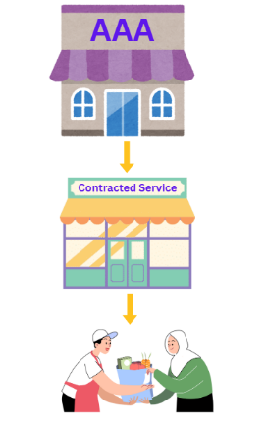
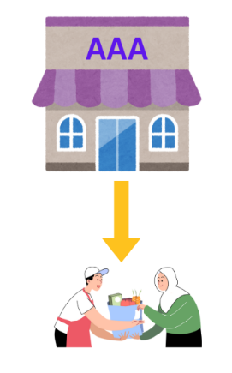
How AAAs Deliver OAA Services
Direct provision of services by the AAA
2
Contract with community providers to deliver services
1
Programs and service delivery vary across AAAs.
Each AAA designs a menu of programs tailored to the unique needs of its community.

Slide 22
OAA Funding Stream
U.S. Department of Health and Human Services
Administration for Community Living (ACL)
State Units on Aging (56)
Area Agencies on Aging (622)
Local Service Provider Organizations
CONSUMERS
Tribal and Native Hawaiian Grantees (282)

Slide 23

But wait, there’s more!
Non-OAA Services

Slide 24
AAA Non-OAA Services
partnership with the VA, this allows veterans to manage their own home and community-based
Medicaid Waiver Services
providing personal care, case management, and home modifications not covered by OAA funds
MCO Contracts
contract with healthcare systems and insurers to provide social service
Transportation Programs
Pet Food Programs
Through the Virginia Department of Rail and Public Transportation
Veterans Directed Care
Senior Medicare Patrol
Some Examples:
Many AAAs offer services and programs outside of the OAA
  Funded through:
    State General Funds
    Grants
    Donations
    Fee for service programs
New services/programs
Expand services to individuals not eligible for OAA programs

Slide 25
DARS-Administered Programs
Virginia Insurance Counseling & Assistance Program (VICAP)
Federally funded through ACL
Senior Cool Care
Sponsored by Dominion Energy
DARS receives the funds and contracts with AAAs to provide the services
Trained counselors provide free, local, in-depth, and unbiased Medicare information and help beneficiaries navigate Medicare enrollment, claims, and benefit
DARS receives the funds and contracts with AAAs to provide the services
Provides free AC or fan to low-income older adults

Slide 26
DARS-Administered Programs
Farm Market Fresh
Federally funded through USDA
Lifespan Respite Voucher
Federally funded through ACL
DARS receives the funds and contracts with AAAs to provide the services
Older adults receive $50 benefit to purchase fresh fruit and vegetables at authorized farmers markets
Caregivers can receive up to $595 reimbursement for the cost of temporary, short-term respite from caregiving

Slide 27
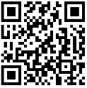
DARS-Administered Programs
Virginia GrandDriver
Funded through the Virginia DMV
Dementia Capable Virginia
An initiative of the ADRD Commission and DARS, in collaboration with the Virginia Department of Health
Educational resource providing information and resources about staying safe and mobile on the road.
Provides dementia resources and training materials to individuals, families, caregivers, and providers.

Slide 28
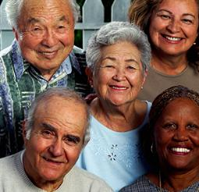
The Bottom Line
AAA
Other State Agencies
DARS
Community Organizations
Health Organizations
Supporting older adults requires collaboration across the entire aging services network: SUA, AAAs, and community partners.

Slide 29

Questions?
Jodi Winship
Director of Aging Programs
Jodi.winship@dars.virginia.gov
Nick Slentz
Assistant Director of Aging Programs
Nick.Slentz@dars.virginia.gov

