Slide 1
The PATH of No Wrong Door Virginia
May 6, 2026

Slide 2

Agenda
1
What is No Wrong Door?
  Brief History
  2
  Current Work & Team
  3
  North Star
  4
  PATH Forward
  5

Slide 3





What is No Wrong Door?
An initiative that supports older adults, individuals with disabilities, veterans, caregivers, and their communities in making informed choices about long-term care by providing accessible information, person-centered support and streamlined access to Virginia’s network of public and private service providers.

Slide 4

Mission
No Wrong Door improves access to streamlined, person-centered services for older adults, individuals with disabilities, veterans, and caregivers—strengthening communities and enhancing lives across the Commonwealth.
Vision
A future where all Virginians access the support they need through streamlined systems powered by technology, trusted partners, and person-centered care.
1. What is NWD?

Slide 5
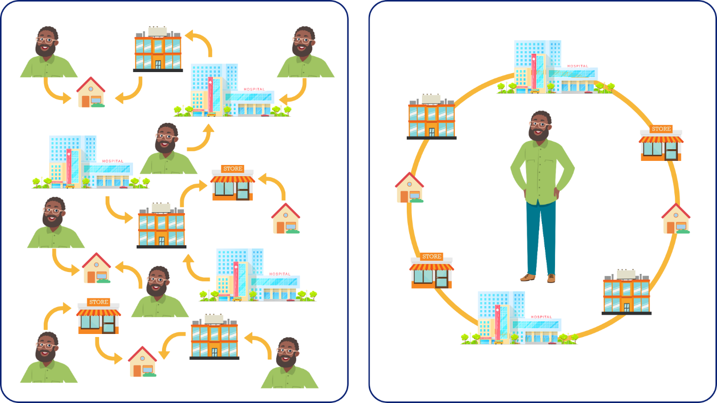
Without and With No Wrong Door
1. What is NWD?
Without No Wrong Door
With No Wrong Door

Slide 6





No Wrong Door Initiative
1. What is NWD?
NO WRONG DOOR INITIATIVE
Mission: No Wrong Door improves access to streamlined, person-centered services for older adults, individuals with disabilities, veterans, and caregivers—strengthening communities and enhancing lives across the Commonwealth.
Streamlined Technology System
Governance & Administration
Coordinated Partner Network
Person Centered Support
Resource Advisory Council
DARS NWD Team
Easy Access
CRIA
Community Partners
Network Partners
Caregiver
Older Adult
AAA Lead Agencies
Training Platform
Resource Database Partners
Local Advisory Councils
Tech Users
Veteran
Disability

Slide 7
NWD in Virginia
1. What is NWD?
Coordinated Partner Network
Home- and community-based service providers, agencies, organizations and other groups that serve older adults, adults with disabilities, veterans and caregivers who work towards our shared goal of streamlined, accessible and person-centered services across Virginia.
NWD Technology System
Group of web-based tools for both professionals and the public that provide virtual access points for services and supports, with tools and features to streamline workflows and find information.
Virginia Easy Access | CRIA/PeerPlace | Direct Connect | NWD Training Platform

Slide 8
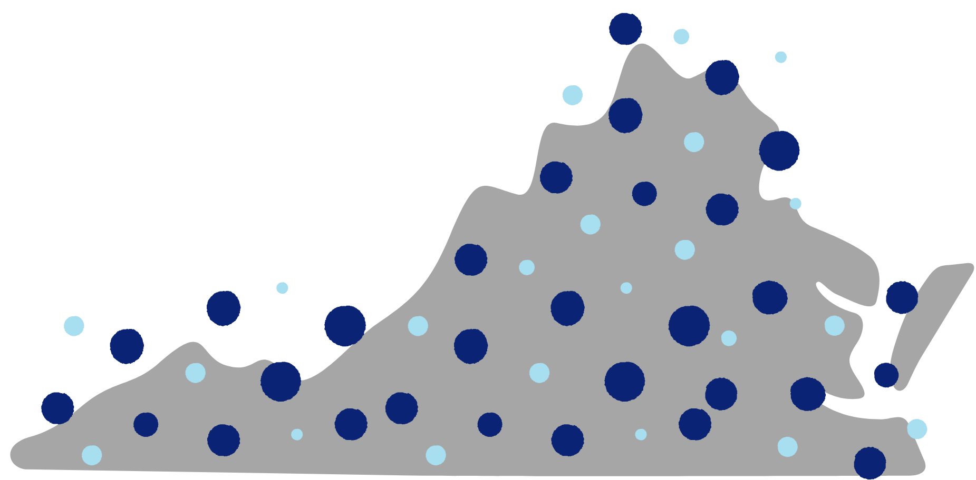
History, part 1
2. History
Before No Wrong Door - Virginia’s home- and community-based service providers.

Slide 9
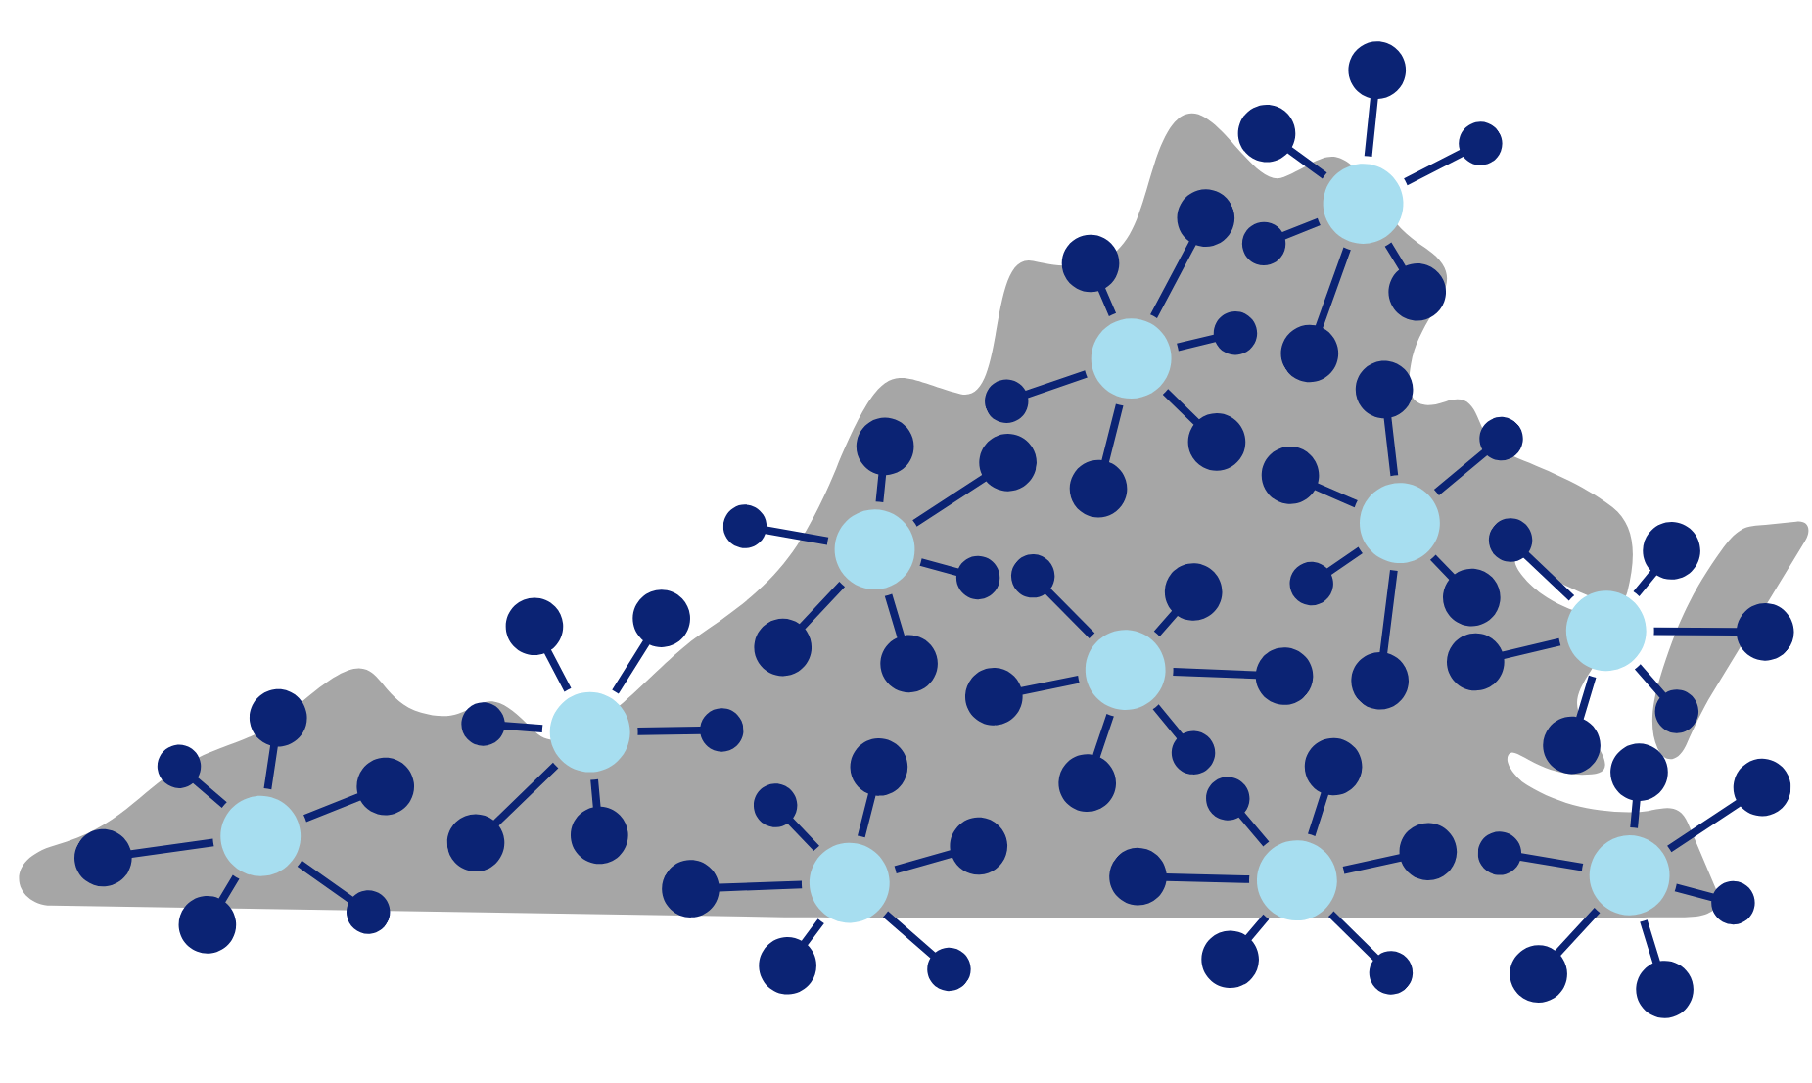
History, part 2
2. History
Early 2000s - Coordinated access or entry points to receive aging and disability services (ADRCs).
Code of Virginia§ 51.5-135.6 “Designate area agencies on aging … each of which shall be designated as the lead agency in each respective area for the No Wrong Door system of aging and disability resource centers”

Slide 10
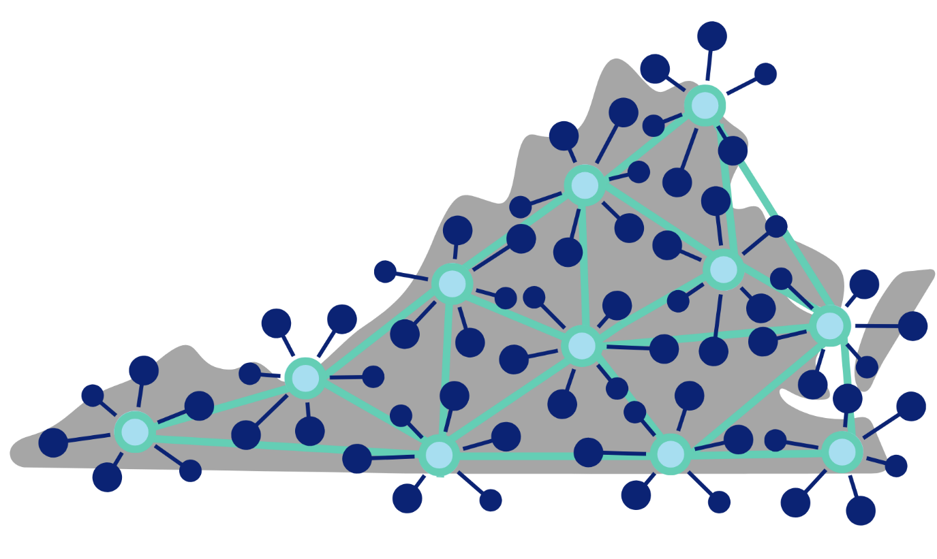
History, part 3
2. History
2010s - Network strengthened with the development of NWD technology...but not everyone can make it to the central access points!
2012 – Person Centered Options Counseling statewide standards with AAAs and CILs

Slide 11
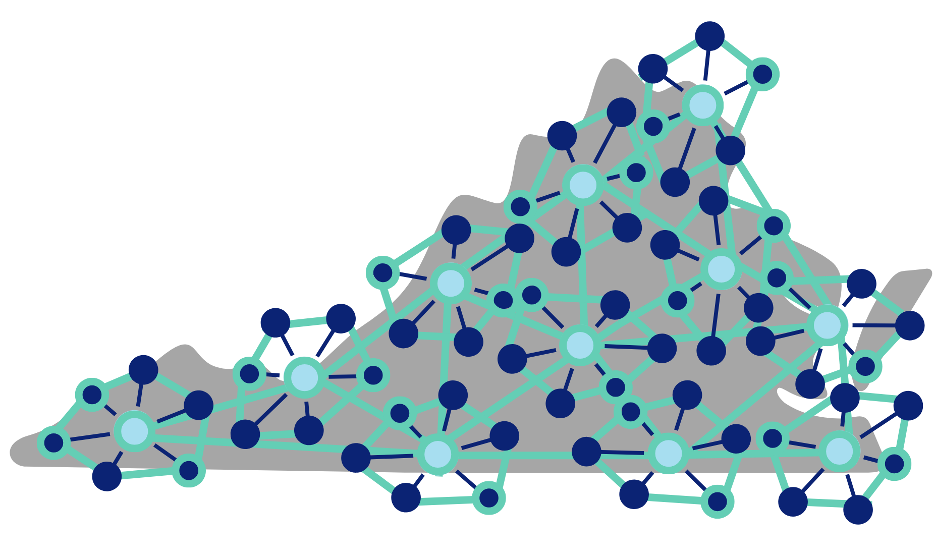
History, part 4
2. History
Past 5 years – A shared technology system among No Wrong Door network partners allows more entry points into the network…but not all partners can use a new technology.

Slide 12

Current
3. Current
Today – We are pursuing innovative, integrated solutions for improving access to streamlined, person-centered support.
A single-technology is not the only answer!

Slide 13


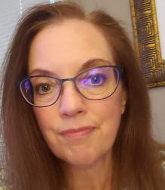
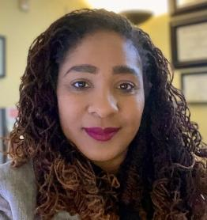

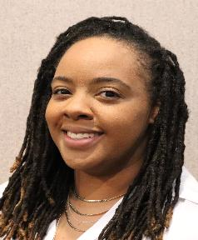

Our Team
3. Current
Erika Okonsky
Project Specialist
Val Murphy
Coordinator
Christy Miller
HCBS IT Operations Manager
Dr. Felencia McGee
Director
Sarah Arnold
Public Relations Specialist
Melissa Armstead
Training & Options Counseling Specialist
David Baker
IT Operations Specialist

Slide 14
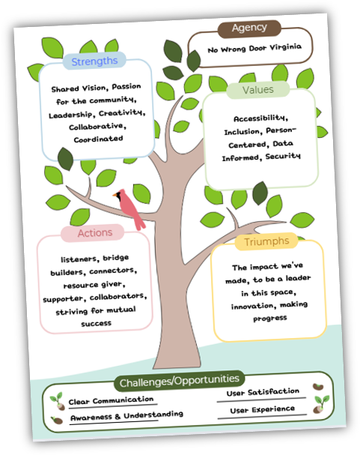

3. Current

Slide 15
Our Current Work
3. Current
In the past year, NWD Virginia has:
Clarified what “No Wrong Door” is, and stated our mission and vision
Created a "NWD 101" common language and templates for consistency
Crafted our Identity Map and 3 key focuses for our work
Visited all 25 AAAs to engage in shared discussions and learning
Connected with current and new partners at the NWD Summit!
Dreamed of our North Star and drew the PATH Plan to get there
Launched new features on Easy Access: brain injury screener tool, brain injury and ombudsman service finder widgets, “Explore Services” pages

Slide 16

North Star:
Our Dream
4. North Star

Slide 17
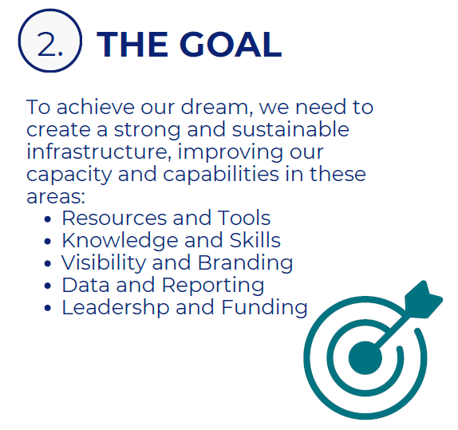
North Star:
Our Goal
4. North Star

Slide 18
Our PATH Forward: Clarify
5. PATH Forward
Who we are, how we collaborate, and how we support partners and the public
Messaging and branding in marketing and communications
NWD information on new DARS website and Easy Access
Improving and refining internal and external business processes
  User access management for CRIA/PeerPlace
  Contract renewals for Network Partners
Updating training and technical assistance materials
  Partner’s Page on Easy Access
  Microlearning videos and job aids

Slide 19
Our PATH Forward: Connect
5. PATH Forward
DARS Divisions – aligning & strategizing
  Leadership
  Aging
  Voc Rehab & EPIC Project
  Ombudsman
  Brain Injury
  Community Living
State Agencies
Governor & HHR Secretary
Associations
Advocacy Organizations
Thought Leaders
AAAs
Current Network Partners

Slide 20
Our PATH Forward: Collaborate
5. PATH Forward
Broadening and deepening partnership opportunities
  Not just CRIA!
  Local: Network Partners, Community Partners, Local Advisory Councils (LAC)
  State: Resource Advisory Council (RAC) membership and leadership
  NWD Ambassadors group with AAAs
Technology system improvements & enhancements with user input sessions
Feedback loops and surveys from all audiences engaged with NWD
  Easy Access, CRIA, Training

Slide 21
Our PATH Forward: Next Up
5. PATH Forward
More training and technical support materials and strategies
Additional technology system improvements and investments
  For AAAs and Network Partners
  For the DARS NWD Team
Metrics of Success
  Defining, tracking and reporting our impact and ROI over time
In conjunction with OAA New Regulations for FY27:
  Updated Service Standards for CRIA and Options Counseling
  First ever No Wrong Door Manual and Policies and Procedures

Slide 22
Thank you!
Thank You!
nowrongdoor@dars.virginia.gov

