Slide 1

Beyond the Basics:
Alignment between NWD & the Aging Services Network

Slide 2




Learning Objectives
Understand the core components of the No Wrong Door (NWD) system
Review how AAAs fit within the NWD framework
Highlight how existing AAA programs already support NWD goals
Identify opportunities to strengthen alignment and coordination

Slide 3

What is No Wrong Door?
No Wrong Door (NWD) is a systems-change initiative that helps individuals access long-term services and supports through multiple coordinated entry points
Serves older adults, individuals with disabilities, veterans, and caregivers
Focuses on:
  Accessible information
  Person-centered support
  Streamlined access to services

Slide 4
The NWD Vision
A future where all Virginians access the support they need through streamlined systems powered by technology, trusted partners, and person-centered care.
No matter where someone enters the system:
  They receive consistent information
  They are connected to appropriate services
  They experience coordinated support
Moves from:
  Fragmented system → Coordinated network

Slide 5
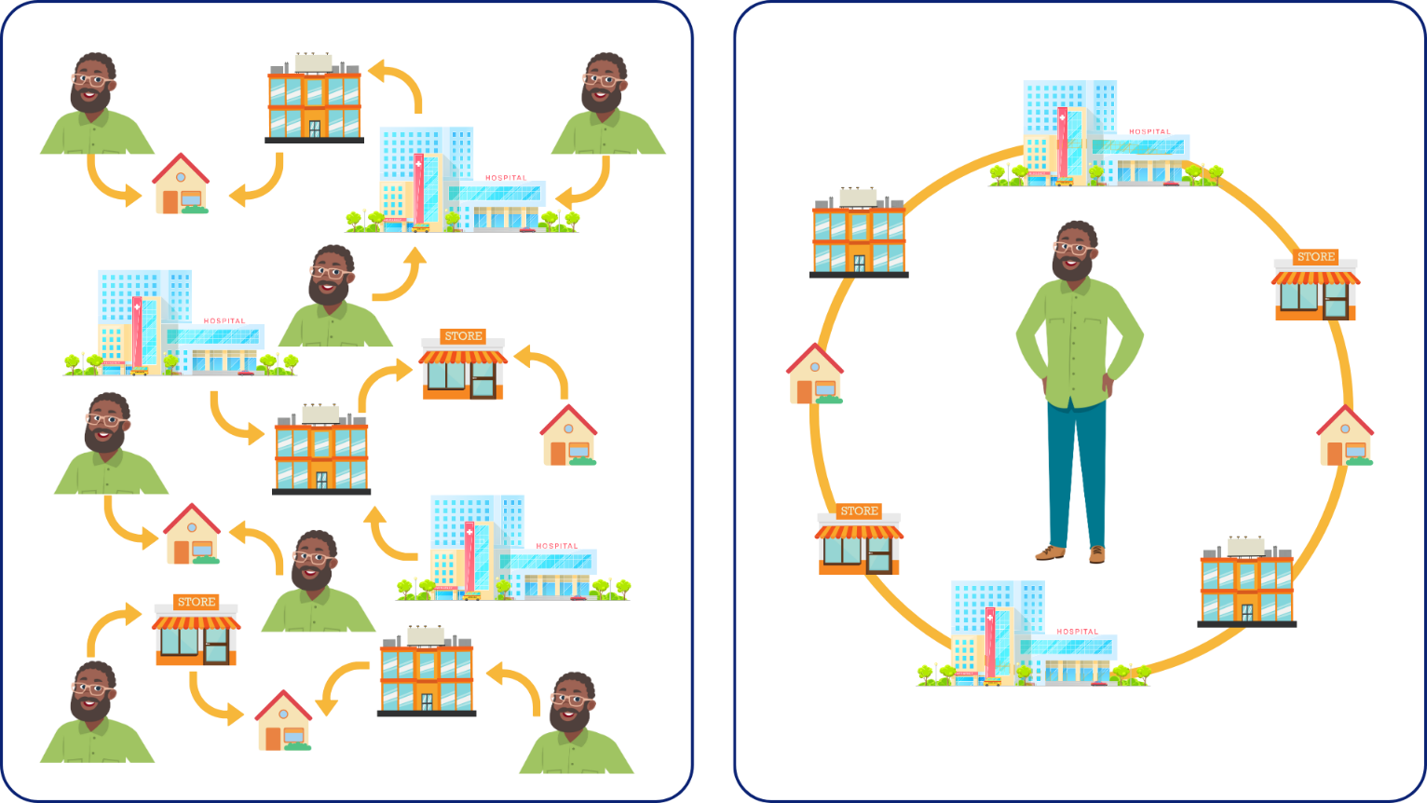
Without No Wrong Door
With No Wrong Door

Slide 6
The 4 Pillars of NWD
The four pillars of the No Wrong Door (NWD) system represent the core framework that shapes how the system is designed and implemented, guiding a consistent and person-centered approach to access and service delivery.
Governance and Administration in a multi-level model for statewide alignment and local responsiveness
Streamlined Technology System for Access to Services
Coordinated Partner Network supports public outreach and coordination strategies
Person-Centered Support through Person-Centered Options Counseling and Other Access Services

Slide 7





NO WRONG DOOR INITIATIVE
Mission: No Wrong Door improves access to streamlined, person-centered services for older adults, individuals with disabilities, veterans, and caregivers—strengthening communities and enhancing lives across the Commonwealth.
Streamlined Technology System
Governance & Administration
Coordinated Partner Network
Person Centered Support
Resource Advisory Council
DARS NWD Staff
Easy Access
CRIA
Community Partners
Network Partners
Caregiver
Older Adult
AAA Lead Agencies
Training Platform
Resource Database Partners
Local Advisory Council Members
Tech Users
Veteran
Disability

Slide 8


AAAs as Part of the NWD System
AAAs function as Aging and Disability Resource Centers (ADRCs) in Virginia
Serve as primary access points for long-term services and supports
Provide:
  Direct services
  Information & assistance
  Options counseling
  Referrals to partner agencies

Slide 9

Pillar 1: Governance & Administration
What NWD Requires
What AAAs Already Do
Shared responsibility across agencies
Ongoing coordination
NWD Lead Agencies
Advisory councils
Community partnerships
Local coordination efforts
Participation in statewide systems

Slide 10
Pillar 2: Streamlined Access
What NWD Requires
What AAAs Already Do
Easy entry into services
Multiple access points
Information & Assistance
Intake processes
Service navigation
Use of tools like Virginia Easy Access

Slide 11
Pillar 3: Coordinated Referrals
What NWD Requires
What AAAs Already Do
Cross-agency referrals
Shared communication systems
Referral networks with community partners
Use of CRIA/shared systems (where applicable)
Coordination with healthcare, social services & nonprofits

Slide 12
Pillar 4: Person-Centered Counseling
What NWD Requires
What AAAs Already Do
Help individuals make informed choices
Align services with goals and preferences
Options Counseling
Care Coordination
Person-focused service planning

Slide 13
Why This Matters
Helps align local work with statewide and federal initiatives
Strengthens consistency across the network
Improves outcomes for individuals and caregivers
Positions AAAs as leaders within the system

Slide 14
What This Means for You
This work is already happening at your agency, now let’s continue to develop it:
Strengthen Local NWD Advisory Councils
Work with partners to streamline access to resources and information in their local communities to improve how people access services
Expand and deepen disability partnerships
Build stronger relationships with disability organizations to improve cross-referrals and shared understanding of services
Leverage shared systems and tools
Make full use of Virginia Easy Access and PeerPlace. Engage key partners to improve communication, tracking, and coordinated service delivery
Take a bird’s eye view
Look for opportunities to streamline processes across agencies, not just connect individuals to services

Slide 15

Key Takeaways
NWD is the framework for how the system operates
AAAs play a central role as ADRCs and local lead agencies
Much of this work is already happening, it's about strengthening alignment and consistency
The biggest opportunity is moving from individual service delivery to coordinated system-level impact
Stronger partnerships and shared tools are key to making NWD work as intended

Slide 16

Final Thoughts
NWD is not new work! It is a way of connecting and strengthening the work you already do
The goal is a system where no matter where someone enters, the experience is consistent, coordinated, and person-centered
You are critical to making that system work

