Slide 1
Finding Resources in the Community​
Aligning Tools and Teams to Help Virginians Find the Right Resources
No Wrong Door Virginia Summit
May 6, 2026
​

Slide 2



Meet the Panel
Amanda Holcolmb
Director of Community Engagement
211 Virginia
Kim Tarantino
Deputy Director
VirginiaNavigator
Erika Okonsky
Project Specialist
No Wrong Door Virginia
Moderator: Sarah Arnold
Public Relations Specialist
No Wrong Door Virginia

Slide 3
Virginia Easy Access
Erika Okonsky

Slide 4

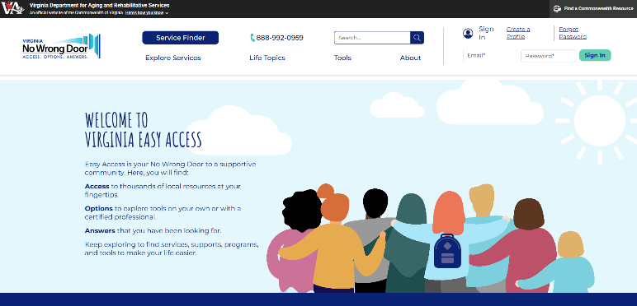

Virginia Easy Access
An online access point for finding services, benefits, and local support across the Commonwealth.
Leverages technology and partnerships with two statewide resource databases: 211 Virginia and VirginiaNavigator
Easy to use features:
  Service Finder
  Direct Connect
  Live Chat & Toll-Free Number
  Life Topics
  Save Links to Profile
https://www.easyaccess.virginia.gov

Slide 5





What is No Wrong Door?
An initiative that supports older adults, individuals with disabilities, veterans, caregivers, and their communities in making informed choices about long-term care by providing accessible information, person-centered support and streamlined access to Virginia’s network of public and private service providers.

Slide 6





NO WRONG DOOR INITIATIVE
Mission: No Wrong Door improves access to streamlined, person-centered services for older adults, individuals with disabilities, veterans, and caregivers—strengthening communities and enhancing lives across the Commonwealth.
Vision: A future where all Virginians access the support they need through streamlined systems powered by technology, trusted partners, and person-centered care.
Streamlined Technology System
Governance & Administration
Coordinated Partner Network
Person Centered Support
Resource Advisory Council
DARS NWD Staff
Easy Access
CRIA
Community Partners
Network Partners
Caregiver
Older Adult
AAA Lead Agencies
Training Platform
Resource Database Partners
Local Advisory Council Members
Tech Users
Veteran
Disability

Slide 7
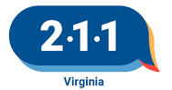


NWD Technology System
Professionals (supported path)
Public (self-directed path)
  CRIA (PeerPlace Module)
  Virginia Easy Access
The tools leverage technology and partnerships with two robust statewide resource databases
​

Slide 8

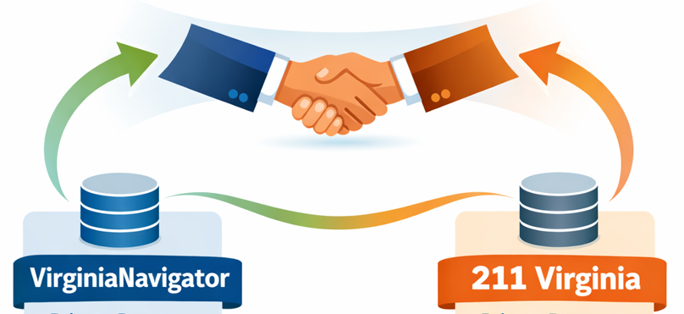
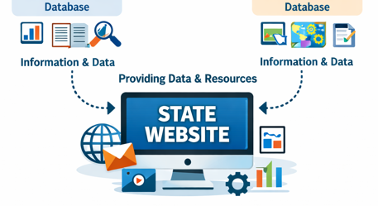
DARS partners with VirginiaNavigator and 211 Virginia
Virginia Easy
Access
NWD Technology Systems

Slide 9
211 Virginia
Amanda Holcolmb

Slide 10

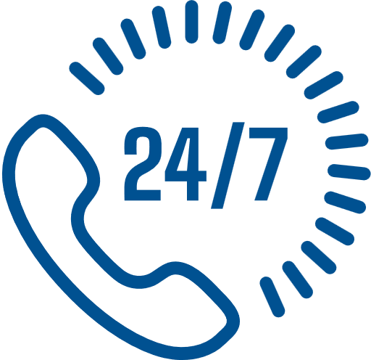


What is 211 Virginia?
211 Virginia is an easy-to-remember three-digit dialing code connecting people with information on available community services throughout the Commonwealth.
211 Virginia is a free and confidential service available 24 hours a day, 365 days a year. 211 Virginia is always open.

Slide 11



About 211 Virginia
211 Virginia is a contracted service of the Commonwealth of Virginia. The nonprofit organization Council of Community Services is the sole contractor under the Virginia Department of Social Services.
  Established in the Code of Virginia in 1984.
  211 number launched in February 2006.
  A directory of over 15,000 programs across the Commonwealth and beyond.
  A nationally accredited source for referrals to government, nonprofit, and faith-based agencies.

Slide 12
Benefits of 211 Virginia
  Acts as a central access point to Virginia’s health and human services agencies, reducing time and frustration.
  Fields the first call, reducing the burden on service providers.
  Pre-screens individuals to ensure referrals are made only to programs they are eligible for.
  Generates need and resource data, from individual cases to statewide trends.
  Makes resources accessible by...
    Operating 24/7/365 days a days a year for agencies and community members
    Providing live Spanish translation and access to a language line supporting over 240 languages.
    Offering multiple contact options in both written and auditory formats.

Slide 13







Ways to Connect
  Dial 2-1-1
  Out of State? Dial 1-800-230-6977
  Hearing-impaired? Dial 7-1-1 and then 1-800-230-6977
  Text CONNECT to 247211 (message and data rates may apply.)
  Live Chat and email are available at 211virginia.org
  Search for resources at 211virginia.org
TEXT
CONNECT
TO 247211
DIAL
211
LIVE CHAT 211VIRGINIA.ORG
SEARCH 211VIRGINIA.ORG

Slide 14

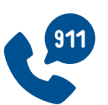



HELP IS 3
NUMBERS AWAY
911 Provides First Responder Dispatch for:
  Medical Emergency
  Fire
  Reporting a Crime
  Disaster Response
  Life Threatening Situation
VIRGINIA’S CRITICAL RESOURCES ARE WORKING TOGETHER.
Call for Emergencies
211 Maintains a Comprehensive
Community Resource Directory and Provides Information & Referrals for:
  Food
  Housing & Shelter
  Utility Assistance
  Healthcare Services
  Government Services
  Transportation
  Legal Services
  Counseling & Support Groups
  Emergency Preparedness & Disaster Response
  & Everything Else
Whole
Person
Care
988 Provides Support for:
  Thoughts of Suicide
  Mental Health Crisis
  Emotional Distress
Call for Suicide Intervention & Crisis Support
Warm
Handoff
Call for
Essential Services

Slide 15









2025 Data Snapshot
TOP 5 MOST REFERRED
NEEDS BY CATEGORY
1
87K+
121K+
340K+
HOUSING
individuals served.
contacts
handled.
referrals to helping programs and services.
2
UTILITY ASSISTANCE
3
FOOD AND MEALS
97K+ referrals for utility assistance.
133K+ referrals to
housing and homeless
prevention services.
34K+ referrals
to reduce hunger
and food insecurity.
4
INDIVIDUAL, FAMILY & COMMUNITY SUPPORT
7K+ referrals
to individual, family,
and community support.
7K+ referrals
for healthcare services.
5
HEALTHCARE

Slide 16
VirginiaNavigator
Kim Tarantino

Slide 17

The VirginiaNavigator
Family of Websites

Slide 18

Hello!
Kim Tarantino
Deputy Director
VirginiaNavigator

Slide 19





VirginiaNavigator is
Celebrating A Milestone!

Slide 20





VirginiaNavigator Family of Websites

Slide 21

VirginiaNavigator: By The Numbers
961,814 Visits to Family of Websites
In 2025
2,250+
Curated Content
Articles, Tip Sheets, Books, Apps, Videos, Links
27,000+
Vetted Community-Based Programs in Resource Directory
433
Programs
Opted-In To Receive
NWD
“Direct Connect”
Referrals
3,200
Virginians Reached
in 2025

Slide 22
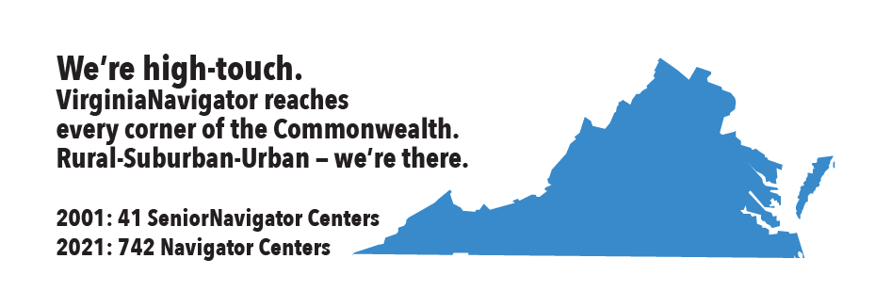
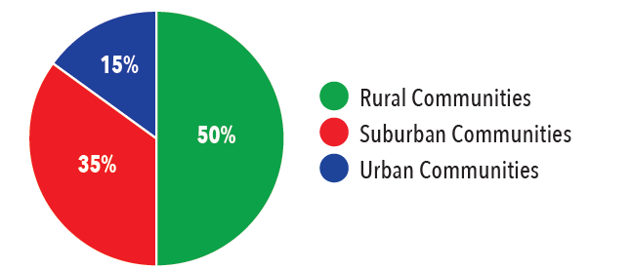
VirginiaNavigator: By The Numbers
We’re high-touch.
VirginiaNavigator reaches
every corner of the Commonwealth.
Rural-Suburban-Urban – we’re there.
705 Navigator Centers trusted community access points
3,200
Virginians Reached
in 2025

Slide 23
Visit VirginiaNavigator.org
or our family of websites:
disAbilityNavigator.org
SeniorNavigator.org
VeteransNavigator.org

Slide 24
Thank You!
The good news is, we’re not starting from scratch — we have a powerful network of tools designed to connect people to support.
The challenge isn’t whether resources exist… it’s making sure people can find them.

Slide 25
Panelist Q&A

