Slide 1

Trauma Informed Care:
It starts with YOU!
Melissa Armstead white

Slide 2

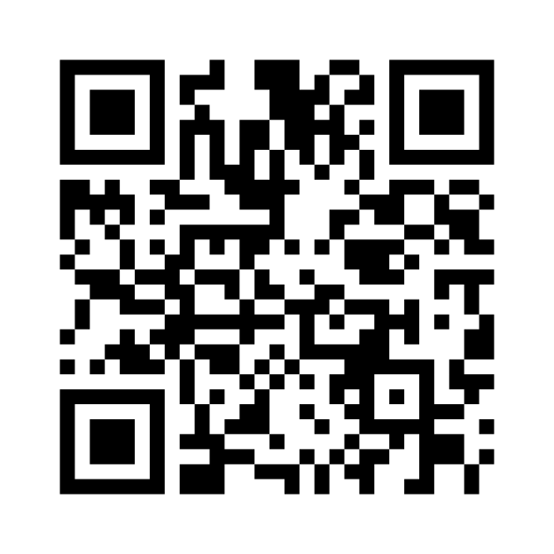
Menti
Knowledge Check

Slide 3

The Training Environment
Safety is priority
Voluntary participation
Demonstrate respect
Preserve confidentiality
Limit over-sharing of client or personal concerns
Attend to self and others

Slide 4
Objectives
By the end of this session, attendees will be able to:
The effects of trauma
What person-centered, trauma-informed (PCTI) care is
How PCTI care can mitigate trauma triggers
How to incorporate PCTI care into policies and procedures, agency space, staff, and service delivery

Slide 5
Knowledge Check

Slide 6
Defining Trauma (3Es)
Trauma is an event, series of events, or set of circumstances that is experienced by an individual as physically or emotionally harmful or threatening and has lasting adverse effects on the individual's functioning and physical, social, emotional, or spiritual well-being.
www.SAMHSA.gov

Slide 7
Trauma….
is pervasive
can impact development and behavior
has a far reaching and long-lasting impact
affects how individuals and their families approach services designed to help them

Slide 8
Impact of Trauma & Toxic Stress
Changes in physiology
Changes in brain architecture & function
Changes in skills, abilities and behavior
Changes in long-term health and mental health

Slide 9
3 Primary Categories of Response
Fight
(Physical Arousal)
Aggression
Flight
(Withdrawal & Escape)
Social isolation
Freeze
(Stilling & Constricting)
Constricted emotional expression
Trouble concentrating
Hyperactivity
Avoidance of others
Running away
Stilling behavior
Over compliance and denial of needs

Slide 10
ACEs Intro Slide

Slide 11
Long Term Impacts:
The Adverse Childhood Experiences (ACE) Study
1997 study conducted by CDC & Kaiser Permanente
Surveyed 17,000 adults (middle aged, white, middle income)
Counted adverse childhood experiences (up to 10)
2/3 had at least one ACE; 12% had 4 or more

Slide 12

ACE Questionnaire

Slide 13
Menti
ACES

Slide 14
Findings: As ACE Score , So Does Risk For:
(ACE Score 4 or More)
  Smoking (2.2)
  Multiple sexual partners (3.2)
  Adult alcoholism (7.4)
  Drug use (4.7)
  STDs (2.5)
  Depression (4.6)
  Suicide attempts (12.2)
  Pulmonary disease (3.9)
  Heart disease (2.2)
  Liver disease (2.4)
  Lost time from work (2.5)
  Early death
  (Those with ACE score of 6 or more, died 20 years earlier)

Slide 15
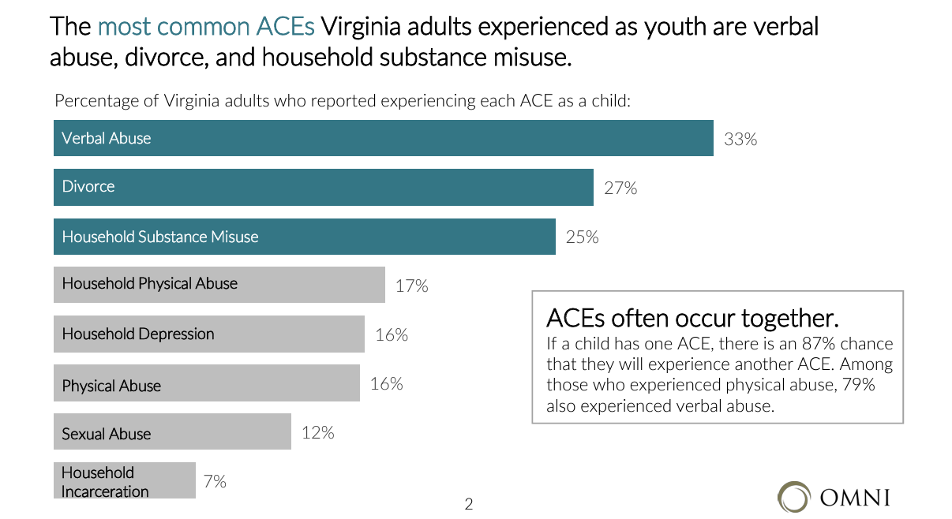
Trauma’s Prevalence in Virginia
----

Slide 16
Trauma Triggers
A stimulus that prompts traumatic response and includes sound, smell, touch, sight, taste, feeling, or circumstance that reminds an individual of a past trauma. Once experienced, triggers can elicit a fight, flight, or freeze response in the body.

Slide 17
Trauma Triggers (Reminders)
Are rarely clear
Often unnoticed, even by the individual
Can be invisible (sensory oriented)
Can seem trivial/minor
Are often uncontrolled factors
Don’t always make sense
Revert us to less functional versions of ourselves

Slide 18
The Connection of Trauma and Health
An individual’s trauma exposure is linked to their propensity for developing a wide range of conditions that negatively impact their physical, mental, and cognitive health.

Slide 19
The Connection of Trauma and Health
Physical Health | Mental Health | Cognitive Health
Lung disease Gum disease Fibromyalgia Chronic fatigue Cardiovascular disease Gastrointestinal disorders Endocrine disorders Reproductive disorders | Anxiety Depression Suicidal Ideation Mood Disorders Eating disorders Substance abuse | Dementia Sleep Disorders Cognitive Impairments Headache Disorders
Center on Aging and Trauma (2020). Health and Trauma. Factsheet. https://cdn.fedweb.org/fed-42/2/HealthAndTrauma_FactSheet_CenterOnAgingAndTrauma%25281%2529.pdf

Slide 20
Trauma In Older Adults
Trauma impacts individuals of all ages and the effects of trauma evolve over time.
Symptoms of trauma can evolve after long symptom-free periods.
Symptoms of trauma can emerge for the first time during older adulthood - decades after exposure to traumatic events.
Symptoms of trauma emerging in older adulthood can be more extreme that previously experienced.
Center on Aging and Trauma (2020). Aging and Trauma. Factsheet. https://cdn.fedweb.org/fed-42/2/AgingAndTrauma_FactSheet_CenterOnAgingAndTrauma%25281%2529.pdf

Slide 21
Trauma Reemergence
1
Changes of Familial Roles
2
Beginning of Retirement
3
Emergence of Health Problems
4
Loss of Independence
5
Loss of Loved Ones
6
Changes Coping Mechanisms

Slide 22

SAMHSA's Principles

Slide 23






SAMHSA Principles
Person-centered, trauma-informed care combines the principles of person-centered care – self-determination and individual preference – with SAMHSA’s principles of trauma-informed care:
Safety
Collaboration & Mutuality
Trustworthiness & Transparency
Empowerment, Voice, & Choice
Peer Support
Cultural Competency
Substance Abuse and Mental Health Services Administration (2014) SAMHSA’s Concept of Trauma and Guidance for a Trauma-Informed Approach. HHS Publication No. (SMA), 14-4884.

Slide 24
1. Safety
Ensure physical and emotional safety for clients and staff.
Example: Clearly marked exits, welcoming environment, de-escalation strategies.

Slide 25
2. Trustworthiness & Transparency
Build and maintain trust through clear expectations and honest communication.
Example: Share how decisions are made, be consistent.

Slide 26
3. Peer Support
Encourage support and understanding among individuals with shared experiences.
Example: Peer mentors, group support programs.

Slide 27
4. Collaboration & Mutuality
Foster shared power and decision-making between staff and clients.
Example: Include clients in goal-setting and treatment planning.

Slide 28
5. Empowerment, Voice & Choice
Recognize individuals' strengths and honor their voice in all aspects of service.
Example: Offer options, respect autonomy, reinforce strengths.

Slide 29
6. Cultural, Historical & Gender Issues
Actively work to avoid cultural stereotypes and biases; be responsive to historical trauma.
Example: Culturally competent staff, inclusive policies.

Slide 30
Putting It All Together
All principles must work together to create a trauma-informed environment.
Use these principles as a lens for every interaction.

Slide 31
Application Activity
Review a case scenario. Identify how each principle could be applied.
Debrief with a partner or group.

Slide 32
Reflection & Wrap-Up
Which principle resonates most with your work?
How can you incorporate these principles into your daily role?

Slide 33
Overall….
Not
But
“What is wrong with you?”
“What happened to you?”

Slide 34
A JOURNEY….
Trauma Aware
Trauma Sensitive
Recognition of trauma prevalence and impact on child development and learning/behavior
Trauma Responsive
Beginning exploration of TIS principles within environment
Consensus building around principles of TIS
PREPARE for change
Beginning of change in culture to highlight role of trauma
TIS principles integrated at all levels
Ultimate Outcome: Trauma Informed
Missouri Model: A Developmental Framework for Trauma Informed, MO Dept. of Mental Health and Partners (2014).

Slide 35
Why Trauma Informed Services?
Recovery and healing are possible
Protective factors facilitate healing and resilience
Healing occurs within the context of RELATIONSHIPS.
(adapted from Fallot and Harris, 2002)

Slide 36
What Does It Mean to Provide
Trauma Informed Services?
Delivers services, (mental health, legal, child welfare, education, public health, addiction, housing supports, vocational or employment counseling services, etc.,) in a manner that acknowledges the role that trauma, (violence and victimization) plays in the lives of many people seeking these services . . .
(adapted from Fallot and Harris, 2001)

Slide 37

Trauma Informed Services
Compassionate care
An approach not an intervention
Supports healing & resilience

Slide 38
Psychological First Aid

Slide 39
What is PFA?
PFA is a humane, supportive response to a person suffering and who may need support.

Slide 40
When to Use PFA
Use in the aftermath of trauma: natural disasters, community violence, personal loss, etc.

Slide 41
RAPID Model Overview
Reflective Listening
Assessment
Prioritization
Intervention
Disposition

Slide 42
Reflective Listening
Listen without judgment. Provide a calm, compassionate presence.

Slide 43
Assessment
Evaluate needs and stress reactions. Who needs the most help, and what do they need?

Slide 44
Prioritization
Determine urgency. Who is at greatest risk or in most need?

Slide 45
Intervention
Offer practical help, coping support, and connection to resources.

Slide 46
Disposition
Connect the person with long-term support and follow-up resources.

Slide 47
Scenario Practice
Work in pairs. Use RAPID to support:
A student in crisis
An employee after an accident
A parent facing eviction

Slide 48
Reflection
How can PFA be applied in your work?

Slide 49
Mindfulness & Self-Care

Slide 50
Why Self-Care Matters
Chronic stress can lead to burnout.
Self-care improves focus, resilience, and well-being.

Slide 51
What is Mindfulness?
Paying attention, on purpose, in the present moment—without judgment.
Helps regulate emotions and reduce anxiety.

Slide 52
Common Stressors in Human Services
- Emotional labor
- Vicarious trauma
- High workloads
- Client crises

Slide 53
Mindfulness Techniques
Deep breathing
Grounding exercises
Body scans
Guided imagery

Slide 54

Let’s Practice: Deep Breathing
Inhale for 4… Hold for 4… Exhale for 4… Repeat.

Slide 55
Guided Exercise: Grounding (5-4-3-2-1)
Identify:
5 things you see
4 things you can touch
3 things you hear
2 things you smell
1 thing you taste

Slide 56
Personal Reflection
How do you currently manage stress?
Which mindfulness practices feel most accessible to you?

Slide 57
Barriers to Self-Care
Guilt
Time
Lack of resources

Slide 58
Possible Strategies

Slide 59
Creating a Self-Care Plan
List:
- Daily stress-relievers
- Weekly self-care goals
- Emergency coping strategies

Slide 60
Resources for Virginia Staff
- DBHDS wellness resources
- EAP programs
- Mindfulness apps (Headspace, Insight Timer)

Slide 61
Being Trauma-Informed at Work
Use person-first, nonjudgmental language
Create predictable environments
Provide choices when possible
Acknowledge client emotions

Slide 62
Scenario Practice
Scenario: A client becomes upset when asked to fill out a form.
How can you apply trauma-informed care in your response?

Slide 63
Self-Care for Providers
Working with trauma can affect us too.
Prioritize self-care, boundaries, and debriefing with supervisors.

Slide 64
Virginia Resources
- DBHDS Trauma-Informed Community Networks
- Virginia HEALS
- Local CSB supports
- Professional development opportunities

Slide 65
Reflection & Wrap-Up
What is one trauma-informed strategy you will apply?
How can your team support trauma-informed practices?

Slide 66
Trauma-Informed Professionals…
Appreciate the high prevalence of traumatic experiences among older adults/individuals seeking support
Understand the profound neurological, biological and social effects of trauma and violence
Engage with those they support in a manner that recognizes and addresses trauma-related issues
Are collaborative, supportive, and skilled
(adapted from Harris and Fallot, 2001) and NASMHPD, 2003-present)

Slide 67
Next Steps

Slide 68
Contact:
Melissa Armstead White, MEd
Training and Options Counseling Specialist,
No Wrong Door Virginia
Virginia Department of Aging & Rehabilitative Services
Melissa. White@dars.virginia.gov

