Slide 1






Improving Access for Virginia
Implementing a No Wrong Door Framework

Slide 2
Agenda
Warm-up
Interactive Activity: Connecting the Dots
National Vision

Slide 3

Breaking down silos is about mindset

Slide 4
Think, Pair, Share
Reflect on a time you successfully worked across silos to help someone connect to the services they need

Slide 5
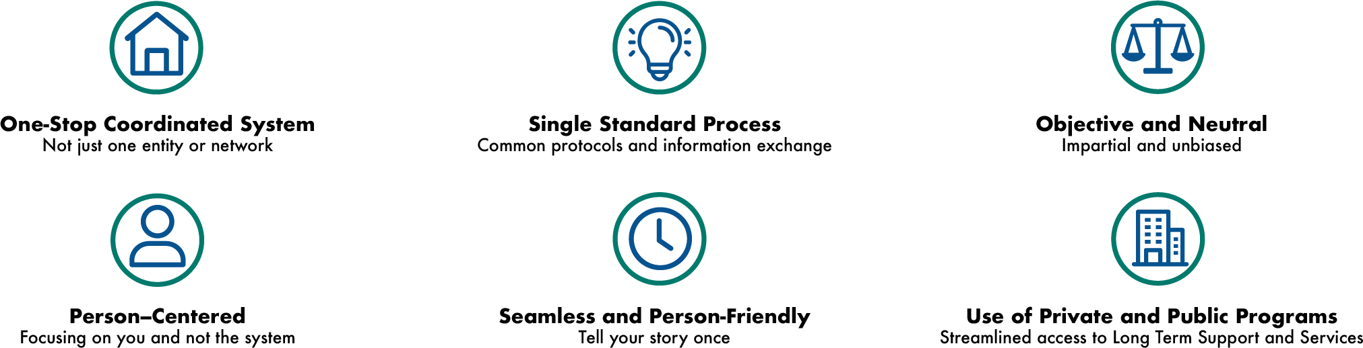
No Wrong Door
A No Wrong Door system makes it easier for people to get the services they need.

Slide 6
No Wrong Door: Catalyst for ACL Strategic Priorities
Person-Centered Counseling: Workforce focused on what matters to the person and ensuring people can make informed choices.
Cross-Cutting Themes:
-Equip high-impact service delivery
-Achieve better health
-Maintain community living
Caregiving
Connecting People to Services
Whole-Person Health
Employment
Protecting Rights & Preventing Abuse
Economic Security
Governance: Aligning state government for efficiency
MAHA Agenda
Streamlined Eligibility:
Making the process easier, starting with the initial request for help
Public Outreach: Building partnerships so more organizations are working together
ACL: Mission, Vision, & Priorities
Notes:
The No Wrong Door vision/framework is a dynamic catalyst for ACL’s recently published priorities.
The US Department of energy defines a catalyst as “a substance that speeds up a chemical reaction, or lowers the temperature or pressure needed to start one, without itself being consumed during the reaction”
The blue circles are ACL’s strategic priorities. As you can see Caregivers, Connecting People to Service and Whole Person Health are right up there.
The four pillars of a No Wrong Door system support these strategic priorities in very specific ways…
Public Outreach and Coordination with Key Referral Sources: Helping people learn how to get services and building partnerships so more organizations are working together to improve people’s experiences.
Person-Centered Counseling: Training the workforce across aging and disability to focus on what matters to the person and ensuring people can make informed choices.
Streamlined Eligibility to Public Programs: Making the whole process easier, starting with the initial request for help and assessing individual needs and program eligibility, to figuring out the right services and tracking progress.
State Governance and Administration: Creating a leadership team across different state and local agencies to guide their state’s No Wrong Door vision and using that information to maximize the use of resources and technology.

Slide 7
Mission, Vision, & Priorities
ACL’s role in the Make America Healthy Again Agenda
No Wrong Door Supports Cross Cutting Themes
Equip high-impact service delivery through training, technical assistance, and sustainable business models
Achieve better health, making clear that the MAHA agenda includes interventions that address health outcomes for older adults and people with disabilities
Maintain community living through outcome-driven services and supports

Slide 8
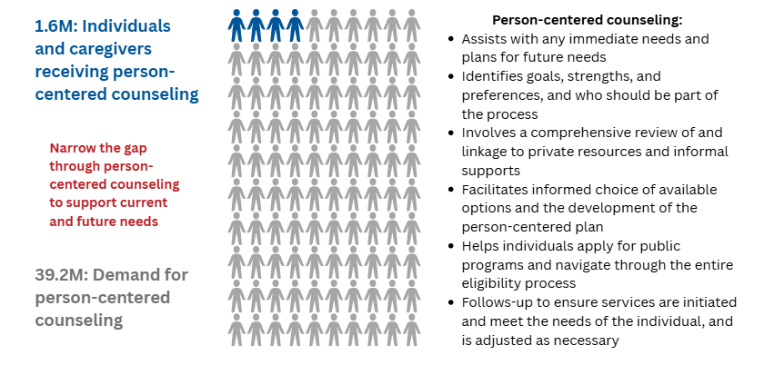
No Wrong Door Reach & Marketing
Person-centered counseling:
Assists with any immediate needs and plans for future needs
Identifies goals, strengths, and preferences, and who should be part of the process
Involves a comprehensive review of and linkage to private resources and informal supports
Facilitates informed choice of available options and the development of the person-centered plan
Helps individuals apply for public programs and navigate through the entire eligibility process
Follows-up to ensure services are initiated and meet the needs of the individual, and is adjusted as necessary

Slide 9
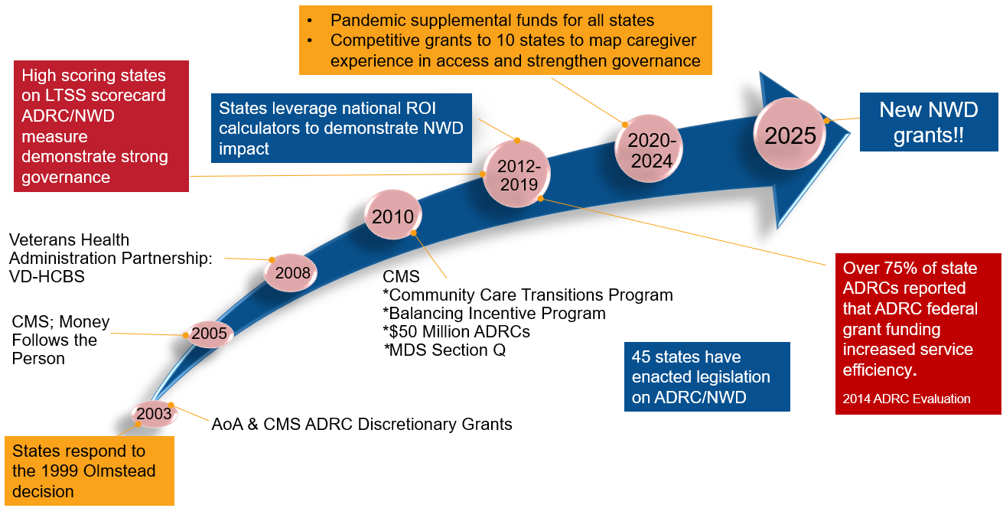
Federal Investment Spurred State Progress

Slide 10
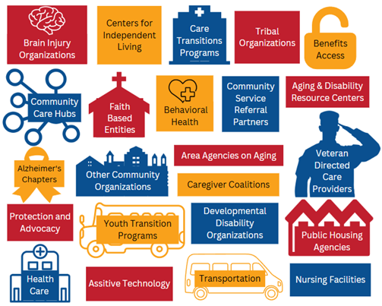
Federal Vision into State Governance
No Wrong Door is a network of state agencies and community-based organizations that help people access long-term services and supports (LTSS) by coordinating entry points.

Slide 11
Partnering with Hospitals
Individuals need support with accessing and navigating services especially following health crises that result in a hospital stay
Smoother hand‑offs from medical care to community support
Stronger navigation across complex systems
Earlier identification of social and functional needs (e.g., mobility limits, cognitive changes, caregiver strain)
Reinforcement of person-centered, self-directed care planning
Better support for caregivers

Slide 12
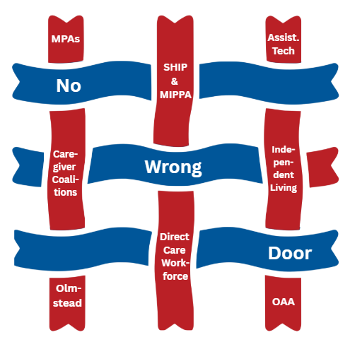
Intersecting Initiatives

Slide 13
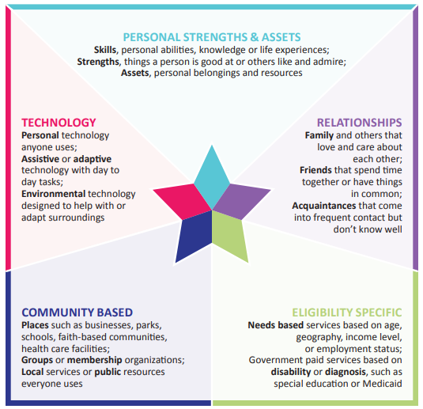
Person-Centered Counseling
Government programs are a safety net of last resort
No Wrong Door systems can delay Medicaid enrollment by connecting people with informal and private pay supports or expedite HCBS enrollment to prevent costlier nursing facility placement.

Slide 14
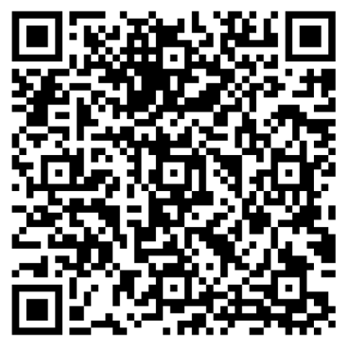
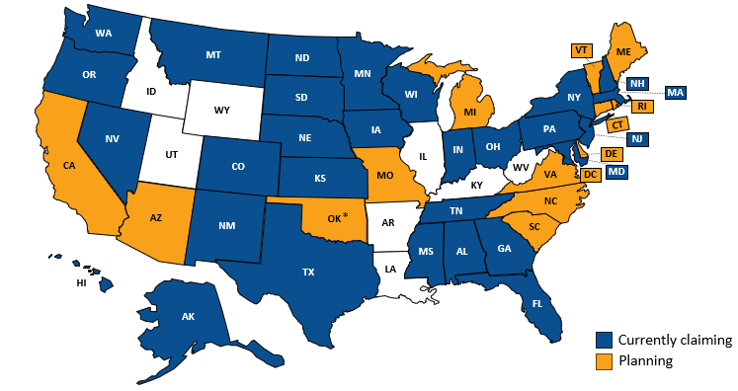
Streamlined Access and Sustainability
Medicaid Administrative Claiming
State General Funds
Veterans Health Administration Programs
Medicaid Service Dollars
Medicare
Health Plans
Hospital Systems
Public/Private Partnerships
State Examples of NWD Funding
Medicaid Administrative Claiming by State as of March 2026

Slide 15
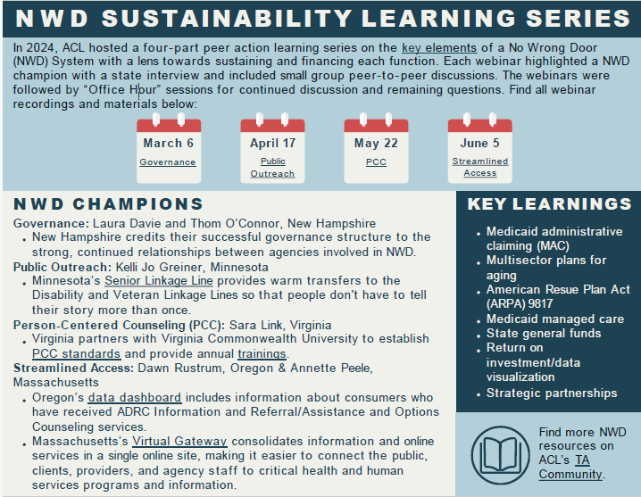
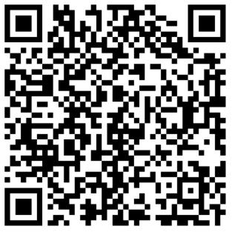
Sustainability Series

Slide 16
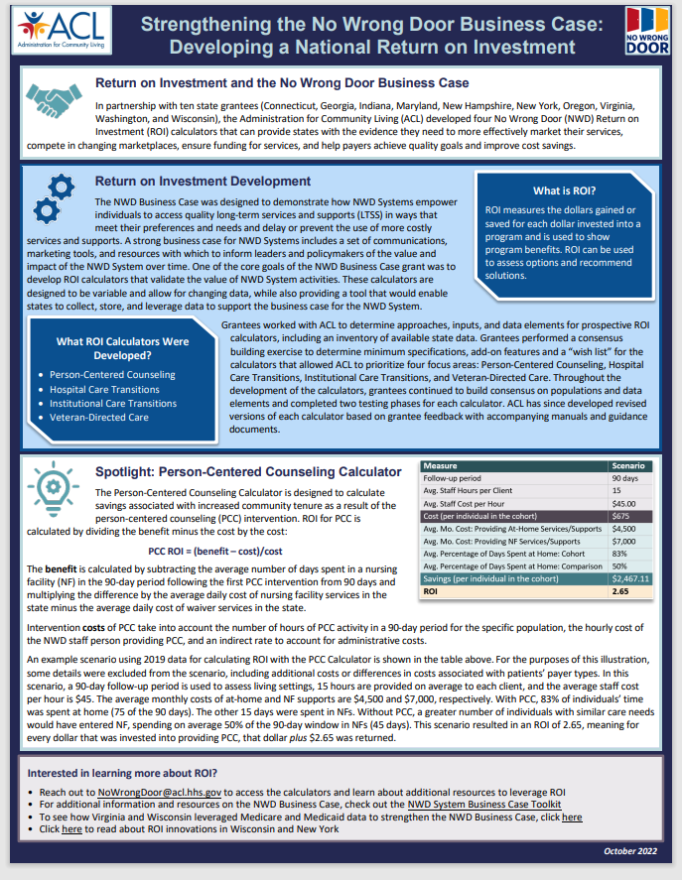
Demonstrate Return on Investment (ROI)
ACL developed four No Wrong Door ROI calculators that provide states with the evidence they need to:
  effectively market their services,
  compete in changing marketplaces,
  ensure funding for services, and
  help payers achieve quality goals and improve cost savings
No Wrong Door ROI Calculators:
  Person-Centered Counselling
  Hospital Care Transitions
  Institutional Care Transitions
  Veteran-Directed Care
Strengthening the No Wrong Door Business Case: Developing a National Return on Investment

Slide 17
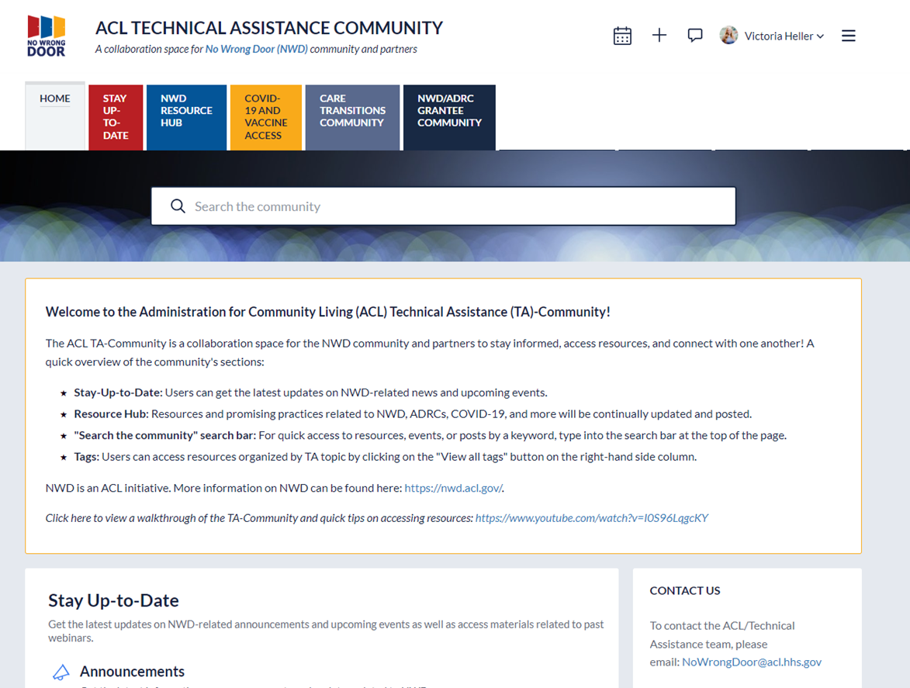

No Wrong Door TA Community
The TA Community is a collaboration space for the No Wrong Door community and partners to stay informed, access resources, and connect with one another.
https://www.ta-community.com/

Slide 18
Explore Resources to Better Understand the No Wrong Door Vision
Disability and Aging Partnerships in No Wrong Door
NWD Person-Centered Counseling Training
NWD Person-Centered Counseling Defined
NWD Person-Centered Counseling Policies
Charting the LifeCourse Nexus: Tips Sheets for No Wrong Door System

Slide 19
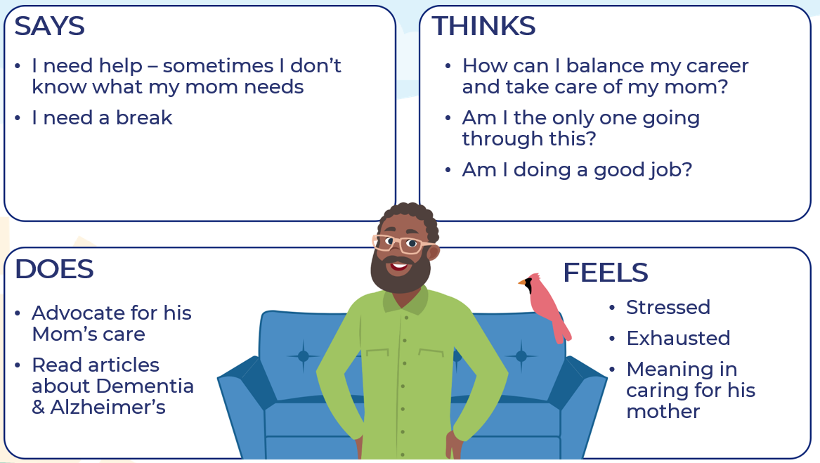
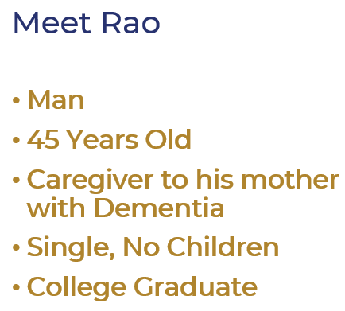
Connecting the Dots Activity: Map an ideal path for your sample persona

Slide 20
Leaving in Action
“If you think you are too small to make a difference, try sleeping with a mosquito”
Dalai Lama

Slide 21
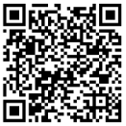
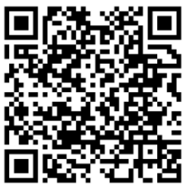
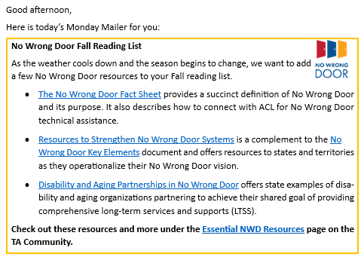
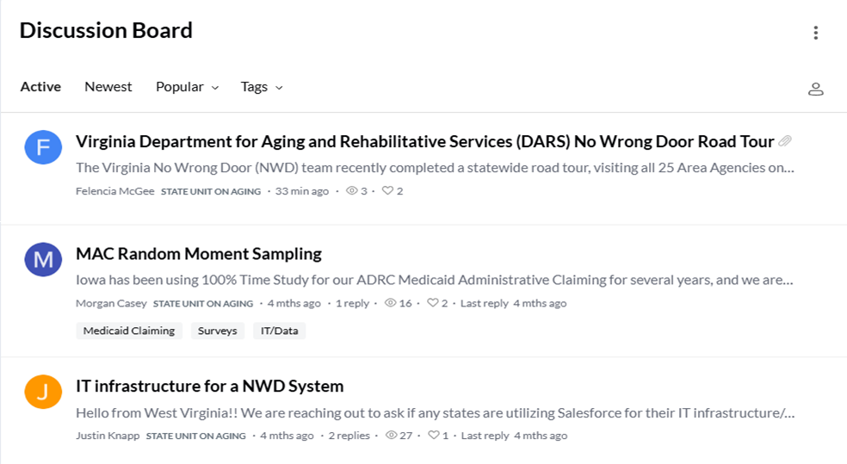
Stay in touch!
The Monday Mailer is a brief, weekly email with resources, events, and opportunities related to No Wrong Door
The NWD Community Discussion Board is a closed community for you to engage with your peers

