Slide 1
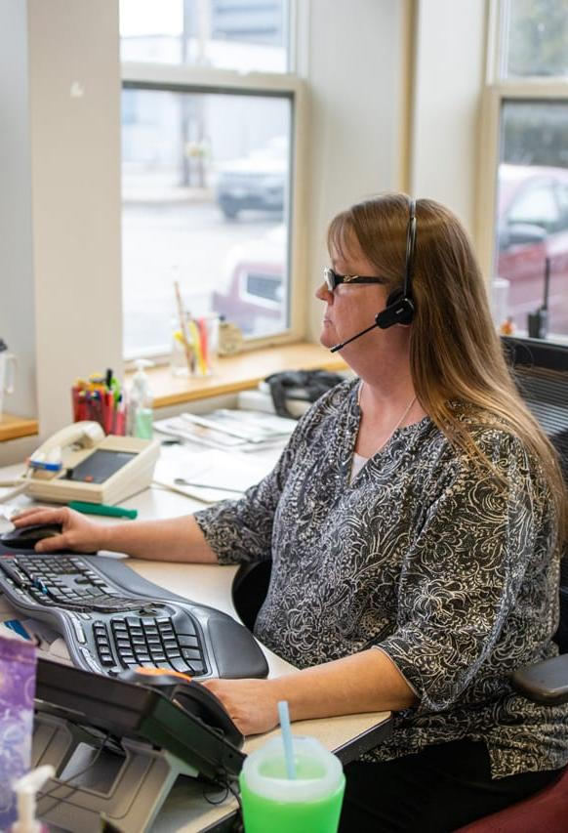






Exploring Mobility Hubs in Virginia
Presentation for No Wrong Door Summit
Jess Maffey, Statewide Transit Program Manager
May 6, 2026
Notes:
Grant kick it off

Slide 2
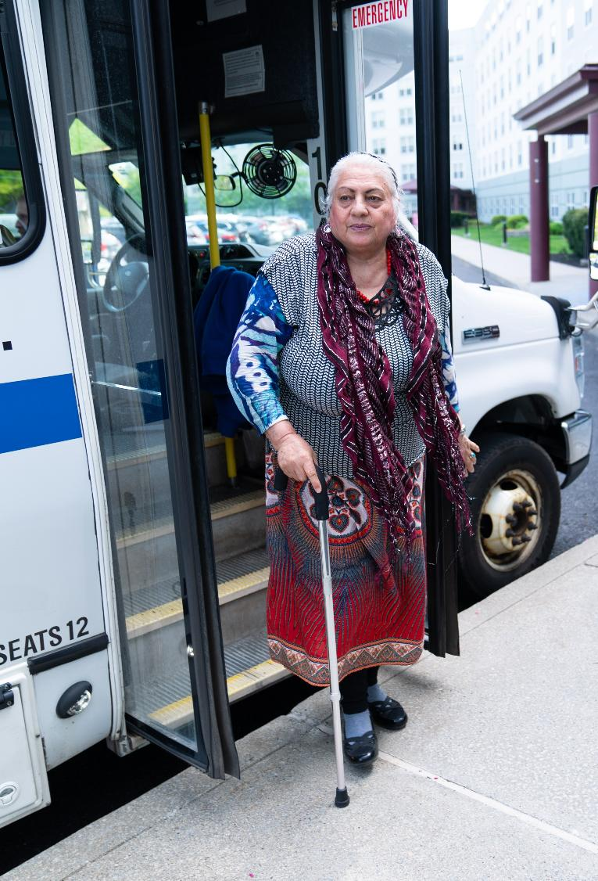
Agenda
  Overview of 5310 Program
  2026 Coordinated Human Services Mobility Plan Recommendations
  Overview of Mobility Management
  Mobility Hubs Concept
  Next Steps
  Questions/Discussion
Notes:
Grant

Slide 3
FTA Section 5310:
DRPT Program Overview
Notes:
Jess – intro myself if Grant hasn’t already

Slide 4
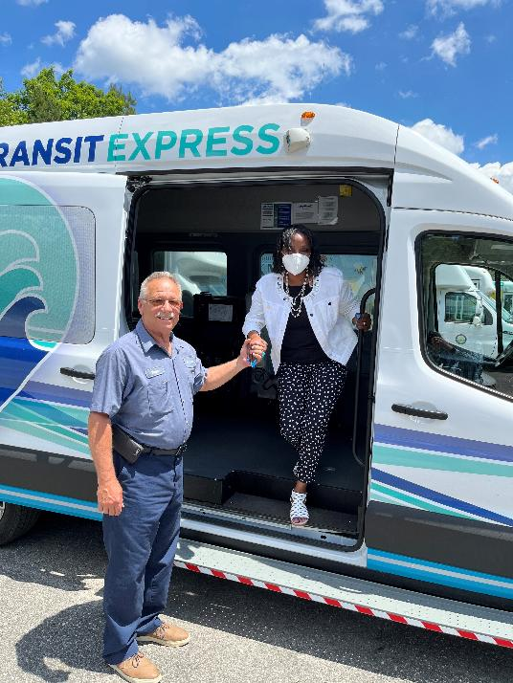
FTA Section 5310 Program Overview
Program Purpose
  To improve mobility for seniors (65+) and individuals with disabilities by removing barriers to transportation and expanding the available transportation options
Eligible Activities
  Capital – Vehicle
    Replacement or expansion vehicles for transportation to the eligible population
  Other Capital
    Mobility management (one call/one click, travel training, trip coordination, planning); contracted transportation; other capital purchases, such as software
  Operating
    Direct transportation expenses for the approved project, or reimbursements for volunteer drivers or vouchers for clients
Bay Transit
Notes:
The program I manage comes from the FTA Section 5310 funding. The purpose of the program…
What we focus on in the program is this eligible population. Services we fund must be designed to meet the needs of older adults and people with disabilities. We refer to this as human services transportation or specialized transportation

Slide 5
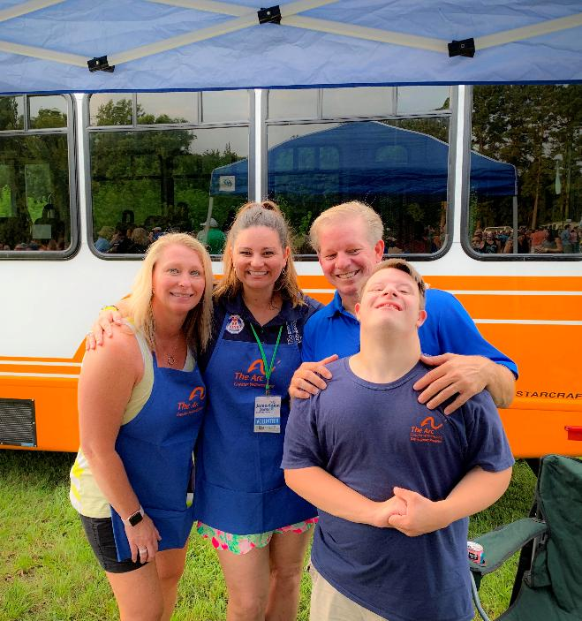
FTA Section 5310 Program Overview
Eligible Applicants
  Private nonprofit organizations
  State or local governments that:
    Are approved by the state to coordinate services for seniors and individuals with disabilities, or
    Certify that there are no nonprofit organizations readily available in the area to provide the service
  Public transportation operators
Funding
  DRPT receives all the 5310 funding for the Commonwealth, with the exception of DC Metro area (MWCOG)
  Approx. $10M federal, $3M state match
Planning
  Projects selected for funding must be consistent with and included in regional plans or a state-level coordinated plan
The Arc of Greater Williamsburg
Notes:
When we talk about services designed to meet the needs of older adults and ppl with disabilities, that’s often not just transit agencies
These are groups that are often Fill in the gap services where transit ends or is not there – such as area agencies on aging, county govts, or volunteers
Program has several types of eligible applicants
Funding
FTA stipulates that there must be a planning process attached to these projects to ensure that services are not duplicated and wants these different operators to be working together
They require either regional plans or a state-level plan that identifies the operators and project types to prioritize for funding

Slide 6
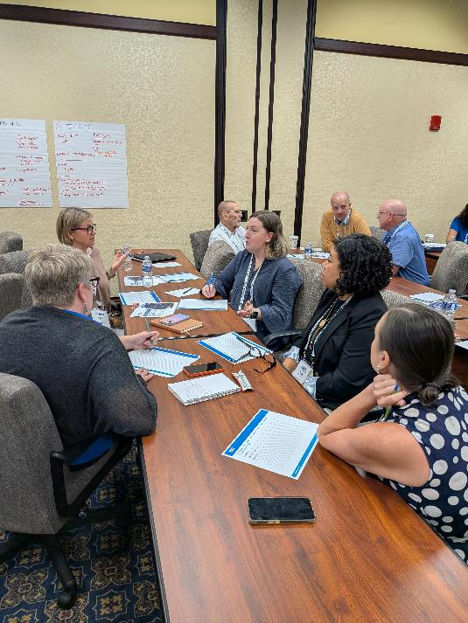
DRPT Coordinated Human Service Mobility Plan
DRPT Statewide CHSM Plan
  Identifies transportation gaps and needs for older adults and people with disabilities, as well as veterans and low-income
  Goals, strategies, and action items by region
2026 CHSM Plan completed in February
CHSM recommendations include increasing regional coordination:
  Reconsider current CHSM boundaries
  Reintegrate regional plans to better capture regional needs/projects
  Expand and standardize management of mobility hubs
CHSM Working Group at CTAV
Notes:
Since 2019 we have done a
DRPT does the statewide plan but within that plan we have six CHSM regions
Map on the next page

Slide 7
CHSM Identified Gaps + Needs
Demand for trips is greater than capacity
  Increased demand for medical trips
  Recurring trips + long-distance challenges capacity
Funding limitations prevent expansion of services
  Small agencies have limited capacity to administer funds
Coordination challenges limit efficiency of service
  Blurred lines between transportation and other human service functions
Unclear information hinders riders and caregivers from making informed choices on available transportation
  Lack of awareness of all available options
  Struggle to find consistent information, understand eligibility
  Difficulty making regional or statewide connections

Slide 8
Overview of Mobility Management
Notes:
Bridging this –
Transportation generally is easy to understand - public transportation is a common mode, easy to understand.
For specialized transportation – still transportation, but there is a lot happening behind the scenes – client-based approach says we want to make it easy for the user to know where to go and what types of services they are eligible for, esp for people with the greatest need, including but not limited to people who cannot drive themselves. MM centers around that concept.
Transition from the program to mobility management – operational side of what mobility management is

Slide 9
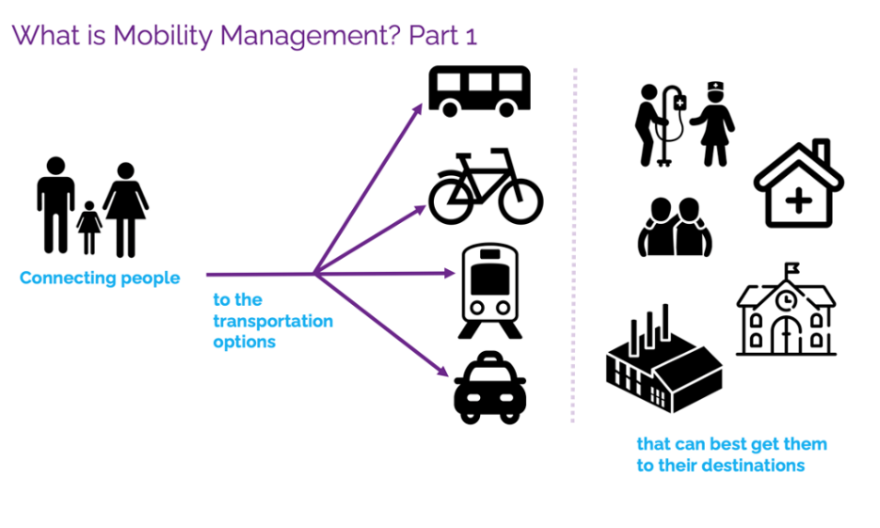
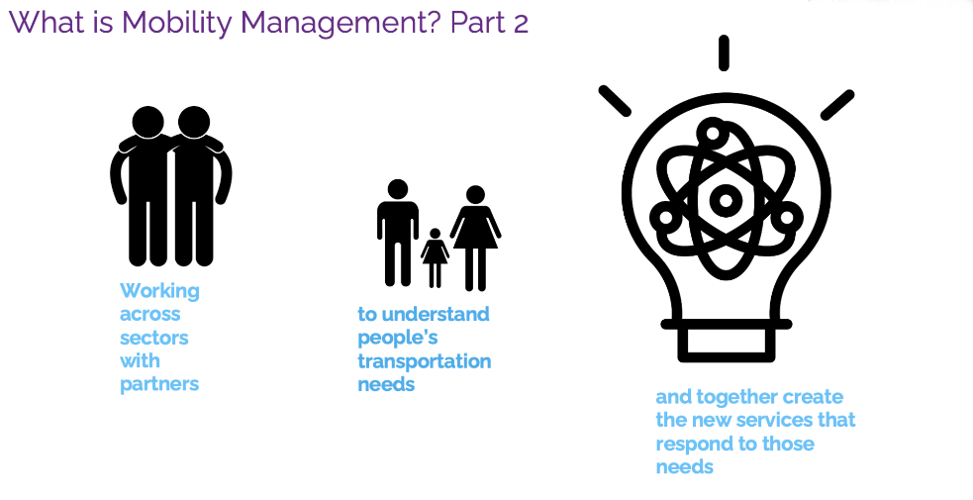
What is Mobility Management?
Source: Coordinating Council for Access and Mobility Technical Assistance Center (CCAM-TAC)
Notes:
Definition comes for CCAM-TAC – and FTA technical center

Slide 10

What is Mobility Management?
“One Call/One Click Center”
Source: Coordinating Council for Access and Mobility Technical Assistance Center (CCAM-TAC)
Notes:
Next few slides I’ll be walking us through just this first box

Slide 11
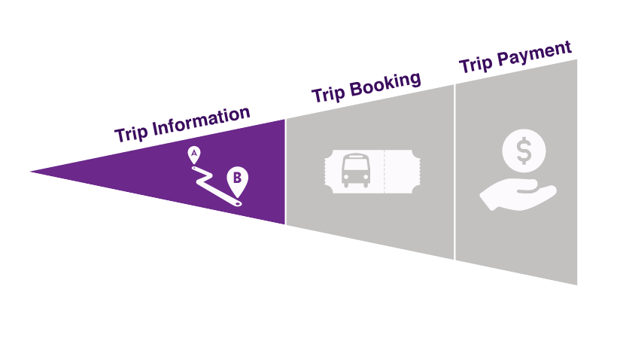
What is One-Call/One-Click?
There are three basic levels to mobility management as direct assistance:

Slide 12
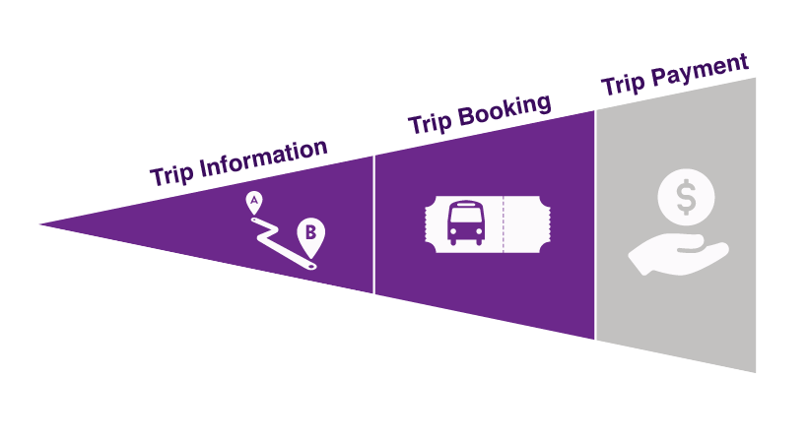
What is One-Call/One-Click?
There are three basic levels to mobility management as direct assistance:

Slide 13
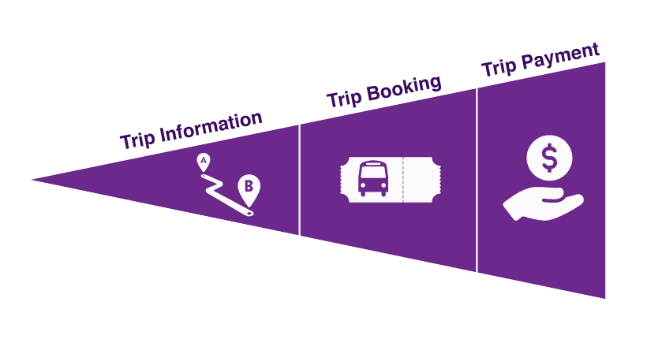
What is One-Call/One-Click?
There are three basic levels to mobility management as direct assistance:
Notes:
Next slides – what this can look like in practices, how a hub is structured, what the inputs and outputs are

Slide 14
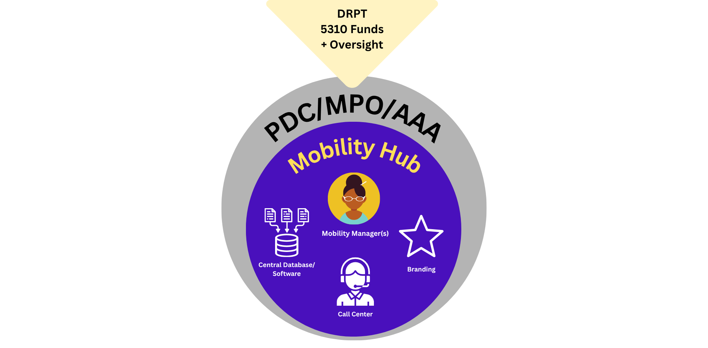
Mobility Hub Concept
Notes:
Describe what is in there
Agency already responsible for some regional coordination function -
All combined in the purple circle are key aspects of the mobility hub

Slide 15
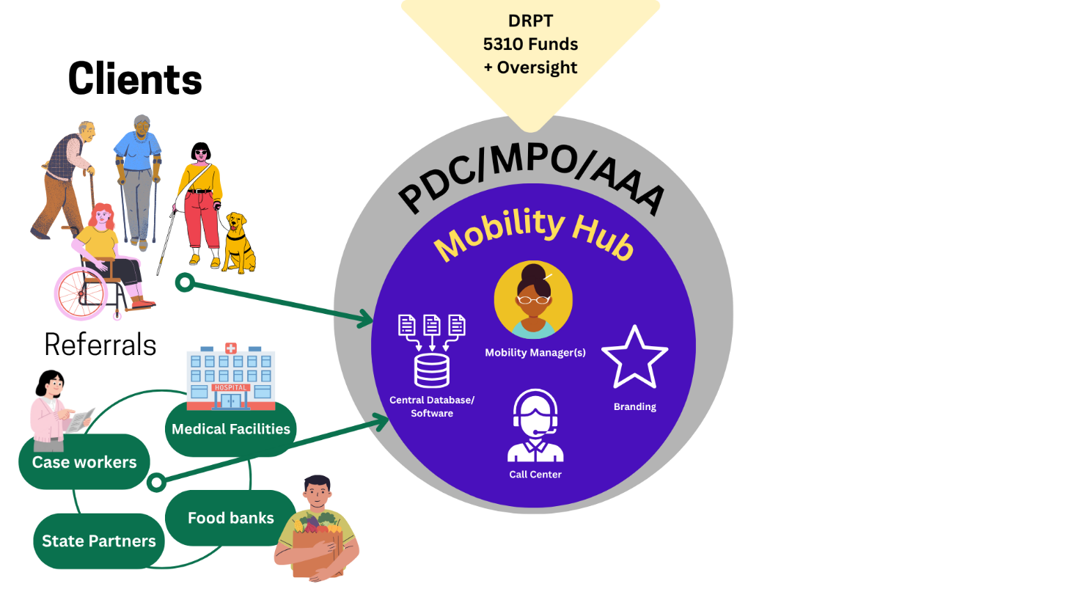
Mobility Hub Concept

Slide 16
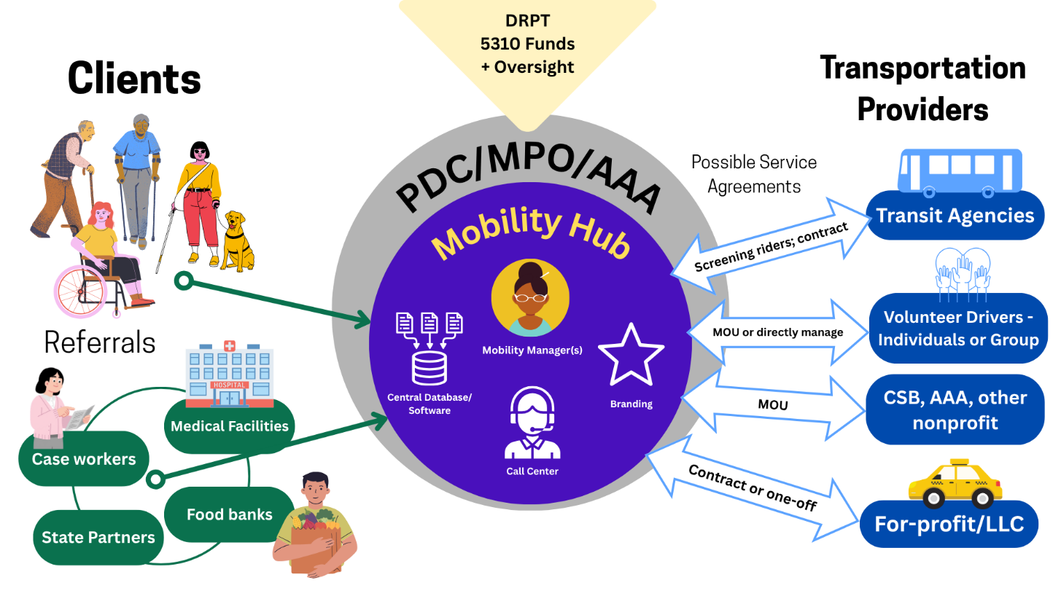
Mobility Hub Concept
Notes:
Talk about the relationships – how provider relationships are established based on needs/gaps in service
Pause for questions

Slide 17
What is Mobility Management?
Coordinated plans + implementation
Source: Coordinating Council for Access and Mobility Technical Assistance Center (CCAM-TAC)

Slide 18
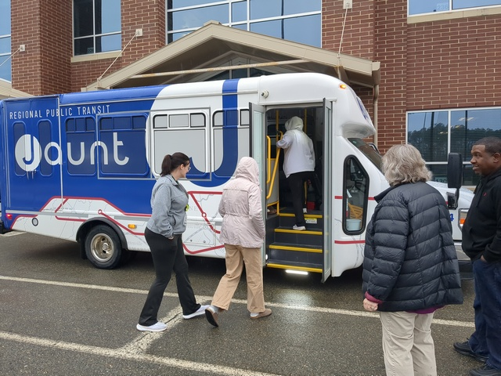
Mobility Managers as Planners
Mobility Managers see the landscape of services and where potential new services or partnerships can take place
Placed in a regional body, can inform a regional coordinated transportation plan
  Can also advocate for other funding at their local/regional level
That plan then informs what projects get funded by DRPT
PATH partnering with Jaunt for travel training

Slide 19
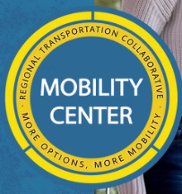

Virginia Mobility Hubs
RRRC: RTC Mobility Center
First one-call/one-click center
in VA
Robust partnership network
  7 volunteer transportation providers
  Local CSB
  Public transportation
  DSS
  Aging Together
Centralized database and data sharing
Serves an area without public transit through network of partners, vehicle sharing, and cost-sharing
TJPDC: PATH
Third year of operation
Establishing partnerships – Jaunt, volunteer transportation organizations, local healthcare systems
Following RRRC model, but in a different transportation environment – two major transit providers
Notes:
These hubs came about in response to the needs in their area and their own regional planning work
Rappahannock Rapidan Regional Commission
Regional Transportation Collaborative
Talk about this then pause for Patrick if he’d like to comment
Same with TJPDC

Slide 20
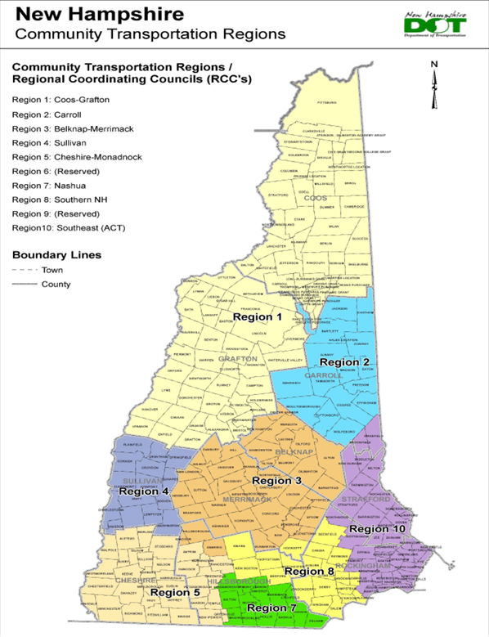
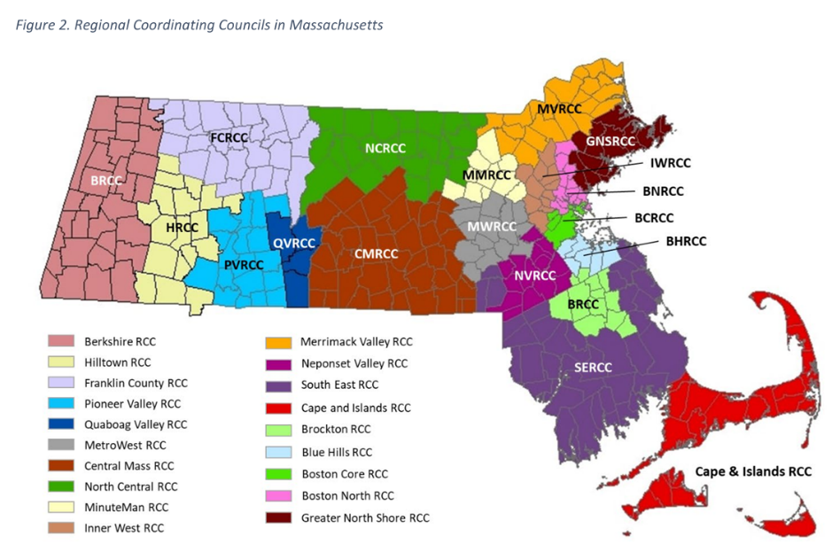
National examples: Centralized State-wide Mobility Hubs
Massachusetts DOT and New Hampshire DOT identified Regional Coordinating Councils as the host organizations for mobility managers
Notes:
Quickly touch on how this can function in terms of DRPT establishing a statewide network of mobility hubs
Top down approach

Slide 21
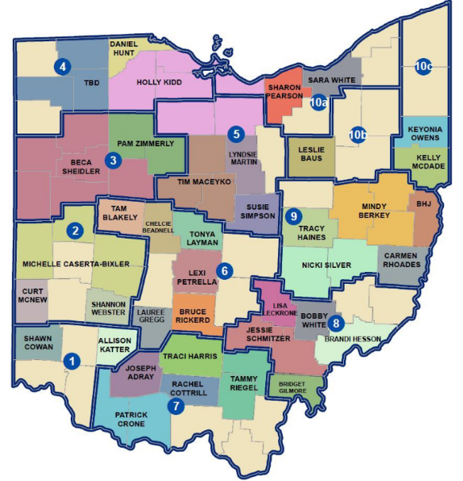
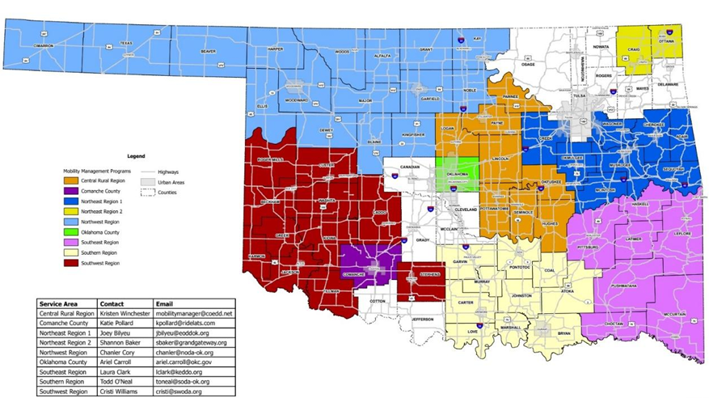
National examples: Less Centralized State-wide Mobility Hubs
Ohio DOT divided the state into regions, with multiple mobility managers covering counties within the region
MMs are housed at local nonprofits
Oklahoma DOT regions have organizations that opt-in to host a mobility manager for a set period of time, with options to renew
Notes:
More ground up approach

Slide 22
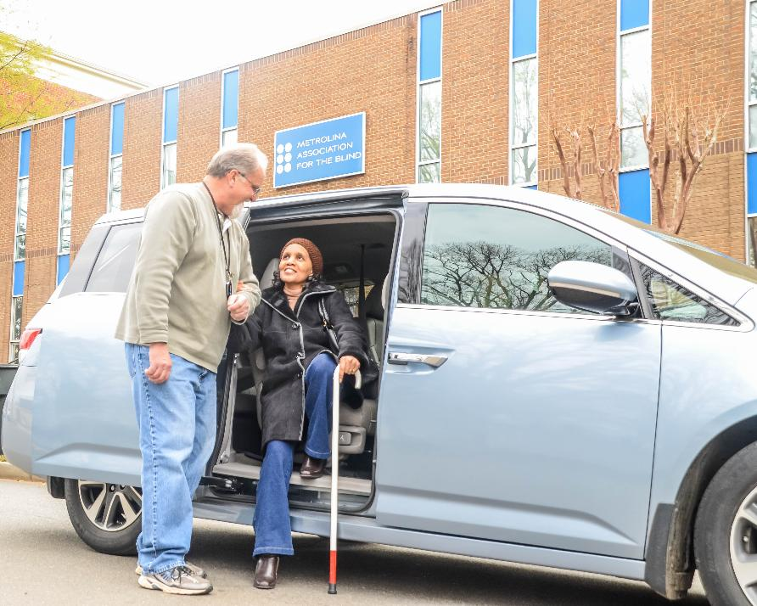
What DRPT is Considering
Innovation has been difficult to pursue with 5310 due to funding constraints
State funding has been flat; federal amount remains flat (apportionment based on census)
Costs continue to go up
CHSM showed a better opportunity for coordinating services and reducing duplication through mobility hubs
New opportunity through state funding
Notes:
Grant – existing funding program could have this as eligible project type

Slide 23
Next Steps
Coordinated plan regions:
  Determine what level of planning might best serve coordination in the Commonwealth
  Gather feedback
Regional mobility hubs:
  Engage in a statewide mobility management planning effort, with significant outreach efforts
  Determine level of funding/capacity needed
  Identify hub hosts
  Pilot programs
Notes:
Jess – go through, Grant expand on this in terms of the new administration
4 years until the next plan

Slide 24
Questions/Discussion

Slide 25
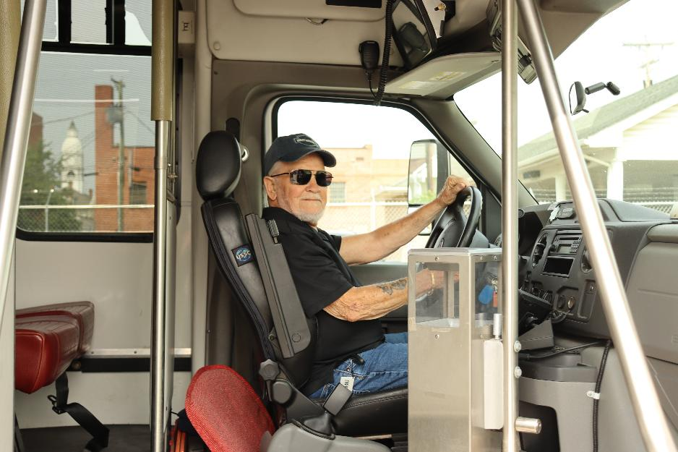
Questions from DRPT
Who else should we talk to?
What are the barriers to success?

Slide 26
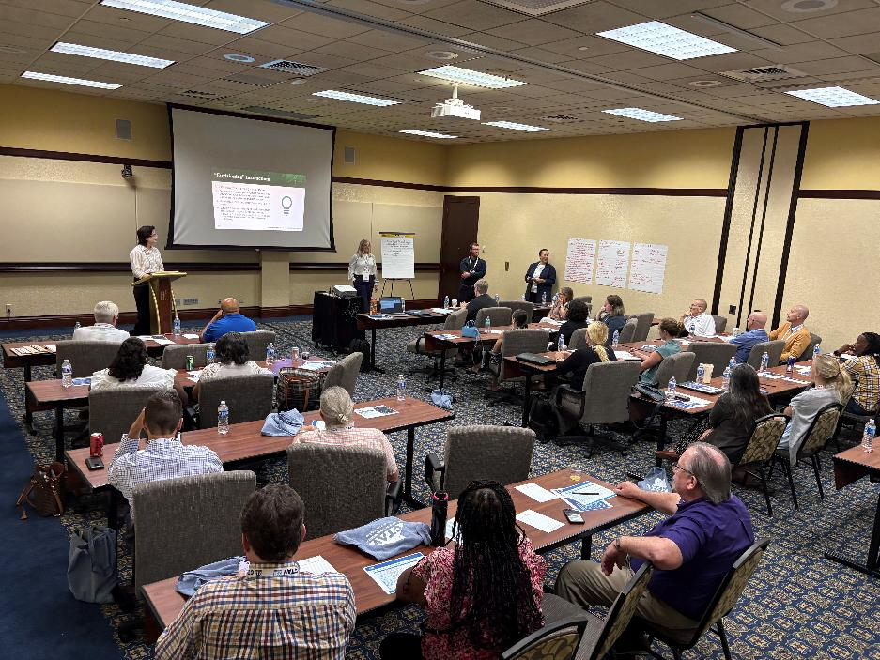
Opportunities to Engage
DRPT is hosting a strategic planning session on July 29th in Richmond
Currently engaging state-level and regional partners in quarterly discussions

Slide 27
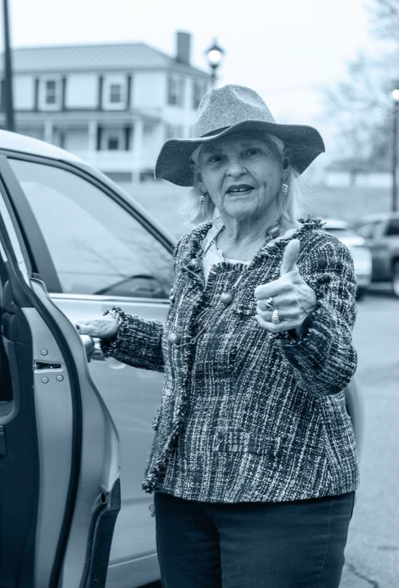
Thank you!
Jess Maffey
Statewide Transit Program Manager
Jessica.Maffey@drpt.virginia.gov
804.573.5269

Slide 28
Appendix Slides

Slide 29
Capital – Vehicles
Overview
Replacement or expansion vehicles
  Prioritizes oldest replacement vehicles
New, accessible vehicles purchased by DRPT
  DRPT collects local match and purchases directly from vendor
Vehicles must be used for the sole purpose of transporting seniors and/or individuals with disabilities
*State match is subject to funding availability
Notes:
DRPT does not award funds for a grantee to purchase their own vehicles. We only purchase new, wheelchair accessible vehicles.
Useful life for FTA-funded vehicles is 4 years old and 100,000 miles. If you don’t meet these two criteria, then we may consider earlier replacements – this is typically only for vehicles that are 10 years old or older or vehicles that have ongoing documented issues. Keep in mind that this is the minimum required useful life. You may choose to operate your vehicles for additional years and miles – you do not have to hold yourself to these minimum criteria.
When you are requesting a vehicle replacement, ensure that the vehicle you are replacing is recorded in TransAM. On the application, you will be asked to list the VIN, year, date put into service, make, model and mileage. Make sure this information matches TransAM, and ensure that you are giving us the VIN and not your asset ID. We want the number assigned by the manufacturer and that is listed on the title.
The reason we ask for the VIN is that if awarded, your contract will list the VIN that you are required to replace. If you submit an application asking for a replacement vehicle, please be sure that you will be removing that vehicle from service for disposal or use as backup only. If you are still going to be regularly using the vehicle then DO NOT request a replacement for it – you should be requesting an expansion. If you have questions about whether you should request a replacement or an expansion, then please contact me.
As I mentioned earlier, the local match rate is now 10% for grantees. The local match must be documented in the application will be collected from you before the vehicles are ordered.
And another reminder that all vehicles are to be used for the sole purpose of transporting seniors and individuals with disabilities.

Slide 30
Other Capital
Overview
Mobility Management
  Intended to improve coordination between existing public and human service transportation providers; does not include the cost of trips or providing transportation
  Trip planning and coordination across agencies
  One-call/one-click systems
  Travel training
  Planning activities
Contracted Transportation
  Subrecipient contracts with a transportation provider (such as a turnkey service)
Other Capital (ex: Software)
Notes:
Other capital includes mobility management, travel training, the capital cost of contracting for transportation services, and other non-vehicle capital expenses.
Mobility management is intended to improve coordination between existing transportation providers, including public and human service providers. A person who works with one vendor or agency to set up rides is not a mobility manager. This is a true coordination service across agency types. If you have questions about this, I am happy to discuss it further. If you do submit an application for mobility management that should be operating, DRPT will consider it to be an operating request. Mobility management grants are for staff and their limited associated costs, which I’ll talk about more on the next slide.
The cost to provide a trip is not a mobility management expense, that is operating. There are some mobility management programs that require operating to succeed. In those cases, you need to be submitting a mobility management and operating budget. They are funded differently and require different matches.
In terms of contracting, an organization can follow a federally compliant process to procure transportation services from a transportation provider, such as a turnkey service. Examples of this include Hanover DASH and CORTRAN in Roanoke.
If you are procuring new software or technology, that will likely fall under an other capital grant application – this is somewhat dependent on the price of the software – but if you are going to be procuring something, you will need to submit an indendent cost estimate with your application

Slide 31
Operating
Overview
Operating is the direct delivery of transportation service for individuals with disabilities and seniors
Eligible activities:
  Publicly available transportation to seniors and individuals with disabilities
  Expanded paratransit (beyond ¾ mile)
  Expanded hours
  Travel training
  Vouchers (volunteer, taxi, human service)
Notes:
Operating is a broad category, but it’s basically the delivery of service beyond existing public and human service transportation options. It could be expanded paratransit, more hours, providing same-day or door-to-door service that come with higher costs, travel training, vouchers for various non-public transit options, and other transportation expenses for services that are publicly available to seniors and individuals with disabilities.
What the last bullet means is that transportation that is provided to set clients is not public and is not eligible for operating support. For example, If you are a community services board transporting individuals to and from your group homes to community locations, this is not eligible for operating support. If anyone in the eligible population can call your agency and get a ride, that is public.

