Slide 1
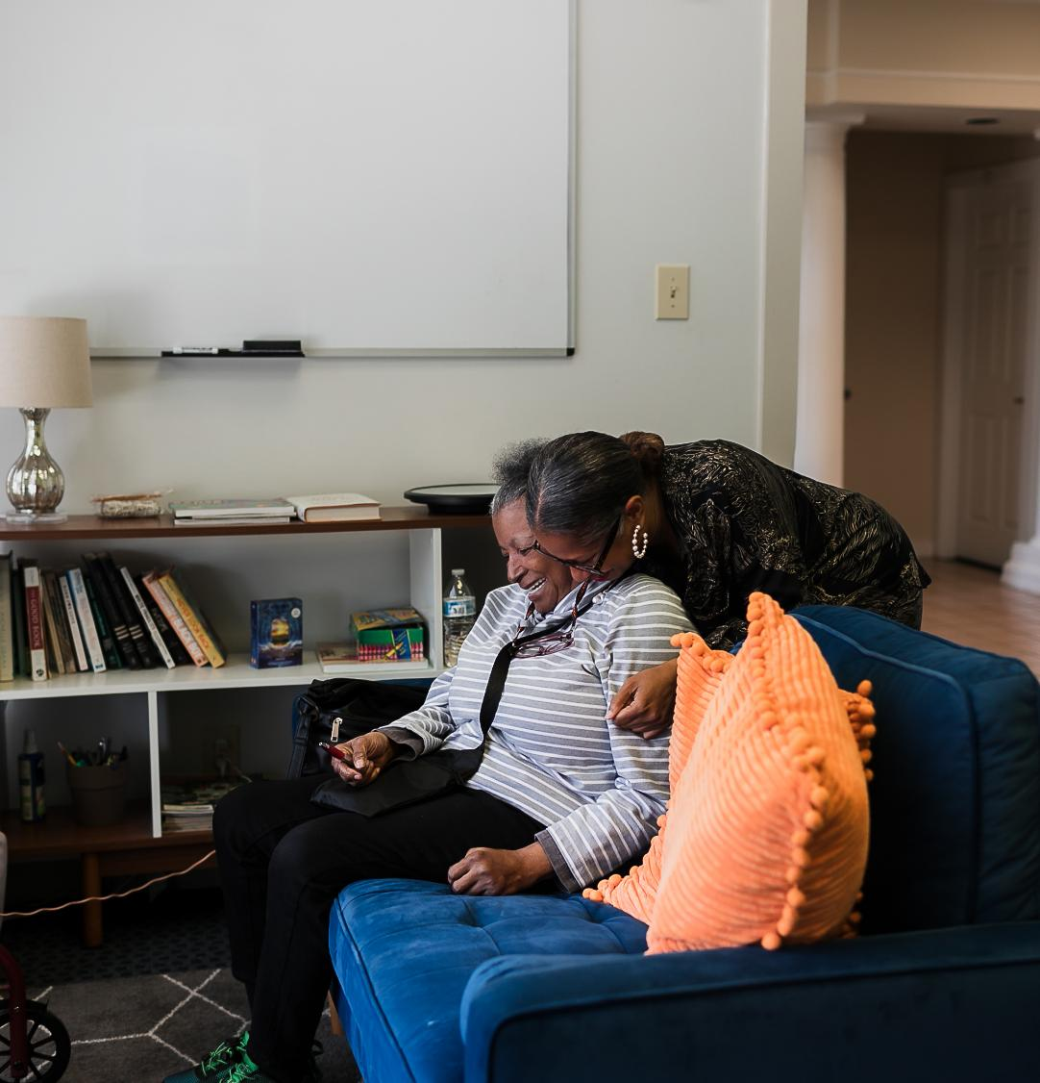

Caring for the Care Workforce: Supporting and Retaining Frontline Staff
Presented by Jenn Case, LCSW

Slide 2

Introduction
Family Lifeline is a home visiting organization serving children, caregivers, older adults, and persons with disabilities across the Richmond and Petersburg region. Our frontline staff provide intensive, relationship-based support, making them the heart of everything we do.

Slide 3
Agenda
Welcome & Framing
Setting the Context: Workforce Reality
What we learned: Key Drivers of Retention
Strategy Showcase: What’s working
Small Group Activity: Build Your Strategy
Key Takeaways & Closing

Slide 4
How are you feeling about your workforce right now?

Slide 5
The Reality We’re Facing
Burnout
  50% of nonprofit organizations report burnout as a major factor in recruitment and retention challenges
  Turnover
  Nearly one-third of nonprofit staff left roles due to stress and burnout
  Workforce shortages
  U.S. direct care workforce includes ~4.6 million workers, but demand is rapidly outpacing supply
  Increased complexity of client needs
  Direct care workers support individuals with increasingly complex medical, behavioral, and social need
Notes:
“

Slide 6
What is the biggest challenge impacting your frontline staff right now?

Slide 7
What We Set Out To Learn
3 Year Demonstration Project between FLL, JFS, and Leading Age

Slide 8


Pilot Project Strategy Areas
Wage increase
Create a competitive, person-centered compensation package for all Care Providers.
Transportation
Decrease barriers to employment and increase reliability by establishing a dependable system of backup transportation.
Education
Increase the skills, knowledge, and confidence of Care Providers by offering holistic training opportunities.
Technology
Improve overall capabilities by converting to a new Home Care software.

Slide 9
Strategies as we move forward
Area | Impact on engagement
Wage | While pay increased it is still insufficient to cover living expenses
Training & Support | Care providers want more enhanced mentorship opportunities
Advancement | Desire for ways to advance in their careers and for it to be tied to financial support.
Transportation | Transportation is a huge benefit to working and allows care providers to access employment that otherwise they could not.

Slide 10
How do the results of this pilot project connect with the work you do?

Slide 11
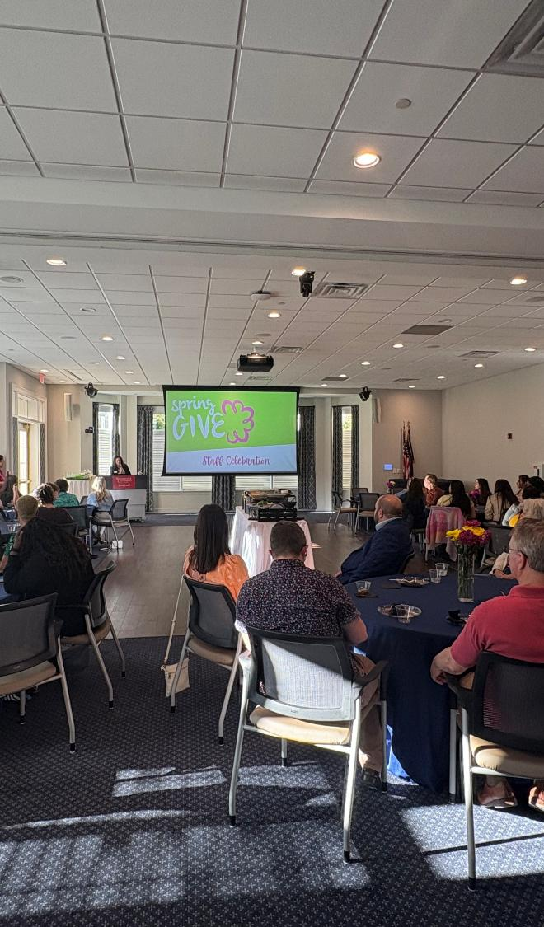

What Matters Most
Feeling Valued
Employees who feel recognized are 5x more likely to stay
Tangible Support
Pay & Benefits remain a top 2 driver of retention in non-profits
Flexibility
Flexibility is one of the top 3 factors employees look for in a job
Connection & Voice
Employees who feel heard are 4.6x more likely to feel empowered to do their best work

Slide 12

Strategy Framework
Whole Person Benefits
Mental Health & Wellness
Voice & Shared Leadership
Recognition & Belonging

Slide 13

Whole-Person Benefits
Healthcare Benefits Improvement
Free Telehealth & Mental Health for Employee and all family members
PTO & Holiday Review
Reviewed and increased number of holidays observed and Base PTO rate
Flexible weekly hour for appointments
1-hour weekly lunch to use as needed for personal errands or appointments

Slide 14

Mental Health & Wellness
Free Mindfulness Sessions
Free Telehealth & Mental Health for Employee and all family members
Encouraging time for therapy
Reviewed and increased number of holidays observed and Base PTO rate
Culture of Permission
1-hour weekly lunch to use as needed for personal errands or appointments

Slide 15
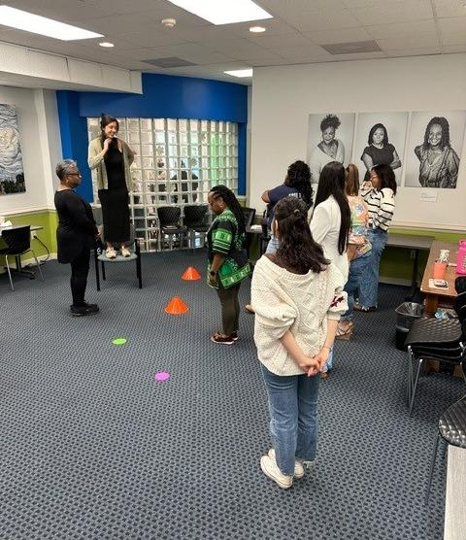

Voice & Shared Leadership
Employee Engagement Surveys
Developed survey in collaboration with staff.
Staff Engagement Committee
Facilitates formal and informal staff recognition
Change Leaders Committee
Facilitates information sharing between leadership and staff and supports a shared leadership approach.

Slide 16
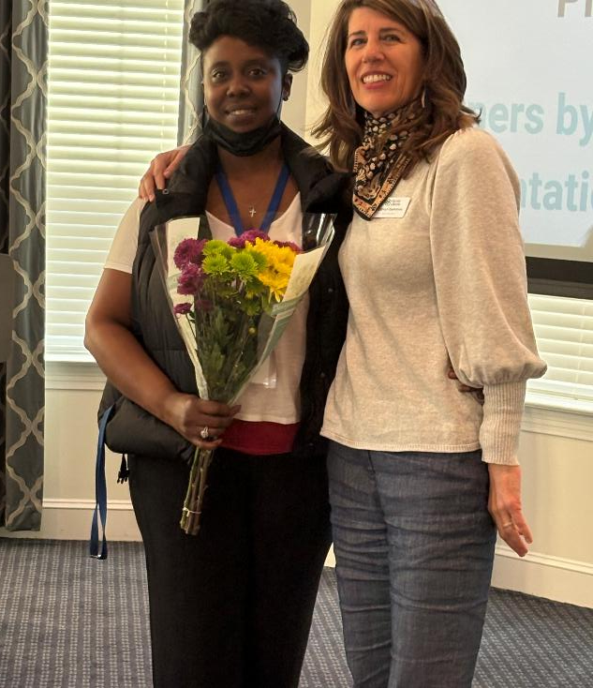

Recognition & Belonging
Celebrations
Celebrate birthdays, work anniversaries, and more.
Appreciation months
Social Workers, Nurses, Administrative professionals, Caregivers, etc.
Small Moments of Joy
Offices decorated with streamers for birthdays, snacks at a staff meeting, cultural office celebrations with food and drinks, etc.
Notes:
This doesn’t have to be expensive to be meaningful
Consistency matters more than scale
So now you’ve heard what we’ve tried—let’s make this about you.

Slide 17
Design one strategy you could implement in the next 6 months.

Slide 18
Delivering with confidence
Small Group Guiding Questions:
What is the need?
What’s the idea?
Who do you need to involve?
What barriers may you face?
How can you overcome them?

Slide 19
33%
of employees strongly agree they received recognition in the past 7 days.

Slide 20
Delivering with confidence, continued
If we want staff to care for others, we have to show them they are cared for first.

Slide 21

Q & A

Slide 22
References
Nonprofit Workforce & Burnout
National Council of Nonprofits. (2023). Nonprofit Workforce Survey Results.
https://www.councilofnonprofits.org/files/media/documents/2023/2023-nonprofit-workforce-survey-results
(Reports widespread vacancies and burnout impacting nonprofit staffing)
Sikich LLP. (2023). Nonprofit Turnover: Causes and Solutions.
https://www.schgroup.com/insights/blog/accounting/nonprofit-turnover
Direct Care & Aging Workforce
RAND Corporation. (2023). The Direct Care Workforce in the United States.
https://www.rand.org/content/dam/rand/pubs/research_reports/RRA1900/RRA1966-1/RAND_RRA1966-1.pdf
Employee Engagement & Retention
Gallup. (2023). Employee Retention Depends on Getting Recognition Right.
https://www.gallup.com/workplace/650174/employee-retention-depends-getting-recognition-right.aspx
Gallup. (2022). Employee Experience and Workplace Culture.
https://www.gallup.com/workplace/323573/employee-experience-and-workplace-culture.aspx

Slide 23

Contact Info
Contact Information
Jenn Case, LCSW
Mobile Number : 804-994-7441
Website : www.familylifeline.org
Email Address : jcase@familylifeline.org

