Slide 1

Being a Good Stewart of Taxpayer Dollars
No Wrong Door Summit

Slide 2
Agenda
Fiscal Transparency and Accountability
Efficient Spending
Managing Resources
Sustainability
Culture of Stewardship
Best Practices
Question and Answer

Slide 3
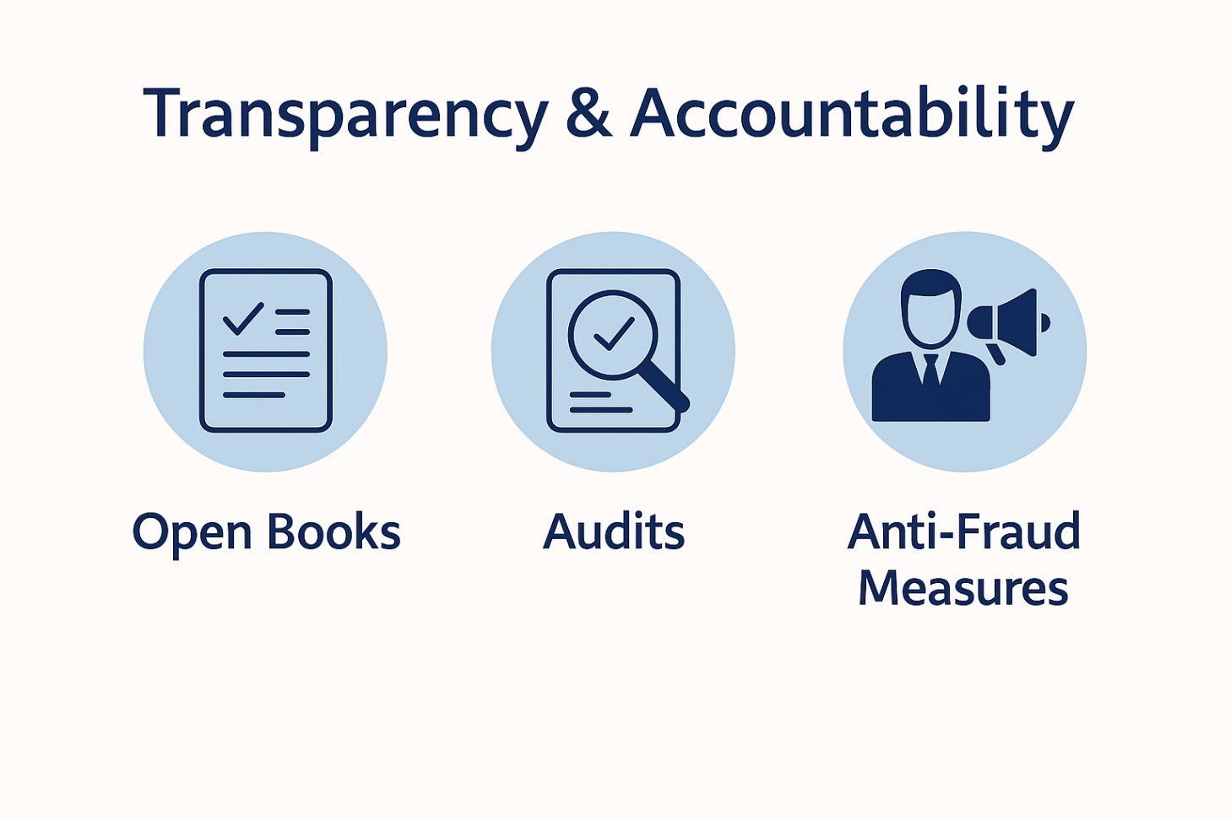
Transparency

Slide 4
Transparency & Accountability
Open Books: Make spending data easily accessible to the public through reports and portals. Ensure robust compliance with Freedom of Information Act (FOIA) requests, with minimal exceptions.
Audits: Conduct regular internal and external audits to verify accuracy and detect irregularities. Publish audit results for public review.
Anti-Fraud Measures: Establish whistleblower programs and anonymous reporting channels to identify fraud, waste, and abuse. Implement strong internal controls to prevent misuse of funds.

Slide 5
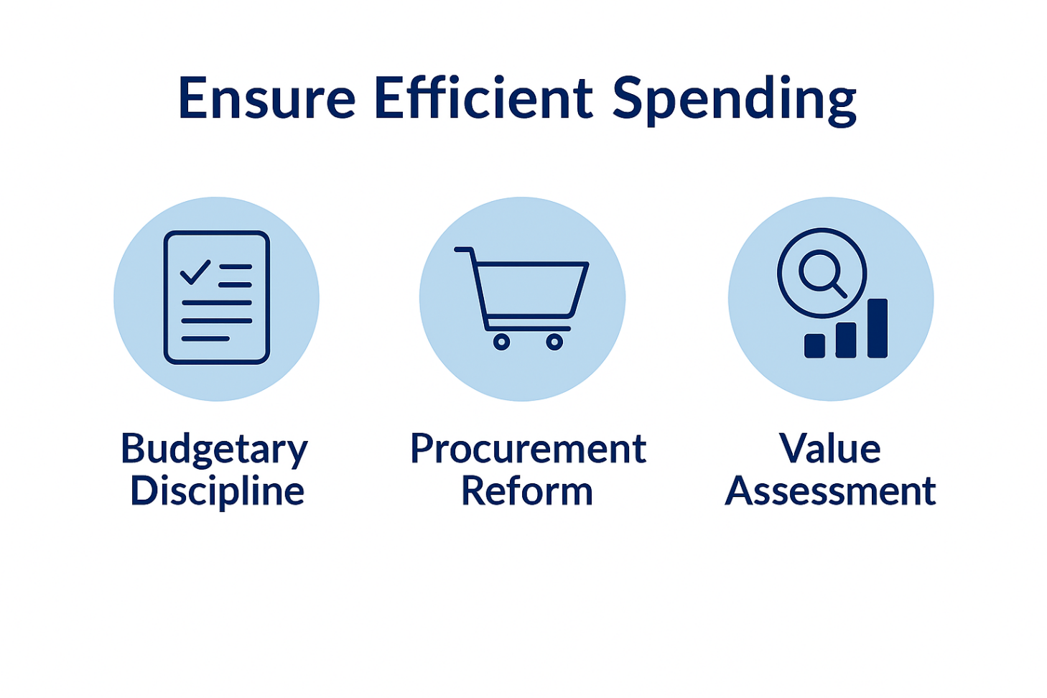
Spending

Slide 6
Ensure Efficient Spending
Budgetary Discipline: Pass balanced budgets annually and avoid unnecessary long-term debt. Require justification for any supplemental funds needed or budget modifications.
Procurement Reform: Use competitive bidding processes to eliminate favoritism and ensure fair vendor selection. Require cost-benefit analysis for major contracts.
Value Assessment: Prioritize projects that deliver measurable public benefits. Seek alternative funding sources such as grants, partnerships, and user fees to reduce reliance on tax dollars.

Slide 7
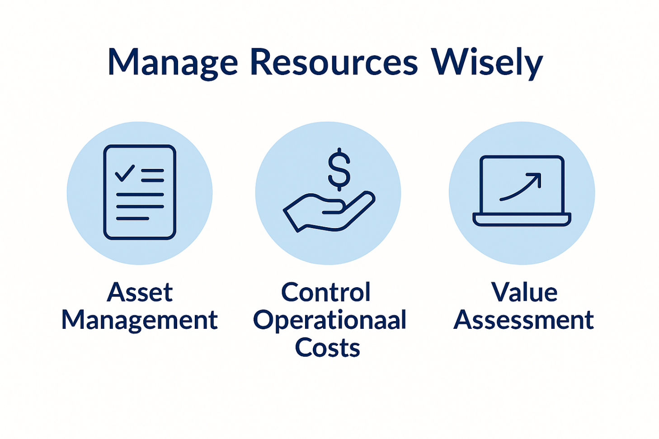
Resources

Slide 8
Manage Resources Wisely
Asset Management: Inventory owned property and dispose of or repurpose excess, unused assets to reduce maintenance costs.
Control Operational Costs: Set clear, reasonable allowances for travel, lodging, and meals. Require pre-approval for discretionary spending.
Modernization: Invest in technology to automate routine tasks, streamline operations, and reduce administrative overhead. Examples include e-procurement systems and digital payment platforms.

Slide 9
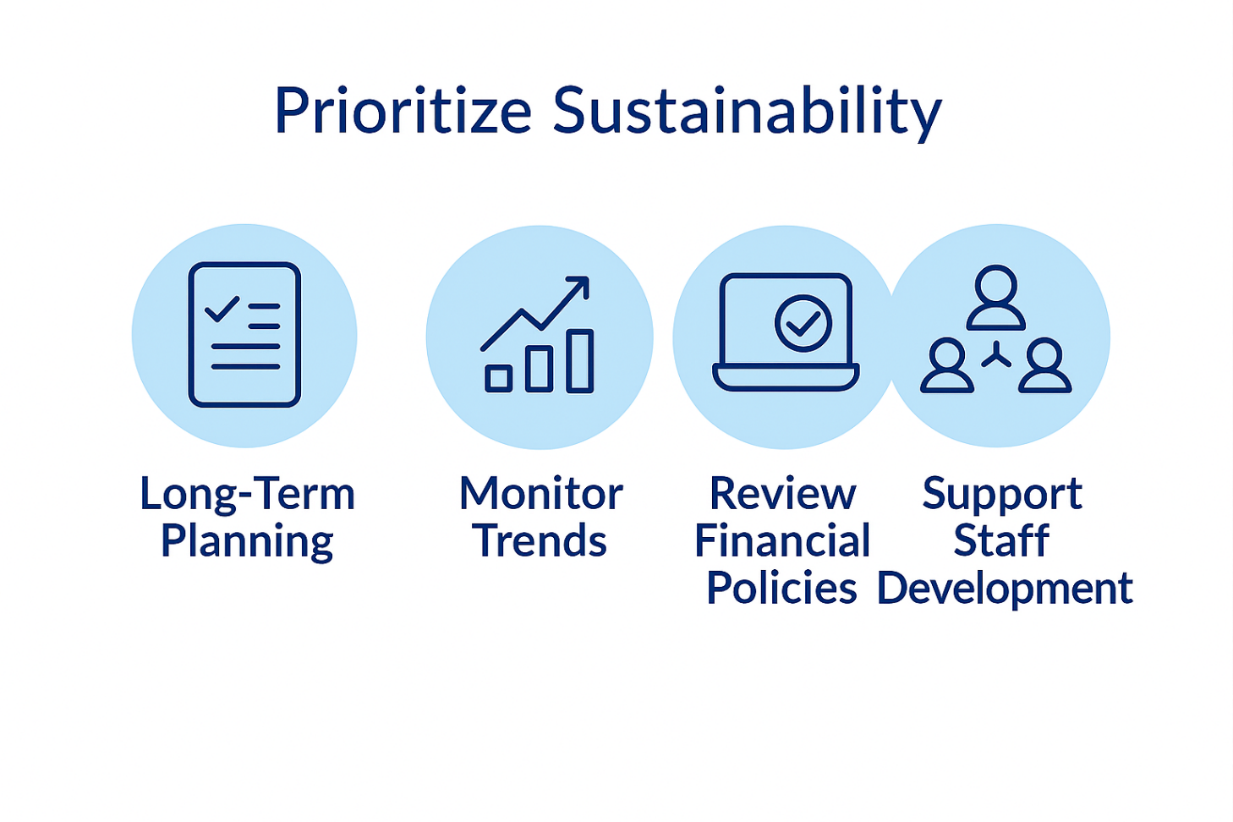
Sustainability

Slide 10
Prioritize Sustainability
Long-Term Planning: Develop multi-year financial plans to avoid last-minute funding crises and emergency referendums.
Monitor Trends: Use data analytics to track spending patterns and identify anomalies early. Implement dashboards for real-time financial monitoring.
Review Financial Policies: Maintain up-to-date policies on reserves, investments, overall financials, and procurement.
Support Staff Development and Retention: Reducing turnover lowers recruitment efforts and training costs and increases organizational expertise.

Slide 11
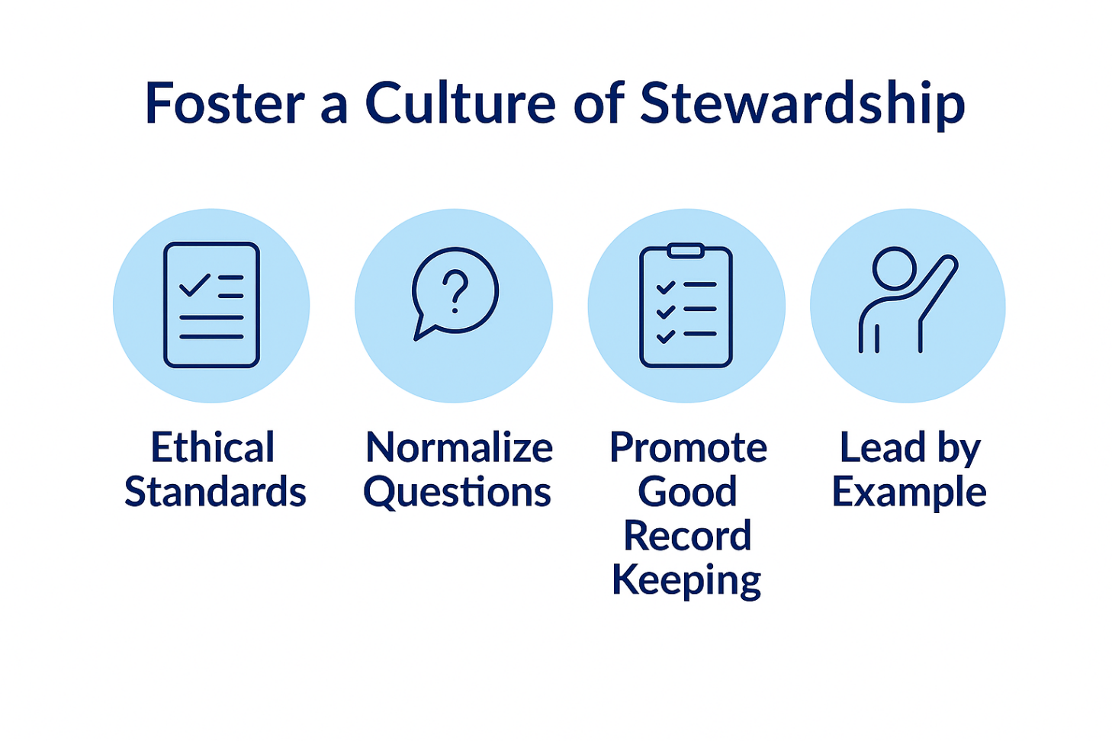
Stewardship

Slide 12
Foster a Culture of Stewardship
Ethical Standards: Enforce strict codes of conduct for all employees handling public funds. Provide regular ethics training.
Normalize Questions: Encourage team members to ask: “Do we need this?”, “Is there a lower cost option”, “Is this purchase aligned with our budget?”. These questions should feel welcomed, not critical.
Promote Good Record Keeping: Accurate documentation is a cornerstone of public stewardship.
Lead by Example: When leadership demonstrates frugality, follows procurement rules, and avoids unnecessary spending, the culture naturally follows.

Slide 13
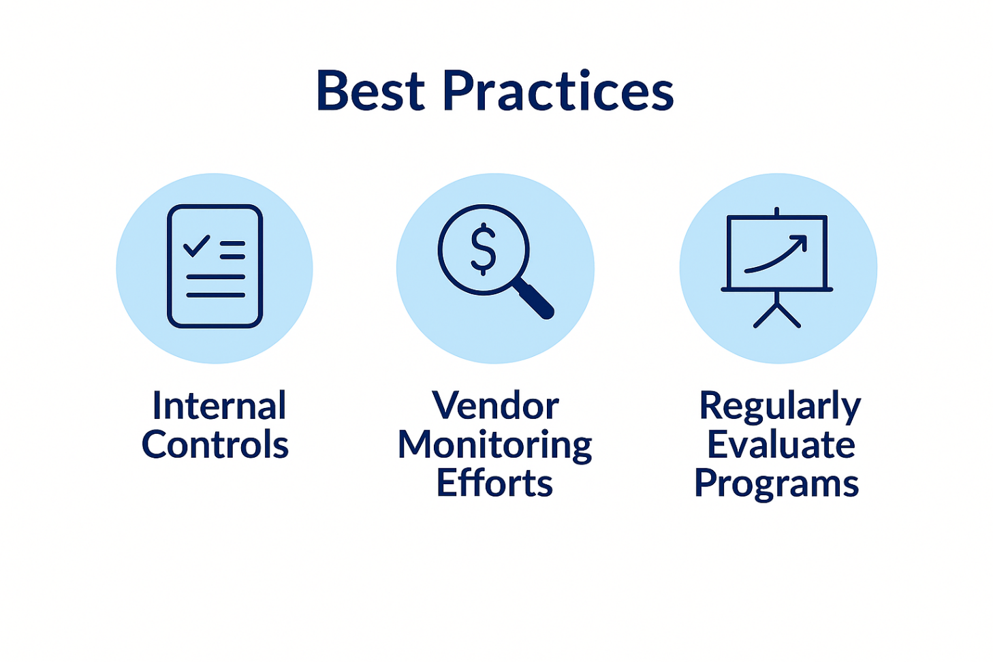
Internal Control

Slide 14
Best Practices
Build and Follow Strong Internal Controls: Clear approval processes, separation of duties, regular reviews, and proper documentation help prevent errors and detect problems early.
Monitor Subcontractors and Vendors: Regularly evaluate the performance of individuals and partners supporting your organization’s work.
Regularly Evaluate Programs: Use data to determine which programs are effective, which need improvement, and where changes can be made to maximize results for each dollar spent.

Slide 15
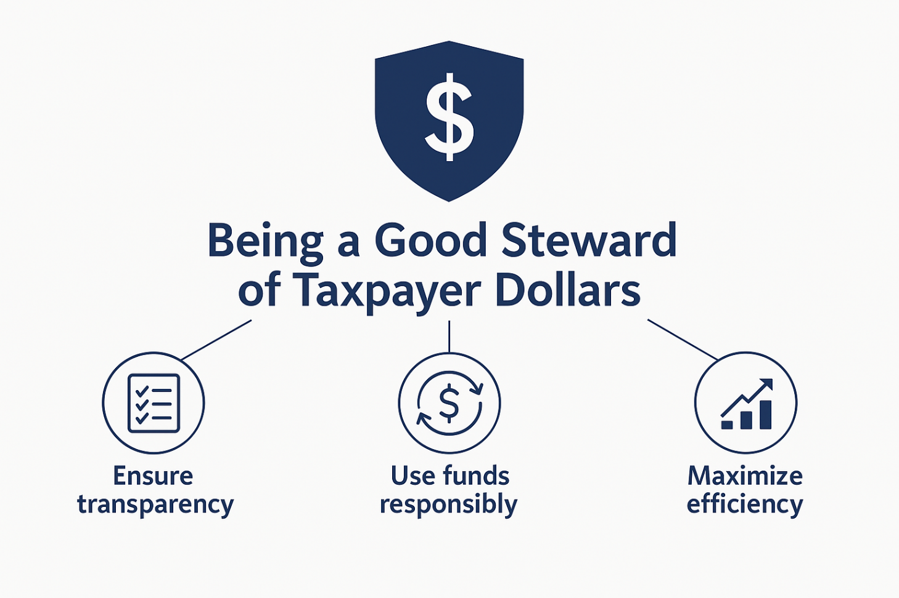
Closing Slide

Slide 16

Questions?

