Slide 1
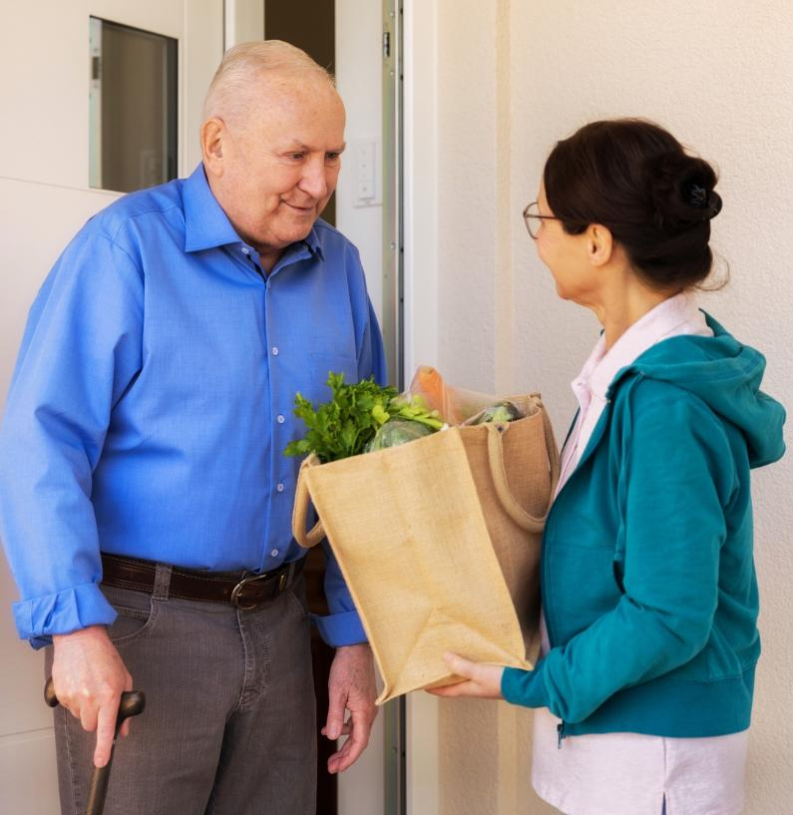







Elder Justice Shelter Innovation
Lessons in Communication, Collaboration, and Cooperation
Dr. Georganna Amateau is a paid consultant for The Span Center, a subrecipient on this award.
Notes:
Link to project narrative
https://docs.google.com/document/d/1xlxnM4qDqYTyfSWE2UbIM2tmmDlmq-6j1kVuaoi-5Vk/edit?usp=sharing

Slide 2
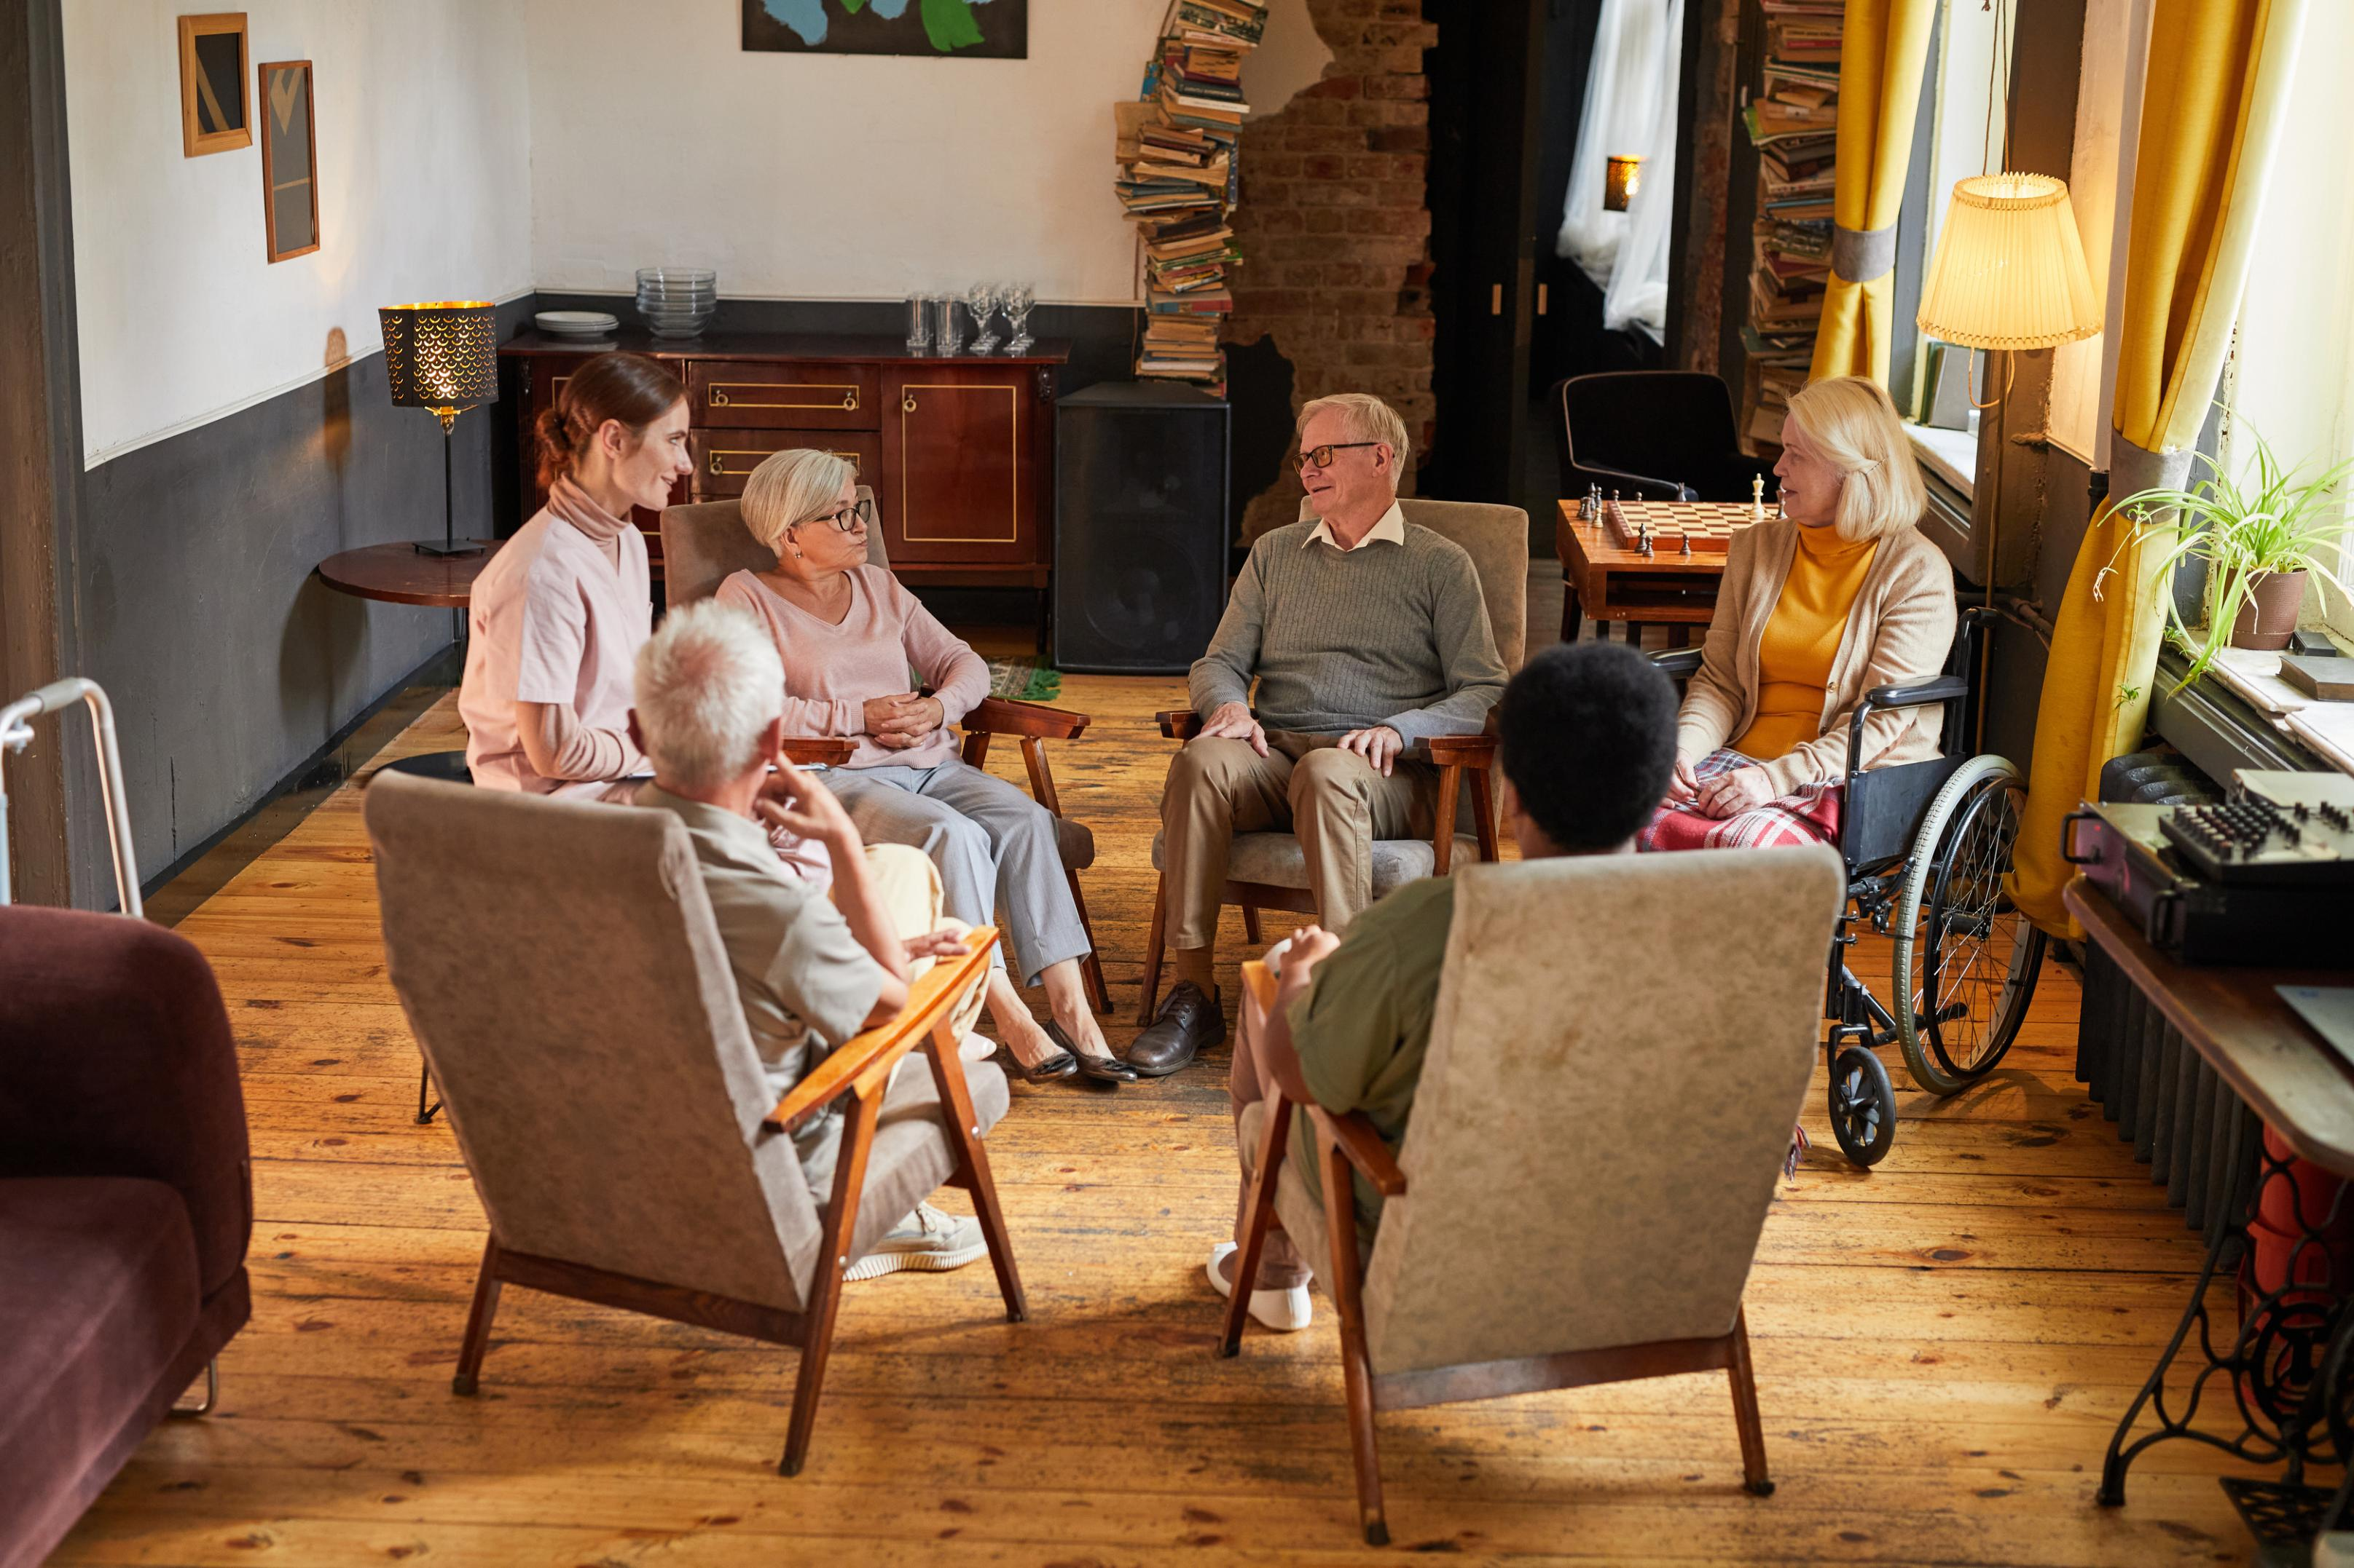

Acknowledgement of Federal Funding
Thie Greater Richmond Elder Justice Shelter Initiative is supported by the Administration for Community Living (ACL), U.S. Department of Health and Human Services (HHS) as part of a financial assistance award totaling $595,310, with 80% funded by ACL/HHS and 20% funded by non-government source(s). The contents are those of the author(s) and do not necessarily represent the official views of, nor an endorsement by, ACL/HHS, or the U.S. Government.

Slide 3
Panelists
Gigi Amateau, Assistant Professor Virginia Commonwealth University, Department of Gerontology
Choice East, CoC Referral and Lived Expertise Coordinator
Jen Johnson, Director of CoC Operations, Homeward

Slide 4
Session Agenda
Project Overview
E-referral Overview
Discussion

Slide 5
Session Agenda 3
Project Overview

Slide 6


The Escalating Trend of Elder Homelessness
More than 1,500 adults over 55 experience homelessness in Virginia.
“Trend lines are all moving in the same direction and accelerating, which should create a shared sense of urgency to address the growing number of older adults experiencing homelessness” (King Horne & Strite, 2024)
Greater Richmond
50%
experiencing homelessness were 50 or older
1year
avg. time experiencing homelessness
67%
73%
Medicaid is their health insurance
have one or more disabilities
37%
29%
had been a victim of
domestic violence
had been a victim of violence
Point-in-Time 2025, Homeward
Notes:
The number of older adults in Virginia is expected to increase from nearly 2 million to over 2.2 million by 2030 (DARS, 2023)
Data from Virginia Mercury and Point-in-Time (PIT) counts
Increasing trend of older adult homelessness in Virginia
Virginia Mercury reports that the most recent statewide data found more than 1,500 adults who are over 55 experience homelessness in the Commonwealth. They go on to note that “trend lines are all moving in the same direction and accelerating, which should create a shared sense of urgency to address the growing number of older adults experiencing homelessness.”
The Point-in-Time count provides a one-night snapshot of homelessness in our region, including those in shelters, transitional housing, domestic violence shelters, or unsheltered locations.
50% of people experiencing homelessness on a given night are 50 or older
67.3% have one or more disabilities
73.3% report that Medicaid is their health insurance.
The average length of time reported as experiencing homelessness was about one year.
36.8% indicated that they had been a victim of violence and 28.6% reported that they had been a victim of domestic violence. (Point-in-Time 2025, Homeward)

Slide 7
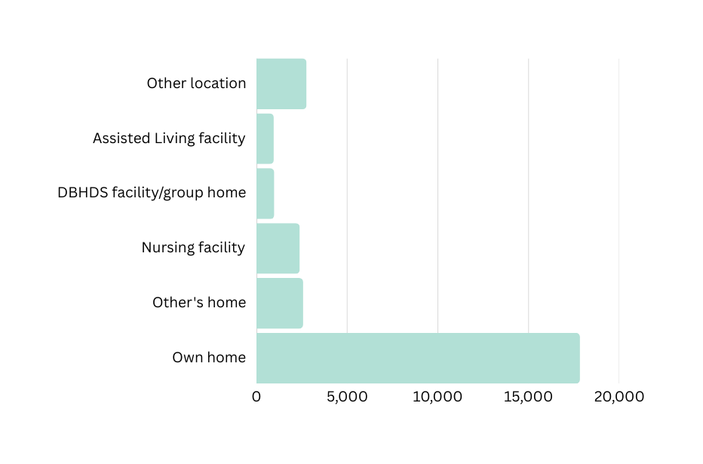

Elder Mistreatment is also Escalating
1 in 6 people 60 years and older experience elder abuse (1).
In Virginia in 2023 (2)
  12,514 substantiated reports
  77% of APS clients were aged 60 and older
  23% were under 60 and had disabilities
Likely a vast underestimation of the true prevalence.
Research suggests that only 1 in 24 cases of elder abuse become known to authorities (3)
Where Elder Abuse Occurs
Other location
2,763
DBHDS facility/ group home
953
65%
within the elder’s own home
Assisted Living facility
982
Nursing facility
2,387
Other’s home
2,574
Own home
17,833
1/2
by a family member
1.Virginia APS. 2024; 2. Storey. 2020; 3.Mikton et al. 2017.
Notes:
In Virginia in 2023 (2)
12,514 substantiated reports (46% of investigated reports).
77% of APS clients were aged 60 and older.
65% of elder abuse cases occurred within the elder’s own home and almost half the time by a family member (1).
Home can quickly become the least safe place for an older adult, especially for those at greater risk of elder mistreatment (2,3).
Many legal solutions are arduous and time-consuming, leaving elders with no choice but to remain in an unsafe environment.
This can lead to elders cycling through services and systems while the mistreatment remains unresolved (4). Such as, frequent visits to the ED, use of multiple differents EDs, repeat visits to the ED at short intervals, and low-urgency ED visits (5).
1. APS, 2024; 2. Dong et al., 2014; 3. Bolkan et al., 2023; 4. Levin et al., 2020; 5. Rosen et al., 2023.

Slide 8
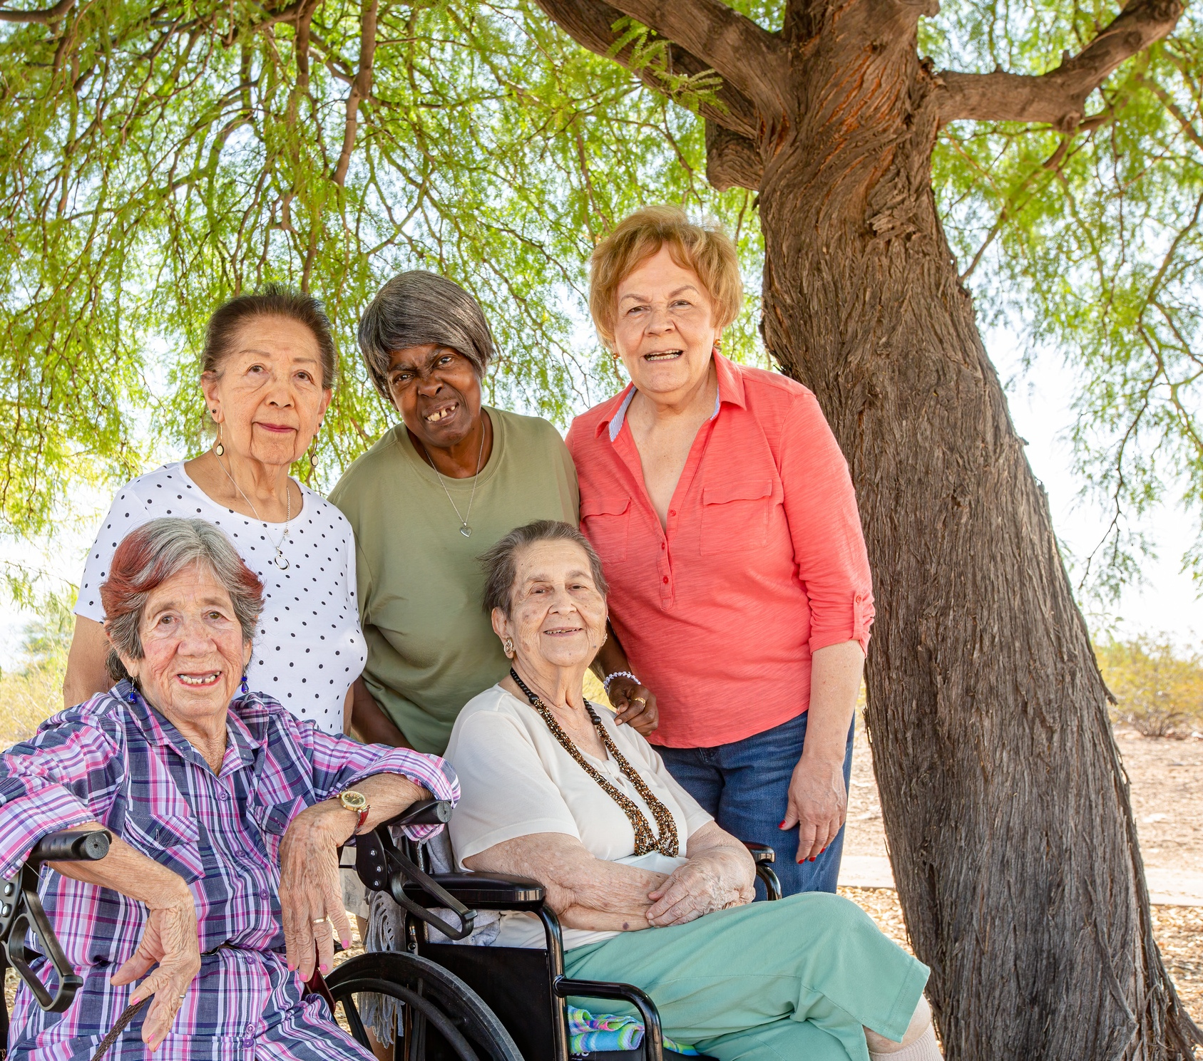
Our Innovation
Establishing, piloting, and evaluating an innovative decentralized elder shelter model serving the greater Richmond region.
This model will include strategies for emergency and transitional housing needs incorporating support services for older adults ages 60+, including those with disabilities, who have experienced abuse, neglect, and exploitation.

Slide 9
Communication, Collaboration, and Cooperation:
A Public Private Partnership
Higher Education | State Government | Private non-profit
Working Together for Positive Change

Slide 10
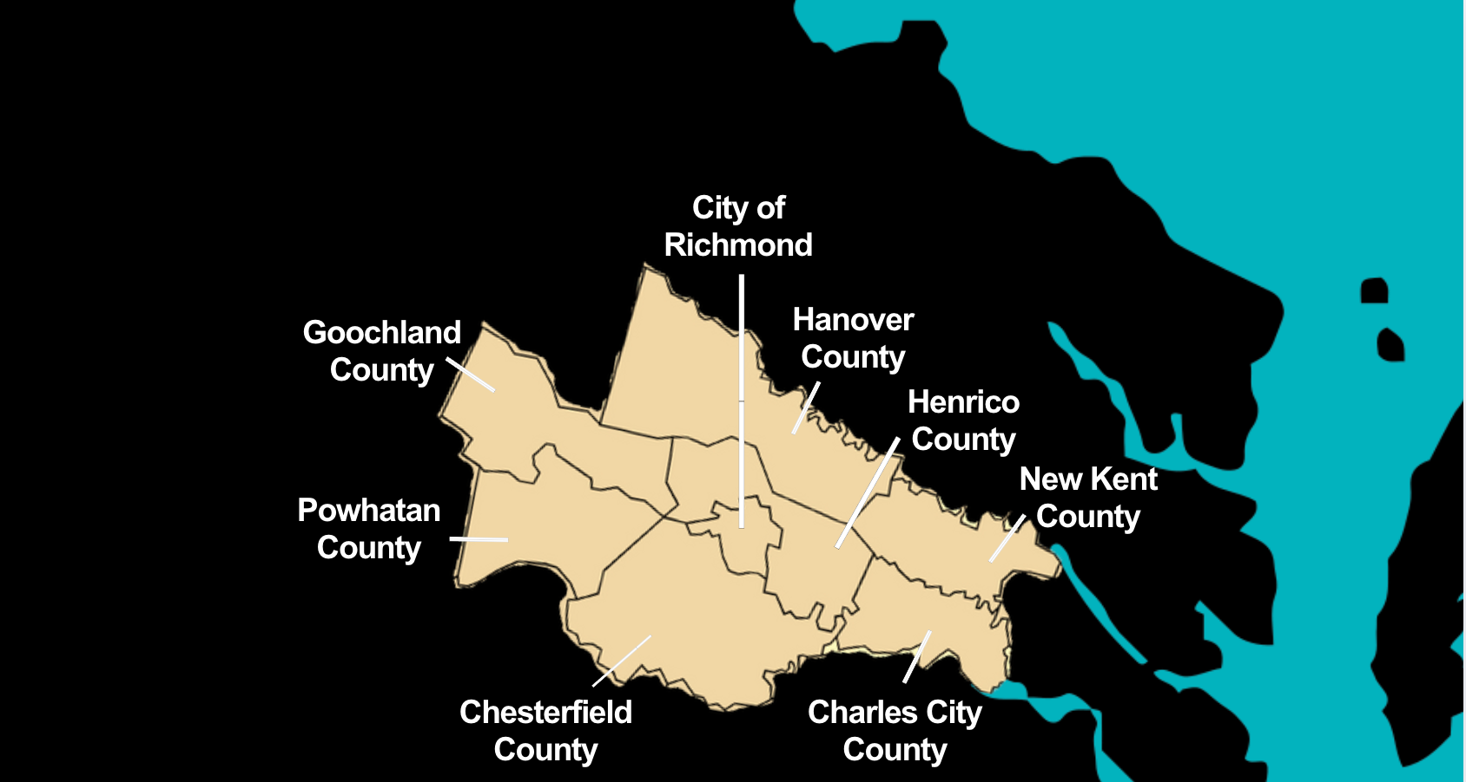
Where We Serve
ppP
Planning District 15
Notes:
Overview of key partners.
Roles and contributions of each.
Emphasis on long-standing, evolving partnerships
Workgroups:
1. Housing Strategy
2. Service Coordination
3. Volunteer Care Team
4. Workforce Support
(5. Sustainability>> joined United Way)
The Span Center serves the citizens of Planning Service Area 15 (PSA15) which includes the counties of Charles City, Chesterfield, Goochland, Hanover, Henrico, New Kent and Powhatan, and the City of Richmond.
Greater Richmond has a population of more than 1.3 million, and comprises seven counties (Charles City, Chesterfield, Goochland, Hanover, Henrico, New Kent, Powhatan) and the City of Richmond, offering a unique combination of affordability and quality of life in urban, suburban, and rural settings.
https://www.vedp.org/region/greater-richmond

Slide 11

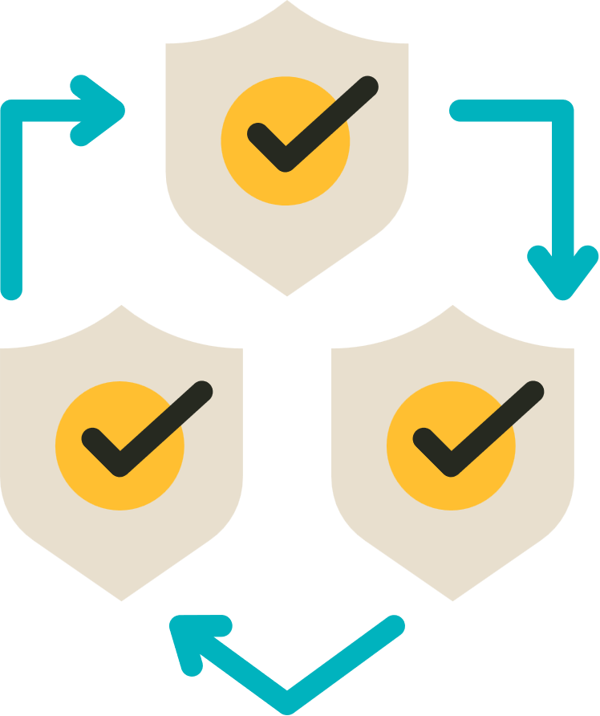






How We Are Changing Systems
1. Housing Strategy
2. Cross-Sector Service Protocol
Establish a person-centered, trauma-informed housing strategy with a continuum of partners. . 12 elders and 3 grandchildren served.
Develop a service coordination protocol for elders experiencing mistreatment and homelessness. Case Conferencing launched.
3. Electronic Referral Process
4. Volunteer Care Team Model
Develop an electronic referral process between homeless and aging services providers. Recently launched!
Develop a volunteer care team model to provide social and practical supports. Training underway.
6. Replicable Blueprint
5. Workforce Support
Develop a replicable blueprint of a decentralized elder justice shelter model and protocols
Boost workforce support and training to decrease moral injury and moral distress. Ongoing series
Notes:
1. Housing Strategy
Establish a person-centered, trauma-informed housing strategy with a continuum of partners.
CARITAS will be one of our core housing partners – they’ll dedicate sober living apartments as one component of an elder justice shelter continuum.
Other housing partners are being identified as part of the needs assessment, such as hospital guest houses and assisted living or nursing facilities and we will convene a Housing Strategy Workgroup to kick things off.
2. Cross-Sector Service Protocol
Develop a service coordination protocol for elders experiencing mistreatment and homelessness.
Core Partners: The Span Center, Homeward, Adult Protective Services
The Service Coordination Workgroup will identify strengths, remove barriers, and clear pathways for information sharing, collaboration, decision-making, and cross-sector workflow. They will review and develop detailed protocols for responding to elders experiencing maltreatment via intake, assessment, and care team transition support, and improve the pathway to APS.
(To transform a disjointed and inequitably functioning service system into one of greater coordination, collaboration, and partnership)
3. Electronic Referral Method
Develop an electronic referral method between homeless and aging services providers.
DARS, No Wrong Door Virginia; The Span Center; Homeward
NWD will adapt Direct Connect-their secure system to providers to receive self-referrals directly from older adults, people with disabilities, veterans, families, and caregivers-to connect homeless services (Homeward) and aging services (Span Center) – by establishing a seamless, secure electronic referral pathway between
the Homeless Management Information System (HMIS) and No Wrong Door Virginia (NWD-VA) for effective data sharing to support older adults’ transition from emergency housing back to safe, stable, and permanent housing of their choice
4. Volunteer Care Team Model
Develop a volunteer care team model to provide social and practical supports.
The Span Center will take the lead role in innovating the care team approach to serve elders experiencing maltreatment and housing loss. They will collaborate with CARITAS to recruit 18-25 volunteers to pilot the care team model with 3-5 teams working in groups of 5-8 volunteers. Each team will work with one older adult. We expect to match 3-5 older adults with Care Teams, recognizing that not every older adult will prefer to participate in this model.
Volunteer Care Team workgroup
The care team curriculum to be finalized and will draw from existing models such as Powerful Tools for Caregivers and the Thelma Bland Watson Personal Care Aide (PCA) School (covers trauma and resilience, person-centered care, ethical decision-making, elder abuse and maltreatment, activities of daily living skills, social connection and well-being, body systems, dementia care, community resources, and death and dying. Power dynamic and socio-emotional boundary setting will be incorporated into the curriculum with intentionality).
Emotional support will be offered to the volunteer teams.
5. Workforce Support
Boost workforce support and training to decrease moral injury and moral distress.
Workforce Support Workgroup
Planned trainings:
• Virginia Helping Elders Access Resources (HEAR) training (Shared language and knowledge)
• Trauma and resilience among older adults + an introduction to person-centered, trauma-informed care - an approach developed and supported by the Center for Holocaust Survivor Care Institute on Aging and Trauma - which bridges the principles of person-centered care and trauma-informed care.
• Ageism and elderhood training for homeless and aging services providers.
• Virginia Memory Project (VMP) will educate cross-sector agency staff on identifying and supporting older adults with the “3Ds” (Dementia, Delirium, and Depression) are common in older adults who have been unhoused, and these conditions may co-occur and superimpose on one another.
6. Replicable Blueprint
Develop a replicable blueprint of a decentralized elder justice shelter model and protocols
VCU Gerontology and the Virginia Center on Aging

Slide 12



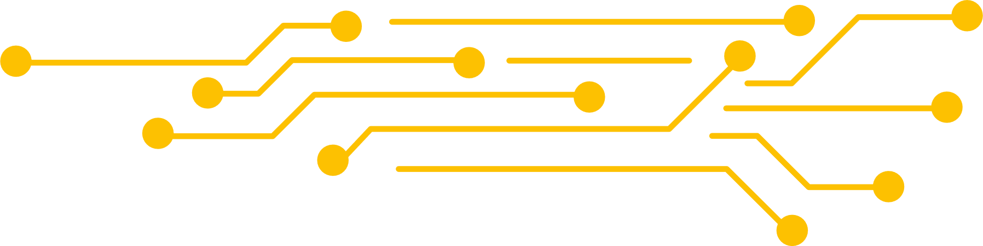
Person-Centered Data: Formal and Informal
  Surveys, interviews, focus groups (needs & patterns)
  Enhanced PIT count (50+ and 60+ data)
  Homeless Management Information System (HMIS) de-identified data
  Uniform Assessment Instrument (UAI) deidentified data
  Real-time data sharing
  Responsive and reflective conversations
Notes:
These elders were identified by Homeward, all over 60, all have at least one disability, and all indicated that their physical safety was at risk

Slide 13

What we’re learning: Wider Contributing Issues
Lack of affordable housing is the biggest issue I see. Many older adults receive little income and are completely unprepared for the modern prices of housing when they need to move.
The other main issue I see is personal care needs. These services are often prohibitively expensive and difficult for older adults to navigate. The agencies are also short-staffed so it can be difficult for the patients to find aides.

Slide 14
What we’re hearing: Homelessness and Risk of Abuse
I would say probably because we are older and the younger guys may think they can bully us or something like that. Do you know what I mean? I just want to say this, this is my first time ever being in a shelter. I’m basically finding my way. An example, if you are out in the street, which I have never experienced that, thank God, I would say that I think you would have 100% chance of being more abused than being in a closed in environment. If you are outside and homeless, it is basically anything goes unless the police are involved.

Slide 15
What we’re learning: Families Under Pressure
“We are seeing such a high level of caregiver fatigue right now, to the point where we are having what we’re calling dumping, basically, where a caretaker will bring their loved one here and just say, ‘I can’t care for them any longer,’ and expect us, the hospital system, to evaluate their medical needs, housing needs, any type of social determinants of health needs and then put things in place for that. …That has been a huge shift and a huge trend that we have been seeing, I would say in the last two years, people no longer able to care for family members as they age.” In that same focus group, a different hospital social worker concurred, adding “I would say it’s at least every other day that we’re having somebody come in and say, ‘I can’t do this anymore. I can’t afford it. I don’t understand medical needs’, especially when they start to see things like incontinence.

Slide 16

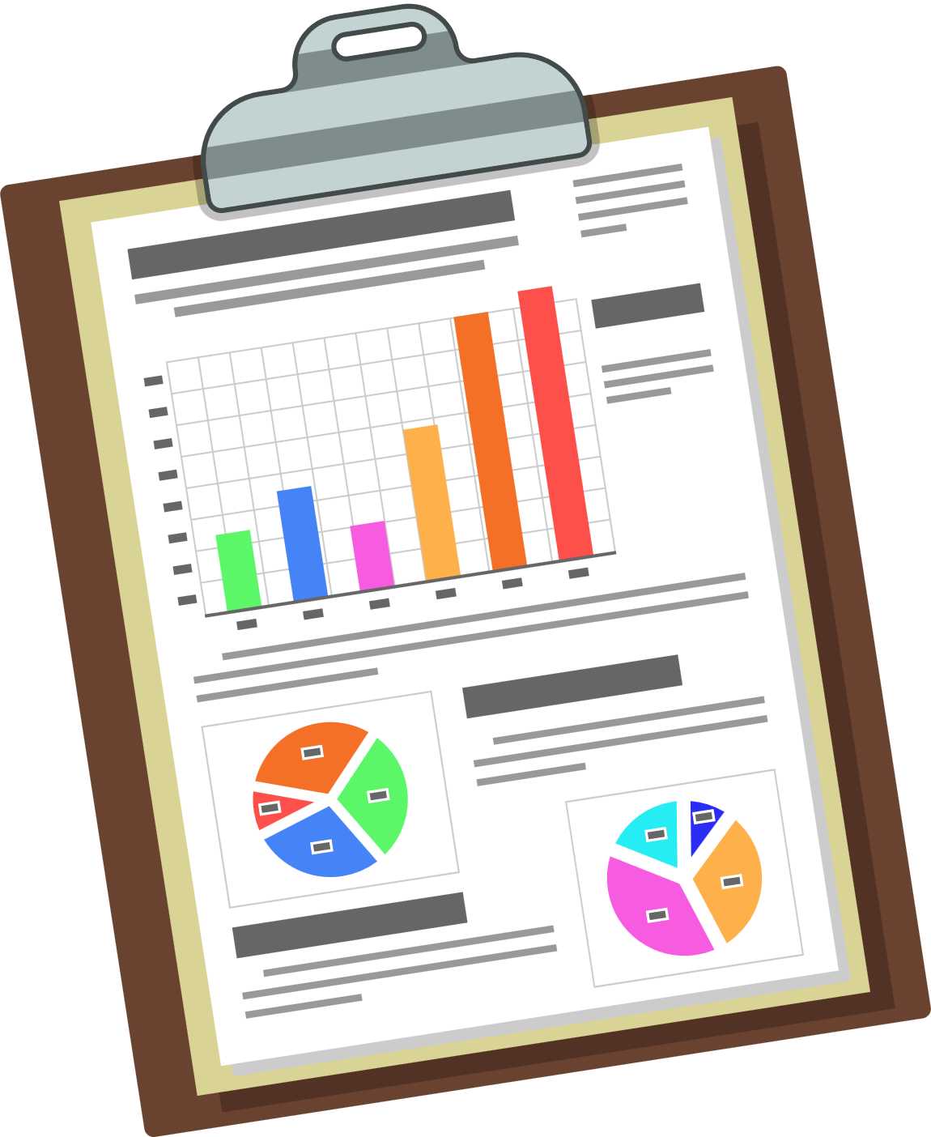
Responding Together: Innovation Through Partnership
Longstanding evolving partnerships: trust and high tolerance for ambiguity
Spotlighting the needs creates opportunity for learning and advocacy
Homeless Services
Public-private partnership leveraging funding, solutions, and resources
Aging Services
Deepening relationships throughout partner organizations
Systems coordination and innovation will benefit the entire community
Elder Justice Hub
Shared priorities, values, opportunity, vision, community needs
Trust, pragmatism, transparency, and adaptability in practice
Notes:
Background: Early seeds of the partnership (2017, Kelly & Gigi)
History between Homeward and SPAN (racial equity grant, homeless connection line, training then led to (frames the issue as we know them now) care coordination that meets care coordination of OAA and also housing stability needs.
Emphasis on long-standing, evolving partnerships
The intersection of elder justice and homelessness
Shared values include a foundation of trust, a pragmatic approach to challenges, and a willingness to adapt practices to meet evolving needs.
Systems coordination, changes and partnerships will benefit the entire community
DARS’ (the state unit on aging) support going in, is huge step. Homeless and aging services are overstretched, and for the state to acknowledge that they see this and support it is huge.

Slide 17
Agenda
E-referral Overview

Slide 18

Building the Elder Justice E-Referral: Development Process
Step 1: Define Specifications and Constraints
Clarified purpose of the e-referral (elder justice coordination and service navigation)
Identified partner roles and referral pathways
Determined essential information while minimizing burden
Addressed privacy, consent, and data-sharing considerations
Identified technical and system constraints
Step 2: Develop and Test Prototype
Created initial referral form
Streamlined data fields and workflow
Tested usability and practicality
Identified redundancies and workflow challenges
Step 3: Review and Gather Partner Feedback
Reviewed clarity and relevance of referral questions
Assessed alignment with real-world workflows
Identified potential barriers to adoption
Collected partner input
ppP
Planning District 15
Notes:
Overview of key partners.
Roles and contributions of each.
Emphasis on long-standing, evolving partnerships
Workgroups:
1. Housing Strategy
2. Service Coordination
3. Volunteer Care Team
4. Workforce Support
(5. Sustainability>> joined United Way)
The Span Center serves the citizens of Planning Service Area 15 (PSA15) which includes the counties of Charles City, Chesterfield, Goochland, Hanover, Henrico, New Kent and Powhatan, and the City of Richmond.
Greater Richmond has a population of more than 1.3 million, and comprises seven counties (Charles City, Chesterfield, Goochland, Hanover, Henrico, New Kent, Powhatan) and the City of Richmond, offering a unique combination of affordability and quality of life in urban, suburban, and rural settings.
https://www.vedp.org/region/greater-richmond

Slide 19
Why We Developed E-Referral
System Reality
Older adults interact with multiple systems
AAAs already use multiple platforms
Continuums of Care use HMIS
Full interoperability is not feasible (time and resource constraints)
Workflow Challenges
Referrals were happening through multiple channels (phone, email)
Information sharing was inconsistent
Documentation practices varied across partners
Communication across systems was fragmented
Opportunity for Improvement
Improve consistency in information sharing
Improve consistency in documentation
Strengthen partner communication
Case conferencing created an opportunity to expand coordination beyond EJSI
ppP
Planning District 15
Notes:
Overview of key partners.
Roles and contributions of each.
Emphasis on long-standing, evolving partnerships
Workgroups:
1. Housing Strategy
2. Service Coordination
3. Volunteer Care Team
4. Workforce Support
(5. Sustainability>> joined United Way)
The Span Center serves the citizens of Planning Service Area 15 (PSA15) which includes the counties of Charles City, Chesterfield, Goochland, Hanover, Henrico, New Kent and Powhatan, and the City of Richmond.
Greater Richmond has a population of more than 1.3 million, and comprises seven counties (Charles City, Chesterfield, Goochland, Hanover, Henrico, New Kent, Powhatan) and the City of Richmond, offering a unique combination of affordability and quality of life in urban, suburban, and rural settings.
https://www.vedp.org/region/greater-richmond

Slide 20
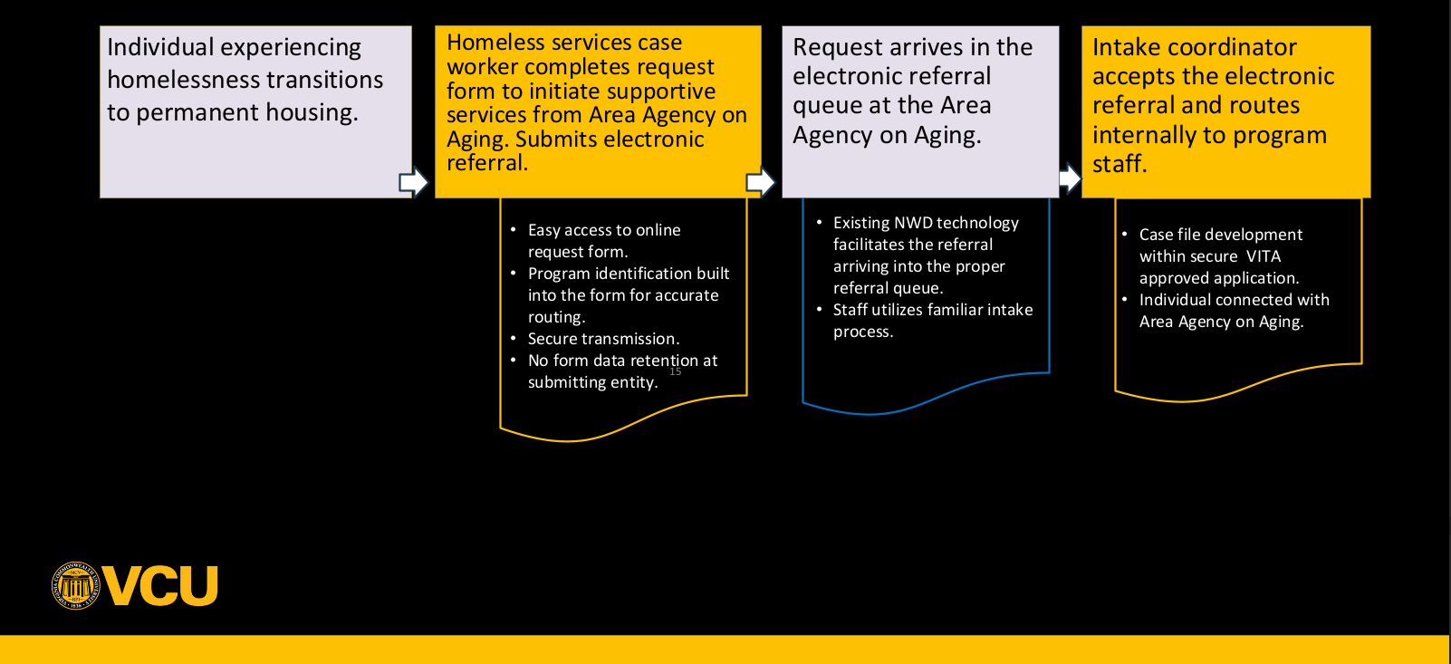
Elder Justice Shelter Initiative E-referral Process Flow
ppP
Notes:
Overview of key partners.
Roles and contributions of each.
Emphasis on long-standing, evolving partnerships
Workgroups:
1. Housing Strategy
2. Service Coordination
3. Volunteer Care Team
4. Workforce Support
(5. Sustainability>> joined United Way)
The Span Center serves the citizens of Planning Service Area 15 (PSA15) which includes the counties of Charles City, Chesterfield, Goochland, Hanover, Henrico, New Kent and Powhatan, and the City of Richmond.
Greater Richmond has a population of more than 1.3 million, and comprises seven counties (Charles City, Chesterfield, Goochland, Hanover, Henrico, New Kent, Powhatan) and the City of Richmond, offering a unique combination of affordability and quality of life in urban, suburban, and rural settings.
https://www.vedp.org/region/greater-richmond

Slide 21
Building the Elder Justice E-Referral: Development Process 2
Step 1: Define Specifications and Constraints
Clarified purpose of the e-referral (elder justice coordination and service navigation)
Identified partner roles and referral pathways
Determined essential information while minimizing burden
Addressed privacy, consent, and data-sharing considerations
Identified technical and system constraints
Step 2: Develop and Test Prototype
Created initial referral form
Streamlined data fields and workflow
Tested usability and practicality
Identified redundancies and workflow challenges
Step 3: Review and Gather Partner Feedback
Reviewed clarity and relevance of referral questions
Assessed alignment with real-world workflows
Identified potential barriers to adoption
Collected partner input
ppP
Key lesson: Technology was straightforward. Business process is continuous improvement.
Notes:
Overview of key partners.
Roles and contributions of each.
Emphasis on long-standing, evolving partnerships
Workgroups:
1. Housing Strategy
2. Service Coordination
3. Volunteer Care Team
4. Workforce Support
(5. Sustainability>> joined United Way)
The Span Center serves the citizens of Planning Service Area 15 (PSA15) which includes the counties of Charles City, Chesterfield, Goochland, Hanover, Henrico, New Kent and Powhatan, and the City of Richmond.
Greater Richmond has a population of more than 1.3 million, and comprises seven counties (Charles City, Chesterfield, Goochland, Hanover, Henrico, New Kent, Powhatan) and the City of Richmond, offering a unique combination of affordability and quality of life in urban, suburban, and rural settings.
https://www.vedp.org/region/greater-richmond

Slide 22
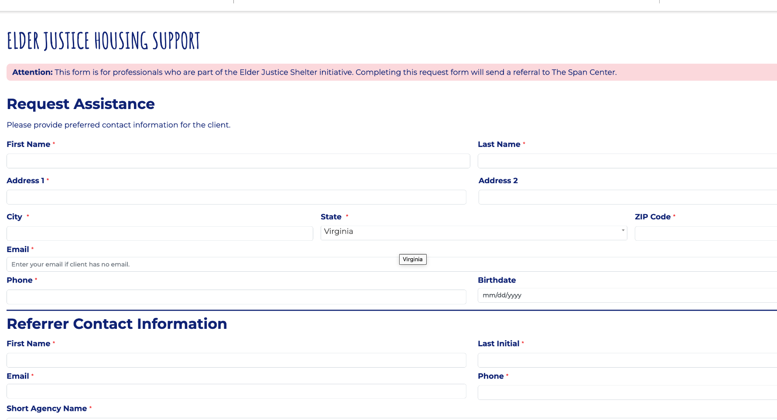
Elder Justice Shelter Initiative E-referral Solution
Meets VITA security requirements
Data fields drawn from Direct Connect
Hidden URL for controlled access
Captcha for security
Text cues to support workflow
Appends directly to Peer Place notes
ppP
Notes:
Overview of key partners.
Roles and contributions of each.
Emphasis on long-standing, evolving partnerships
Workgroups:
1. Housing Strategy
2. Service Coordination
3. Volunteer Care Team
4. Workforce Support
(5. Sustainability>> joined United Way)
The Span Center serves the citizens of Planning Service Area 15 (PSA15) which includes the counties of Charles City, Chesterfield, Goochland, Hanover, Henrico, New Kent and Powhatan, and the City of Richmond.
Greater Richmond has a population of more than 1.3 million, and comprises seven counties (Charles City, Chesterfield, Goochland, Hanover, Henrico, New Kent, Powhatan) and the City of Richmond, offering a unique combination of affordability and quality of life in urban, suburban, and rural settings.
https://www.vedp.org/region/greater-richmond

Slide 23
Client Fields
First name
Last name
Address 1, 2 + City, State, Zip
Email
Phone
Birth date
Referring Case manager fields
First name
Last initial
Email
Phone
Short agency name
Medicaid/Medicare
Additional Information
Elder Justice Shelter Initiative E-referral Form Detail
ppP
Planning District 15
Notes:
Overview of key partners.
Roles and contributions of each.
Emphasis on long-standing, evolving partnerships
Workgroups:
1. Housing Strategy
2. Service Coordination
3. Volunteer Care Team
4. Workforce Support
(5. Sustainability>> joined United Way)
The Span Center serves the citizens of Planning Service Area 15 (PSA15) which includes the counties of Charles City, Chesterfield, Goochland, Hanover, Henrico, New Kent and Powhatan, and the City of Richmond.
Greater Richmond has a population of more than 1.3 million, and comprises seven counties (Charles City, Chesterfield, Goochland, Hanover, Henrico, New Kent, Powhatan) and the City of Richmond, offering a unique combination of affordability and quality of life in urban, suburban, and rural settings.
https://www.vedp.org/region/greater-richmond

Slide 24
Arrives in PP queue as a web referral
Elder Justice Shelter Initiative E-referral in Peer Place
*Please note: this presentation and the slide included screenshots of PeerPlace, the DARS client management system, that is used by Area Agencies on Aging and NWD Partners. These screenshots have been removed to comply with PeerPlace's policy that the proprietary technology is not shared with external audiences.
ppP
Planning District 15
Notes:
Overview of key partners.
Roles and contributions of each.
Emphasis on long-standing, evolving partnerships
Workgroups:
1. Housing Strategy
2. Service Coordination
3. Volunteer Care Team
4. Workforce Support
(5. Sustainability>> joined United Way)
The Span Center serves the citizens of Planning Service Area 15 (PSA15) which includes the counties of Charles City, Chesterfield, Goochland, Hanover, Henrico, New Kent and Powhatan, and the City of Richmond.
Greater Richmond has a population of more than 1.3 million, and comprises seven counties (Charles City, Chesterfield, Goochland, Hanover, Henrico, New Kent, Powhatan) and the City of Richmond, offering a unique combination of affordability and quality of life in urban, suburban, and rural settings.
https://www.vedp.org/region/greater-richmond

Slide 25
E-referral detail view
Elder Justice Shelter Initiative E-referral Detail View
*Please note: this presentation and the slide included screenshots of PeerPlace, the DARS client management system, that is used by Area Agencies on Aging and NWD Partners. These screenshots have been removed to comply with PeerPlace's policy that the proprietary technology is not shared with external audiences.
ppP
Intake reviews, checks for duplicate, assigns to care coordinator
Planning District 15
Notes:
Overview of key partners.
Roles and contributions of each.
Emphasis on long-standing, evolving partnerships
Workgroups:
1. Housing Strategy
2. Service Coordination
3. Volunteer Care Team
4. Workforce Support
(5. Sustainability>> joined United Way)
The Span Center serves the citizens of Planning Service Area 15 (PSA15) which includes the counties of Charles City, Chesterfield, Goochland, Hanover, Henrico, New Kent and Powhatan, and the City of Richmond.
Greater Richmond has a population of more than 1.3 million, and comprises seven counties (Charles City, Chesterfield, Goochland, Hanover, Henrico, New Kent, Powhatan) and the City of Richmond, offering a unique combination of affordability and quality of life in urban, suburban, and rural settings.
https://www.vedp.org/region/greater-richmond

Slide 26
Building the Elder Justice E-Referral: Business Process
Defining Business Process (Ongoing and Most Complex Phase)
Determined when referrals are appropriate
Defined roles and responsibilities
Established triage and follow-up processes
Integrated case conferencing workflows
ppP
Planning District 15
Notes:
Overview of key partners.
Roles and contributions of each.
Emphasis on long-standing, evolving partnerships
Workgroups:
1. Housing Strategy
2. Service Coordination
3. Volunteer Care Team
4. Workforce Support
(5. Sustainability>> joined United Way)
The Span Center serves the citizens of Planning Service Area 15 (PSA15) which includes the counties of Charles City, Chesterfield, Goochland, Hanover, Henrico, New Kent and Powhatan, and the City of Richmond.
Greater Richmond has a population of more than 1.3 million, and comprises seven counties (Charles City, Chesterfield, Goochland, Hanover, Henrico, New Kent, Powhatan) and the City of Richmond, offering a unique combination of affordability and quality of life in urban, suburban, and rural settings.
https://www.vedp.org/region/greater-richmond

Slide 27
Case Conferencing: The Foundation
Reduce homelessness among adults 60+ as part of United Way’s Catalytic Change Initiative
Support progress toward housing stability and safety
Identify strengths and opportunities
Promote trauma-informed and person-centered care
Reduce duplication of services
Improve coordination across systems
Streamline referrals and service connections
ppP
Planning District 15
Notes:
Overview of key partners.
Roles and contributions of each.
Emphasis on long-standing, evolving partnerships
Workgroups:
1. Housing Strategy
2. Service Coordination
3. Volunteer Care Team
4. Workforce Support
(5. Sustainability>> joined United Way)
The Span Center serves the citizens of Planning Service Area 15 (PSA15) which includes the counties of Charles City, Chesterfield, Goochland, Hanover, Henrico, New Kent and Powhatan, and the City of Richmond.
Greater Richmond has a population of more than 1.3 million, and comprises seven counties (Charles City, Chesterfield, Goochland, Hanover, Henrico, New Kent, Powhatan) and the City of Richmond, offering a unique combination of affordability and quality of life in urban, suburban, and rural settings.
https://www.vedp.org/region/greater-richmond

Slide 28
Case Conferencing: Current Participants
Reduce homelessness among adults 60+
Homeward
The Span Center
Richmond Behavioral Health Authority/CSBs
Shelter and housing providers
Local government aging offices and departments of social services
Hospitals, MCOs
Legal Services
ppP
Planning District 15
Notes:
Overview of key partners.
Roles and contributions of each.
Emphasis on long-standing, evolving partnerships
Workgroups:
1. Housing Strategy
2. Service Coordination
3. Volunteer Care Team
4. Workforce Support
(5. Sustainability>> joined United Way)
The Span Center serves the citizens of Planning Service Area 15 (PSA15) which includes the counties of Charles City, Chesterfield, Goochland, Hanover, Henrico, New Kent and Powhatan, and the City of Richmond.
Greater Richmond has a population of more than 1.3 million, and comprises seven counties (Charles City, Chesterfield, Goochland, Hanover, Henrico, New Kent, Powhatan) and the City of Richmond, offering a unique combination of affordability and quality of life in urban, suburban, and rural settings.
https://www.vedp.org/region/greater-richmond

Slide 29
Case Conferencing: The Process
1. Shared Understanding of the Individual’s Situation
2. Trauma-Informed, Person-Centered Framing
3. Identification of Existing Supports and Service Involvement
4. Strengths and Opportunities Assessment
5. Coordinated Action Planning
6. Ongoing Communication and Follow-Up
Involves e-referral
ppP
Planning District 15
Notes:
Overview of key partners.
Roles and contributions of each.
Emphasis on long-standing, evolving partnerships
Workgroups:
1. Housing Strategy
2. Service Coordination
3. Volunteer Care Team
4. Workforce Support
(5. Sustainability>> joined United Way)
The Span Center serves the citizens of Planning Service Area 15 (PSA15) which includes the counties of Charles City, Chesterfield, Goochland, Hanover, Henrico, New Kent and Powhatan, and the City of Richmond.
Greater Richmond has a population of more than 1.3 million, and comprises seven counties (Charles City, Chesterfield, Goochland, Hanover, Henrico, New Kent, Powhatan) and the City of Richmond, offering a unique combination of affordability and quality of life in urban, suburban, and rural settings.
https://www.vedp.org/region/greater-richmond

Slide 30
Session Agenda 2
Discussion

Slide 31

Let’s Talk About Change
How have you had to change to do this work?
What has changed because of this work?
What are you learning?
Notes:
How have you had to change to do this work?
Interoperability workarounds (federal database constraints)
Using real-time data to shift practice

Slide 32
Q & A
  What questions do you have?

Slide 33


Would you like to learn more, or connect with us?
Email us
Dr. Gigi Amateau, Co-Principal Investigator amateaugg@vcu.edu
Aisling Clardy, Project Manager clardya@vcu.edu

